Slide 1
ACCEPTED
ADMISSIONS
ACCEPTED ADMISSIONS / SAT MASTERY SERIES
SAT PREP IV
Information & Ideas + Craft & Structure
01 INFERENCES
02 CROSS-TEXT CONNECTIONS
SAT Reading & Writing • Digital SAT Reading & Writing
SAT PREP IV
01 / 39

Slide 2
THE BIG PICTURE
ACCEPTED
ADMISSIONS
Where this lesson fits
SAT Reading & Writing focuses on four complementary skill areas.
01
Standard English Conventions
02
Expression of Ideas
03
Information & Ideas
THIS LESSON
04
Craft & Structure
THIS LESSON
SAT PREP IV / INFORMATION & IDEAS + CRAFT & STRUCTURE
02

Slide 3
SKILL FRAMEWORK
ACCEPTED
ADMISSIONS
Ideas in, from, and for the text
IN • Central Ideas & Details
FROM • Inferences
FOR • Command of Evidence
Identify the main point and directly stated details.
Make the safest conclusion supported by the text.
Choose evidence that best supports a claim.
SAT PREP IV / INFORMATION & IDEAS + CRAFT & STRUCTURE
03

Slide 4
ACCEPTED
ADMISSIONS
QUESTION TYPE
Inferences
Use only what the passage supports to complete the thought.
01
SAT PREP IV / INFORMATION & IDEAS + CRAFT & STRUCTURE
04

Slide 5
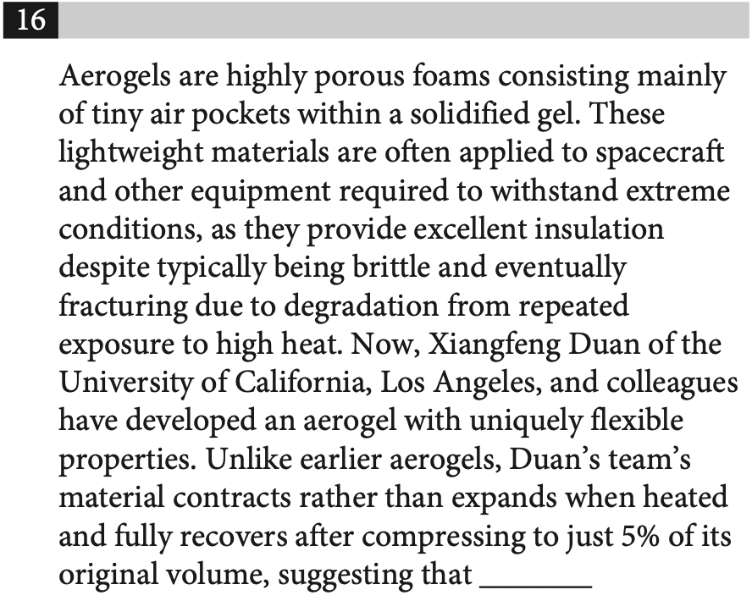
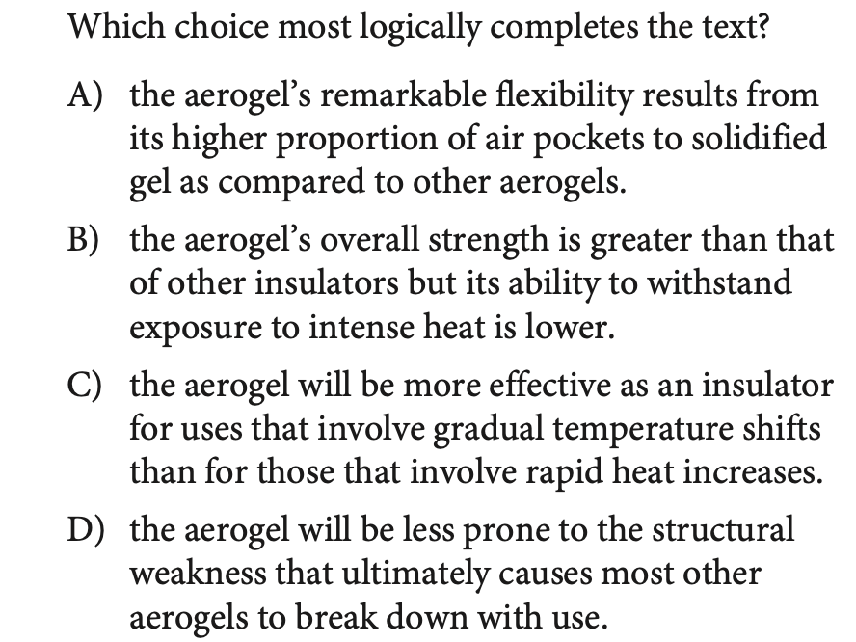
INFERENCES
ACCEPTED
ADMISSIONS
PRACTICE 01
TRY IT FIRST
SAT PREP IV / INFORMATION & IDEAS + CRAFT & STRUCTURE
05

Slide 6
INFERENCES
ACCEPTED
ADMISSIONS
REVIEW 01
ANSWER CHECK
SAT PREP IV / INFORMATION & IDEAS + CRAFT & STRUCTURE
06

Slide 7
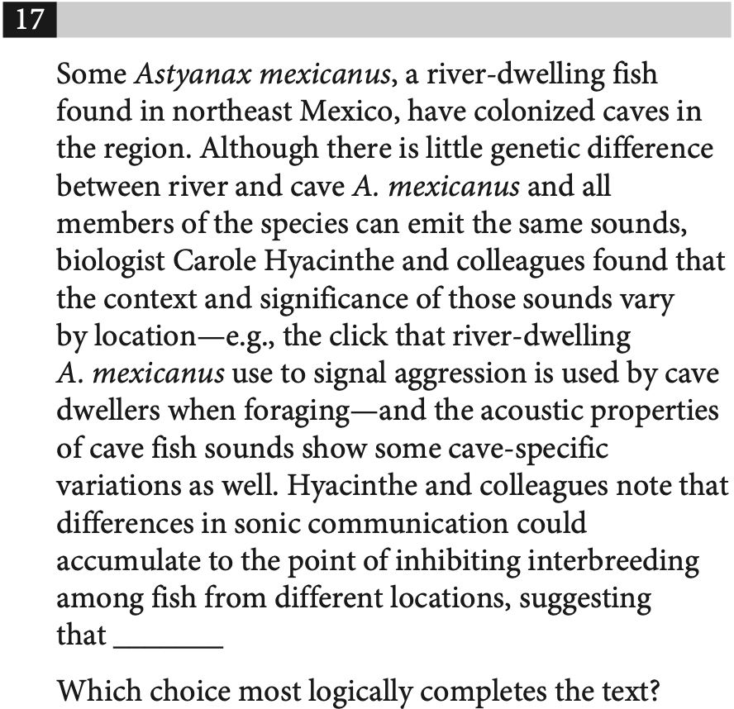
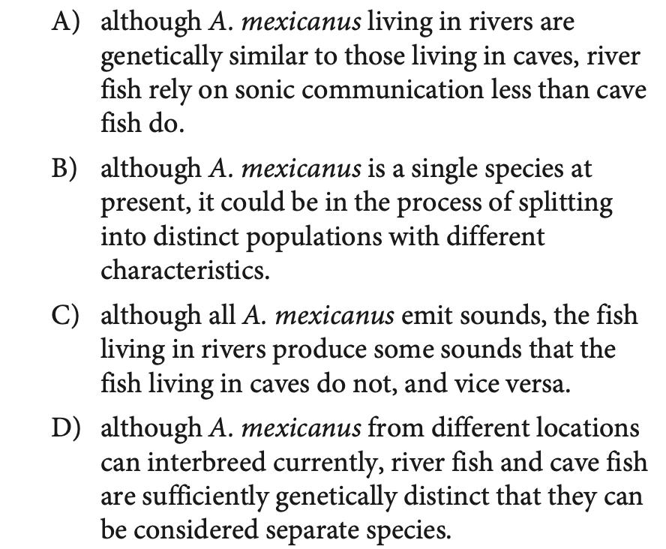
INFERENCES
ACCEPTED
ADMISSIONS
PRACTICE 02
TRY IT FIRST
SAT PREP IV / INFORMATION & IDEAS + CRAFT & STRUCTURE
07

Slide 8
INFERENCES
ACCEPTED
ADMISSIONS
REVIEW 02
ANSWER CHECK
SAT PREP IV / INFORMATION & IDEAS + CRAFT & STRUCTURE
08

Slide 9
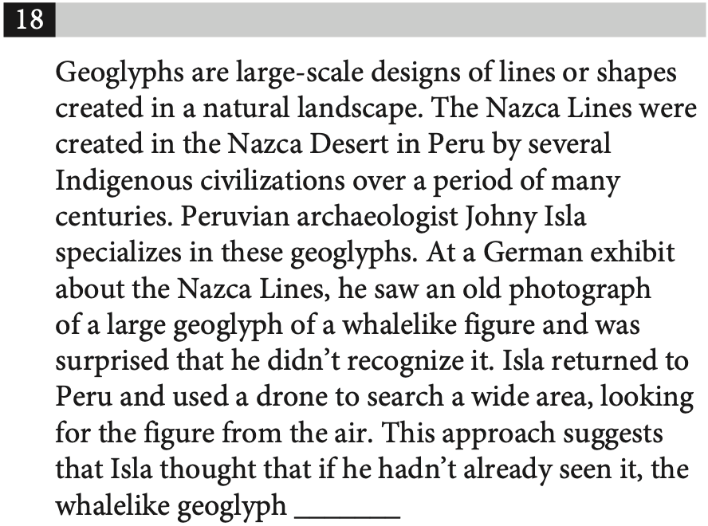
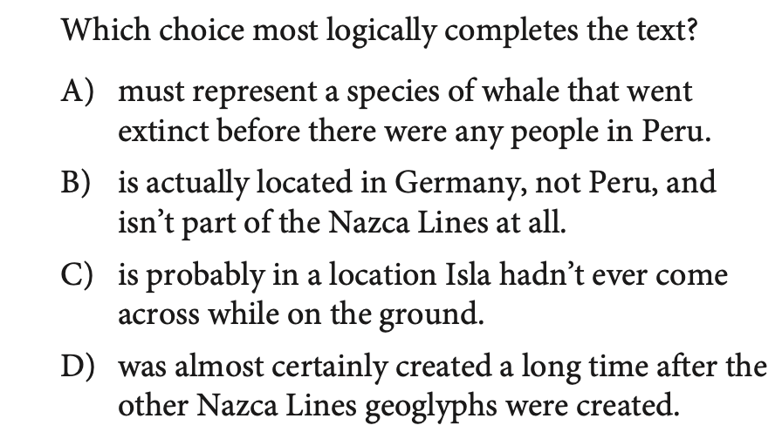
INFERENCES
ACCEPTED
ADMISSIONS
PRACTICE 03
TRY IT FIRST
SAT PREP IV / INFORMATION & IDEAS + CRAFT & STRUCTURE
09

Slide 10
INFERENCES
ACCEPTED
ADMISSIONS
REVIEW 03
ANSWER CHECK
SAT PREP IV / INFORMATION & IDEAS + CRAFT & STRUCTURE
10

Slide 11
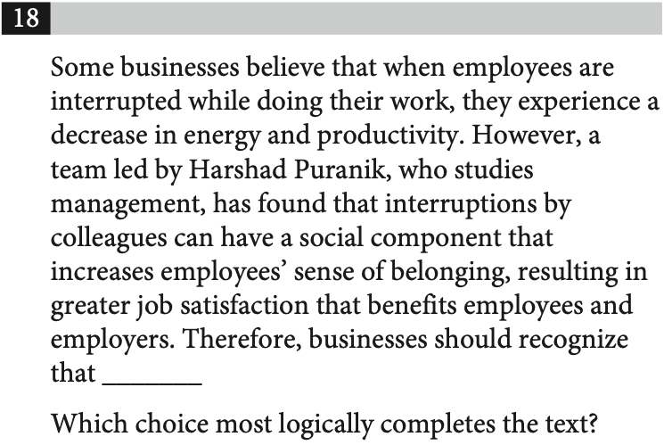
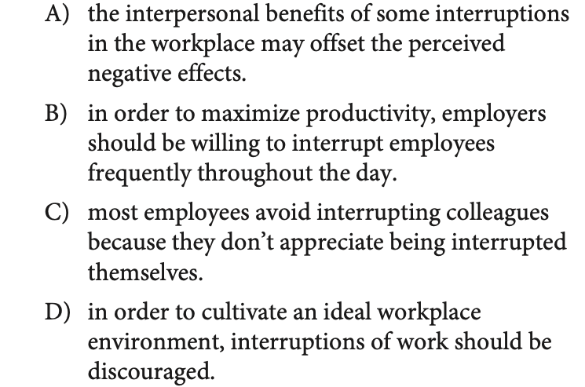
INFERENCES
ACCEPTED
ADMISSIONS
PRACTICE 04
TRY IT FIRST
SAT PREP IV / INFORMATION & IDEAS + CRAFT & STRUCTURE
11

Slide 12
INFERENCES
ACCEPTED
ADMISSIONS
REVIEW 04
ANSWER CHECK
SAT PREP IV / INFORMATION & IDEAS + CRAFT & STRUCTURE
12

Slide 13
SKILL FRAMEWORK
ACCEPTED
ADMISSIONS
Command of Evidence
Textual Evidence
Quantitative Evidence
Which finding or quotation supports or challenges the claim?
Which table or graph detail strengthens the conclusion?
SAT PREP IV / INFORMATION & IDEAS + CRAFT & STRUCTURE
13

Slide 14
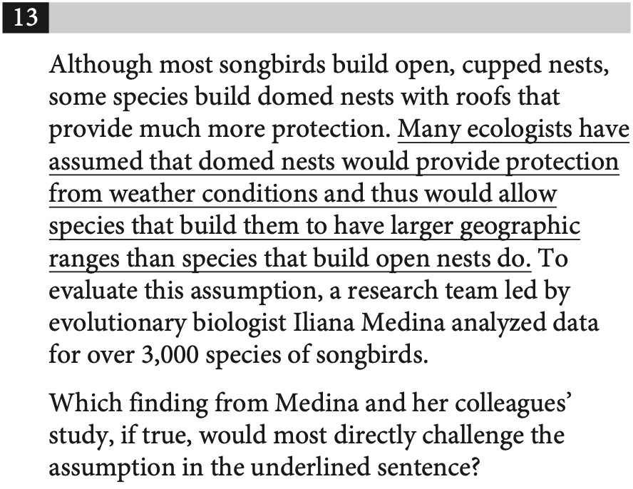
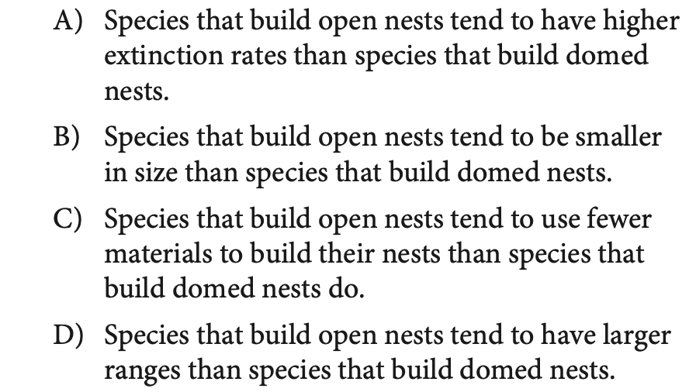
COMMAND OF EVIDENCE
ACCEPTED
ADMISSIONS
PRACTICE 05
TRY IT FIRST
SAT PREP IV / INFORMATION & IDEAS + CRAFT & STRUCTURE
14

Slide 15
COMMAND OF EVIDENCE
ACCEPTED
ADMISSIONS
REVIEW 05
ANSWER CHECK
SAT PREP IV / INFORMATION & IDEAS + CRAFT & STRUCTURE
15

Slide 16
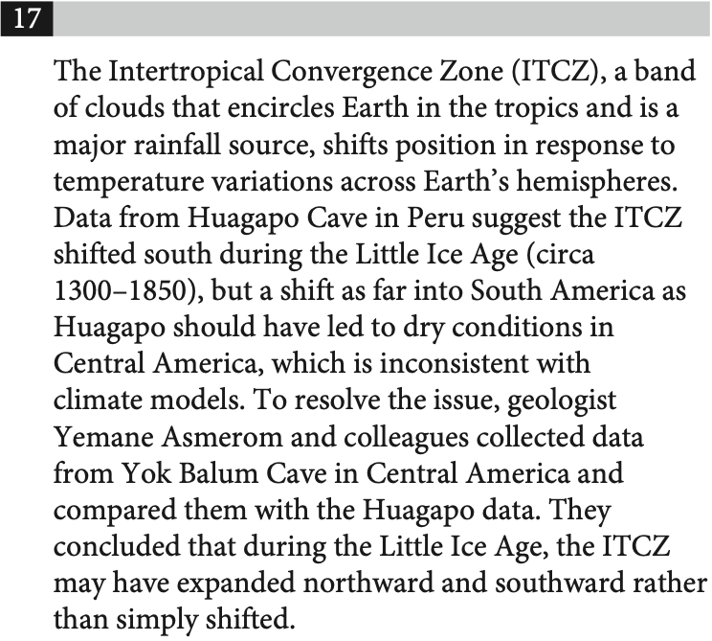
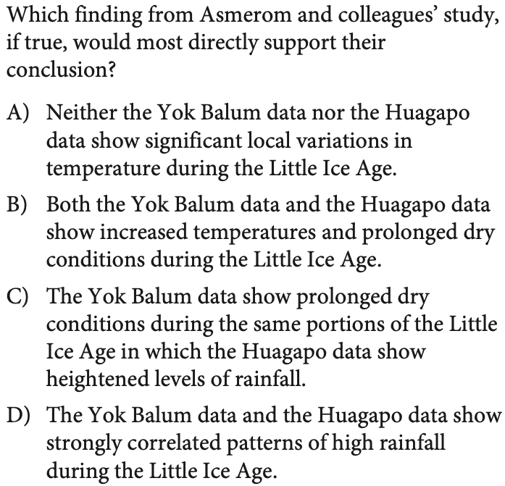
COMMAND OF EVIDENCE
ACCEPTED
ADMISSIONS
PRACTICE 06
TRY IT FIRST
SAT PREP IV / INFORMATION & IDEAS + CRAFT & STRUCTURE
16

Slide 17
COMMAND OF EVIDENCE
ACCEPTED
ADMISSIONS
REVIEW 06
ANSWER CHECK
SAT PREP IV / INFORMATION & IDEAS + CRAFT & STRUCTURE
17

Slide 18
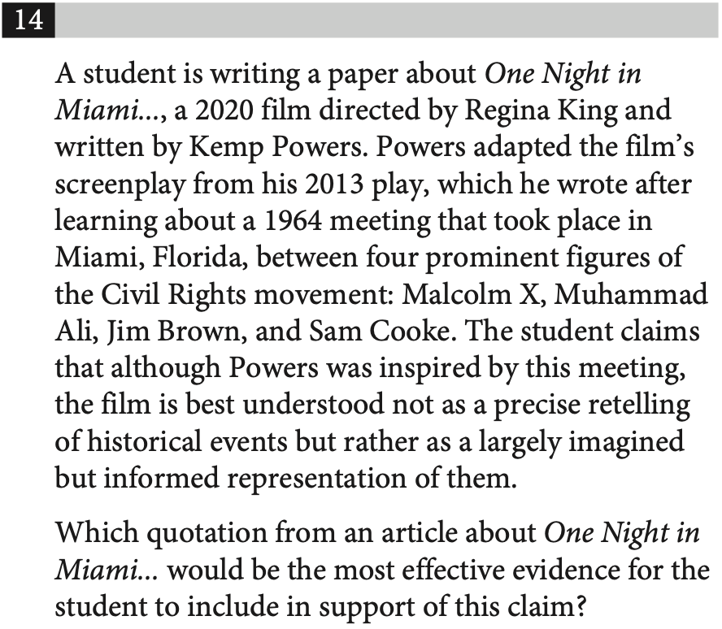
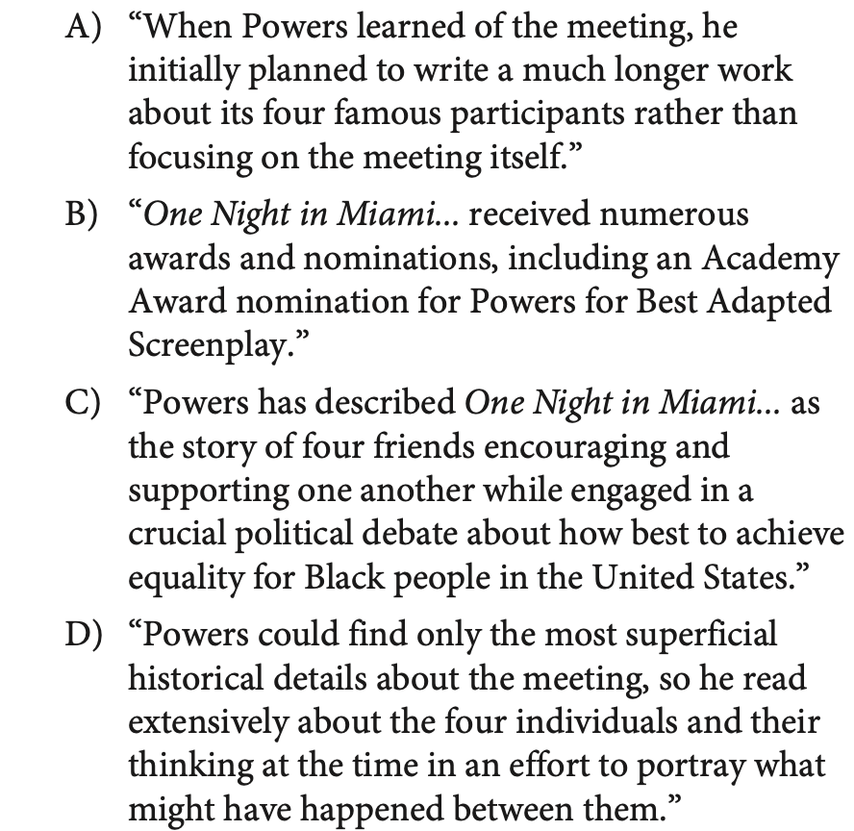
COMMAND OF EVIDENCE
ACCEPTED
ADMISSIONS
PRACTICE 07
TRY IT FIRST
SAT PREP IV / INFORMATION & IDEAS + CRAFT & STRUCTURE
18

Slide 19
COMMAND OF EVIDENCE
ACCEPTED
ADMISSIONS
REVIEW 07
ANSWER CHECK
SAT PREP IV / INFORMATION & IDEAS + CRAFT & STRUCTURE
19

Slide 20
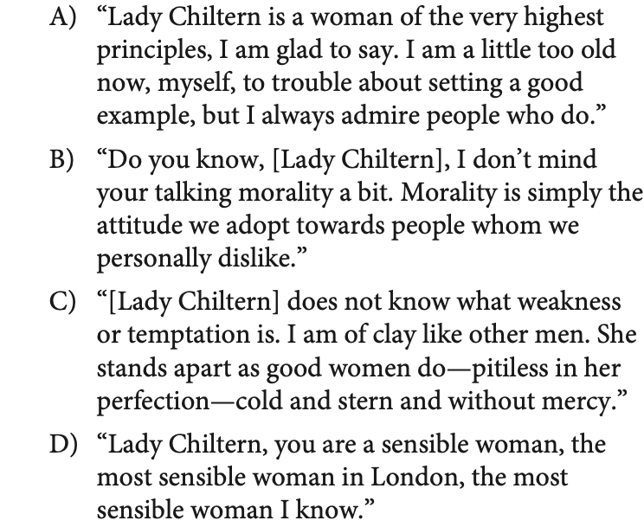
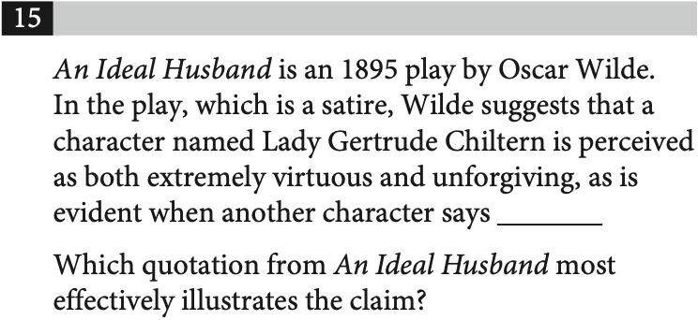
COMMAND OF EVIDENCE
ACCEPTED
ADMISSIONS
PRACTICE 08
TRY IT FIRST
SAT PREP IV / INFORMATION & IDEAS + CRAFT & STRUCTURE
20

Slide 21
COMMAND OF EVIDENCE
ACCEPTED
ADMISSIONS
REVIEW 08
ANSWER CHECK
SAT PREP IV / INFORMATION & IDEAS + CRAFT & STRUCTURE
21

Slide 22
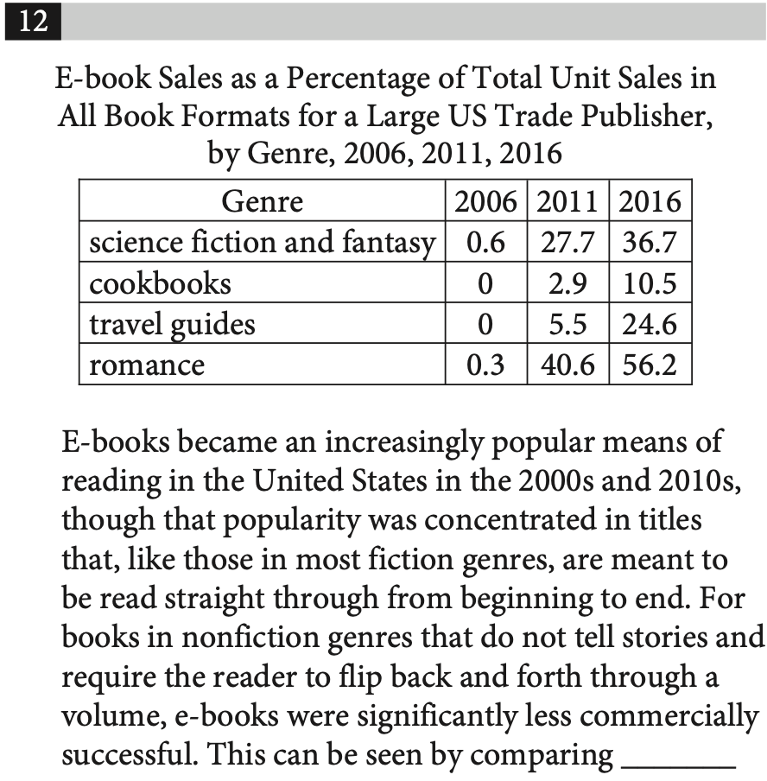
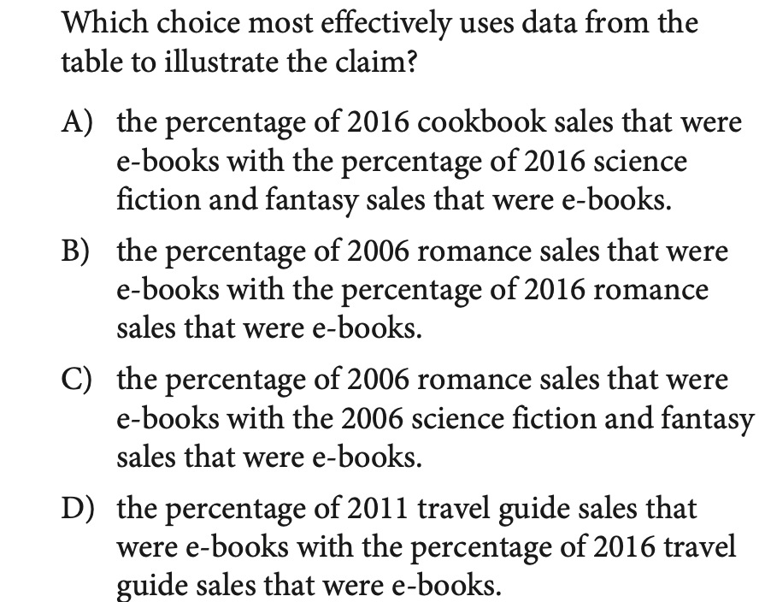
COMMAND OF EVIDENCE
ACCEPTED
ADMISSIONS
PRACTICE 09
TRY IT FIRST
SAT PREP IV / INFORMATION & IDEAS + CRAFT & STRUCTURE
22

Slide 23
COMMAND OF EVIDENCE
ACCEPTED
ADMISSIONS
REVIEW 09
ANSWER CHECK
SAT PREP IV / INFORMATION & IDEAS + CRAFT & STRUCTURE
23

Slide 24
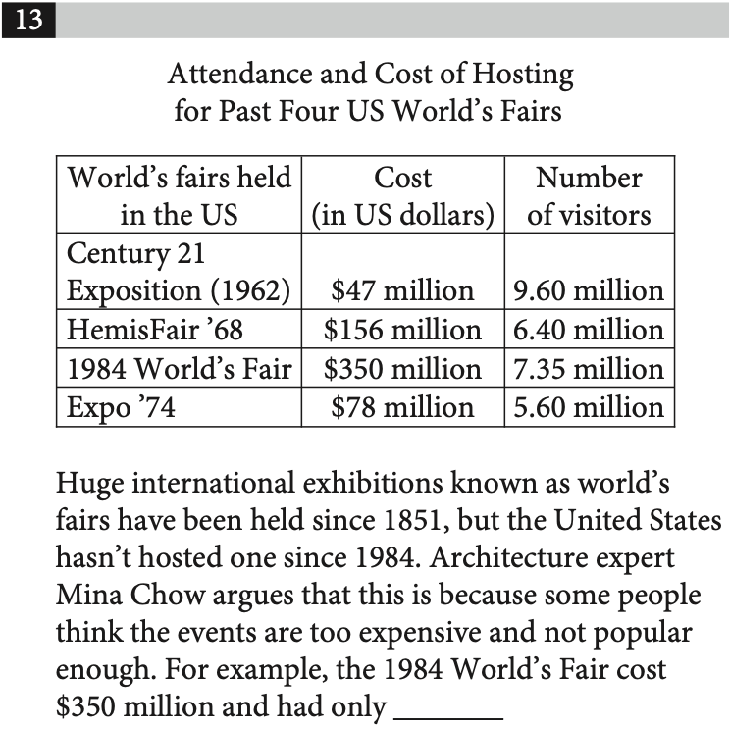
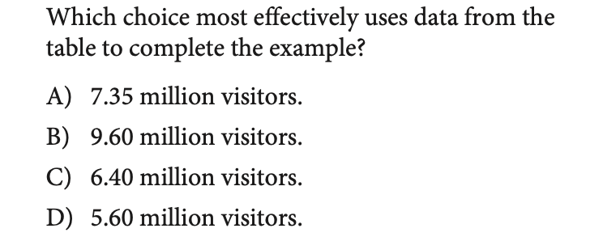
COMMAND OF EVIDENCE
ACCEPTED
ADMISSIONS
PRACTICE 10
TRY IT FIRST
SAT PREP IV / INFORMATION & IDEAS + CRAFT & STRUCTURE
24

Slide 25
COMMAND OF EVIDENCE
ACCEPTED
ADMISSIONS
REVIEW 10
ANSWER CHECK
SAT PREP IV / INFORMATION & IDEAS + CRAFT & STRUCTURE
25

Slide 26
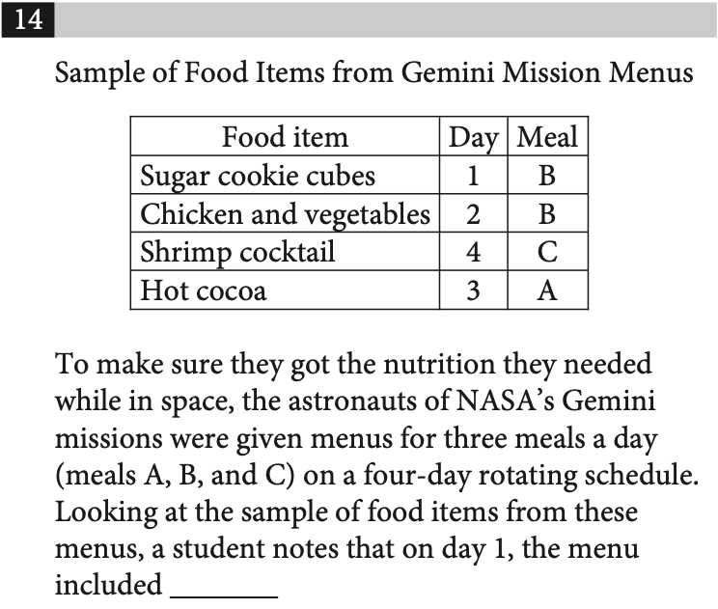
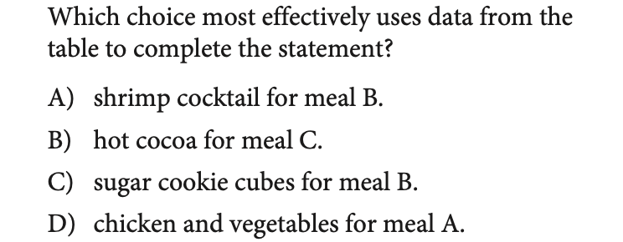
COMMAND OF EVIDENCE
ACCEPTED
ADMISSIONS
PRACTICE 11
TRY IT FIRST
SAT PREP IV / INFORMATION & IDEAS + CRAFT & STRUCTURE
26

Slide 27
COMMAND OF EVIDENCE
ACCEPTED
ADMISSIONS
REVIEW 11
ANSWER CHECK
SAT PREP IV / INFORMATION & IDEAS + CRAFT & STRUCTURE
27

Slide 28
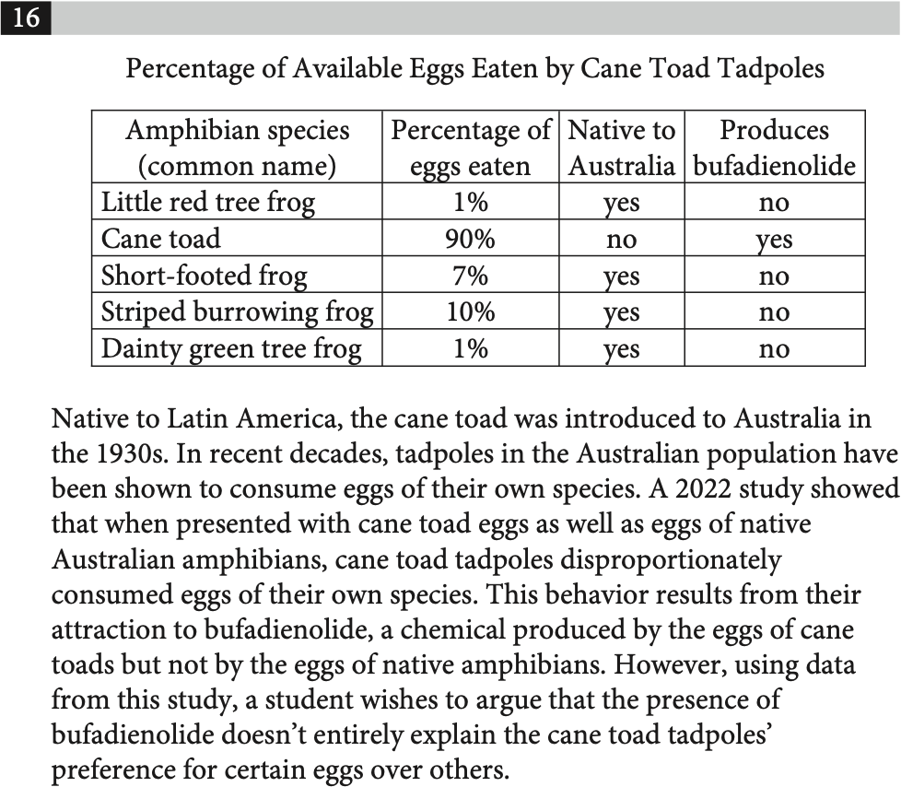
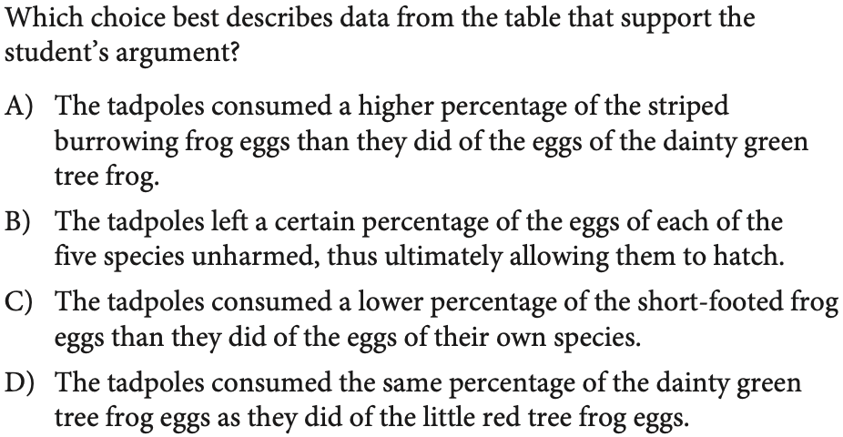
COMMAND OF EVIDENCE
ACCEPTED
ADMISSIONS
PRACTICE 12
TRY IT FIRST
SAT PREP IV / INFORMATION & IDEAS + CRAFT & STRUCTURE
28

Slide 29
COMMAND OF EVIDENCE
ACCEPTED
ADMISSIONS
REVIEW 12
ANSWER CHECK
SAT PREP IV / INFORMATION & IDEAS + CRAFT & STRUCTURE
29

Slide 30
ACCEPTED
ADMISSIONS
NEW MATERIAL
Now: Craft & Structure
Shift from extracting information to analyzing how language works.
01
SAT PREP IV / INFORMATION & IDEAS + CRAFT & STRUCTURE
30

Slide 31
SKILL FRAMEWORK
ACCEPTED
ADMISSIONS
Three Craft & Structure question types
Words in Context
Text Structure & Purpose
Cross-Text Connections
Determine the precise meaning of a word or phrase in this passage.
Explain how the passage or a specific sentence functions.
Compare two perspectives on a shared topic.
SAT PREP IV / INFORMATION & IDEAS + CRAFT & STRUCTURE
31

Slide 32
SKILL FRAMEWORK
ACCEPTED
ADMISSIONS
What each question asks you to do
Words in Context
Text Structure & Purpose
Cross-Text Connections
Define a word as it is used in its surrounding sentence.
Describe how the author develops the passage.
Compare what two authors would say about one another.
SAT PREP IV / INFORMATION & IDEAS + CRAFT & STRUCTURE
32

Slide 33
GENERAL STRATEGY
ACCEPTED
ADMISSIONS
A repeatable method for every question
01 Read the passage
Understand the topic and the author’s central point.
02 Predict an answer
Make a rough prediction before evaluating choices.
03 Eliminate distractors
Cross out answers that are clearly unsupported or off-topic.
04 Choose the best fit
Select the answer that fulfills the exact task.
05 Check if time allows
Revisit other choices only if it improves your confidence.
SAT PREP IV / INFORMATION & IDEAS + CRAFT & STRUCTURE
33

Slide 34
ACCEPTED
ADMISSIONS
QUESTION TYPE
Words in Context
Choose the most logical and precise meaning for this particular sentence.
01
SAT PREP IV / INFORMATION & IDEAS + CRAFT & STRUCTURE
34

Slide 35
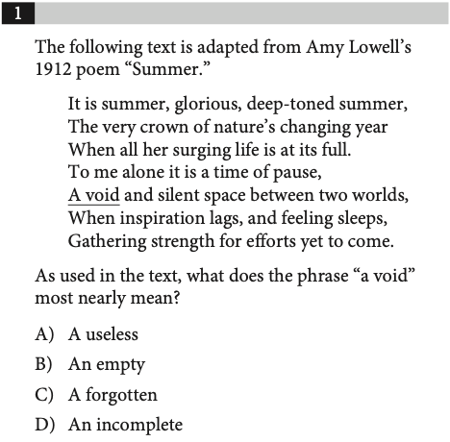
WORDS IN CONTEXT
ACCEPTED
ADMISSIONS
PRACTICE 13
TRY IT FIRST
THINK ALOUD
Context First
What does the word mean here—not in general?
EXPLAIN YOUR REASONING
SAT PREP IV / INFORMATION & IDEAS + CRAFT & STRUCTURE
35

Slide 36
WORDS IN CONTEXT
ACCEPTED
ADMISSIONS
REVIEW 13
ANSWER CHECK
ANSWER REVIEW
Context First
Substitute the meaning back into the original sentence.
EXPLAIN YOUR REASONING
SAT PREP IV / INFORMATION & IDEAS + CRAFT & STRUCTURE
36

Slide 37
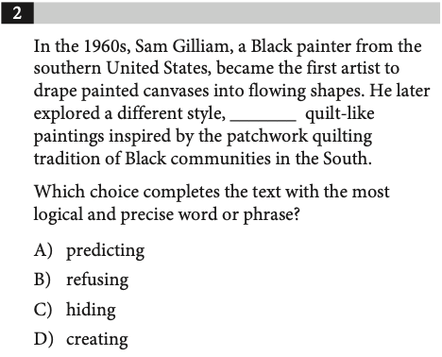
WORDS IN CONTEXT
ACCEPTED
ADMISSIONS
PRACTICE 14
TRY IT FIRST
THINK ALOUD
Context First
What does the word mean here—not in general?
EXPLAIN YOUR REASONING
SAT PREP IV / INFORMATION & IDEAS + CRAFT & STRUCTURE
37

Slide 38
WORDS IN CONTEXT
ACCEPTED
ADMISSIONS
REVIEW 14
ANSWER CHECK
ANSWER REVIEW
Context First
Substitute the meaning back into the original sentence.
EXPLAIN YOUR REASONING
SAT PREP IV / INFORMATION & IDEAS + CRAFT & STRUCTURE
38

Slide 39
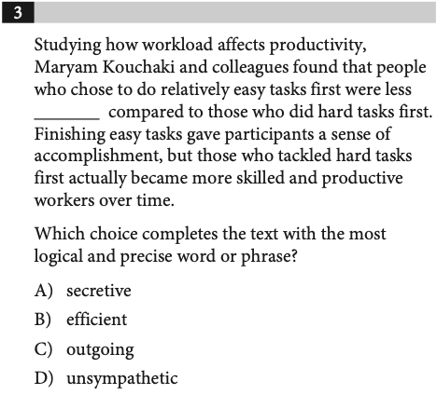
WORDS IN CONTEXT
ACCEPTED
ADMISSIONS
PRACTICE 15
TRY IT FIRST
THINK ALOUD
Context First
What does the word mean here—not in general?
EXPLAIN YOUR REASONING
SAT PREP IV / INFORMATION & IDEAS + CRAFT & STRUCTURE
39

Slide 40
WORDS IN CONTEXT
ACCEPTED
ADMISSIONS
REVIEW 15
ANSWER CHECK
ANSWER REVIEW
Context First
Substitute the meaning back into the original sentence.
EXPLAIN YOUR REASONING
SAT PREP IV / INFORMATION & IDEAS + CRAFT & STRUCTURE
40

Slide 41
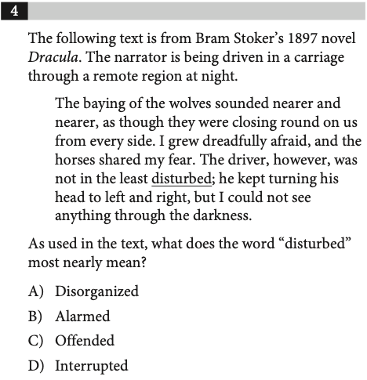
WORDS IN CONTEXT
ACCEPTED
ADMISSIONS
PRACTICE 16
TRY IT FIRST
THINK ALOUD
Context First
What does the word mean here—not in general?
EXPLAIN YOUR REASONING
SAT PREP IV / INFORMATION & IDEAS + CRAFT & STRUCTURE
41

Slide 42
WORDS IN CONTEXT
ACCEPTED
ADMISSIONS
REVIEW 16
ANSWER CHECK
ANSWER REVIEW
Context First
Substitute the meaning back into the original sentence.
EXPLAIN YOUR REASONING
SAT PREP IV / INFORMATION & IDEAS + CRAFT & STRUCTURE
42

Slide 43
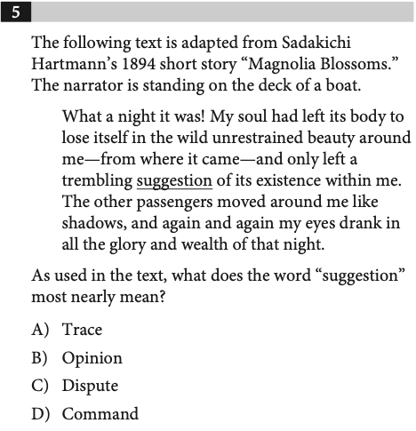
WORDS IN CONTEXT
ACCEPTED
ADMISSIONS
PRACTICE 17
TRY IT FIRST
THINK ALOUD
Context First
What does the word mean here—not in general?
EXPLAIN YOUR REASONING
SAT PREP IV / INFORMATION & IDEAS + CRAFT & STRUCTURE
43

Slide 44
WORDS IN CONTEXT
ACCEPTED
ADMISSIONS
REVIEW 17
ANSWER CHECK
ANSWER REVIEW
Context First
Substitute the meaning back into the original sentence.
EXPLAIN YOUR REASONING
SAT PREP IV / INFORMATION & IDEAS + CRAFT & STRUCTURE
44

Slide 45
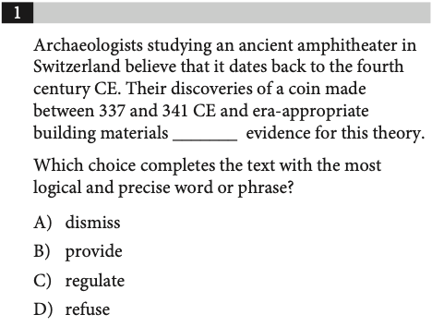
WORDS IN CONTEXT
ACCEPTED
ADMISSIONS
PRACTICE 18
TRY IT FIRST
THINK ALOUD
Context First
What does the word mean here—not in general?
EXPLAIN YOUR REASONING
SAT PREP IV / INFORMATION & IDEAS + CRAFT & STRUCTURE
45

Slide 46
WORDS IN CONTEXT
ACCEPTED
ADMISSIONS
REVIEW 18
ANSWER CHECK
ANSWER REVIEW
Context First
Substitute the meaning back into the original sentence.
EXPLAIN YOUR REASONING
SAT PREP IV / INFORMATION & IDEAS + CRAFT & STRUCTURE
46

Slide 47
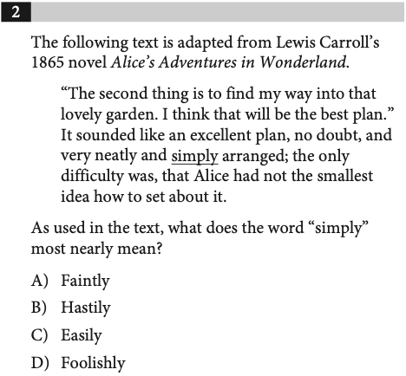
WORDS IN CONTEXT
ACCEPTED
ADMISSIONS
PRACTICE 19
TRY IT FIRST
THINK ALOUD
Context First
What does the word mean here—not in general?
EXPLAIN YOUR REASONING
SAT PREP IV / INFORMATION & IDEAS + CRAFT & STRUCTURE
47

Slide 48
WORDS IN CONTEXT
ACCEPTED
ADMISSIONS
REVIEW 19
ANSWER CHECK
ANSWER REVIEW
Context First
Substitute the meaning back into the original sentence.
EXPLAIN YOUR REASONING
SAT PREP IV / INFORMATION & IDEAS + CRAFT & STRUCTURE
48

Slide 49
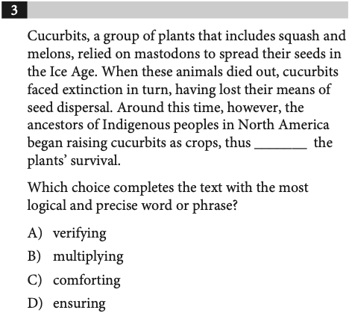
WORDS IN CONTEXT
ACCEPTED
ADMISSIONS
PRACTICE 20
TRY IT FIRST
THINK ALOUD
Context First
What does the word mean here—not in general?
EXPLAIN YOUR REASONING
SAT PREP IV / INFORMATION & IDEAS + CRAFT & STRUCTURE
49

Slide 50
WORDS IN CONTEXT
ACCEPTED
ADMISSIONS
REVIEW 20
ANSWER CHECK
ANSWER REVIEW
Context First
Substitute the meaning back into the original sentence.
EXPLAIN YOUR REASONING
SAT PREP IV / INFORMATION & IDEAS + CRAFT & STRUCTURE
50

Slide 51
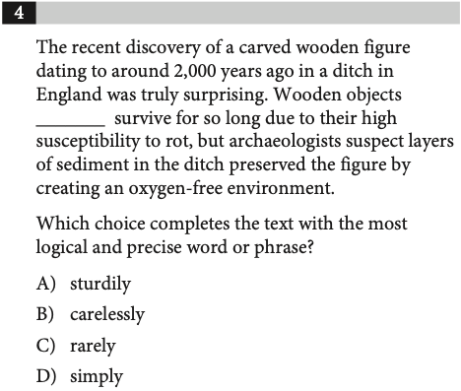
WORDS IN CONTEXT
ACCEPTED
ADMISSIONS
PRACTICE 21
TRY IT FIRST
THINK ALOUD
Context First
What does the word mean here—not in general?
EXPLAIN YOUR REASONING
SAT PREP IV / INFORMATION & IDEAS + CRAFT & STRUCTURE
51

Slide 52
WORDS IN CONTEXT
ACCEPTED
ADMISSIONS
REVIEW 21
ANSWER CHECK
ANSWER REVIEW
Context First
Substitute the meaning back into the original sentence.
EXPLAIN YOUR REASONING
SAT PREP IV / INFORMATION & IDEAS + CRAFT & STRUCTURE
52

Slide 53
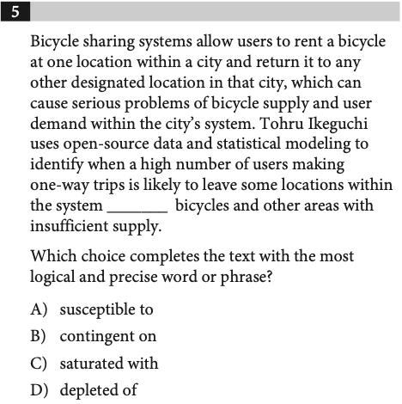
WORDS IN CONTEXT
ACCEPTED
ADMISSIONS
PRACTICE 22
TRY IT FIRST
THINK ALOUD
Context First
What does the word mean here—not in general?
EXPLAIN YOUR REASONING
SAT PREP IV / INFORMATION & IDEAS + CRAFT & STRUCTURE
53

Slide 54
WORDS IN CONTEXT
ACCEPTED
ADMISSIONS
REVIEW 22
ANSWER CHECK
ANSWER REVIEW
Context First
Substitute the meaning back into the original sentence.
EXPLAIN YOUR REASONING
SAT PREP IV / INFORMATION & IDEAS + CRAFT & STRUCTURE
54

Slide 55
ACCEPTED
ADMISSIONS
QUESTION TYPE
Text Structure & Purpose
Focus on what each sentence or paragraph does in the passage.
01
SAT PREP IV / INFORMATION & IDEAS + CRAFT & STRUCTURE
55

Slide 56
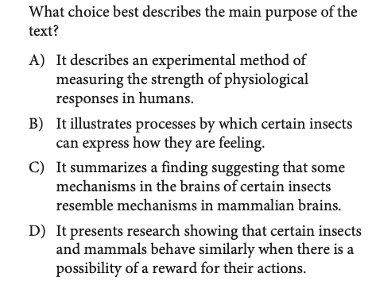
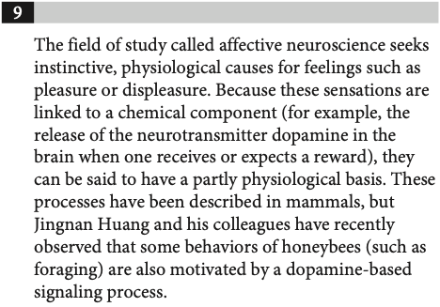
TEXT STRUCTURE & PURPOSE
ACCEPTED
ADMISSIONS
PRACTICE 23
TRY IT FIRST
SAT PREP IV / INFORMATION & IDEAS + CRAFT & STRUCTURE
56

Slide 57
TEXT STRUCTURE & PURPOSE
ACCEPTED
ADMISSIONS
REVIEW 23
ANSWER CHECK
SAT PREP IV / INFORMATION & IDEAS + CRAFT & STRUCTURE
57

Slide 58
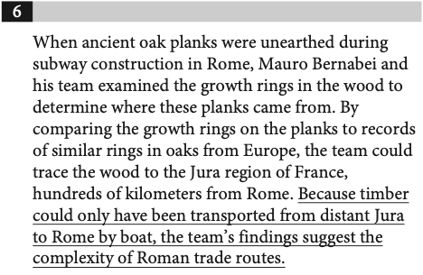
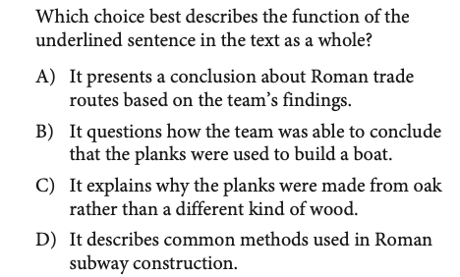
TEXT STRUCTURE & PURPOSE
ACCEPTED
ADMISSIONS
PRACTICE 24
TRY IT FIRST
SAT PREP IV / INFORMATION & IDEAS + CRAFT & STRUCTURE
58

Slide 59
TEXT STRUCTURE & PURPOSE
ACCEPTED
ADMISSIONS
REVIEW 24
ANSWER CHECK
SAT PREP IV / INFORMATION & IDEAS + CRAFT & STRUCTURE
59

Slide 60
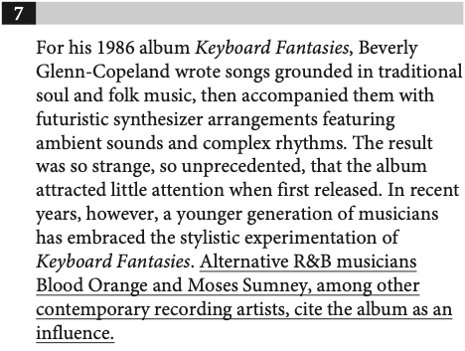
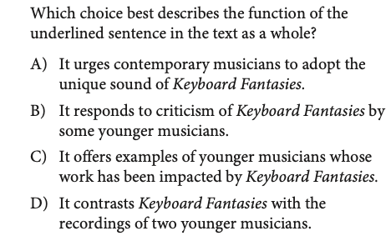
TEXT STRUCTURE & PURPOSE
ACCEPTED
ADMISSIONS
PRACTICE 25
TRY IT FIRST
SAT PREP IV / INFORMATION & IDEAS + CRAFT & STRUCTURE
60

Slide 61
TEXT STRUCTURE & PURPOSE
ACCEPTED
ADMISSIONS
REVIEW 25
ANSWER CHECK
SAT PREP IV / INFORMATION & IDEAS + CRAFT & STRUCTURE
61

Slide 62
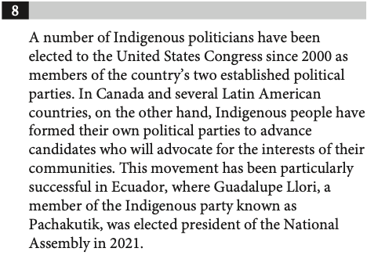
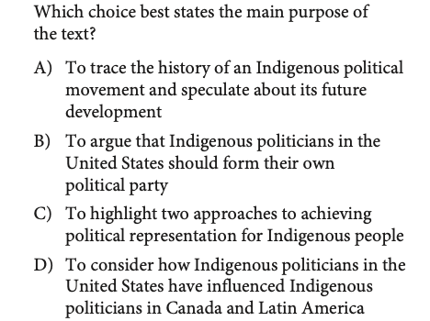
TEXT STRUCTURE & PURPOSE
ACCEPTED
ADMISSIONS
PRACTICE 26
TRY IT FIRST
SAT PREP IV / INFORMATION & IDEAS + CRAFT & STRUCTURE
62

Slide 63
TEXT STRUCTURE & PURPOSE
ACCEPTED
ADMISSIONS
REVIEW 26
ANSWER CHECK
SAT PREP IV / INFORMATION & IDEAS + CRAFT & STRUCTURE
63

Slide 64
ACCEPTED
ADMISSIONS
QUESTION TYPE
Cross-Text Connections
Compare claims, assumptions, and the authors’ points of view.
01
SAT PREP IV / INFORMATION & IDEAS + CRAFT & STRUCTURE
64

Slide 65
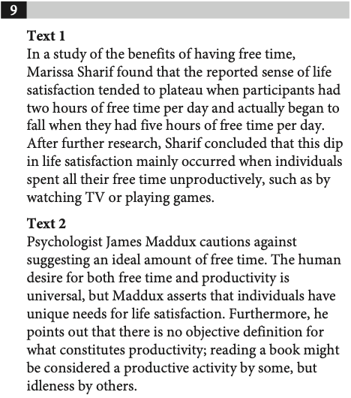
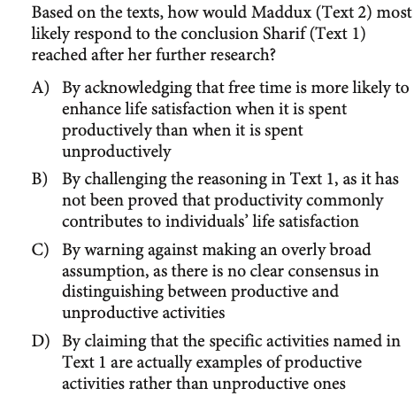
CROSS-TEXT CONNECTIONS
ACCEPTED
ADMISSIONS
PRACTICE 27
TRY IT FIRST
SAT PREP IV / INFORMATION & IDEAS + CRAFT & STRUCTURE
65

Slide 66
CROSS-TEXT CONNECTIONS
ACCEPTED
ADMISSIONS
REVIEW 27
ANSWER CHECK
SAT PREP IV / INFORMATION & IDEAS + CRAFT & STRUCTURE
66

Slide 67
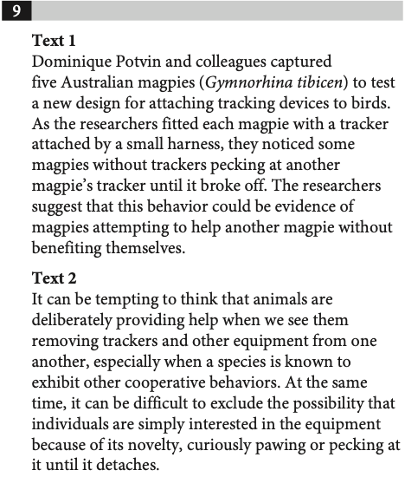
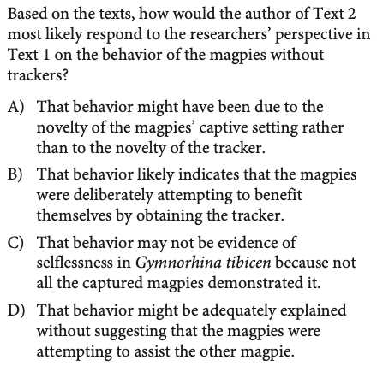
CROSS-TEXT CONNECTIONS
ACCEPTED
ADMISSIONS
PRACTICE 28
TRY IT FIRST
SAT PREP IV / INFORMATION & IDEAS + CRAFT & STRUCTURE
67

Slide 68
CROSS-TEXT CONNECTIONS
ACCEPTED
ADMISSIONS
REVIEW 28
ANSWER CHECK
SAT PREP IV / INFORMATION & IDEAS + CRAFT & STRUCTURE
68

Slide 69
ACCEPTED
ADMISSIONS
REVIEW & RETAIN
What will you remember
next time?
Explain one strategy that helped you reject a tempting wrong answer.
SAT PREP IV / INFORMATION & IDEAS + CRAFT & STRUCTURE
69

