Slide 1
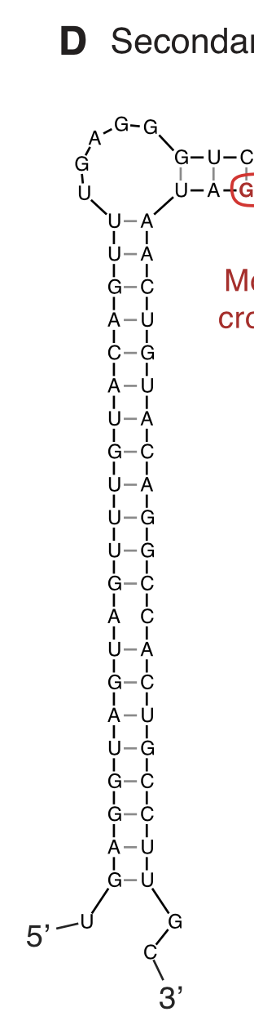
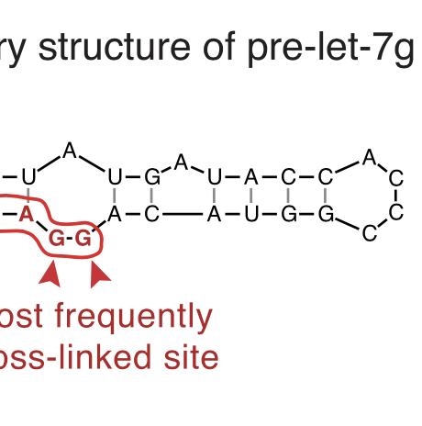
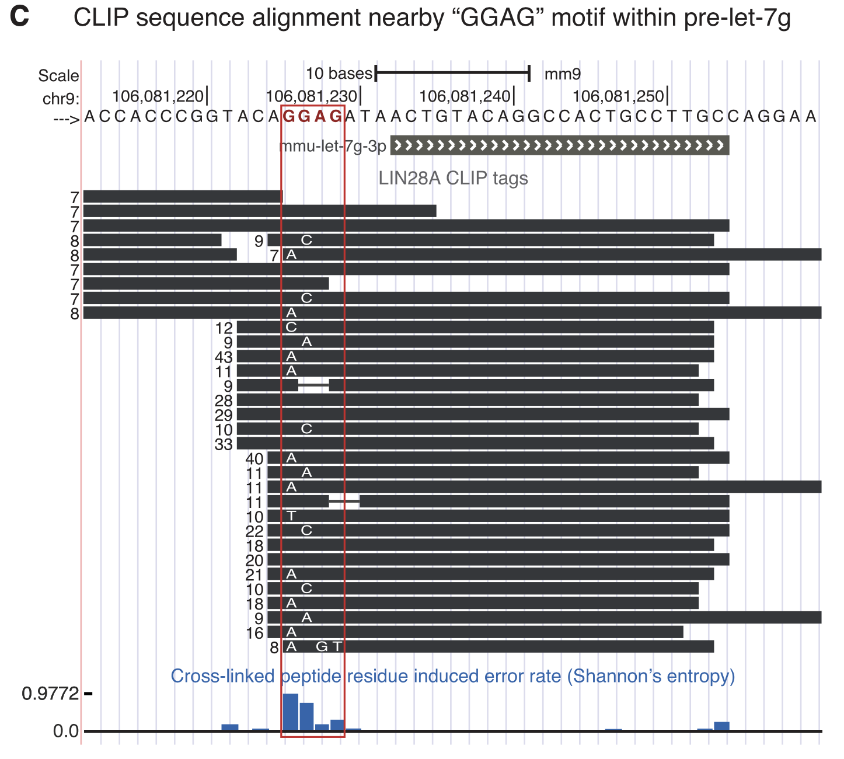
Introduction
Background / Motivation
LIN28A binds to let7 precursors through the GGAG motif
Lin28A CCHC zinc finger
let7 precursor’s GGAG motif in the terminal loop
let-7g CLIP tags mostly contain GGAG sequence, which means it will faithfully reflect physiological interaction between LIN28A & let-7g precursors
Observed frequent GGAG motif sequence alterations, on the first guanosine position to be more specific
Alteration is likely to be an outcome of UV crosslinking to LIN28A which are hardly detached and leads to reverse transcription error
What to do?
Identifying substitution pattern with other kinds of let-7 precursors – Mirlet7d & Mirlet7f-1

Slide 2
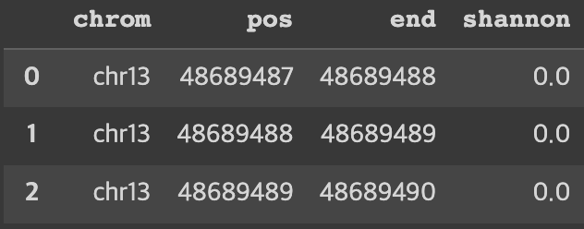
Method
Data-preprocessing
GTF file for gene annotation
Sorted and indexed for IGV operation
BAM file with sequence information of specific type of let7 precursor
CLIP-35L33G.bam: Sequence information of let7 precursor
mirlet7d & mirlet7f-1sequences are from reverse strand
Using gene annotation information from GTF file, selectively obtained regions corresponds to specific type of let7 precursor
Bedgraph file with four columns, each row contains Shannon entropy value for each base positions
Based on information of Pileup file obtained from BAM file
Shannon entropy obtained by calculating base diversity per each position
Each base position number should be subtracted by 1, since chromosome coordinates used for bedgraph are zero-based

Slide 3

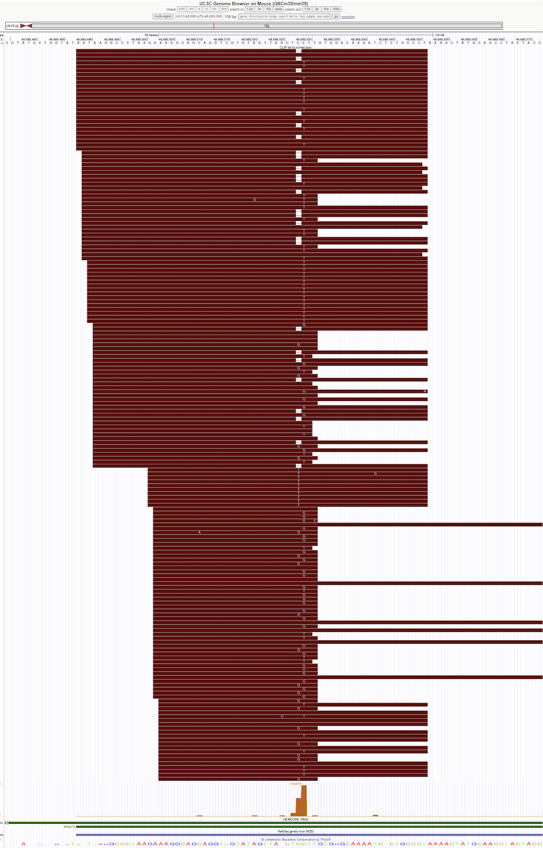
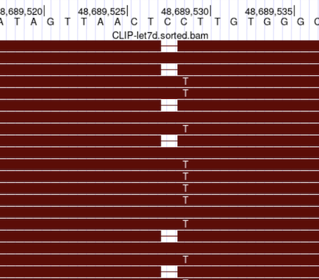
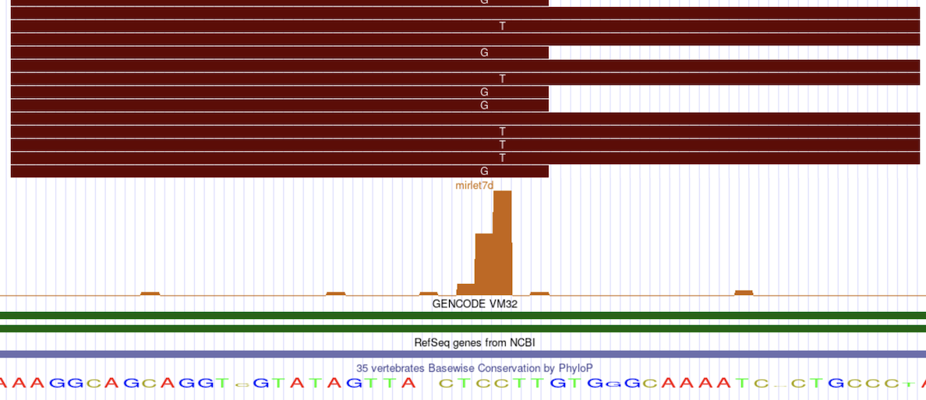
Results
Visualization – Mirlet7d
UCSC
URL (e.g. github) for sorted BAM / BAM.bai file
Bedgraph file for Shannon entropy bar-plot

Slide 4

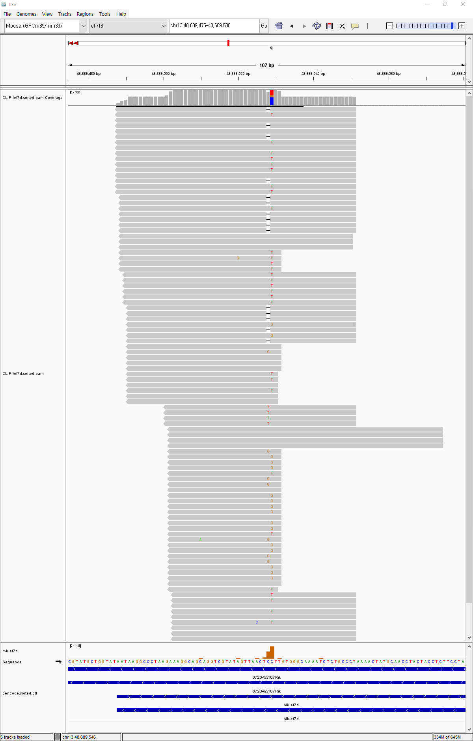
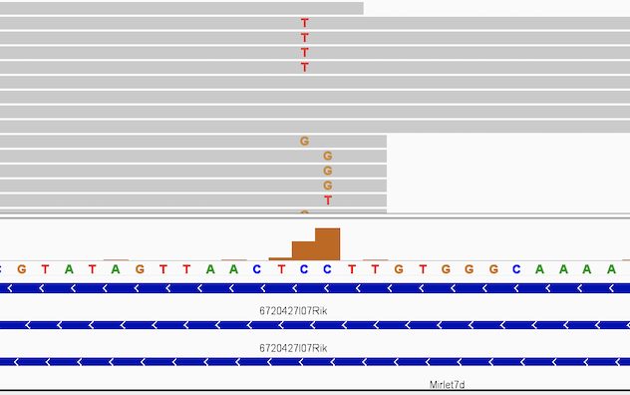
Results
Visualization – Mirlet7d
IGV
Additionally gave sorted GTF file (using IGV-tool) for reference genome input (Given by default)

Slide 5
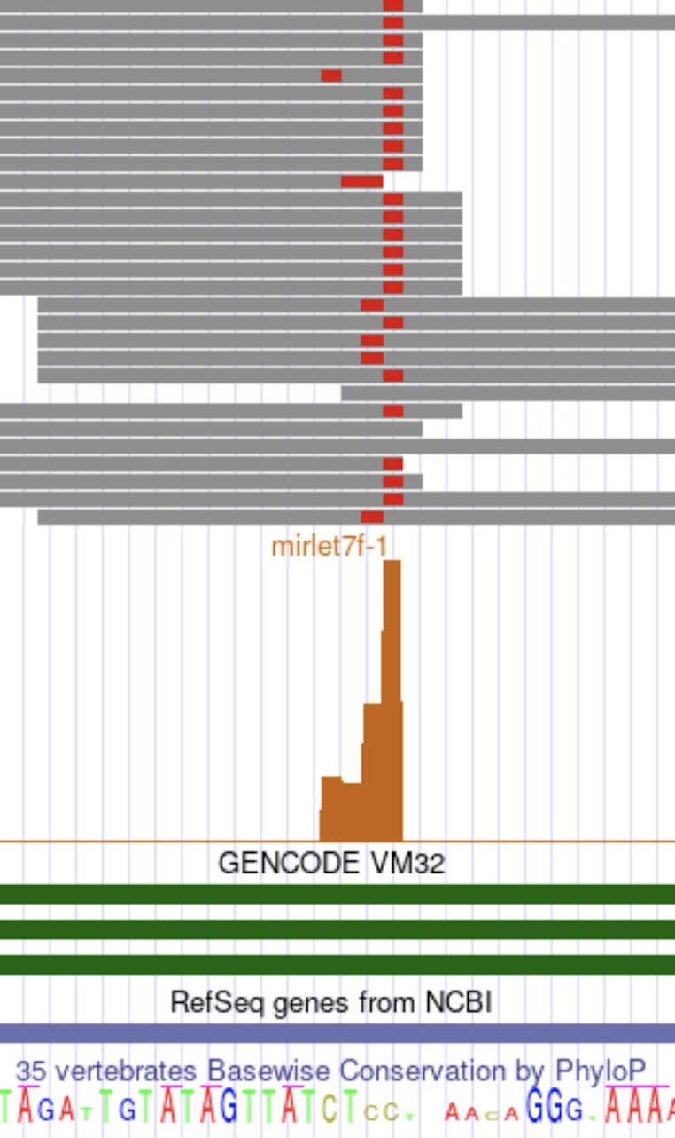
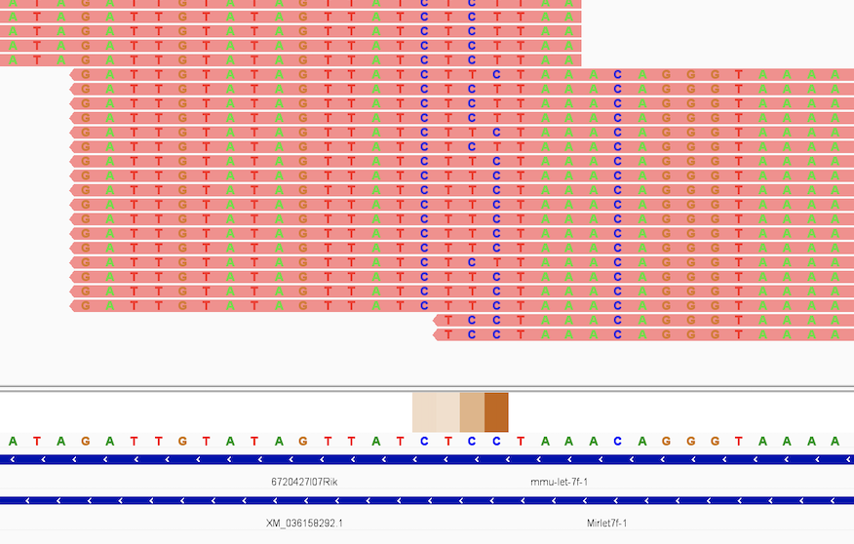
Results
Visualization – Mirlet7f-1
Visualization for Mirlet7f-1 precursor with UCSC (left) and IGV (right)
Used heatmap for IGV instead of barplot
Binding of LIN28A to multiple type of let-7 precursors, including mirlet-7g mirlet-7d and mirlet7f-1, commonly leads to base substitution within the GAGG motif, specifically at the first guanosine position.

