Slide 1

Arduino for Neuroscientists NBHVGR7040
AfN #4: Advanced computer communication

Slide 2
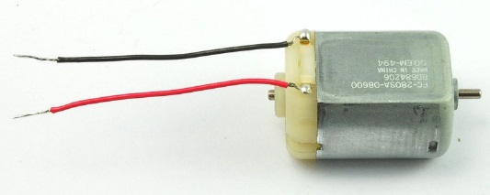
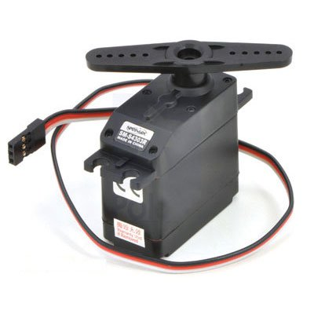
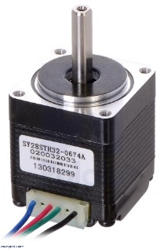
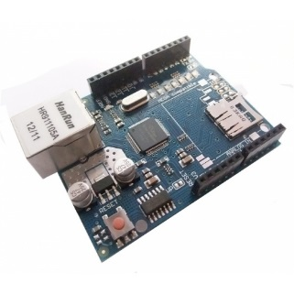
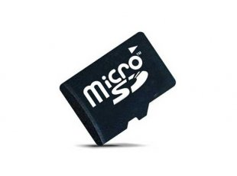
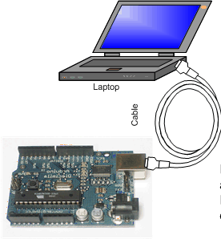
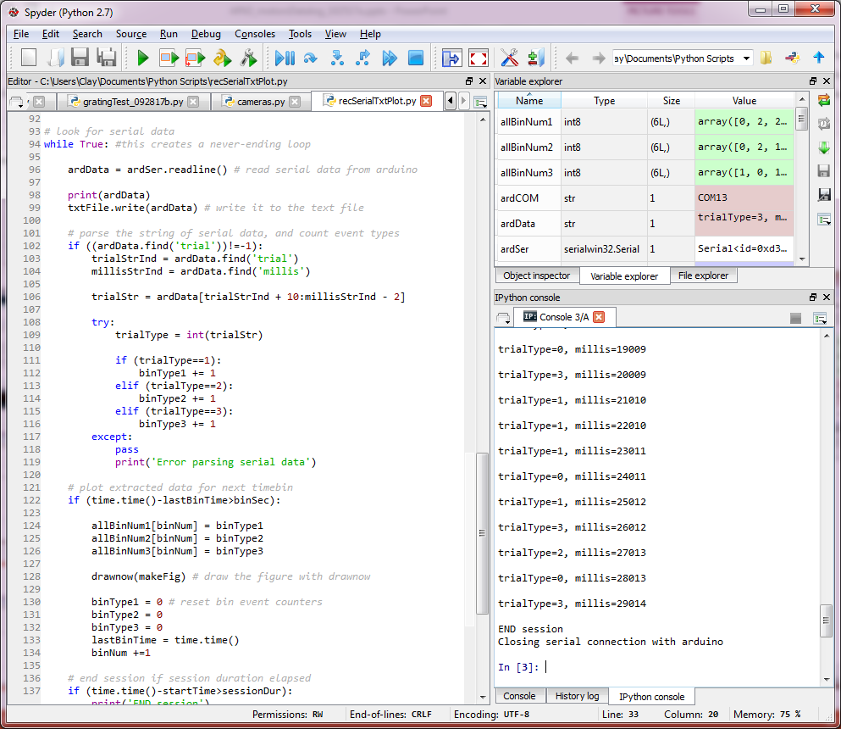

Last week:
Motors
DC motors
Servos
Stepper motors
Logging data
SD card
Talking to computers
Read serial with Python
Record, parse, and plot

Slide 3
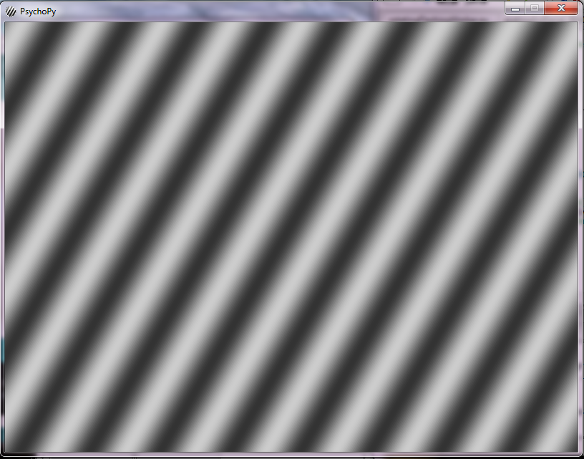

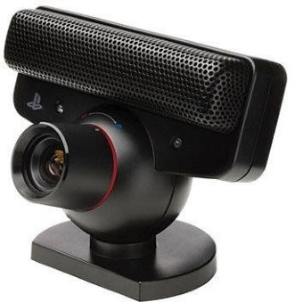
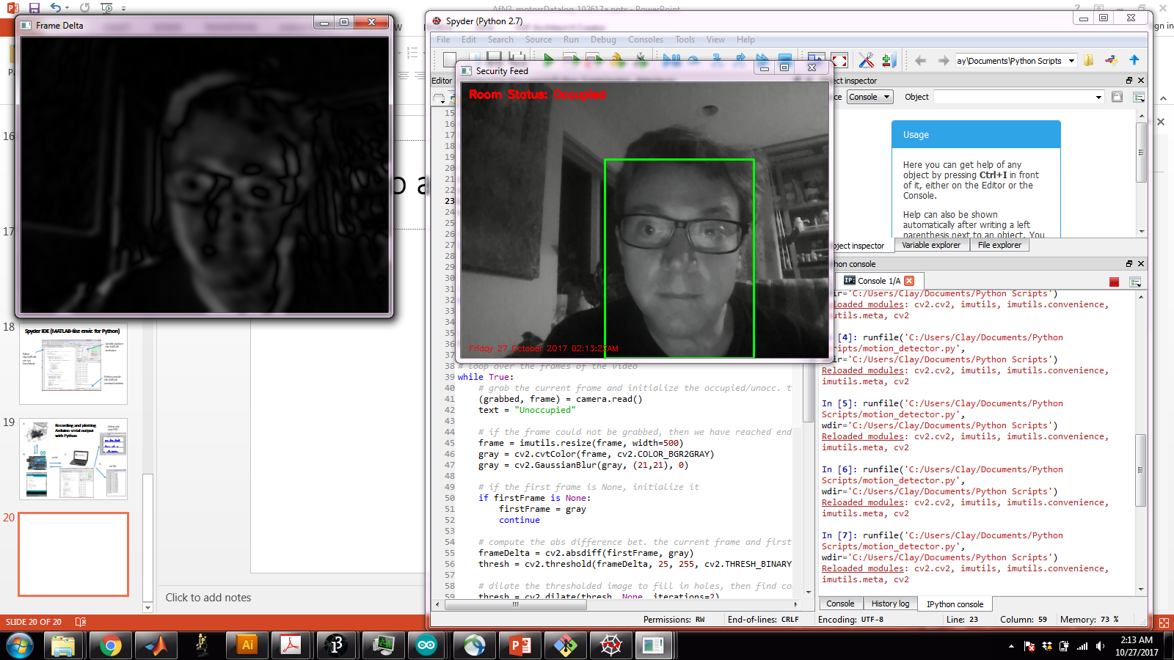
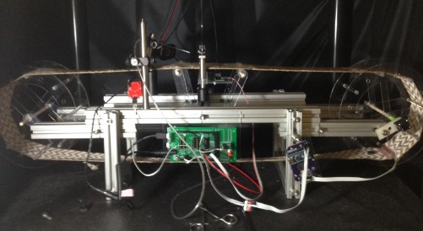
This week: advanced computer interface
Visual operant tasks with PsychoPy and Arduino
Webcam motion tracking with Python/OpenCV and Arduino serial triggering
Arduino behavioral apparatus workshop
Reward zone
1.
A
2.
B
3.
C

Slide 4
But first: Final projects (to be presented in class, Nov. 17)
Three options:
Combine some of the hardware elements (inputs/outputs) from the class to make a novel behavioral paradigm. Write software to control a basic version of the behavior, and if possible, show proof-of-principle for interaction of some of the basic hardware elements.
OR: Take code from a current behavioral paradigm, and program a novel variation for this task.
OR: Choose a novel hardware/software element and show proof-of-principle for its function
Internet communication (Ethernet, wifi)
A new I2C or SPI sensor (e.g. accelerometer, gyro)
Visual stim that changes based upon animal locomotion
3D virtual reality
Dynamic updating of behavioral parameters based upon computer analysis

Slide 5
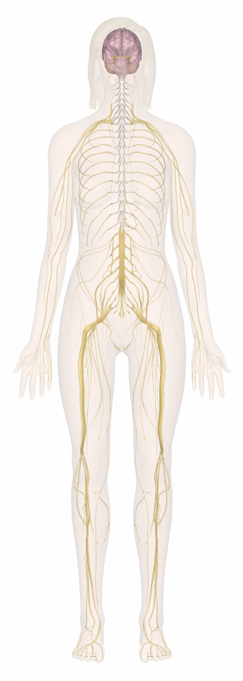
Advanced computer interface: Computer ~= brain
Arduino is decent for simple logic and calculations, but lacks the computational power for more complex operations.
In the human nervous system, a fast input-output system, the spinal cord, is subject to supervisory control by higher processing centers in the brain (a “hierarchical control system”).
Similarly, interfacing an Arduino with a computer can provide functionality analogous to that of the brain.
1.) memory: recording data
2.) high bandwidth operations: video acquisition/processing, visual stim display
3.) high level communication: web services

Slide 6
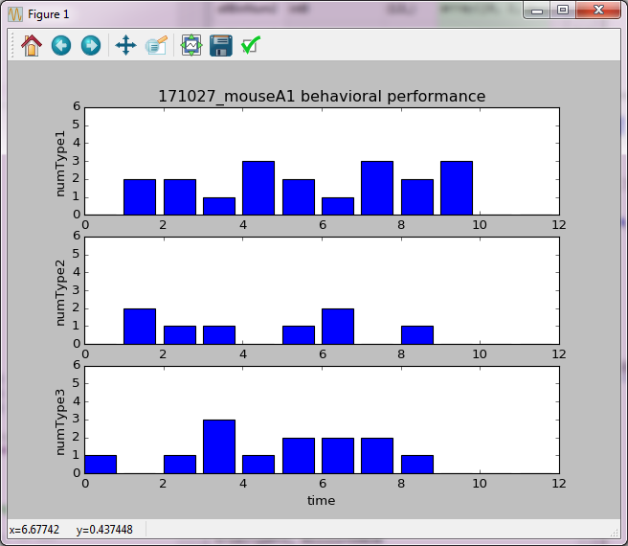

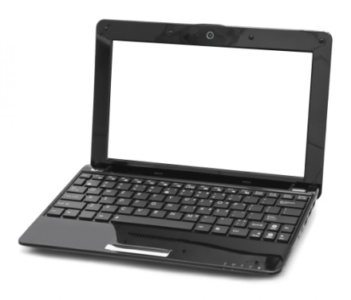

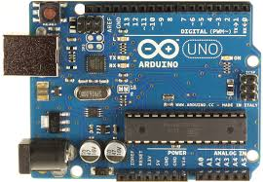
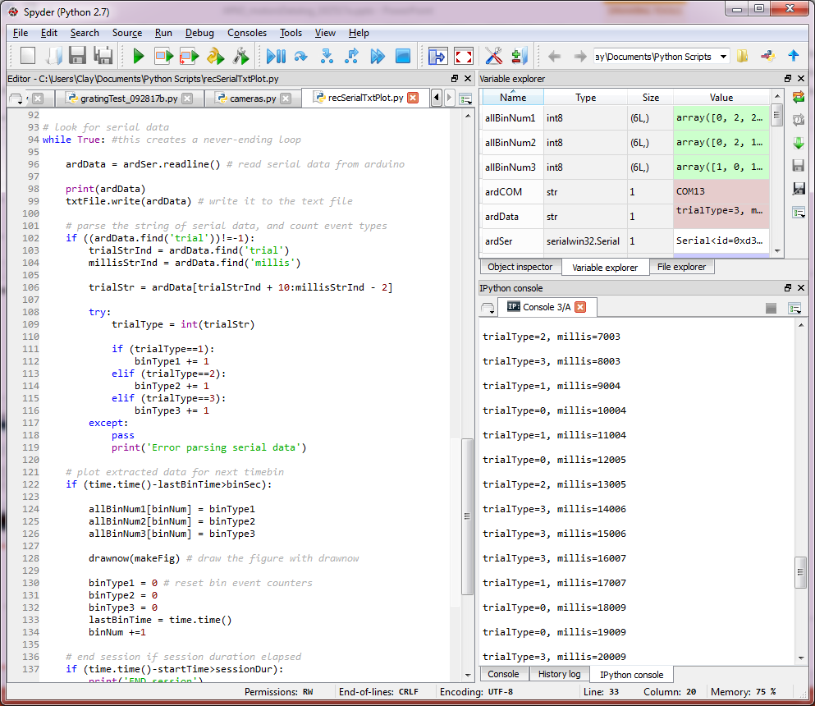
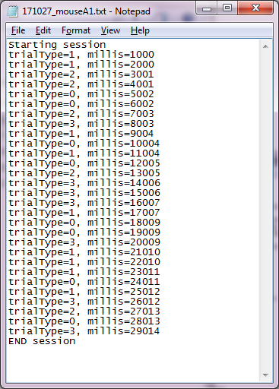
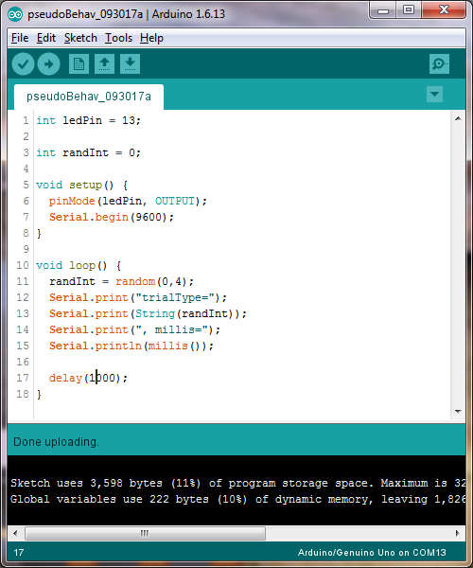
Recording and plotting Arduino serial output with Python
Online plot (and PDF)
B
C
serial
D
.txt file

Slide 7
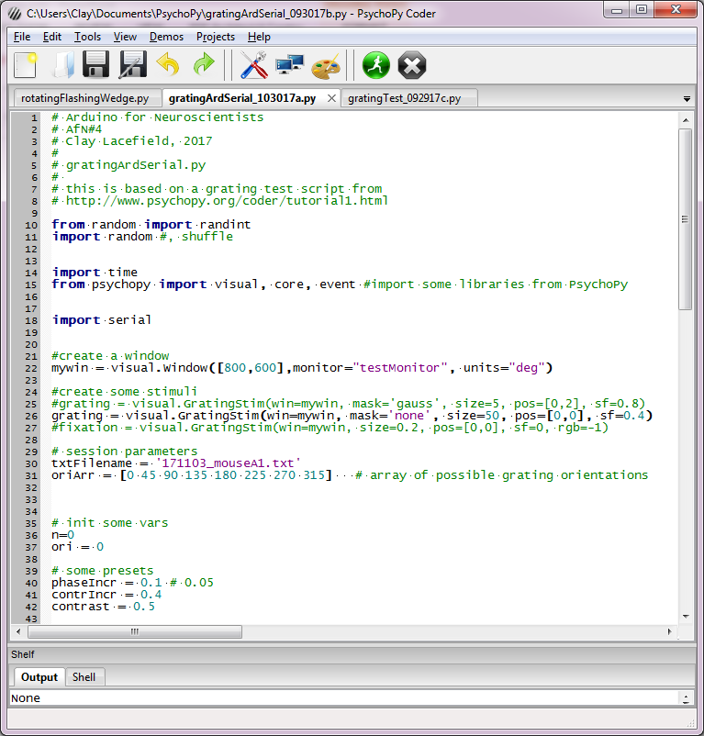
Visual Stimuli
Use PsychoPy to deliver bar grating stimuli for a visual operant task
Use serial connection with Arduino to control trial type, timing, and rewards.

Slide 8
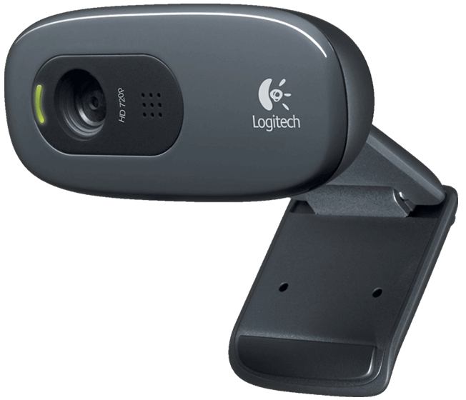
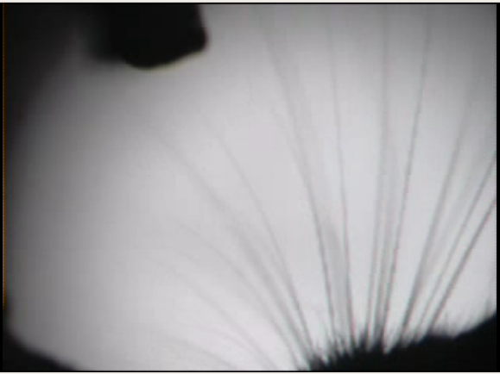
Webcams
Simple Logitech webcam
Webcams are cheap, reasonably high-res. and are easily interfaced with a computer (by USB).
IR filter can be removed for “night-vision” with IR illumination
Some webcams (PS3eye) can also perform at high framerates (up to 187fps)
Can therefore be used easily with computer vision software for animal tracking, to record position or trigger outputs, or to just record high-speed video for subsequent analysis
BUT need some way to align with imaging/ephys (sync pulse)
PS3eye ($5- 187fps)
IR whisker video rec. at 187fps with PS3eye and Kinovea software
Notes:
Note that webcams also have the shortcoming that it is difficult to trigger precise frame acquisition, in contrast to professional industrial-grade cameras.

Slide 9
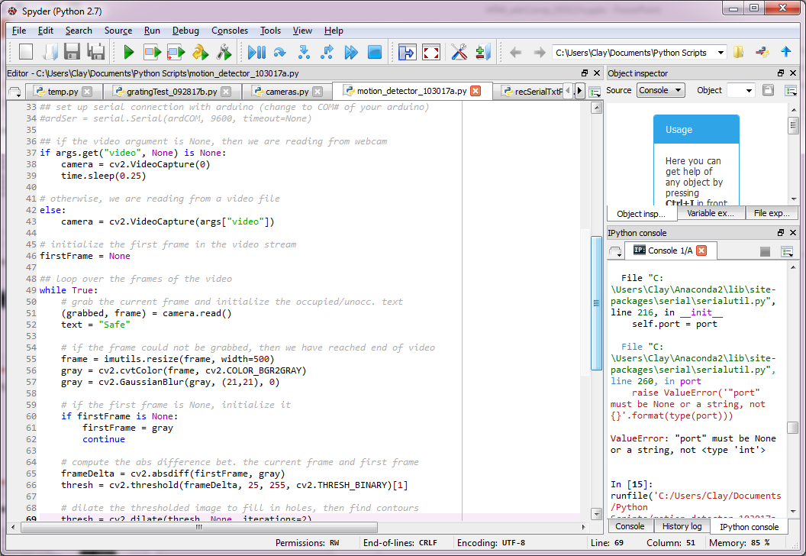
Motion tracking
Use a webcam with Python/OpenCV to detect and track a mouse
Send serial info to have Arduino trigger something (e.g. opto stim, shock) when an animal is in a certain spatial zone

Slide 10
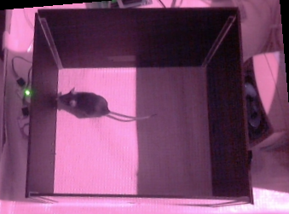
Behavioral setup workshop
2 port box
Headfixed whisker stim
Treadmill
Wheel
Reward zone
1.
A
2.
B
3.
C

