Slide 1

Arduino for Neuroscientists NBHVGR7040
AfN #3: Motors, data logging, computer interface

Slide 2
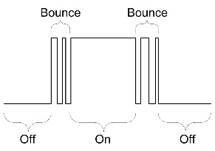
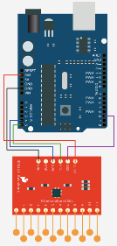
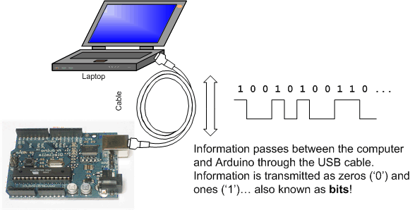
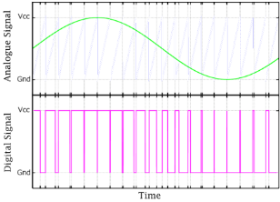
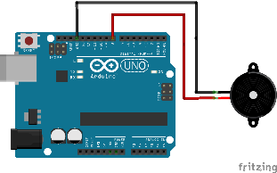
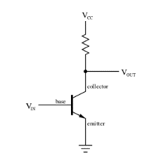
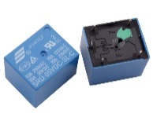
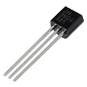
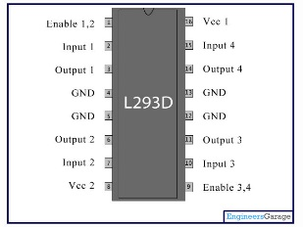
Last week:
More complex Input/Output (“IO”)
“Debouncing” inputs
Digital communication protocols
Serial
I2C/SPI
Analog output
Pulse-width modulation (PWM)
analogWrite(pwmPin, freq.);
tone(pin, freq., dur.);
Digital output
Getting around the 0/+5V limit
Relays
Transistors
H-bridges
Solenoid valves

Slide 3
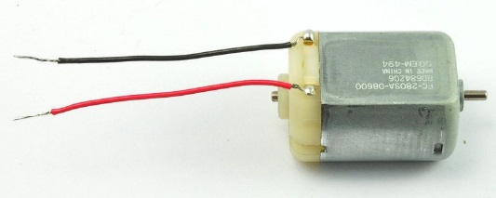
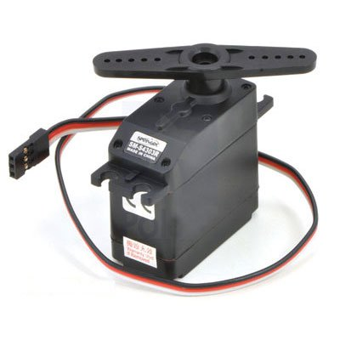
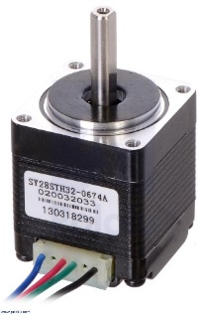
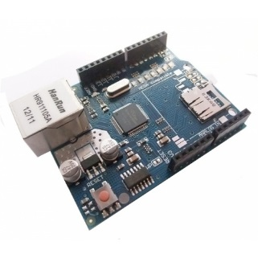
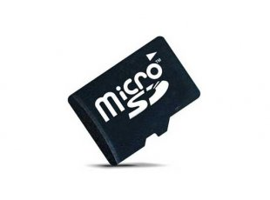
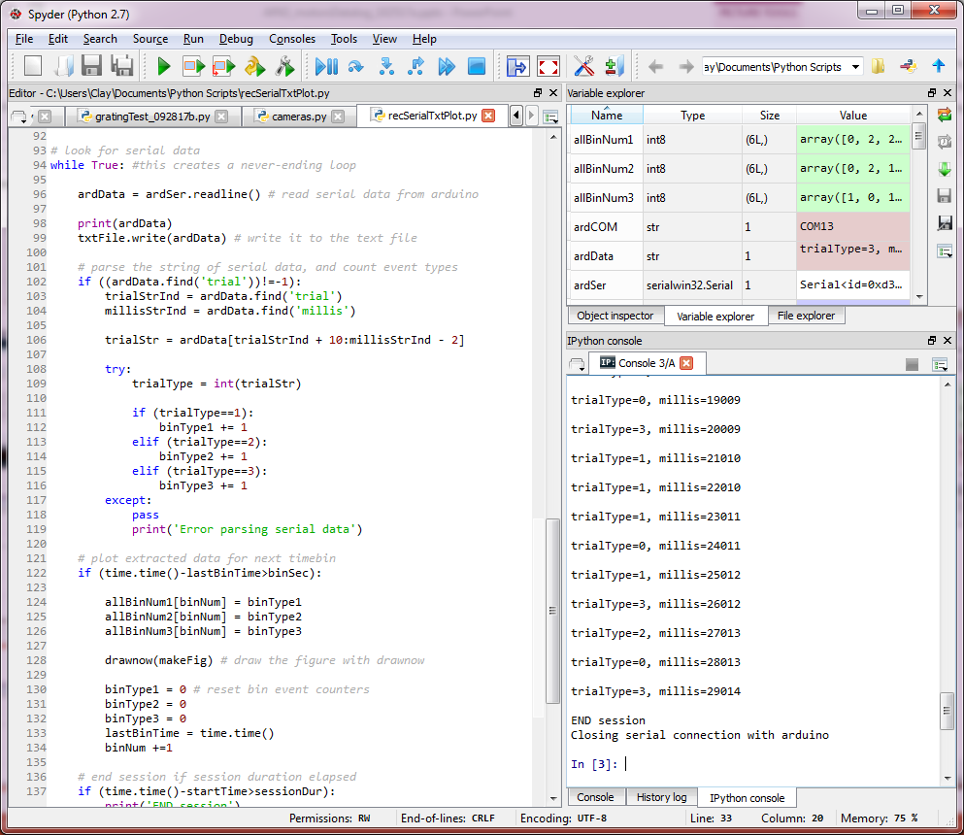

This week:
Motors
DC motors
Servos
Stepper motors
Logging data
SD card
Talking to computers
Read serial with Python
Record, parse, and plot

Slide 4
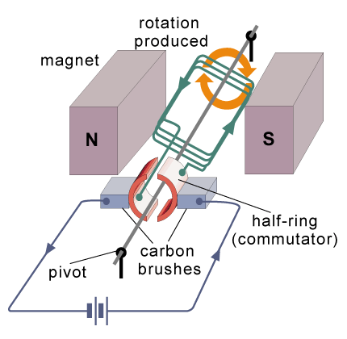
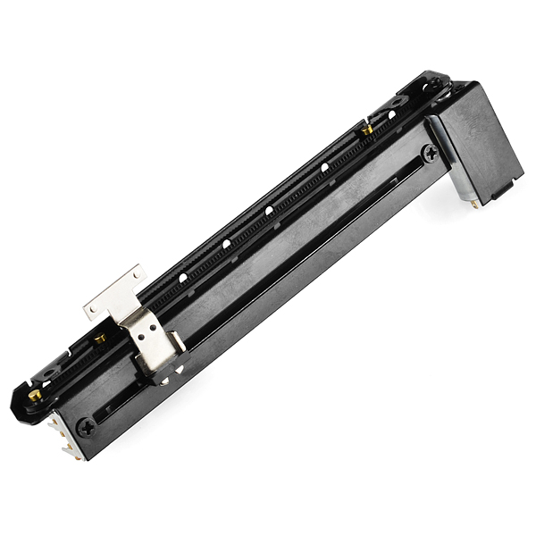
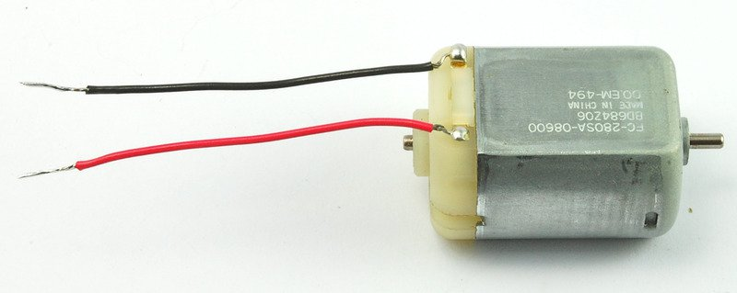
DC motors
Single-coil motor
Use H-bridge to drive forward or backward
No position control
Goes at rate proportional to drive current

Slide 5
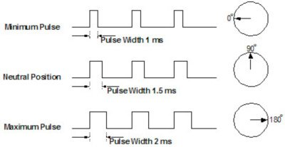
Servo motors
Accurate (internal feedback circuitry)
Easy to control
Arduino Servo library
PWM: 1pulse/20ms
But watch out for timer conflicts
But slow and loud

Slide 6
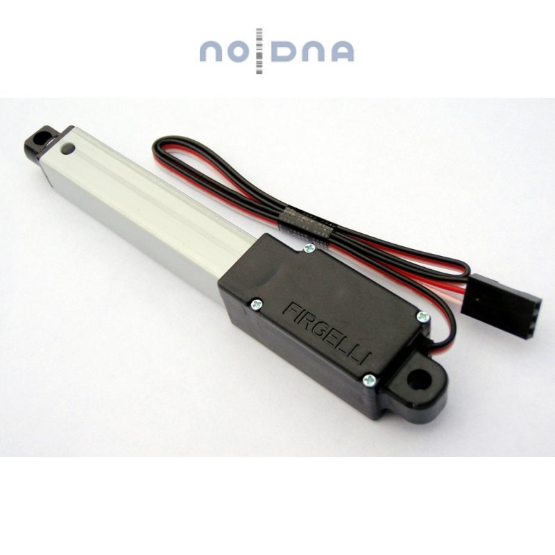
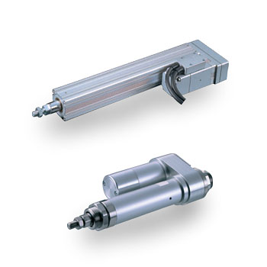
Different types of servos
Rotary and linear servos
Control is similar

Slide 7
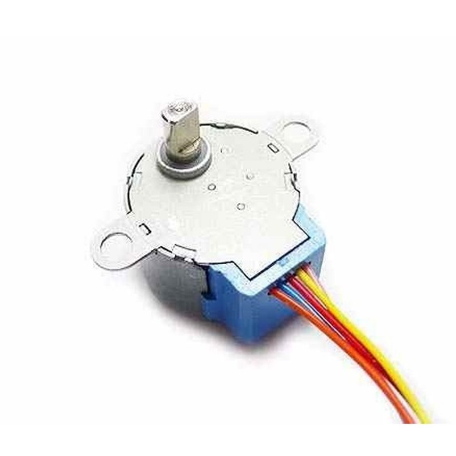
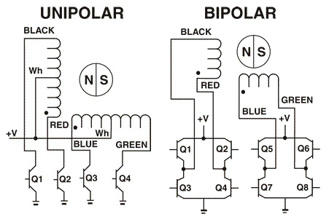
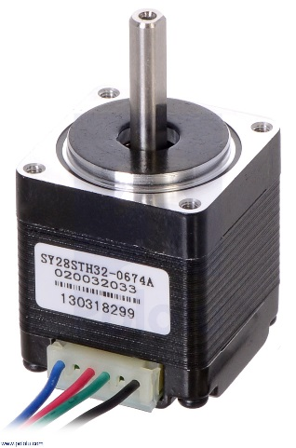
Stepper motors
Fast, quiet, and accurate
But more complex control circuitry (external)
Unipolar vs. bipolar
Unipolar: easier to control, cheaper
Bipolar: need H-bridge, but usu. higher-res. (200 steps/rev.)
Can lose steps if disengaged under asymmetric load

Slide 8
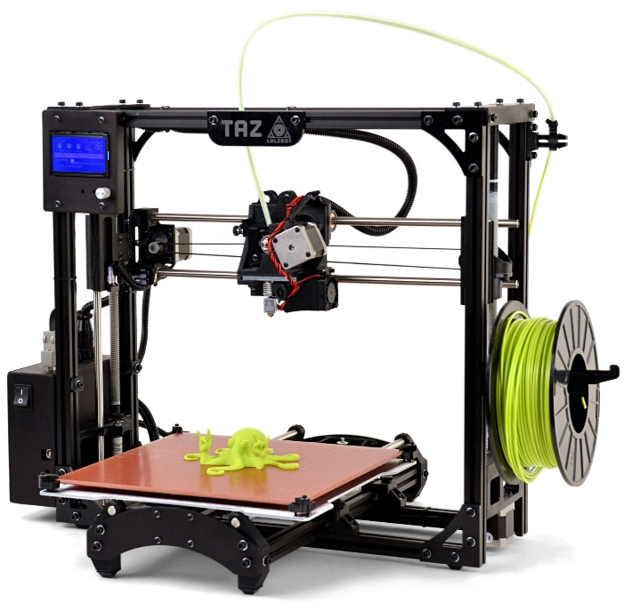
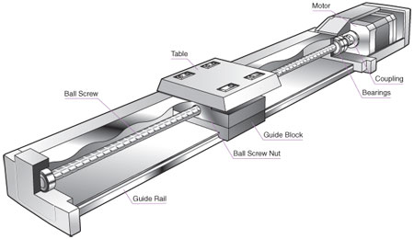
Common stepper uses
Because of the speed, accuracy, quietness, and strength, they are used in a number of modern high-tech devices
3D printers, CNC mills
Microscope control

Slide 9

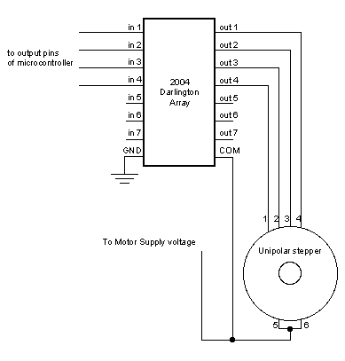
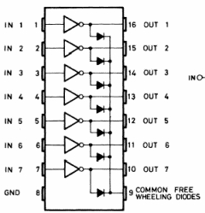
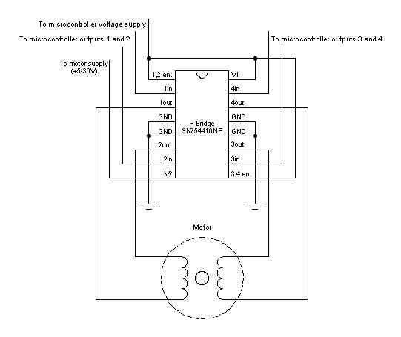
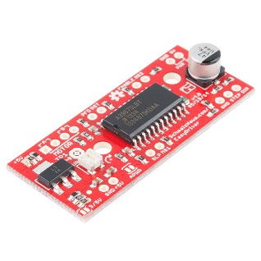
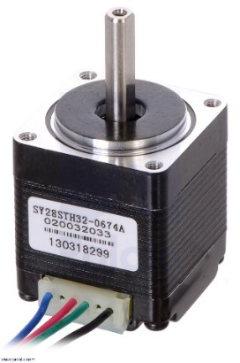
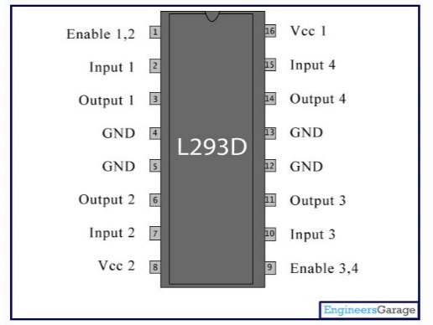
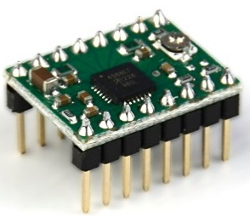
Stepper control
Can use ULN2803 to control 2x unipolar
H-bridge for bipolar
Or use stepper driver (has current control, etc.)

Slide 10
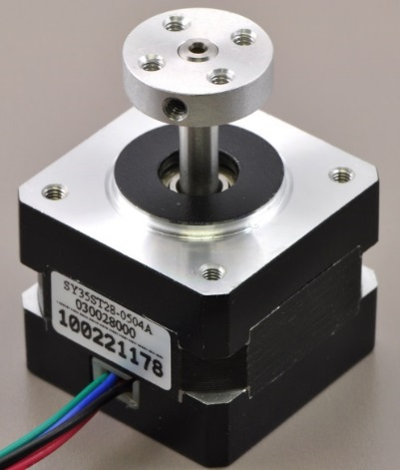
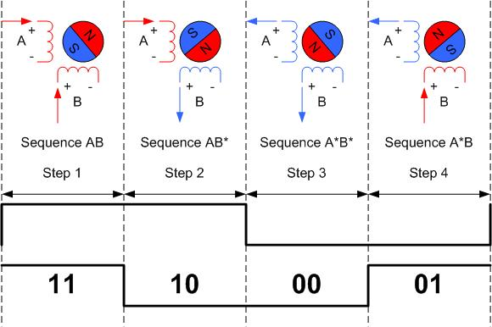
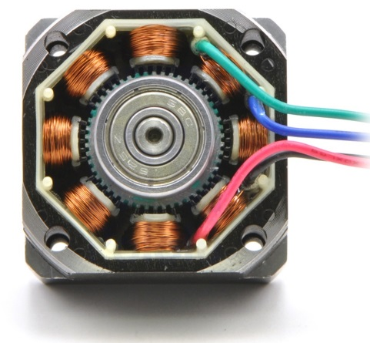
Bipolar steppers
Motor rotation dictated by stereotyped step sequence
Step sequence generated by Arduino Stepper library
Can use 4-wire or 2-wire control
Stepper drivers also allow microstepping, which can increase resolution

Slide 11
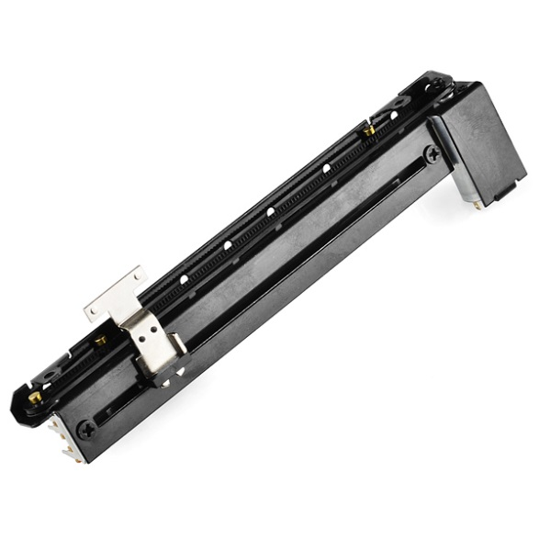
Linear motion
Since most motors are inherently rotational, you need a mechanical apparatus to convert this into linear motion
Each primary motor type can drive linear motion
DC: linear potentiometer
Linear servo
Linear slide driven by stepper and XX drive

Slide 12
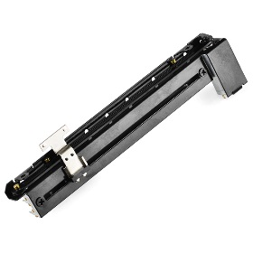

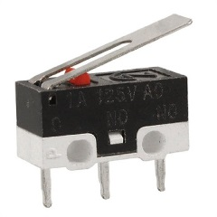
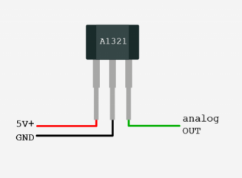
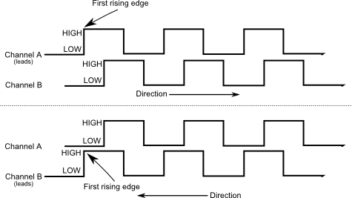
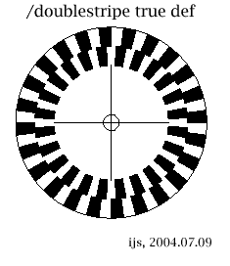
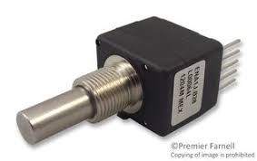
Feedback/position sensing
With the exception of servo motors, which have internal position feedback circuitry, other types of motors need external circuitry to make sure they are in the right position
Some have internal potentiometers for position feedback
Limit switches can be used to reset position occasionally
Mechanical
Magnet / Hall effect sensor
Rotary encoders
Quadrature encoding gives directional, high-res. Position feedback
But can be too fast for Arduino if there are lots of other processes

Slide 13
Motors Exercises
DC motor forward and backward
Servo with potentiometer
Stepper rotation

Slide 14

Data logging
SD card (e.g. on Ethernet shield)
Computer
Ethernet/WiFi (UDP)

Slide 15
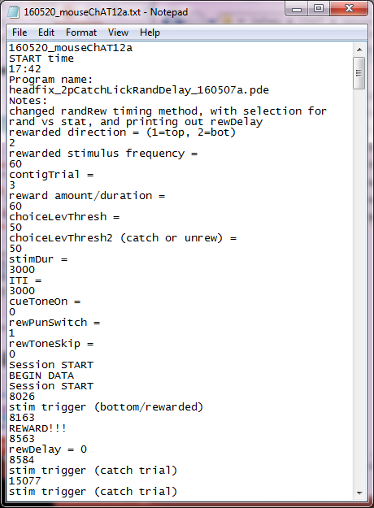
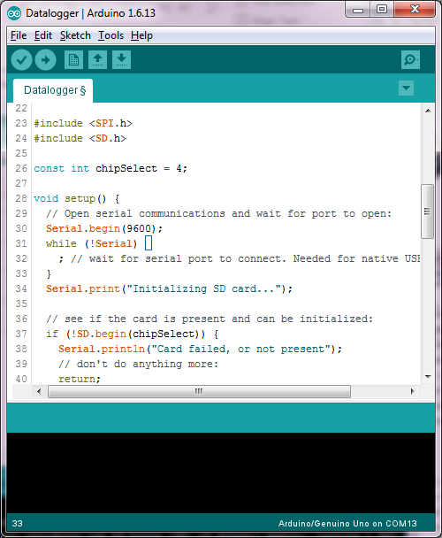
SD card data logging
Can save serial text to text file on SD card
Can save tons of data without attached computer
Pop out card and analyze data on PC
Use SD shield (or one onboard Ethernet shield)

Slide 16

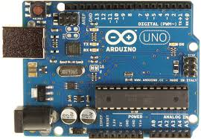

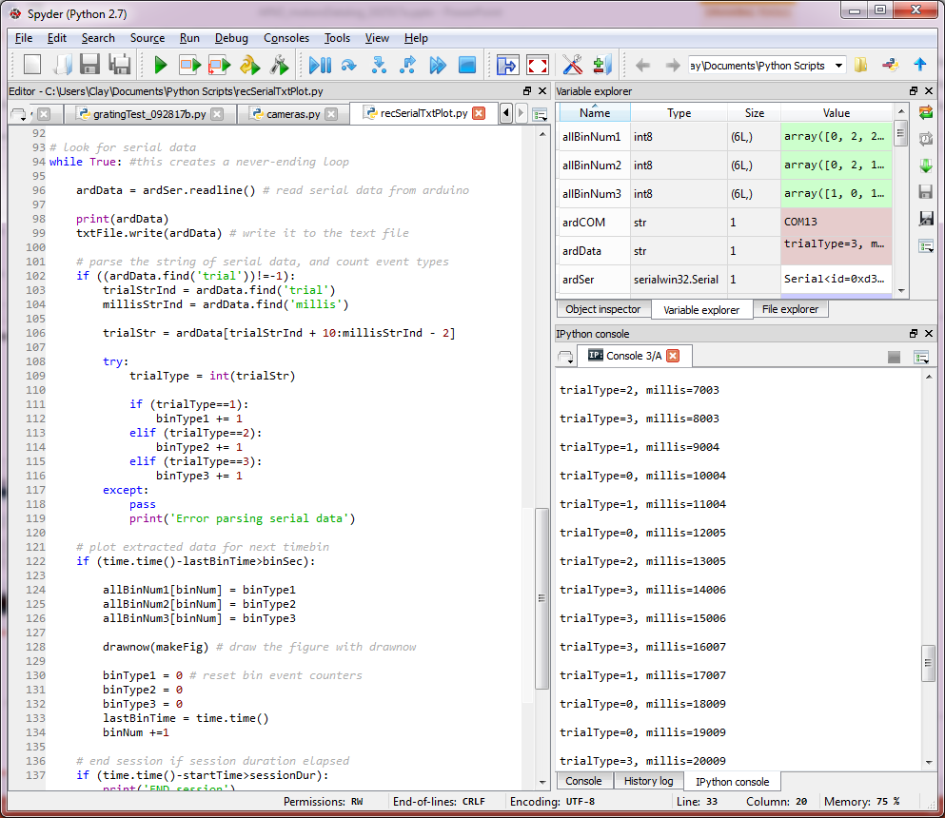
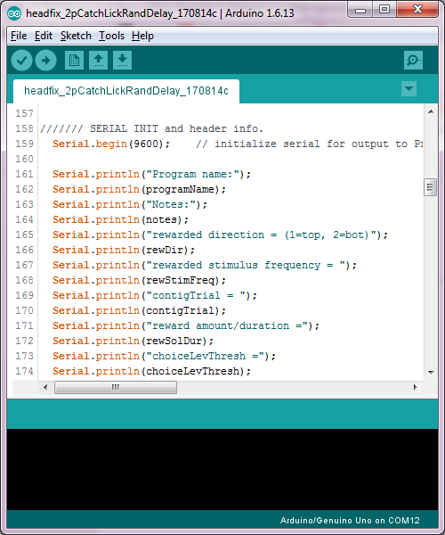
Serial data logging (on a computer)

Slide 17

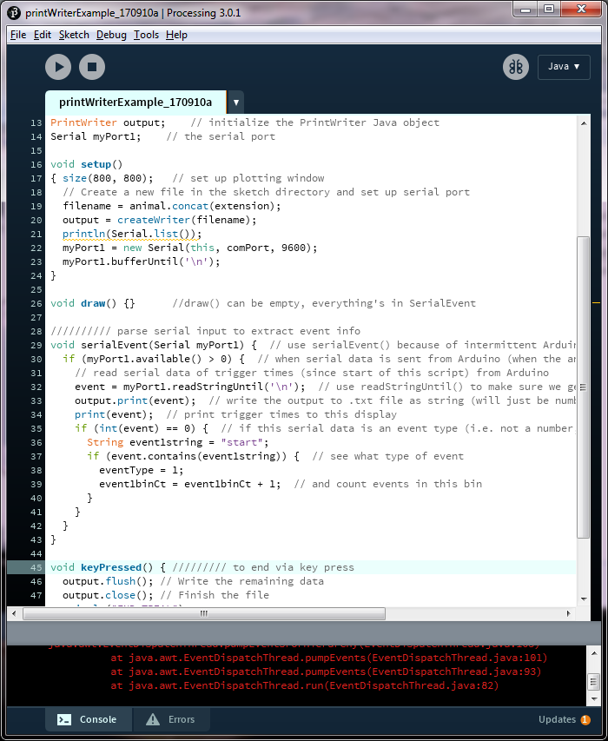
Processing vs. Python: pros and cons
Both:
Free
Cross platform
Open Source
Large devel community
Diverse IO functionality
Plotting
Serial
Multimedia
Huge devel. community
Native on Linux
Can get MATLAB-like IDE (Spyder)
Can be tricky to get some things to work.
Easy to use, and get running
Syntax like Arduino (C)
Graphics oriented
Orig. for artists
Can use JAVA functions
Notes:
So Python has more overall functionality, largely due to an enormous development community, but it can be harder to get projects up and running.

Slide 18
Spyder IDE (MATLAB-like envir. for Python)
Variable explorer:
Like MATLAB workspace
Editor:
Like MATLAB, can run lines/blocks
iPython console:
Like MATLAB command window

Slide 19
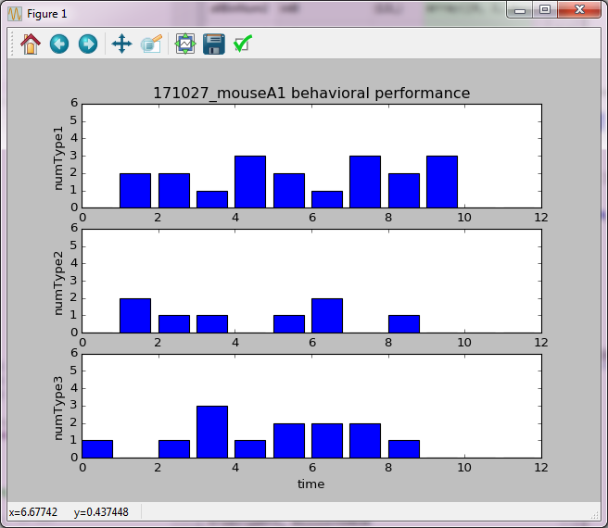



Recording and plotting Arduino serial output with Python
Online plot (and PDF)
B
C
serial
D
.txt file

