Slide 1
massPix
Lipidomics MSI analysis tools
An R package for processing high resolution mass spectrometry imaging data, performing multivariate statistics (PCA, clustering) and lipid identification
University of Cambridge

Slide 2
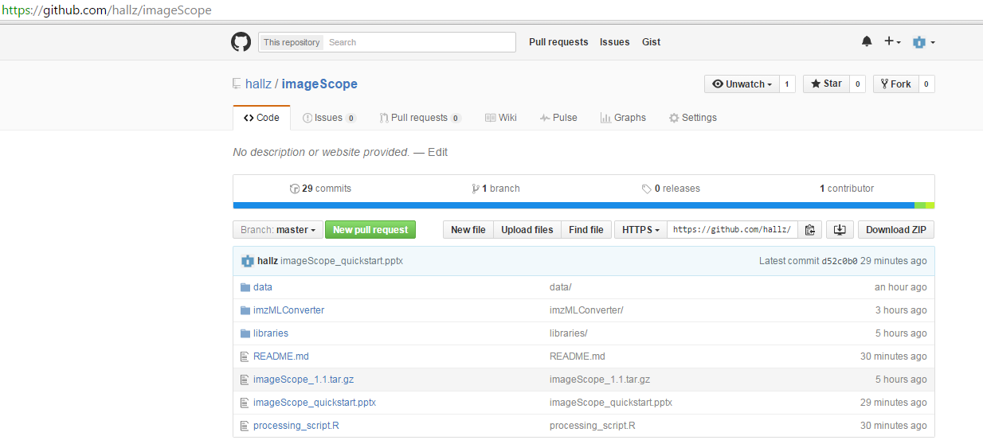
1. Download all files from GitHub/hallz/massPix
Place libraries folder, data folder and other files in your working directory.

Slide 3
1. Download all files from GitHub/hallz/massPix
*** In addition to the files on the github, please download the very large file test_POS.ibd from the dropbox link below – ensure download completes fully – file should be ~ 160 MB.
https://www.dropbox.com/s/5ff7yi3z1irqda0/test_POS.ibd?dl=0
This file should be stored in your “data/” folder, in addition to test_POS.imzML available on github.

Slide 4
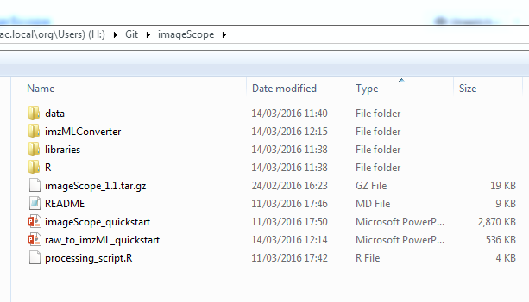
2. Download imzMLConverter
Download imzMLConverter from http://www.cs.bham.ac.uk/~ibs/imzMLConverter/#
Put this folder in the same project folder where the “data” and “libraries” folders are located and ensure name is imzMLConverter.
14/03/2016 12:16 - Screen Clipping
Alan M. Race, Iain B. Styles, Josephine Bunch, Journal of Proteomics, 75(16):5111-5112, 2012

Slide 5
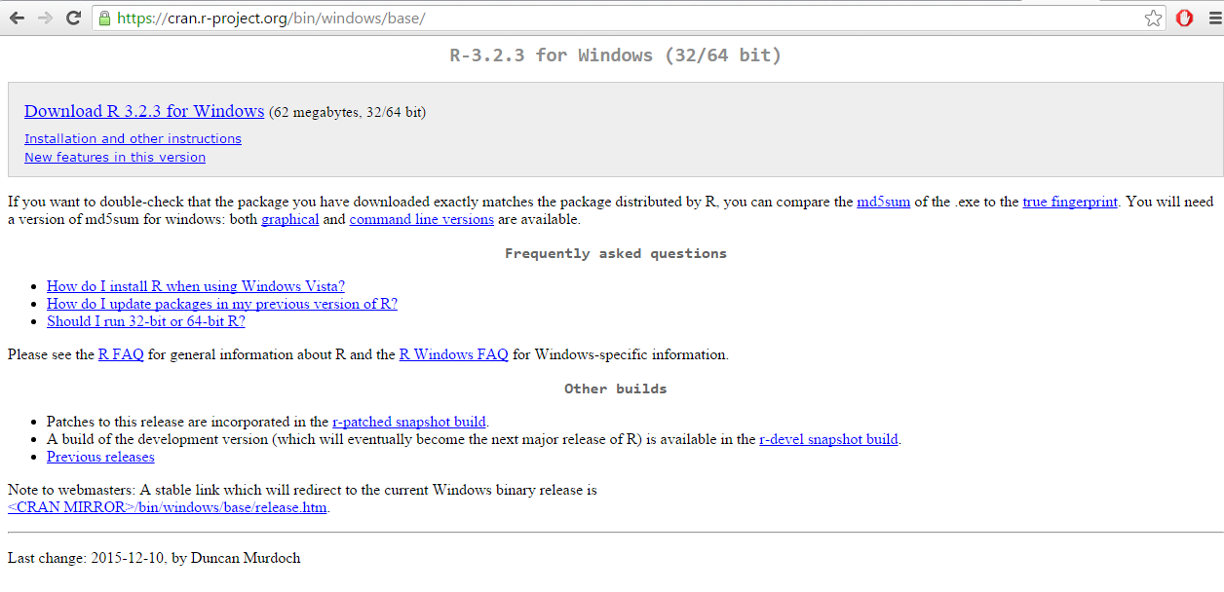
3. Download R and R studio
Install R (if upgrading, uninstall previous versions)

Slide 6
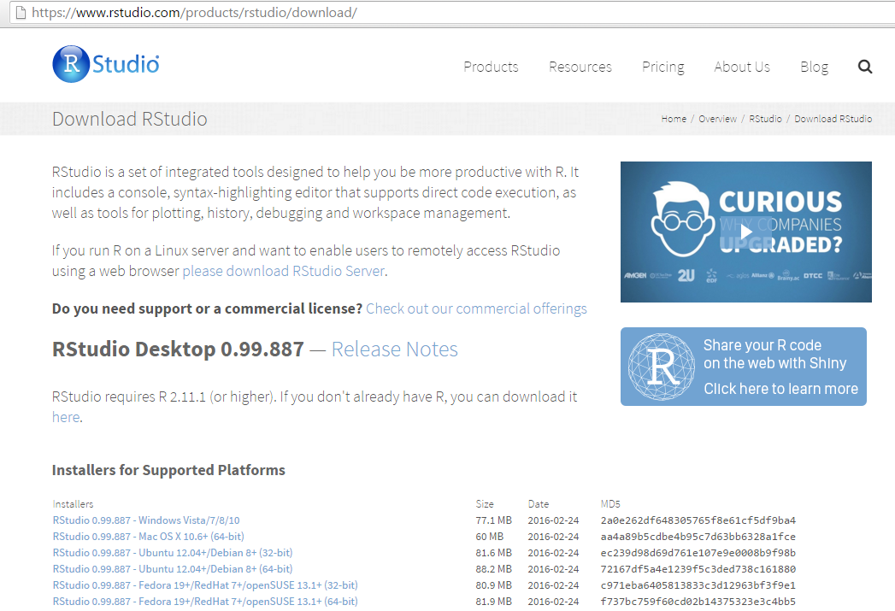
Install R studio

Slide 7
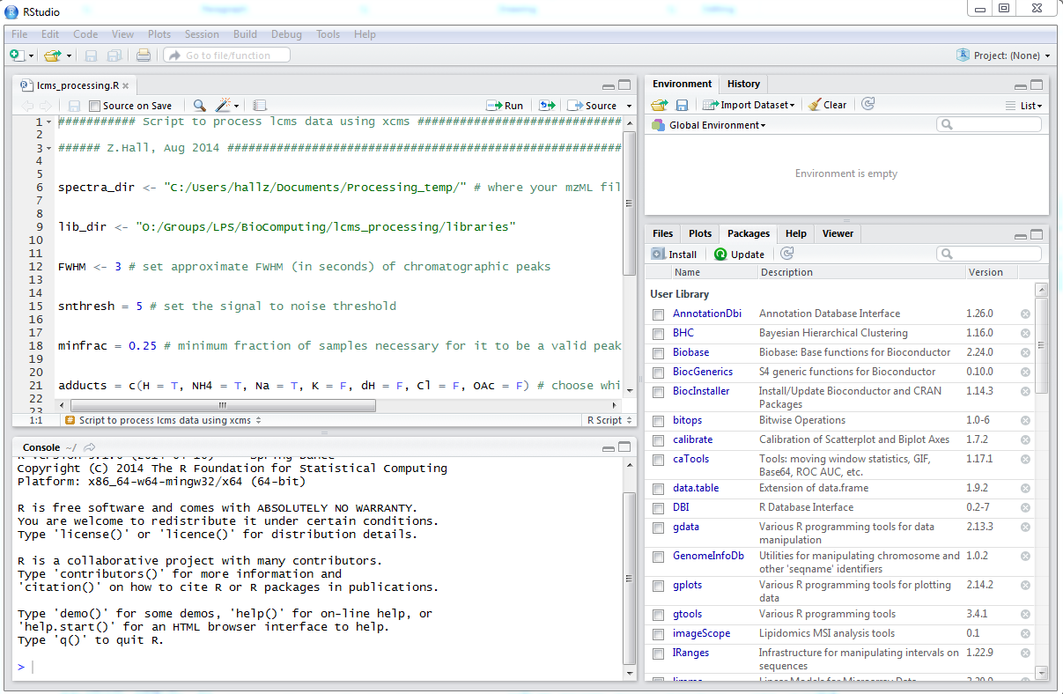
R studio orientation
Open script
Run current line of script
Run whole script
Stores variables/functions
Your script
Click tabs for:
packages
plots
help …
Interactive
console

Slide 8
4. Ensure you have JAVA installed and required R packages “calibrate” “rJava” and “Biobase”
Requires up to date Java – best to have both 32 and 64 bit Java installed to avoid R/Java incompatibility issues
(R will automatically use the appropriate version):
Downloading 32 bit Java:
https://www.java.com/en/download/
Downloading 64 bit Java:
http://www.java.com/en/download/manual.jsp
RESTART R or R studio after installing/updating Java.
*Remember to uninstall previous versions of Java*
Java troubleshooting links:
http://stackoverflow.com/questions/7019912/using-the-rjava-package-on-win7-64-bit-with-r
http://www.r-statistics.com/2012/08/how-to-load-the-rjava-package-after-the-error-java_home-cannot-be-determined-from-the-registry/

Slide 9
4. Ensure you have JAVA installed and required R packages “calibrate” “rJava” and “Biobase”
Open R studio and in the interactive console enter the following:
> install.packages("calibrate")
> install.packages("rJava")
> source("https://bioconductor.org/biocLite.R")
> biocLite("Biobase")
Interactive
console

Slide 10
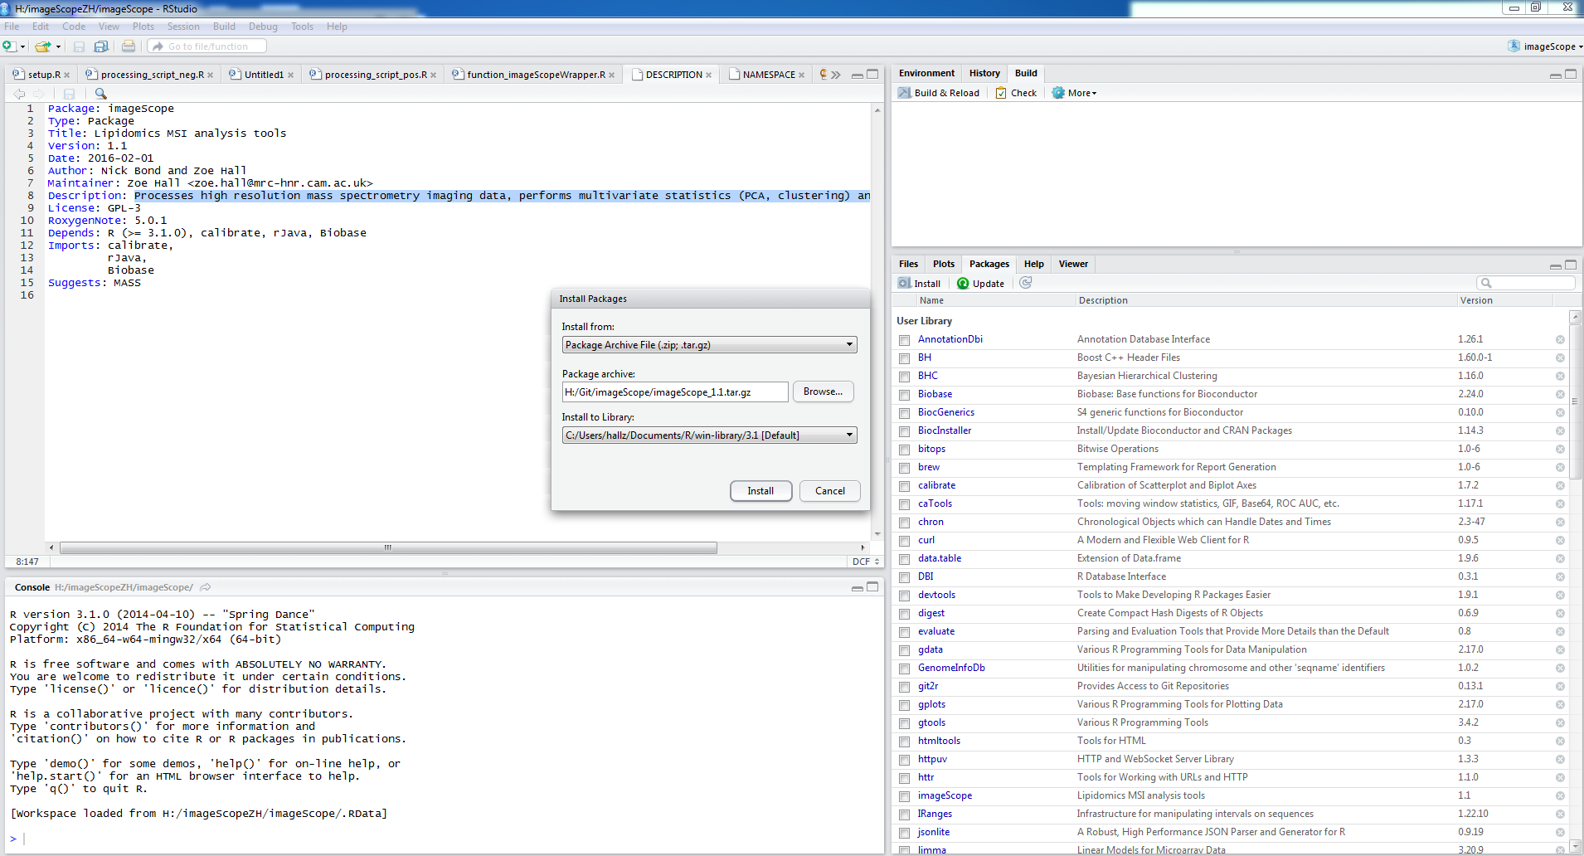
5. Install massPix package to R studio
In R studio go to packages tab, click install, select install from package archive file and browse to find massPix_1.2.tar.gz

Slide 11
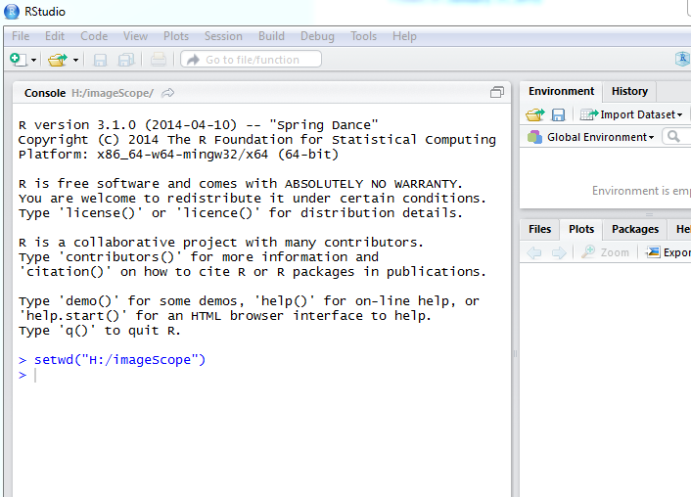
6. Set your working directory
This is where your 3 folders
“libraries”
“data”
“imzMLConverter”
are stored.

Slide 12
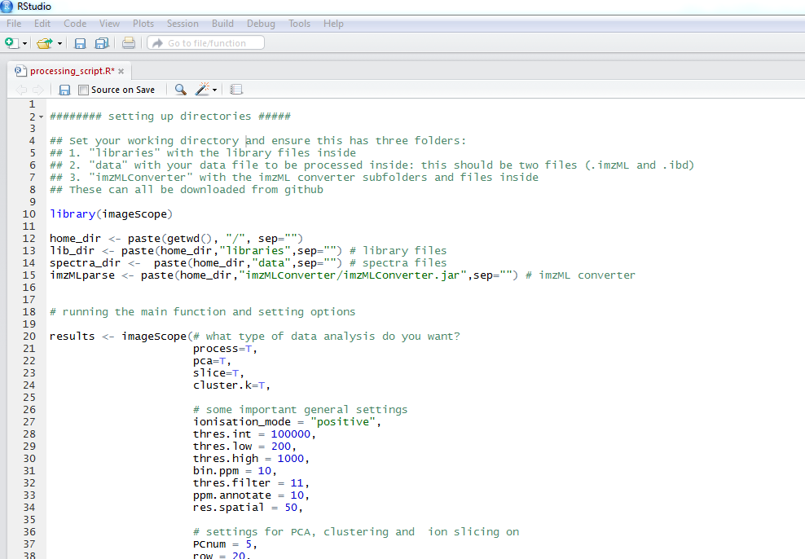
7. Open processing_script.R

Slide 13
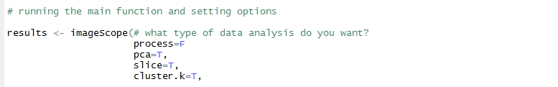
8. Set your processing parameters (or leave as default)
,
If you want to process from the beginning chose process=T
If you want to perform PCA analysis choose pca=T
If you want to perform clustering choose cluster.k=T
If you want to view the distribution of a single ion choose slice=T

Slide 14
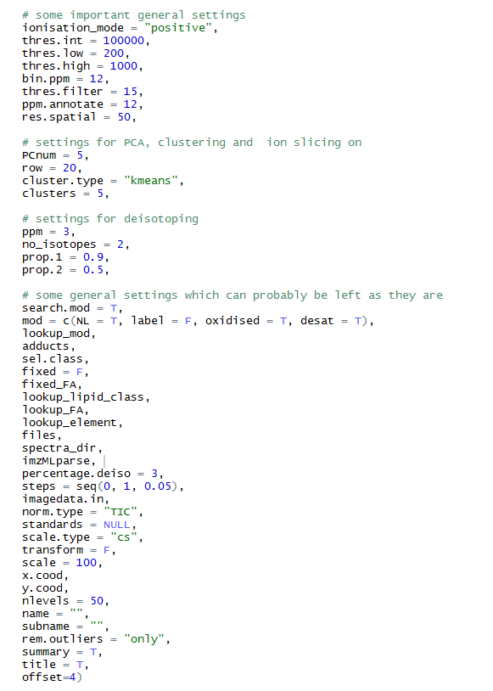
Positive or negative ion mode data?
Threshold intensity for detecting ions?
m/z data range?
If pca=T, how many principal components?
If slice=T, which m/z row to use for making image?
Check in the “image.norm_short.csv” output file.
If cluster.k=T, how many clusters?

Slide 16
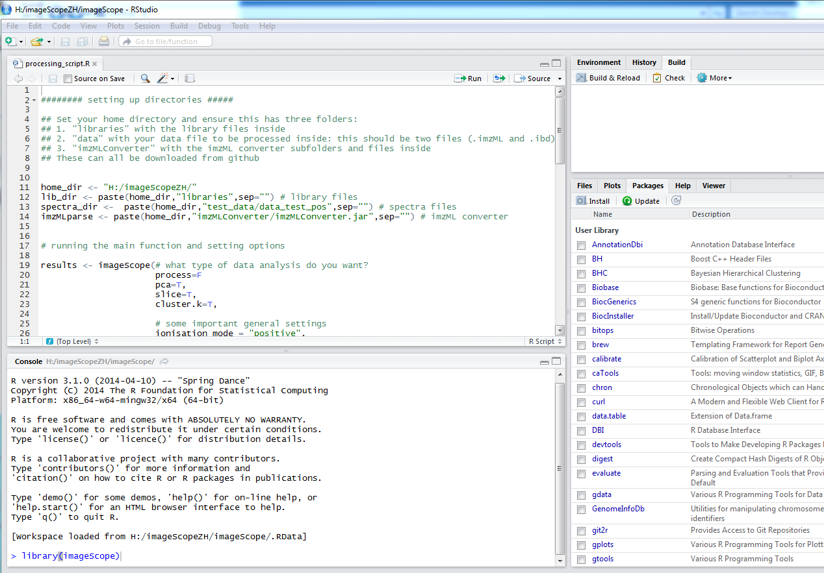
9. Run processing script.
Select all and press run.

Slide 17
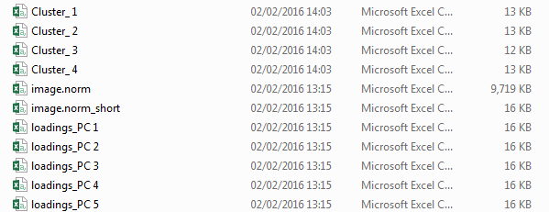
10. Output - excel files
Cluster centers
Full image data file (normalised)
Lipid IDs
(also use this to find “row” number for m/z of interest)
PC loadings

Slide 18
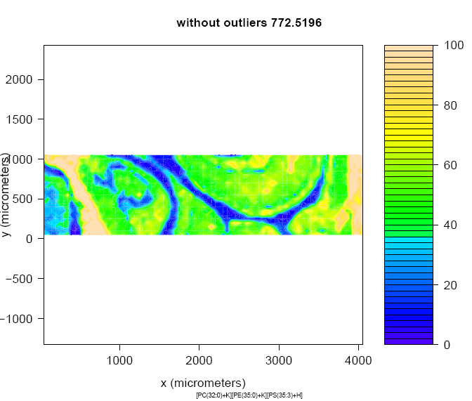
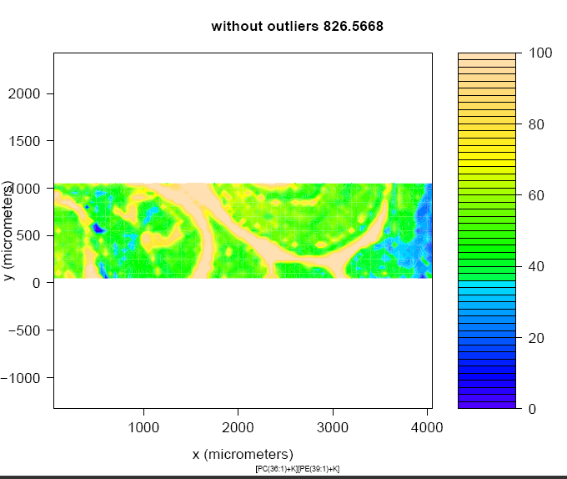
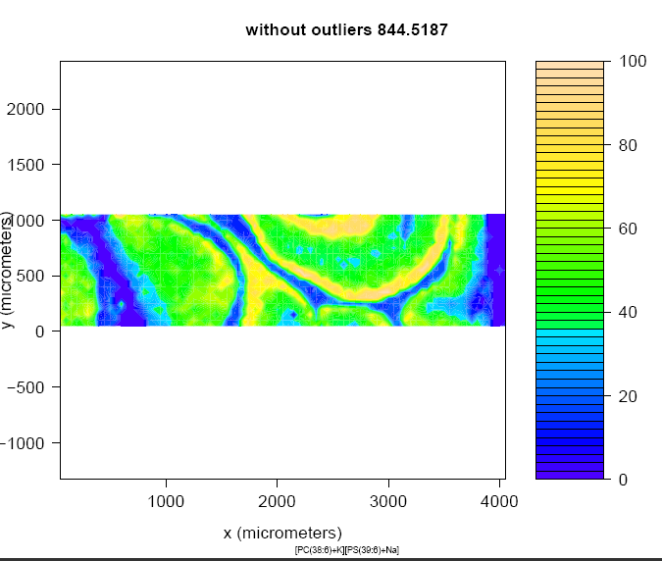
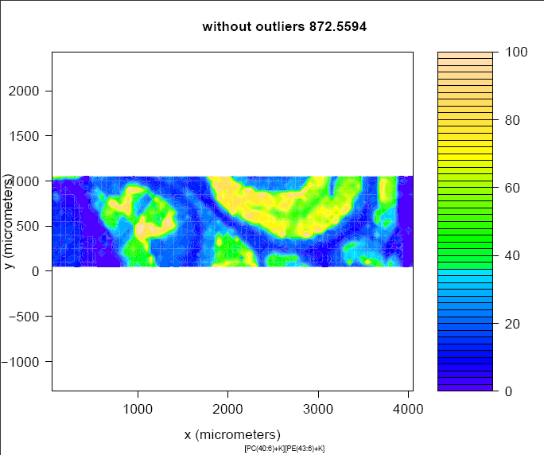
10. Output - Slice

Slide 19
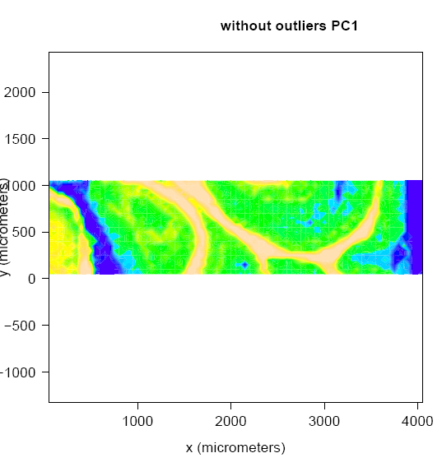
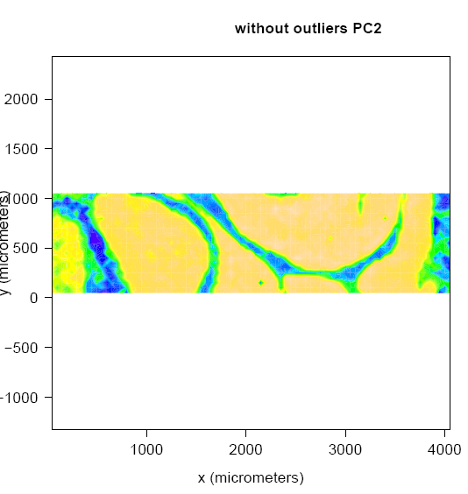
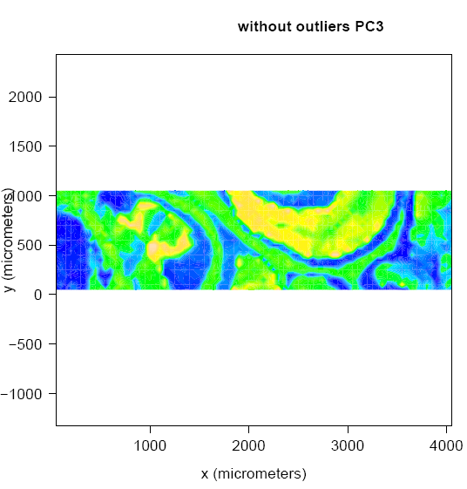
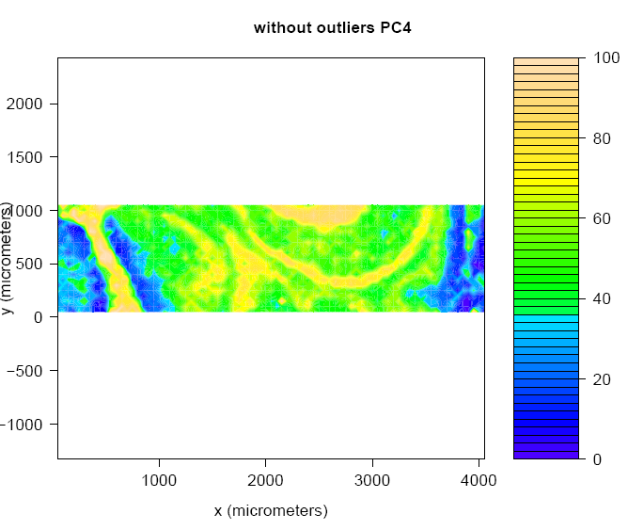
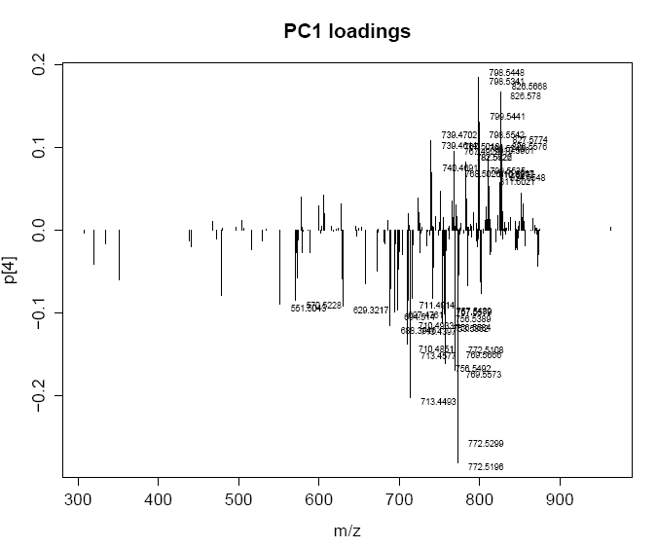
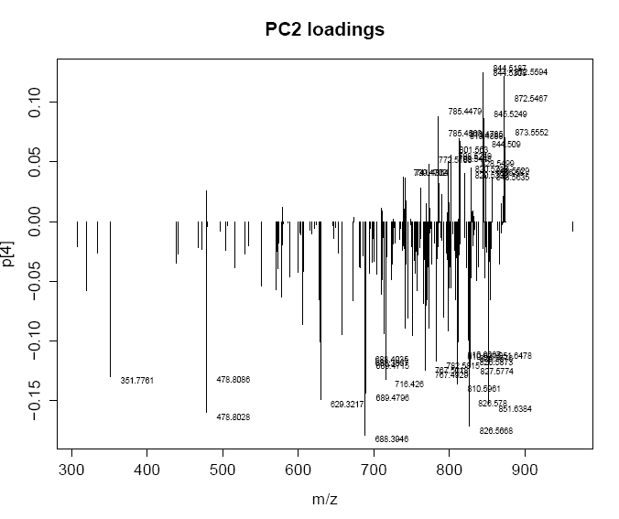
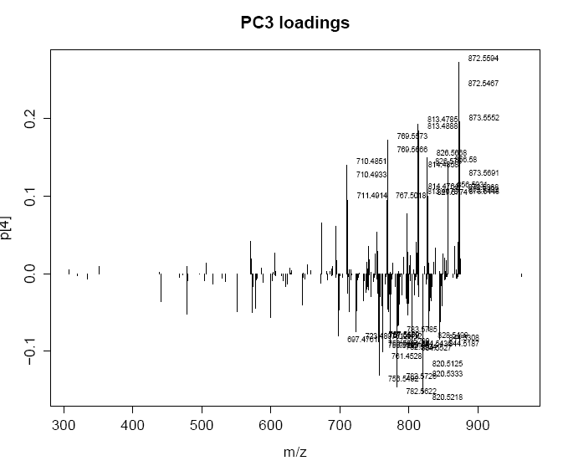
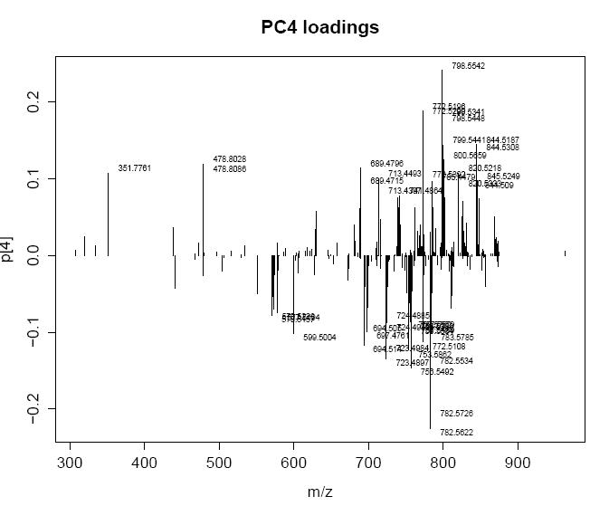
10. Output - PCA

Slide 20
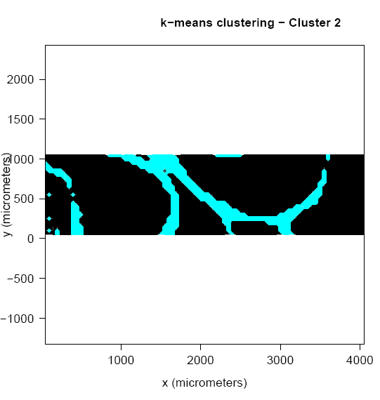
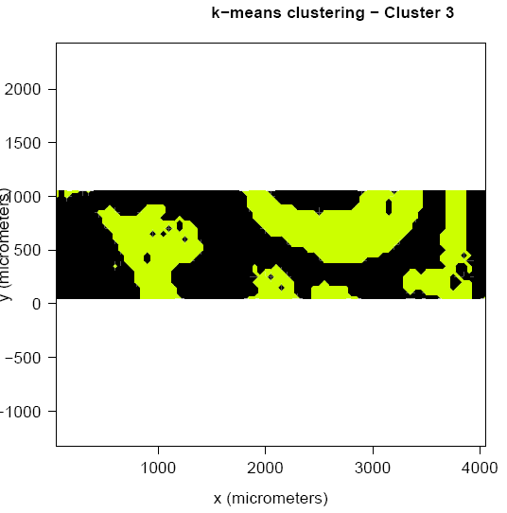
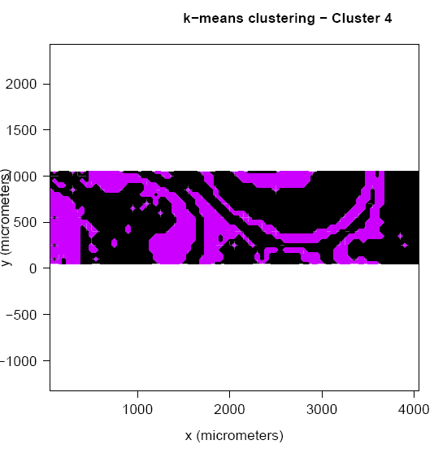
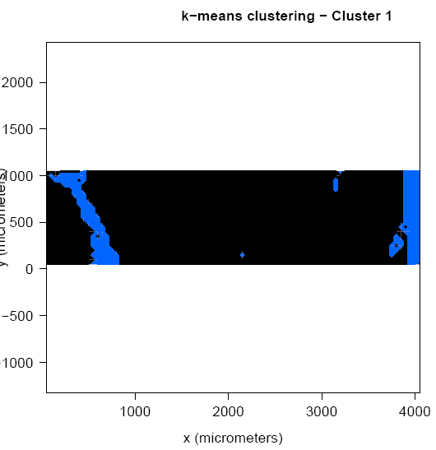
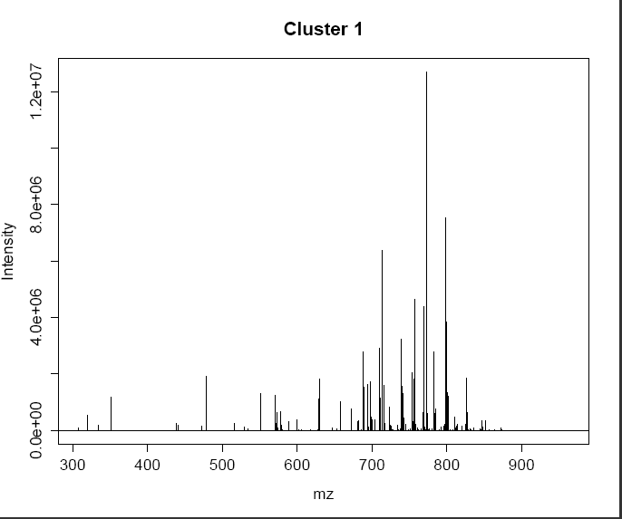
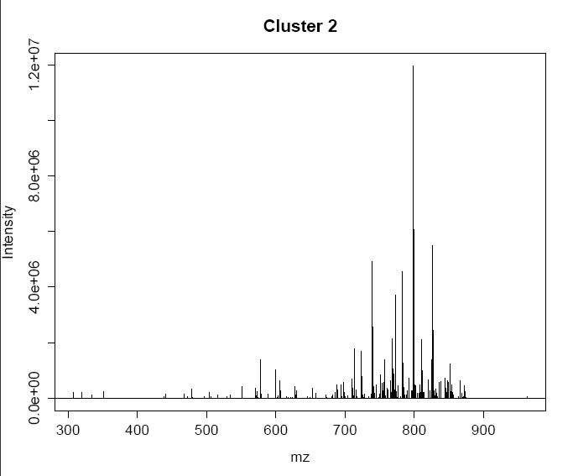
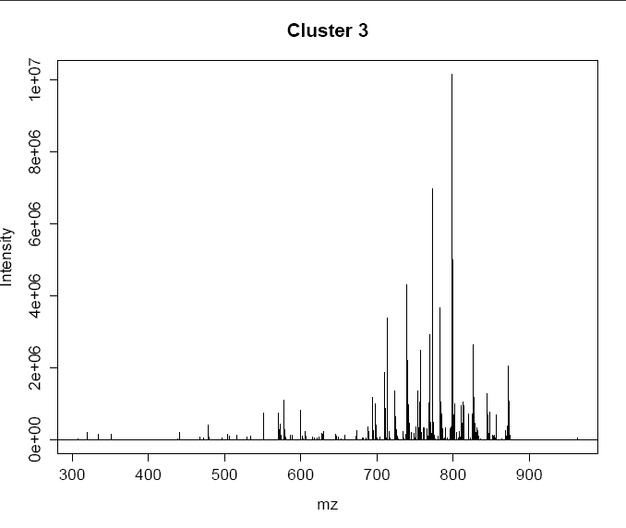
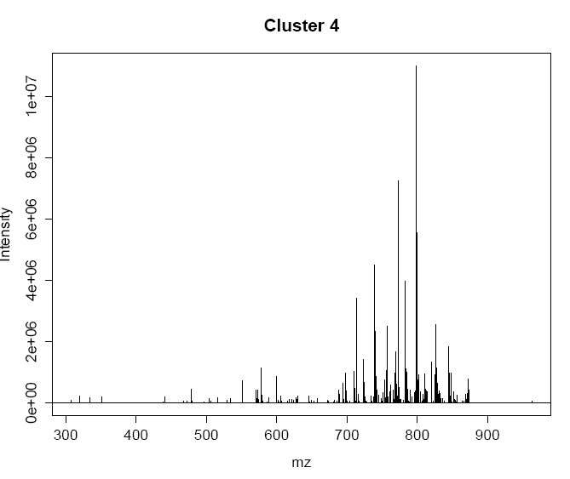
10. Output - clustering

Slide 21
11. Rerun with different parameters
If you want to choose a different number of clusters, PC components, or select a different row for “slicing”, then rerun processing script, but select process=F.
If you want to choose a different threshold intensity, or m/z range etc you will need to process again (process=T).

Slide 22
12. massPix Step by Step
An R script has also been provided breaking the massPix wrapper function into its composite functions, to use for troubleshooting and/or to adapt the source code.
massPix_step_by_step.R
R scripts for each individual function are also provided in the github repository and advanced users may wish to adapt these.
Manual files for all functions are embedded in the massPix package, providing further details for each function.

