Slide 1
Converting Thermo .raw file to .imzML format

Slide 2
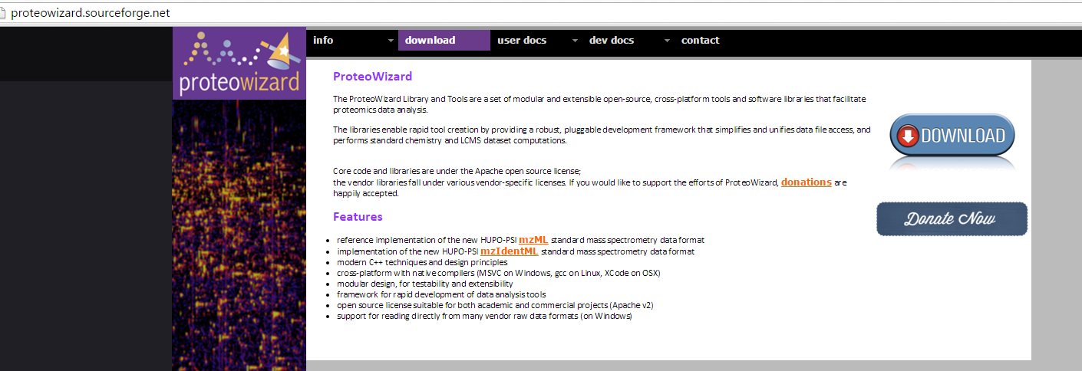
1. Convert your .raw file to .mzML
Download proteowizard from http://proteowizard.sourceforge.net/ and use MSCovert tool to convert files to mzML format
test_POS.raw is given as an example.

Slide 3
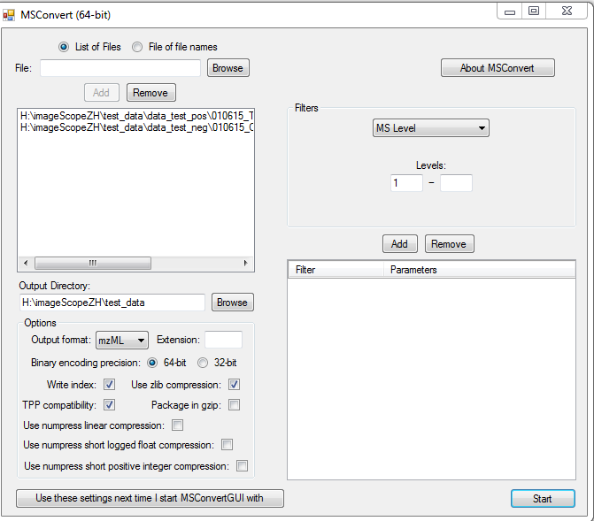
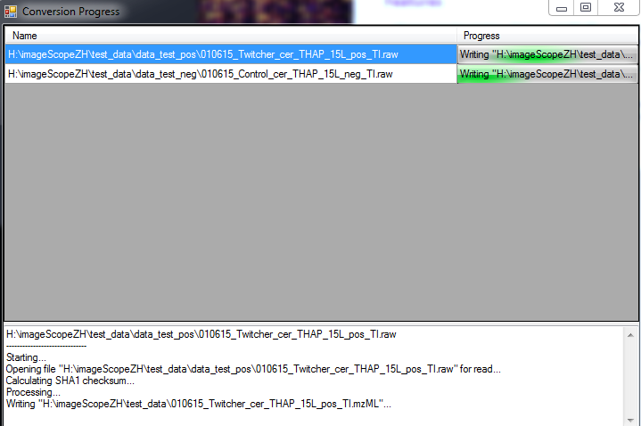
1. Convert your .raw file to .mzML

Slide 4
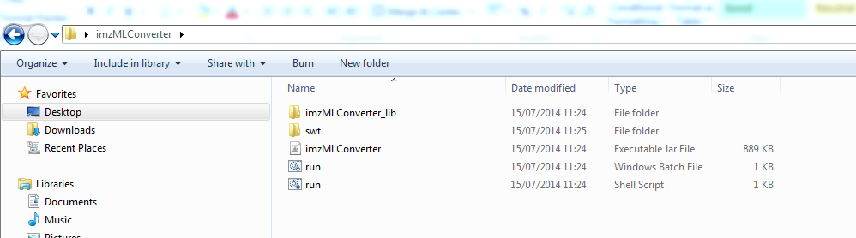
2. Convert from mzML format to imzML format
Download imzMLConverter from http://www.cs.bham.ac.uk/~ibs/imzMLConverter/#
Open the imzMLConverter executable Jar file.
Alan M. Race, Iain B. Styles, Josephine Bunch, Journal of Proteomics, 75(16):5111-5112, 2012

Slide 5
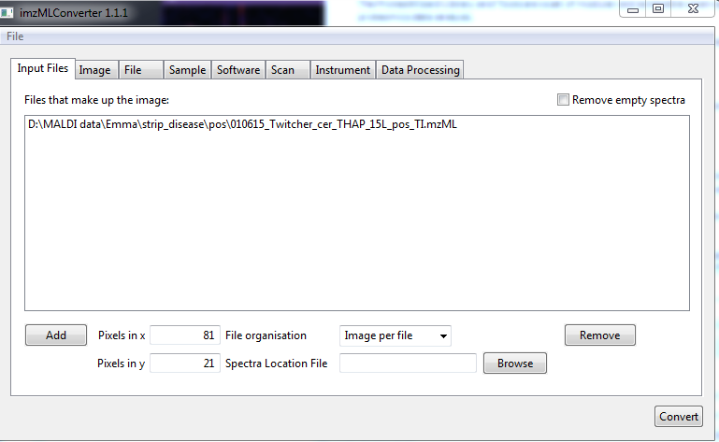
2. Convert from mzML format to imzML format
Choose “image per file” and define pixels in x and y of your image.
Test data given is 81 x 21 = 1701 pixels

Slide 6
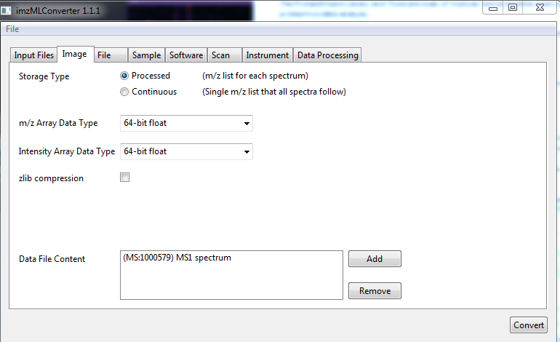
2. Convert from mzML format to imzML format
Settings may depend on instrument and acquisition parameters.
Typical settings used with Thermo MALDI Orbitrap XL data.

Slide 7
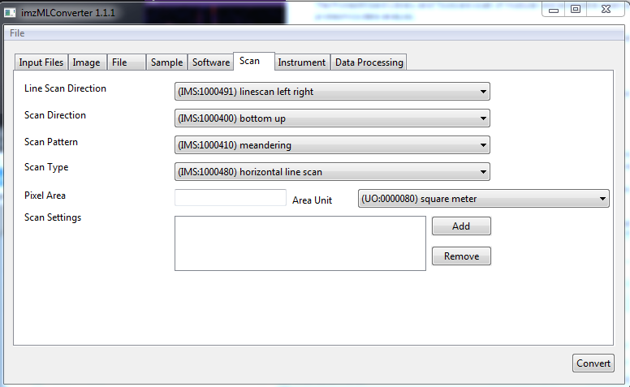
2. Convert from mzML format to imzML format
Settings may depend on instrument and acquisition parameters.
Typical settings used with Thermo MALDI Orbitrap XL data.
Produces .imzML and .ibd files – keep both together!

Slide 8
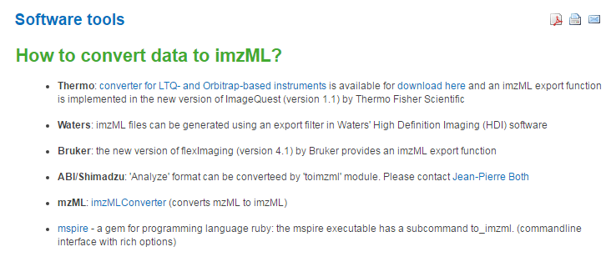
3. Converting to .imzML from other formats
www.imzML.org

