Slide 1
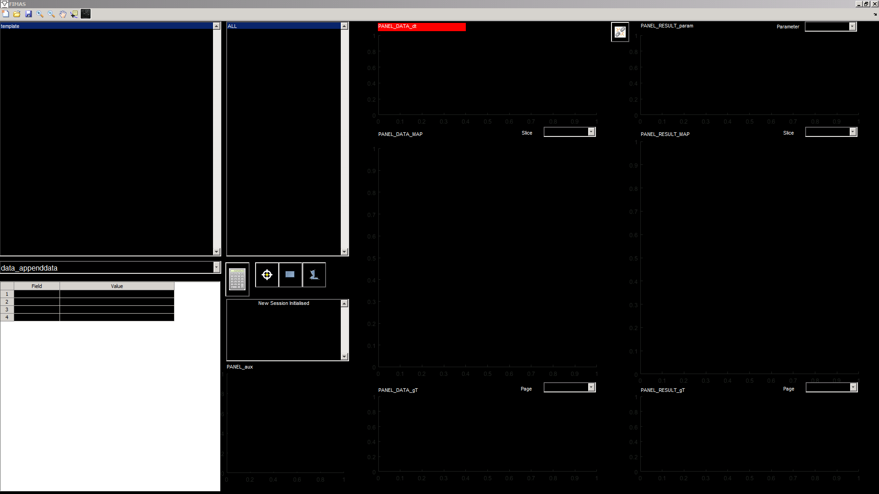
Title bar
Toolbar
PANEL_DATA_dt
Button_Link
PANEL_RESULT_param
List_ROI
List_Data
Menu_Data_ZSlice
Menu_Result_ZSlice
Calculate User_Op
Menu_User_Op
Create ROI Button
PANEL_DATA_MAP
PANEL_RESULT_MAP
Table_Data_info
Edit_info
Menu_Data_TPage
Menu_Result_TPage
PANEL_aux
PANEL_DATA_gT
PANEL_RESULT_gT

