Slide 1
The core idea of our analysis is:
Use normal distribution to fit background light intensity for each of the four sets of experiments.
Normalize light intensity to standard normal scale, so that we can compare values in four sets of experiments because they are now converted to the same condition.

Slide 2
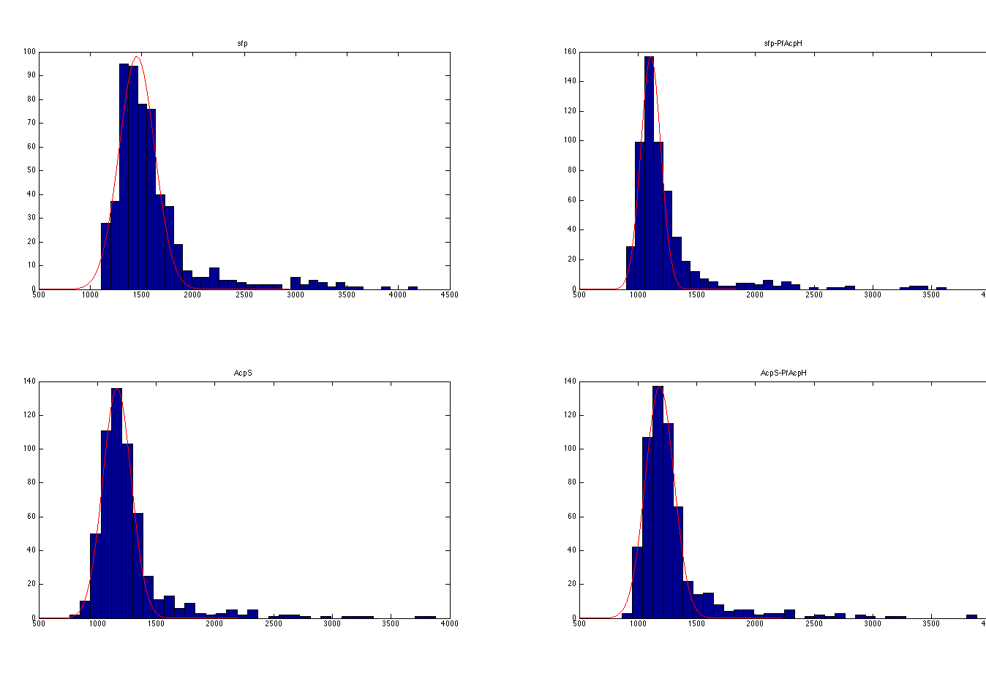
Histogram plot before normalization

Slide 3
After fitting, we get mean and standard deviation of normal distribution in each plot:
Sfp-labeling
mean = 1455.19
std (standard deviation) = 172.88
Sfp-PfAcpH
mean = 1109.3
std = 85.52
AcpS-labeling
mean = 1166.76
std = 121.49
AcpS-PfAcpH
Mean = 1185.07
std = 122.27
Then we normalize light intensity by Ynorm = (Yraw – mean) / std for Sfp-labeling, Sfp-PfAcpH, AcpS-labeling and AcpS-PfAcpH.

Slide 4
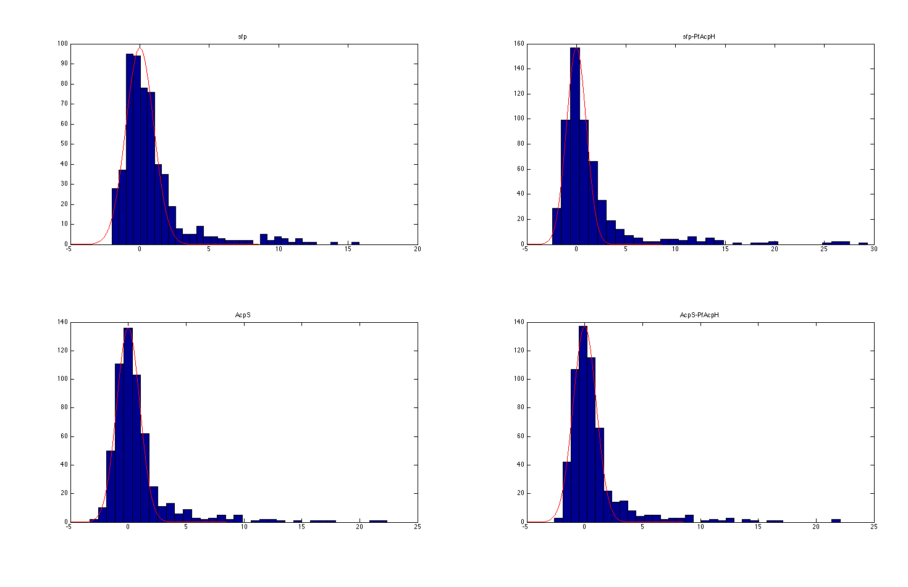
Histogram plot after normalization

Slide 5
Breakdown of Results (Details in excel spreadsheet)
LABELING RESULTS:
AcpS labeling results:
38 total peptides were specifically labeled by AcpS.
12 predicted AcpS peptides
22 predicted Sfp peptides
Sfp labeling results:
46 total peptides were labeled.
11 Sfp predicted peptides
33 AcpS predicted peptides
UNLABELING RESULTS:
AcpS unlabeling:
4 total peptides specifically labeled by AcpS were unlabeled.
2 predicted AcpS peptides
1 predicted Sfp peptides
Sfp Unlabeling:
23 total peptides specifically labeled by Sfp were unlabeled.
7 Sfp predicted peptides
16 AcpS predicted peptides

