Slide 1
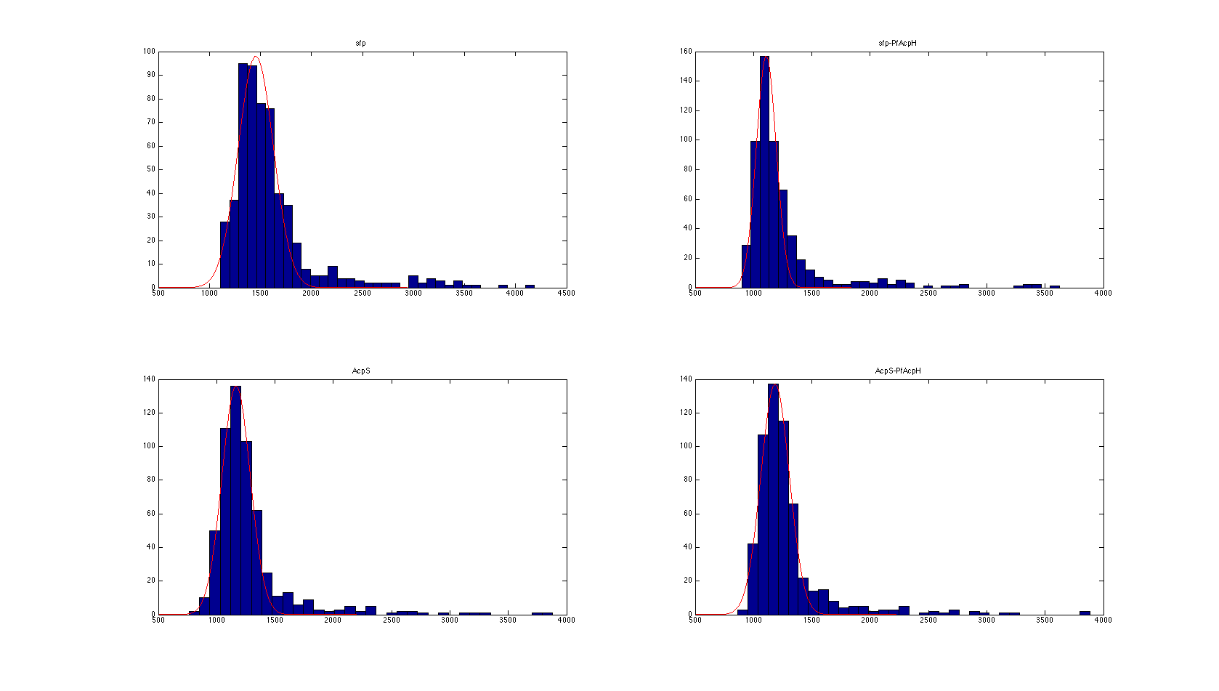
Before normalization, histograms of light intensity are on different scales.
Membrane treated with Sfp only
Membrane treated with Sfp & PfAcpH
Integrated Intensity
Integrated Intensity
Centered near 1500
Centered near 1100
Membrane treated with AcpS only
Membrane treated with AcpS & PfAcpH
Centered near 1200
Integrated Intensity
Centered near 1200
Integrated Intensity

Slide 2
The previous normalization method only partially addressed this issue.
Before normalization
Membrane treated with Sfp only
For the moment, let’s focus on images taken from membranes treated by Sfp only and AcpS only.
The previous normalization method performed the following calculation for these images:
Normalized Intensity =
(Raw Intensity – MIN) / (MAX – MIN)
Where MIN & MAX are the minimum and maximum intensities across all spots in both membranes.
MIN=763.514
MAX=4183.726
Integrated Intensity
Membrane treated with AcpS only
Integrated Intensity

Slide 3
Using the previous normalization method, the Sfp-only background is still bigger (0.21) than the AcpS-only background (0.13).
Before normalization
After normalization
Membrane treated with Sfp only
Membrane treated with Sfp only
Integrated Intensity
Integrated Intensity
Centered near 1500
Centered near 0.21
Membrane treated with AcpS only
Membrane treated with AcpS only
Centered near 1200
Integrated Intensity
Centered near 0.13
Integrated Intensity

Slide 4
This issue made it appear that there were few peptides labeled by AcpS
The previous normalization method shifts Sfp-only and AcpS-only by the same amount.
This makes it appear as if Sfp labels lots of peptides, and AcpS labels few.
We recommend a new renormalization method, detailed below, that accounts for differences in average background.
Using this new renormalization method, we see many more peptides labeled by AcpS.

Slide 5
We can use a new normalization method to address this issue
The core idea of our renormalization method is:
Using a normal distribution, fit a mean and standard deviation for the background light intensity for each of the four sets of experiments.
Normalize the light intensity to the standard normal scale. This puts the four sets of experiments on the same scale.

Slide 6
Here’s how our new normalization method works
Step 1: we assume that the background raw light intensity is normally distributed, and treat active peptides as outliers. We estimate the mean and standard deviation (std) of the underlying normal.
Sfp only: mean=1455.19, std=172.88
Sfp & PfAcpH: mean = 1109.3 std = 85.52
AcpS only: mean = 1166.76 std = 121.49
AcpS & PfAcpH: Mean = 1185.07 std = 122.27
Step 2: we normalize light intensity by
Ynorm = (Yraw – mean) / std for Sfp-only, Sfp-PfAcpH, AcpS-only and AcpS-PfAcpH.

Slide 7
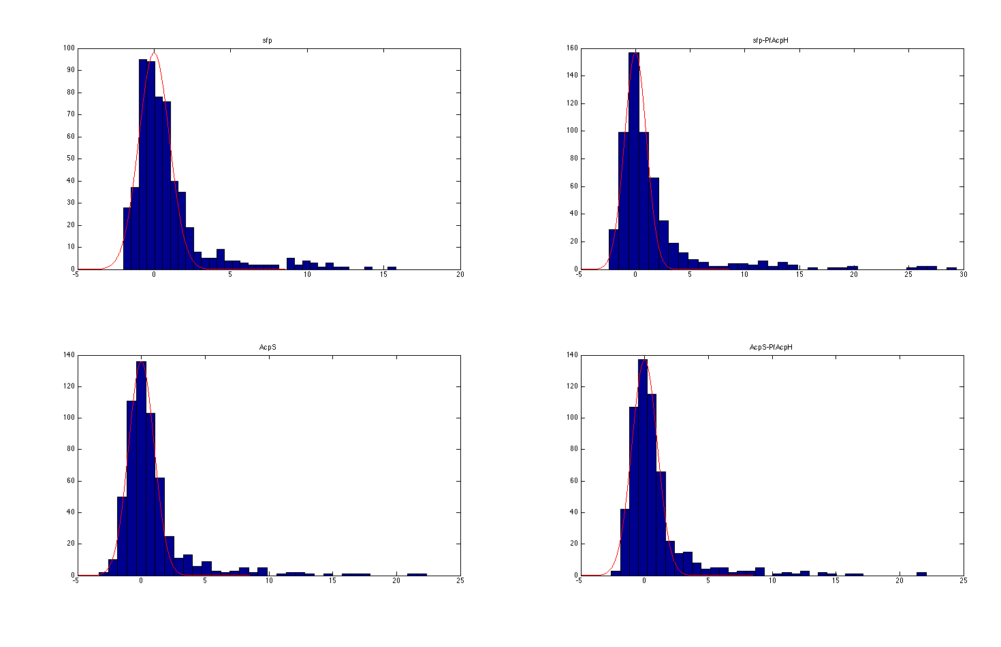
Histogram plot after normalization: all histograms are on the same scale
Membrane treated with Sfp only
Membrane treated with Sfp & PfAcpH
Centered at 0
Centered at 0
Membrane treated with AcpS & PfAcpH
Centered at 0
Centered at 0

Slide 8
This new normalization changes our results: especially for AcpS
LABELING RESULTS:
Sfp labeling results:
46 peptides were specifically labeled by Sfp.
11/46 were Sfp predicted peptides, 33/46 were AcpS predicted peptides, 2/46 were controls
Compare to 60 under the old normalization
AcpS labeling results:
38 total peptides were specifically labeled by AcpS.
12/38 were AcpS predicted peptides, 22/38 were Sfp predicted peptides, 4/38 were controls
Compare to 7 under the old normalization
UNLABELING RESULTS:
AcpS unlabeling:
4 total peptides specifically labeled by AcpS were unlabeled.
2/4 were AcpS predicted peptides, 1/4 was a Sfp predicted peptide, 1/4 was a control
Compare to 0 under the old normalization
Sfp Unlabeling:
23 total peptides specifically labeled by Sfp were unlabeled.
7/23 were Sfp predicted peptides, 16/23 were AcpS predicted peptides
Under the new normalization:
38 peptides specifically labeled by AcpS; of these, 4 were unlabeled

Slide 9
This new normalization changes our results: especially for AcpS
LABELING RESULTS:
Sfp labeling results:
46 peptides were specifically labeled by Sfp.
11/46 were Sfp predicted peptides, 33/46 were AcpS predicted peptides, 2/46 were controls
Compare to 60 under the old normalization.
AcpS labeling results:
38 total peptides were specifically labeled by AcpS.
12/38 were AcpS predicted peptides, 22/38 were Sfp predicted peptides, 4/38 were controls
Compare to 7 under the old normalization.
UNLABELING RESULTS:
Sfp Unlabeling:
23 total peptides specifically labeled by Sfp were unlabeled.
7/23 were Sfp predicted peptides, 16/23 were AcpS predicted peptides.
Compare to 41 under the old normalization.
AcpS unlabeling:
4 total peptides specifically labeled by AcpS were unlabeled.
2/4 were AcpS predicted peptides, 1/4 was a Sfp predicted peptide, 1/4 was a control
Compare to 0 under the old normalization.

