Slide 1
Presentation for Hugh DeLong & Rajesh Naik, UCSD, Feb 10 2014.
Peter Frazier
Jialei Wang
Cornell University, School of Operations Research & Information Engineering

Slide 2
Agenda
Phage display
Combinatorial library design
Planned & ongoing enhancements to POOL
Collaborations with other groups

Slide 3
We are developing statistical methods that correct bias in phage display
Phage Library
Panning
Amplification
PCR & Sequencing
This work is in collaboration with Rajesh Naik, Christina Harsch, and Rachel Krabacher at AFRL.

Slide 4
In an ideal world, selection comes entirely from panning
Phage Library
Panning
Amplification
PCR & Sequencing
In an ideal world:
Each peptide is equally numerous in the phage library.
Each peptide gets amplified equally.
Each peptide gets sequenced equally.
So selection comes entirely from panning.

Slide 5
In the real world, selection is influenced by library, amplification, and PCR bias.
Phage Library
Panning
Amplification
PCR & Sequencing
In the real world:
Some peptides are more numerous in the phage library.
Some peptides get amplified more readily.
Some peptides get sequenced more readily.
Selection is influenced by these effects, and not just panning.

Slide 6
We are developing statistical models that correct this undesirable bias
Phage Library
Panning
Amplification
PCR & Sequencing
Using data from AFRL, we can estimate sequence-dependent probability distributions over:
The # of copies of each peptide in the library.
The # of times each peptide reproduces itself in amplification.
These are estimates of each source of bias.

Slide 7
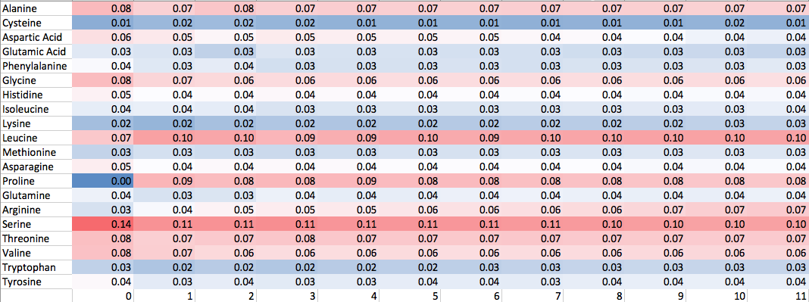
Step 1: Estimate the library’s amino acid distribution, at each position.
Position within the 12mer
This heatmap is consistent with the one in Rajesh, Christina, and Rachel’s working paper on phage display analysis.

Slide 8
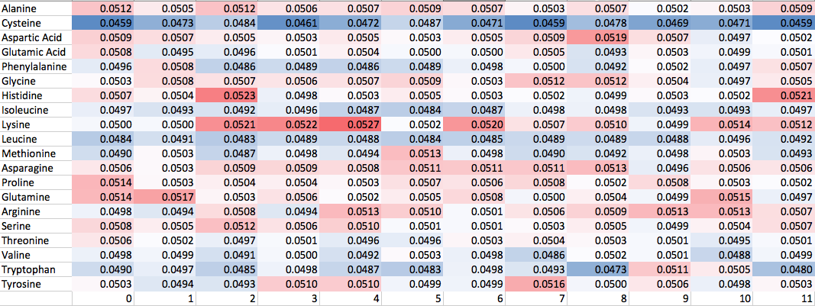
Step 2: Estimate each amino acid’s amplification factor, at each position
Position within the 12mer
The amplification factor differs across positions, consistent with the change in heatmaps between library-only and library + amplification in Rajesh, Christina, Rachel’s working paper.

Slide 9
We then estimate each amino acid’s panning factor, at each position
Phage Library
Panning
Amplification
PCR & Sequencing
Using these inputs:
estimate of library+PCR bias (from previous step)
Estimate of amplification bias (from previous step)
sequences from phage display
We calculate this output:
Amino acid / position “panning factor” heatmap: used to calculate a peptide’s probability of getting through panning.

Slide 10
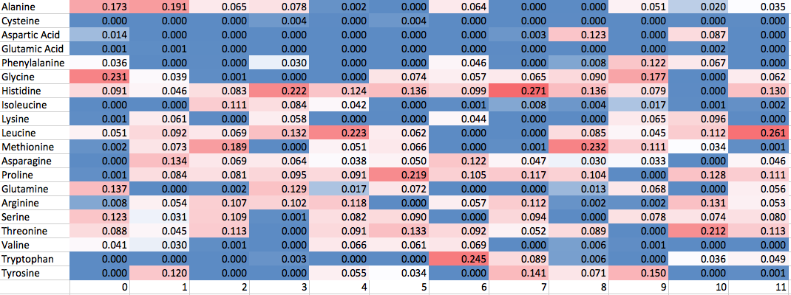
Here’s each amino acid’s panning factor, at each position

Slide 11
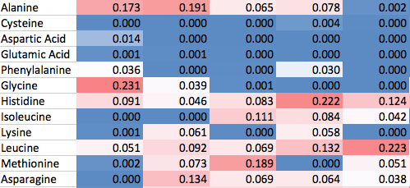
We use the panning factors to predict a peptide’s probability of getting through panning
Training
Data
Amino-acid/Position
Panning Factor
Prediction
Peptides observed
Seq 1
Seq 2
Seq 3
Seq 4
…
Probability of going through panning
12%
70%
1%
98%
Position
Peptide to predict SLRATPFHDQLA
TPAQRYNPTFPP
AVPHRVGGLHSL
FMPKSHKSHLPS

Slide 12
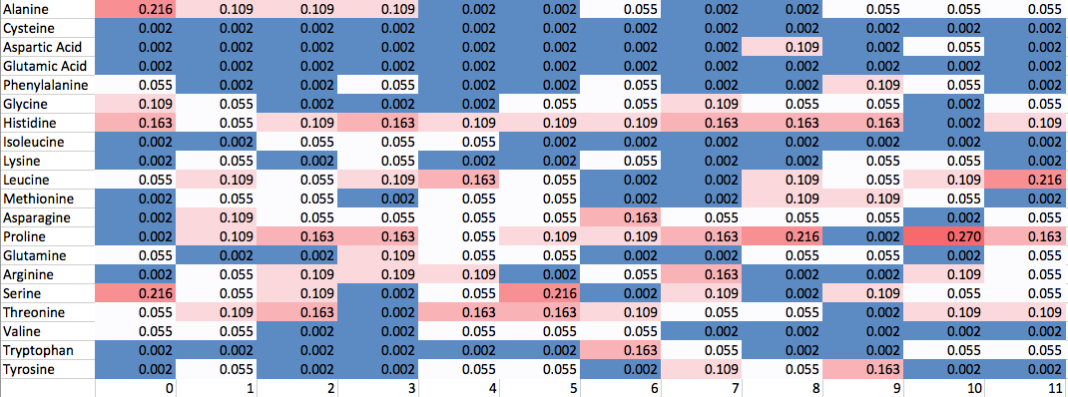
Our panning factor computation corrects the bias due to the library, amplification, and PCR.
With correction
Without correction

Slide 13
These corrected measures of binding can be used in these ways:
They let us rank sequences observed in phage display, for prioritizing confirmatory experiments.
They show which amino acids & positions play a strong role in binding, corrected for bias.
They can be used as a starting point by POOL, to search for additional stronger binders.
We can use them to search for selective peptides.

Slide 14
We can search for selective peptides
Suppose we want a peptide that binds to gold, and not to silver.
We could use phage display directly, with two panning steps, one that selects for gold, and the other that selects for NOT silver.
Selecting for NOT silver seems difficult.

Slide 15
We can search for selective peptides
Instead, we do 2 phage display experiments.
Experiment 1: select for gold. Experiment 2: select for silver.
Feed the results from both into our statistical model, and get: 1. Panning factors for gold 2. Panning factors for silver.
Use these panning factors to predict P(gets through panning with gold, and not with silver)
Recommend peptides using this probability.

Slide 16
We have some preliminary experimental results
We use phage display sequences from highly ordered pyrolytic graphite (HOPG) collected by Rajesh’s lab & sent 11/2012.
Some sequences are from 3 rounds of phage display, others are from 4 rounds.
Some sequences are 12mers, others are 7mers. We used only the 12mers.
There are 7 12mers from 3 rounds, and 11 12mers from 4 rounds.
We use library+PCR and amplification bias estimates based on data collected by Rajesh’s lab and sent 9/2014.

Slide 17
We have some preliminary experimental results
Hold out a peptide sequence from the data.
Train our method on all by this held out sequence.
Generate 999 other sequences at random.
Use our method to rank all 1000 sequences.

Slide 18
We have some preliminary experimental results
Rank
Random (grey) & held-out (blue) peptides, ranked by our method.

Slide 19
We have some preliminary experimental results
Rank
If we “select” 5% of the peptides, then 2/18=11% of the held-out peptides are selected.
[these numbers are just for this example --- for real data, see the next slide]
% of held-out selected
.11
.05
% overall selected
Random (grey) & held-out (blue) peptides, ranked by our method.
Fraction of peptides selected

Slide 20
We have some preliminary experimental results
Rank
If we “select” 10% of the peptides, then 3/18=17% of the held-out peptides are selected.
[these numbers are just for this example --- for real data, see the next slide]
% of held-out selected
.17
.10
% overall selected
Random (grey) & held-out (blue) peptides, ranked by our method.
Fraction of peptides selected

Slide 21
Our method worked well
Our method
% of held-out selected (“recall”)
Random
% overall selected

Slide 22
We are ready to do more experimental comparisons
Caveats with the results I just showed:
The held-out peptides have bias.
Our library+PCR and amplification bias are estimated from different data than used when generating the phage display sequences.
Rajesh mentioned a larger set of sequences we could use to do a better validation. We’re ready for that.

Slide 23
Combinatorial Library Design
Data on a single round of phage display (even without amplification) with many sequences might be more useful for prediction than later rounds.
One could imagine designing the phage display library.
A related idea is the design of split pool experiments.

Slide 24
Enhancements to POOL

Slide 25
We are working on these enhancements to POOL
Incorporate prior information from phage display.
Use quantitative, rather than binary, responses.
Enhance the way we leverage amino acid similarity.
More sophisticated optimization under the hood.
Build a simulation tool for answering this question: How many peptides do I need to test before I find what I’m looking for?

Slide 26
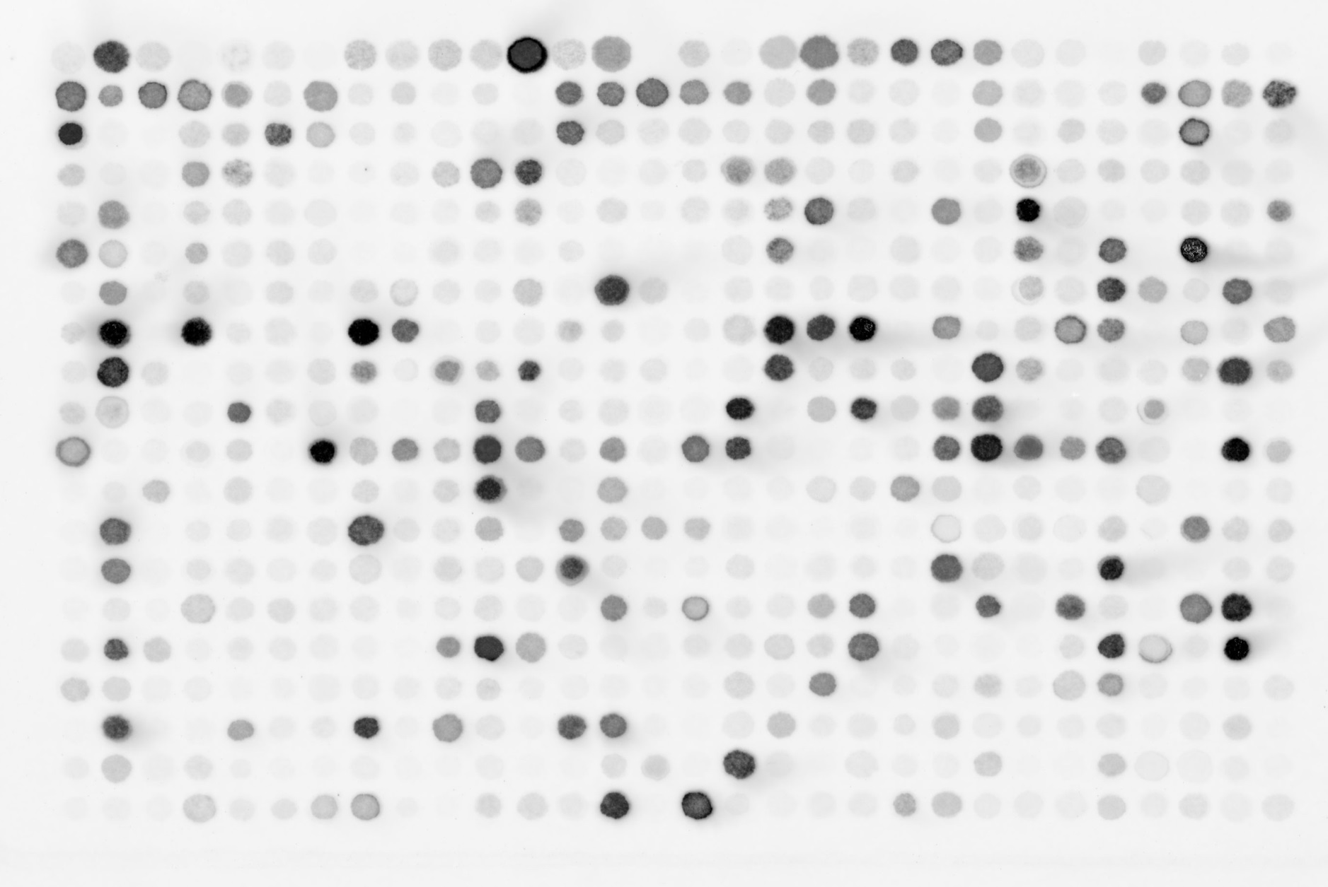
Enhancements to POOL: use quantitative responses
 | 1 | 2 | 3 | 4 | 5 | 6 | 7 | 8 | 9 | 10 | 11 | 12 | 13 | 14 | 15 | 16 | 17 | 18 | 19 | 20 | 21 | 22 | 23 | 24 | 25 | 26 | 27 | 28 | 29 | 30
A
B
C
D
E
F
G
H
I
J
K
L
M
N
O
P
Q
R
S
T

Slide 27
Using quantitative responses has these advantages
Be able to take on a larger number of applications (see next slide).
Get more information out of each experiment.
No need for an arbitrary cutoff between “worked” & “didn’t work”.

Slide 28
Our ongoing collaborations with these groups that would benefit from these enhancements
Tiff Walsh / Marc Knecht / Paras Prasad: Find peptides that bind specifically to metal.
Mirkin: Find stable RNA-nanoparticle constructs.

Slide 29
We discussed new applications of POOL with these groups at the program review
David Ginger: Find DNA sequences with high quantum yeld when azobenzene is embedded.
Lydia Contreras: Find peptides that bind to target protein / DNA / RNA sequences.
Carole Perry: Peptide binders
Teri Odom: Design DNA sequences that link hybrid nanoparticle superlattices.

Slide 30
Let’s have dinner!

