Slide 1
Victor Castillo, Jun Zhang and Balint Kovacs
February 20, 2019
Artificial Neural Networks and Deep Architectures, DD2437
Presentation for lab assignment 3
Hopfield networks

Slide 2
3.1 Convergence and attractors
The network was able to store the tree vectors.
If we use synchronous update mode, the system was able to restore the original patterns for the first one from x1d. However, in the case of the second and the third pattern, the resulting association of x2d and x3d was oscillating between the following 2 states.
[ 1 1 -1 1 1 1 1 1]
[ 1 1 -1 1 -1 -1 1 1]
To find the number of attractors in the system, we generated all the possible patterns and checked which points they converge to.
We have found 6 attractors: the original patterns, and their opposites.
When we make the starting pattern more then half wrong compared to the original, it is closer to the opposite of the target, so recalling it is impossible.

Slide 3
3.1 Convergence and attractors
However, if we use asynchronous update, we are able to recall x1, x2, x3 from x1d, x2d, x3d, respectively.
To find the number of attractors in the system, we generated all the possible patterns and checked which points they converge to.
We have found 6 attractors: the original patterns, and their opposites.
When we make the starting pattern more then half wrong compared to the original, it is closer to the opposite of the target, so recalling it is impossible.

Slide 4
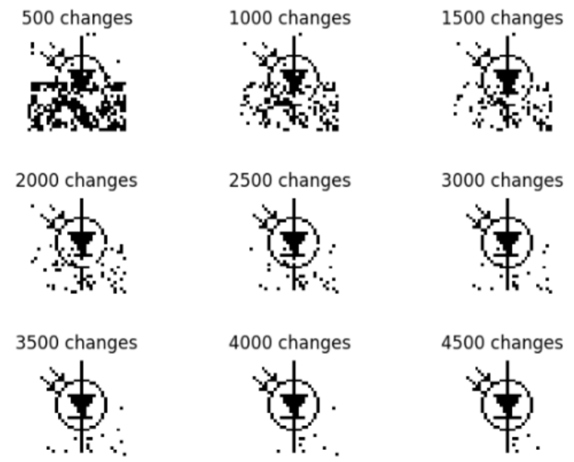
3.2 Sequential Update
The patterns can be stored and they are stable in this case as well. The network can restore p1 from the distorted version, p10, in both the synchronous and asynchronous case. However, in the case of p11, it can only recall p2 correctly with the asynchronous method. The restoration of p10 is displayed in Figure 1, with sequential updates and selecting indices randomly.

Slide 5
3.3 Energy
The energy function has a local minima at the attractors. The energy of the distorted patterns are decreasing over iterations. For the synchronous case with the basic patterns in 3.1, a minima is achieved in the first ’epoch’ for the original patterns, and on the first pattern, it stops at the energy state of the original pattern. However, in the case of the other two distorted patterns, it gets stuck between two incorrect patterns with same energy, resulting in a loop.

Slide 6
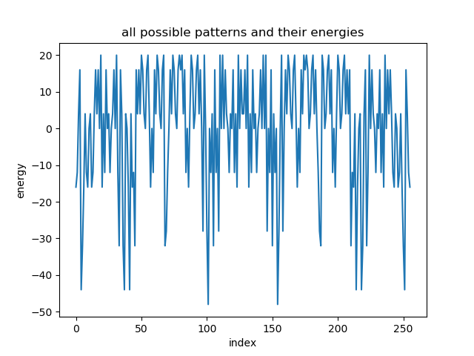
3.3 Energy
For the asynchronous case with the basic patterns in 3.1, all the distorted patterns converge to the attractors, which are local minimas. We draw the energies of all possible patterns and found that there are actually 8 minimas but only 6 attractors.

Slide 7
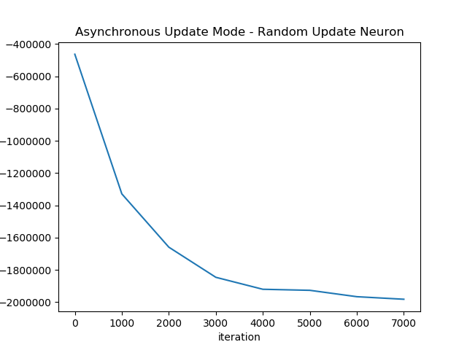
3.3 Energy
For the asynchronous case with the image patterns in 3.2, we randomly update the neuron. And we can see that as the iteraion goes on, the energy decreases consistently and converge. At the same time the network reaches an attractor.

Slide 8
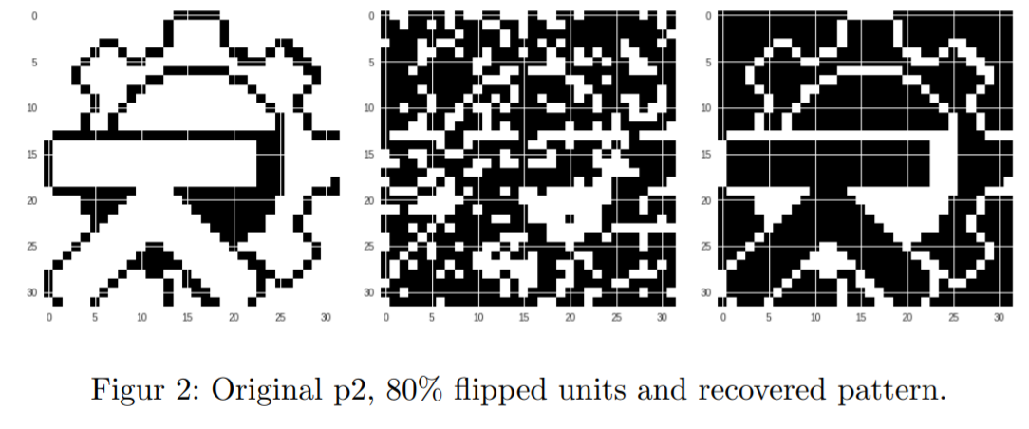
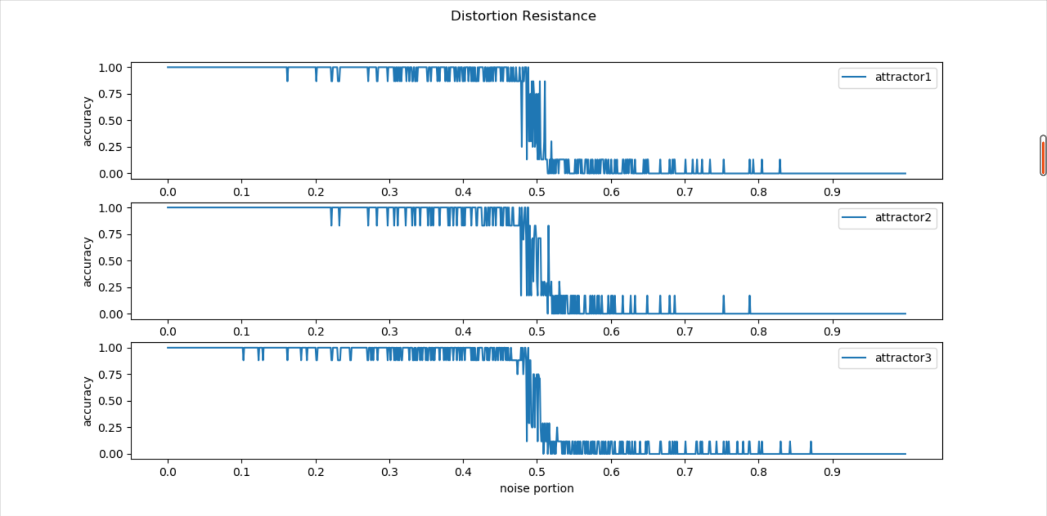
3.4 Distortion Resistance
Pattern p1, by flipping random units from 0% noise to roughly 45%, it’s possible to recall the original pattern. Between 45% and roughly 80%, the recalled pattern is a spurious pattern and from 80% to 100%, the network is recalls the opposite of the original pattern. The same pattern is seen with p2.
p3, around 50% of flipped units result in recalling p1, from 60% to 70% recalls a spurious state and after 80% the opposite of the original pattern is recalled.

Slide 9
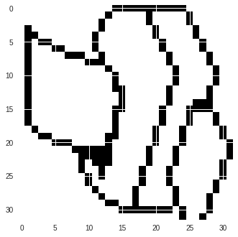
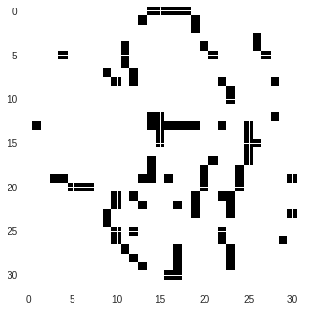
3.5 Capacity
The configuration is only able to remain stable with the three original patterns (p1, p2, p3).
Adding additional patterns causes the network to become unstable and abruptly loses the ability to store the patterns, recalling spurious patterns.

Slide 10
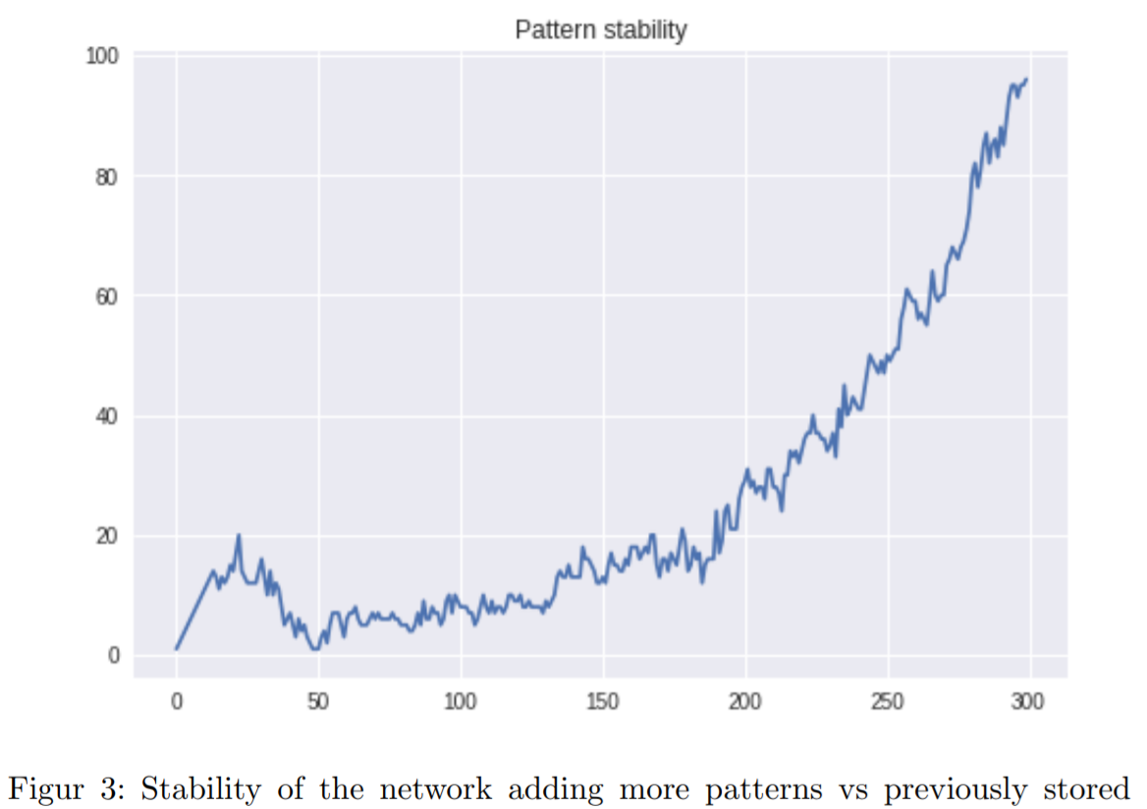
3.5 Capacity
By generating random patterns (100) instead of the pictures, the network was able to store many patterns, but it starts to lose the ability to remain stable and store all the patterns at around 60 patterns.
Testing the pattern stability behaviour with 300 random patterns using 100 units, we get the graphic in the image, which is relatively lineal below 17 and then loses stability with more patterns.

Slide 11
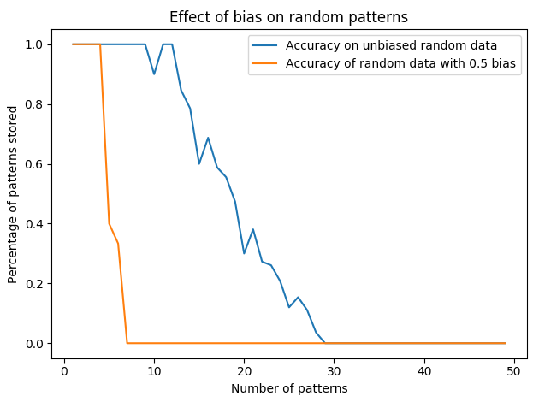
3.5 Capacity
By generating the 300 patterns and adding a bias that skews the data in a direction (like +0.5), the capacity of the network is reduced abruptly.
This corresponds to the image data, because there is a skew in how many “positives” are there, considering white color positive, so the data is very imbalanced and that explains the difference when comparing against random generated data, where correlation is very low.

Slide 12
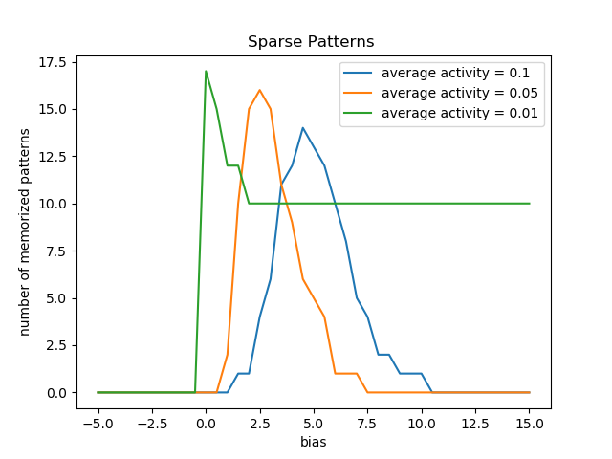
3.6 Sparse Patterns
With smaller average activity, we need smaller bias to make the network memorize most patterns.
The more sparse the patterns, the more patterns the network can remember. We believe this is because sparse patterns are more like to be orthogonal.

