Slide 1
Victor Castillo, Jun Zhang and Balint Kovacs
March 1, 2019
Artificial Neural Networks and Deep Architectures, DD2437
Presentation for lab assignment 4
Deep neural network architectures

Slide 2
3.1 Autoencoder for binary-type MNIST images
The more hidden layer we used resulted in the better performance.
The difference in performance in the overcomplete case is less significant as we continue increasing the number of hidden nodes.
One thing to note is that we had to use unusually high learning rates for the best performing models (around 30).
When comparing the performance of the networks with ReLU and sigmoid activation functions, we have found that the ReLU outperforms the sigmoid. The cause for this could be vanishing gradients in the case of sigmoid

Slide 3
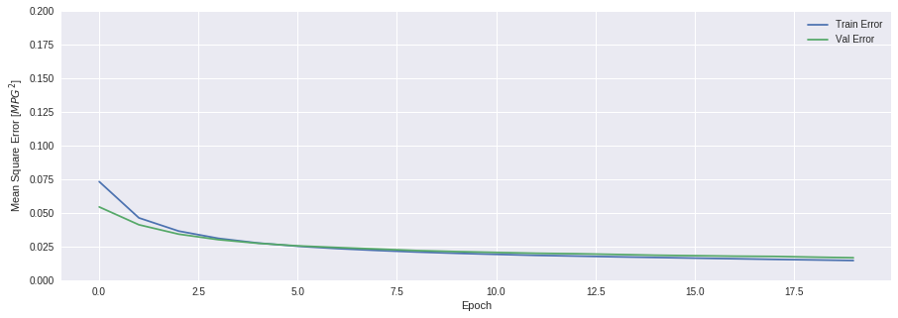
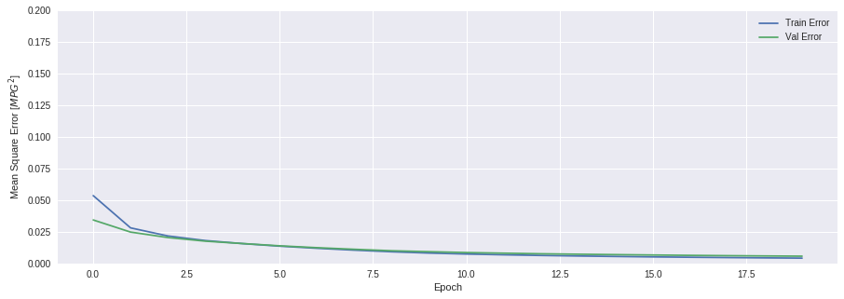
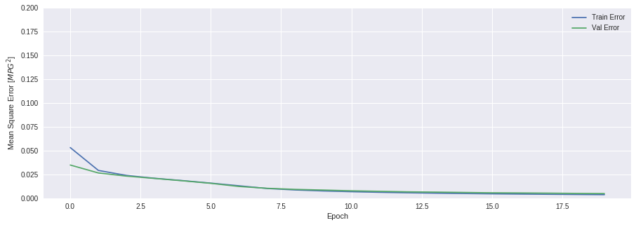
3.1 Autoencoder for binary-type MNIST images
100 Nodes
400 Nodes
1000 Nodes

Slide 4
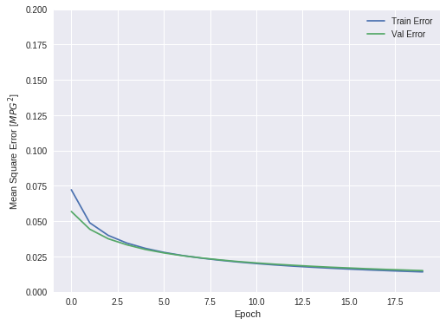
3.1 Autoencoder for binary-type MNIST images
1000 Nodes - 0 Momentum
1000 Nodes - 0.9 Momentum

Slide 5
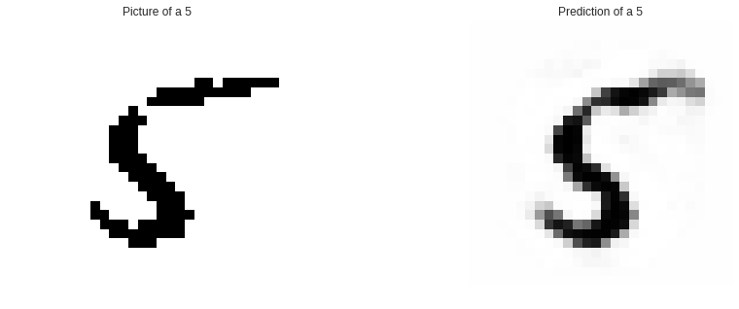
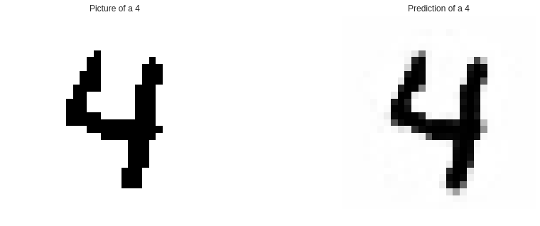
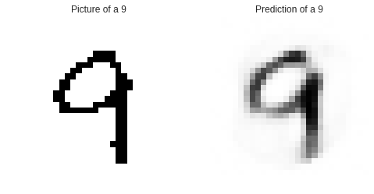
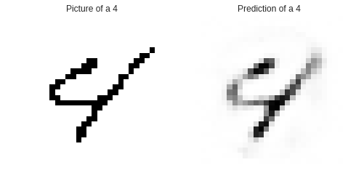
3.1 Autoencoder for binary-type MNIST images
100 Nodes - 0.9 Momentum
1000 Nodes - 0.9 Momentum
100 Nodes - 0 Momentum
1000 Nodes - 0 Momentum

Slide 6
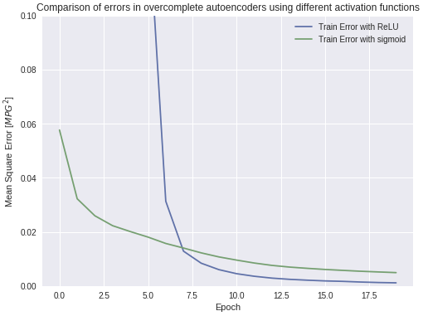
3.1 Autoencoder for binary-type MNIST images
When comparing the performance of the networks with ReLU and sigmoid activation functions, we have found that the ReLU slightly outperforms the sigmoid.
The cause for this could be vanishing gradients in the case of sigmoid, which the ReLU doesn't suffer from, given the linearity of the function when the input is greater than zero.

Slide 7
3.1 Autoencoder for binary-type MNIST images
When we examined the sparsity of hidden layer representations, in the case of a 1000 hidden nodes, in average, 66% of them had non-zero values.
One interesting aspect to notice was that when we used an 1500 node hidden layer and sigmoid activation, all the hidden layer values were non-zero, but with the same configuration, except using ReLU, the sparseness was 51%
In the case of undercomplete representation, the weights are more blurred and in the overcomplete case, they are specific on small spots.

Slide 8
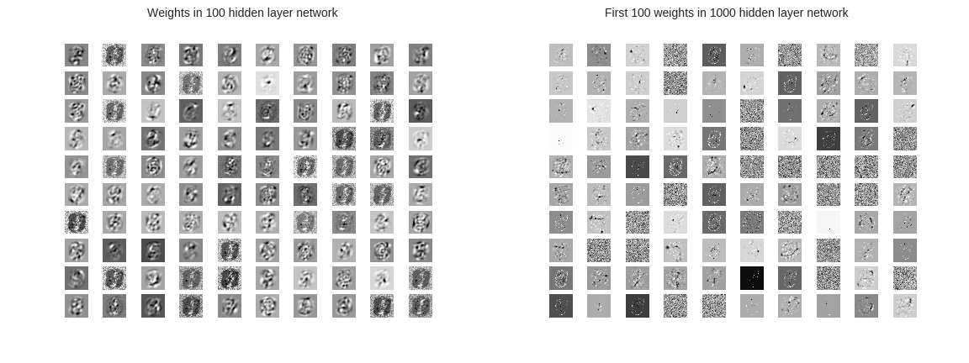
3.1 Autoencoder for binary-type MNIST images

Slide 9
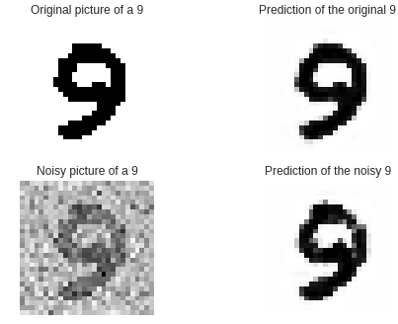
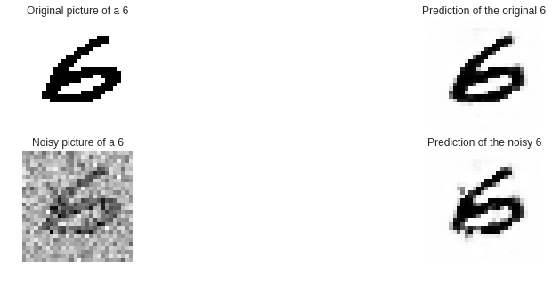
3.1 Autoencoder for binary-type MNIST images
The undercomplete network showed great capabilities in restoring noisy samples.

Slide 10
3.2 Stacked autoencoders for MNIST digit classification
In this part of the assignment, we used a layer with softmax activation function as a last layer to make class predictions. We used categorical entropy as our loss metric.
In the case of the simple classifier with no hidden layers, the results were quite convincing, with around 90% accuracy. By adding hidden layers, we managed to increase the accuracy values a bit, more in the case of brier score.
We used a 1000 nodes as the size of the first hidden layer, then added smaller layers (600 in the case of 2 hidden layer network, 800 and 500 in the case of 3 hidden layer network). We have not found significant difference if we change the order of these layers.

Slide 11
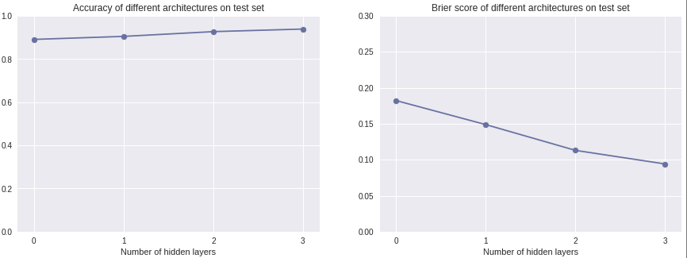
3.2 Stacked autoencoders for MNIST digit classification

