Slide 1




ACL 2019
Modeling Semantic Compositionality
with Sememe Knowledge
Fanchao Qi, Junjie Huang, Chenghao Yang, Zhiyuan Liu, Xiao Chen, Qun Liu and Maosong Sun

Slide 2
Semantic Compositionality (SC)
农民 (peasant)
起义 (uprising)
？
农民起义 (peasant uprising)
Notes:
Given two words "peasant" and "uprising“ in Chinese, Suppose we know the meaning of these two words, and if we put them together, can we infer the meaning of their composition "peasant uprising"? Literally we can understand that peasant uprising is a kind of revolution dominated by peasants

Slide 3
Semantic Compositionality (SC)
农民 (peasant)
起义 (uprising)
农民起义 (peasant uprising)
画 (draw)
句号 (a period)
画句号 (draw a period)
Notes:
But if we put together “draw" and “a period", its meanings will change. Because the combination “draw a period” in Chinese means ending or finishing.

Slide 4
Semantic Compositionality (SC)
Semantic Compositionality:
The phenomenon that the meaning of a complex linguistic unit can be composed of the meanings of its constituents (Pelletier, 1994) .
Vast applications:
Language modeling (Mitchell and Lapata, 2009)
Sentiment analysis (Maas et al., 2011; Socher et al., 2013b)
Syntactic parsing (Socher et al., 2013a)
So on…
农民起义 (peasant uprising)
农民 (peasant)
起义 (uprising)
画句号 (draw a period)
画 (draw)
句号 (a periiod)
Examples of Semantic Compositionality
Notes:
So this interesting phenomenon is called semantic compositionality.
It’s defined as a pheno- that the meaning of a complex linguistic unit, like multiword expressions, can be composed of the meanings of its constituents.
Some linguists regard SC as the fundamental truth of semantics.
And it has proved effective in many NLP tasks including LM, SA, SP and so on.

Slide 5
SC Task Formulation
Mainstream task:
learn representations of multiword expressions (MWEs)
Notes:
Recent literature on SC focus on using vector-based distributional models to learn the representation of multiword expressions, that is the embeddings of phrases or compounds.

Slide 6
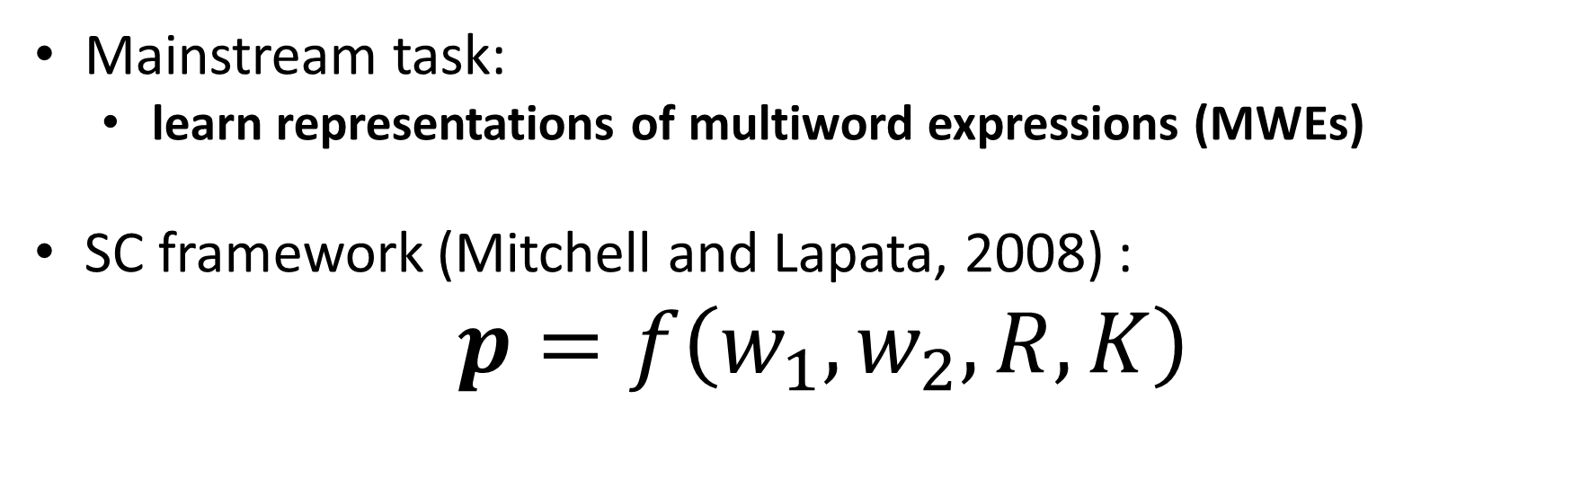
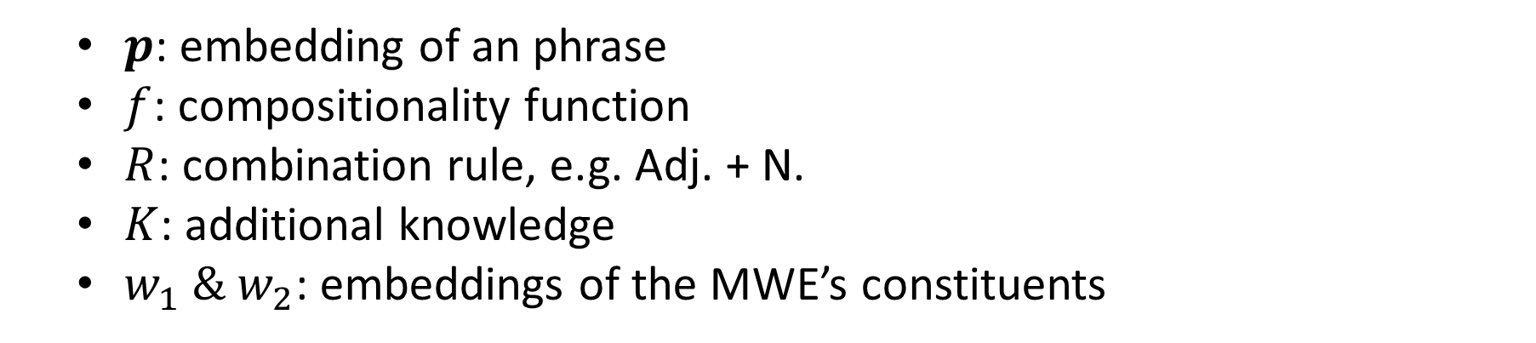
SC Task Formulation
Mainstream task:
learn representations of multiword expressions (MWEs)
SC framework (Mitchell and Lapata, 2008) :
$p=f\left(w_{1},w_{2},R,K\right)$
$p$: embedding of an phrase
$f$: compositionality function
$R$: combination rule, e.g. Adj. + N.
$K$: additional knowledge
$w_{1} \& w_{2}$: embeddings of the MWE’s constituents
Notes:
To do this, Mitchell and Lapata propose a general framework to acquire the embedding of a phrase.
They propose the embedding of a phrase is the function of its constituent word embedding one, word embedding two, its combination rule and external knowledge.
Notice that this formula only applies to two-word MWEs, sometimes we call it a phrase, but the formula can be easily extended to longer MWEs. In fact, we also focus on modeling SC for two-word MWEs in this paper because they are the most common.

Slide 7
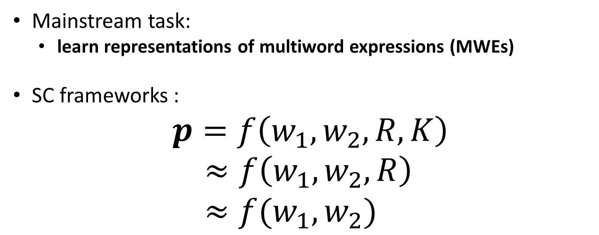
SC Task Formulation
Mainstream task:
learn representations of multiword expressions (MWEs)
SC frameworks :
$p=f\left(w_{1},w_{2},R,K\right)$
$≈f\left(w_{1},w_{2},R\right)$
$≈f(w_{1},w_{2})$
Notes:
Based on this general framework, many semantic composition models were proposed.
They are often the simplified versions of the Mitchell’s framework.
Basically they focus on reforming composition function f or incorporating combination rule R.
While few works consider K, the additional knowledge. Probably because they didn’t find a proper knowledge.

Slide 8
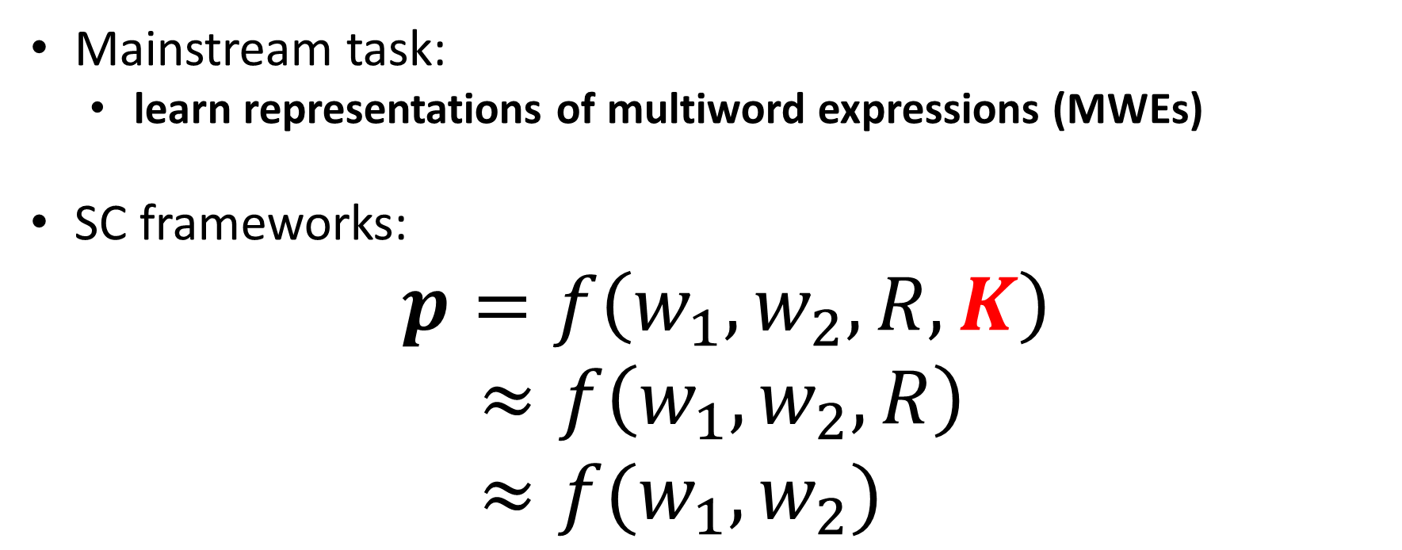
SC Task Formulation
Mainstream task:
learn representations of multiword expressions (MWEs)
SC frameworks:
$p=f\left(w_{1},w_{2},R,K\right)$
$≈f\left(w_{1},w_{2},R\right)$
$≈f(w_{1},w_{2})$
Notes:
So in our work, try to incorporate a kind of knowledge to model SC
And that knowledge is sememe.

Slide 9
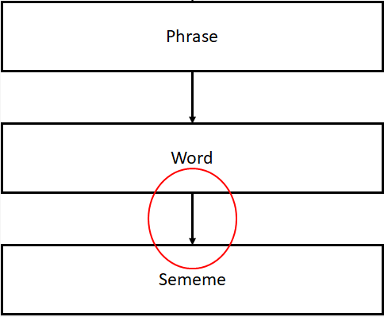
Words & Sememes
Sememes:
minimum semantic units. (Bloomfield, 1926)
All the semantic meanings of concepts can be composed of a limited closed set of sememes.
e.g. boy → human, male, child
girl → human, female, child
Notes:
Sememes are the minimum semantic units of human languages defined by linguists which can finely depict the meaning of a word.
In this view, all the semantic meanings of concepts, like words, can be composed of a limited closed set of sememes.

Slide 10
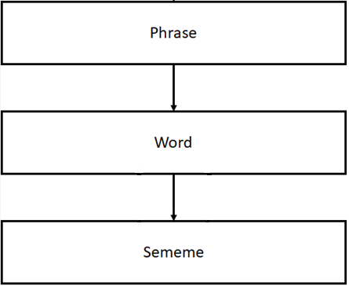
Words & Sememes
Sememes are suitable for modeling semantic compositionality!
Notes:
Sememes compose the meanings of words, and the meanings of words compose the meaning of phrases in SC
So because of this hierarchical structure, we believe that sememes are suitable for modeling semantic composition.

Slide 11


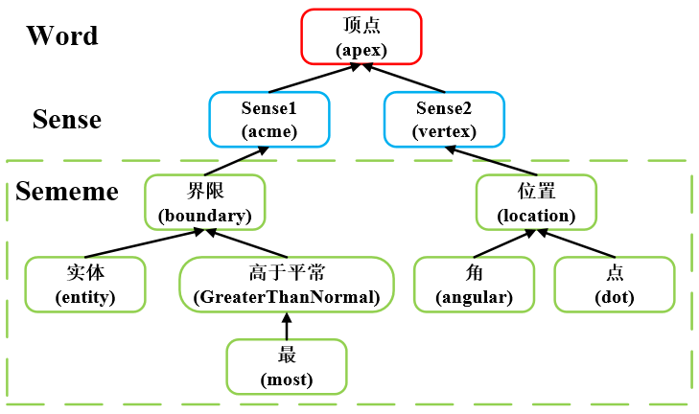
Words, Sememes & HowNet
HowNet:
a famous open-sourced sememe-based linguistic KB 。
Annotate more than 100,000 words and phrases in Chinese and English using about 2,000 sememes.
An example of words in HowNet
Notes:
Sememes are annotated by experts in linguistic knowledge base. HowNet is one of the famous sememe-based KB.
There are more than 100, 000 words and phrases annotated with their sememes in HowNet. And experts only use about 2,000 sememes to annotate. Here you can see an example of the word APEX in HowNet.
It has two senses, and each of these two senses has several sememes.
// Furthermore, words are annotated with sememes in tree structure,
this is because a word may have multiple senses and sememes may have some kinds of relation between each other.

Slide 12
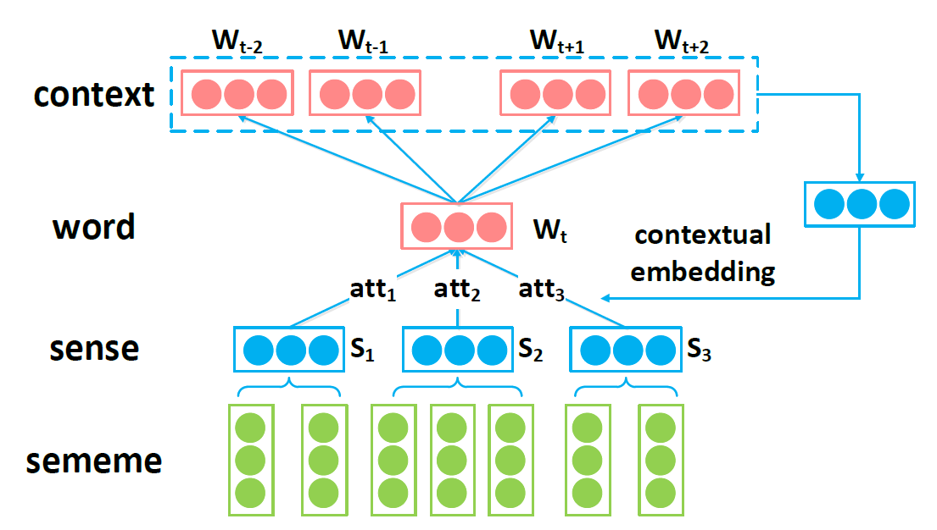
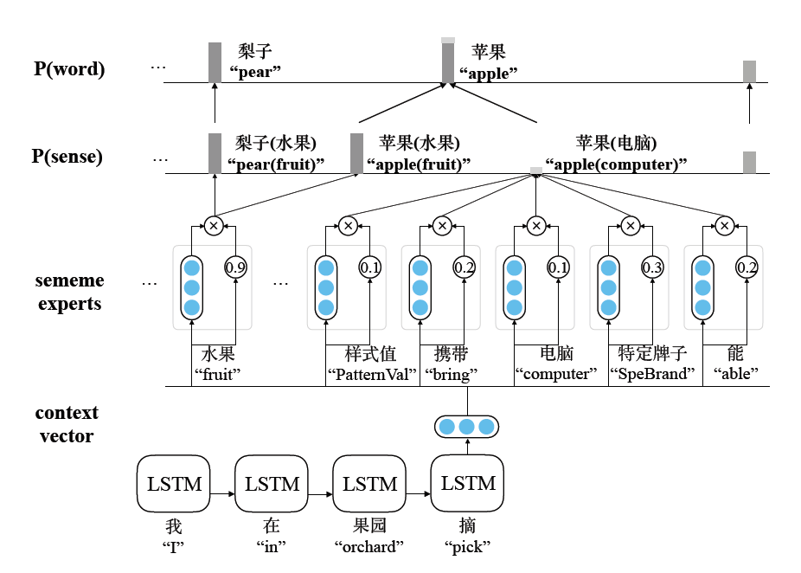
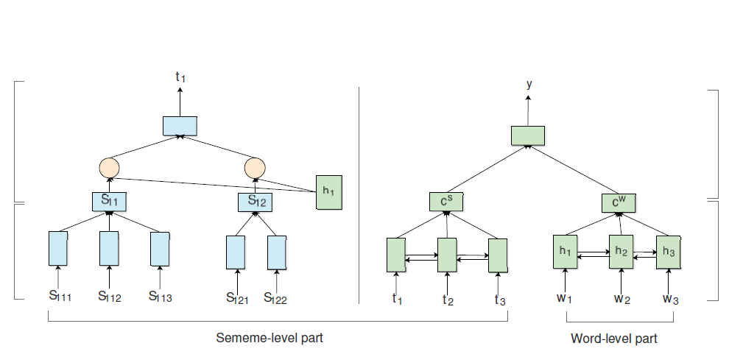
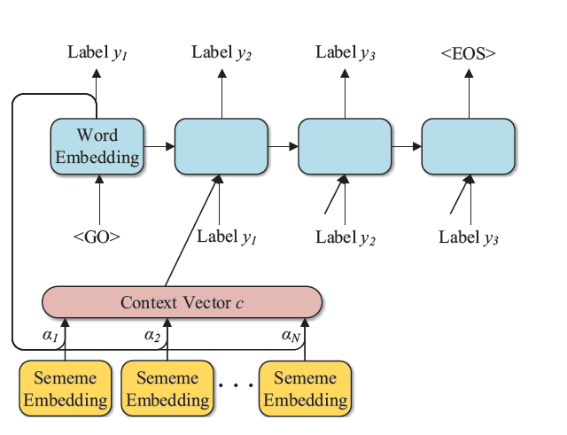
Applications of Sememes & HowNet
Word Representation Learning (Xie et al., 2017)
Language Modeling (Gu et al, 2018)
Modeling Semantic Rationality (Liu et al., 2018)
Lexicon Expansion (Zeng et al, 2018)
Notes:
And there are also lots of applications of sememes and HowNet, like similarity computation, word representation learning, language modeling and so on.

Slide 13
Assumption
Sememes are useful in semantic compositionality!
Notes:
To confirm our assumption that sememes are useful to modeling SC, first we do a confirmatory experiment on the measurement of SC Degree.

Slide 14
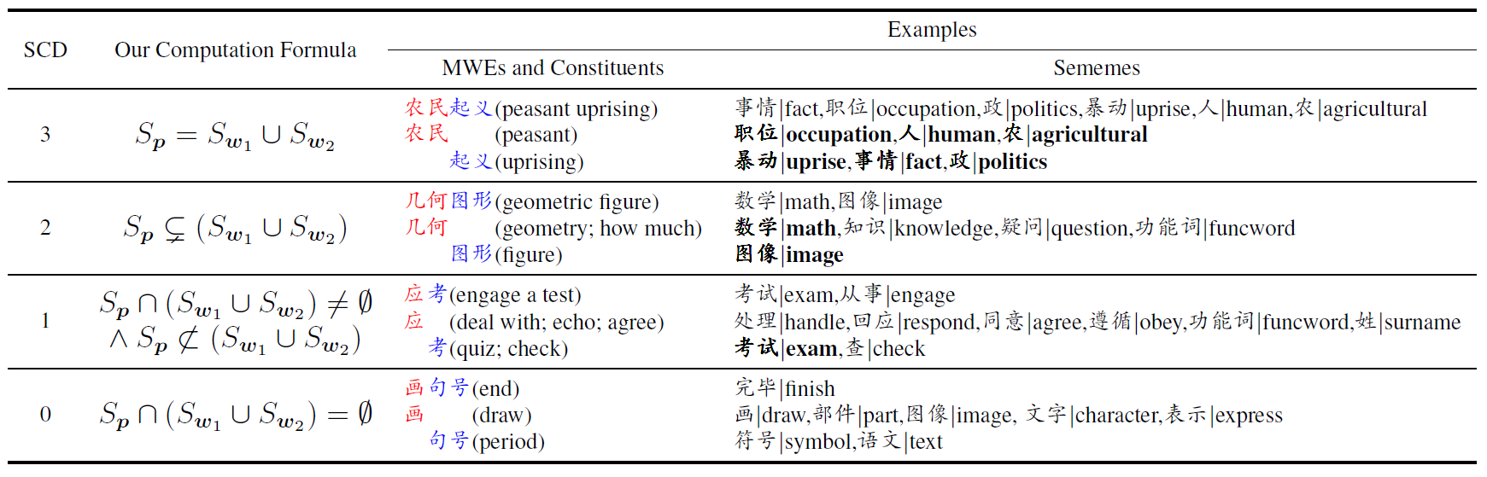
SCD Formula – confirmatory experiment
Semantic Compositionality Degree (SCD):
How much meaning of an MWE can be composed of its constituents.
Notes:
SCD is a score which describes how much meaning of a MWE can be composed of its constituents.
If a MWE has higher Degree, it has more meanings from its constituents.
But if the MWE has some other meanings beyond its two constituents, or if the constituents have some meanings which is not expressed in the MWE, it has a lower Degree.

Slide 15
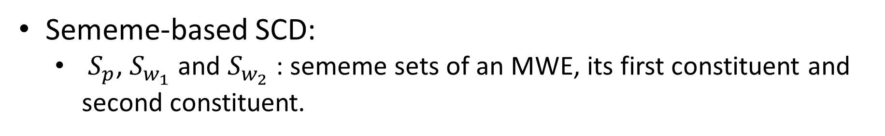
SCD Formula – confirmatory experiment
Sememe-based SCD:
$S_{p}$, $S_{w_{1}}$ and $S_{w_{2}}$: sememe sets of an MWE, its first constituent and second constituent.
Notes:
We propose a simple method to compute the SC degree just based on the coverage level of the sememes of a MWE and constituents.

Slide 16
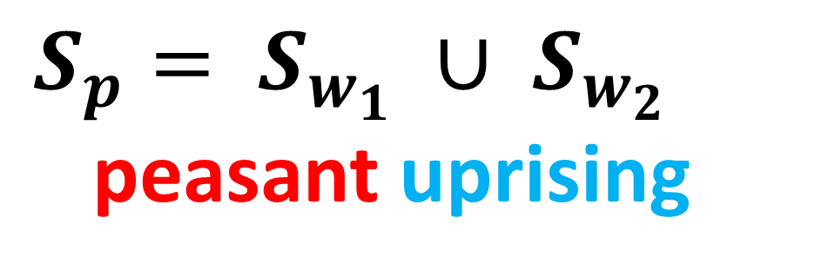
SCD Formula – confirmatory experiment
$S_{p}= S_{w_{1}} ∪ S_{w_{2}}$
peasant uprising
Sememe-based SCD:
$S_{p}$, $S_{w_{1}}$ and $S_{w_{2}}$: sememe sets of an MWE, its first constituent and second constituent.
Notes:
Like the example at the beginning of my presentation, “Peasant Uprising” has the highest SCD of 3 in our formula

Slide 17

SCD Formula – confirmatory experiment
$S_{w_{1}}$ sememes of “peasant”:
occupation, human, agricultural
Sememe-based SCD:
$S_{p}$, $S_{w_{1}}$ and $S_{w_{2}}$: sememe sets of an MWE, its first constituent and second constituent.
Notes:
Because the sememes of peasant are occupation, human and agricultural.
//
both of its two constituents only have one exact meaning, and the meaning of “peasant uprising” is simply the sum of the meanings of its two constituents. 我们人的判断也是3，

Slide 18
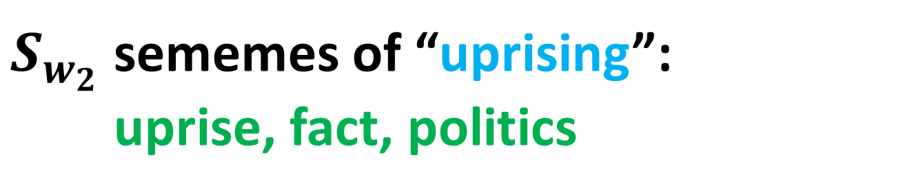
SCD Formula – confirmatory experiment
$S_{w_{2}}$ sememes of “uprising”:
uprise, fact, politics
Sememe-based SCD:
$S_{p}$, $S_{w_{1}}$ and $S_{w_{2}}$: sememe sets of an MWE, its first constituent and second constituent.
Notes:
And the sememes of uprising are uprise, fact and politics.

Slide 19
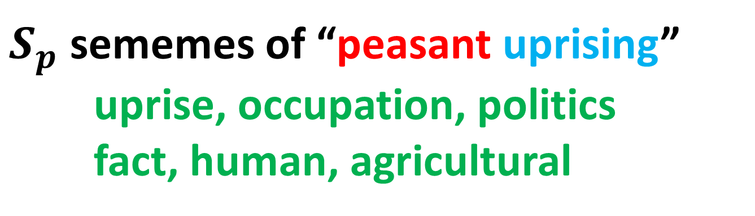
SCD Formula – confirmatory experiment
$S_{p}$ sememes of “peasant uprising”
uprise, occupation, politics
fact, human, agricultural
Sememe-based SCD:
$S_{p}$, $S_{w_{1}}$ and $S_{w_{2}}$: sememe sets of an MWE, its first constituent and second constituent.
Notes:
And their composition peasant uprising has the same six sememes I mentioned before,
The meaning of “peasant uprising” in Chinese is simply the sum of the meanings of its two constituents.
So it has highest score of 3 in our formula which agrees with human judgement.

Slide 20
SCD Experiment
Results:
Pearson’s correlation: 0.75;
Spearman’s rank correlation: 0.74.
Notes:
And there are also three other formula to compute SCD. I will not introduce all of them in detail.
To evaluate our method, we compare the SCD computed by our method and the score assigned by human.
Surprisingly, we find they have high correlation. The Pearson's correlation is up to 0.75, which is quite significant and also prelimirily verify our assumption.
//
Close relation between SCD and Sememes.
Ask native speakers to label SCDs for 500 Chinese MWEs.
There are also four degrees to choose. Annotators are shown the dictionary definitions of both the MWE and its constituents.
Each MWE is labeled by 3 annotators, and the average of the 3 annotated SCDs is the MWE’s final SCD.
This result shows that sememes can finely depict meanings of MWEs and their constituents, and capture the semantic relations between the two sides

Slide 21
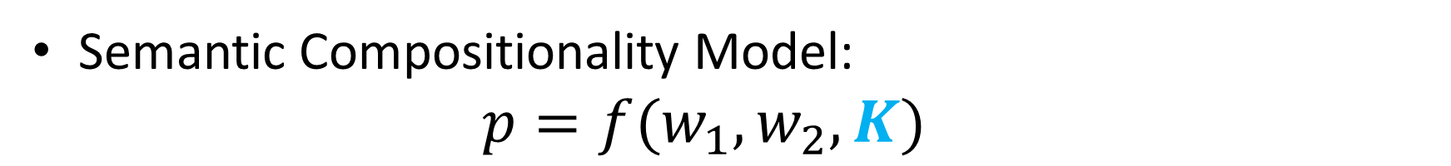
Sememe-based SC — Methodology
Semantic Compositionality Model:
$$p=f(w_{1},w_{2},K)$$
Notes:
Next we try to incorporate sememes into SC models.
First we introduce the models under the framework that phrase embedding is the function of word embedding one, word embedding two and external knowledge.
We propose two models.

Slide 22
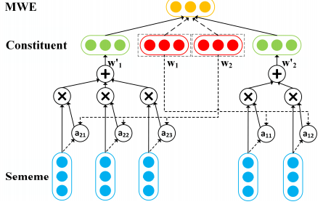
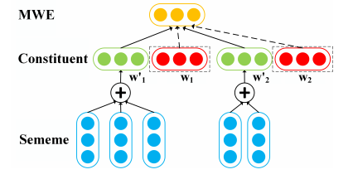
Sememe-based SC — Methodology
Semantic Compositionality Model:
$$p=f(w_{1},w_{2},K)$$
Semantic Compositionality with Aggregated Sememe Model (SC-AS)
Semantic Compositionality with Mutual Sememe Attention Model (SC-MSA)
Notes:
The left model, semantic compositionality with aggregated sememes, simply uses the sum of all the sememe's embedding of a constituents as additional knowledge.
And the right model uses mutual attention on sememes.
The idea of using mutual attention mechanism is that a constituent's meaning may vary with the other constituent.
So this model can adjust the weight on each sememe to better incorporate knowledge.

Slide 23
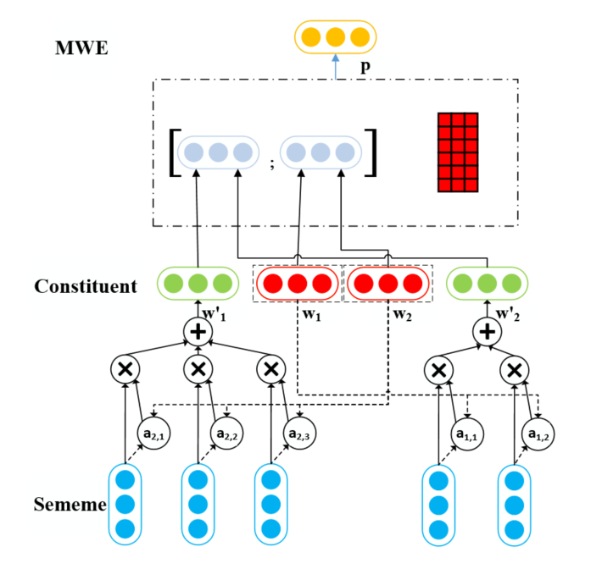
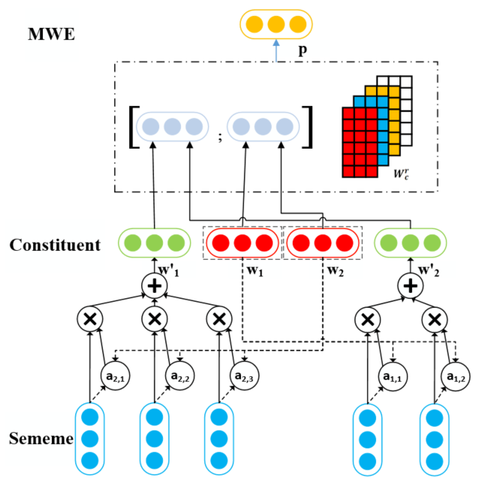
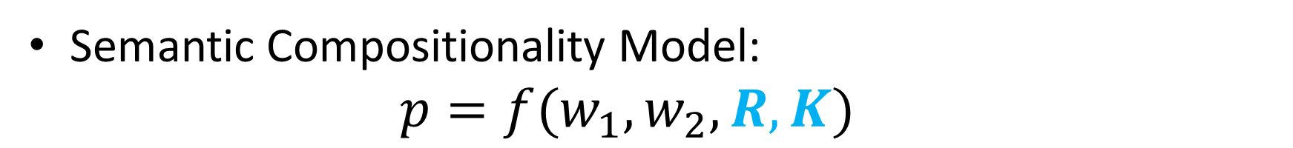
Sememe-based SC — Methodology
Semantic Compositionality Model:
$$p=f(w_{1},w_{2},R,K)$$
+R
Notes:
Furthermore we also consider incorporate combination rules, which is full framework that phrase embedding is the function of word embedding one, word embedding two, combination rule and external knowledge.
This is a variant of our two previous models.

Slide 24
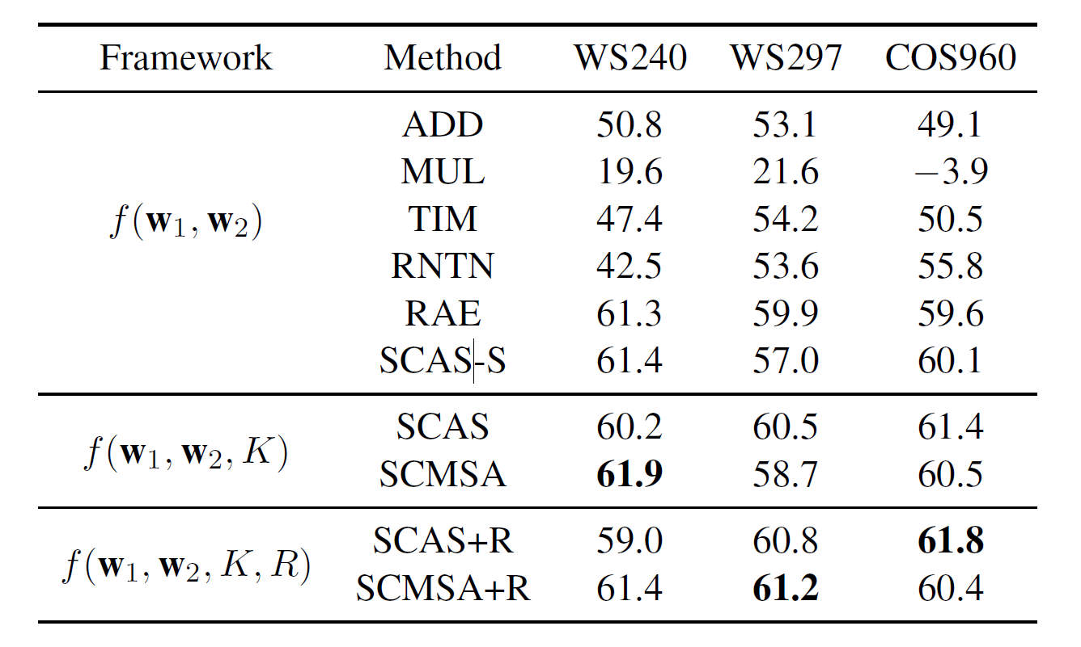
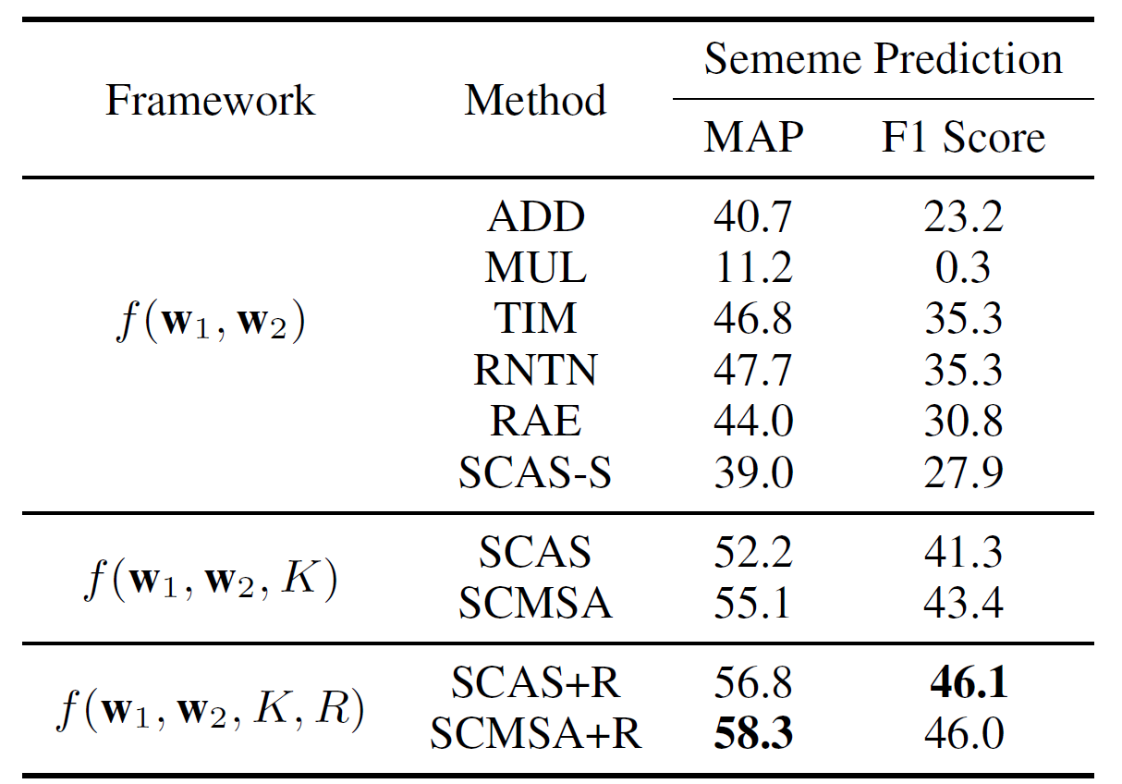
Sememe-based SC — Experiments (1)
Results for MWE similarity
Results for MWE sememe prediction
Our models achieve improvement on the two tasks!
Notes:
We evaluate our semantic composition model on two tasks
The first is Similarity computation. Similarity computation is a traditional method to measure the quality of learned word embeddings.
And we also propose to predict the sememes of MWEs to evaluate the quality of compositional embeddings.
To do this, we apply a single perception layer after the compositional phrase embedding as a classifier.
The results show the advantage of our methods.
The idea to experiment on sememe prediction is that sememes of a word can finely depict the semantics of the word.
On the other hand, the high quality embedding of a word is also supposed to accurately represent the meaning of the word.
Therefore, we believe that the better the embedding is, the better sememes it can predict.
//
More specifically, whether an SC model can predict correct sememes for MWEs reflects the SC model’s ability to learn the representations of MWEs.
MWE similarity(dataset: WS240, WS297, COS960)
WS240 and WS297 have too few MWEs and most of the word pairs are annotated according to Relatedness.
COS960 is our created MWE similarity dataset, which contains 960 Chinese MWE-pairs (Come out soon!)
For the task of MWE similarity computation, we use the squared Euclidean distance loss following (Luong et al., 2013) , combined with L2 regularization.
MWE sememe prediction (dataset: HowNet)
For the task of MWE sememe prediction, we use a single-layer perceptron classifier

Slide 25
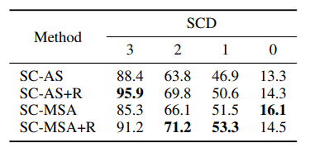
Sememe-based SC — Experiments (2)
Auxiliary Experiments 1:
Sememe prediction on MWEs with different sememe-based SCDs.
Notes:
We also perform two auxiliary experiments which have more interesting results.
We first divide our test set into 4 groups based on their SCD and test the models’ performance on the four subsets.

Slide 26
Sememe-based SC — Experiments (2)
Analysis:
Higher SCDs→better performance.
Auxiliary Experiments 1:
Sememe prediction on MWEs with different sememe-based SCDs.
Notes:
From the horizontal view of this table, we find that the higher SCD a MWE has, the better performance the model achieves, which is easy to explain.
MWEs with higher SCDs have more meanings from their constituents, and consequently, models can better capture the meanings of these MWEs.

Slide 27
Sememe-based SC — Experiments (2)
Analysis:
Higher SCDs→better performance.
Our mutual attention models perform better than the aggregated sememe models, other than on the subset of SCD 3.
Auxiliary Experiments 1:
Sememe prediction on MWEs with different sememe-based SCDs.
Notes:
The second finding is that,
our mutual attention models perform better than the aggregated sememe models, EXCEPT on the subset of SCD 3.
This is because an MWE whose SCD is 3 has totally the same sememes as its constituents.
And our aggregated sememe models simply add all the sememes of constituents. So this model perfectly fits the characteristics of MWEs whose SCDs are 3.
Therefore it has better performance on this subset.

Slide 28
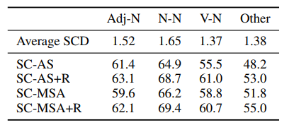

Sememe-based SC — Experiments (3)
Analysis:
Adding combination rule → better performance.
+
+
Auxiliary Experiments 2:
Sememe prediction on MWEs with different combination rules.
Notes:
In the second auxiliary experiment, we investigate the effect of combination rules on sememe prediction performance.
We find that integrating combination rules into models is beneficial to the performance with whichever combination rule

Slide 29
Sememe-based SC — Experiments (3)
Analysis:
Adding combination rule → better performance.
Interestingly, performance of sememe prediction is positively correlated with their average SCDs.
Auxiliary Experiments 2:
Sememe prediction on MWEs with different combination rules.
Notes:
And interestingly, we also find that the performance of sememe prediction is positively correlated with their average SCDs, and this result is quite consistent with our first auxiliary experiment

Slide 30
Conclusion and Future Work
Conclusion:
Sememe knowledge is beneficial to modeling semantic compositionality.
Our SC degree measurement preliminarily proves the usefulness of sememes.
Our sememe-incorporated SC models achieve impressive performance gain.
Future Work
Combine contextual information.
Longer MWEs than two-word.
Notes:
To conclude, we believe that sememe knowledge is bene
To verify this, we conduct simple SC degree (SCD) measurement experiment, which preliminarily proves our assumption.
Our proposed sememe-incorporated SC models achieve impressive performance gain on two tasks, which further strengthens our argument.
In the future, we can explore to Combine contextual information, which is also essential to MWE representation learning.
We can also explore longer MWEs.

Slide 31


Thanks!
Paper
Code and data

Slide 32
References
Francis Jeffry Pelletier. 1994. The Principle of Semantic Compositionality. Topoi, 13(1):11–24.
Francis Jeffry Pelletier. 2016. Semantic Compositionality, volume 1.
Jeff Mitchell and Mirella Lapata. 2008. Vector-based Models of Semantic Composition. In Proceedings of ACL, pages 236–244
Andrew L Maas, Raymond E Daly, Peter T Pham, Dan Huang, Andrew Y Ng, and Christopher Potts. 2011. Learning word vectors for sentiment analysis. In Proceedings of ACL-HLT, pages 142–150.
Leonard Bloomfield. 1926. A set of postulates for the science of language. Language, 2(3):153–164.
Zhendong Dong and Qiang Dong. 2006. Hownet and the computation of meaning. World Scientific
Yilin Niu, Ruobing Xie, Zhiyuan Liu, and Maosong Sun. Improved word representation learning with sememes. In ACL 2017
Xiangkai Zeng, Cheng Yang, Cunchao Tu, Zhiyuan Liu, Maosong Sun. Chinese LIWC Lexicon Expansion via Hierarchical Classification of Word Embeddings with Sememe Attention. In AAAI 2018
Yihong Gu, Jun Yan, Hao Zhu, Zhiyuan Liu, Ruobing Xie, Maosong Sun, Fen Lin and Leyu Lin. Language Modeling with Sparse Product of Sememe Experts. In EMNLP 2018

Slide 33
References
Xiangyu Duan, Jun Zhao, and Bo Xu. Word sense disambiguation through sememe labeling. In IJCAI 2007
Qun Liu and Sujian Li. 2002. Word similarity computing based on HowNet. International Journal of Computational Linguistics & Chinese Language Processing, 7(2):59–76.
Yuntao Zhang, Ling Gong, and Yongcheng Wang. Chinese word sense disambiguation using hownet. In Proceedings of International Conference on Natural Computation 2005.
Xianghua Fu, Liu Guo, Guo Yanyan, and Wang Zhiqiang. 2013. Multi-aspect sentiment analysis for Chinese online social reviews based on topic modeling and HowNet lexicon. Knowledge-Based Systems, 37:186–195
Yunqing Xia, Taotao Zhao, Jianmin Yao, and Peng Jin. 2011. Measuring Chinese-English cross-lingual word similarity with HowNet and parallel corpus. In COLING 2011
Kok Wee Gan and Ping Wai Wong. 2000. Annotating information structures in Chinese texts using HowNet. In The Second Chinese Language Processing Workshop
Thang Luong, Richard Socher, and Christopher Manning. 2013. Better word representations with recursive neural networks for morphology. In Proceedings of the Seventeenth Conference on Computational Natural Language Learning, pages 104–113. Association for Computational Linguistics.

Slide 34
References
Ruobing Xie, Xingchi Yuan, Zhiyuan Liu, and Maosong Sun. Lexical sememe prediction via word embeddings and matrix factorization. In IJCAI 2017
Meng Zhang, Haoruo Peng, Yang Liu, Huan-Bo Luan, and Maosong Sun. Bilingual lexicon induction from non-parallel data with minimal supervision. In AAAI 2017
Shu Liu, Jingjing Xu, Xuancheng Ren, and Xu Sun. Evaluating Semantic Rationality of a Sentence: A Sememe-Word-Matching Neural Network Based on HowNet. arXiv preprint arXiv:1809.03999.

