Slide 1
Review Data Authenticity Analysis
DILAB 1901611 조준영
2023.08.05

Slide 2
목 차
About BERT
Clustering Embedding Vectors
Bayesian DL & MC Dropout

Slide 3
1. About BERT
BERT
/
GPT
RNN
LSTM
Seq2Seq
Attention
Transformer

Slide 4
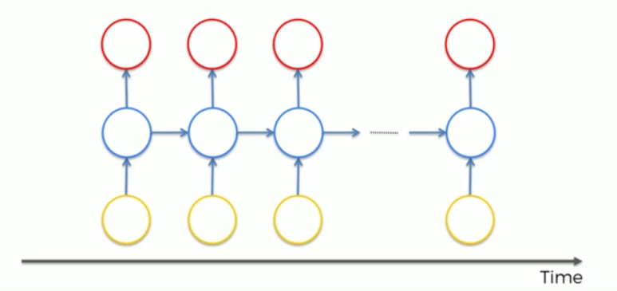
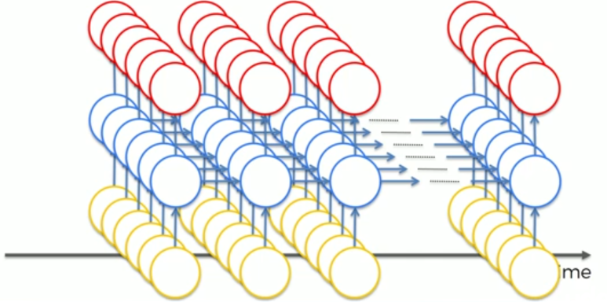
1. About BERT
1.1 RNN
우리가 흔히 알던 architecture

Slide 5
1. About BERT
1.1 RNN
실제 architecture

Slide 6
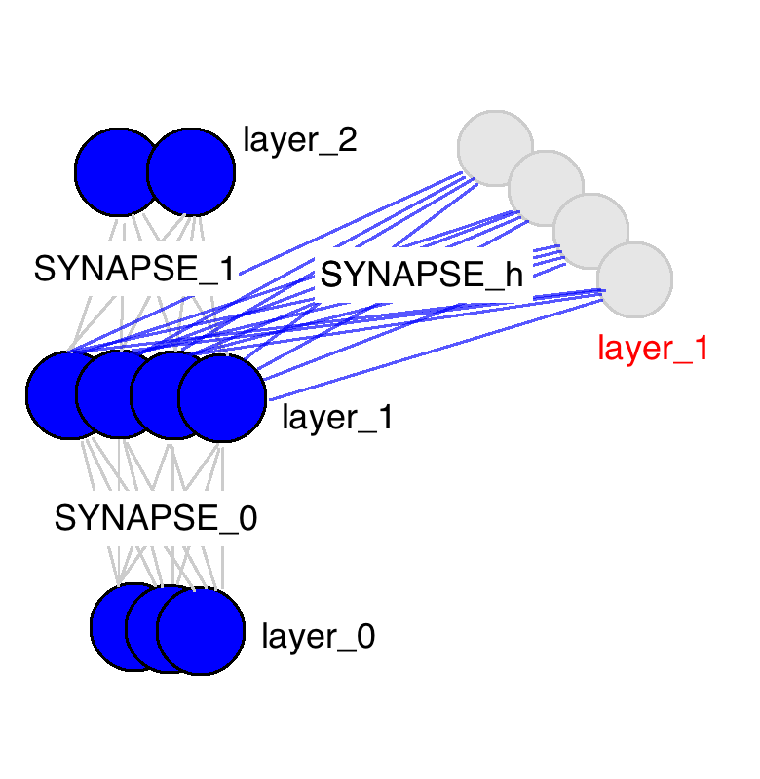
1. About BERT
1.1 RNN
Language Representation

Slide 7
1. About BERT
1.1 RNN
RNN Fowarding

Slide 8
1. About BERT
1.1 RNN
RNN Backpropogation

Slide 9
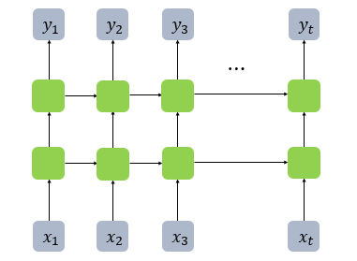
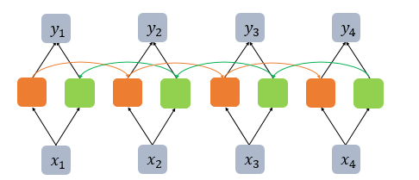
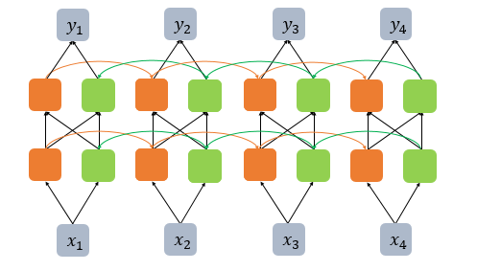
1. About BERT
1.1 RNN
Deep RNN
Bidirectional RNN
Bidirectional Deep RNN

Slide 10
1. About BERT
1.1 RNN
Slow
Gradient Vanishing
병렬처리를 못하기 때문에
속도가 매우 느림
길이가 긴 sequence를
처리하기 힘듬

Slide 11
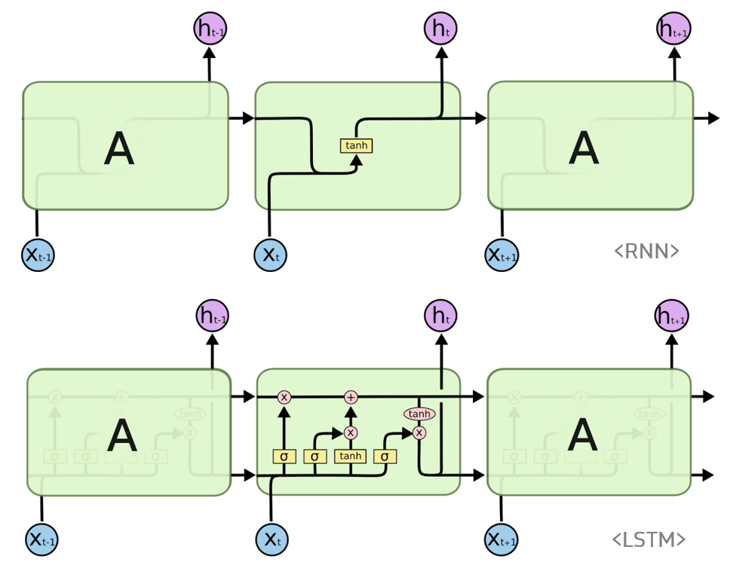
1. About BERT
1.2 LSTM

Slide 12
1. About BERT
1.2 LSTM
병렬처리의 문제를 해결하지 못함

Slide 13
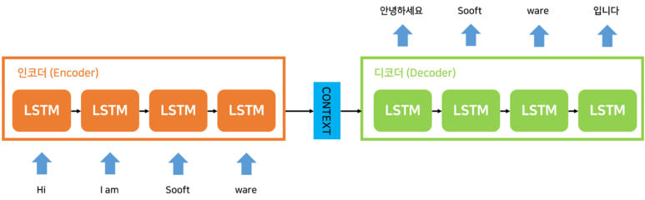
1. About BERT
1.3 seq2seq

Slide 14
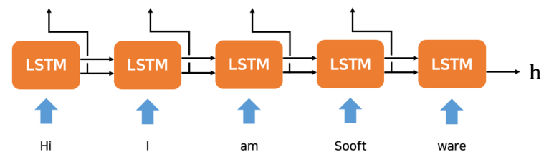
1. About BERT
1.3 seq2seq
Encoder
고정 길이 벡터

Slide 15
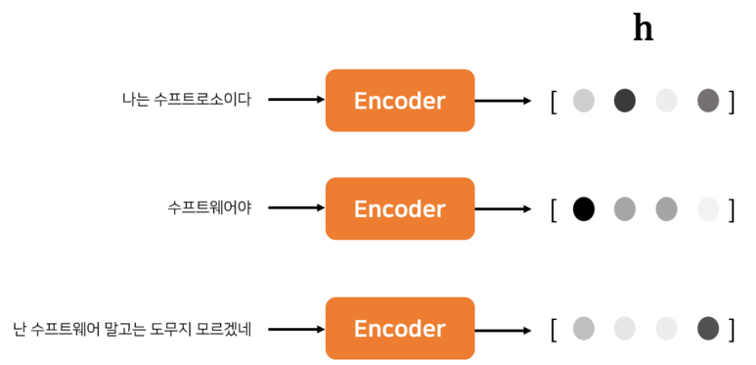
1. About BERT
1.3 seq2seq

Slide 16
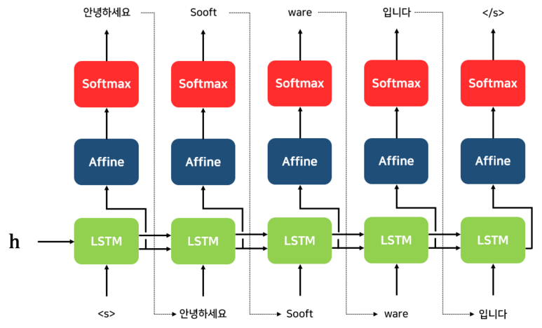
1. About BERT
1.3 seq2seq
Decoder

Slide 17
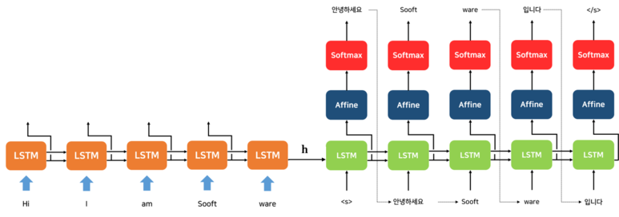
1. About BERT
1.3 seq2seq

Slide 18
1. About BERT
1.3 seq2seq
여전히 long sequence에 대해 낮은 성능을 보임

Slide 19
1. About BERT
1.4 seq2seq
hidden state들이 사용되지 않음

Slide 20
2. Clustering Embedding Vectors

Slide 21



Thankyou

