Slide 1
Introduction to Deep Learning

Slide 2
Background
  Prevalence of Deep Learning
  Machine Learning and Deep Learning
Introduction to Machine learning
  What can Machine learning do for us
  Paradigm of the Machine Learning
  Objective Function and Gradient Descent
Introduction to Deep Learning
  Why we move from traditional ML approaches to DL
  Prerequisite to DL
  Popular framework for DL
  Successful applications of DL (including AlphaGo!)

Slide 3
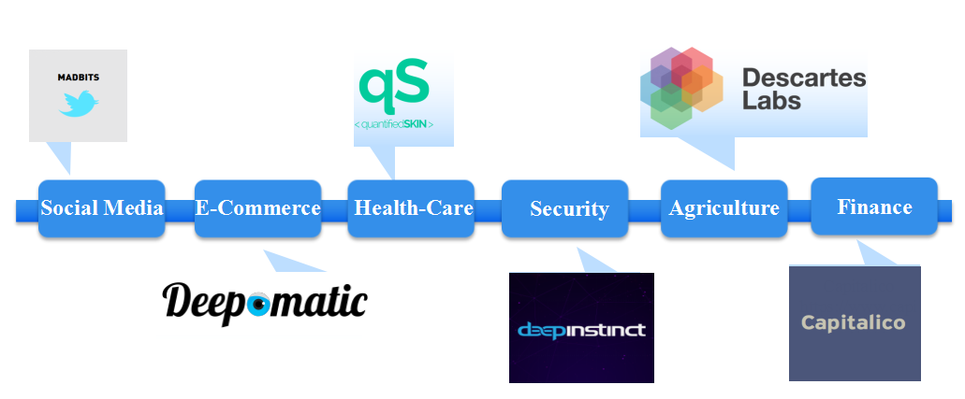


Prevalence of Deep Learning

Slide 4
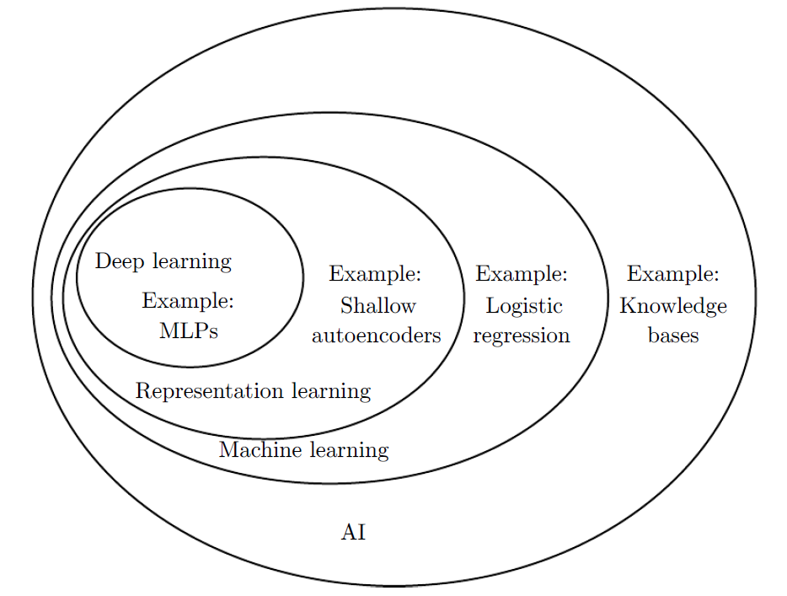
Deep Learning is a Kind of Machine Learning
from http://www.deeplearningbook.org/

Slide 5
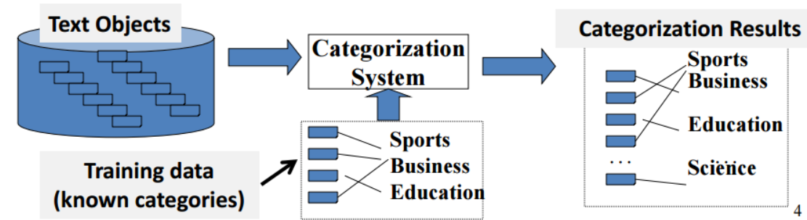
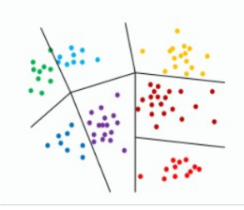
Introduction to Machine Learning
Supervised {(x1,y1)(x2,y2)......(xn,yn) }
- classification tasks, e.g. sentiment analysis
- regression tasks, e.g. predicting prices of stocks
Unsupervised {x1,x2,......,xn}
- e.g. Clustering algorithms

Slide 6
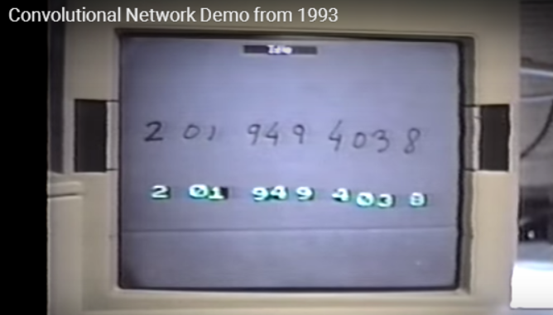
An Example Classification Task
https://devblogs.nvidia.com/parallelforall/deep-learning-nutshell-history-training/

Slide 7
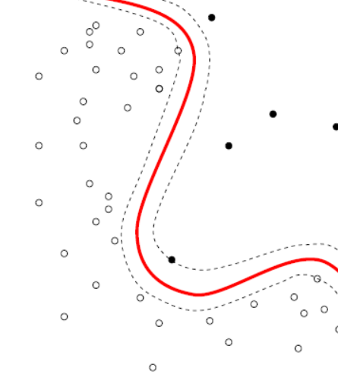
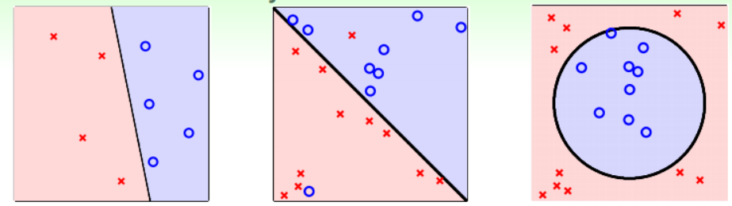
Basic Steps in Classification
Step 1: Representation Learning
Step 2: Classifier Training, which can be modelled as an optimization problem
from https://class.coursera.org/ntumlone-003/lecture

Slide 8
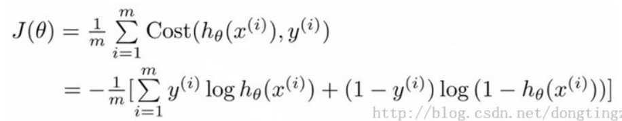





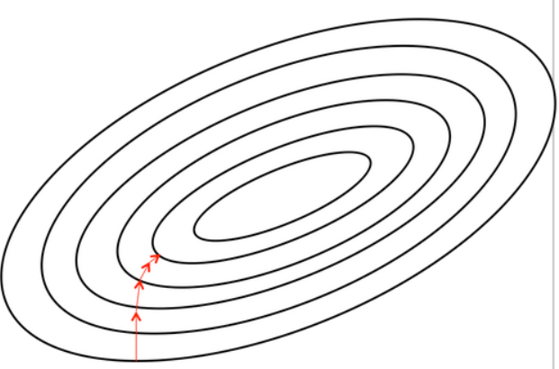
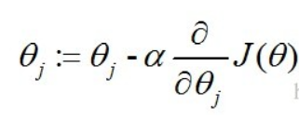
Objective function and Gradient Descent
Take logistic regression for example
Min.

Slide 9
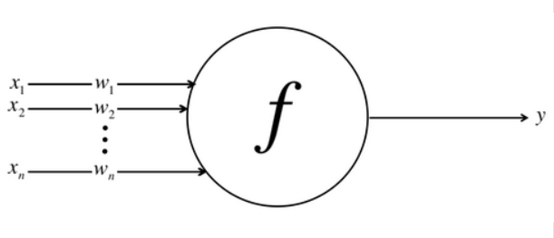
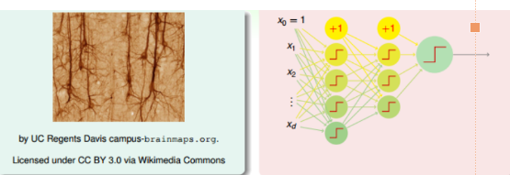
Introduction to Deep Learning
DL can be viewed as Deep Neural Networks
Neural Networks (inner product+f)

Slide 10
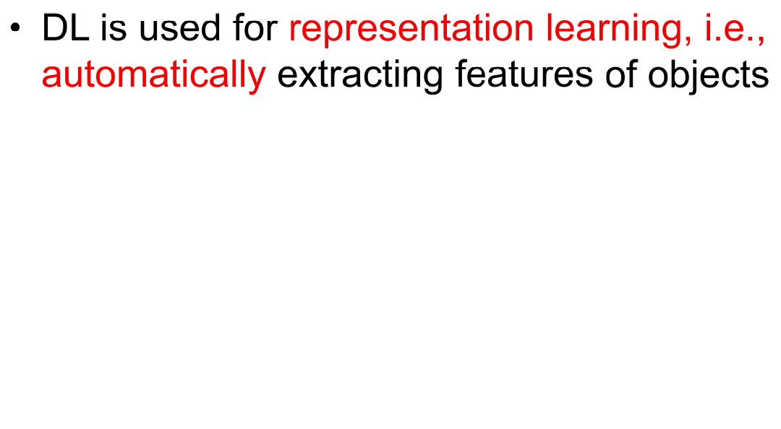
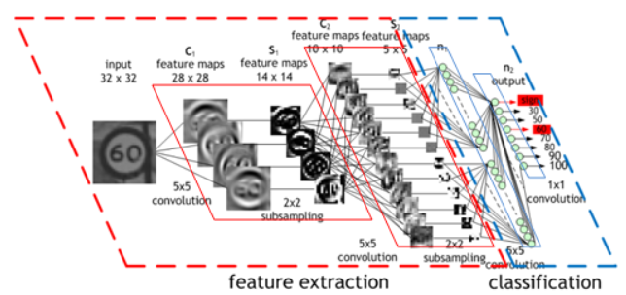
Introduction to Deep Learning

Slide 11
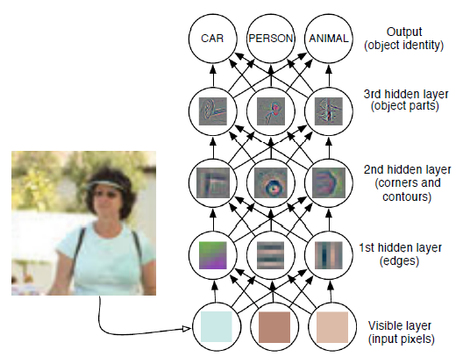
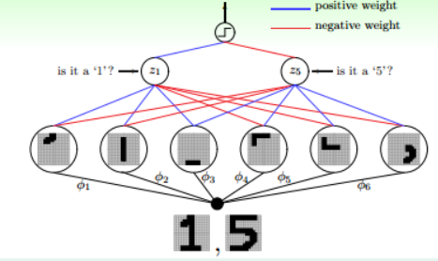
Introduction to Deep Learning

Slide 12
Introduction to Deep Learning
Deep learning is a particular kind of machine learning that achieves great power and flexibility by learning to represent the world as a nested hierarchy of concepts and representations, with each concept defined in relation to simpler concepts, and more abstract representations computed in terms of less abstract ones.

Slide 13
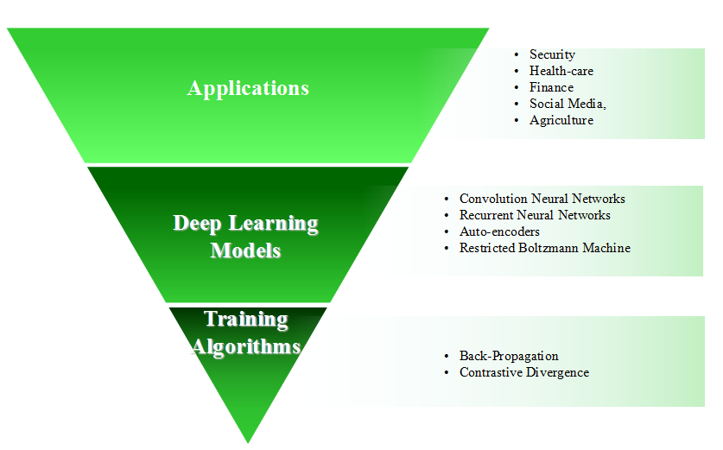
Prerequisites to DL
Math: Knowing how to take derivatives is enough
Model Design: It is better to know some basic concepts about machine learning and optimization problems
Model Training: A good GPU( 100× faster ！ )

Slide 14
Existing frameworks of DL
Theano
TensorFlow
Keras (Minimalism)
SINGA (Distributed framework)

Slide 15
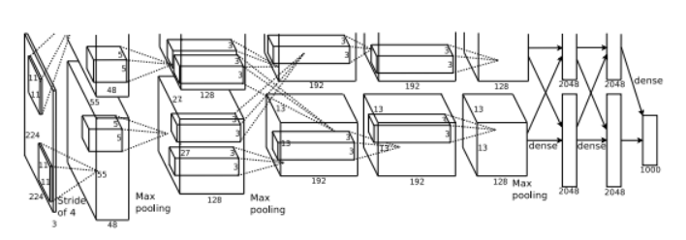
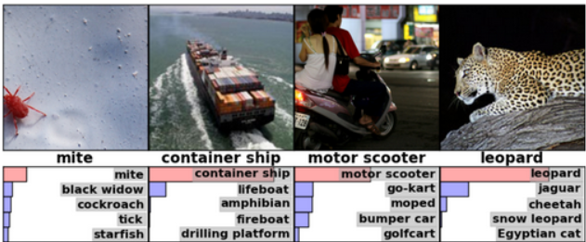
DL in Computer Vision
ImageNet Classification with Deep Convolutional Neural Networks
from http://120.52.72.48/www.cs.toronto.edu/c3pr90ntcsf0/~fritz/absps/imagenet.pdf

Slide 16
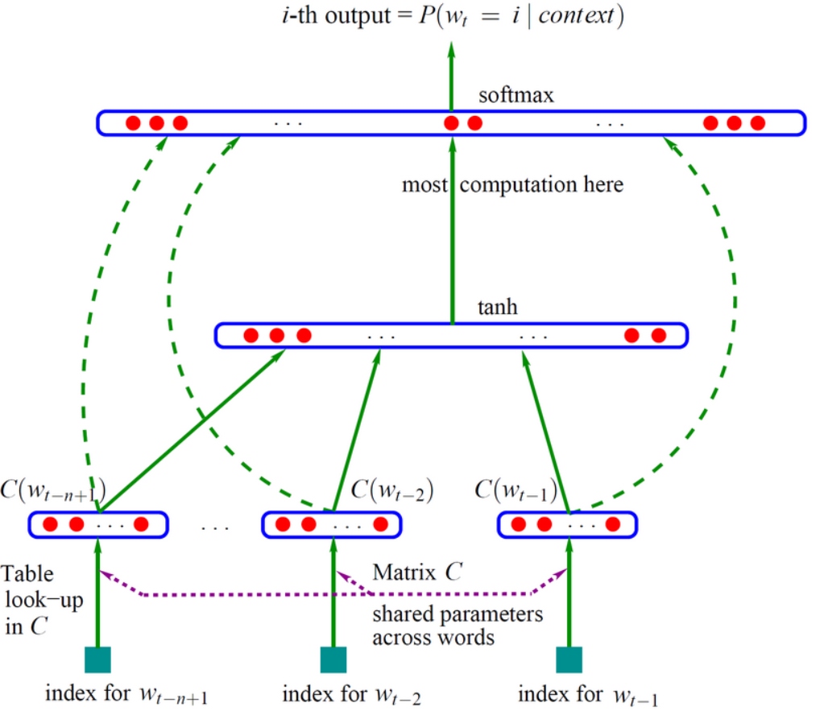
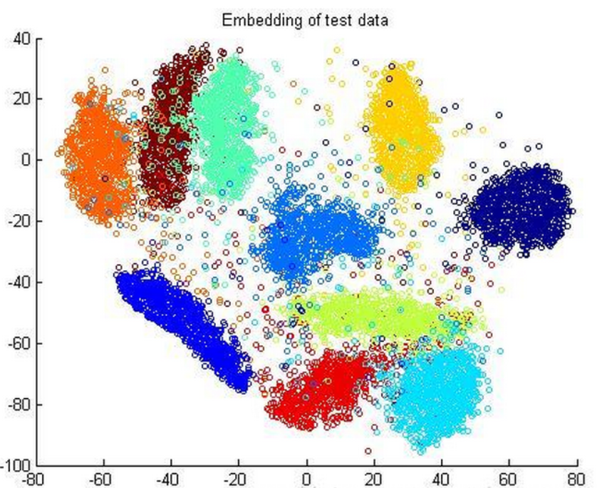
DL in Natural Language Processing
Word Embedding

Slide 17

AlphaGo
Supervised learning policy network (CNN)
Reinforcement learning policy network (self-play + SGD)
Value network (CNN, again!)

