Slide 1
Deep Learning models for sentiment classification

Slide 2
Task Definition: What's the sentiment classification
Extracting people's sentiment tendencies through raw texts
Input: raw texts (e.g. movie reviews)
Output: sentiment labels (e.g. positive or negative)
Sentiment classification can be viewed as a special text categorization problems. The way of handling sentiment classification problems is similar with text categorization

Slide 3
Models for sentiment analysis
Traditional machine learning methods: human-designed features + classifiers (e.g. BOW features + logistic regression) [sida wang, 2012]
Deep learning methods: extracting features automatically (e.g. convolutional neural network, recursive neural network), achieving state of the art results.

Slide 4
Traditional machine learning methods
Features + Classifiers
Usually features are more important than classifiers. the quality of features is crucial for the performance
Different classifiers perform similar with one another.
One of the most fundamental features for texts is BOW (bag-of-words)
Weakness: sparsity

Slide 5
Texts features
Word n-grams
POS tag n-grams
Word classes
Parse tree
etc......
The choice of text features requires domain knowledge, which is labour intensive.

Slide 6
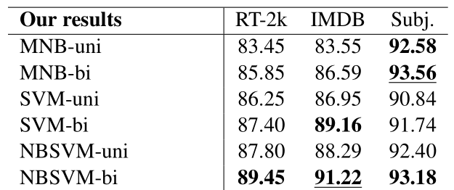
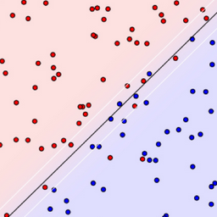
A simple but effective method: NBSVM
Text features: uni-gram, bi-gram, tri-gram with weighting scheme
classifier: SVM or LR (remember yet? Drawing a line!)
Notes:
Baselines and Bigrams Simple Good Sentiment and Topic Classiﬁcation

Slide 7
Deep learning methods
Deep learning methods are known for their automatic feature extracting abilities.
Instead of obtaining text features by human-labour, deep leaning methods use neural networks to extract features automatically.
They overcome the weakness of BOW representations to some extent and are reported to generalize better. [Tomas Mikolov, 2014]
The fundamental blocks for deep learning approaches is word embedding.

Slide 8
Deep learning methods
In summary, deep learning on sentiment analysis has the following dinstinct features:
(1) dense representation. Both words and texts are represented by low-dimensional real vectors. We do not know what each feature exactly represents.
(2) automatic feature extraction. Without requirement of prior knowledge and human-designed features.
(3) deep? In most cases, the answer is no! neural network on NLP is usually shallow, though some researches argue that deep models can bring improvements in some situations. [Mohit Iyyer, 2015]

Slide 9
Word embedding
embedding syntactic and semantic information of words into low-dimensional vectors (usually from 50 to 500)
words that share similar meanings have close vectors
word embeddings are initialized randomly, and are trained by modling the relationships between target words and their contexts (e.g. word2vec) [Tomas Mikolov, 2013]
neural networks can not handle high-dimensional inputs, and most of the deep learning methods for natural language processing are constructed upon word embeddings [Yoav Goldberg, 2015]
Notes:
Efﬁcient Estimation of Word Representations in Vector Space

Slide 10
Compositionalities: from word embedding to text embedding
Natural language is designed for human communication. It is very hard for computer to understand it.
Understand human language for computer is one of the most difficult challenges in AI.
Generating text embedding from word embedding is a big challenge.
commonly used models: Recursive neural networks, Convolutional neural networks, Paragraph Vector, etc.

Slide 11
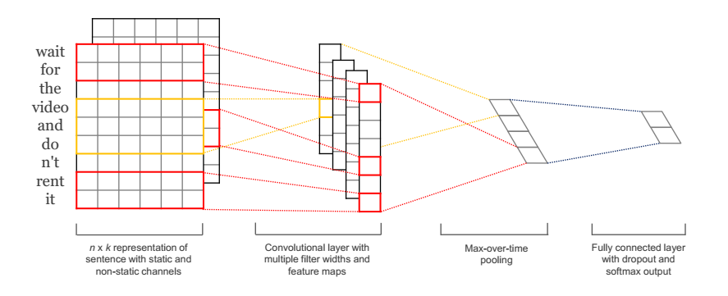
Convolutional neural networks
Convolutional layer: extracting n-gram features [Yoon Kim, 2014]
Max pooling layer: selecting most salient features
state of the art results on sentence-level classification
Notes:
onvolutional neural networks for sentence classification

Slide 12
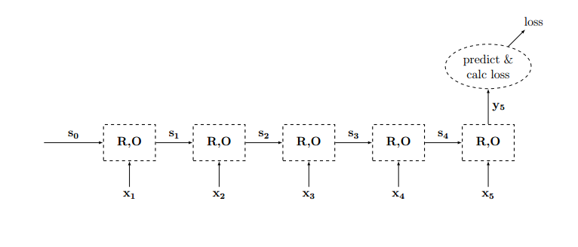
Recurrent neural networks
Hidden layers can in theory store all history information
The last hidden layer stores the entire text information
One of the most active research areas. Achieving state-of-the-art on a range of NLP tasks [Andrew Dai, 2015]
Notes:
Semi-supervised Sequence Learning

Slide 13
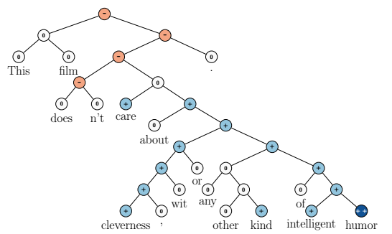
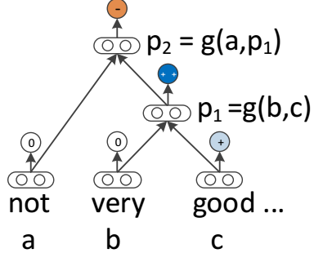
Recursive neural networks[Richard Socher, 2013]
Constructing neural networks upon parse trees
Making full use of syntactic information of the texts
can generate fine-grained labels for texts
state of the art results on sentence-level texts
Notes:
Semantic Compositionality through Recursive Matrix-Vector Spaces

Slide 14
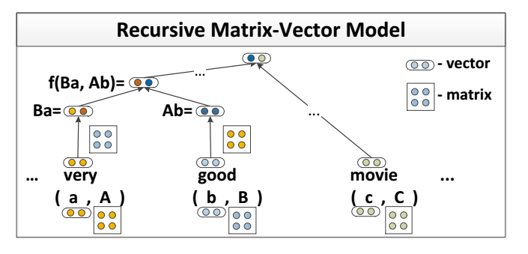
Recursive neural networks
An example of RecNN: Recursive matrix-vector model

Slide 15
Tree structure vs. flat structure
RecNNs build neural networks upon tree structures, where texts are modeling hierarchilly
ConNNs and RNNs employ flat structures. Flat models are more efficient. Usually, flat structure models are good enough for texts modeling.
Detailed comparsions in [Jiwei Li, 2015]
Notes:
When are tree structures necessary for deep learning of representations?

Slide 16
Combination of neural networks
Modling texts hierarchically. From words to sentence and from sentences to document(e.g. using RecNN extract sentence features from word features and using RNN extract document features form sentence features)
Hierarchical models can not only model word order, syntactic information, but also take the relationships between sentences into consideration
Hierarchical models are specially designed for document-level texts

Slide 17
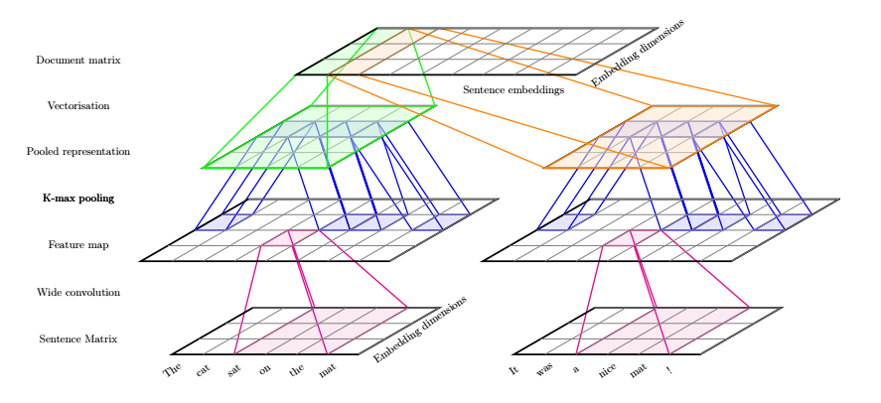
Combination of neural networks
The framework of DCNN (CNN-CNN)
CNN is used for both word-sentence layer and sentence-document layer [Misha Denil, 2014]
Notes:
Modelling, Visualising and Summarising Documents with a Single Convolutional Neural Network

Slide 18
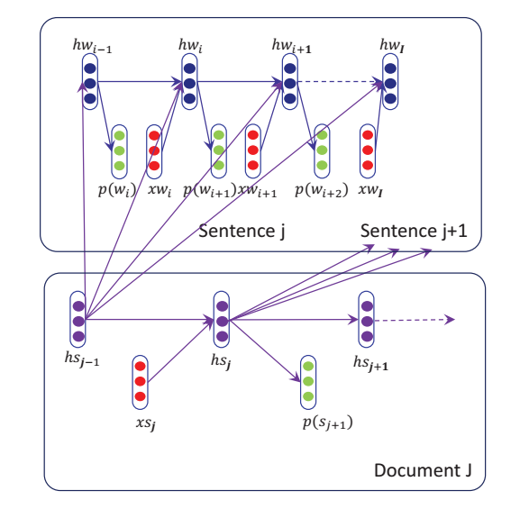
Combination of neural networks
The framework of RNN-RNN
RNN is used for both word-sentence layer and sentence-document layer [Rui Lin, 2015]
Notes:
Hierarchical Recurrent Neural Network for Document Modeling

Slide 19
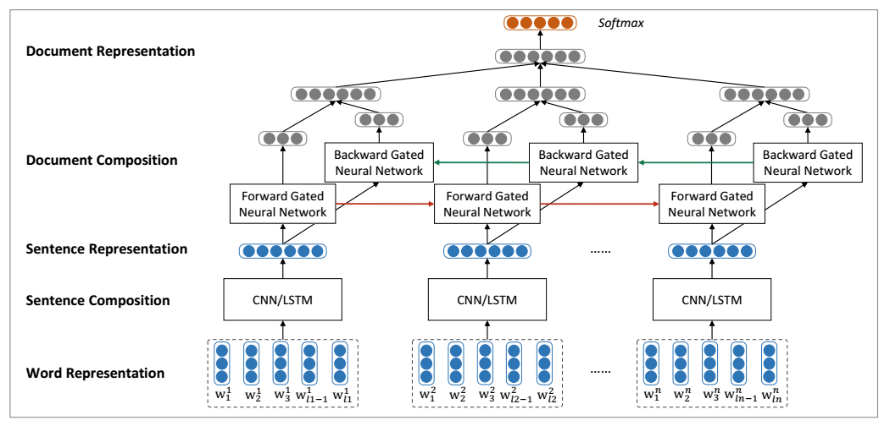
Combination of neural networks
The framework of LSTM-LSTM [Duyu Tang, 2015]
Notes:
Document Modeling with Gated Recurrent Neural Network for Sentiment Classiﬁcation

Slide 20
Neural bag-of-words models
Sentiment classifcation does not require very delicate analysis of texts, sometimes even a word can decide the sentiment tendency of the whole texts
Neural bag-of-words models leverage average compositionality upon word embeddings (e.g. PV, DAN)
Word order is totally igored by these models. That is the reason why these models are called neural Bag-of-words models

Slide 21
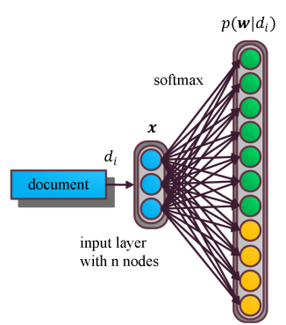
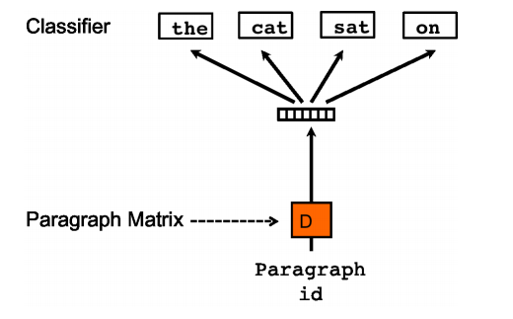
Paragraph Vector [Quoc Le, 2014]
Text embeddings are trained to be useful to predict the words in the texts
The models can be extended to predict N-grams, where order information are taken into consideration
Notes:
Distributed Representations of Sentences and Documents

Slide 22
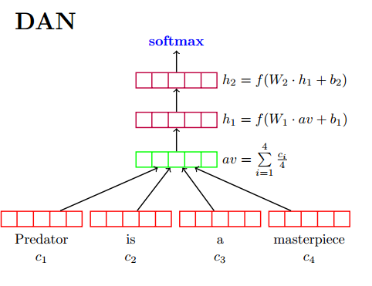
Deep Average Network [Mohit Iyyer, 2015]
Applying multi nerual layers upon average of word embeddings
Deep architectures can reflect slight difference between texts.
Notes:
Deep Unordered Composition Rivals Syntactic Methods for Text Classiﬁcation

Slide 23
Conclusion
The performance of the models are largely depend on texts representations
Traditional BOW representations are simple but effective
State of the art results on sentiment classification is achieved by deep learning methods
Neural bag-of-words models are efficient and at the same time can achieve state-of-the-art results on sentiment classification

Slide 24
Reference
A Primer on Neural Network Models for Natural Language Processing [Yoav Goldberg, 2015]
Deep Unordered Composition Rivals Syntactic Methods for Text Classiﬁcation [Mohit Iyyer, 2015]
Document Modeling with Gated Recurrent Neural Network for Sentiment Classiﬁcation [Duyu Tang, 2015]
Semantic Compositionality through Recursive Matrix-Vector Spaces [Richard Socher, 2013]
Distributed Representations of Sentences and Documents [Quoc Le, 2014]
Baselines and Bigrams Simple Good Sentiment and Topic Classiﬁcation [Sida Wang, 2012]
Efﬁcient Estimation of Word Representations in Vector Space [Tomas Mikolov, 2013]
Semi-supervised Sequence Learning [Andrew Dai, 2015]
Convolutional neural networks for sentence classification [Yoon Kim, 2014]
Hierarchical Recurrent Neural Network for Document Modeling [Rui Lin, 2015]
Modelling, Visualising and Summarising Documents with a Single Convolutional Neural Network [Misha Denil, 2014]
When are tree structures necessary for deep learning of representations? [Jiwei Li, 2015]

