Slide 1
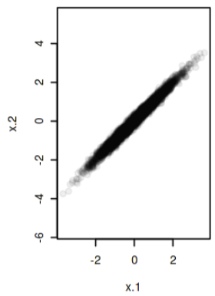
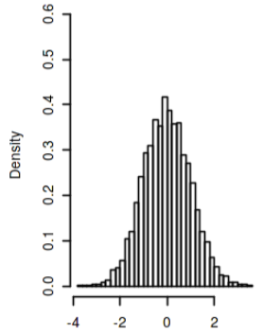
x1, x2 are highly correlated:
MSE₁, MSE₂, .. MSE_{n} are highly correlated:
x1 | x2
1.5 | 2.1
0.7 | 0.5
-1 | -1.3
-2 .. | -1.8 ..
MSE₁ | MSE₂ | MSE₃ | …. | MSE_{n}
1.3 | 0.8 | 1.2 |  | 1.6
-1.9 | -2 | -1.85 |  | -1.5
0.2 | 0.1 | 0.11 |  | 0.3
1.8 … | 1.2 … | 1.4 … |  | 1.9 …
Training set for LOOCV:
Whole Data set
Training set to get MSE₁
MSE__{j}
Training set to get MSE₂
Training set to get MSE₃
MSE__{i}
Mean of MSE₁, MSE₂… =
estimate of test MSE(CV_{n}), and its density:
Training set to get MSE₄
Mean of x1, x2, and its density:
Mean of MSE = error
Training set to get MSE_{n}
the mean of many highly correlated quantities has higher variance
Observations in each training set are almost identical => MSE₁, MSE₂, .. MSE_{n} are highly (positively) correlated !
5_variance_of_correlated_quantities_Kaggle.pdf
5_variance_of_correlated_quantities.irnb

