Slide 1
Dialogue systems as a smart banking conversational service
Do Dung Vu
vudodung85@gmail.com
https://dungdovu.github.io/portfolio/
+1 514 813 6660
Montreal, Quebec, Canada

Slide 2
Content
Introduction
Challenges
Motivations
Objectives
Methodologies
Strategies and Plan
Conclusion

Slide 3
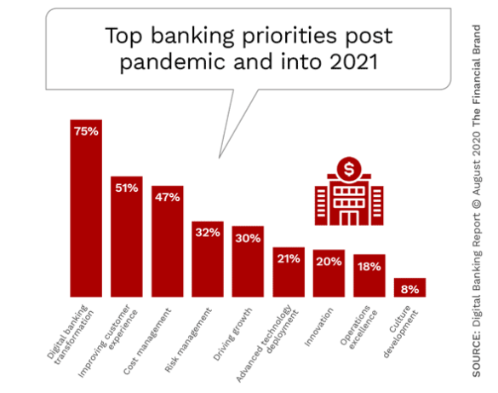
Introduction

Slide 4
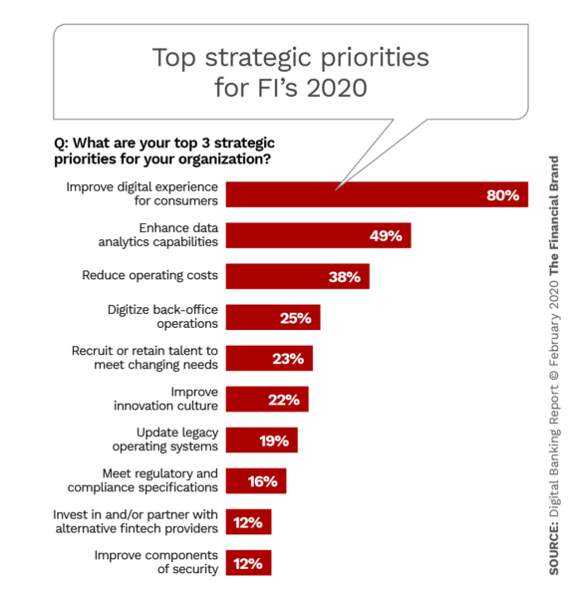
Introduction

Slide 5
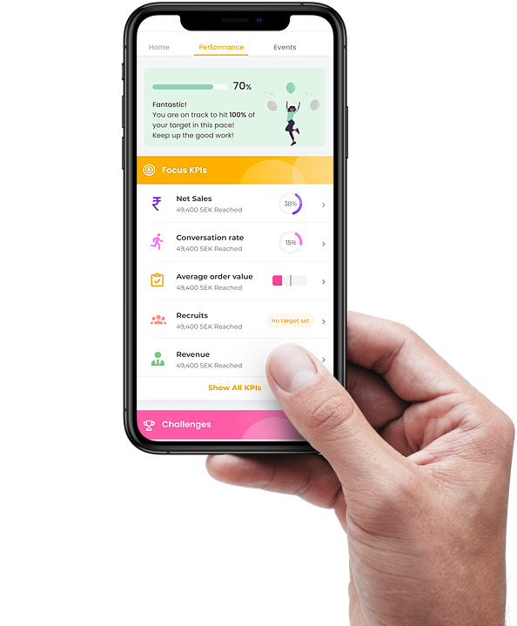
Introduction
Banking sector has undergone a massive transformation of its services from e-banking to smart banking
A smart banking conversational service is grounded in a smart dialogue system which includes the components of recognizing, analyzing, generating and recommending based on users’ interactions
Smart banking conversational service is powered by a context-aware knowledge based to provide smart services, which are capable of actively adapting and responding based on the circumstance of interests and user contexts

Slide 6

Challenges
Campaign Bots
+ Helping the application process: loan, credit, debit, etc.,
+ AI/NLP takes customer through the process to the approval in a single conversation
+ In-bound request and out-bound request for loyalty programs
+ Up-selling, cross-selling, and building loyalty for different products and services
+ AI/NLP targets to the campaign and collect late payment, feedback, or alert fraud activity
Application Bots
Customer Service Bots
+ Managing the detail of users’ account: authentication, business tasks, transfer, etc.,
+ Handling FAQ, tracking service, fetching documents, or other information
+ AI/NLP helps customers manage their account in a single frictionless conversation
Compliance Bots
+ Fraud detections, money laundering risks, etc.,
+ AI/NLP prevents and detects risks or compliance failure, at a lower cost
^{https://servisbot.com}

Slide 7
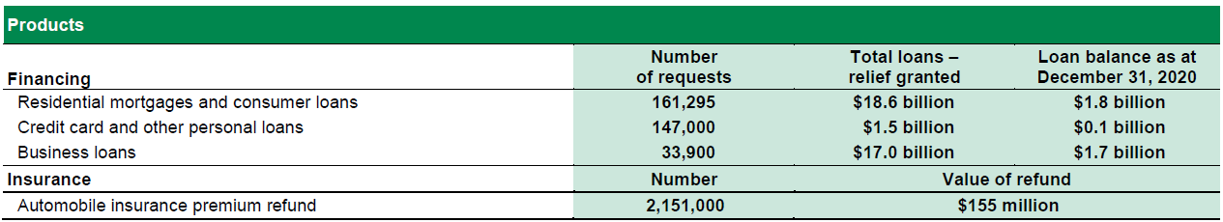
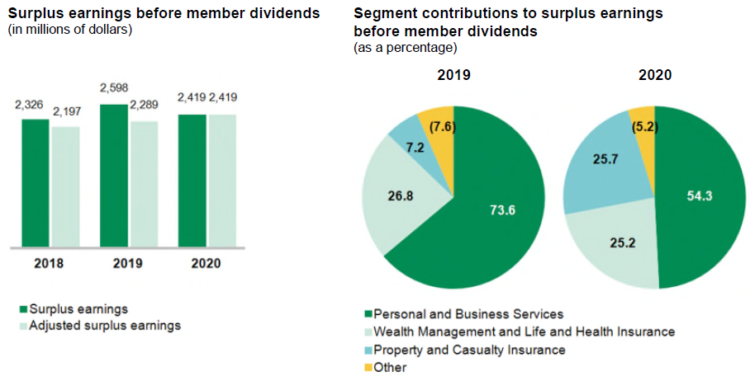
Motivations
Source: https://www.desjardins.com/ca/about-us/investor-relations/desjardins-group-annual-report/index.jsp

Slide 8
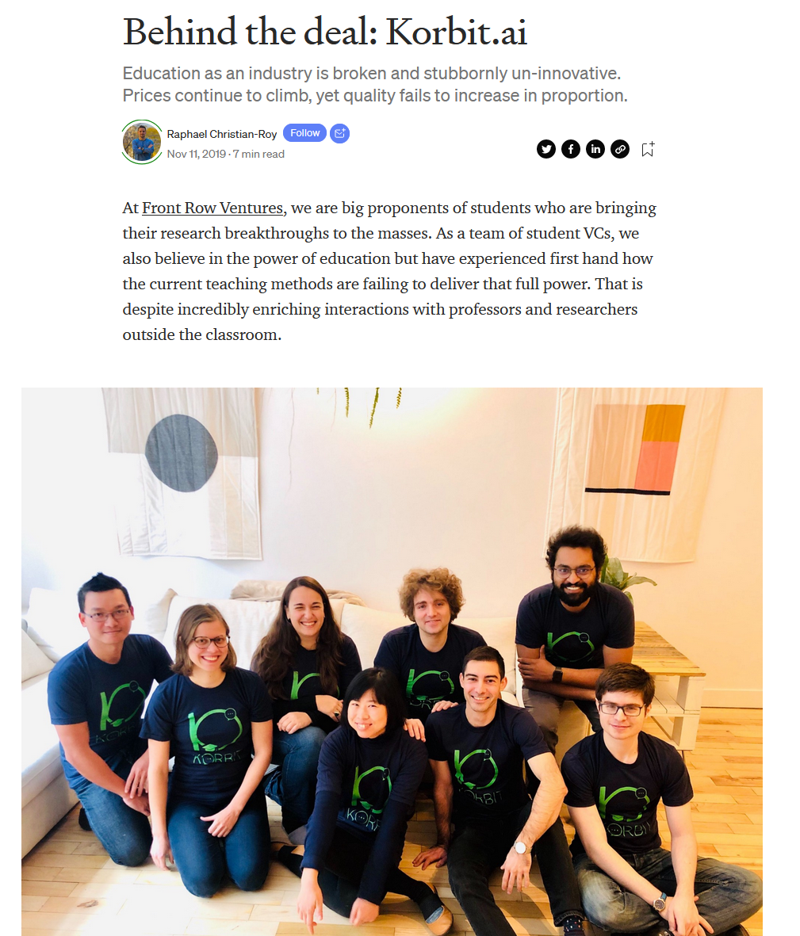
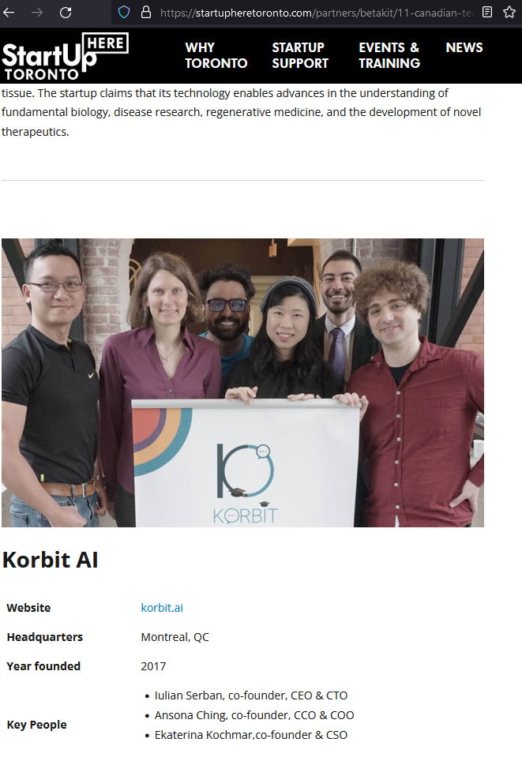
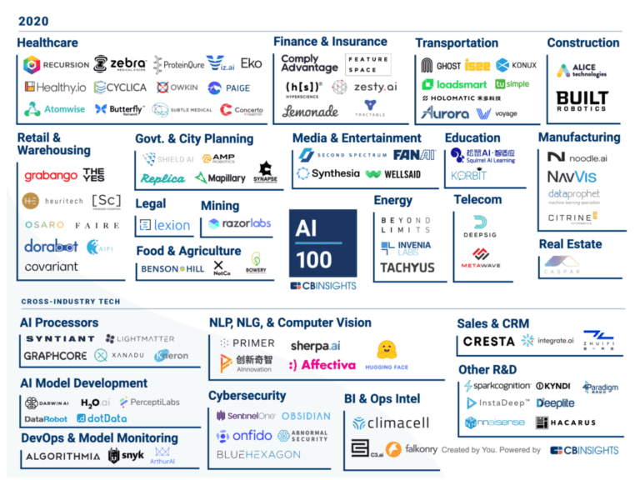
Motivations
My Ph. D thesis: Natural Language Generation in Intelligent Tutoring System
Work as ML Researcher at Korbit.ai & ETS university in 3 years under Mitacs grant

Slide 9
Motivations
Trends of Bank
Generation Z is too value
Social media storytelling
Customer data platform
Artificial Intelligent
The demand for self-service
Source: https://www.phase2technology.com/

Slide 10
Motivations
In the case of Canadian banking systems, the conversation can include both asking for information and solve some relevant problems to satisfy certain user’s requirements in both French and English.
Most of the companies in the digital age are confronted with both the online and offline world [22] to improve the competitions.
Consequently, multi-channel management and customer experience have become the main differentiation and have turned into a management priority [23].
Customer journey management takes a customer perspective and at gaining a better understanding of customer experience is emerging in retail banking [24].
➔ Therefore, it is indispensable to conciliate the dialogue system with the customer knowledge management system.

Slide 11
Objectives
A framework for smart banking conversational services

Slide 12
Smart Dialogue System
Multiple Languages (French & English)
Recognize the elements of users’ questions
Determine and process the relationships of these elements
Query the knowledge base
Generate and show the response to users
Natural Language Processing (NLP)
Dialogue Management (DM)

Slide 13
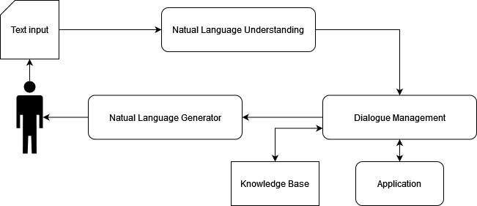
System architecture
NLP
Natural Language Understanding (NLU): converts the raw user message into semantic slots, tighter with classification of domain and user intentions with deep learning methods[1][2][3]
Dialogue Management (DM): contains Dialogue State Tracking (DST) and Policy Learning (DPL) where DST iteratively calibrates the states based on current input and history, DPL decides next actions by using supervised and reinforcement learning methods [4][5]
Knowledge Base (KB): contains the ontology of content, context management, knowledge management, and data management
Natural Language Generator (NLG): convert the selected dialogue actions into surface-level natural language, which is usually ultimate form of response with deep learning methods [6]
Application: the add-in to help admin, consultant, and expert to work with system

Slide 14
Methodologies
Develop and measure artefacts of the smart dialogue systems in smart banking conversational service with DSRP (Design Science Research Process)
Problem Identification & Motivation
Objectives of a solution
Design & Development
Demonstration
Evaluation
Communication
Problem centered approach
Objective centered solution
Design & Development centered approach
Observing a solution
Ken Peffers and Tuure Tuunanen and Marcus A. Rothenberger and Samir Chatterjee
“A design science research methodology for information systems research,”
Journal of Management Information Systems, vol. 24, 3, pp. 45–77, Dec. 2007.

Slide 15
Methodologies
Problem Identification & Motivation: Literature review will be performed with relevance topics: Dialogue system for finance and bank, Natural Language generation models, Chatbot, Question taxonomies. Data analysis will also need to be conducted to clarify the problem
Objectives of a solution: Create the system architecture which is inferred rationally from the problem banking conversation specification
Design & Development: Create the artifacts such are potentially constructs, models, methods
NLU: The NLU module manages three tasks: Domain Classification, Intent Detection, and Slot Filling based on Deep learning methods [7], Restricted Boltzmann Machine and Deep Belief Network [8], RNN [9], CNN [10], BERT [11], LSTM [12]
NLG: The NLG modules contains: Content Determination, Ordering and Structuring, Sentence Planning, and Surface Realisation based on LSTM [13], [14], or by jointing control of semantic correctness and language style [14]. To avoid the mistakes such as slot value missing or redundancy, Iterative Rectification Network (IRN) is applied [15]
DM: DM contains: Dialogue State Tracking by using user message to track the state [16][17] based on (Bidirectional Encoder Representations from Transformers ) BERT for slot valued prediction. Dialogue Policy Learning in [18][19] is based on supervised learning and reinforcemance learning.

Slide 16
Methodologies
Demonstration: Experimentation, simulation, case study, proof, and testing, and feedback analysis
Evaluation: Comparing the objectives of a solution to actual observed results from use of the artifacts in the demonstration or pilot campaign. Analysis the quantifiable measure of system performance, accuracy with relevance metrics and analysis techniques.
Communication: Research publications with problem definition, literature review, hypothesis, data, analysis, result, discussion, and conclusion. Moreover, the technical and transformation documents are required.

Slide 17



Research Team
Do Dung Vu
Ph.D. Candidate at ETS
5y+ experienced AI & ML application Research and Development
2y+ B2B Project Manager & Coordinator at Korbit.ai, Canada
2y Big Data Analysis at Dankook University, Korea
1y+ Civil Infrastructure Platform Project Leader at Renesas Inc, Vietnam
2y+ Information Technology Internal Audit leader at Tien Phong Bank, Vietnam
Thang LE DINH, Ph.D., PMP
Professeur agrégé en systèmes d'information
Département Marketing et systèmes d'information
Coresponsable du PC de 2e en marketing numérique Codirecteur du LARIDEPED (larideped.org)
Université du Québec à Trois-Rivières, Canada
VU-Thi My Hang, Ph. D
Ph.D Computer Science, University
Grenoble Alpes, France
7y+ Lecturer-Researcher, University of Sciences, Ho Chi Minh City, Vietnam

Slide 18
Strategies and Plan
Publish papers and Transform Technologies
Proposal
Mitacs Fund
Integrate Modules
Improve and Upgrade System
Feb, 2022
Oct, 2022
Before December 2021
Jan 2022
Sept, 2022
Experiment
December 2023
R&D

Slide 19
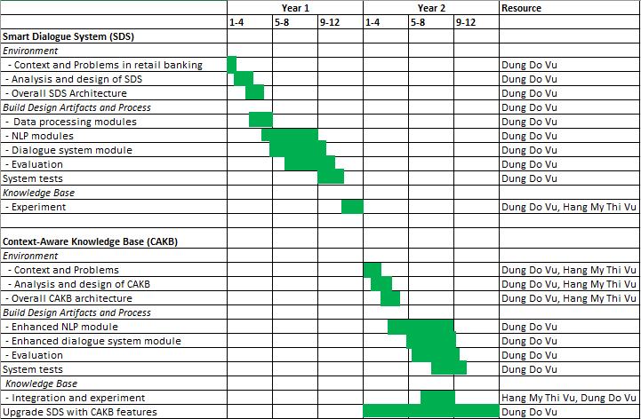
Strategies and Plan

Slide 20
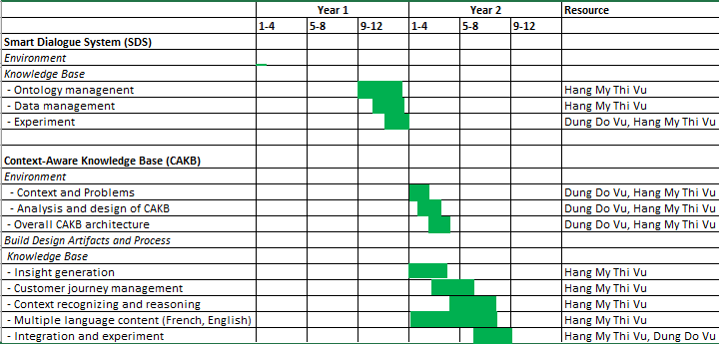
Strategies and Plan

Slide 21
Expected deliverables
A literature review report about dialogue systems for the retail banking business
A literature review report about customer knowledge management in the finance and banking business
A framework for the Smart banking dialogue system with its’ components
A system architecture proposal for smart banking conversational services
A software prototype for the smart banking conversational service
A report on the evaluation of the framework qualitatively
A report on the evaluation of the framework quantitatively with regards to user tests
Peer-reviewed conference or journal publications.
A workshop about smart banking conversational services for Desjardins

Slide 22
Project Risk Analysis
 |  | Consequence
 |  | negligible | minor | moderate | major | catastrophic
Likelihood | almost certain | Internal training | Pattern | Resource | Pandemic | Funding
 | likely | Economic | Infrastructure | Marketing | Maintain | Management
 | possible | Public Relation | Security | Technology | Habit | Scale up
 | unlikely | Capability | Operation | Policy | Retention | Data
 | rare | Research | Volume | Procurement | Design | Development
Low risk
Medium risk
High risk
Fatal risk

Slide 23
Reference
[1] Li X, Chen YN, Li L, Gao J, Celikyilmaz A (2017b) End-to-end task-completion neural dialogue systems. arXiv preprint arXiv:170301008
[2] Deng L, Tur G, He X, Hakkani-Tur D (2012) Use of kernel deep convex networks and end-toend learning for spoken language understanding. In: 2012 IEEE Spoken Language Technology Workshop (SLT), IEEE, pp 210–215
[3] Tur G, Deng L, Hakkani-Tür D, He X (2012) Towards deeper understanding: Deep convex networks for semantic utterance classification. In: 2012 IEEE international conference on acoustics, speech and signal processing (ICASSP), IEEE, pp 5045–5048
[4] Henderson M (2015) Machine learning for dialog state tracking: A review. In: Proceedings of The First International Workshop on Machine Learning in Spoken Language Processing
[5] Chen H, Liu X, Yin D, Tang J (2017a) A survey on dialogue systems: Recent advances and new frontiers. Acm Sigkdd Explorations Newsletter 19(2):25–35
[6] Wen TH, Gasic M, Kim D, Mrksic N, Su PH, Vandyke D, Young S (2015a) Stochastic language generation in dialogue using recurrent neural networks with convolutional sentence reranking. arXiv preprint arXiv:150801755
[7] Yann D, Tur G, Hakkani-Tur D, Heck L (2014) Zero-shot learning and clustering for semantic utterance classification using deep learning. In: International Conference on Learning Represe
[8] Sarikaya R, Hinton GE, Deoras A (2014) Application of deep belief networks for natural language understanding. IEEE/ACM Transactions on Audio, Speech, and Language Processing 22(4):778– 784
[9] Ravuri S, Stolcke A (2015) Recurrent neural network and lstm models for lexical utterance classification. In: Sixteenth Annual Conference of the International Speech Communication Association
[10] Hashemi HB, Asiaee A, Kraft R (2016) Query intent detection using convolutional neural networks. In: International Conference on Web Search and Data Mining, Workshop on Query Understanding
[11] Wu CS, Hoi S, Socher R, Xiong C (2020a) Tod-bert: Pre-trained natural language understanding for task-oriented dialogues. arXiv preprint arXiv:200406871
[12] Yao K, Peng B, Zhang Y, Yu D, Zweig G, Shi Y (2014) Spoken language understanding using long short-term memory neural networks. In: 2014 IEEE Spoken Language Technology Workshop (SLT), IEEE, pp 189–194

Slide 24
Reference
[13] Wen TH, Gasic M, Mrksic N, Rojas-Barahona LM, Su PH, Ultes S, Vandyke D, Young S (2016a) Conditional generation and snapshot learning in neural dialogue systems. arXiv preprint arXiv:160603352
[14] Elder H, O’Connor A, Foster J (2020) How to make neural natural language generation as reliable as templates in task-oriented dialogue. In: Proceedings of the 2020 Conference on Empirical Methods in Natural Language Processing (EMNLP), pp 2877–2888
[15] Li Y, Yao K, Qin L, Che W, Li X, Liu T (2020b) Slot-consistent nlg for task-oriented dialogue systems with iterative rectification network. In: Proceedings of the 58th Annual Meeting of the Association for Computational Linguistics, pp 97–106
[16] Wang Y, Guo Y, Zhu S (2020e) Slot attention with value normalization for multi-domain dialogue state tracking. In: Proceedings of the 2020 Conference on Empirical Methods in Natural Language Processing (EMNLP), pp 3019–3028
[17] Hu J, Yang Y, Chen C, Yu Z, et al. (2020) Sas: Dialogue state tracking via slot attention and slot information sharing. In: Proceedings of the 58th Annual Meeting of the Association for Computational Linguistics, pp 6366–6375
[18] Chen H, Liu X, Yin D, Tang J (2017a) A survey on dialogue systems: Recent advances and new frontiers. Acm Sigkdd Explorations Newsletter 19(2):25–35
[19] Takanobu R, Liang R, Huang M (2020) Multi-agent task-oriented dialog policy learning with roleaware reward decomposition. arXiv preprint arXiv:20040380
[20] Z. Rahman, “Customer experience management — A case study of an Indian bank,” J. Database Mark. Cust. Strateg. Manag., vol. 13, no. 3, pp. 203–221, 2006
[21] K. N. Lemon and P. C. Verhoef, “Understanding Customer Experience Throughout the Customer Journey,” J. Mark., vol. 80, no. 6, pp. 69–96, Nov. 2016.
[22] C. Homburg, D. Jozić, and C. Kuehnl, “Customer experience management: toward implementing an evolving marketing concept,” J. Acad. Mark. Sci., vol. 45, no. 3, pp. 377–401, May 2017.
[23] S. Holmlid and S. Evenson, “Bringing Service Design to Service Sciences, Management and Engineering,” 2008, pp. 341–345.

Slide 25
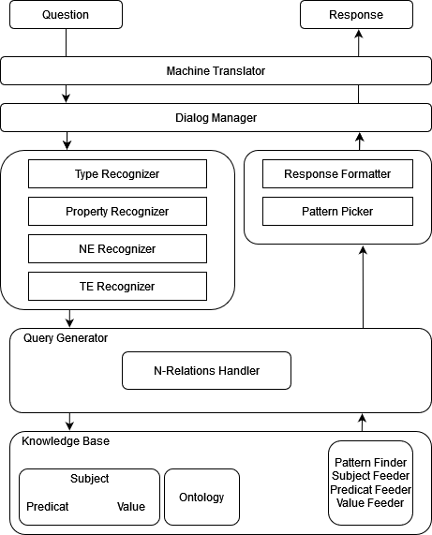
Appendix

Slide 26
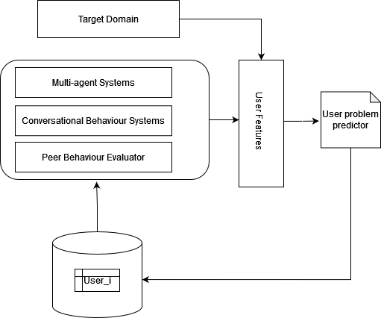
Appendix

