Slide 1

Computational Analysis of USA Swimming Data
Junfu Xu
School of Computer Engineering and Science,
Shanghai University
Notes:
Good morning, everyone. It is my honor to give this talk. My name is Xu Junfu, a student of Shanghai University. I would like to talk about some of my work in the computational [kɒmpjʊ'teɪʃənl] analysis [ə'nælɪsɪs] of USA swimming data.

Slide 2
Outline
Machine Learning
Summary And Outlook
Data Set Description And Representation
Statistical Analysis
Notes:
I will give this talk in four parts, including our data, statistical analysis, and prediction of swimmer’s level performance based on machine learning tools.

Slide 3
Data Set Description
Data source: http://www.usaswimming.org/DesktopDefault.aspx
Swimming athletes: top 5512 male and 2218 female swimmers in 100M FR
Age range : from 10 to 50
Person times: containing 2,762,237 records
……
Notes:
Ok, at first, let me introduce my dataset. Our observational data for swimmers' performance are obtained from the USA Swimming website which is the national governing body for competitive swimming in the United States.
We choose the top 5512 male swimmers and 2218 female swimmers based on their swimming times in their 100 meters (100M) long course meters freestyle by May 3, 2014. The athletes are age from 10 to 50.
So we construct a data set containing about 3 million records of 7730 swimming athletes.

Slide 4
Data Representation
A vector model of record
A sample of USA swimming data set
R = (stroke, cource, age, time, power point)
stroke | course | age | Time (sec.) | Power points
50Y_FR | SCY | 21 | 18.47 | 1049
100Y_FR | SCY | 21 | 41.12 | 1053
100M_FL | LCM | 24 | 53.83 | 926
100M_FR | LCM | 25 | 50.01 | 930
200Y_FR | SCY | 20 | 96.52 | 897
400M_IM | LCM | 18 | 273.69 | 834
800M_FR | LCM | 16 | 520.64 | 750
··· | ··· | ··· | ··· | ···
Four swimming strokes:
freestyle(FR)
butterfly(FL)
backstroke(BK)
breaststroke(BR)
Two course options:
long-course, measured in meters (LCM)
short-course, measured in yards (SCY)
……
Notes:
A vector model is used to describe the records of each data point. This vector has five elements containing swimming stroke [strəʊk], course, age, time, and power point
There are four swimming strokes: freestyle (FR), butterfly (FL), backstroke (BK) and breaststroke (BR) with different distances.
The swimming course includes two options: long-course, measured in meters (LCM) and short-course, measured in yards (SCY).
The time of each performance, which is always measured in seconds.
The power point is a Hy-Tek value that allows for comparison on the quality of performances across strokes, distances and events, as well as between age groups.
A sample of the data set is shown in this table.

Slide 5
Our Work
Variance to analyze the stability of swimmer’s performance
Pearson correlation to estimate how performances at age of 18 may depend on the performance at younger ages
Regression analysis to approximate the performance curve
Making prediction of swimmer’s level of performance based on machine learning tools(ANN and SVM)
Notes:
We perform statistical analysis and machine learning tools to mine and analyze such data. We investigate performance characteristics at different ages in different strokes for both male and female. We use variance to analyze the stability of performance in each stroke at different age; as we all known parents always care about their children’s furtrue performance . So we use Pearson correlation to estimate how performances at age of 18 may depend on the performance at younger ages; we use regression analysis to approximate the performance curve in different groups for different strokes. In addition, we make prediction of swimmer’s performance based on machine learning tools, including support vector machine (SVM) method.

Slide 6
Statistical Analysis
Variance analysis
Pearson correlation coefficient
Regression analysis
Notes:
Time is limited, I will go through [over] the next three points very briefly. Variance analysis, Pearson correlation coefficient [,kəʊɪ'fɪʃ(ə)nt] and regression analysis.

Slide 7
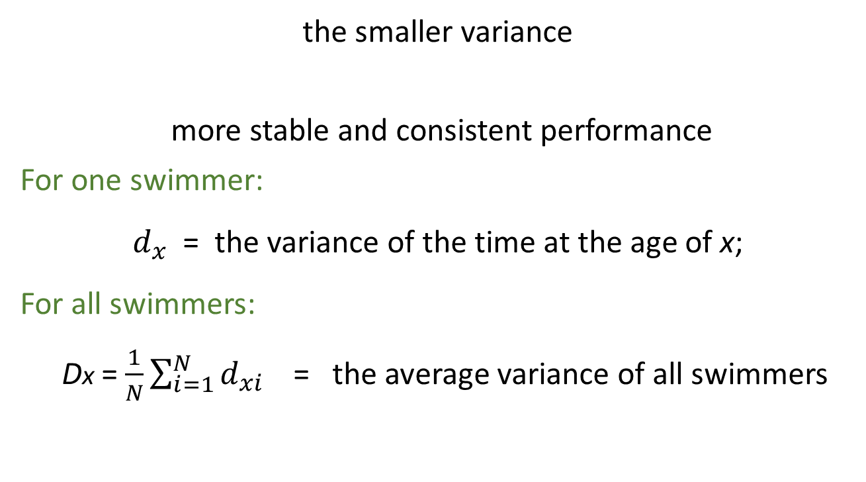
Variance Analysis
the smaller variance
more stable and consistent performance
For one swimmer:
$d_{x}$ = the variance of the time at the age of x;
For all swimmers:
Dx = $\frac{1}{N}\sum_{i=1}^{N}{d_{xi}}$ = the average variance of all swimmers
Notes:
In principle, the smaller variance indicates more stable and consistent performance at each age. We measure stability of swimmer’s performance by variance.
For one swimmer, we denote $d_{x}$ as the variance of the time at the age of x;
For all swimmers, the variance is defined as big Dx

Slide 8
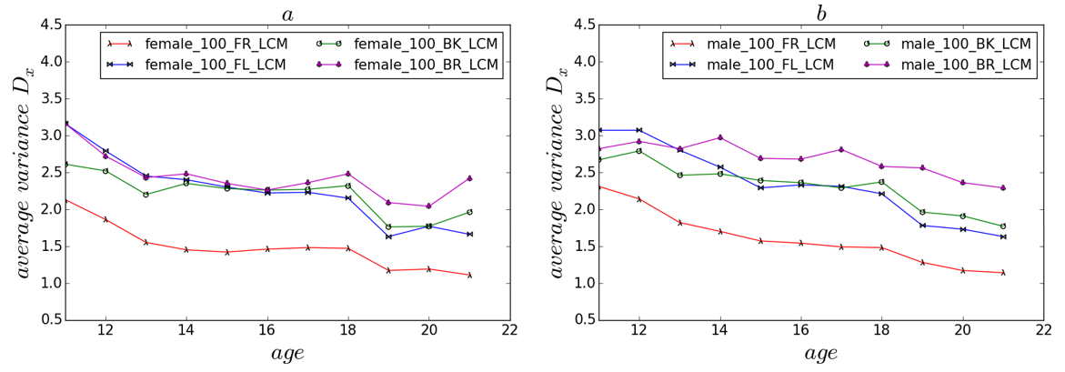
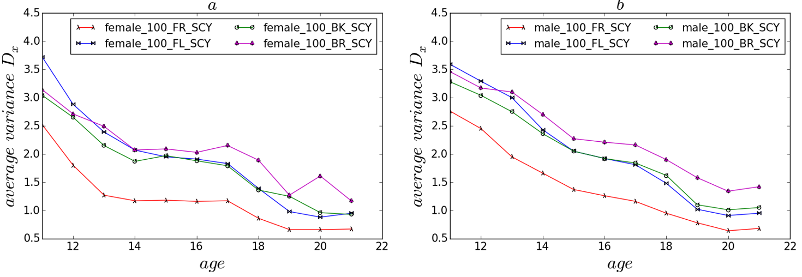
Variance of Performance
Fig 1. The variance of performance in LCM
Fig 2. The variance of performance in SCY
More stable performance of swimmers as they age.
Among both male and female athletes, 100BR has the largest variances while 100FR has the smallest variances in old ages.
Interestingly, at younger ages(e.g. From ages 10 to 13), the 100FL is the least stable stroke.
……
Notes:
As the age increases, the performance variances of both male and female athletes decrease, indicating more stable performance of swimmers as they become older.
Among both male and female athletes, 100BR has the largest variances while 100FR has the smallest variances in old ages (>13), suggesting challenges in maintaining performance in the breaststroke – a timing stroke. Interestingly, at younger ages (e.g. From ages 10 to 13), the 100FL is the least stable stroke.
……

Slide 9
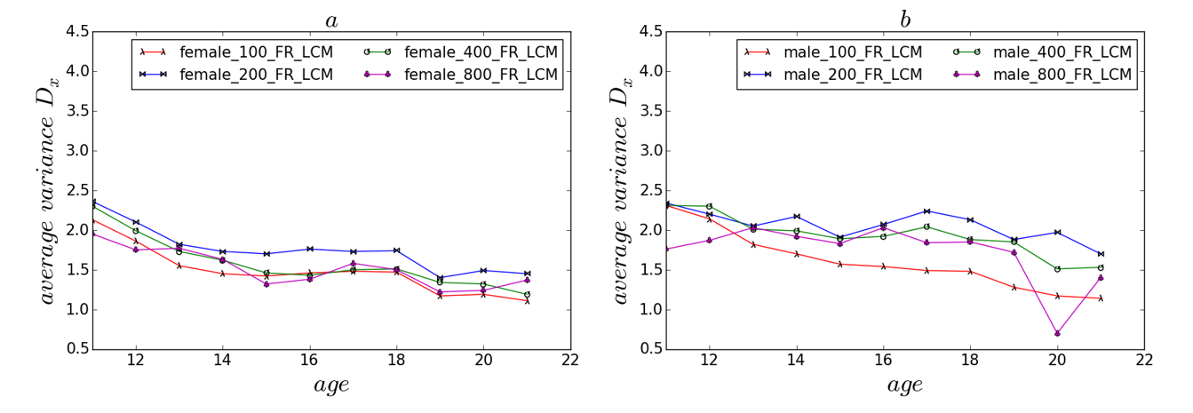
Variances of Time in Different Distances
Normalizing every distance by a different corresponding factor to measure the variances of the time in 100 meter
200M FR LCM having the largest variance
The male’s 100FR in meter more significantly stable than other distances
……
Notes:
Next, we analyze ['ænə,laɪz] variances of different distances of FR in 100M, 200M, 400M and 800M. Because the mean time of each distance varies greatly, we normalize every distance by a different corresponding factor to measure the variances of the time in 100 meter, i.e. Halving the time in 200M, dividing by four for the time in 400M, and dividing by eight for the 800M.
Interestingly, female 200M FR LCM has the largest variance on each age, compared with other distances as seen in Figure 2a. Male has similar trend but the variances for the four distances in meter are more visible than female. One interesting observation is that the male’s 100FR in meter is significantly more stable than other distances while for female the variances in the four distances are smaller.

Slide 10
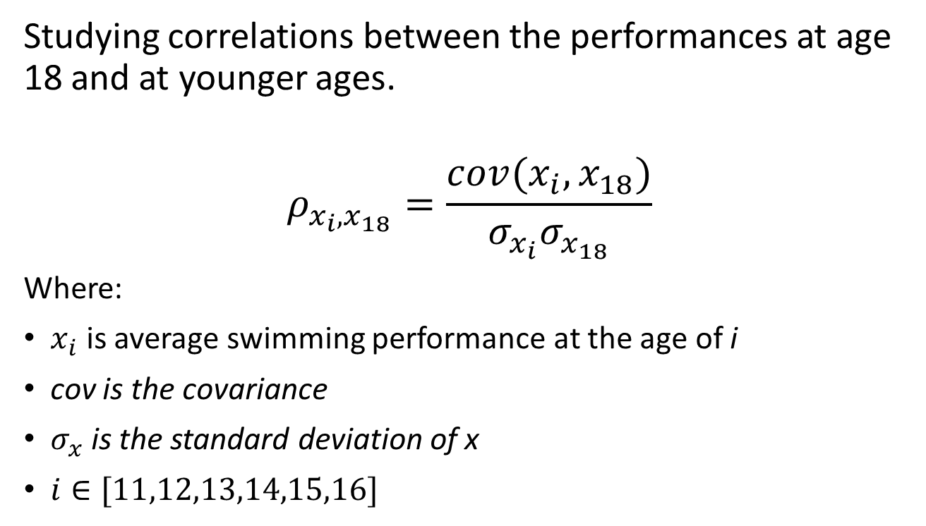
Pearson Correlation Coefficient
Studying correlations between the performances at age 18 and at younger ages.
$$ρ_{x_{i},x_{18}}=\frac{cov(x_{i}, x_{18})}{σ_{x_{i}}σ_{x_{18}}}$$
Where:
$x_{i}$ is average swimming performance at the age of i
cov is the covariance
$σ_{x}$ is the standard deviation of x
$i∈[11,12,13,14,15,16]$
Notes:
Pearson product-moment coefficient is a measure of the linear ['lɪnɪə] correlation between two variables. Here we use this quantity to study potential correlation between the swimmer‘s performances at age 18 and at their younger ages.
X_{i} is the average swimming performance at the age of a
Cov is the covariance$and σ_{x}$ Is the standard deviation of x.
We use Pearson correlation coefficient to measure the degree of swimming performance correlation between the swimmer’s time x_{i}
and x₁₈

Slide 11
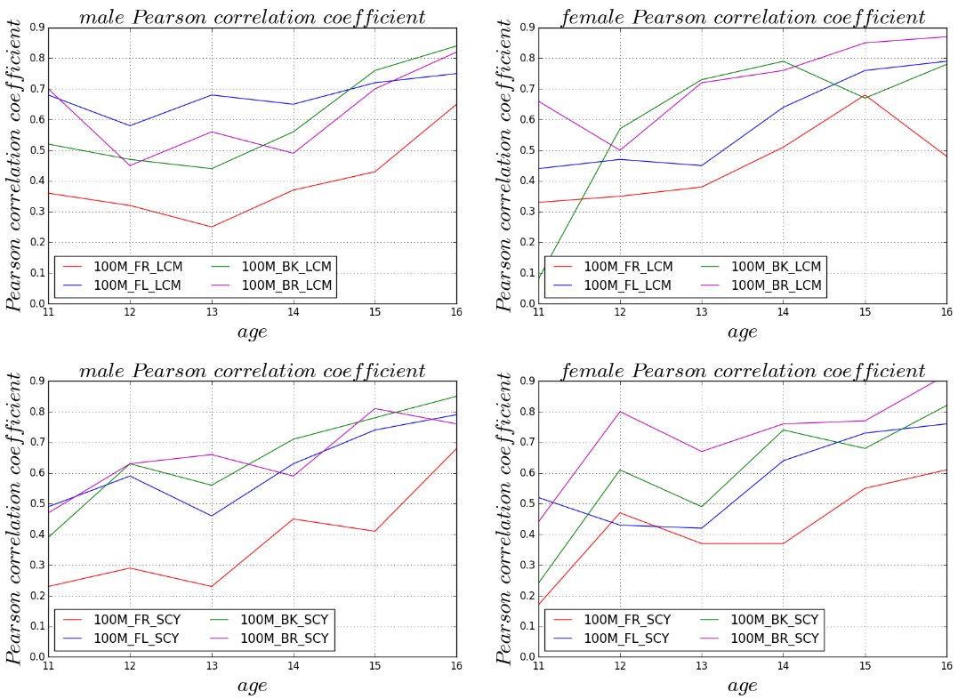
Pearson Correlation Coefficient
Notes:
The Pearson correlation coefficient of 100M FR in the four sub-panels is not high compared with others. For 100M FR athletes, future swims are uncertain because there is small correlation between at younger ages and at age 18 compared to other strokes. For each panel, the Pearson correlation coefficient of four strokes almost have a steady rise after the age of 13. With this information, the coach [kəʊtʃ] should enhance training for male swimmers once they are over 13 years old. Excepting 100M FR, other strokes times have a strong Pearson correlation between at age 14-16 and 18.

Slide 12
Regression Analysis
Dividing the athletes into four groups
The top 25%: Group 1;
The top 25-50% : Group 2;
and so on
Plotting and fitting
Plotting scatter diagram of swimmers’ performances
Fitting performance with a quadratic polynomial
Notes:
For the more, We divide the athletes into four groups based on their fastest time of 100M FR at a given age. The top 25% is named as Group 1; 25-50% is Group 2, and so on.
We plot scatter diagram of all male and female swimmers’ performances from ages 10 to 18 in each group at different ages. Performances is fitted with a quadratic [kwɒ'drætɪk] polynomial [,pɒlɪ'nəʊmɪəl] for each group.

Slide 13
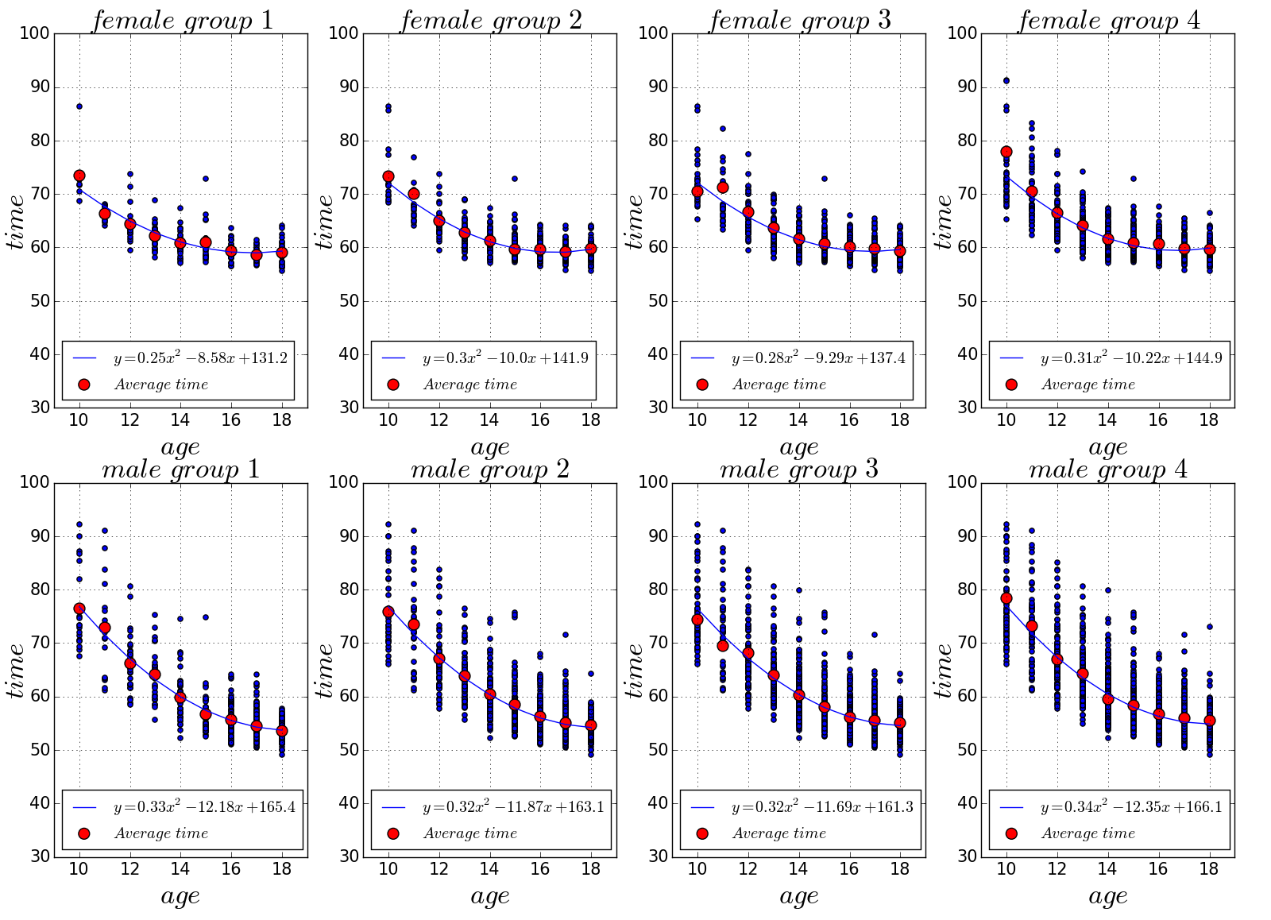
100M FR LCM Performances Regression Analysis
Notes:
We observe for females, the coefficients of each curve are very close to each other for both meter and yard courses. Although athletes may move from one group to another group as age increases, the athletes make similar progress as a group. The local slopes at different ages are very similar, suggesting a constant time improvement at each age regardless of your age and performance level. The slopes of the four curves decrease slowly as ages increase and become very flat after age of 14, suggesting little progress in swimming time during the age of 14 and 18 for female athletes.
For male athletes, the performance after age of 14 still shows major improvement, as seen in the curves that have much larger slopes compared to female athletes at the same age. The overall slopes for males from age 10 to 14 are similar to those of after age 14, showing males potentially improve consistently between age of 10 and age of 18. The female clearly has a different trend in which age of 14 is a turning point. Before this age, the level of improvement of time from age to age is much more significant than after age 14.

Slide 14
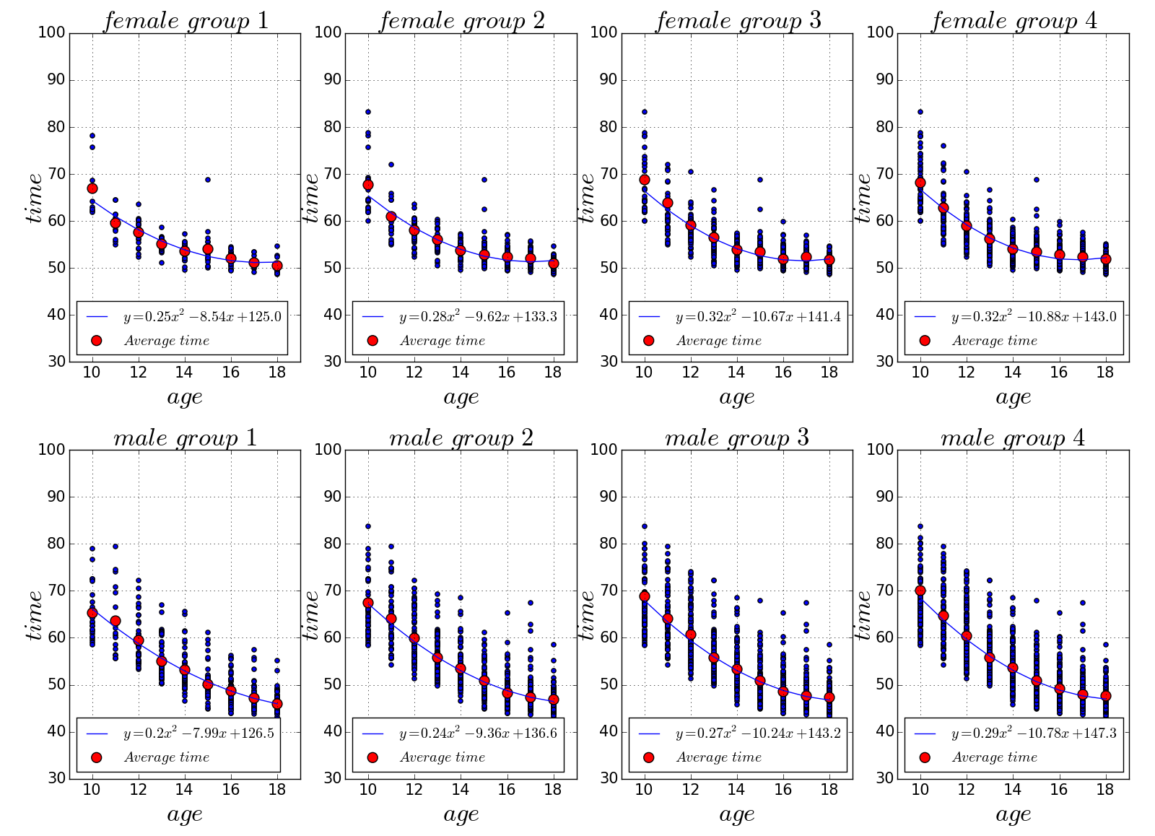
100M FR SCY Performances Regression Analysis
Notes:
We observe for females, the coefficients of each curve are very close to each other for both meter and yard courses. Although athletes may move from one group to another group as age increases, the athletes make similar progress as a group. The local slopes at different ages are very similar, suggesting a constant time improvement at each age regardless of your age and performance level. The slopes of the four curves decrease slowly as ages increase and become very flat after age of 14, suggesting little progress in swimming time during the age of 14 and 18 for female athletes.
For male athletes, the performance after age of 14 still shows major improvement, as seen in the curves that have much larger slopes compared to female athletes at the same age. The overall slopes for males from age 10 to 14 are similar to those of after age 14, showing males potentially improve consistently between age of 10 and age of 18. The female clearly has a different trend in which age of 14 is a turning point. Before this age, the level of improvement of time from age to age is much more significant than after age 14.

Slide 15
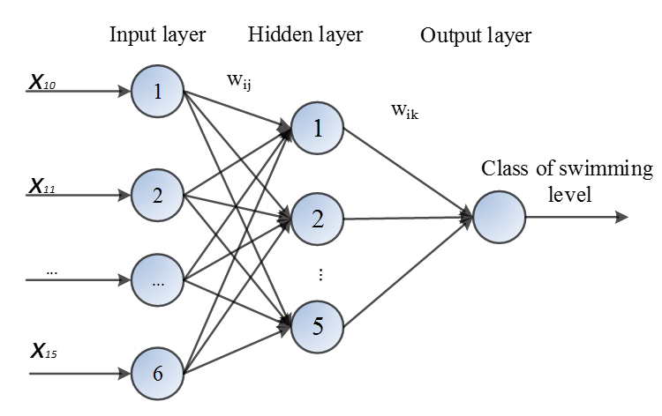
Machine Learning
Methods: using ANN and SVM for swimming level classification.
Input features: average performance of swimmer at age from 10 to 15
Output labels: level of performance at age 18.
Classification level labels
Level labels | Description(the mean time of 18 years old)
Level_1 | Top 50%
Level_2 | After ranking 50%
ANN classification model
Notes:
We use artificial [ɑːtɪ'fɪʃ(ə)l] neural ['njʊər(ə)l] network (ANN) and support vector machine(SVM) methods for swimming level classification. From the data set, we sift through out 496 athletes who have swim records when they were 10, 11, 12, 13, 14, 15 and 18 years old. Each age performance is represented by the average performance of all swimmers in our data set at this age in 100M FR. Let the average performance of swimmer at age from 10 to 15 be the input features.
We define classification level labels in this table
To improve the accuracy of results, standardization and normalization operation are applied to the inputs.

Slide 16
Accuracy in Classification of Swimmers
Method | SVM | ANN
Accuracy | 77.30% | 71.80%
Notes:
The experiment data collected for this analysis is divided into two parts at random, training set and testing set. 80% of the sample is used as the initial training set, and the remaining 20% of the data set is used as the test data set.
The ANN achieved 71.8% overall accuracy in classification of swimmers while SVM achieves 77.3% which is more than the ANN method getting. The experiments show that both the SVM and ANN methods are able to discriminate the 100M FR swimmer level of performance.

Slide 17
Summary And Outlook
Summary:
We analyze the relationship between swimming performances and ages, strokes and gender.
measuring the stable by variance;
studying the linear correlation by using Pearson correlation;
quadratic curve regression method is used to analysis the time.
Forecasting and classifying the swimming level via machine learning tools.
Outlook:
Adding other impact factors, such as height, weight and so on;
drawing a better conclusion;
Notes:
We analyze the relationship between swimming performances and ages, strokes and gender. At first, we measure the stable of swimmer by previous data; Than, we use Pearson correlation to study the linear correlation. What is more，quadratic curve regression method is used to analysis the time. At last we use High dimensional linear (SVM) and Nonlinear(ANN) classification method to forecast and classify the swimming level.
As is known to all, besides the age, there are many impact factors. If we can add this impact factors in the future, maybe we can draw a better conclusion.

Slide 18

Notes:
That’s all. Thank you for your attention.

