Slide 1

UK-biobank RAP Research Analysis Platform
操作教學

Slide 2

Introduce the UK biobank RAP
https://youtu.be/T4EsbfoSzVo

Slide 3

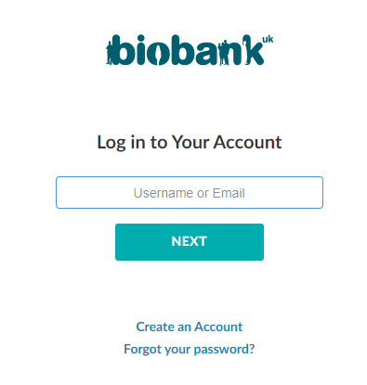
Login
https://ukbiobank.dnanexus.com/landing

Slide 4
Working knowledge
SaaS Platform
Support Ubuntu command line prompt:
Execution Environment: supports ubuntu 16.04 & 20.04
DNAnexus Software Development Kit:
DNAnexus tutorials: https://youtu.be/WXM193e_360
Operation: dx commands
e.g. login, ls, describe, upload/download file, install&run app, monitor/terminate job, …, etc.
Automation: written as Batch file(such as .sh file)
API methods:
All API calls are made over HTTPS, receive JSON input, and return JSON output.
Each API method has a distinct corresponding URL.

Slide 5
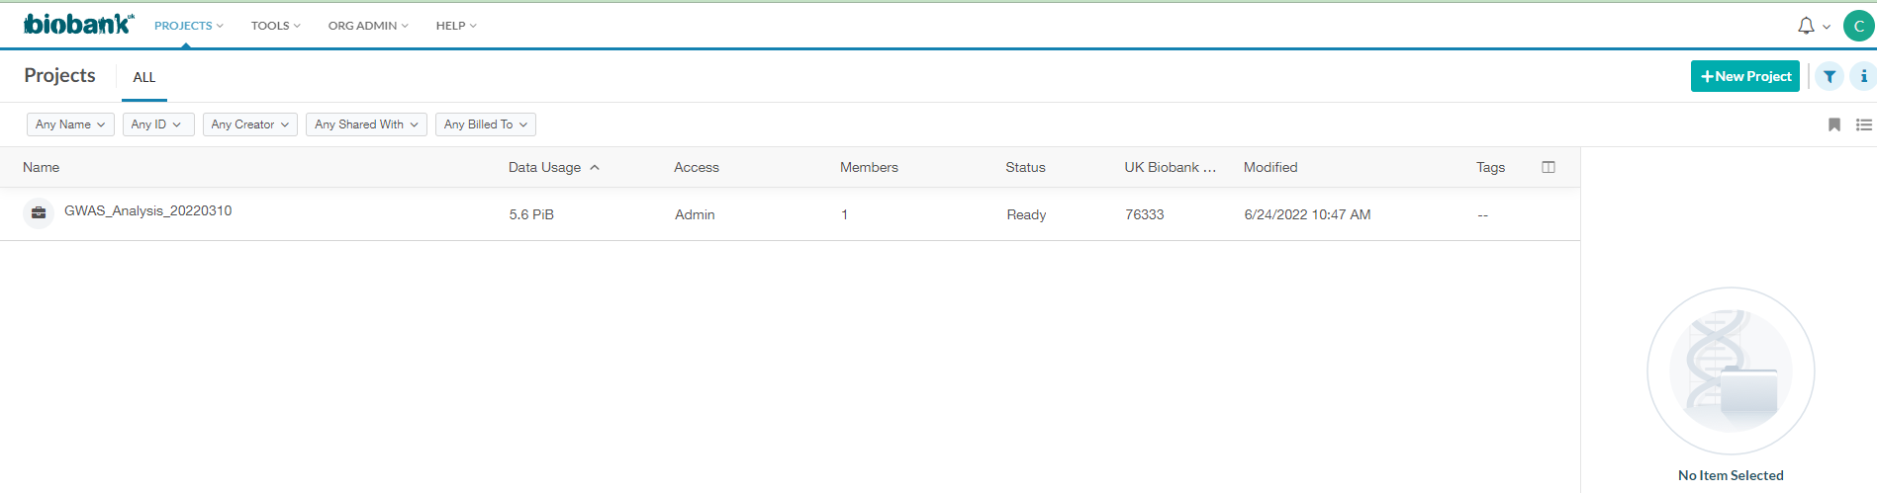
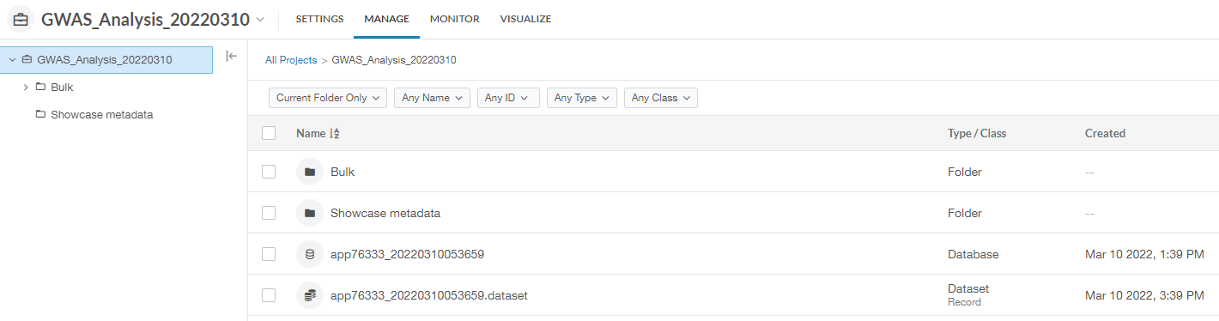
The homepage of UK Biobank RAP after login
Apps, workflow
Project Filter
Create a new project & submit
Project list
Dataset

Slide 6
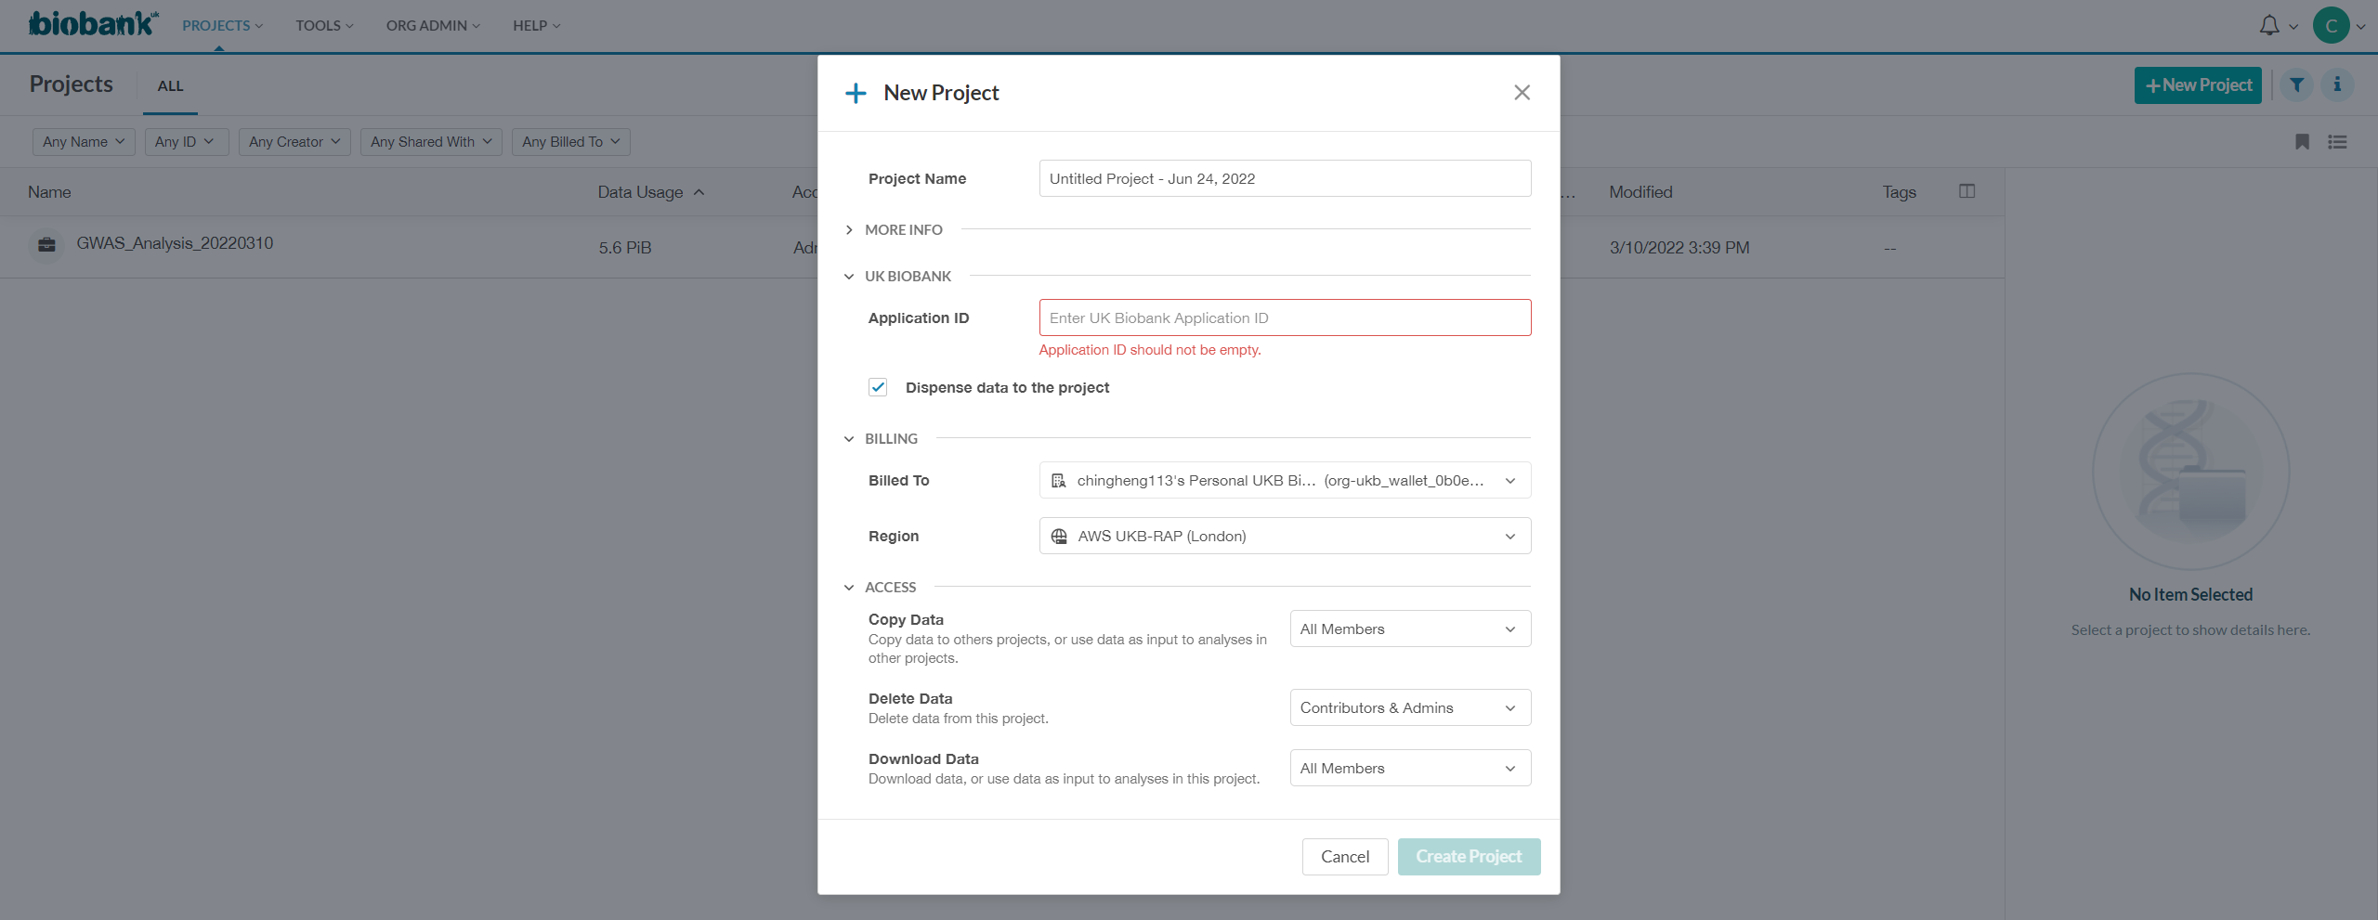
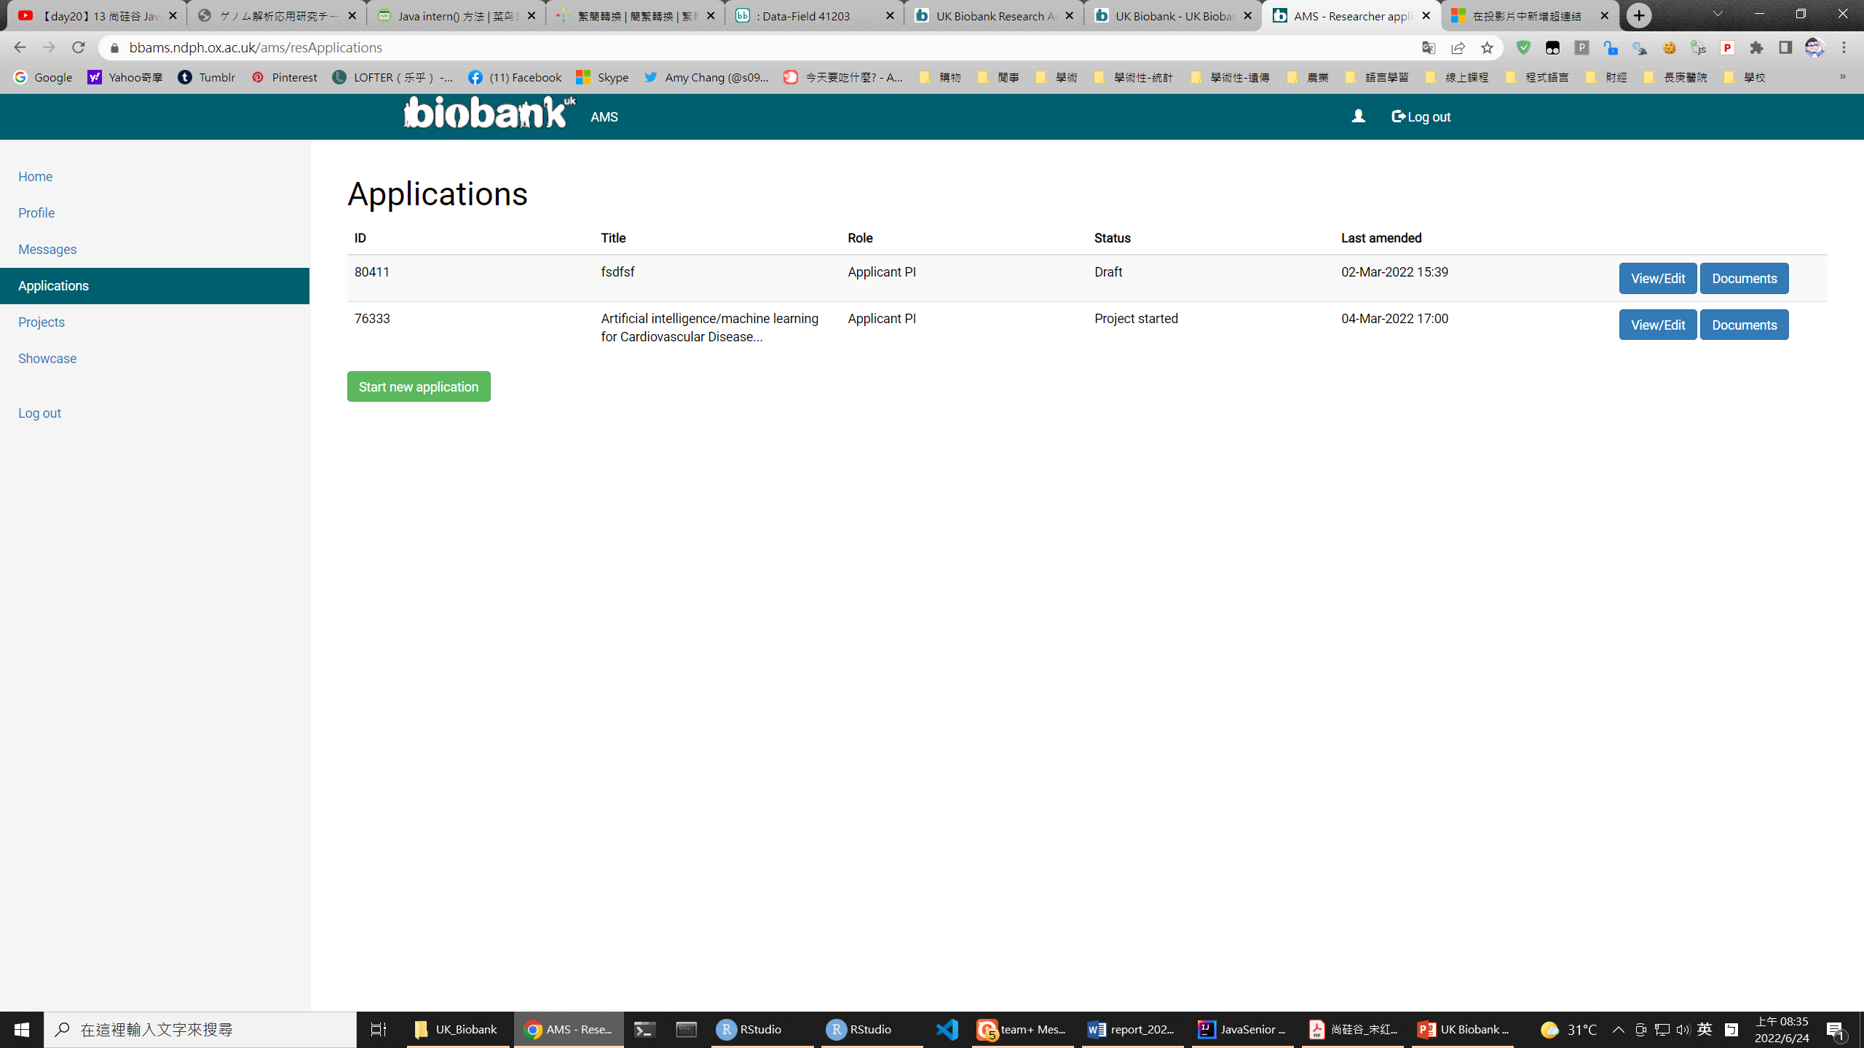
Create a new project¹
RAP platform
input
76333
UK Biobank Access Management System
AMS System (data source)
Draft: for testing

Slide 7
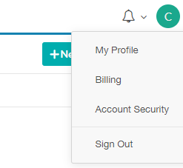
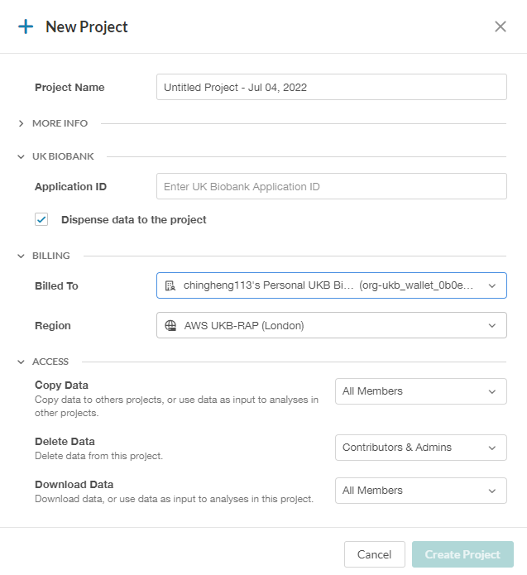
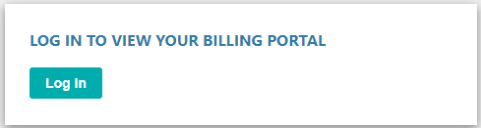
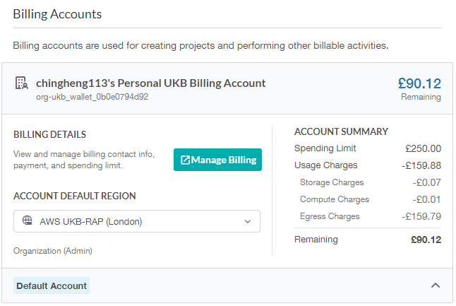
Create a new project² -- Billing
Topright Icon

Slide 8
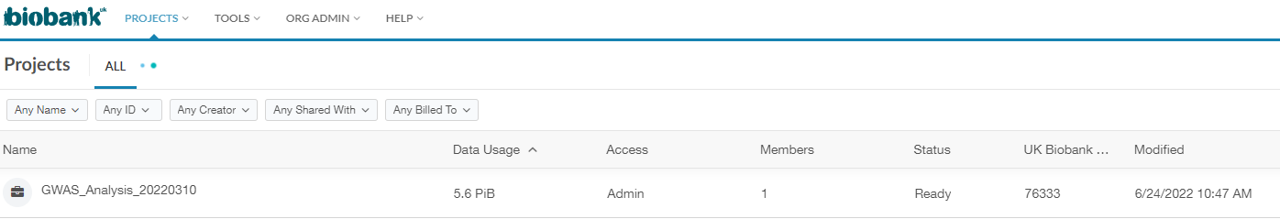
Project ready
Use the data of Project 76333
note Ready
After Submitting, maybe you should wait a long time due to preparing data .

Slide 9
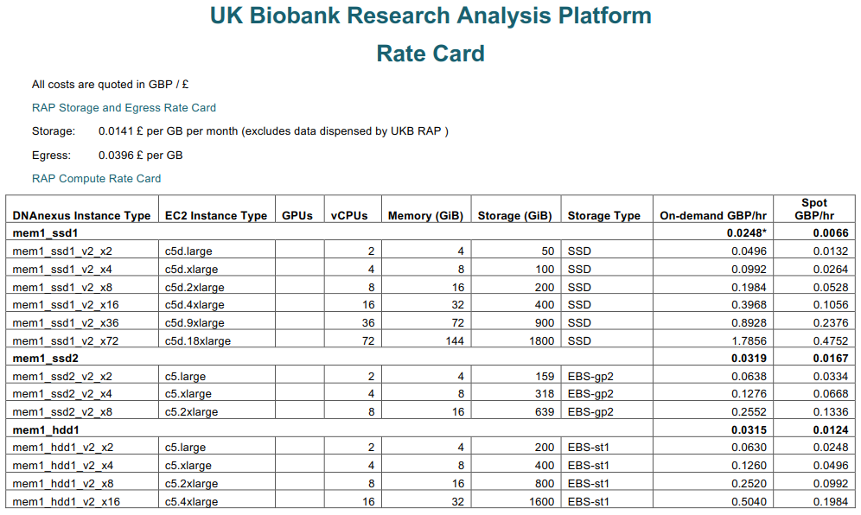
Managing & Setting job Priority¹
Main force
Supportive
檢查
Source: https://dnanexus-prod-asg-dnanexusprodassets4d7ed69b-i607e894f3ya.s3.us-east-1.amazonaws.com/images/files/UKB_Rate_Card-Current.pdf

Slide 10
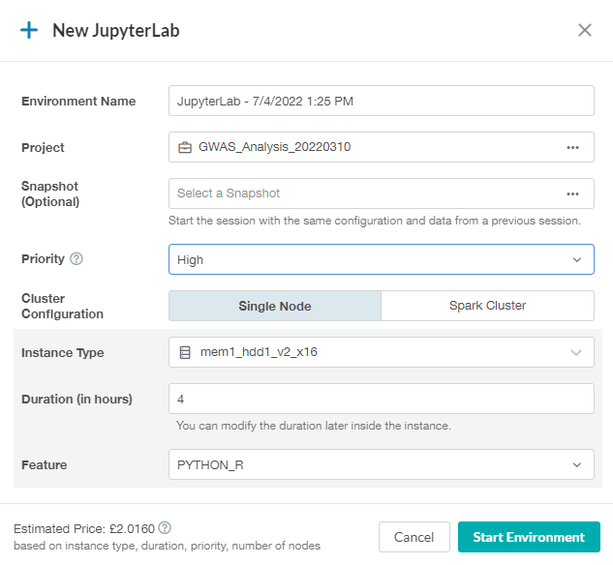
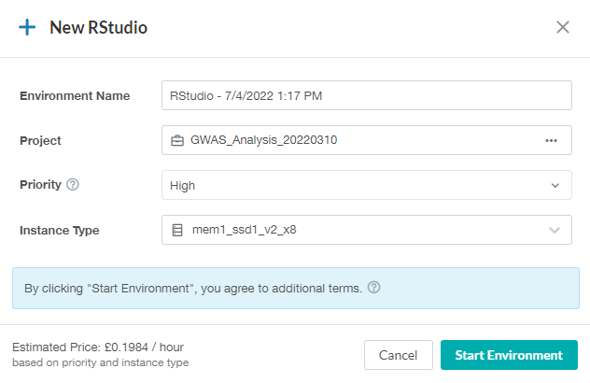
Managing & Setting job Priority²
Create new tools
project
檢查
Setting
priority
Unit price
Source: https://dnanexus-prod-asg-dnanexusprodassets4d7ed69b-i607e894f3ya.s3.us-east-1.amazonaws.com/images/files/UKB_Rate_Card-Current.pdf

Slide 11
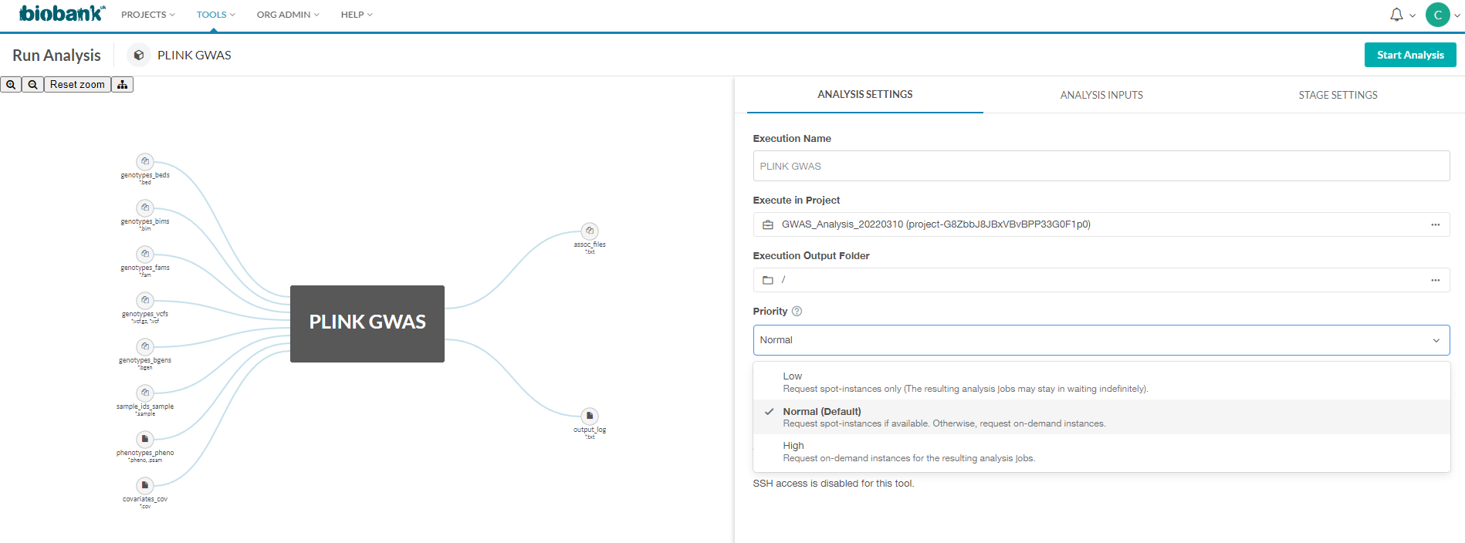
Managing & Setting job Priority³
Main force
Supportive
檢查
project
Setting priority
Low: spot instances only
Normal: spot instances first
High: on-demand instances

Slide 12
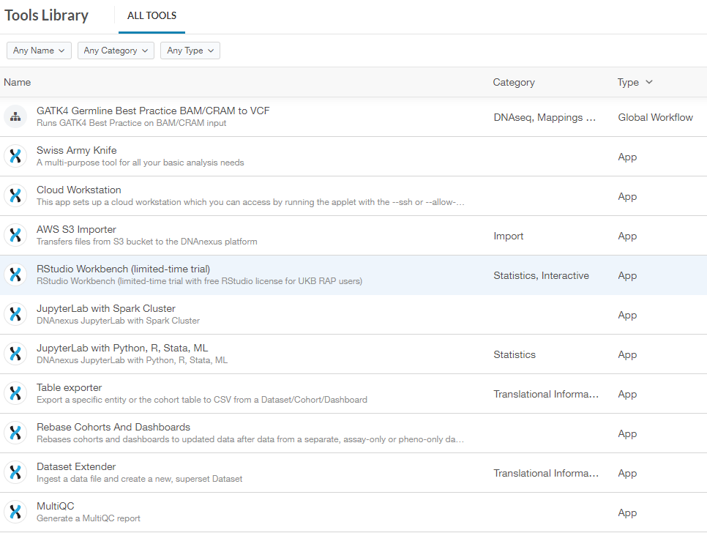
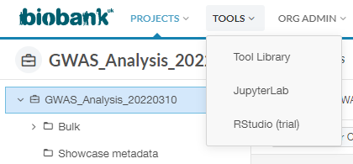
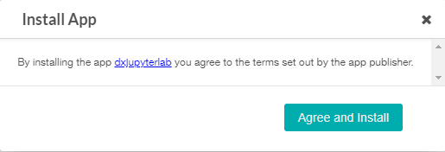
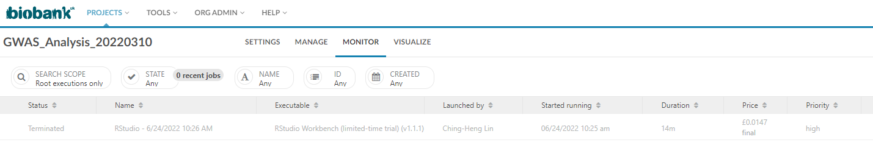
Manage Jobs
1st step: install App
Monitor Jobs status
Grey: stopped status

Slide 13
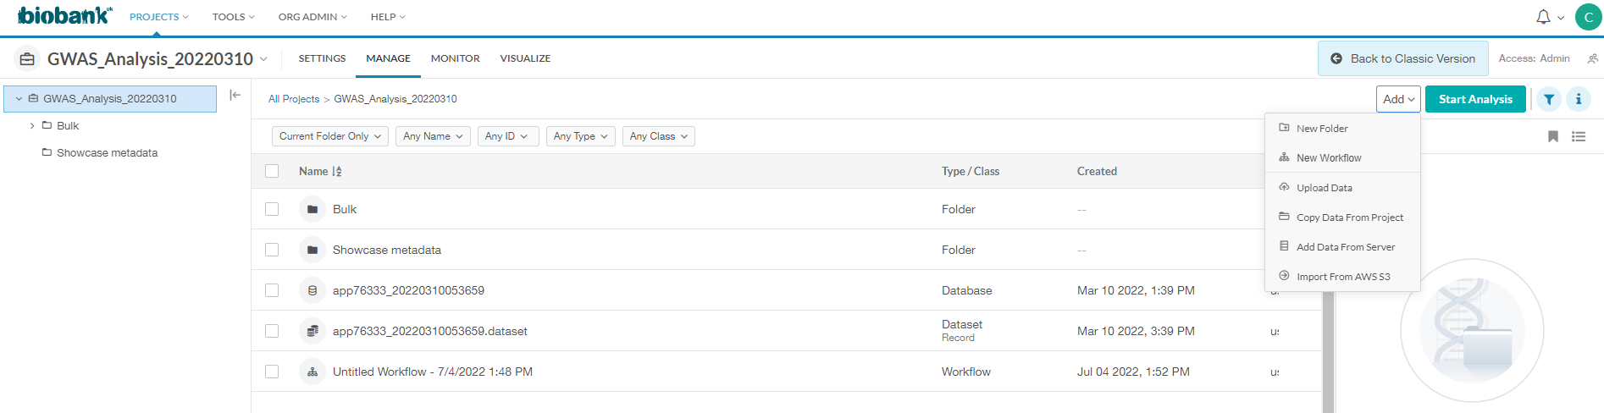
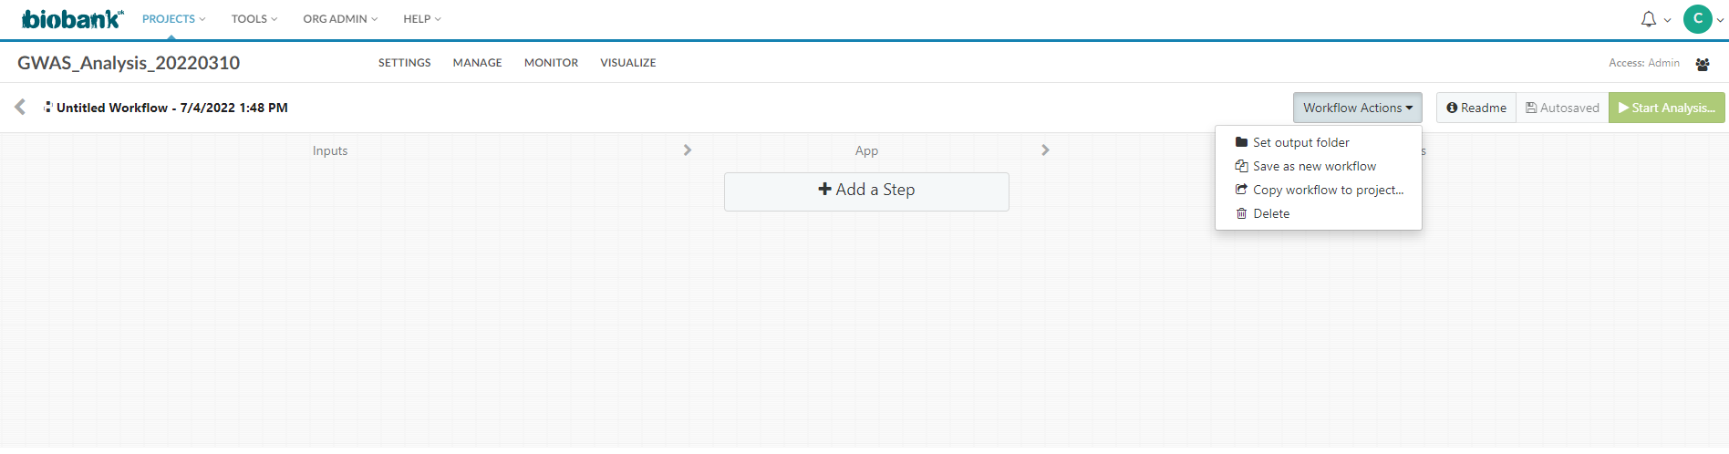
Create a new workflow
Run your
workflow
Edit your workflow

Slide 14
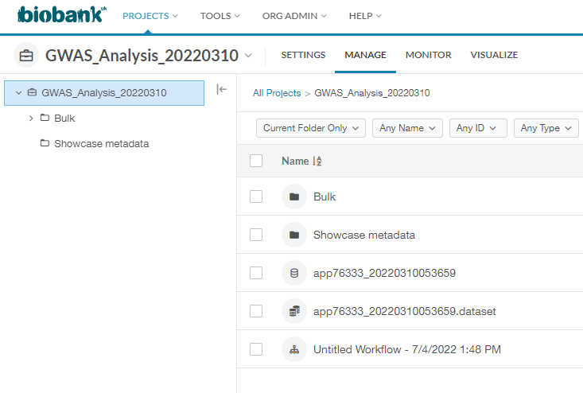
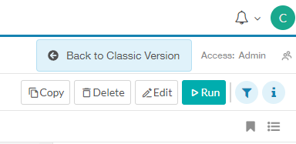
Recall a workflow
Look at the topright of page
This icon means workflow file,
click to choose
After choosing the workflow, this button appears.
And then click to run your workflow.

Slide 15

Bring your own tools to UK Biobank Data

Slide 16
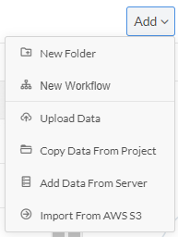
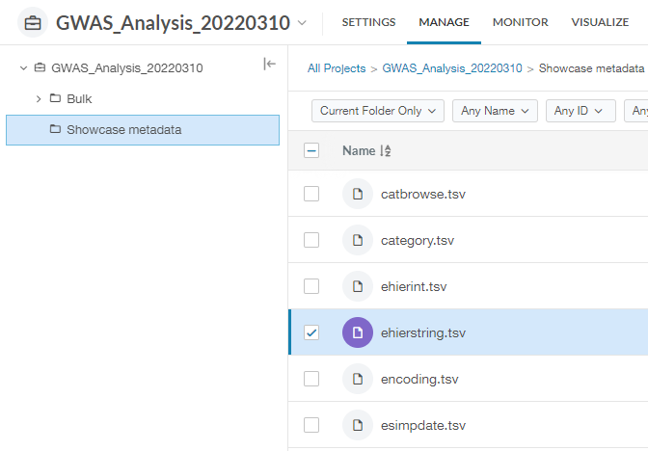
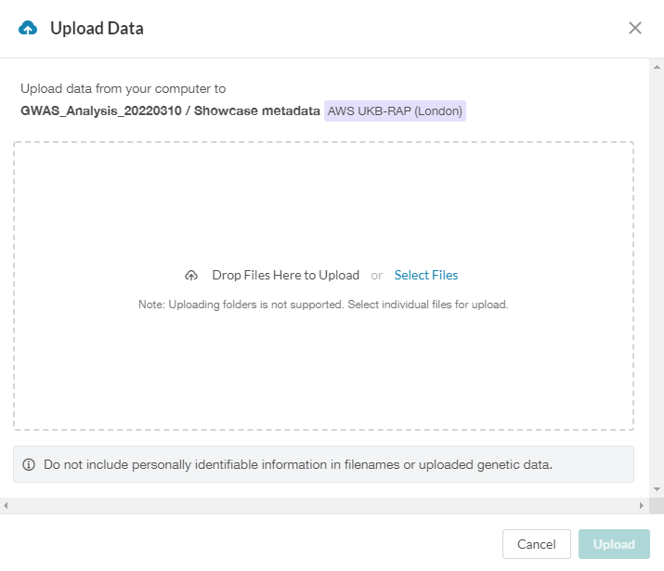
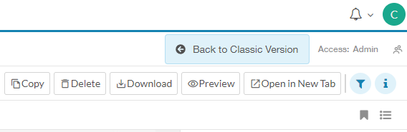
Upload/download data(or results)
1st Step: Choose the files
2nd Step: When this icon appear, click it

Slide 17
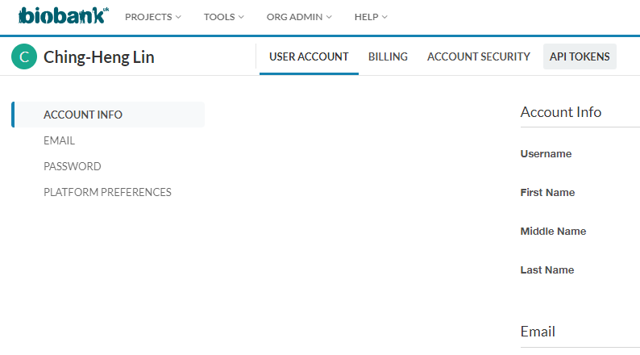
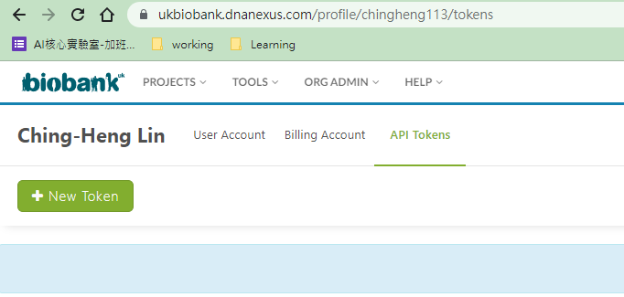
Setup API tokens
①
②
③

Slide 18
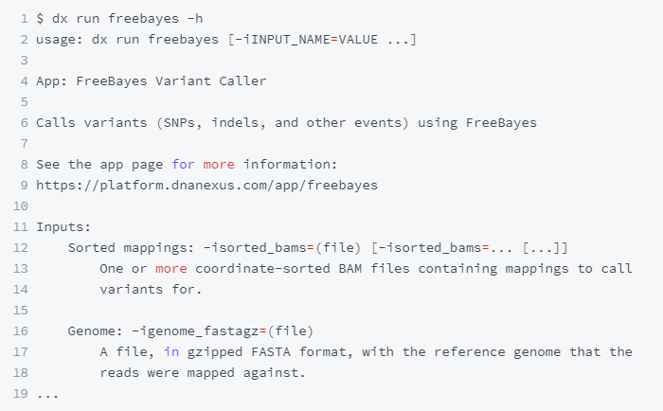
Command Line (dx commands)
Preparation: Install the DNAnexus SDK
Run FreeBayes Variant Caller application
$ dx func [-parameter1] [-parameter2] …
函數參數
函數，如help, login, run, cp, rm, …
dx起始

Slide 19
Downloaded data & R code
Questionnaire, diagnostic test & pathological data
aishare$:\coco40725\MR_Dataset\UK_Biobank\ukb48276.csv
coding book: ukb_codeBook.html
Imputation Genotype Data:
aishare$:\UK-Biobank\Data\imputation_from_genotype
Genotype Data:
aishare$:\UK-Biobank\Data\Genotype
R code for disease surveys(Based on ICD9, ICD10, and self-Report):
aishare$:\coco40725\Code_and_tools\Code\UK Biobank related code\UK_ICD&SelfReport.R

Slide 20
Reminder
RAP cost and billing
Using computing resource, storage & data egress
https://dnanexus.gitbook.io/uk-biobank-rap/working-on-the-research-analysis-platform/billing-and-costs#usage-costs
盡量下載到本機端進行分析! ← RAP平台分析真的很貴
從User guide中有關CLI的敘述，Workflow似乎以JSON檔方式存儲。

Slide 21

Thanks for your Attention

