Slide 1
C for Engineers Data Structures And Alg
Unit 1: Setting up the environment

Slide 2
Compiler + Debugger: gcc + gdb
Copy MinGW.zip from OneDrive
Unzip to your Documents folder

Slide 3
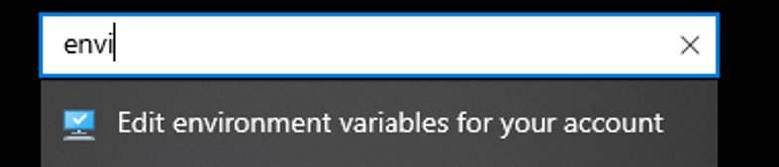
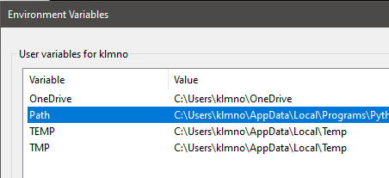
Fix the environment path
Open settings (Win+I), search environment and click on Edit environment variables for your account
Confirm gcc/gdb bin folder is listed in the “path” variable

Slide 4
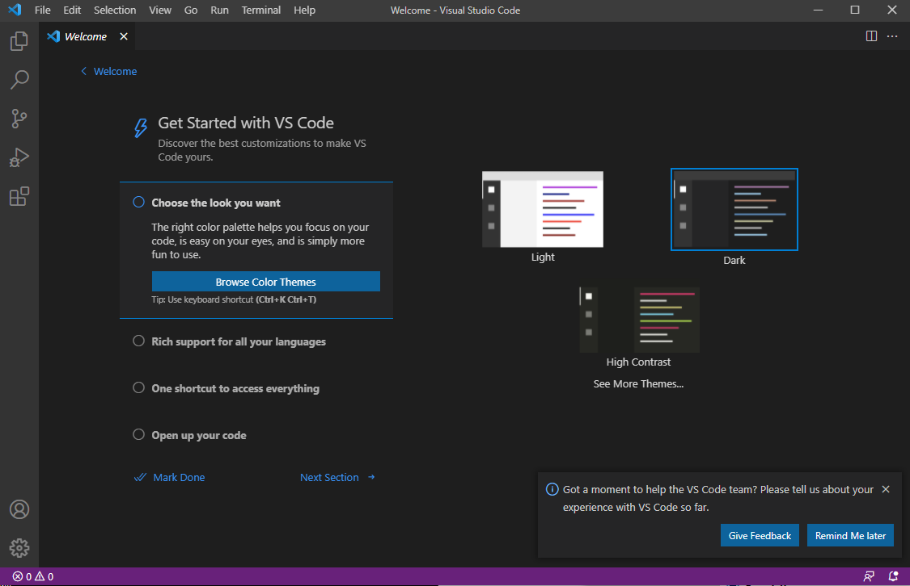
Editor: Visual Studio Code
Go to the Visual Studio Code site and download and install the application fit for your OS: https://code.visualstudio.com/download​

Slide 5
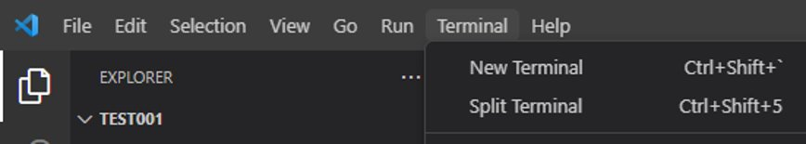
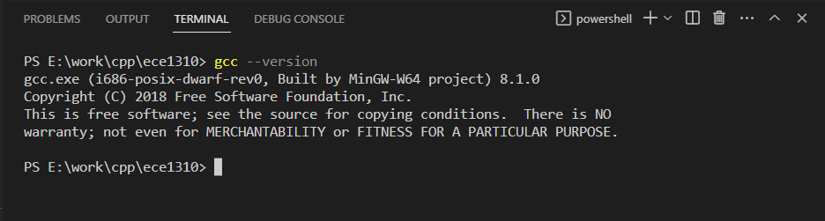
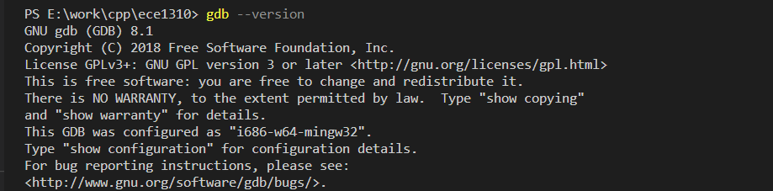
Check gcc and gdb are available
Top menu: Terminal: New Terminal
In the new terminal type: “gcc --version”
Type: “gdb --version”

Slide 6
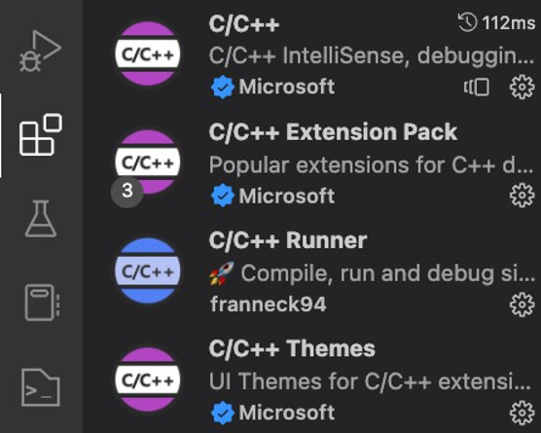
Extensions
From Visual Studio Code select “Extensions” from the left tab
Download the following extensions:
c/c++
c/c++ extension pack
c/c++ runner

Slide 7
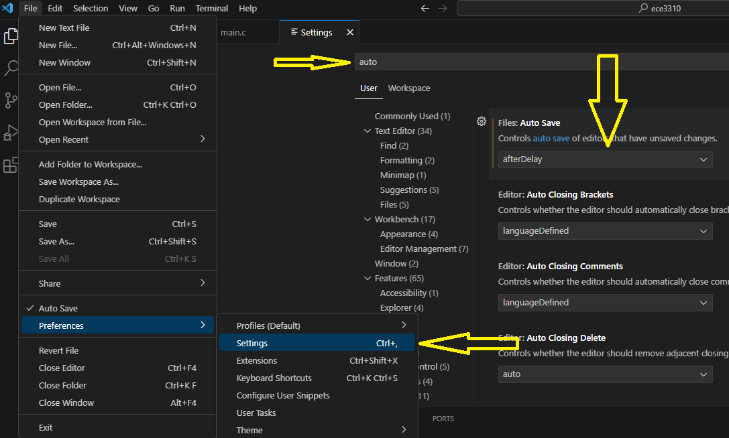
Extensions
Enable auto-save

Slide 8
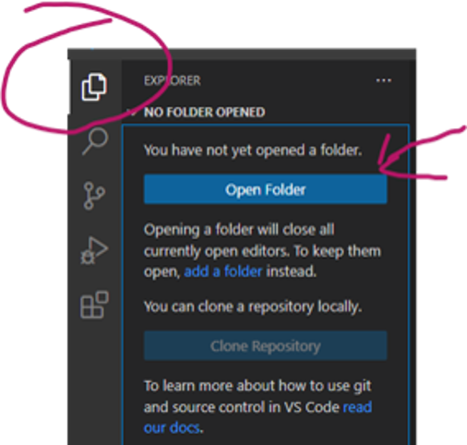
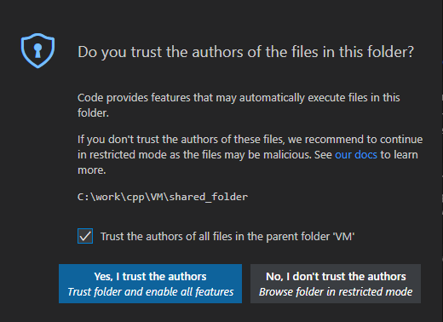
Workspace
Create a working folder
Start Visual Studio Code
Open the folder you just created
Check the “Trust the authors…” checkbox

Slide 9
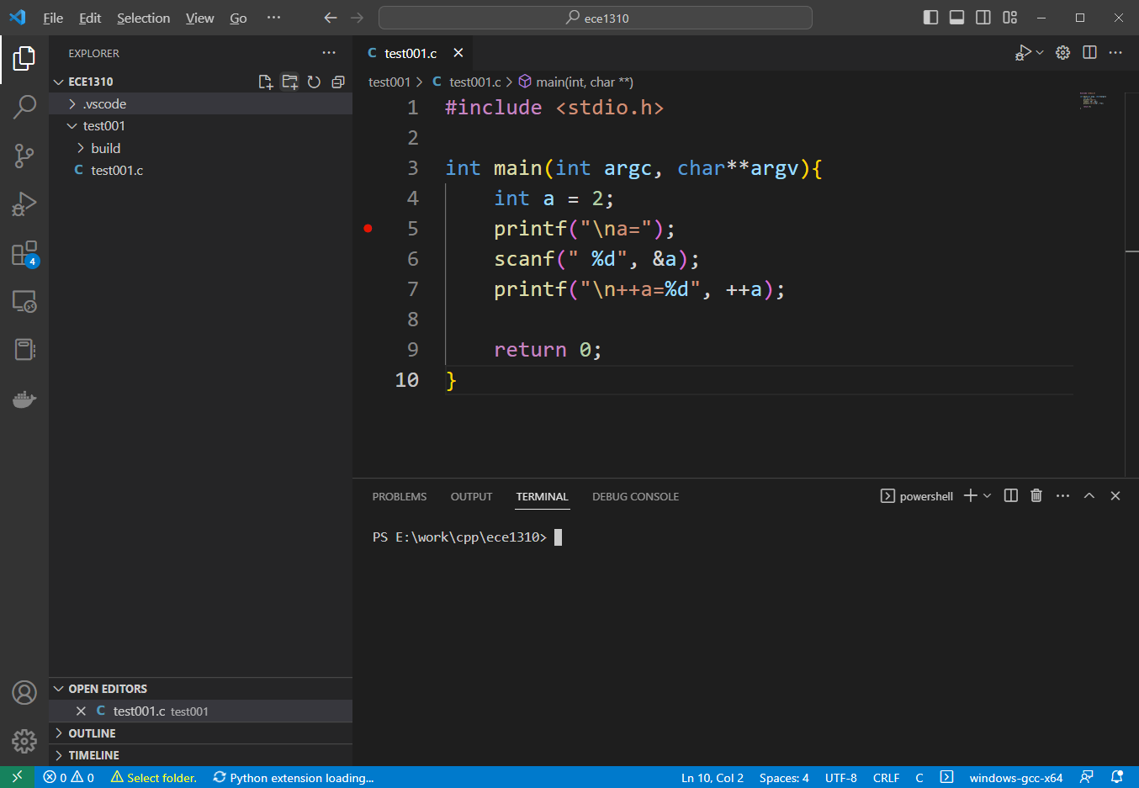
Workspace
1. Create a subfolder (“test001”)
2. Within the new subfolder create a new file (“test001.c”)
3. Open the “test001.c” file and type the content as seen in the image

Slide 10

Compile and Run
Select working folder = test001
Compile the program - click the wheel
Run the program – click the triangle
Debug the application – click on the "Start Debuging" icon

Slide 11
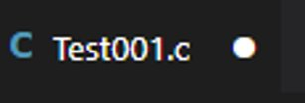
Extra – Save your file (if auto-save not enabled)
Notice the dot next to the file name on the top of the screen: ​
This indicates that the file is not saved so please save it by either pressing Ctrl+S or navigating to the "File" tab up top and clicking "Save".

