Slide 1
Data Science
Term project Final Presentation
최준헌 김지현 양희림

Slide 2
Contents
1
Objective Setting
2
Data Curation
3
Data Inspection
4
Data Preprocessing
5
Data Analysis
6
Data Evaluation
7
Conclusion

Slide 3








Objective Setting
Is the client subscribed a term deposit?
Notes:
은행 고객들의 속성에는 여러가지가 있다. 나이, 결혼여부, 예금잔액 등등… 이 정보를 가지고 정기 예금 마케팅을 했을때 실제로 등록할 고객을 예측한다.

Slide 4
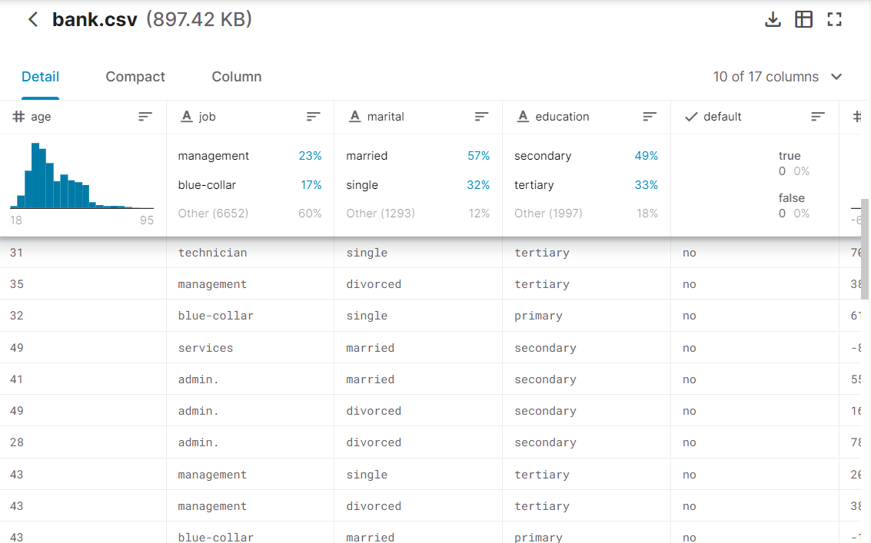


Data Curation

Slide 5
Data Inspection

Slide 6
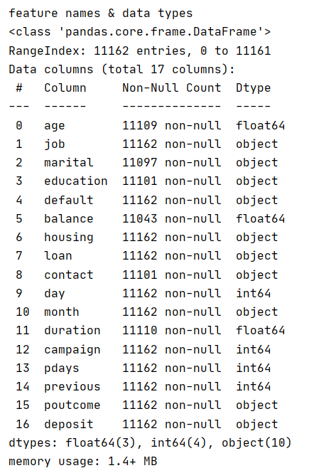
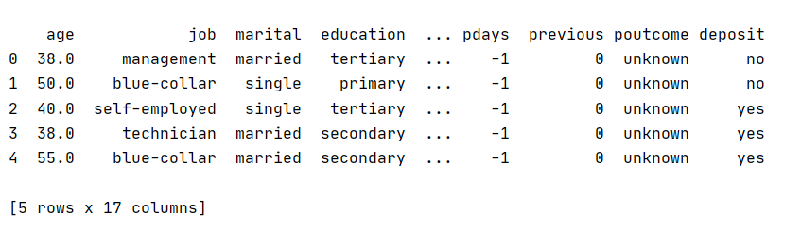
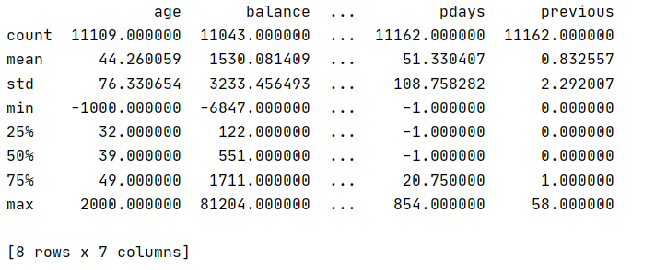
Data Inspection
Column & Data type
Head data
Numerical column Info

Slide 7
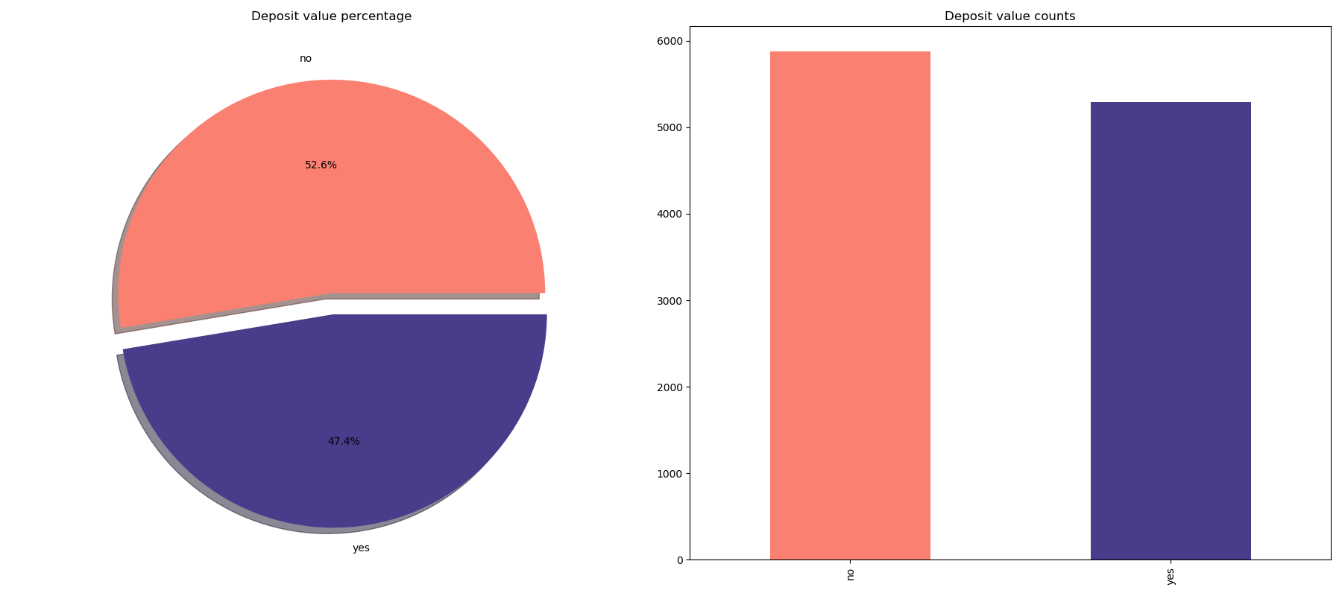
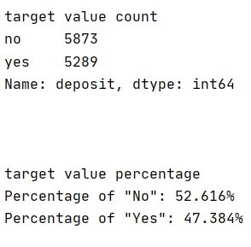
Data Inspection
Percentage of target value
No : 52.616%
Yes : 47.384%
Notes:
타겟 컬럼 value count(yes 몇 개, no 몇 개): 그래프
타겟 value를 퍼센트로 보여줌: 그래프

Slide 8
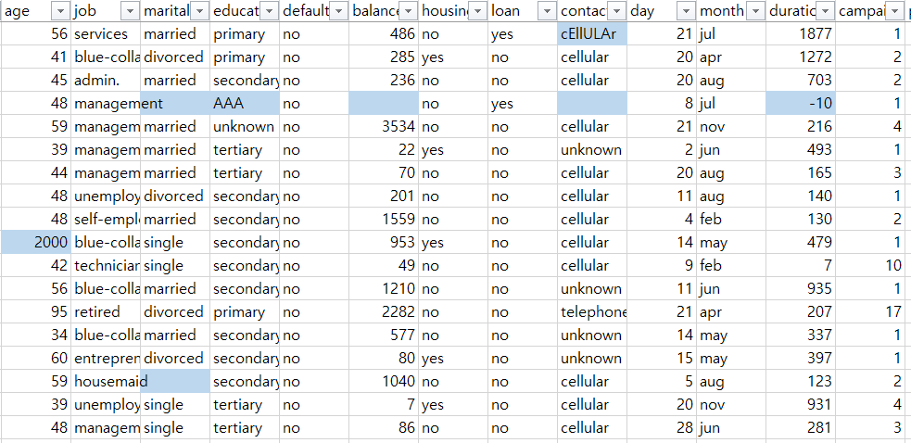
Data Inspection
Missing data

Slide 9
Data Inspection
Wrong data

Slide 10
Data Inspection
Wrong data, But Usable Data

Slide 11
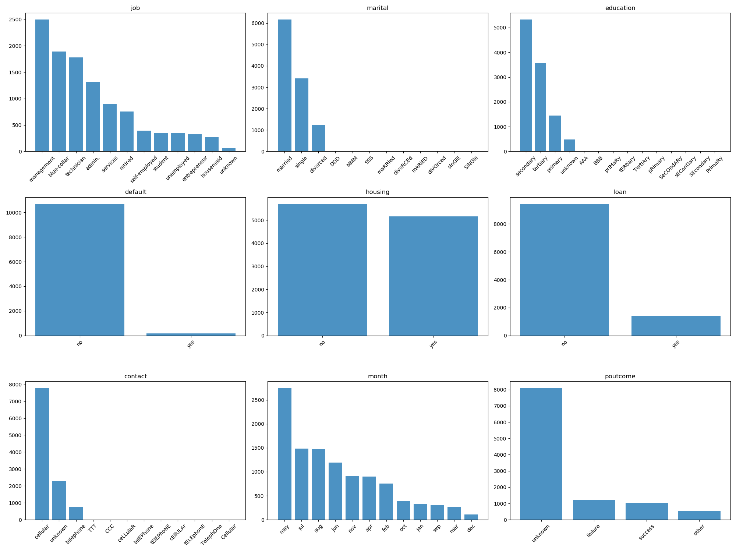

Data Inspection
Distribution graph of Categorical column

Slide 12
Data Inspection
Distribution graph of Categorical column
Invalid Data!!

Slide 13
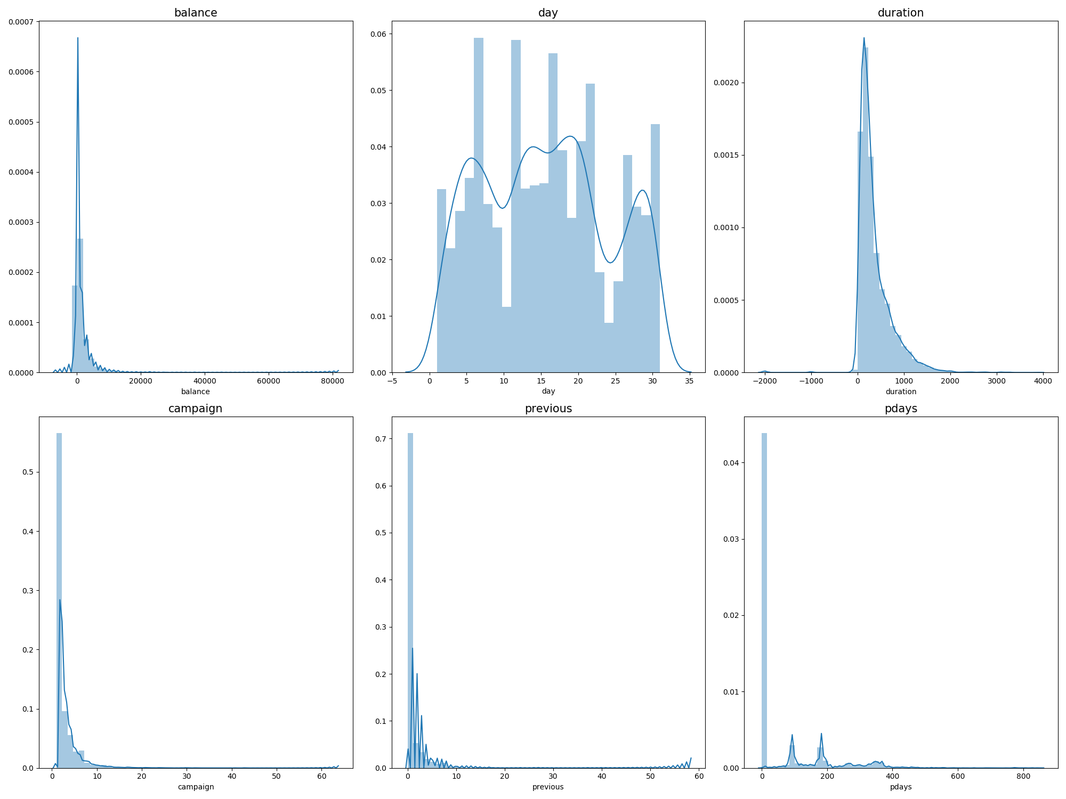
Data Inspection
Distribution graph of Numeric column

Slide 14
Data Preprocessing

Slide 15


Data Preprocessing
What we preprocess?
How preprocessing?
Drop
Fill
Replace
Missing data
Wrong data
1
By target feature value,
Numeric
Categorical
Median
Mode
Wrong data, But Usable Data
Unusable Data
2
By related feature value
Numeric
Categorical
Linear Regression / Median
Mode
Outlier Data

Slide 16
Data Preprocessing
Change uppercase to lowercase

Slide 17
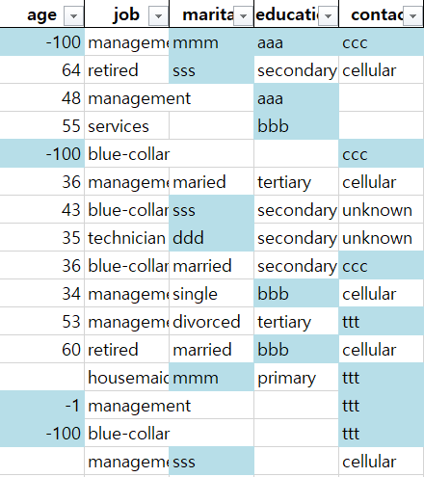
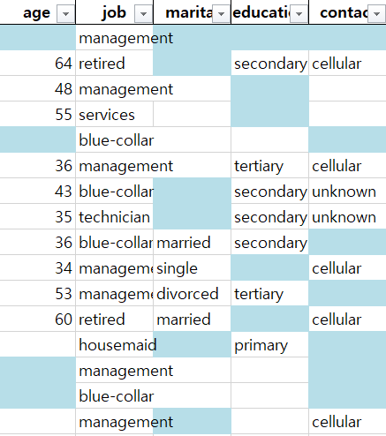
Data Preprocessing
Replace wrong data to NA

Slide 18
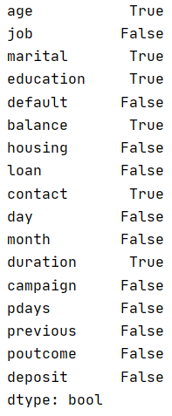
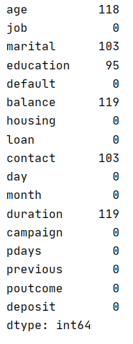
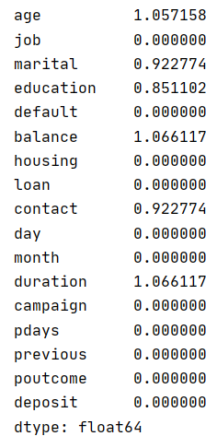
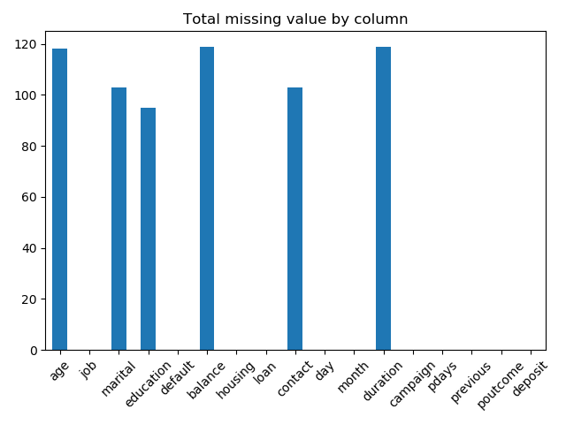
Data Preprocessing
Missing value
existence status
How many
missing value?
Percentage of
missing value
Percentage of that is missing : 0.34%
Notes:
Preprocessing 전

Slide 19

Data Preprocessing
Delete row with more than 5 missing values
1
2
3
4
5
Notes:
Preprocessing 전

Slide 20
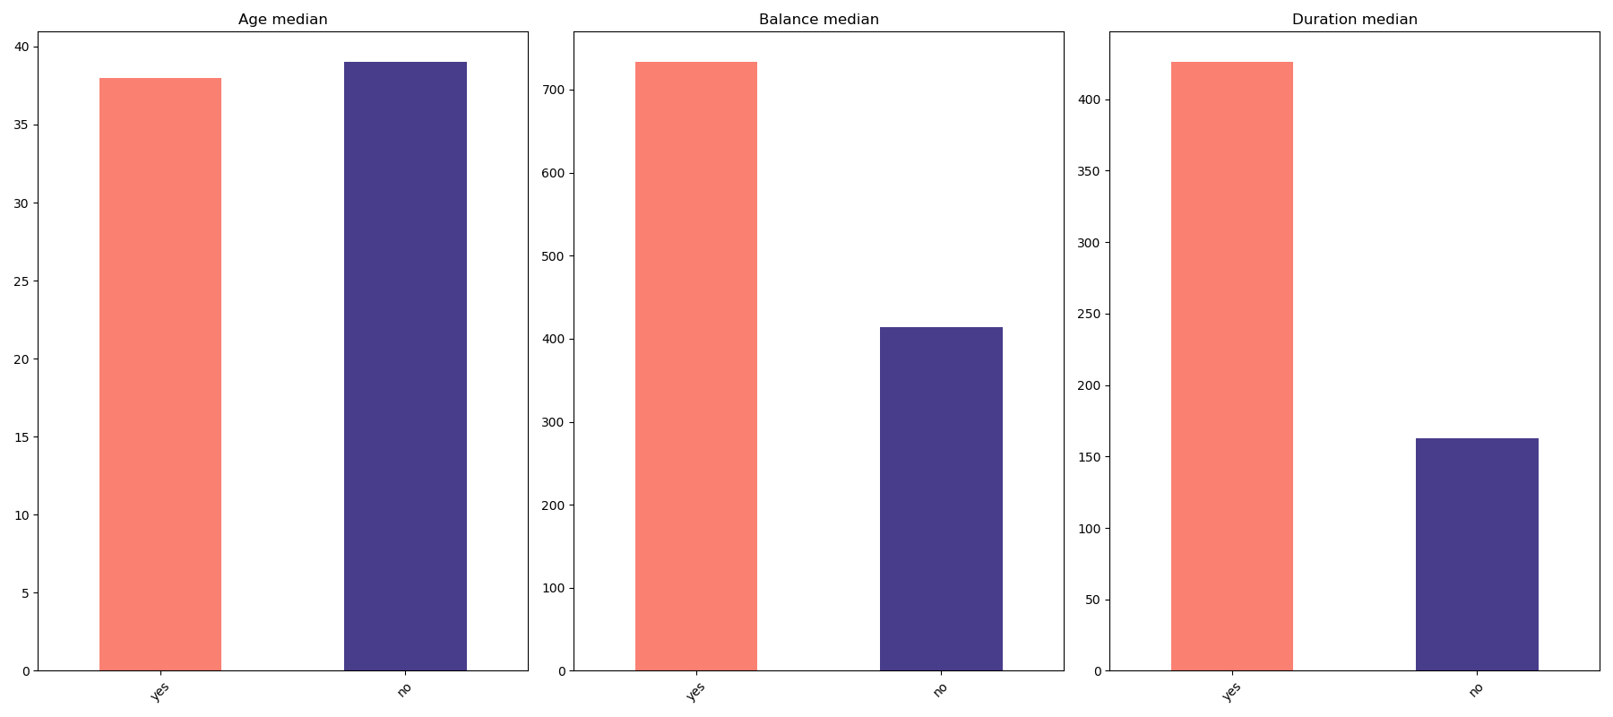
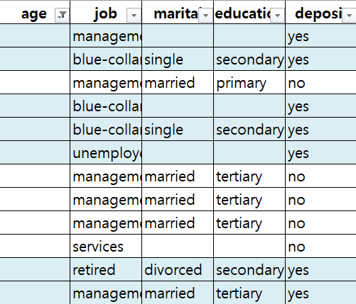
Data Preprocessing
1
By target feature value,
Numeric
Categorical
Median
Mode
Fill missing data to specific values [Numeric]
38
Yes : 38
No : 39
38
39
38
If deposit value is “Yes”
Fill age to 38
If deposit value is “No”
Fill age to 39
38
38
39
39
39
39
38
38
Notes:
타켓 yes/no 의 중간값 혹은 최빈값으로 채움.

Slide 21
Data Preprocessing
1
By target feature value,
Numeric
Categorical
Median
Mode
Fill missing data to specific values [Numeric]
Age
Balance
Duration
Notes:
타켓 yes/no 의 중간값 혹은 최빈값으로 채움.

Slide 22
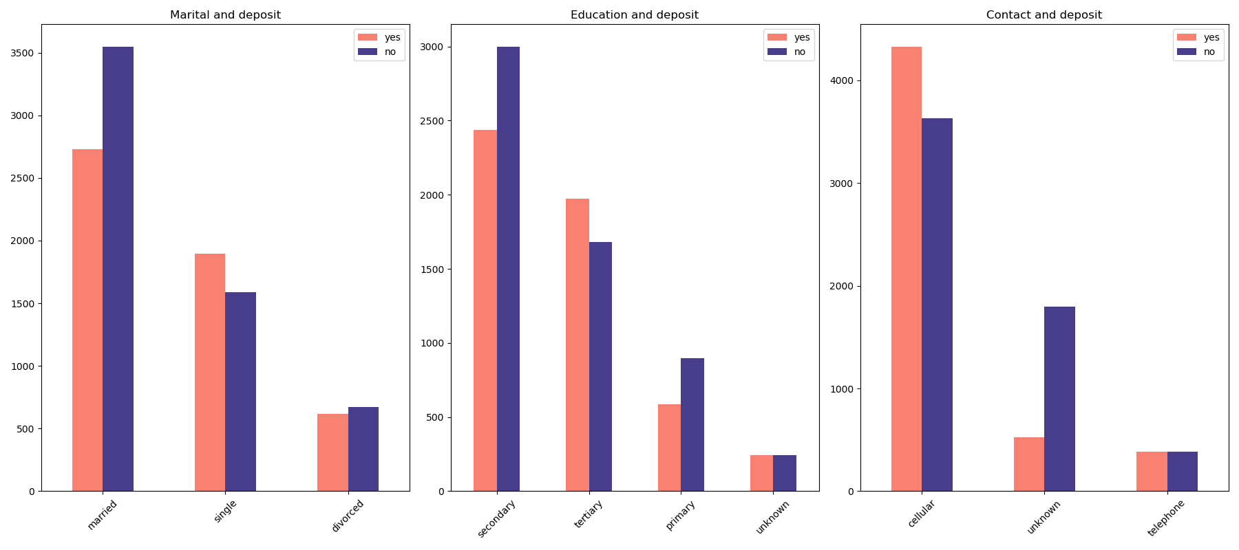
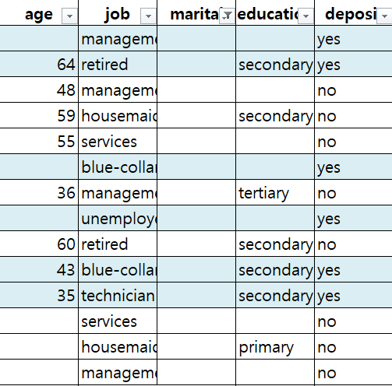
Data Preprocessing
1
By target feature value,
Numeric
Categorical
Median
Mode
Fill missing data to specific values [Categorical]
married
married
The most value!
married
married
If deposit value is “Yes”
Fill to ‘married’
If deposit value is “No”
Fill to ‘married’
Married
married
married
married
married
married
married
married
married
married
married
Notes:
타켓 yes/no 의 중간값 혹은 최빈값으로 채움.

Slide 23
Data Preprocessing
1
By target feature value,
Numeric
Categorical
Median
Mode
Fill missing data to specific values [Categorical]
Marital
Education
Contact
Notes:
타켓 yes/no 의 중간값 혹은 최빈값으로 채움.

Slide 24
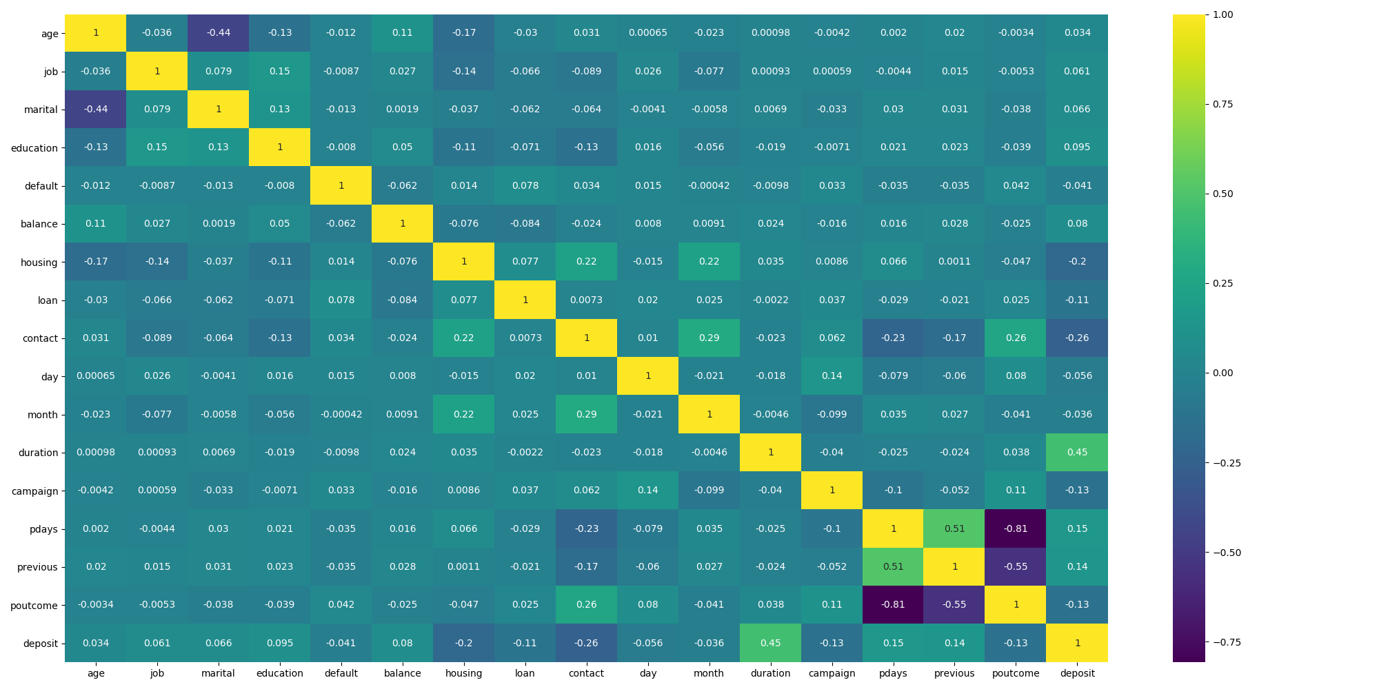
Data Preprocessing
2
By related feature value
Numeric
Categorical
Linear Regression / Median
Mode
Look correlation heatmap and find relational column
age --- marital
balance --- age
duration --- deposit
Notes:
????deposit???
Numeric

Slide 25
Data Preprocessing
2
By related feature value
Numeric
Categorical
Linear Regression / Median
Mode
Look correlation heatmap and find relational column
job --- education
marital --- age
contact --- pcoutcome
Notes:
Categorical

Slide 26
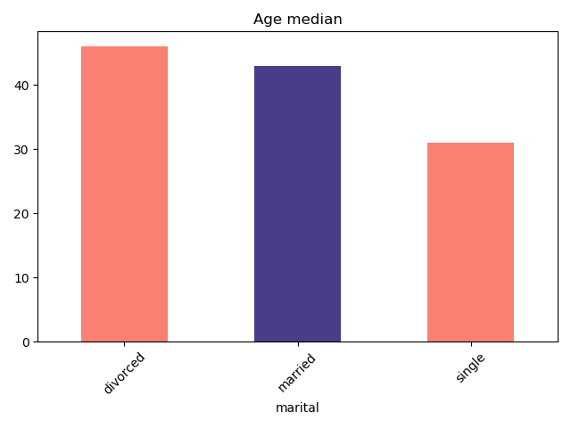
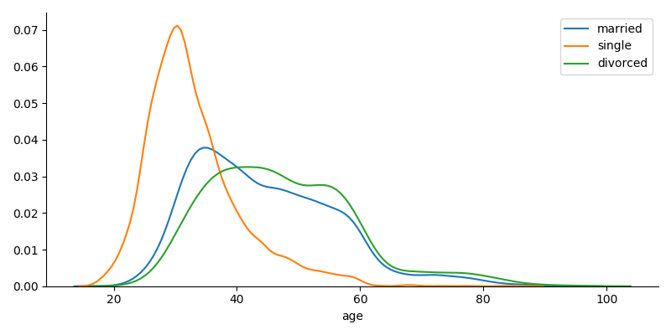
Data Preprocessing
2
By related feature value
Numeric
Categorical
Linear Regression / Median
Mode
Fill missing data to specific values [Numeric]
If marital value is “divorced”
Fill age to ‘46’
If marital value is “married”
Fill age to ‘43’
If marital value is “single”
Fill age to ‘31’
Divorced: 46
Married: 43
Single: 31

Slide 27
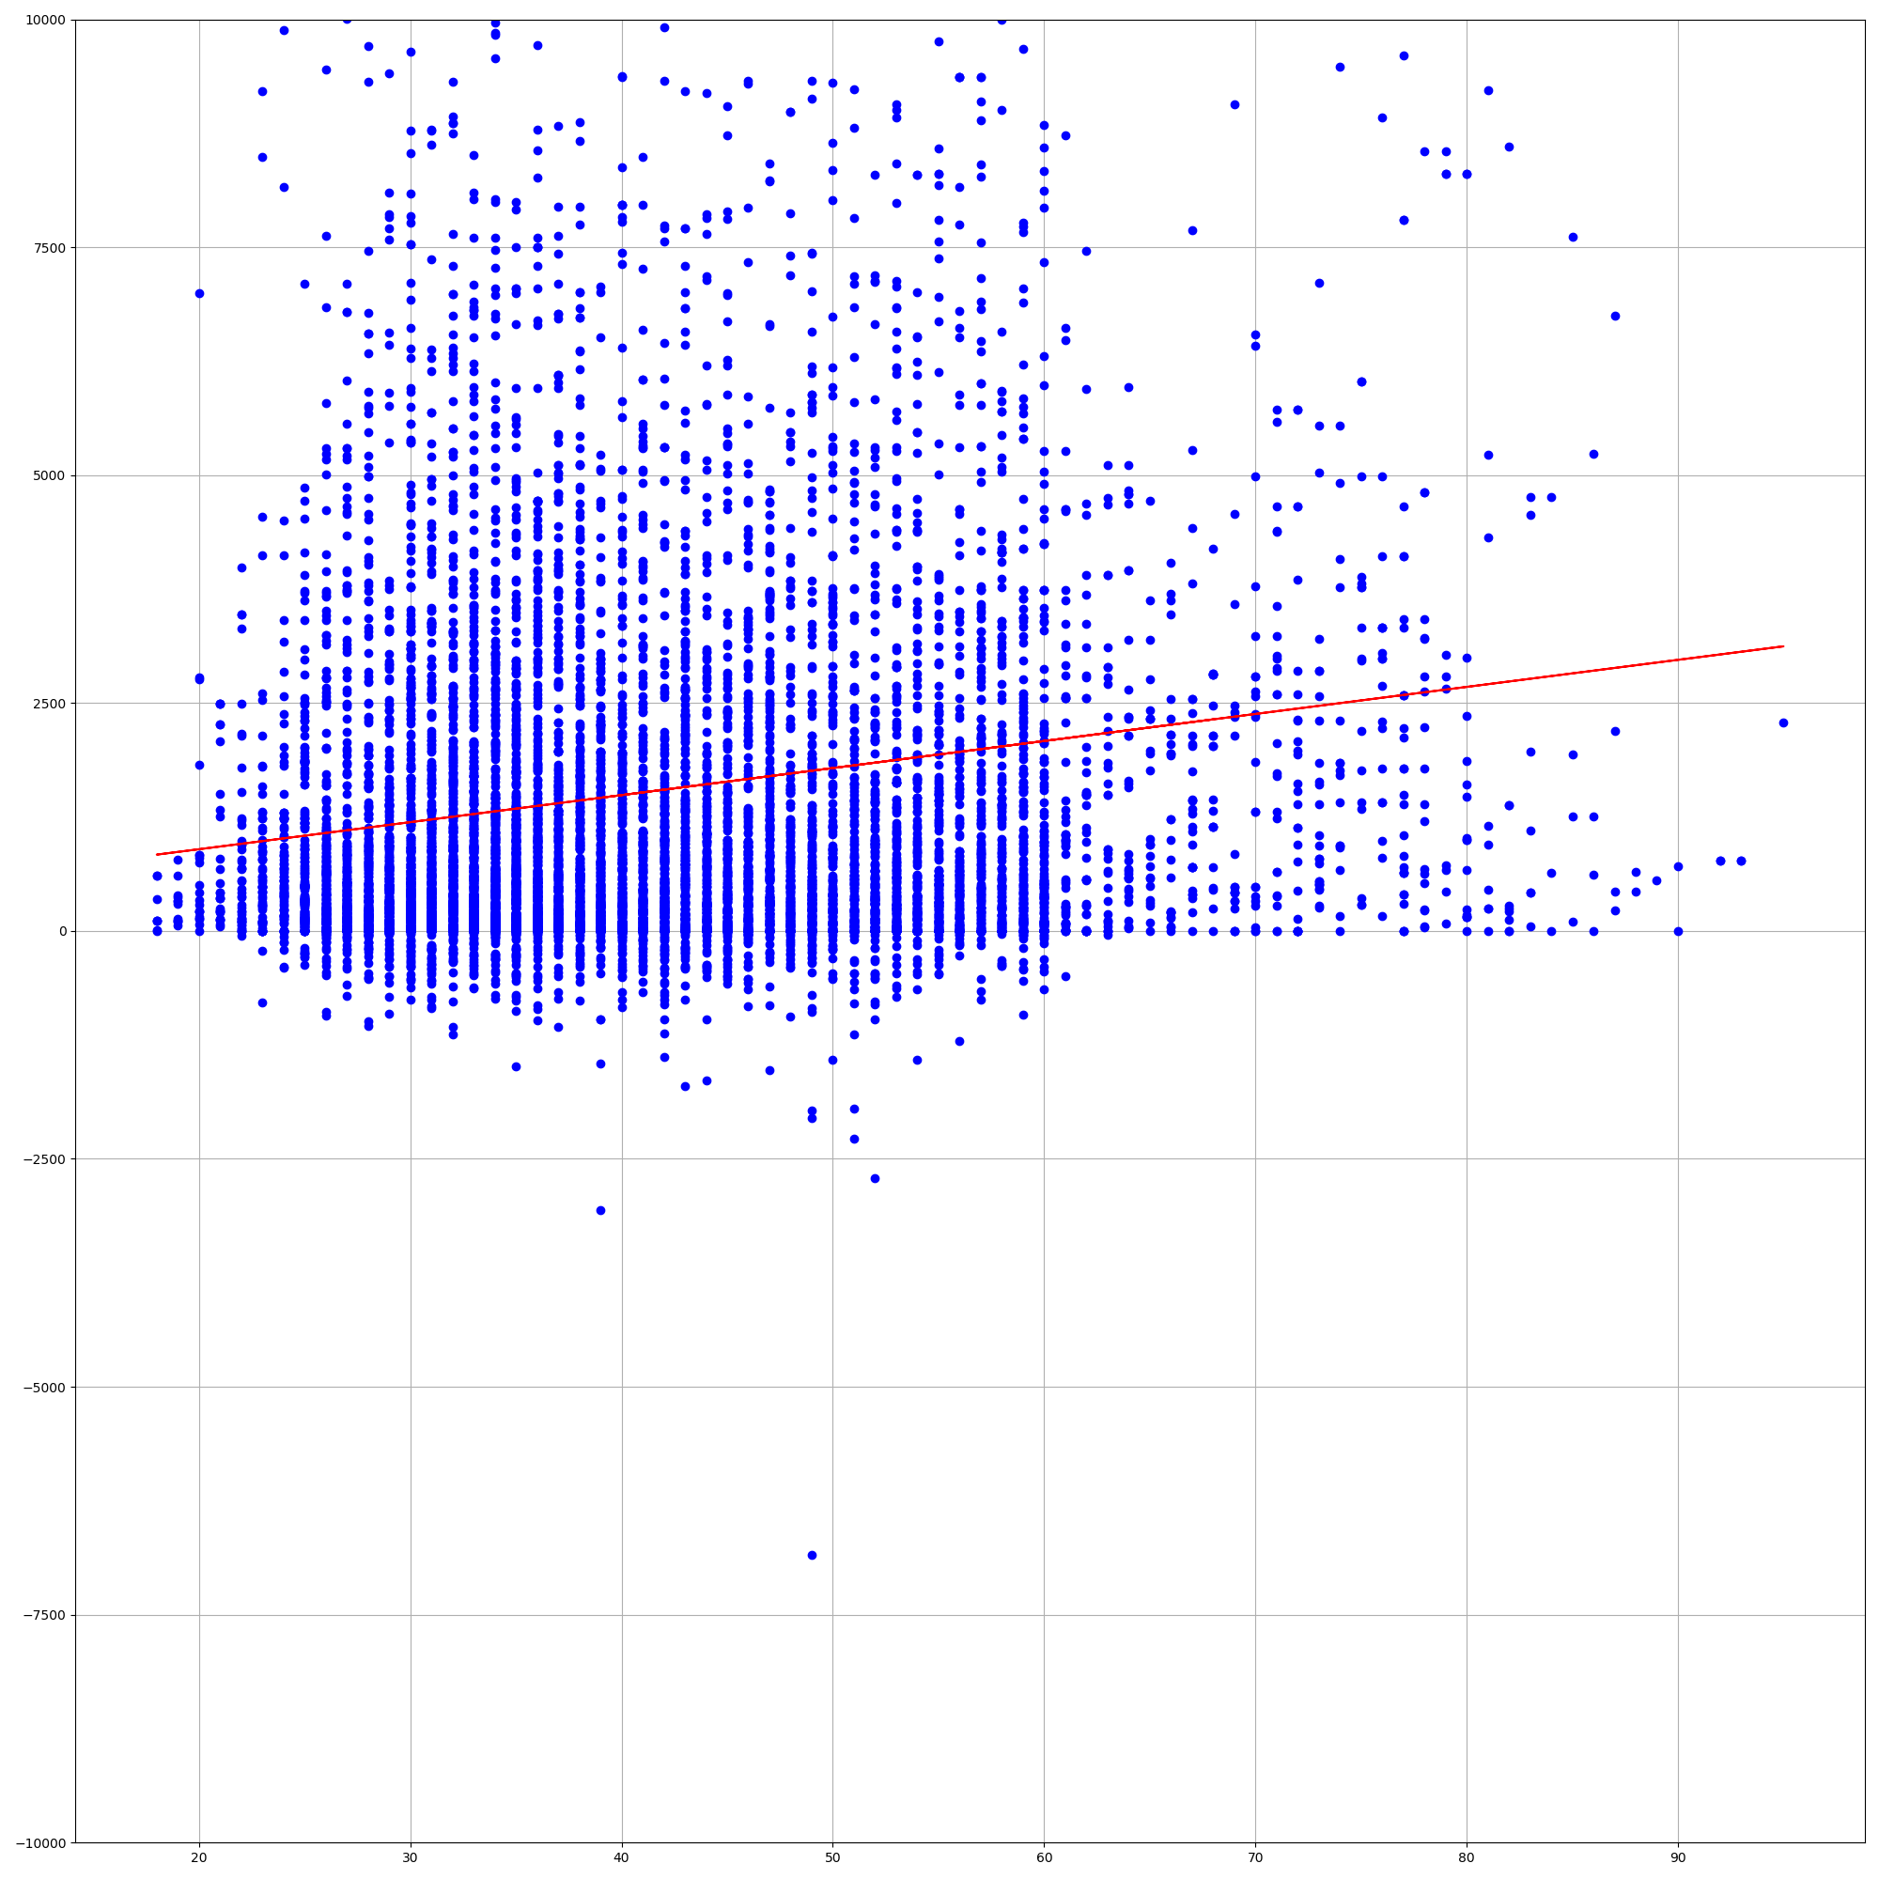
Data Preprocessing
2
By related feature value
Numeric
Categorical
Linear Regression / Median
Mode
Fill missing data to specific values [Numeric]
Linear Regression
Y = 29.679 * X + 302.99
balance
If age value is “20”
’29.679*20 + 302.99’
Age

Slide 28
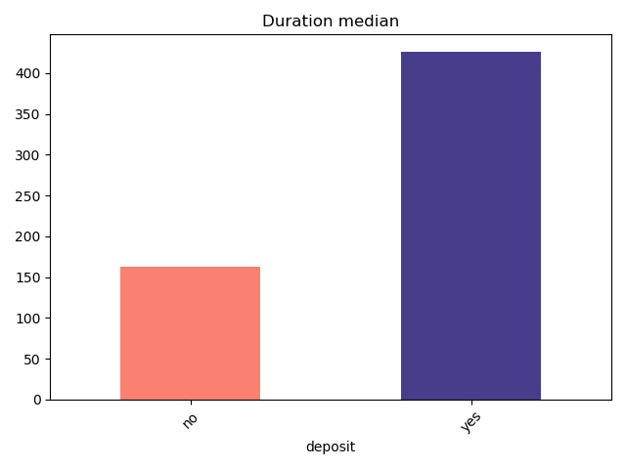
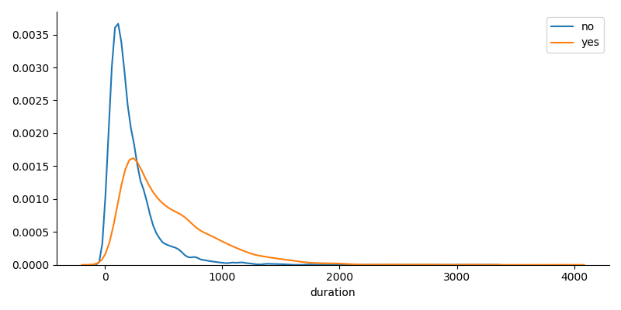
Data Preprocessing
2
By related feature value
Numeric
Categorical
Linear Regression / Median
Mode
Fill missing data to specific values [Numeric]
Yes : 426
If deposit value is “Yes”
Fill duration to ‘163’
If deposit value is “No”
Fill duration to ‘426’
No : 163

Slide 29
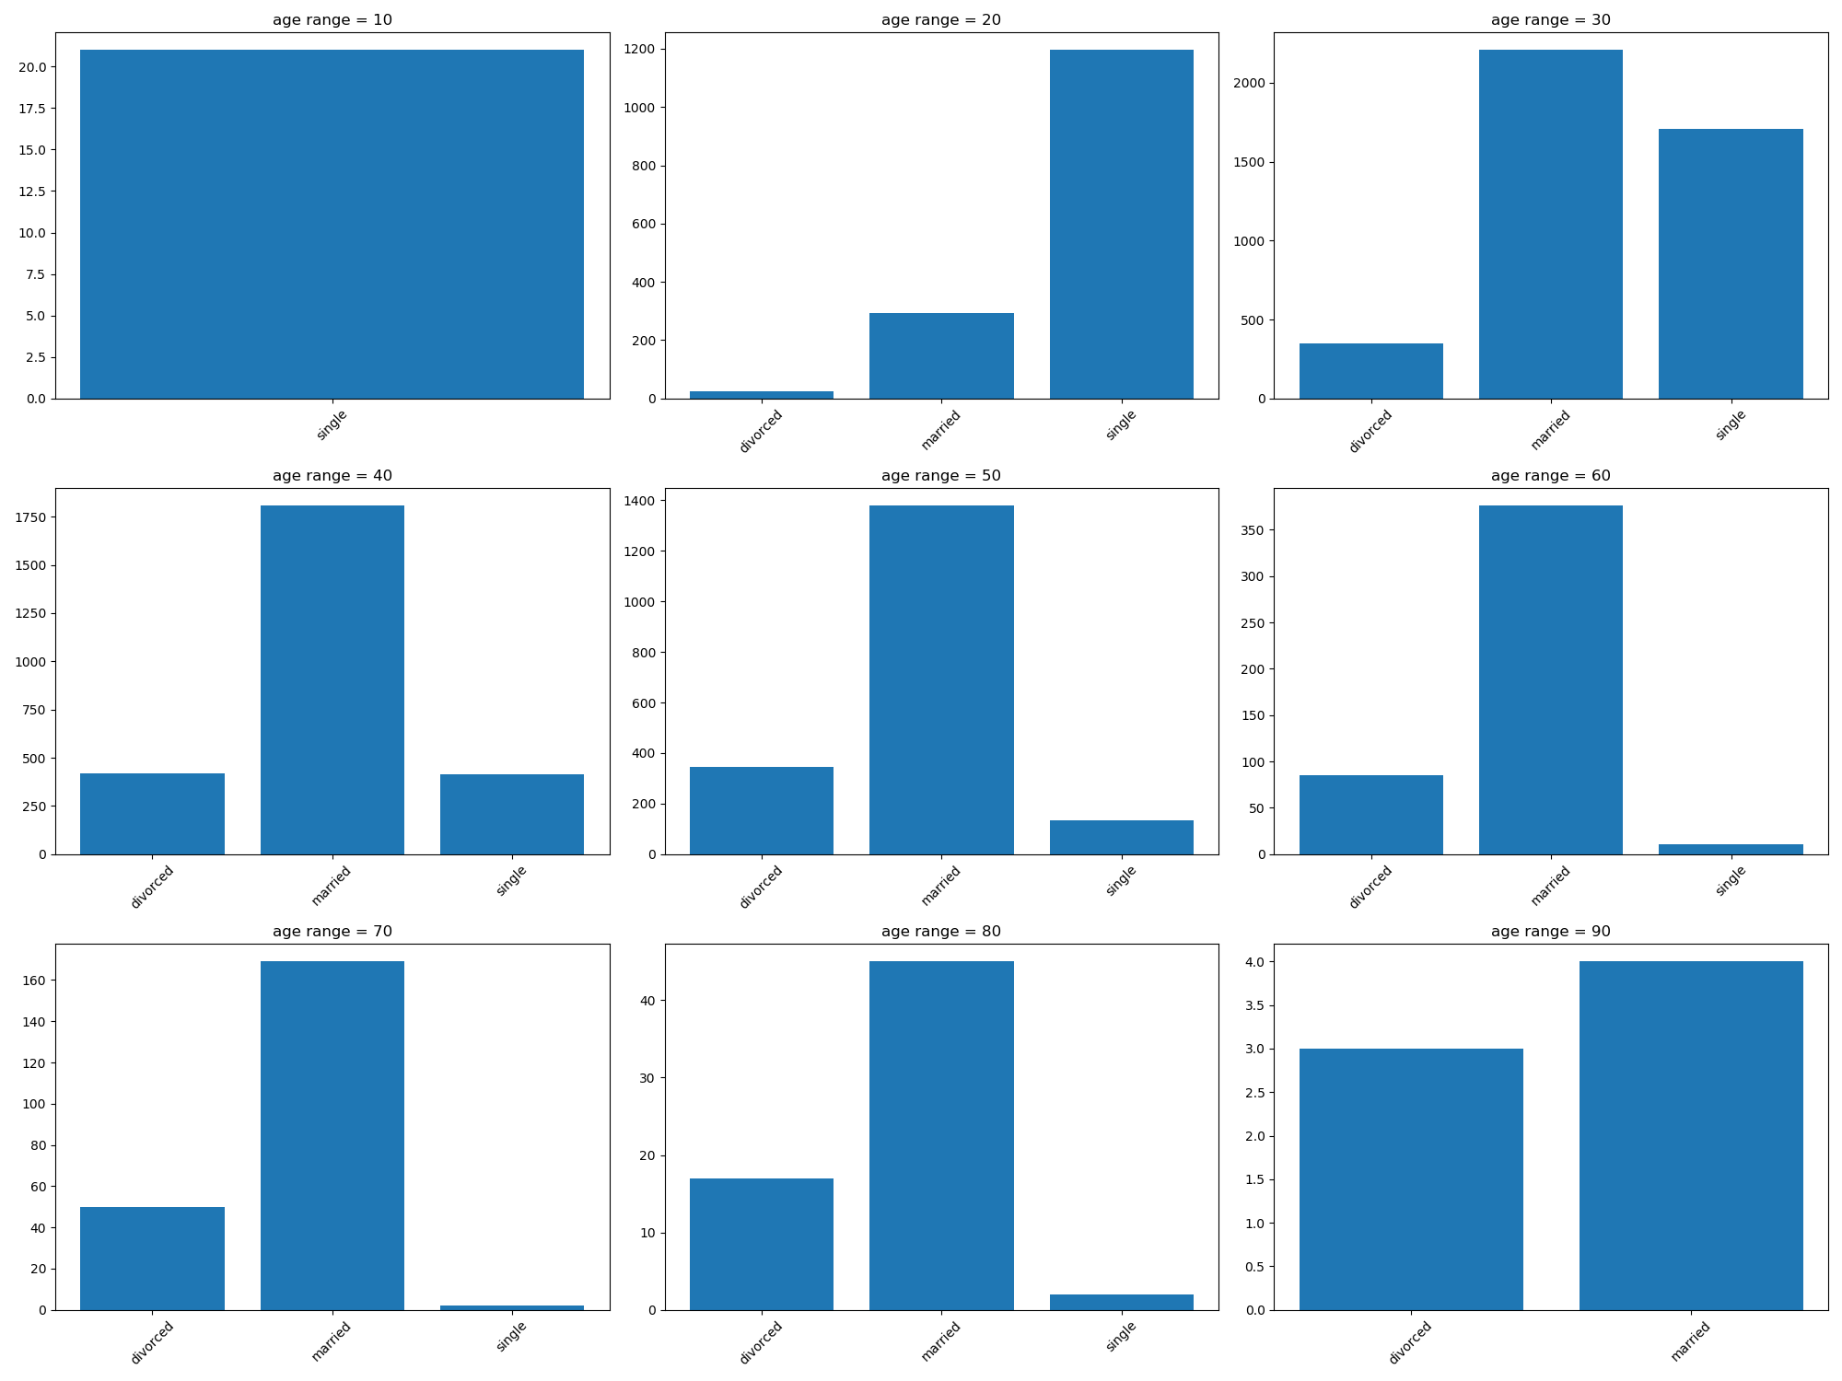
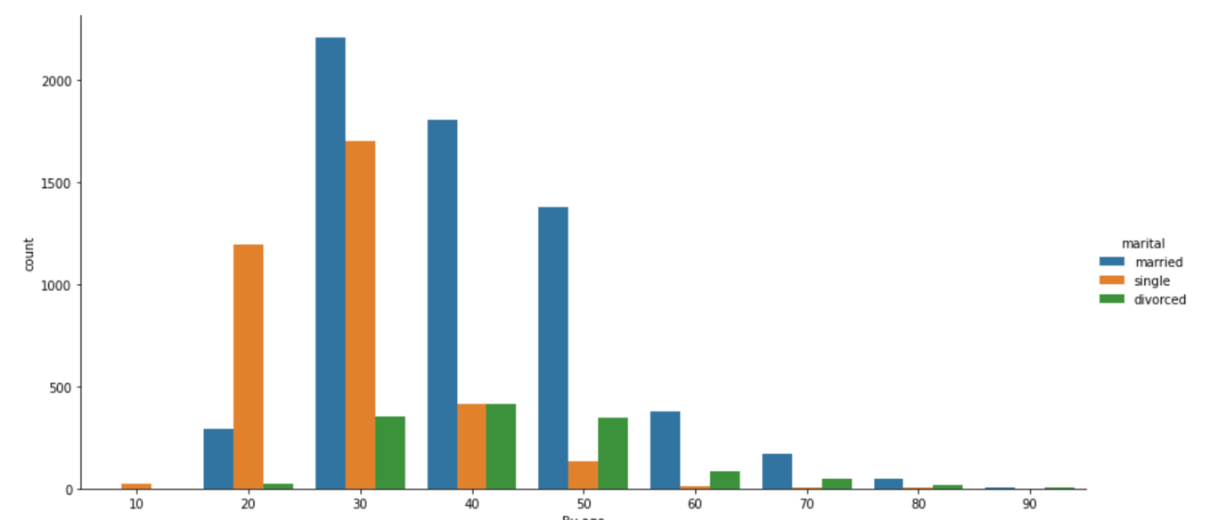
Data Preprocessing
2
By related feature value
Numeric
Categorical
Linear Regression / Median
Mode
Fill missing data to specific values [Categorical]
If 20’s “Single”
If 30’s “Married”
If 40’s “Married”

Slide 30
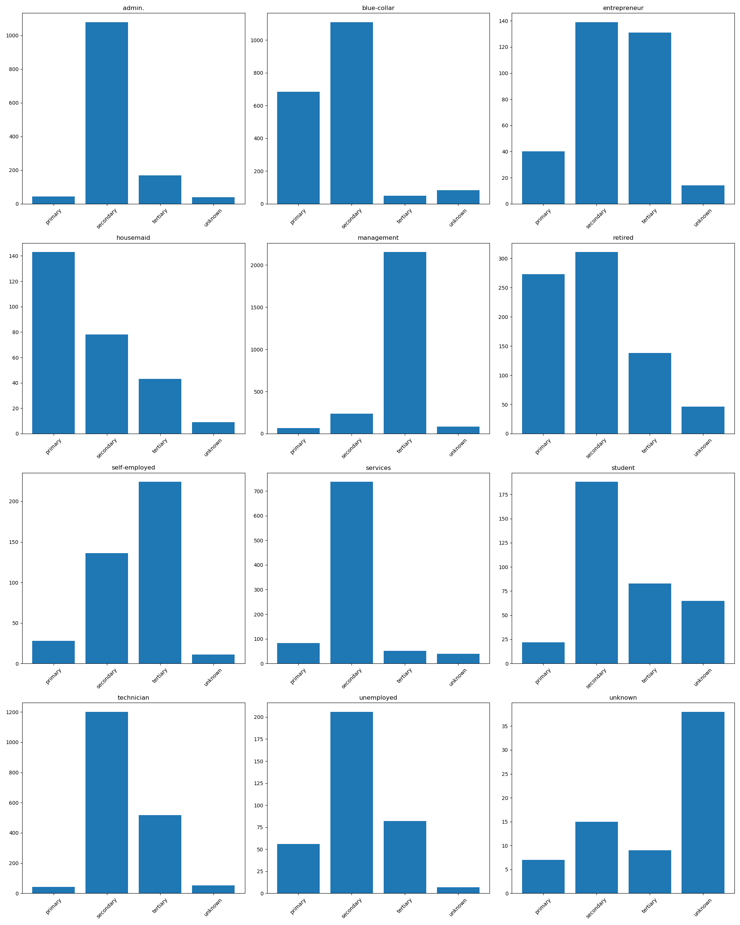
Data Preprocessing
2
By related feature value
Numeric
Categorical
Linear Regression / Median
Mode
Fill missing data to specific values [Categorical]
If the job is “housemaid” “primary”
If the job is “management” “tertiary”
If “retired” “secondary”
primary
tertiary
secondary

Slide 31
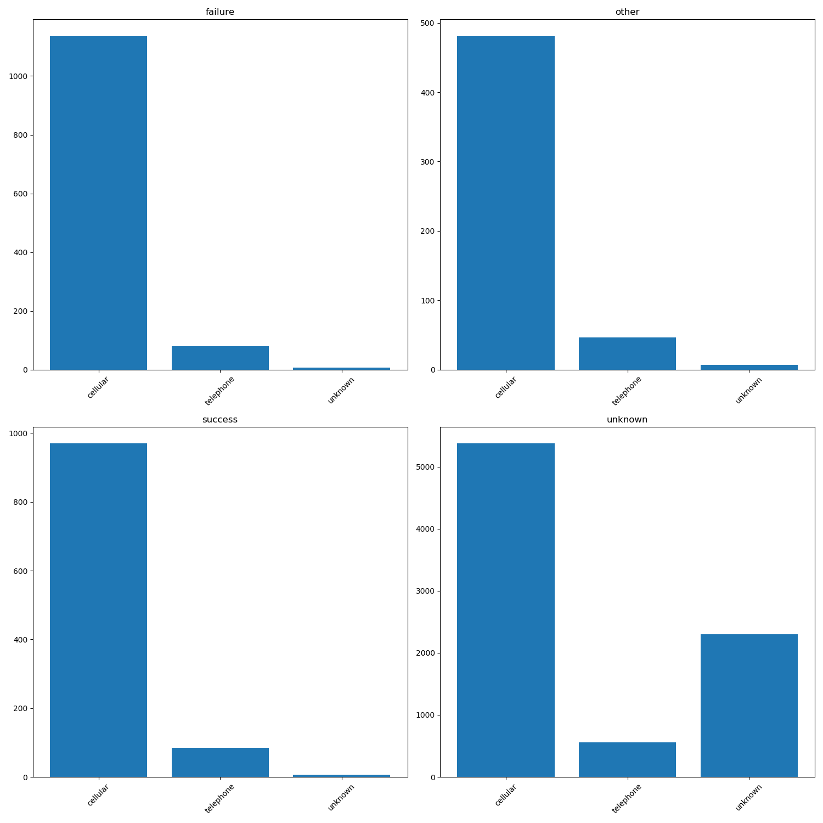
Data Preprocessing
2
By related feature value
Numeric
Categorical
Linear Regression / Median
Mode
Fill missing data to specific values [Categorical]
If contact is “success”
Fill contact to ‘cellular’
If contact is “failure”
Fill contact to ‘cellular’

Slide 32
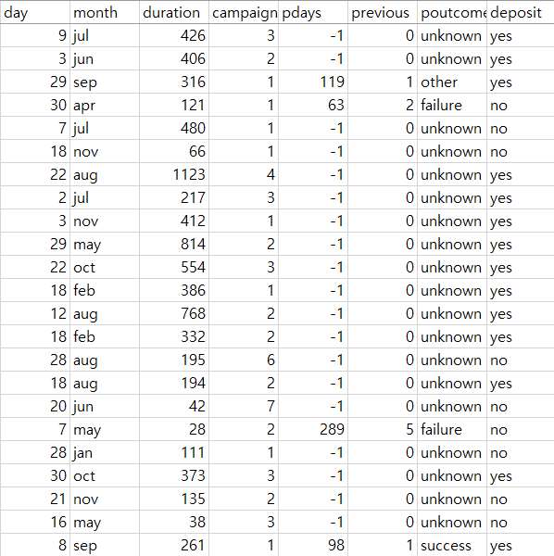
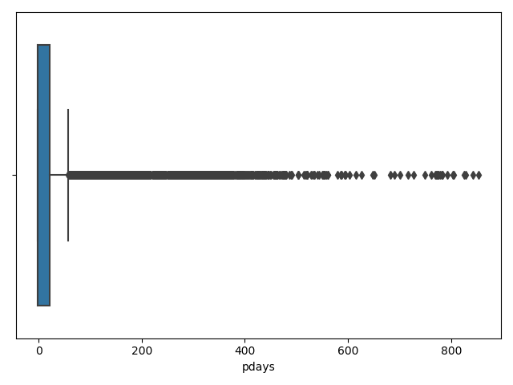
Data Preprocessing
Outlier Data
Percentage of -1 of ‘pdays’ column : 74.5%

Slide 33
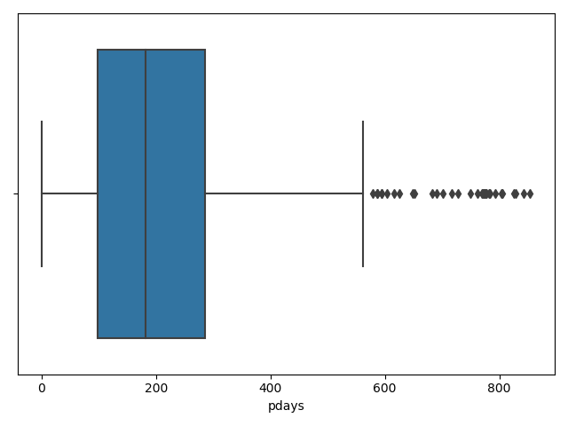
Data Preprocessing
Handle outlier data
Percentage of -1 of ‘pdays’ column : 74.5%
Drop ‘pdays’ feature
Before remove -1
After remove -1
Notes:
detectOutlier

Slide 34
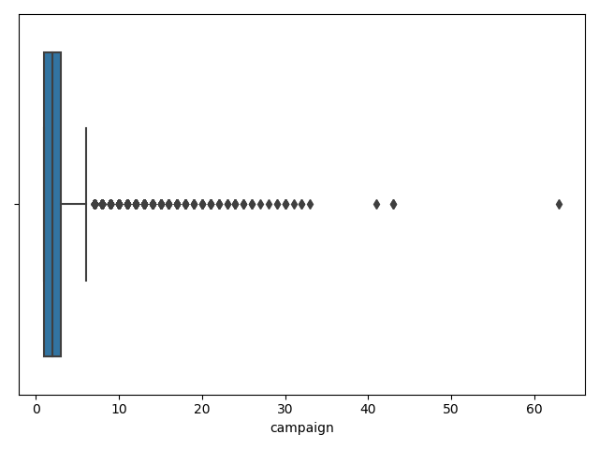
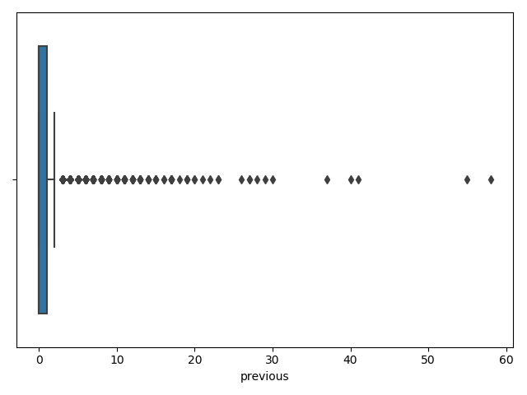
Data Preprocessing
Handle outlier data
Replace to median value !
Above 35
Above 40

Slide 35
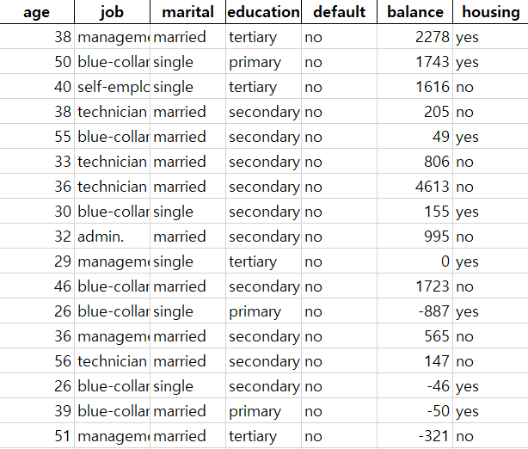
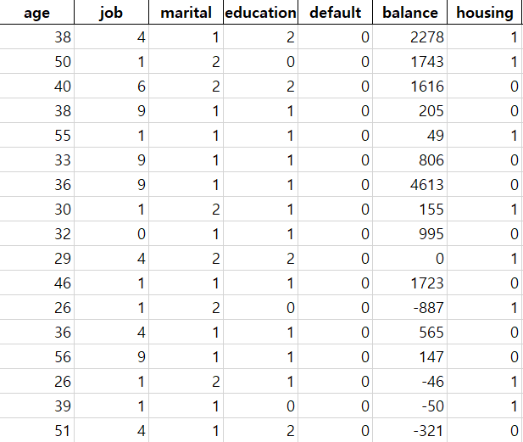
Data Preprocessing
Encoding

Slide 36
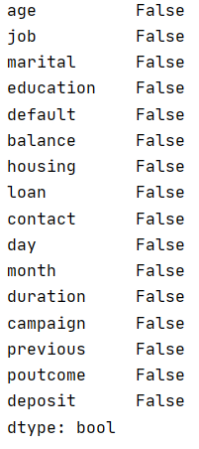
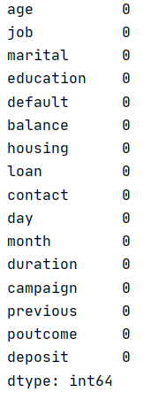
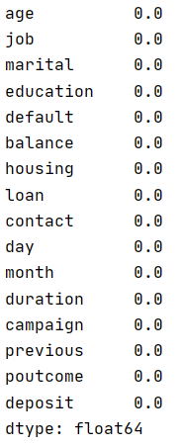
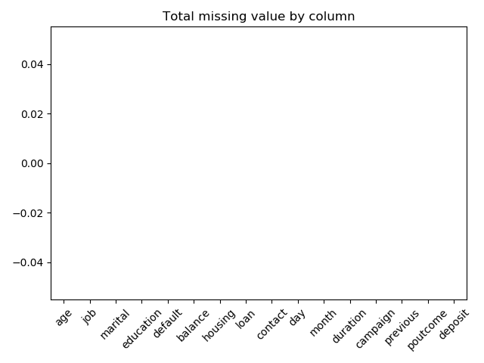
Data Preprocessing
Missing value
existence status
How many
missing value?
Percentage of
missing value
Complete cleaning!
Clean!
Percentage of that is missing : 0 %
Notes:
Preprocessing 후
- 몇 개에서 몇 개 된건지도 보여주면? 좋을듯

Slide 37
Data Analysis

Slide 38

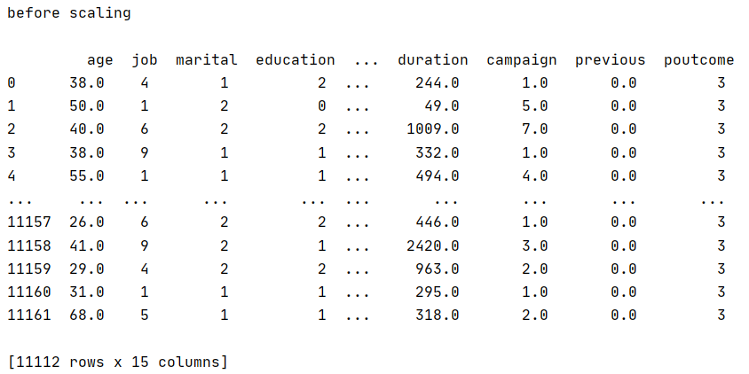
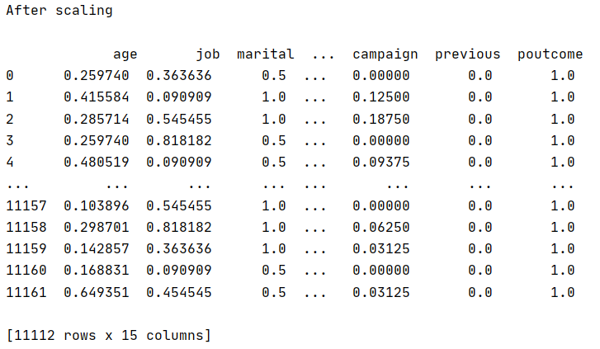
Data Analysis
Data Scaling

Slide 39
Data Analysis
Analysis Algorithm
classifier1 = KNeighborsClassifier()
classifier1.fit(X_train, y_train)
classifier1.predict(X_test)
K-Nearest Neighbors
classifier1 = DecisionTreeClassifier(criterion='entropy', random_state=0)
classifier1.fit(X_train, y_train)
classifier1.predict(X_test)
Decision Tree
classifier1 = xgb.XGBClassifier()
classifier1.fit(X_train, y_train.squeeze().values)
classifier1.predict(X_test)
XGBoost

Slide 40
Data Evaluation

Slide 41
Data Evaluation
Algorithm
K-Nearest Neighbors
Decision Tree
XGBoost
Hold out method
Hold out method
Hold out method
Cross validation
Cross validation
Cross validation
Bagging
Bagging
Classfier 1
Classfier 2
Classfier 3
Majority Voting

Slide 42
Data Evaluation
Hypertuning By GridSearchCV !!
Algorithm
XGBoost
K-Nearest Neighbors
XGBoost
K-Nearest Neighbors
Decision Tree
Decision Tree
Hold out method
Hold out method
Hold out method
Hold out method
Hold out method
Hold out method
Cross validation
Cross validation
Cross validation
Cross validation
Cross validation
Cross validation
Bagging
Bagging
Bagging
Bagging
Bagging
Classfier 1
Classfier 1
Classfier 2
Classfier 2
Classfier 3
Classfier 3
knn_gscv = GridSearchCV(classifier2, param_grid, cv=cv)
knn_gscv.fit(X, y)
bestParams = knn_gscv.best_params_
bestEstimator = knn_gscv.best_estimator_
Get best parameter
Majority Voting

Slide 43
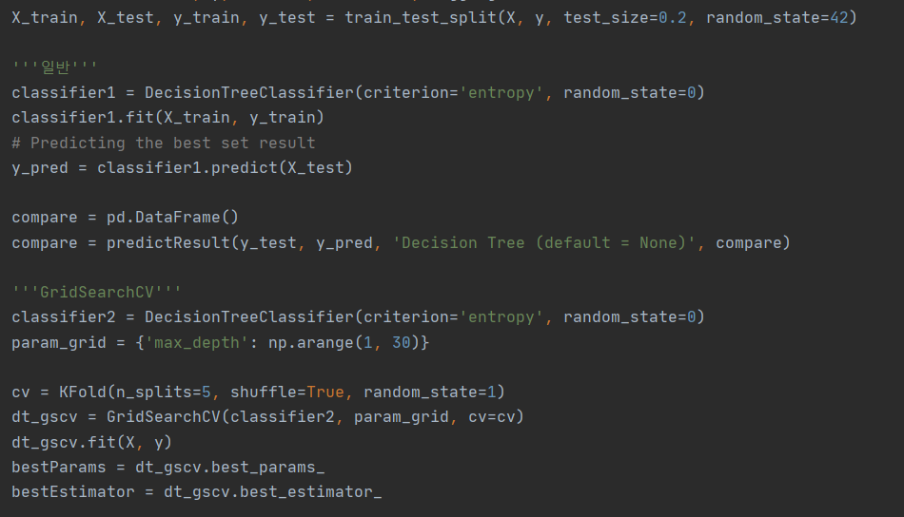
Data Evaluation
Example – Decision Tree
Separate from the train set to the training set and the test set by hold-out method
Perform default parameters without Hyper-parameter tuning.
Tuning Hyper-parameter Using GridSearchCV
Using tuned Hyper-parameter, refit and predict
Compare prediction of holdout method with defaultparameter and with tuned hyper-parameter
Cross validation with tuned hyper-parameter
Use tuned hyper-parameter for bagging algorithm

Slide 44
Data Evaluation
Example – Decision Tree
Separate from the train set to the training set and the test set by hold-out method
Perform default parameters without Hyper-parameter tuning.
Tuning Hyper-parameter Using GridSearchCV
Using tuned Hyper-parameter, refit and predict
Compare prediction of holdout method with defaultparameter and with tuned hyper-parameter
Cross validation with tuned hyper-parameter
Use tuned hyper-parameter for bagging algorithm

Slide 45
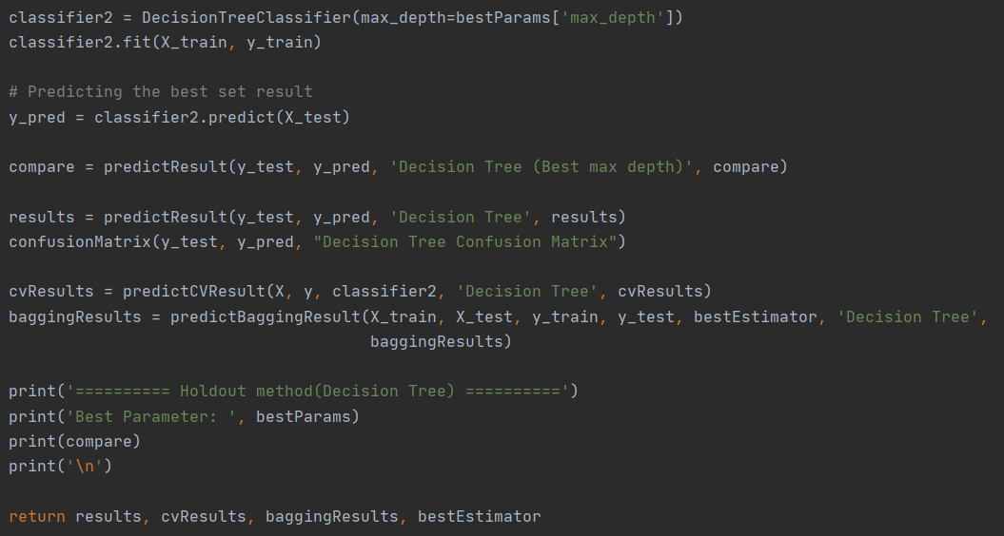
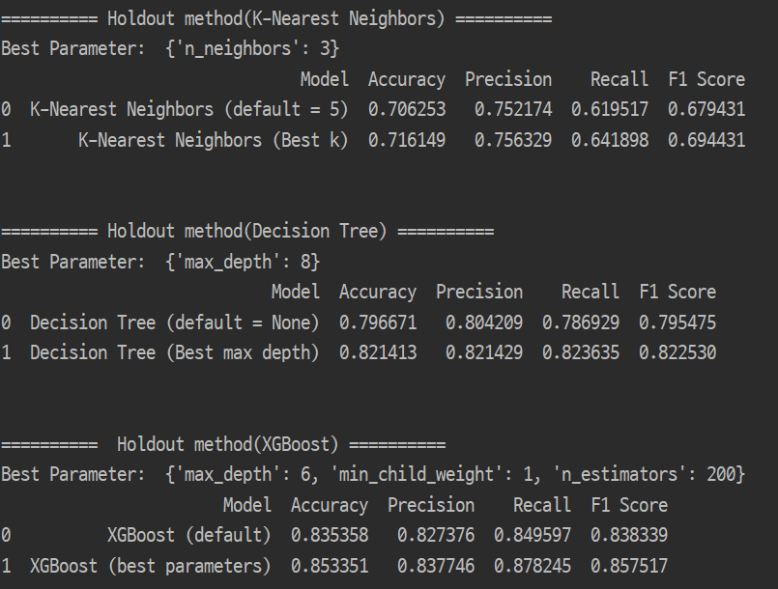
Data Evaluation
Example – Decision Tree
Separate from the train set to the training set and the test set by hold-out method
Perform default parameters without Hyper-parameter tuning.
Tuning Hyper-parameter Using GridSearchCV
Using tuned Hyper-parameter, refit and predict
Compare prediction of holdout method with defaultparameter and with tuned hyper-parameter
Cross validation with tuned hyper-parameter
Use tuned hyper-parameter for bagging algorithm

Slide 46
Data Evaluation
Example – Decision Tree
Separate from the train set to the training set and the test set by hold-out method
Perform default parameters without Hyper-parameter tuning.
Tuning Hyper-parameter Using GridSearchCV
Using tuned Hyper-parameter, refit and predict
Compare prediction of holdout method with defaultparameter and with tuned hyper-parameter
Cross validation with tuned hyper-parameter
Use tuned hyper-parameter for bagging algorithm

Slide 47
Data Evaluation
Result – Parameter tuning
Accuracy increases with parameter tuning.

Slide 48
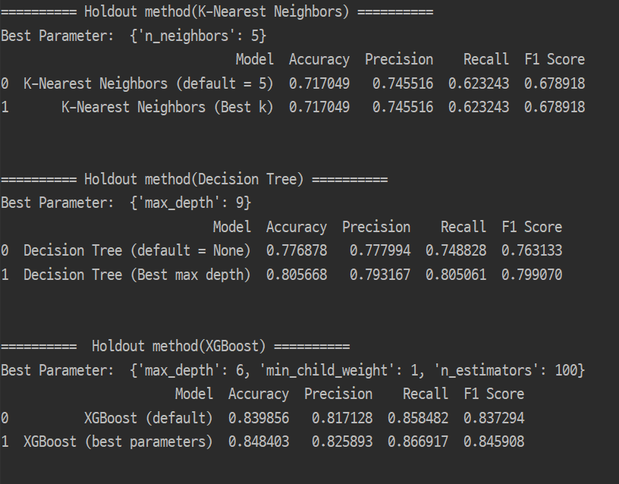
Data Evaluation
Result – Comparison of preprocessing method
In the second cleaning method,
the decision tree and XGBoost accuracy are better.
Cleaning 1
Cleaning 2

Slide 49
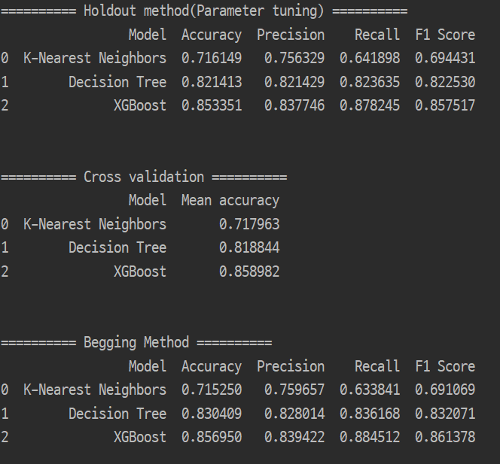
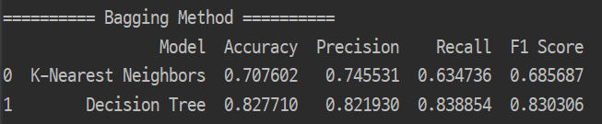
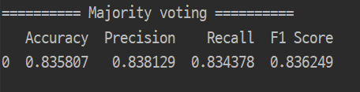
Data Evaluation
Result - Comparison of three algorithms
But did not produce better results in bagging and voting.
When using the bagging method,
the decision tree rose slightly, but the KNN fell slightly.
XGBoost has the highest accuracy !

Slide 50
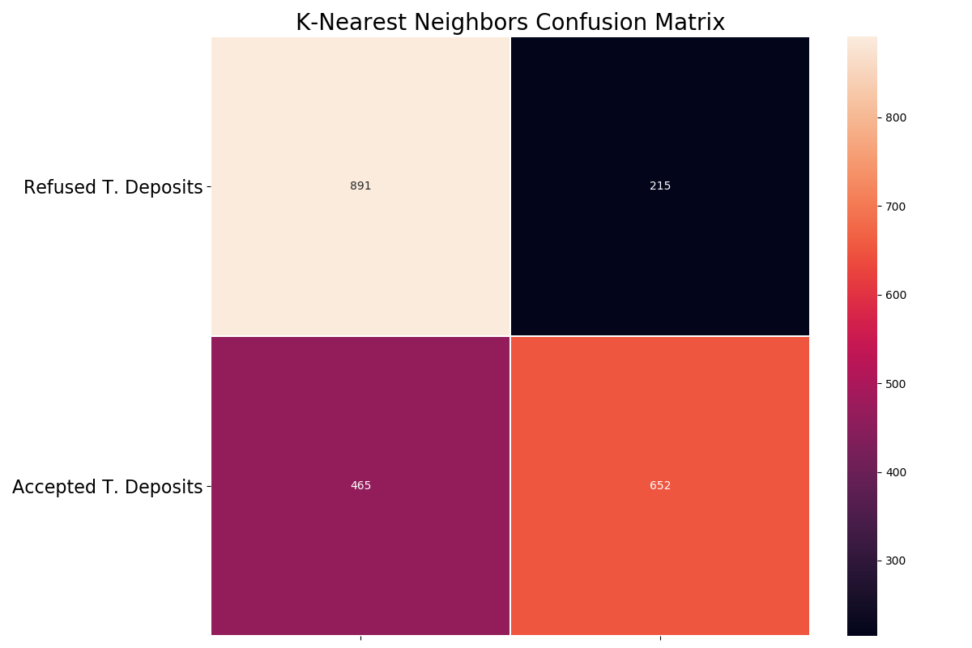

Data Evaluation
Confusion Matrix : K-Nearest Neighbors

Slide 51


Data Evaluation
Confusion Matrix : Decision Tree

Slide 52

Data Evaluation
Confusion Matrix : XGBoost

Slide 53
Conclusion

Slide 54

Conclusion
contact, poutcome, duration → important!
Notes:
정확도가가장높
은XGBoost를사용하여중요컬럼을확인한결과연락수단과과거캠페인결과, 이번캠페인동안의연락한시간, 이전캠페인에서연락한횟수가가장중요하게나왔다.
지난캠페인에서구독했던사람들이이번캠페인에도구독할가능성이굉장히높다.

Slide 55


Conclusion
High possibility that people who have subscribed in the last campaign will subscribe in this campaign.
The higher the number of contacts in the previous
campaign, the higher the average subscription rate.
Notes:
정확도가가장높
은XGBoost를사용하여중요컬럼을확인한결과연락수단과과거캠페인결과, 이번캠페인동안의연락한시간, 이전캠페인에서연락한횟수가가장중요하게나왔다.
지난캠페인에서구독했던사람들이이번캠페인에도구독할가능성이굉장히높다.

Slide 56


Conclusion
The longer you keep in touch during the campaign,
the more likely you are to subscribe.
On the other hand, too much contact during the
campaign leads to a lower subscription rate.

Slide 57



Team Member
최준헌
김지현
양희림
201533673
chjh121@gmail.com
Data preprocessing
Data Analysis
Data Evalution
Conclusion
201633310
zizi39028@gmail.com
Proposal ppt
Graph visualization
Data preprocessing
Final presentation
201735853
yanghl1998@gmail.com
Data preprocessing
Dataset management
Generate invalid data
Final ppt

Slide 58
THANK YOU

