Slide 1
JunHyoung-Lee System Semiconductor Engineering University of Sangmyung
Python(Unit27-Unit33)
Spring 2022

Slide 2
index
File
Palindrome and N-gram
Function
Lambda
Closure

Slide 3
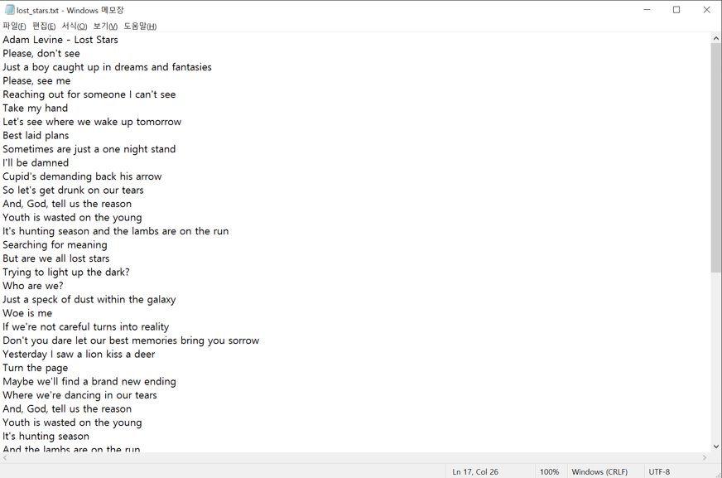
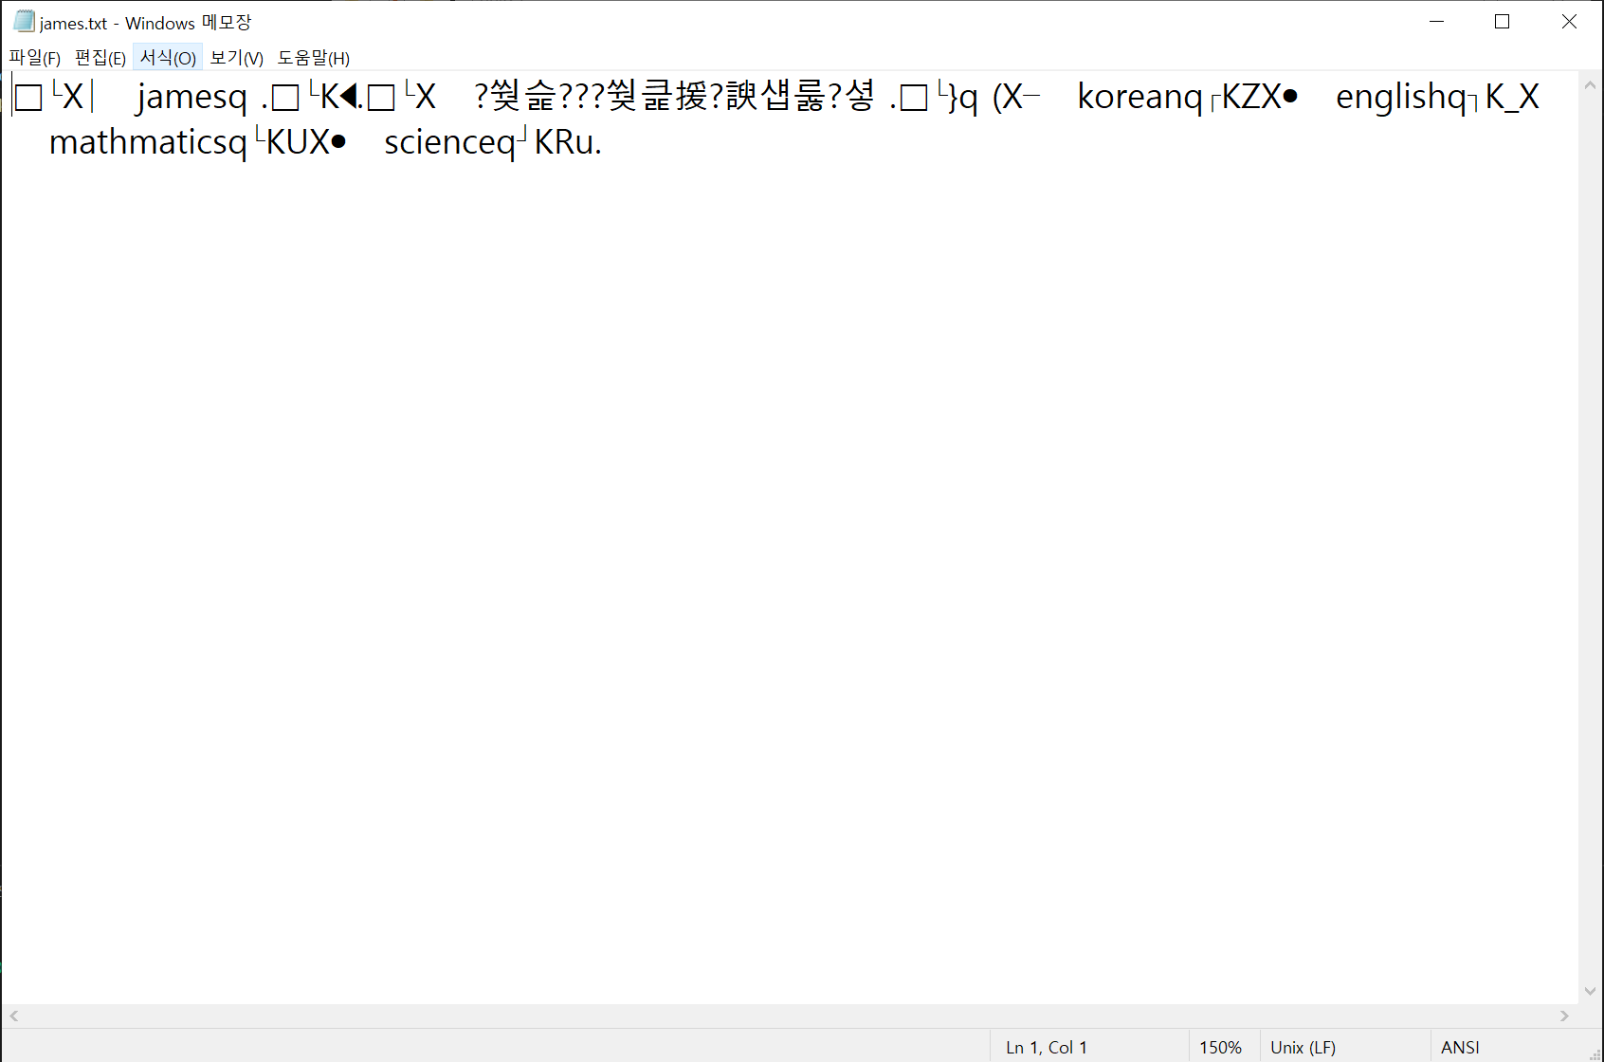
File
vast amounts of data
binary file

Slide 4


File
read
write/save

Slide 5
File
file = open()
read / write
file.close()

Slide 6
File
open()
open(file_address, file_mode)
file = open(‘hello.txt’, ‘w’)

Slide 7
File
file_mode
read
write
read/write
w
(delete and write)
r+
w+
t
b
a
(text mode)
+
r
(write afterwards)
x
(read)
x+
a+
(error if file exists)
(binary mode)

Slide 8
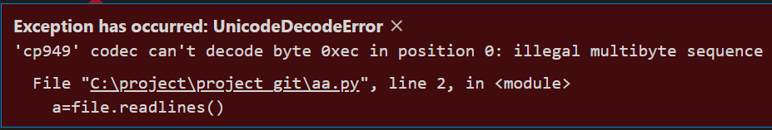
File
encoding
file = open('hello_list1.txt', 'r')
lines = file.readlines()
print(lines)
file.close

Slide 9
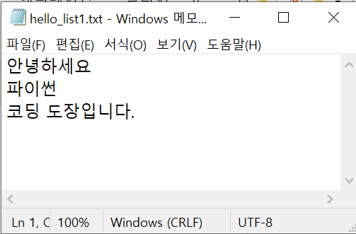
File
encoding
file = open('hello_list1.txt', 'r', encoding='UTF-8')
lines = file.readlines()
print(lines)
file.close

Slide 10
File
encoding
file = open('hello_list1.txt','r', encoding='UTF-8')
lines = file.readlines()
print(lines)
file.close

Slide 11
File
read/write
read
write
read()
readline()
readlines()
write()
writelines()

Slide 12
File
close()
file = open('hello_list1.txt', 'r', encoding='UTF-8')
lines=file.readlines()
print(lines)
file.close
At the end of the operation of the file object

Slide 13
File
with as
with open() as file:
file = open('hello_list1.txt', 'r', encoding='UTF-8')
lines = file.readlines()
print(lines)
file.close
with open('hello_list1.txt','r', encoding='UTF-8') as file:
lines=file.readlines()
print(lines)

Slide 14
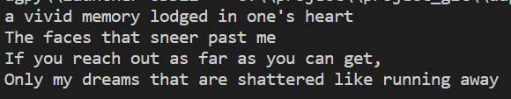
File
Iterator : Objects that can take values out in turn
with open(‘when_the_kid.txt', 'r', encoding='UTF-8') as file:
a, b, c,d = file
print(a, b, c, d, sep='')

Slide 15
File
Iterator
for i in range(100):
…
…
0 | 1 | 2 | 3 | 4 | … | 96 | 97 | 98 | 99

Slide 16
File
Iterator
with open(‘when_the_kid.txt','r', encoding='UTF-8') as file:
print(file)

Slide 17



Palindrome and N-gram
Palindrome and N-gram

Slide 18
Palindrome and N-gram
Palindrome
rotor
Madam, I'm Adam
level
repaper
nauruan
DnD
reviver
bub
deled
kanakanak
race car
mom
noon
marram
madam
rotator
esse
minim
taco cat
Ava
Was it a cat I saw?
PvP
rotavator
bob
pullup
DVD
A man, a plan, a canal - Panama!

Slide 19
Palindrome and N-gram
Palindrome
l | e | v | e | l
=
=

Slide 20
Palindrome and N-gram
Palindrome
l | e | v | e | l
[1] [2] [3] [4] [5]
[-5] [-4] [-3] [-2] [-1]
print(word == word[::-1])
print(list(word) == list(reversed(word)))
print(word == ''.join(reversed(word)))

Slide 21
Palindrome and N-gram
Palindrome
print(list(word) == list(reversed(word)))
list
reversed
l | e | v | e | l
l | e | v | e | l
=
print(word == ''.join(reversed(word)))
‘level’
‘level’
=

Slide 22
Palindrome and N-gram
Palindrome
l | e | v | e | l
[1] [2] [3] [4] [5]
[-5] [-4] [-3] [-2] [-1]
print(word == word[::-1])
print(list(word) == list(reversed(word)))
print(''.join(reversed(word)))
print(word == ''.join(reversed(word)))

Slide 23
Palindrome and N-gram
N - gram
2-gram
a | p | p | l | e
ap
pp
pl
le
5-gram
apple watch
golden apple
apple pie
apple, pple , ple w, le wa, …
golde, olden, … , ppl, appl, apple
apple, pple , ple p, ple p, …

Slide 24

Palindrome and N-gram
N - gram
text[i] text[i+1]
a | p | p | l | e
ap
pp
pl
le
text = 'Hello'
for i in range(len(text)-1):
print(text[i],text[i+1],sep='')

Slide 25
Palindrome and N-gram
N – gram - zip
zip : tie each element of iterable with a tuple
a | p | p | l | e
p | p | l | e

Slide 26

Palindrome and N-gram
N – gram - zip
text = 'hello'
two_gram = zip(text,text[1:])
print(list(two_gram))
for i in two_gram:
print(i[0],i[1],sep='')

Slide 27
Function
Expression
def function_name(Parameters1, Parameters2, ...):
code
return value

Slide 28
Function
Function
def add(x, y):
add_num = x + y
print(add_num)
add(2, 3)

Slide 29
Function
Function
def function_name(Parameters1, Parameters2, ...):
code
return value

Slide 30
Function
Parameters
positional agument
keyword agument

Slide 31
Function
positional agument : method of putting the arguments in order
def add(x, y):
add_num = x + y
print(add_num)
add(2, 3)

Slide 32
Function
positional agument - list unpacking
def add(x, y):
add_num = x + y
print(add_num)
list = [2, 3]
add(*list)
x= [2, 3]
add(*list)
unpacking
add(2, 3)

Slide 33

Function
positional agument – varable argument
def n_print(*n_list):
for i in n_list:
print(i)
n_print(10, 20, 30, 40)

Slide 34

Function
keyword agument
def introduction(name, age, country):
print('name :', name)
print('age :', age)
print('country :', country)
introduction('JunHyoung', 23, 'Korean')

Slide 35

Function
keyword agument
def introduction(name, age, country):
print('name :', name)
print('age :', age)
print('country :', country)
introduction(name = 'JunHyoung', age = 23, country = 'Korean')
def introduction(name, age, country):
print('name :', name)
print('age :', age)
print('country :', country)
introduction(country = 'Korean', age = 23, name = 'JunHyoung')

Slide 36
Function
keyword agument
print(a, b, c, sep=' ', end='')

Slide 37
Function
keyword agument - dictionary unpacking
function(*list)
function(**dictionary)

Slide 38

Function
keyword agument - dictionary unpacking
def introduction(name, age, country):
print('name :', name)
print('age :', age)
print('country :', country)
d = {'name' : 'JunHyoung', 'age' : 23, 'country' : 'Korean'}
introduction(**d)

Slide 39
Function
keyword agument - dictionary unpacking
introduction(**d)
unpacking X 2
unpacking
name
age
country
JunHyoung | 23 | Korean
unpacking

Slide 40
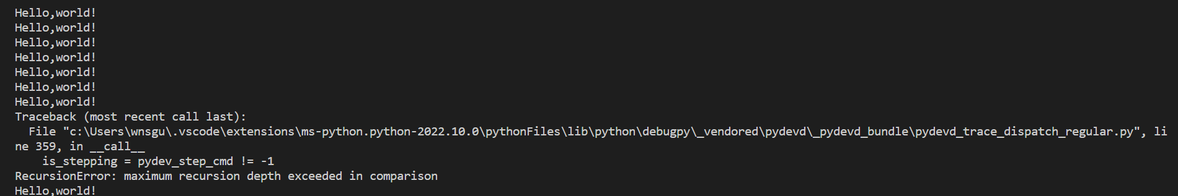
Function
recursive call
Result
def hello():
print('Hello,world!')
hello()
hello()
hello,world! x 80
RecursionError
Hello,world! x 50
Fatal Python error

Slide 41
Function
recursive call
def hello():​
print('Hello,world!')​
hello()​
hello()​​
hello()​​
hello()​​
hello()​​
hello()​​
hello()​​
RecursionError
. . .

Slide 42
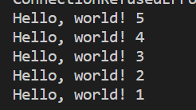
Function
recursive call
Way to end a recursive call : Create an exit condition
def hello(count):
if count == 0:
return
print('Hello,world!',count)
count -= 1
hello(count)
hello(5)

Slide 43
Function
recursive call
def hello(count):
if count == 0:
return
print('Hello,world!',count)
count -= 1
hello(count)
hello(4)​​
hello(3)​​
hello(2)​​
hello(1)​​
hello(0)​​
Exit cursive call

Slide 44
lambda
Expression
lambda parameter : expression

Slide 45
lambda
lambda
Anonymous function
plus_ten = lambda x : x + 10
print(pt_ten(1))
def plus_ten():
return x + 10
print(plus_ten(1))
Add Arguments to the end
print((lambda x : x + 10)(1))

Slide 46
lambda
lambda
a function that is easy to use with lambda
map
filter
reduce

Slide 47
lambda
Lambda - map
map : Functions that treat elements in a list as specified functions
List(map(function, list))
Tuple(map(function, tuple))
Ex) a, b = map(int, input().split())

Slide 48
lambda
Lambda - map
print(list(map(lambda x : x + 10, [1, 2, 3])))
1 | 2 | 3
lambda x : x + 10
11 | 12 | 13

Slide 49

lambda
Lambda - filter
Filter : Gets the element when the return value
of the specified function is True
def f(x):
return x > 5 and x < 10
a = [8, 2, 5, 3, 1, 7, 9, 10, 0]
print(list(filter(f, a)))

Slide 50

lambda
Lambda - filter
a =['q', 'G', 'k', 'O', 'a', 'O', 'b', 'D', 'y']
print(list(filter(lambda x : x > 'A' and x < 'Z', a)))

Slide 51
lambda
Lambda - reduce
reduce : A function that treats each element as a specified function and then returns cumulatively with previous results
From functools import reduce
a = [1, 2, 3, 4, 5]
print(reduce(lambda x, y : x + y, a))
1 | 2 | 3 | 4 | 5
3
6
10
15

Slide 52
Closure
closure - need to know
global & local
nonlocal
fuction
in function
first class Object

Slide 53

closure
Closure - global & local
x = 10
def pri():
x = 5
print(x)
pri()
print(x)

Slide 54
closure
closure - global & local
global
x = 10
def pri():
x = 5
print(x)
pri()
print(x)
x = 10
local
x = 5
print(x)
pri()
print(x)

Slide 55

closure
closure - global & local
global
x = 10
def pri():
print(x)
pri()
print(x)
x = 10
local
print(x)
pri()
print(x)

Slide 56

closure
closure - fuction in function
global
outf()
def outf():
x = 10
def inf(x):
print(x + 2)
inf(x)
outf()
x = 10
inf()
print(x + 2)
add(x)
pri()

Slide 57

closure
closure - nonlocal
def outf():
x = 10
def inf():
nonlocal x
x = 20
inf()
print(x)
outf()

Slide 58

closure
closure – first class object
def fara_to_func(func):
return func()
def ironman():
return 'I am ironman'
print(fara_to_func(ironman))

Slide 59
closure
closure
def calc():
a = 3
b = 5
def mul_add(x):
return a * x + b
return mul_add
c = calc()
print(c(1), c(2), c(3), c(4), c(5))

Slide 60
closure
Closure : When using a combination of local variables and codes
calc()
def calc():
a = 3
b = 5
def mul_add(x):
return a * x + b
return mul_add
c = calc()
print(c(1), c(2), c(3), c(4), c(5))
a = 3
b = 5
mul_add
mul_add(x) return a * x + b
return mul_add

Slide 61
reference
https://www.delftstack.com/ko/howto/python/python-open-modes/
-filemode data
https://www.youtube.com/watch?v=1jo6q4dihoU&t=354s
- encoding data
https://yes90.tistory.com/56 - close() data
https://ko.wikipedia.org/wiki/%ED%9A%8C%EB%AC%B8
- palindrome data
https://agibbyeongari.tistory.com/1141 - Palindrome data
https://blog.hexabrain.net/347 - clrosure data

