Slide 1
System Verilog Verification
8-1조
발표자 이준형 | 장현동
2026.03.03

Slide 2
01 | 개요
02 | 목표
03 | 블럭도
04 | Stopwatch
05 | Clock
06 | Uart Fifo
목차

Slide 3
개요
Verification Objective
Stopwatch / Clock 기능 정확성 검증
모듈 간 인터페이스 및 타이밍 검증
SystemVerilog 기반 Self-checking Testbench 구축

Slide 4
목표
Verification Goal
본 프로젝트의 목표는 SystemVerilog 기반 Testbench를 구축하여
UART RX → FIFO & FIFO → UART TX데이터 흐름 검증
FIFO Full/Empty 동작 검증
Baud Rate 기반 UART 타이밍 정확성 검증
Stopwatch 기능 검증 (Start/Stop/Reset)
Clock 시간설정 정확성 검증 을 수행

Slide 5
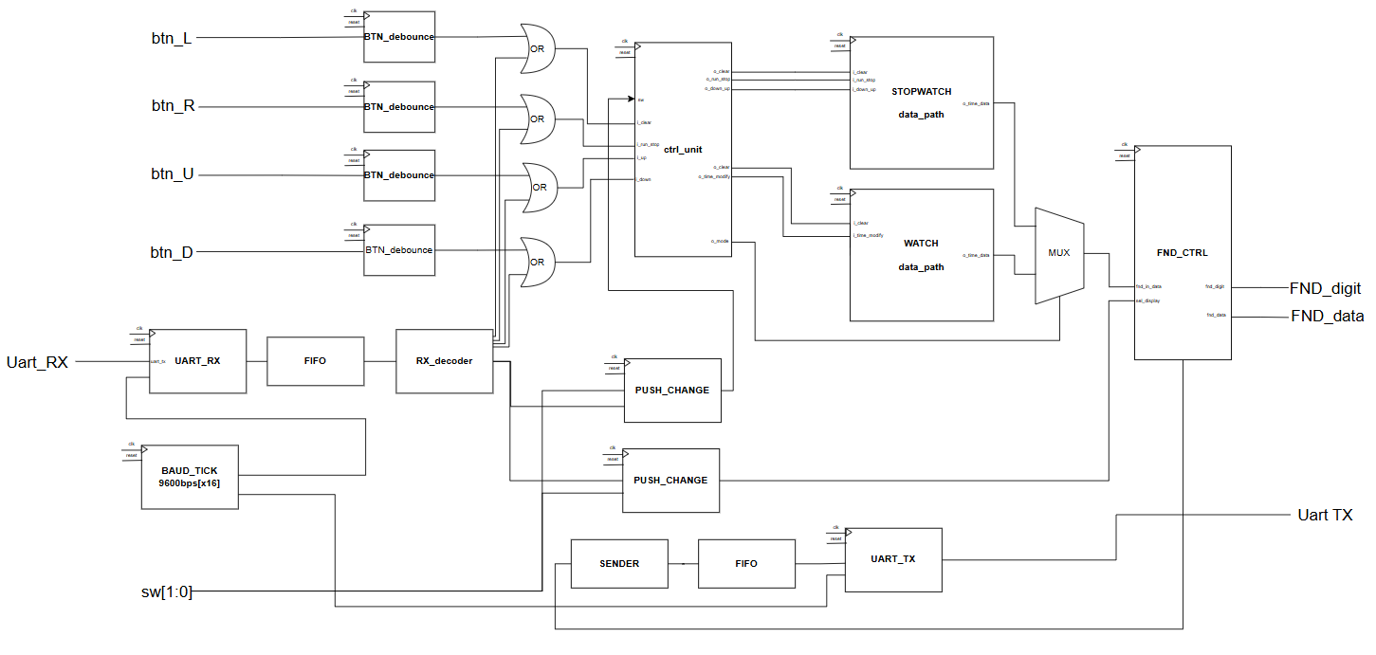
블럭도

Slide 6
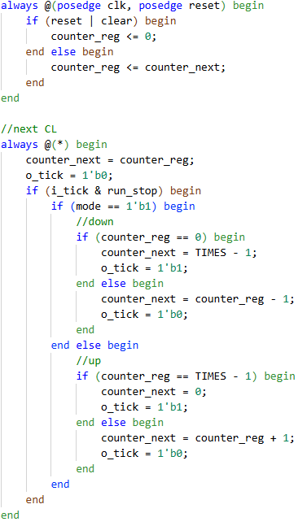
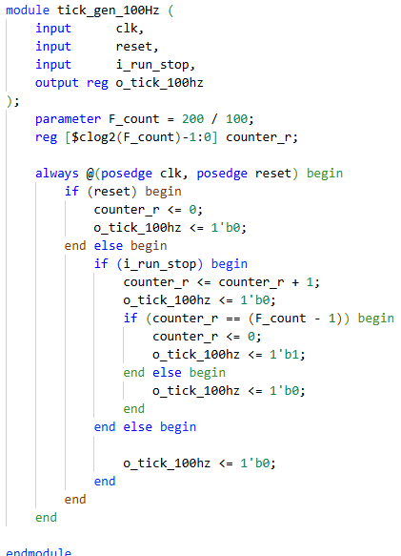
Stopwatch datapath
Stopwatch tick gen
100hz -> clk단위로 변경
run/stop 이 1 일 때 mode 가 1이면 up count, 0이면 down count 동작

Slide 7
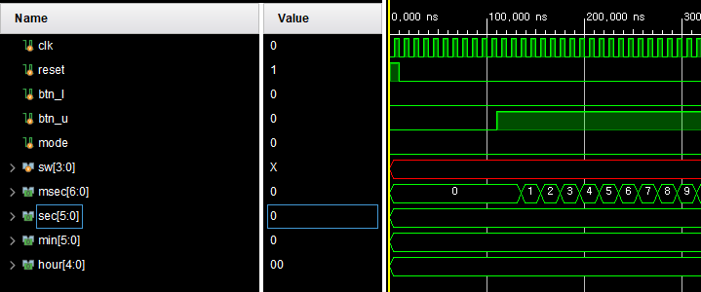
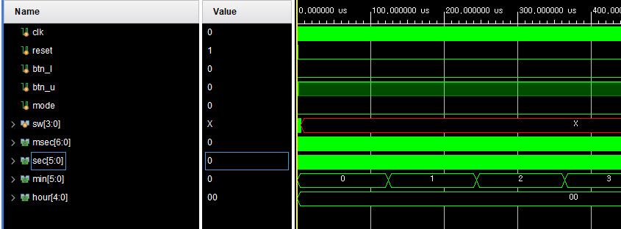
Stopwatch datapath run
run
run

Slide 8
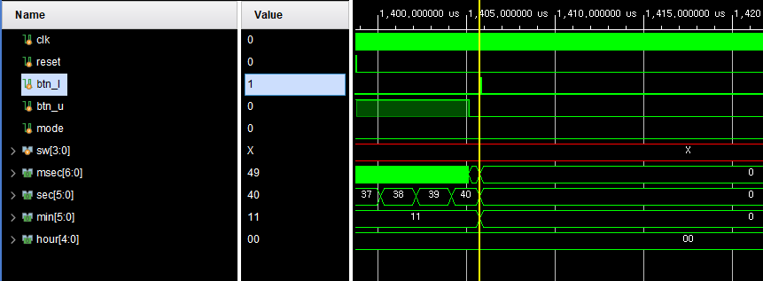
Stopwatch datapath stop / clear
Stop / Clear

Slide 9
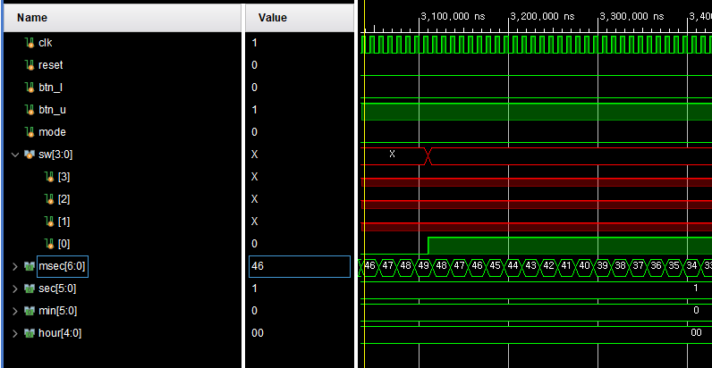
Stopwatch datapath sw[0] downcount
mode

Slide 10



Stopwatch Simulate Scenario
01
02
03
randomize
run/stop = 0 or 1
randomize
mode 0 or 1
randomize
run/stop
mode
clear

Slide 11
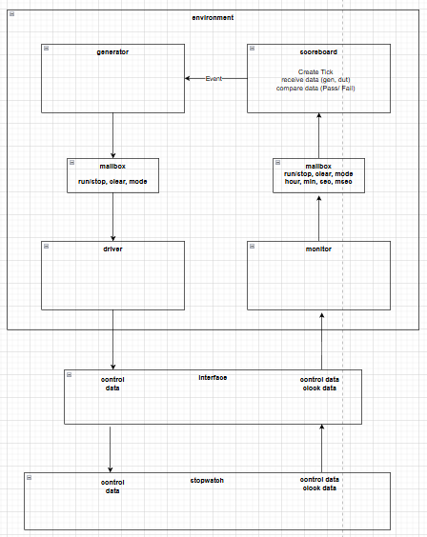
Stopwatch verification Block
run/stop, mode, clear
randomize 생성
기댓값 생성
hour, min, sec, msec
기대값과 dut 출력값을 받아 비교 후 Pass or Fail
이후 gen_next_event
posedge #1
monitor 에서 출력값 샘플해
scorboard로 전달
negedge #4
interface 로 기대값, 입력값 drive

Slide 12
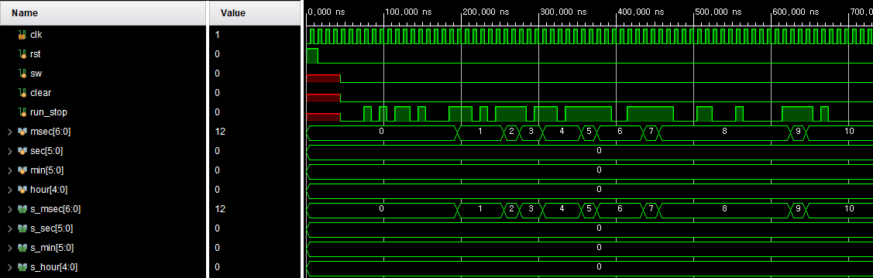
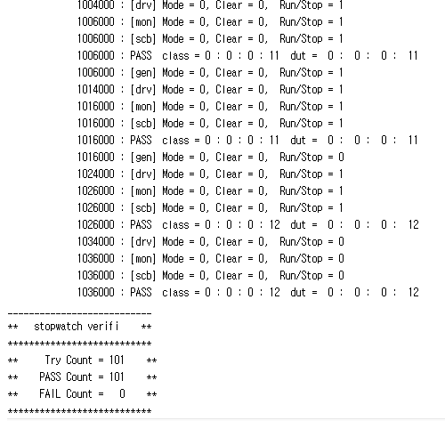
Stopwatch Simulate run / stop
run -> stop -> run

Slide 13
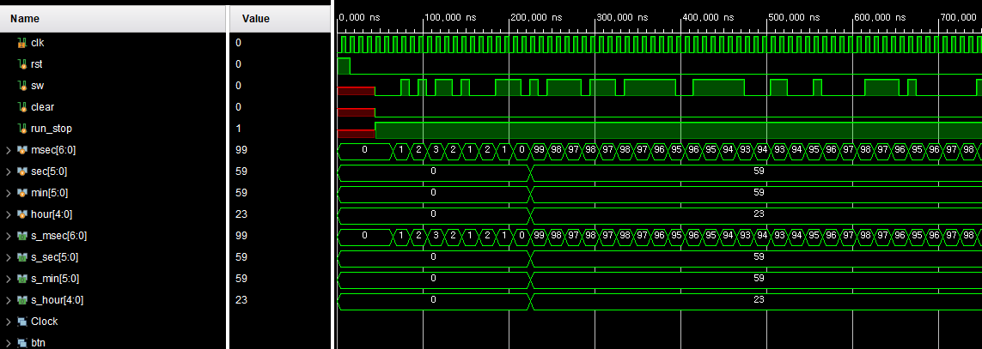
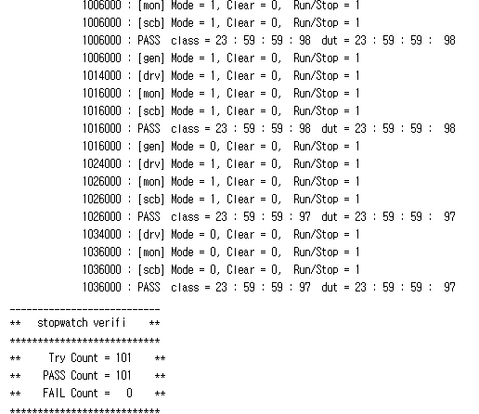
Stopwatch Simulate mode
Down -> Up -> down

Slide 14
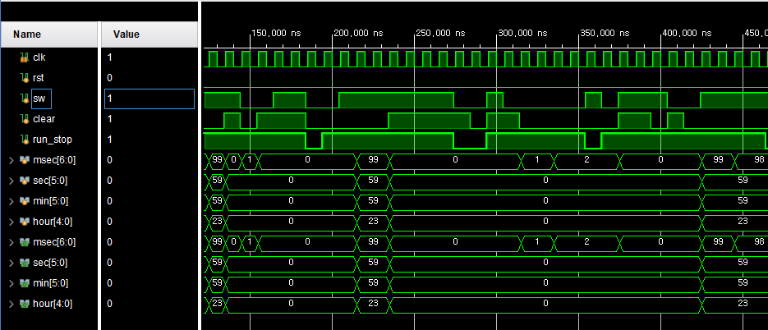
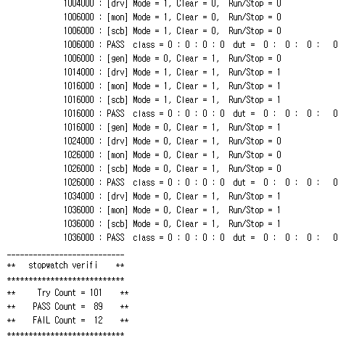
Stopwatch Simulate all
Clear
down
run / stop

Slide 15
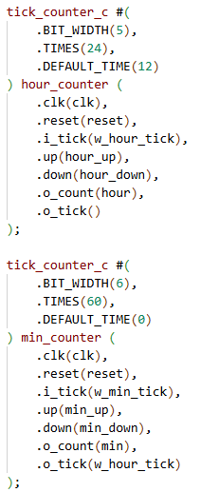
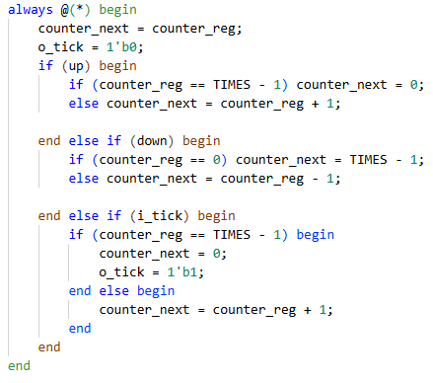
Clock datapath
Clock tick gen
100hz -> clk단위로 변경
단위별 up/down 동작

Slide 16
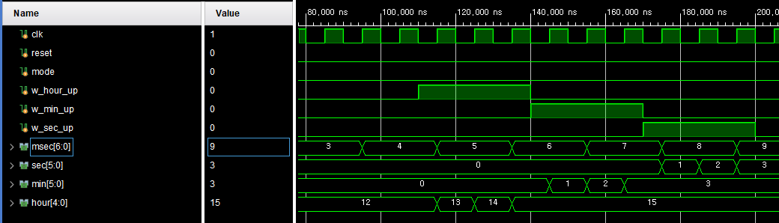
Clock datapath up

Slide 17
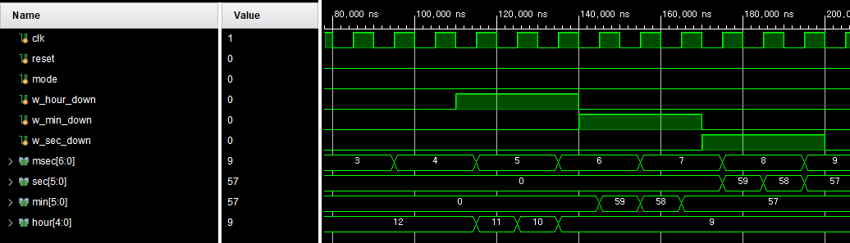
Clock datapath down

Slide 18
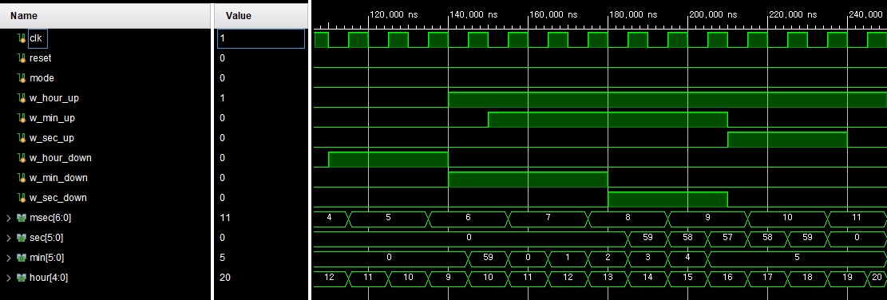
Clock datapath up/down

Slide 19
Clock Simulate Scenario
01
02
03
randomize
hour up
min up
sec up
randomioze
hour down
min down
sec down
randomize
hour up/down
min up/down
sec up/down

Slide 20
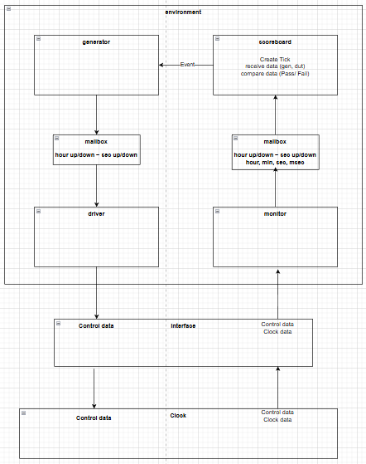
Clock verification Block
hour up/down
min up/down
sec up/down
randomize 생성
기댓값 생성
hour, min, sec, msec
기대값과 dut 출력값을 받아 비교 후 Pass or Fail
이후 gen_next_event
posedge #1
monitor 에서 출력값 샘플해
scorboard로 전달
negedge #4
interface 로 기대값, 입력값 drive

Slide 21
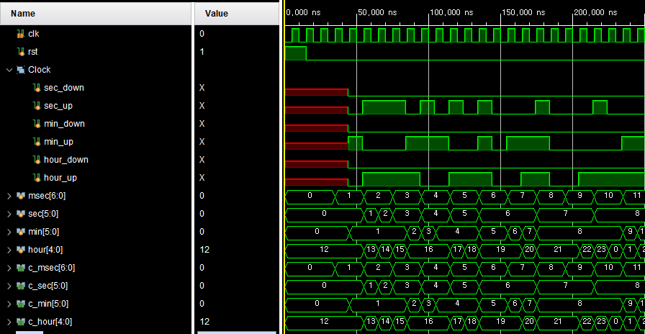
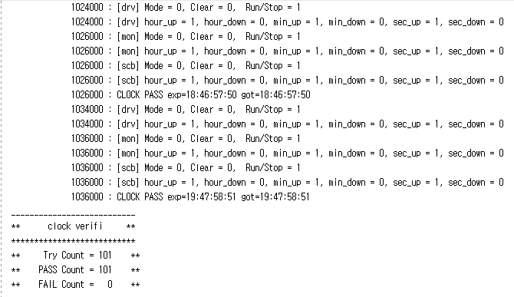
Clock Simulate UP
sec min hour
동시 상승
sec min
동시 상승

Slide 22
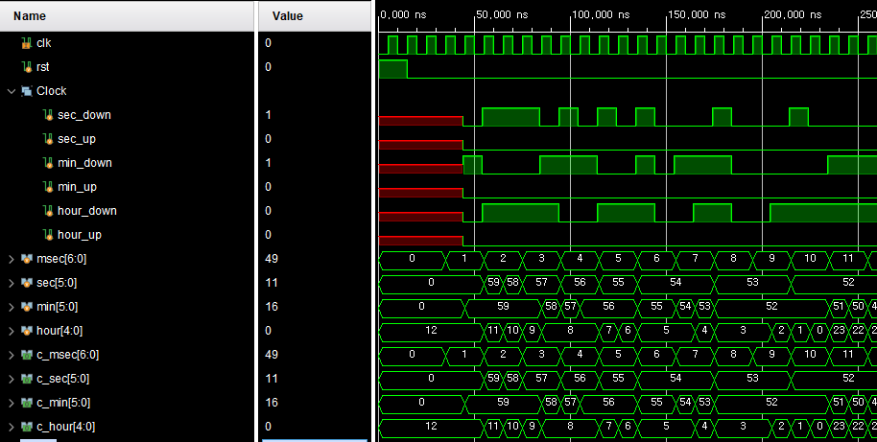
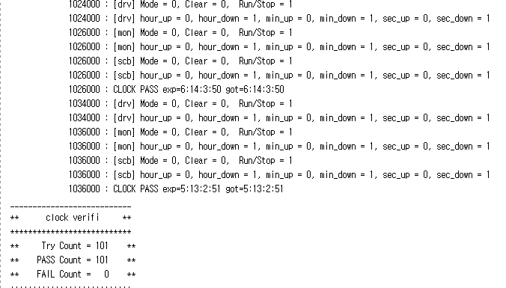
Clock Simulate DOWN
sec min hour
동시 하강
min 하강

Slide 23
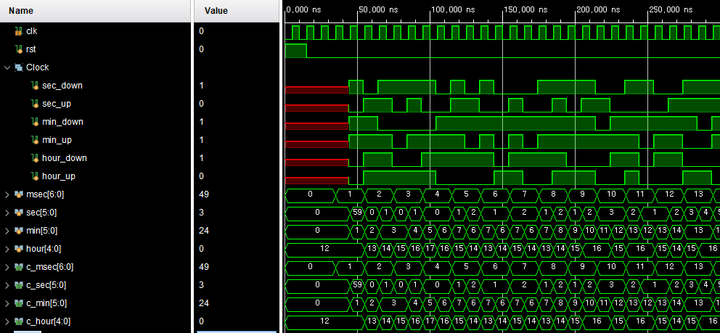
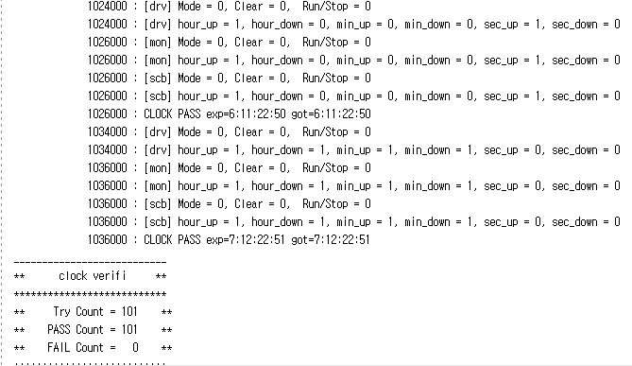
Clock Simulate ALL
sec up / down 동시 = up
min down
hour up
sec down
min up / down
동시 = up
hour up

Slide 24
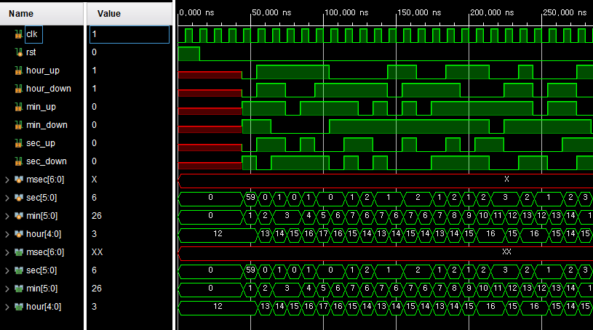
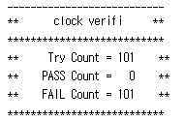
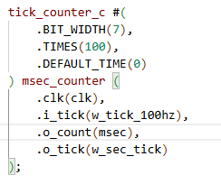
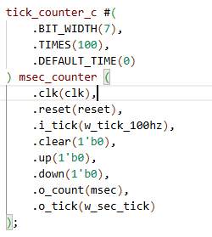
Trouble shooting

Slide 25
FIFO Simulate Scenario
01
02
03
randomize
Only Push/Only Pop
randomize
Push + Pop at the same time
randomize
Push/pop 1000 cycle

Slide 26
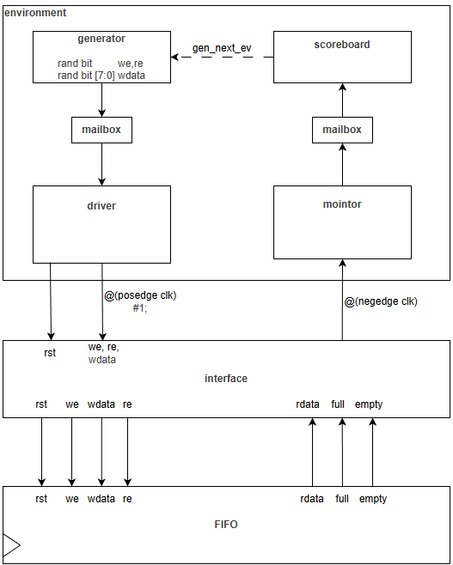
FIFO
Type | name
Rand bit | we
Rand bit | re
Rand bit | wdata
Logic | rdata
bit | full
bit | empty

Slide 27
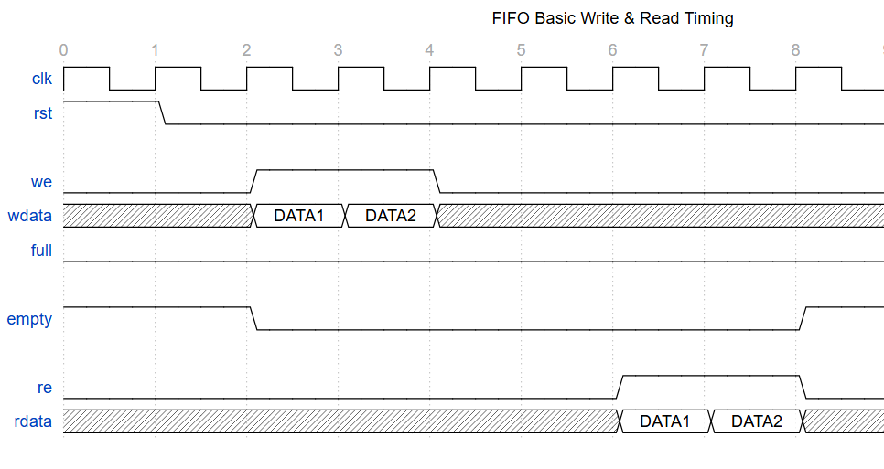
FIFO
driver
monitor

Slide 28
FIFO
wdata
rdata
We && !full
Q list
First input data
T/F
Re && !empty

Slide 29
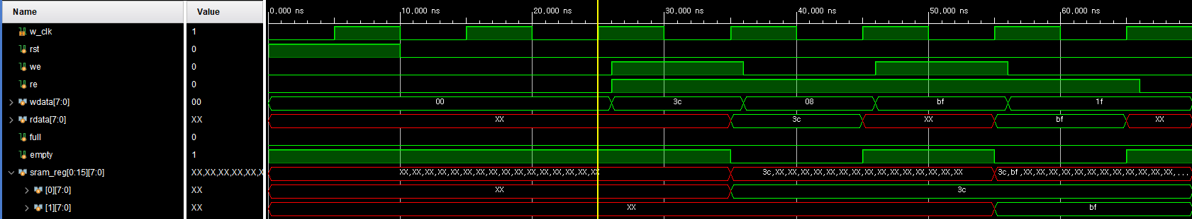
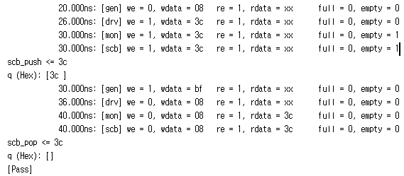
FIFO
- Verification

Slide 30
FIFO
- Verification

Slide 31
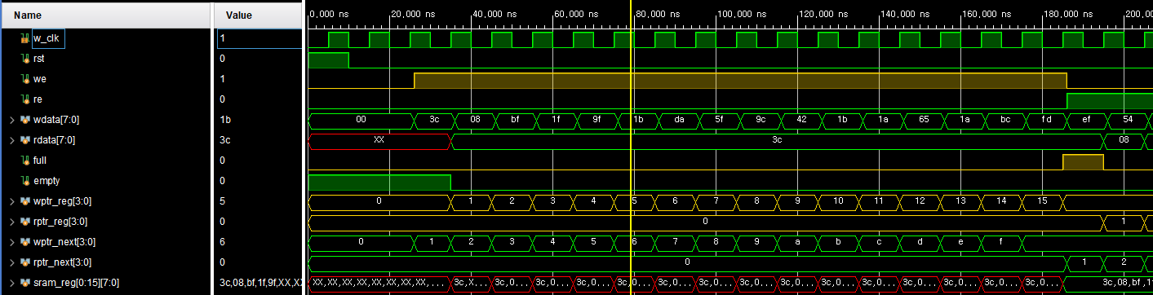
FIFO
- Verification(16번 we)
we -> empty = 0
We -> (wptr_next == rptr_reg) -> full = 1
Re -> full = 0

Slide 32
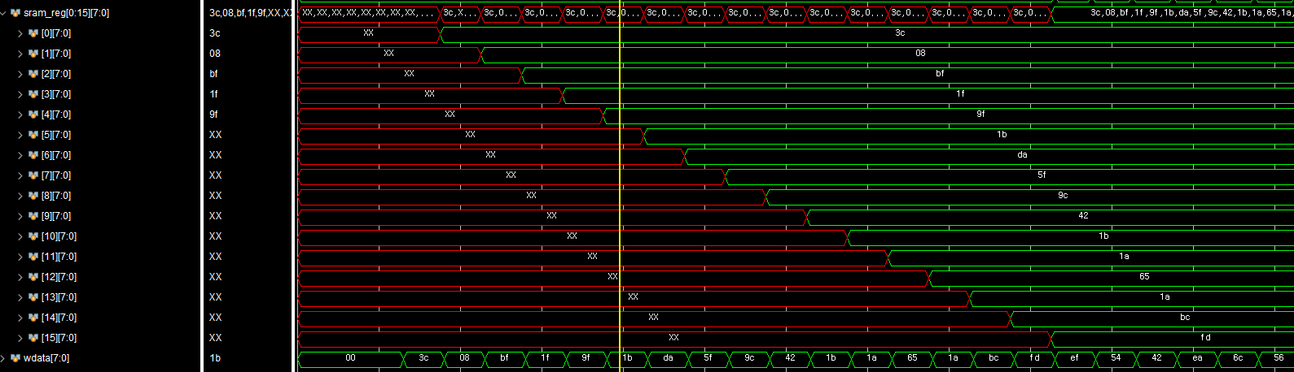
FIFO
- Verification(16번 we)

Slide 33
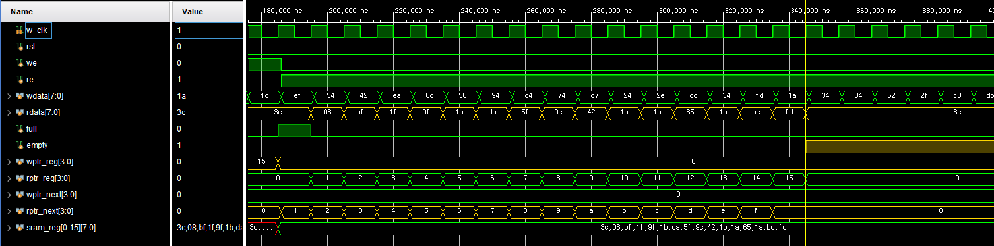
FIFO
- Verification(16번 re)
Re -> (wptr_reg == rptr_next) -> empty = 1

Slide 34
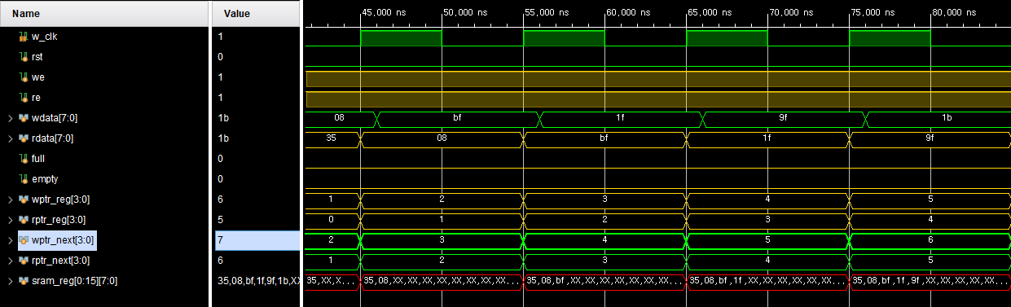
FIFO
- Verification(동시 we= 1, re = 1)
we = 1, re = 1 -> wptr_reg++, rptr_reg++;

Slide 35
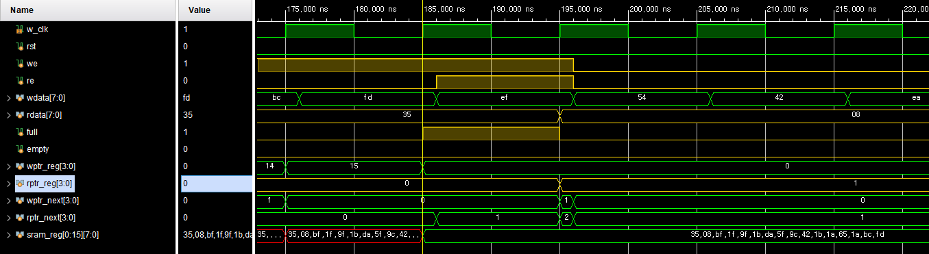
FIFO
- Verification(동시 we= 1, re = 1)
full == 1 상황:
we = 1, re = 1 -> full = 0, rptr_reg++;

Slide 36
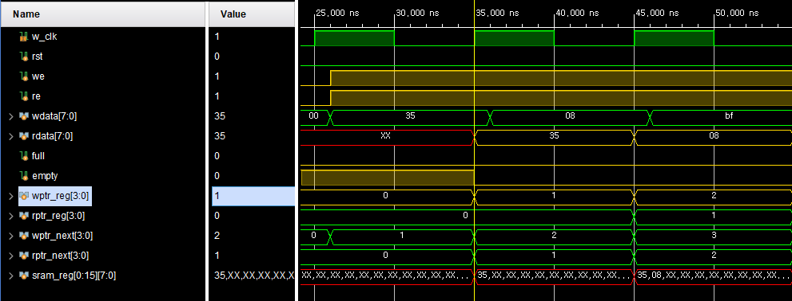
FIFO
- Verification(동시 we= 1, re = 1)
empty == 1 상황:
we = 1, re = 1 -> empty = 0, wptr_reg++;

Slide 37
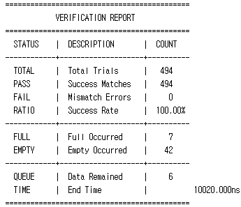
FIFO
- Verification(random 1000 cycle)

Slide 38
RX + FIFO Simulate Scenario
01
02
03
randomize
Run 1 cycle
Check Rx + FIFO data Flow
randomize
Run 1000 cycle
randomize
Baud delay rate Allowable range

Slide 39
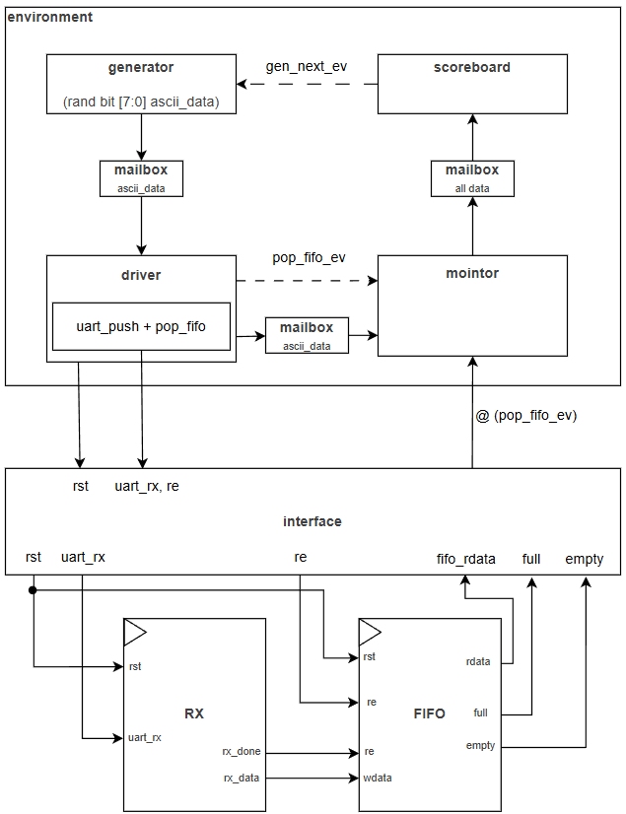
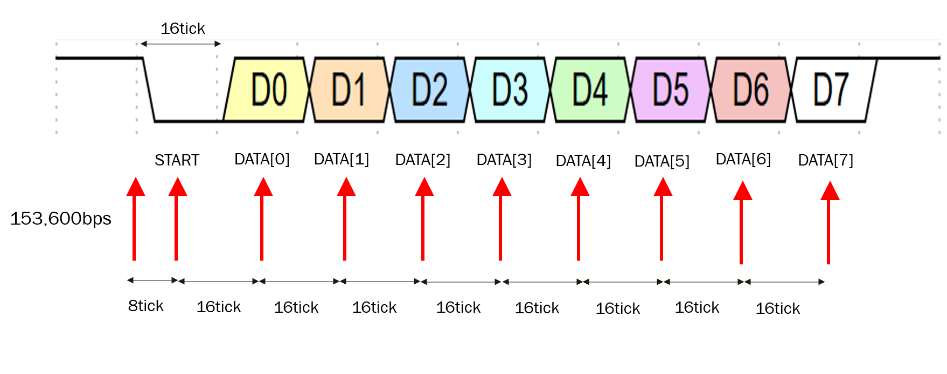
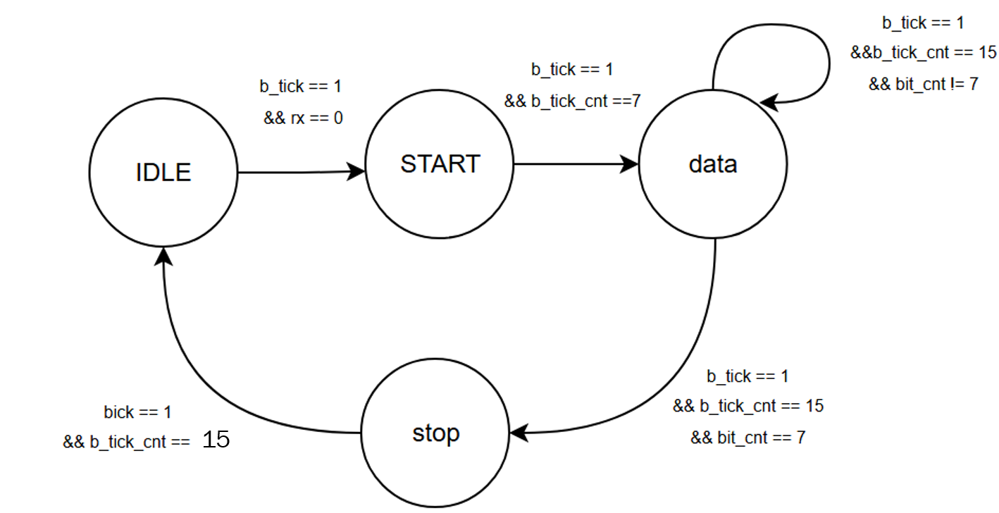
RX + FIFO

Slide 40
RX + FIFO
c
Type | name
Randc bit | ascii_data
bit | re
logic | Fifo_data
bit | full
Bit | empty

Slide 41
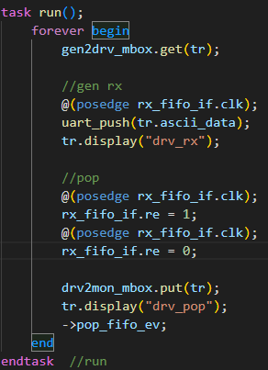
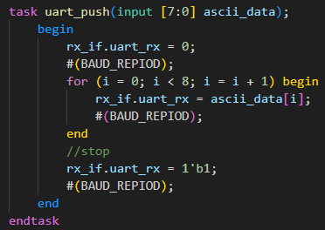
RX + FIFO
BAUD_REPIOD = (100MHz / 9600bpm)*10

Slide 42
RX + FIFO
c
Ascii data + Interface I/O
@(pop_fifo_ev)
mailbox
Scoreboard
ASCII DATA == tr.rx_data

Slide 43
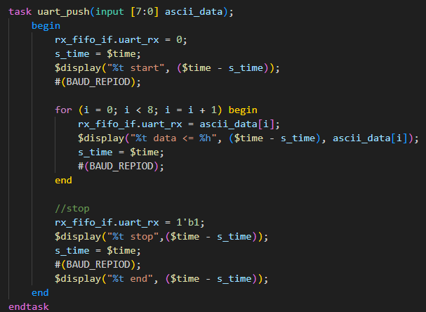
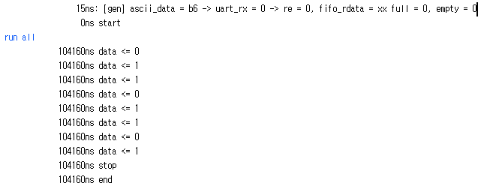
RX + FIFO
- Verification(check gen RX)
BAUD_REPIOD = (100MHz / 9600bpm)*10 = 104160

Slide 44
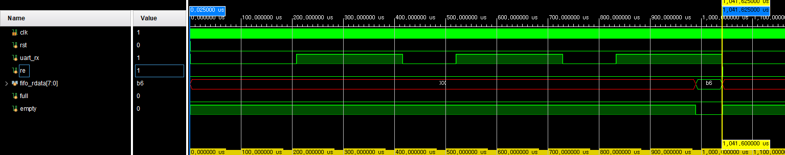
RX + FIFO
- Verification(check gen RX)
Rx = 10bit * 104160 = 1041600ns = 1041.6us

Slide 45
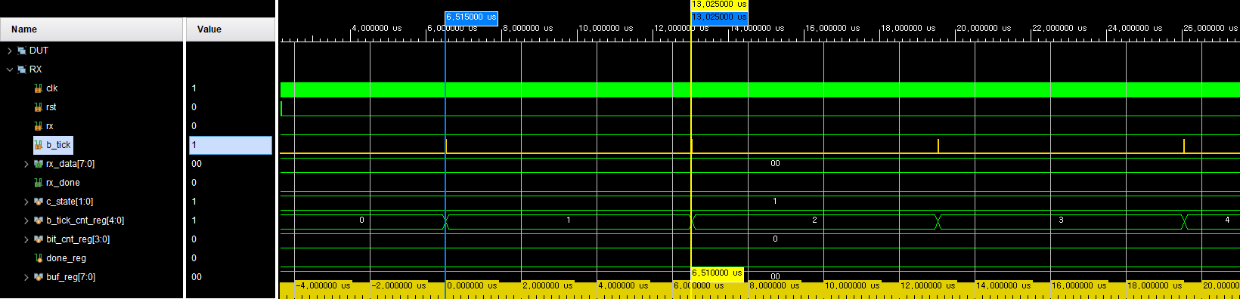
RX + FIFO
- Verification(module RX)
B_tick = 100Mhz / (9600bps * 16배)= 6.51us

Slide 46

RX + FIFO
- Verification(module RX) input(8’hB6)
START
DATA

Slide 47

RX + FIFO
- Verification(module RX) input(8’hB6)
B_tick_cnt 15마다 buf_reg의 MSB에 반영 및 shift 발생

Slide 48
RX + FIFO
- Verification(module RX) input(8’hB6)
B_tick_cnt 15마다 buf_reg의 MSB에 반영 및 shift 발생

Slide 49

RX + FIFO
- Verification(module RX) input(8’hB6)
(Rx_done == 1) ➔ Rx_data = 8’b6

Slide 50

RX + FIFO
- Verification(RX ➔ FIFO) input(8’hB6)

Slide 51

RX + FIFO
- Verification(RX ➔ FIFO) input(8’hB6)
Rx_done은 uart_rx신호를 다 보내기 전에 발생

Slide 52


RX + FIFO
- Verification(random 1000 clcye)
rx_data 검증 data : 14,22,55,59,85,123,185,209제외된 0~255 data

Slide 53


RX + FIFO
- Verification(missing cases 50 clcye)
rx_data 추가 검증 data : 14,22,55,59,85,123,185,209

Slide 54



RX + FIFO
- Verification(baud delay rate)

Slide 55

RX + FIFO
- Verification(baud delay rate)
Add_rate = 1.0
Add_rate = 1.1

Slide 56
RX + FIFO
- Verification(baud delay rate)
rate | 1.1 | 1.07 | 1.06 | 1.05 | 1.04 | 1.02 | 1.0 | 0.98 | 0.95 | 0.94 | 0.93
Total | 50 | 50 | 50 | 50 | 50 | 50 | 50 | 50 | 50 | 50 | 50
Pass | - | - | - | 50 | 50 | 50 | 50 | 50 | 50 | - | -
fail | 50 | 50 | 50 | - | - | - | - | - | - | 50 | 50
Use Rx_delay rate = 95% ~105%

Slide 57
TX + FIFO Simulate Scenario
01
02
03
randomize
Run 1 cycle
Check Tx + FIFO data Flow
randomize
Run 1000 cycle
randomize
fifo[full] -> continuous output

Slide 58



TX + FIFO

Slide 59
TX + FIFO
c
Type | name
bit | Fifo_we
Randc bit | Fifo_wdata
bit | Tx_busy
bit | Tx_done
bit | Uart_Tx
bit | PC_data

Slide 60

TX + FIFO
c

Slide 61

TX + FIFO
c
BAUD/2 + BAUD
BAUD
BAUD
BAUD
BAUD
BAUD
BAUD
BAUD
BAUD * 8cycle

Slide 62

TX + FIFO
c

Slide 63

TX + FIFO
- Verification(TX) input(8’hB6)
Generate wdata
Tx_read data

Slide 64

TX + FIFO
- Verification(FIFO ➔ TX) input(8’hB6)
We==1 Re==1 ➔ rdata = b6,empty = 0 ➔ tx_start = 1

Slide 65

TX + FIFO
- Verification(TX) input(8’hB6)
Uart_tx = 0
Save tx_data

Slide 66

TX + FIFO
- Verification(TX) input(8’hB6)
B_tick 발생 ➔ bt_cnt16_reg ++

Slide 67

TX + FIFO
- Verification(TX) input(8’hB6)
START
DATA

Slide 68

TX + FIFO
- Verification(TX) input(8’hB6)
START
DATA
STOP
DATA bit별 send time = 104.16us
STOP bt send time = 104.16us

Slide 69

TX + FIFO
- Verification(TX) input(8’hB6)
STOP
IDLE
(STOP -> IDLE) ➔ done 1 tick 발생 및 busy = 0

Slide 70


TX + FIFO
- Verification(random 1000 cycle)

Slide 71

TX + FIFO
- Verification(random 1000 cycle)
rx_data 검증 data : 18,246,223

Slide 72


TX + FIFO
- Verification(fifo[full] -> continuous output)

Slide 73

TX + FIFO
- Verification(fifo[full] -> continuous output)

Slide 74


Troubleshooting
RX + FIFO (uart_push 후 FIFO rdata를 read 해야할 상황)
문제: Empty == 0 일때, pop 수행하려 시도 하였지만 re 발생 하지 않음
원인: uart_push와 wait 타이밍의 문제
해결: wait 동작을 거치지 않고 uart_push task가 끝나면 read 진행

