Slide 1
Improving Community Detection Performance in Heterogeneous Music Network by Learning Edge-type Usefulness Distribution
Zheng Gao, Chun Guo, Shutian Ma, Xiaozhong Liu

Slide 2
Background
With music becoming an essential part of daily life, there is an urgent need to develop recommendation systems to assist people targeting better songs with fewer efforts.
The interactions between users and songs naturally construct a complex network, community detection approaches can be applied to reveal users' potential interests on songs by grouping relevant users & songs to the same community.
The type of interactions are heterogeneous, which challenges conventional community detection methods.

Slide 3
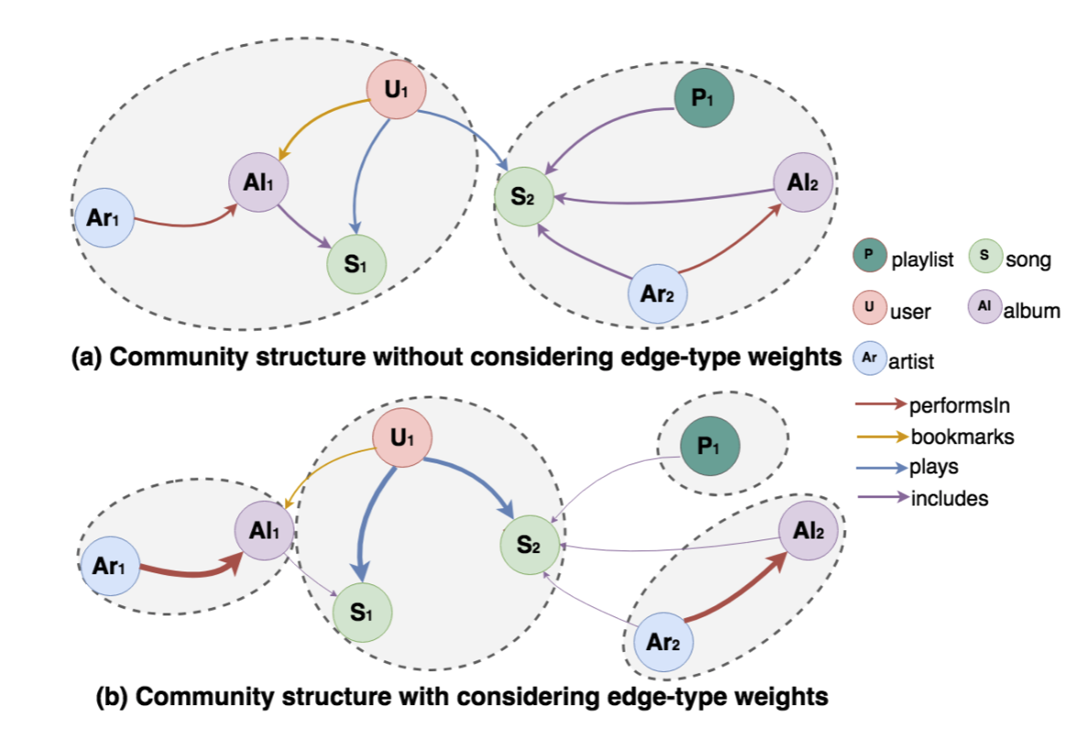
Edge-type Usefulness Distribution (ETUD)
We propose a genetic based method to learn the ETUD on heterogeneous networks in an evolutionary manner. Our model can highlight those edge-types more important for music recommendation by assigning higher weights on them. After that, all edges are updated by multiplying related ETUD values on their original weights, which converts a heterogeneous network to a homogeneous one.

Slide 4
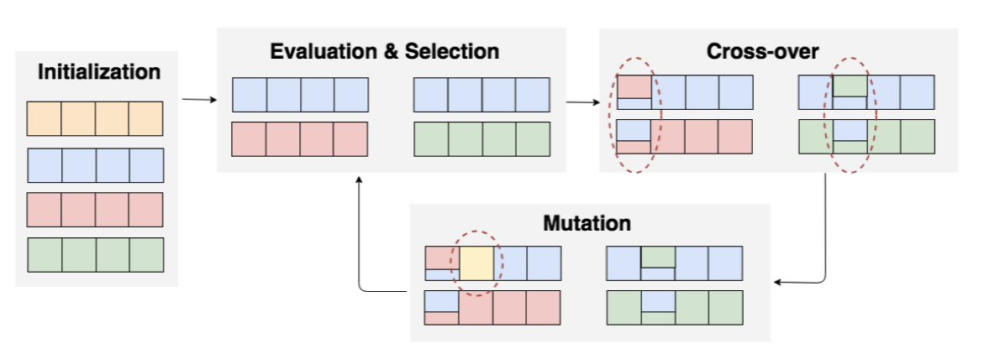
ETUD Pipeline

Slide 5
ETUD Pipeline
Initialization
We define a chromosome to represent a possible ETUD result. A chromosome is constructed by a set of genes ,where each gene refers to an edge-type respectively. The value stores in each gene represents the usefulness score of a particular edge-type.
Assessment and Selection
The best ETUD should be able to best reproduce users' listening preference. In other words, we should find an ETUD that maximizes the similarity between songs' ranking list generated under this ETUD and user real preference on songs.
Personalized PageRank algorithm is utilized to represent user listening preference.
Transformation
Cross-over: generate new ETUD in chromosome pairs.
Mutation: generate new ETUD within a chromosome.
Finalization

Slide 6
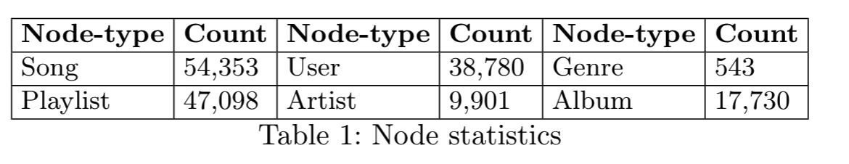
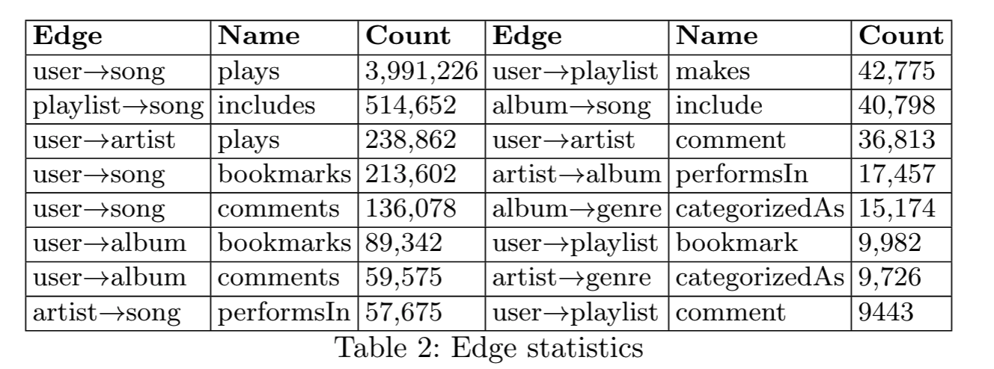
Dataset

Slide 7
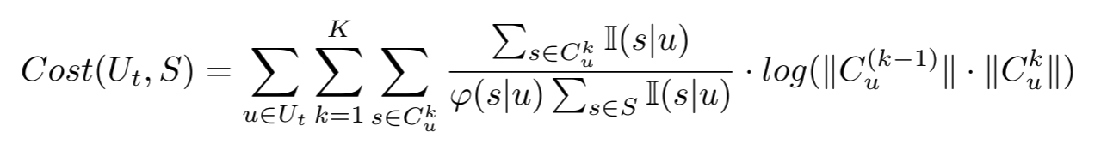
Task 1: Searching Cost with Between-community Jumping
The first task is to examine whether applying ETUD on heterogeneous networks can reduce the searching cost of retrieving all users' listened songs.
In our music network, each user u will belong to a community after a community detection method is leveraged. When user u looks for songs to listen, there is a searching cost for the user to retrieve all his/her favored songs. We simulate user searching behaviours to see how ETUD can help to reduce searching cost when added to existing community detection methods.

Slide 8
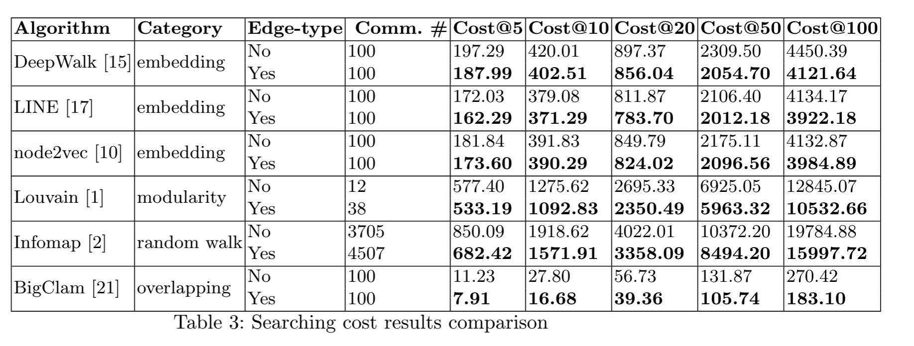
Task 1: Searching Cost with Between-community Jumping

Slide 9
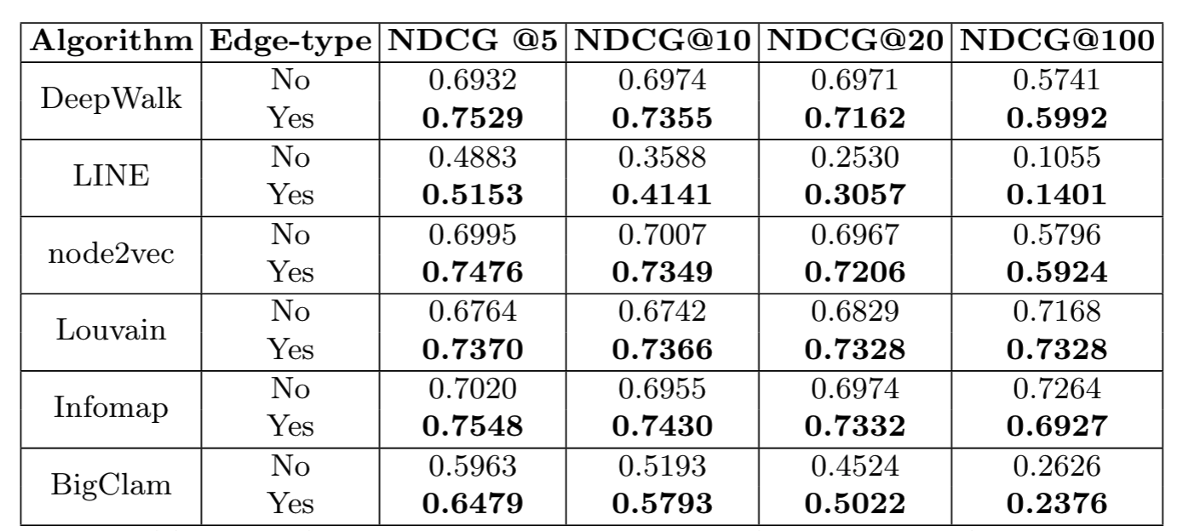
Task 2: Searching Accuracy within Community
We are also willing to see whether it also benefits music recommendation accuracy within communities. For each testing user, we select all songs in the same community as the user, and rank the songs based on their PageRank scores calculated during the training process.

Slide 10
Thanks!

