Slide 1
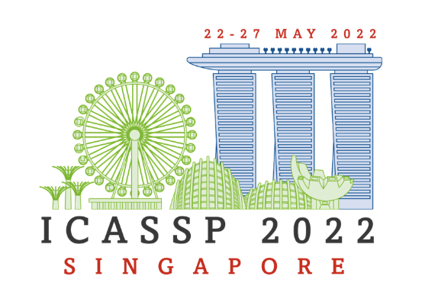
Contrastive knowledge graph attention network for request-based recipe recommendation
Authors : Xiyao Ma, Zheng Gao, Qian Hu, Mohamed AbdelHady
Presented at IEEE ICASSP 2022

Slide 2
Introduction
Kitchen assistant is one of the enabled services in intelligent voice assistants.
Current solutions for recipe recommendation have two limitations:
Neglect user personalized preferences
User recipe interaction noise
We propose a Contrastive Knowledge Graph ATtention network (C-KGAT), which includes:
A knowledge graph attention-based recommender.
Profiling user diversified preferences from user historical behavior sequences.
A contrastive learning module with two auxiliary tasks to improve model robustness.

Slide 3
Problem Formulation
Given a target user and his/her utterance request, we aim to recommend top-K relevant recipes.
The information used in the proposed model includes:
Users U
Recipes I with textual and categorial features (i.e. recipe name, cooking time.)
User recipe interactions with a sequence of behaviors (i.e. browse, add_to_cart)
A recipe knowledge graph with recipe entities I and attribute entities E (i.e. cuisine, ingredients, keywords). Different types of relations connect recipes and corresponding types of attribute entities.
In the end, we merge all information (user-recipe interactions and recipe knowledge graph) together to achieve a Collaborative Knowledge Graph (CKG).

Slide 4
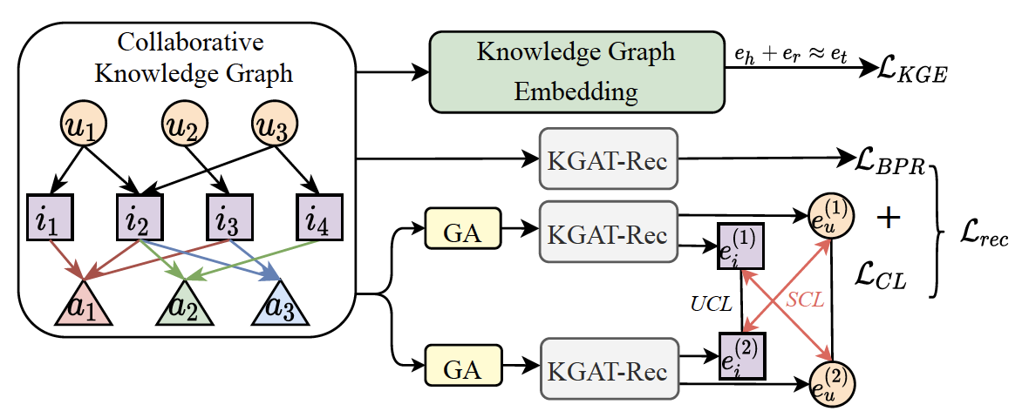
Method: C-KGAT
C-KGAT mainly consists of three components:
Knowledge graph embedding leverage the structure of CKG to learn entity embedding.
A KGAT-based recommender (KGAT-Rec) is proposed to learn collaborative user and recipe embeddings by modeling the diversified user preferences.
A contrastive learning module contrasts user and recipe embeddings from different graph views to improve model robustness.

Slide 5
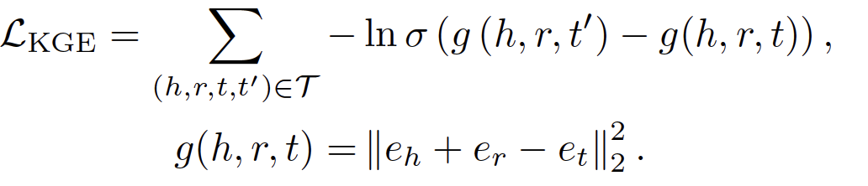
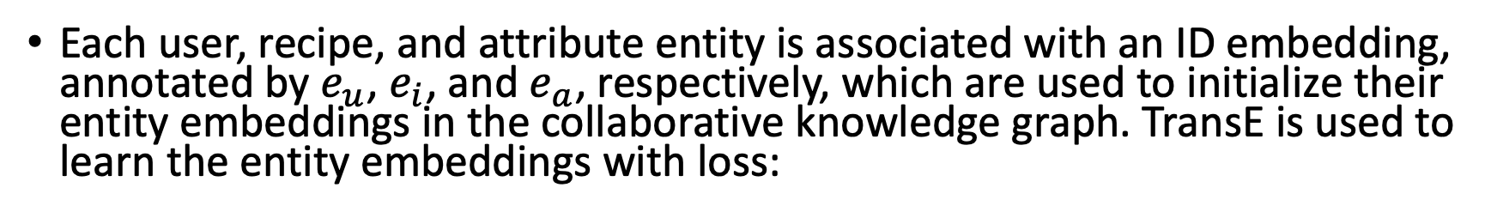
Method: Knowledge Graph Embedding
Each user, recipe, and attribute entity is associated with an ID embedding, annotated by $e_{u}$, $e_{i}$, and $e_{a}$, respectively, which are used to initialize their entity embeddings in the collaborative knowledge graph. TransE is used to learn the entity embeddings with loss:

Slide 6
Method: KGAT-Rec
Alexa Confidential

Slide 7
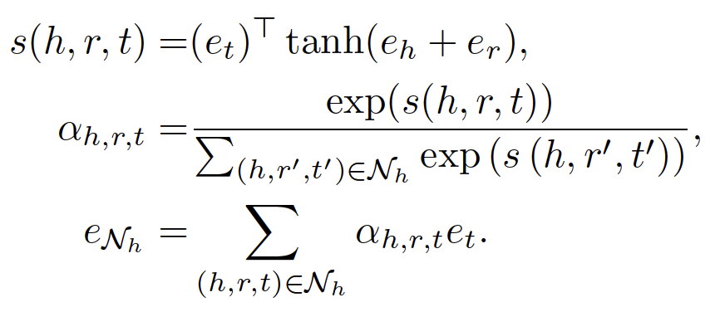
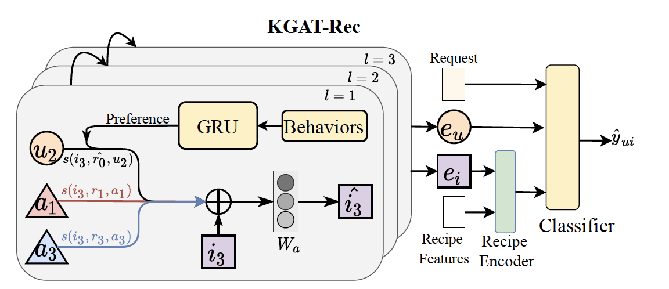
Method: KGAT-Rec
In the collaborative knowledge graph, an entity embedding is updated by aggregating the rich semantic information from its neighbor triplets.

Slide 8
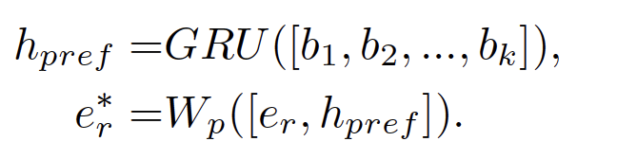
Method: KGAT-Rec
We learn different user preferences from their sequential behaviors towards each interacted recipe by a one layer bidirectional Gated Recurrent Unit (GRU)

Slide 9
Method: KGAT-Rec

Slide 10

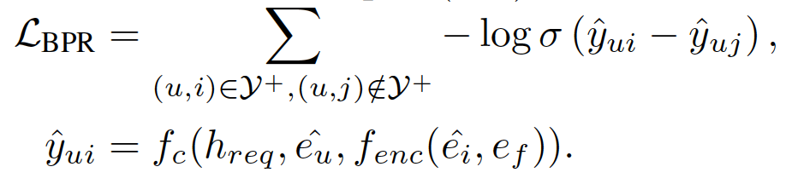
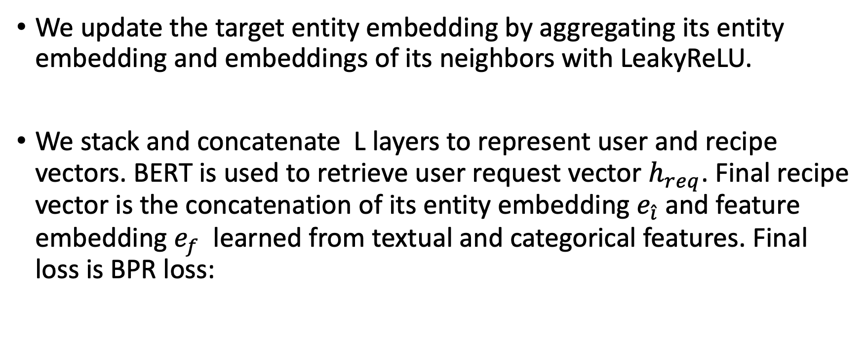
Method: KGAT-Rec
We update the target entity embedding by aggregating its entity embedding and embeddings of its neighbors with LeakyReLU.
We stack and concatenate L layers to represent user and recipe vectors. BERT is used to retrieve user request vector $h_{req}$. Final recipe vector is the concatenation of its entity embedding $e_{\hat{i}}$ and feature embedding $e_{f}$ learned from textual and categorical features. Final loss is BPR loss:

Slide 11
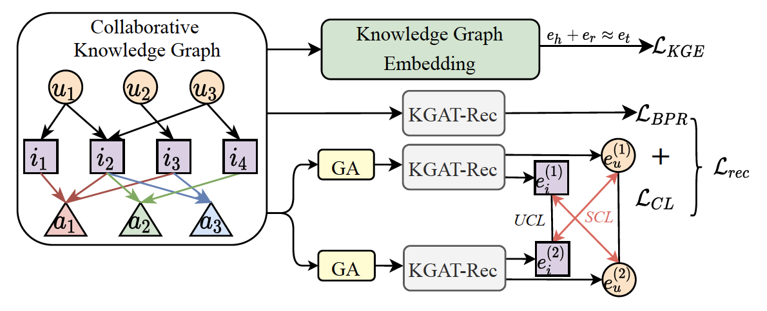
Method: Incorporating Contrastive Learning
Graph Augmentation (GA)
In the graph augmentation (GA) stage, different views of the input graph are generated to expose novel patterns of representations to improve the model generalization. Operations including:
Node Embedding Dropout
Edge Dropout
we apply the operations on the input CKG graph G independently twice to generate two different graph views.

Slide 12
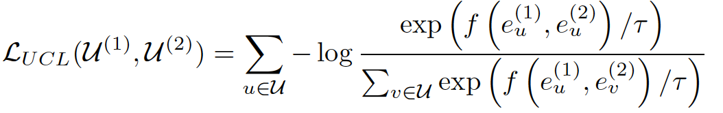
Method: Incorporating Contrastive Learning
Unsupervised Contrastive Learning (UCL)
InfoNCE loss is adopted to pull the different views of the same user entity close and push those of different user entities away:

Slide 13
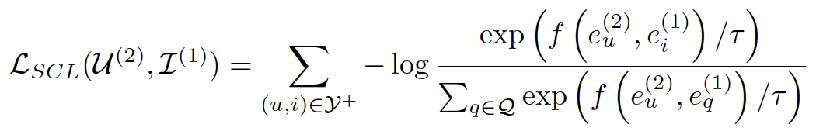
Method: Incorporating Contrastive Learning
Supervised Contrastive Learning (SCL)
Given an observed user-recipe interaction, we encourage the agreement between the user and recipe generated from different views. Meanwhile, we minimize the agreement between unobserved user-recipe pairs.

Slide 14
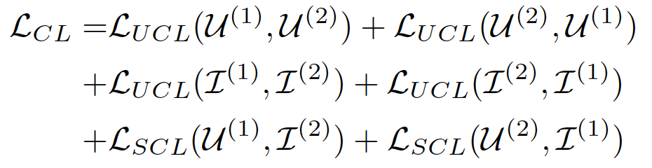
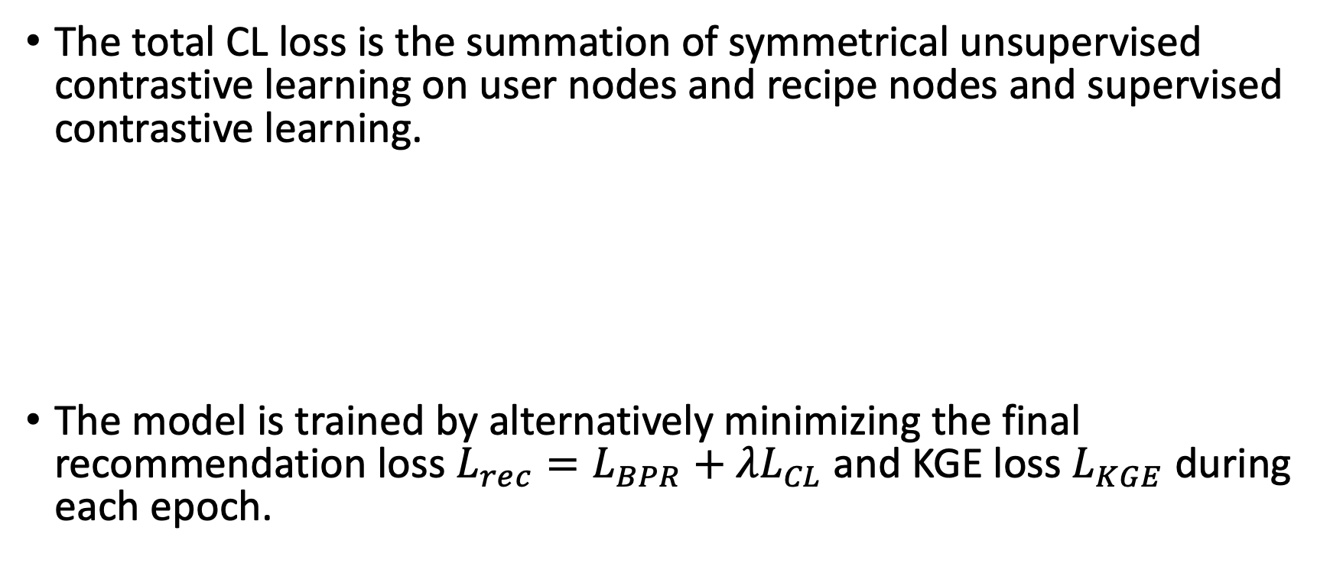
Method: Incorporating Contrastive Learning
The total CL loss is the summation of symmetrical unsupervised contrastive learning on user nodes and recipe nodes and supervised contrastive learning.
The model is trained by alternatively minimizing the final recommendation loss $L_{rec}=L_{BPR}+{λL}_{CL}$ and KGE loss $L_{KGE}$ during each epoch.

Slide 15
Experiments
Datasets & Baselines
Model Performance Comparison
Ablation Study
Model Robustness

Slide 16
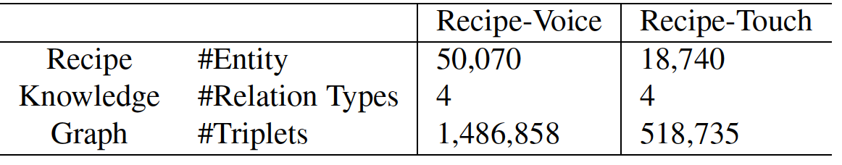
Experiments: Datasets & Baselines
Datasets:
We use Alexa data where customers can interact with devices equipped with screens by vocal request in Recipe-Voice dataset and touching the screen in Recipe-Touch dataset. To ensure the data quality, we take the 3(10)-core subset for the two datasets, where each user or recipe has at least 3 (10) interactions, respectively.
Baselines: Non-graph based CF and Graph based CF
YoutubeDNN
LightGCN
KGCN
KGAT

Slide 17
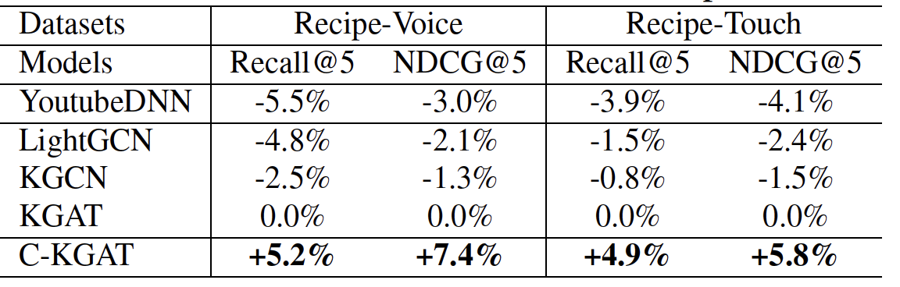
Experiments: Model Performance Comparison
The table shows the relative performance improvement afforded by our method compared to all baseline models.

Slide 18
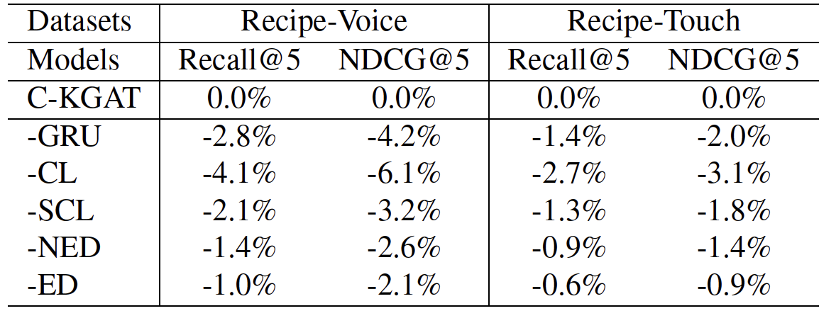
Experiments: Ablation Study
We conduct ablation study to quantify the impact of the components in our proposed model and report the corresponding degradations, including the GRU for preference vector, contrastive learning (CL) that includes both UCL and SCL, supervised contrastive learning (SCL), node embedding dropout (NED), and edge dropout (ED).

Slide 19
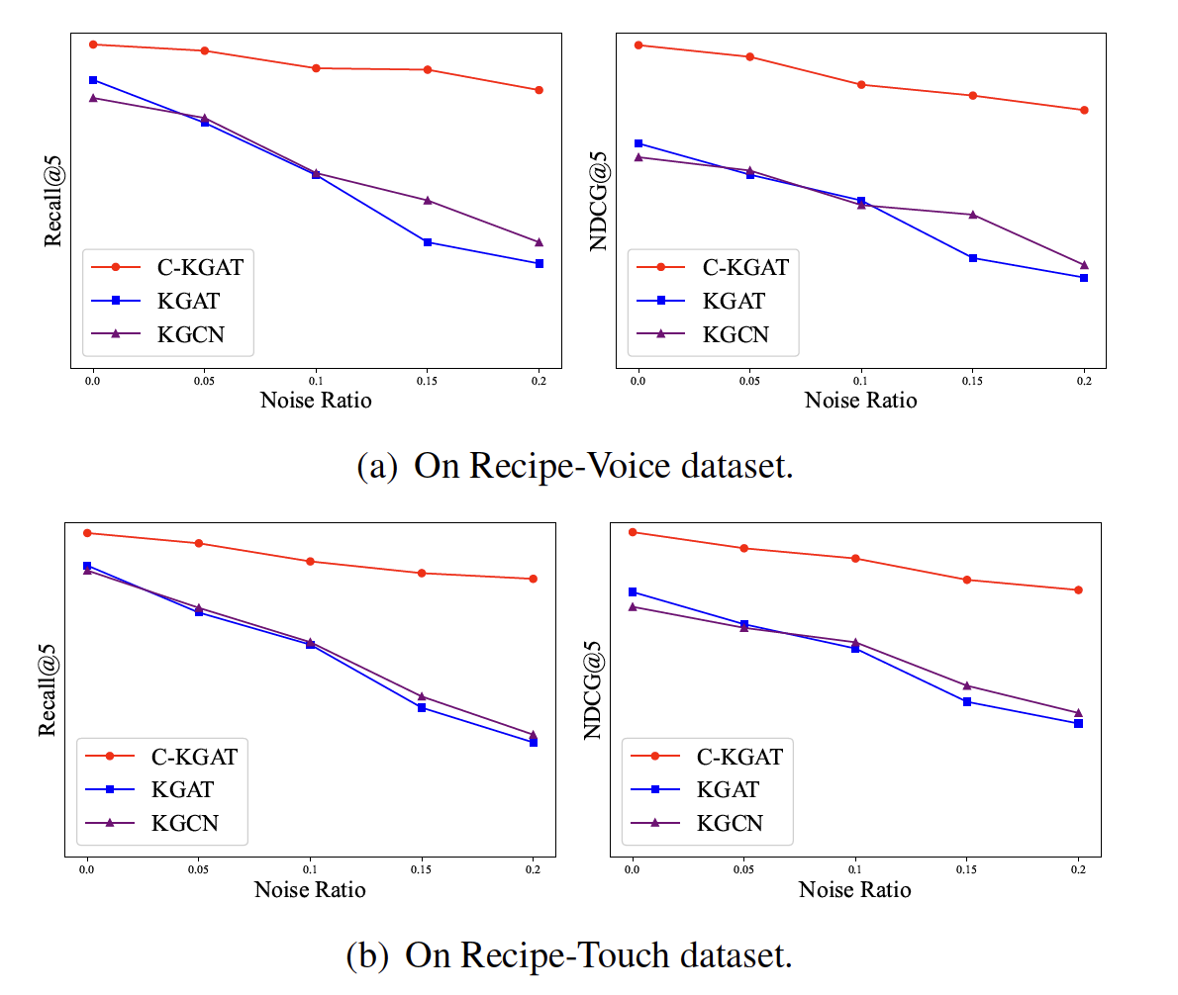
Experiments: Model Robustness
To validate model robustness by adding contrastive learning module, we train models with different ratios of additional noise data sampled from unobserved interactions and compare their performances.

Slide 20
Conclusion
To summarize, we propose a contrastive knowledge graph attention network for user request-based recipe recommendation. The proposed model not only boosts performance by modeling user preferences towards different recipes but also integrates unsupervised and supervised contrastive learning to improve model robustness.
In the future, we plan to improve the model performance with advanced negative sampling strategies and transfer learning for cross-domain recommendation.

Slide 21
Thanks!
Q & A

