Slide 1

Accenture and Technology News Insights Engine
AI Studio Final Presentation
UCLA
December 6, 2024
Notes:
Jasmine

Slide 2

Introductions
Heidi Yu UCLA
Jun Ze He UCLA
Jasmine Wongphatarakul UCLA
May Chan UCLA
Joyce Zhou USC
Notes:
Everyone introduce themselves

Slide 3
Our AI Studio TA and Challenge Advisors
Aryaman Gokarn AI Studio TA
Lauren Jensen Challenge Advisor
Timo Budiono
Challenge Advisor
Notes:
Jasmine

Slide 4
Presentation Agenda
Data Understanding & Preparation
Technology News Sentiment Analysis & Forecasting
Technology News Preprocessing Pipeline & Topic Modeling
Technology News Entity Relationship Mapping
Technology News Recommendation System
Notes:
Jasmine

Slide 5

AI Studio Project Overview

Slide 6
“
The Technology News Insights Engine analyzes various technology news articles to uncover trends in tech products and services for advising tech startups on how to grow their businesses.
Notes:
Joyce

Slide 7

Our Goal
Organize technology news articles into each technology category
Assign a topic name to each group of technology news articles
Uncover short terms trends in the tech industry and development
Identify emerging trends, key players, and potential partnerships within the tech industry
Enable data-driven insights from technology news articles to inform strategic decisions based on a recommendation system
Notes:
Heidi

Slide 8

Business Impact
Aid technology consultants at Accenture:
Assess the tech resources available in their engine or database to gain insights into existing capabilities and infrastructure
Analyze emerging trends and support tech startups in leveraging new market opportunities for growth and innovation
Efficiently gather the latest information on specific technologies tailored to the types of technologies clients work with
Explore strategic partnerships and identify growth opportunities by evaluating potential collaborations, partnerships, or acquisitions with organizations that align with business objectives
Notes:
Joyce

Slide 9
Our Approach
Data Understanding, Preparation, and Topic Modeling
Explored Hackernoon dataset by data visualization, and data preprocessing. After data preprocessing, categorized tech news into each topic.
Entity Relationship Mapping
Find which organizations invest in similar technologies which reveal missing links which might be opportunistically recommended for implementation
Oct 2024
Late Nov 2024
Aug, Sep 2024
Early Nov 2024
Sentiment Analysis & Trend Forecasting
Developed functions that send queries to the Neo4j database to analyze sentiment analysis and trends.
Recommendation System
Developed a recommendation system by retrieve & re-rank, sentiment score , and retrieval augmented generation.
Notes:
Joyce

Slide 10

Summary of Insights & Key Findings
Organize 80,000 Technology News articles into 11 distinct technology categories
Analyzed sentiments of top companies to advise tech startups and Accenture where to allocate their resources
Visualized trends of key words and identified top 5 companies (Google, Microsoft, Sony, Epic Games, Animoca Brands) by article volume
Depicted which companies or organizations invested in similar technologies, focusing on the industries
One of the response from the recommendation model:
Cloud accounting software platforms help small businesses manage finances efficiently through features like automation, integration, real-time reporting, and sustainability benefits, while addressing challenges like security, customization, and internet reliance, with major providers such as QuickBooks and FreshBooks offering scalable solutions that promote environmental and economic sustainability.
Notes:
Joyce

Slide 11
Data Understanding & Data Preparation
Notes:
Heidi

Slide 12



Resources We Leveraged
Coding IDE
Google Colab
Project Management tool
Trello
Database
Neo4j Graph Database
Python Libraries
Pandas, Numpy, Matplotlib, Seaborn, Scikit-Learn
NLTK, Gensim, Groq, Scipy, Network, BERTopic, HDBSCAN, UMAP, KeyBERTInsipred, MaximalMarginalRelevance, PartOfSpeerch
Transformers, Sentence Transformers, Llama-index, langchain, TextBlob
Notes:
Heidi

Slide 13
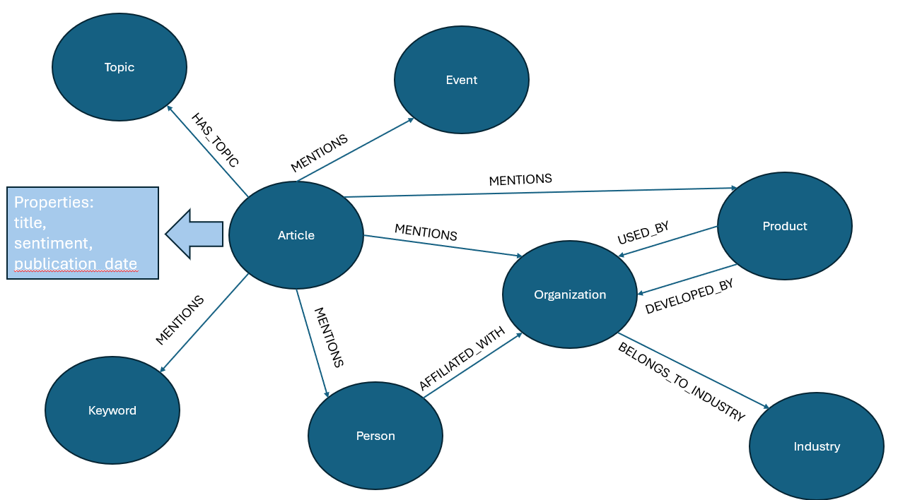
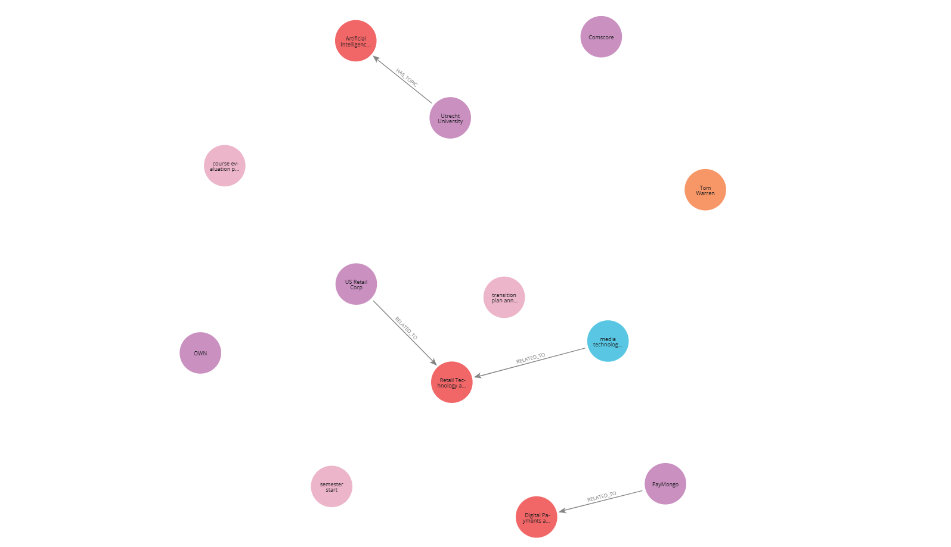
Data Overview
Our team was provided a Neo4j knowledge graph that was built from tech news articles
Initial approach: Scraping and summarizing web article data
Challenges: Google Colab’s computing power made this approach unviable
New approach: Utilizing a knowledge graph and focusing more on data analysis
Notes:
May
Explain what’s on the slide and then say how the knowledge graph relations can be made. For example, we can do organization related to the tech topic and product related to the tech topic.

Slide 14

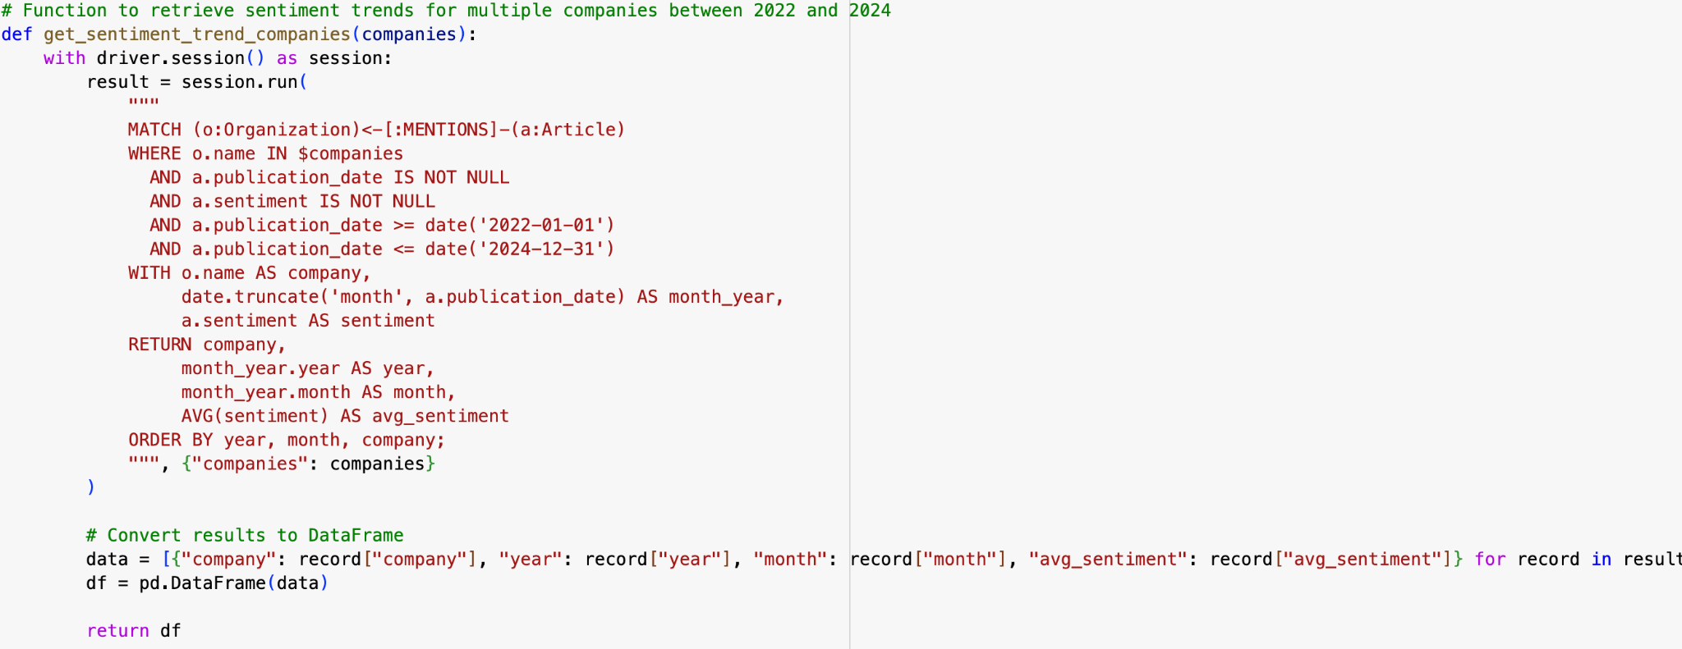
Data Analysis
Created Python functions to send queries to the Neo4j database to access data
Finds organizations in articles
Filters by date and sentiment
Aggregates sentiment by month
Notes:
Jasmine

Slide 15
Technology News Sentiment Analysis &
Trend Forecasting
Notes:
Jasmine

Slide 16
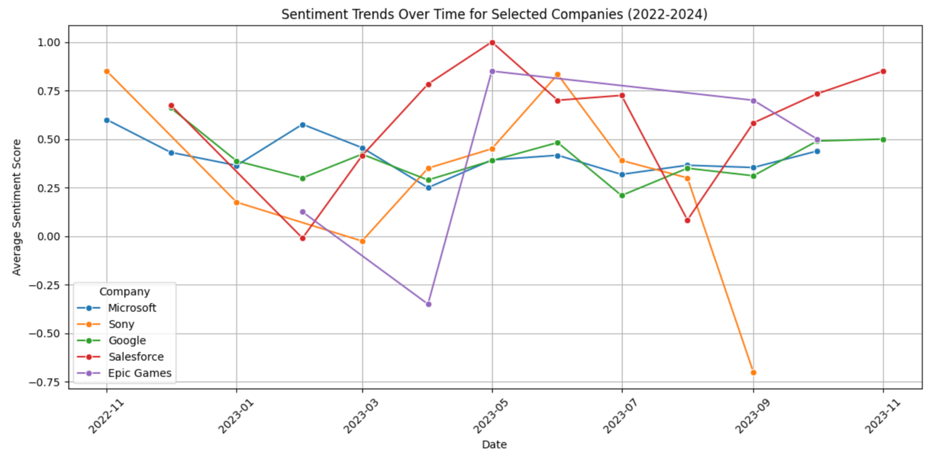
Sentiment Analysis
Approach: Created a function to plot the average sentiment of a company each month
Sent a query to the Neo4j database to grab the average sentiment of the companies every month and plotted the data using a line graph
Graphed sentiment trends for top companies between 2022 - 2024
Further Development: Enables Accenture consultants to use our function by typing in any organization name, which our function will plot directly
Notes:
Jasmine
We can see how Microsoft and Google have a consistent sentiment analysis scores and never goes down to the negatives. Epic Games, Salesforce, and Sony fluctuates a lot. Looking at this data, I would recommend more use of Microsoft and Google products based on the graph because of their consistent sentiment as the sentiment is being measured by if the organization was mentioned in a positive or negative way in the articles.

Slide 17
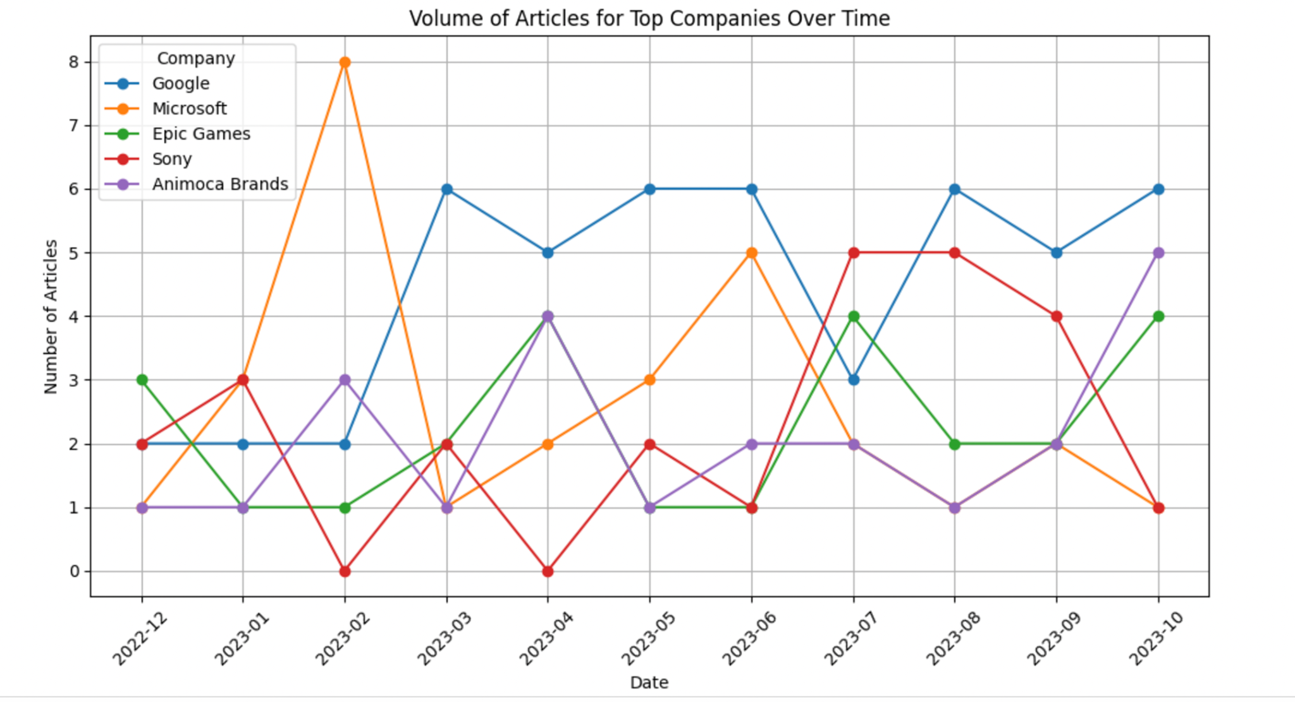
Trend Forecasting
Approach:
Identified top 5 companies with the highest article volume using value_counts()
Visualized the article volume trends over time for top companies between 2022-2024
Notes:
Heidi
We see that Google consistently has the highest volume of articles over time in our sample while the other companies tend to fluctuate more. This tells us that the company receives more media attention and appears to be the leader in terms of influence and innovation in the dataset, so we would recommend Accenture seek potential partnerships and collaborations with the company,

Slide 18
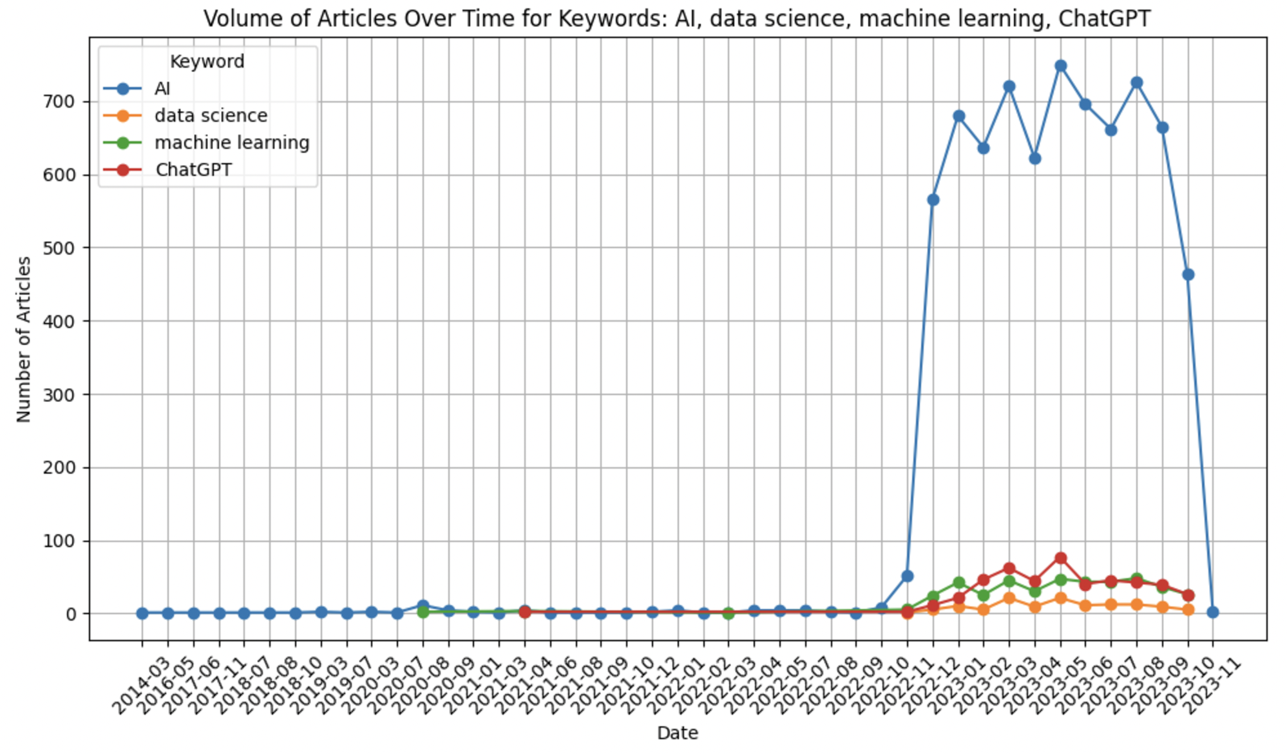
Trend Forecasting
Approach:
Defined a list of target keywords to search for in articles
Filtered articles containing each keyword and aggregated the count of articles mentioning the keywords on a monthly basis
Plotted time-series data for each keyword
Notes:
Heidi
For trend forecasting, we also visualized the volume of target keywords in the articles over time.To do this, we defined a list of target keywords to search for in the articles, filtered the articles containing each keyword and aggregated the count of articles mentioning the keywords on a monthly basis, then plotted the results as time-series data. We decided to plot data for the keywords AI, data science, machine learning, and Chatgpt, and we see that from the graph, AI overwhelmingly appears more in the articles than the rest of the keywords.

Slide 19
Recommendations
From the sentiment analysis and trends, we see from 2022-2024:
Recommend tech startups to move towards AI products and services as there was an large mention of AI in articles in 2023
The trend is expected to be consistent in 2024
Look into Google and Microsoft’s products for building a base for startups
Ex: Google Cloud Platform/Workspace, Microsoft Azure
Salesforce potentially due to upward trend at the end of 2023
Sentiment analysis scores are understandable due to the company’s reputation
Company Trend Forecasting
Allow Accenture to identify potential partnerships or collaborations with leading companies in the media
Companies receiving significant media attention may be expanding or innovating, allowing Accenture to pitch services that align with their priorities
Notes:
Jasmine

Slide 20
Technology News Insight Engine Structure Overview
Notes:
Jun

Slide 21
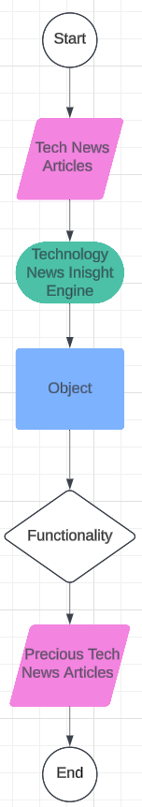
Basic Engine Structure
Raw Data: Technology News Articles
Engine: Engine has the ability of data annotation and recommendation based on a user query
Object / Class: groups instructions / codes to complete a specific task
Functionality: the abilities of an object
Precious technology news articles or other output
Notes:
Jun

Slide 22
Technology News Preprocessing &
Topic Modeling Pipeline
Notes:
Jun

Slide 23
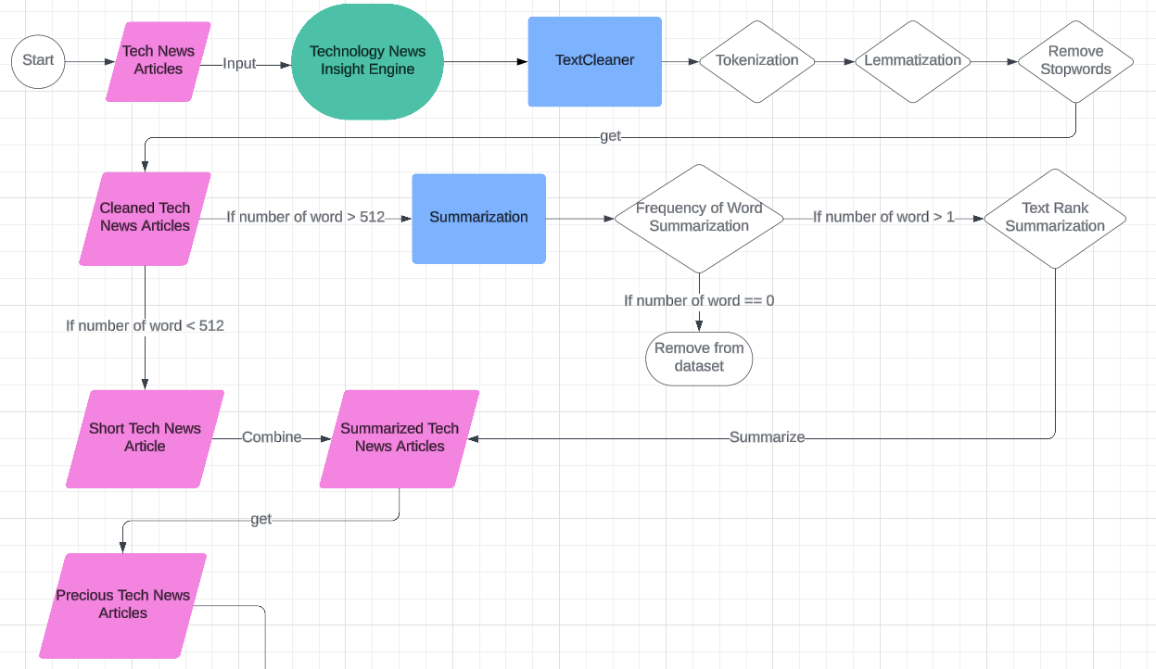
Preprocessing Pipeline
TextCleaner: Split sentences, convert words to their root forms, and remove meaningless words.
Summarization: Summarize by frequency of word and TextRank Summarization
Notes:
Jun

Slide 24
Summarization Methods
Frequency of word summarization:
Calculate the frequency of each word in an article
Assign a score to each sentence based on the frequency of each word in each sentence
Select the sentences has a score greater than the median score over all sentences
TextRank Summarization:
Calculate the similarity scores between each sentence
Pick the sentences has a similarity score greater than the median similarity score over all sentences
Notes:
jun

Slide 25
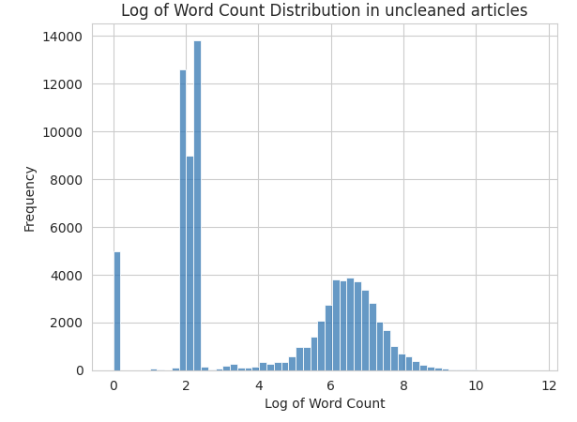
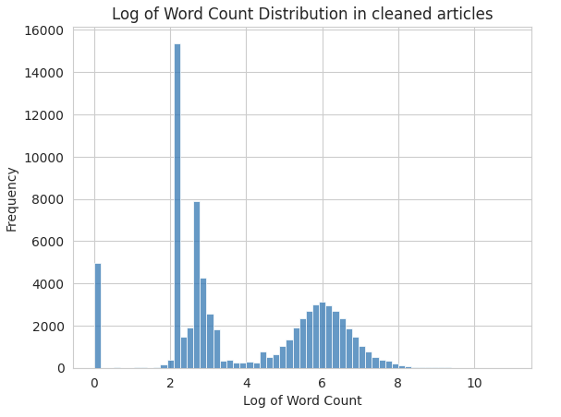
Preprocessing Results
min | max | median | std
0 | 115,782 | 10 | 1338
min | max | median | std
0 | 10,785 | 23 | 168
Notes:
Jun

Slide 26
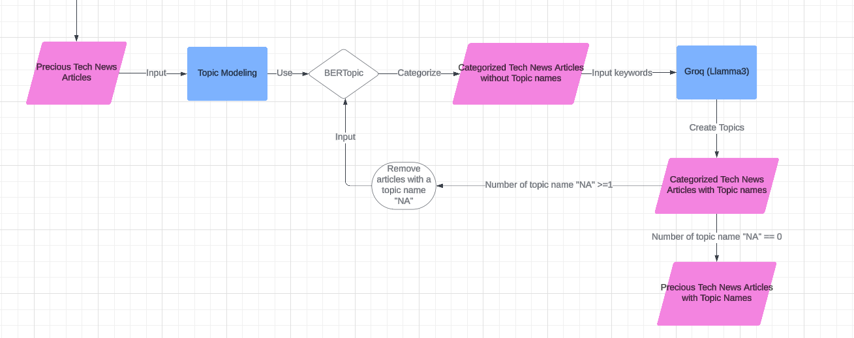
Topic Modeling Pipeline
Goal: Remove articles related to consumer technology and error messages
BERTopic: Python library which can help us to categorize and extract keywords from tech news articles
Groq: free AI Cloud where we can use various fine-tuned large language model (e.g. Llamma3, gemma, whisper)
Notes:
Jun

Slide 27
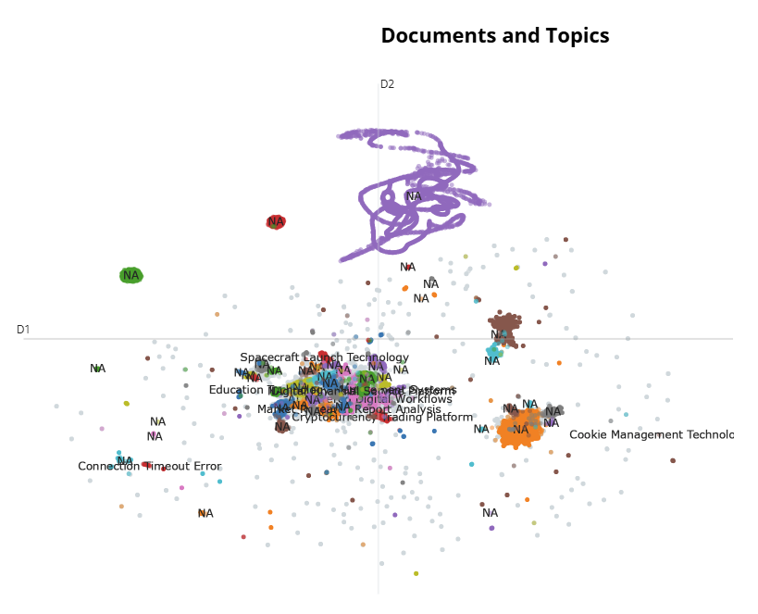
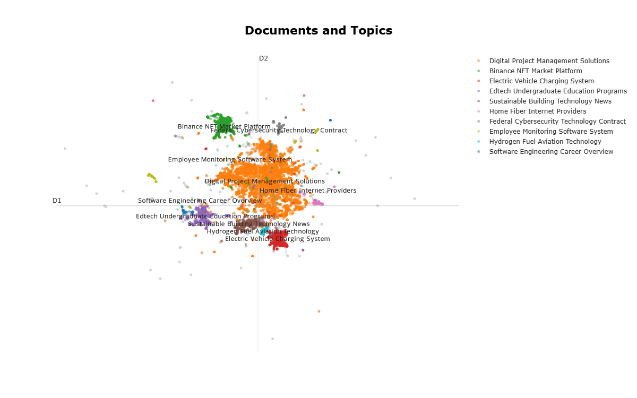
Topic Modeling Results
80,000 Tech News Articles before filtering
12,269 Tech News Articles after filtering
Notes:
Jun

Slide 28
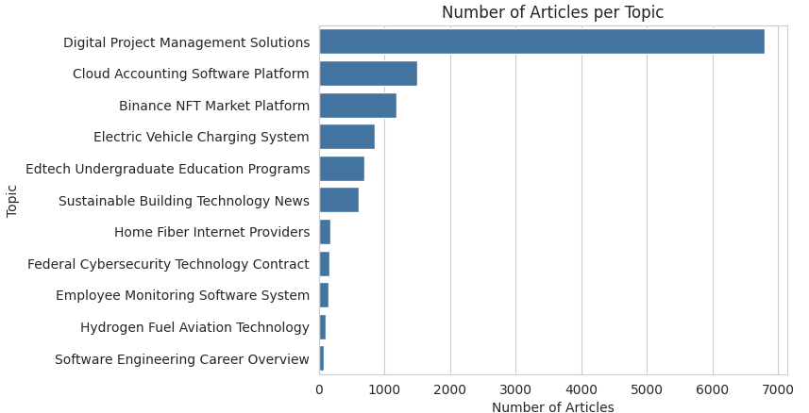
Topic Modeling Results
The topic “Digital Project Management Solutions” has the greatest number of articles in the engine
Notes:
Jun

Slide 29
Entity Relationship Mapping
Notes:
May

Slide 30
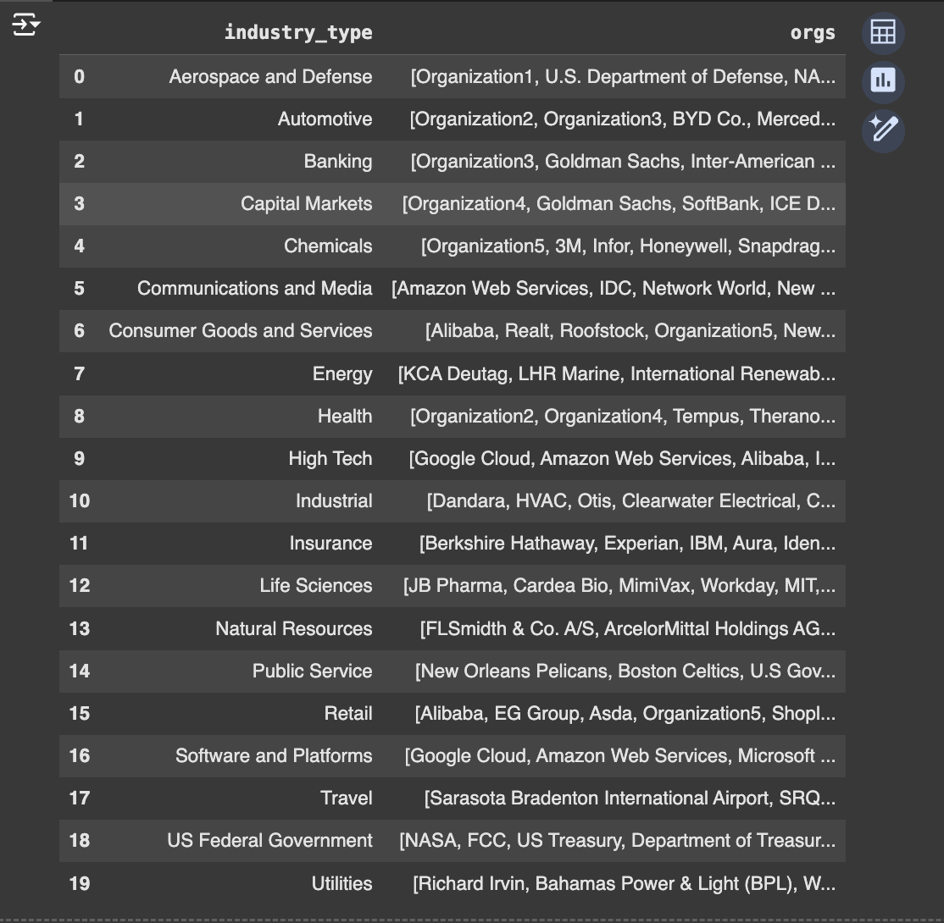
Topic Entity Relationship Mapping
Categorized organizations based on the industries or technologies they invest in with the first column listing industry types and the second column showing the corresponding organizations
Notes:
May

Slide 31
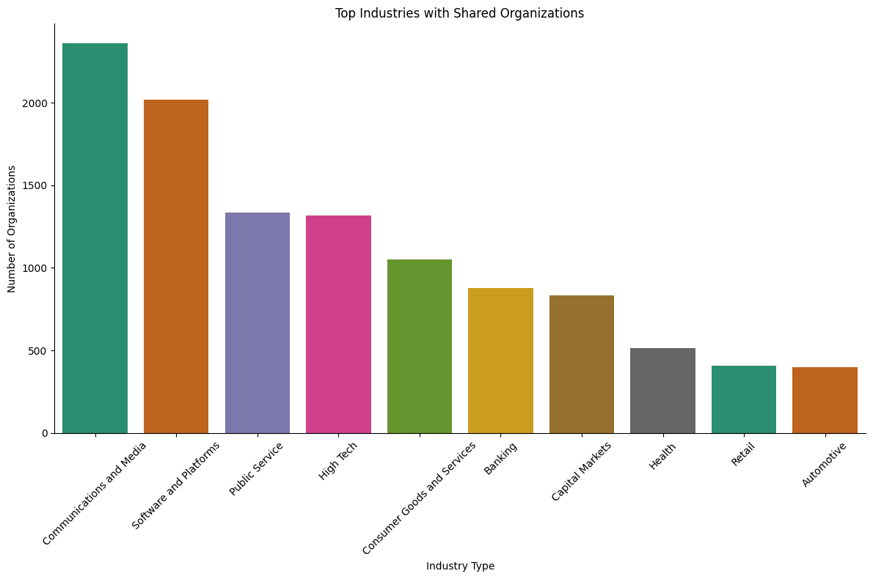
Topic Entity Relationship Mapping
Developed a bar graph to depict which companies and organizations invested in similar technologies, focusing specifically on the top industries.
Notes:
May

Slide 32
Technology News Recommendation System
Notes:
Jun

Slide 33
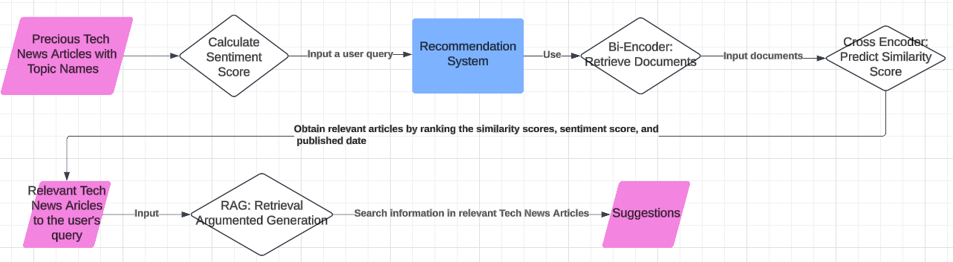
Recommendation System Overview
Goal: Input a list of relevant articles to a user’s query in a chatbot model and receive a suggestion from the model
Recommendation system: consists of Bi-Encoder and Cross Encoder from sentence transformers and Retrieval Argumented Generation (RAG)
Notes:
Jun

Slide 34
Recommendation System Example (1)
Question: What is the initiatives of cloud accounting software platform?
Answer: Cloud accounting software platforms streamline financial management with features like
Automated payroll
Time-saving tools
Seamless system integration
Customizable dashboards
Invoicing, tax management
Flexible subscription plans, and free trials.
Notes:
Jun

Slide 35
Recommendation System Example (2)
Question: Who are the biggest providers of cloud accounting software platform and what type is being used?
Answer:
QuickBooks: A widely used platform for small businesses, offering invoicing, expense tracking, inventory management, and payroll processing.
Xero: Known for invoicing, expense tracking, and project management, with integration to payment gateways and banking apps.
FreshBooks: Tailored for freelancers and small businesses, offering invoicing, time tracking, expense tracking, and integration with payment gateways and project management tools.
Zoho Books: Provides invoicing, expense tracking, and project management, and integrates with Zoho's CRM and inventory management tools.
Wave: A free platform for small businesses and freelancers, offering invoicing, expense tracking, payment processing, and integration with payment gateways and banking apps.
Notes:
Jun

Slide 36
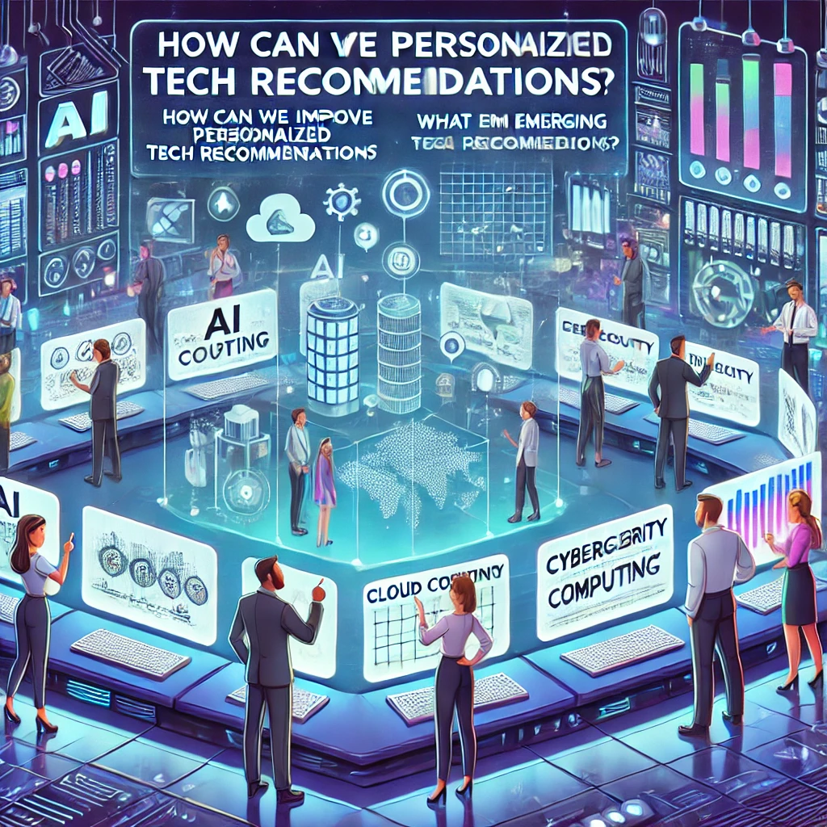
More Questions
Questions:
What are the strength, weaknesses, opportunity, and threats for cloud accounting software platform and each company?
What are the primary challenges or risks faced by clients when adopting or using a cloud accounting software platform?
How much money is being invested in a cloud accounting software platform? How long are they anticipated to take?
What is the impact on sustainability metrics in a cloud accounting software platform? How will this impact jobs?
Notes:
Jun

Slide 37
Final Thoughts

Slide 38
Potential Next Steps
Integrate all our codes to create a complete technology news insight engine that have all the functionalities
Sentiment Analysis and Forecasting
Topic Modeling
Entity Relationship Mapping
Strategic Recommendation System
Add web scraping functionality
Replace the summarization methods with SmolLM-v2 on Transformer
Fine-tuned Llamma2-7b-chat-hf model used by recommendation system and SmolLM-v2
Notes:
Joyce

Slide 39
Thank you!

Slide 40

Questions?

Slide 41
Appendix

Slide 42
Recommendation System Example (3)
Question: What are the strength, weaknesses, opportunity, and threats for cloud accounting software platform and each company?
Answer:
Strengths:
Cloud accounting software is user-friendly, offers real-time reporting, is scalable, facilitates collaboration, and ensures automatic data backups.
Weaknesses:
It may raise security concerns, requires stable internet connectivity, lacks full customization, and can be costly for some businesses.
Opportunities:
There is growing demand, integration potential with other business tools, mobile access for flexibility, and opportunities to expand into new markets.
Threats:
The market is highly competitive, and regulatory changes may pose challenges or necessitate software updates.

Slide 43
Recommendation System Example (4)
Question: What are the primary challenges or risks faced by clients when adopting or using a cloud accounting software platform?
Answer:
Clients may face challenges when adopting cloud accounting software, including:
Concerns over data security and privacy
Loss of control over financial data, and dependence on internet connectivity
Compliance with regulations
Difficulty integrating with other systems
Concerns about cost vs. value
Limited customization options, and the need for support and training.

Slide 44
Recommendation System Example (5)
Question: How much money is being invested in a cloud accounting software platform? How long are they anticipated to take?
Answer:
Cloud accounting software platform will take around 12 months to develop, with an estimated investment of $500,000. However, it is important to note that these estimates are based on the information provided and may not reflect the actual time and investment required for the development of the platform.

Slide 45
Recommendation System Example (6)
Question: What is the impact on sustainability metrics in a cloud accounting software platform? How will this impact jobs?
Answer:
Reduced Carbon Footprint:
It lowers carbon emissions by eliminating the need for physical hardware like servers and data centers.
Energy Efficiency:
The use of energy-efficient technologies minimizes energy consumption and emissions.
Sustainable Data Centers:
Cloud providers are investing in eco-friendly data centers powered by renewable energy sources.
Remote Work:
Enables remote work, reducing commuting and cutting carbon emissions.
Job Creation:
Promotes economic growth by creating new jobs in software development, data analysis, and customer support.

Slide 46
Frequency of Word Summarization
Word Counting:
It tokenizes the article into individual words.
It creates a frequency table (freqTable) storing the count of each word (excluding common stop words).
Sentence Scoring:
It tokenizes the article into sentences.
For each sentence, it calculates a score based on the frequencies of the words present in that sentence using the freqTable.
Sentences containing more frequent words receive higher scores, indicating their potential importance.
Summarization:
It calculates the median sentence score.
It iterates through the sentences and selects those with scores significantly above the median (by a factor of 1.20 in this case).
These selected sentences are combined to form the summary.

Slide 47
TextRank Summarization
Sentence Embeddings:
The text is first split into individual sentences.
Each sentence is then converted into a numerical vector representation called an embedding. These embeddings capture the semantic meaning of the sentences.
Similarity Matrix:
A similarity matrix is constructed to represent the relationships between sentences.
Each element in the matrix indicates the similarity between two sentences based on their embeddings. Higher values denote stronger semantic similarity.
The similarity_matrix method in the code calculates this matrix using cosine similarity.
Graph Representation:
The similarity matrix is then interpreted as a graph where sentences are nodes and the similarity scores are edge weights.
This graph representation captures the interconnectedness of sentences based on their semantic relationships.
PageRank Algorithm:
The PageRank algorithm, originally used for ranking web pages, is applied to this sentence graph.
It iteratively assigns scores to each sentence (node) based on the scores of its connected sentences (neighbors).
Sentences with connections to high-scoring sentences receive higher scores, indicating their importance in the overall context.
Sentence Selection:
Finally, the sentences with the high PageRank scores are selected to form the summary.
These sentences are considered the most central and informative in the text, representing the main ideas.

Slide 48
Retrieval Augmented Generation
Retrieval-Augmented Generation (RAG) combines two key elements—retrieval and generation—to create smarter AI systems.
Retrieval: Imagine having a massive library of information. When you ask a question, instead of trying to remember everything, the system quickly looks up the most relevant articles to find useful information.
Generation: Once the system has the relevant information, it uses AI (like GPT) to write a clear response, combining the facts it found with its own language skills.

