Slide 1
TheMovieDB
API
Predicting Movie Profitability
Data Science Analysis by Koh Jun Kai, Xin Yan, Anamika Kolady
Lab FSP8 Group 10

Slide 2
Table of Contents
01
03
02
04
Problem Defintion
Machine Learning
Framing the real life problem into a Data Science question
Fine-tuning a model that is accurate and useful
Exploratory Analysis
Analysis
Basic Insights & data visualisation
What are some key takeaways from our Data Science analysis

Slide 3
01
Problem Definition

Slide 4

PROFIT
What are the factors that I should consider to ensure my next movie is profitable?

Slide 5
Framing a Data Science Problem
Real Life Problem
What factors affects Profit?
Considerations...
Can we predict if a movie is profitable or not? (Classification)
Can we predict the profits of a movie? (Regression)
Final Problem Statement
Given x variables, can we predict the profit of a movie?

Slide 6
Data Extraction/Preparation

Slide 7
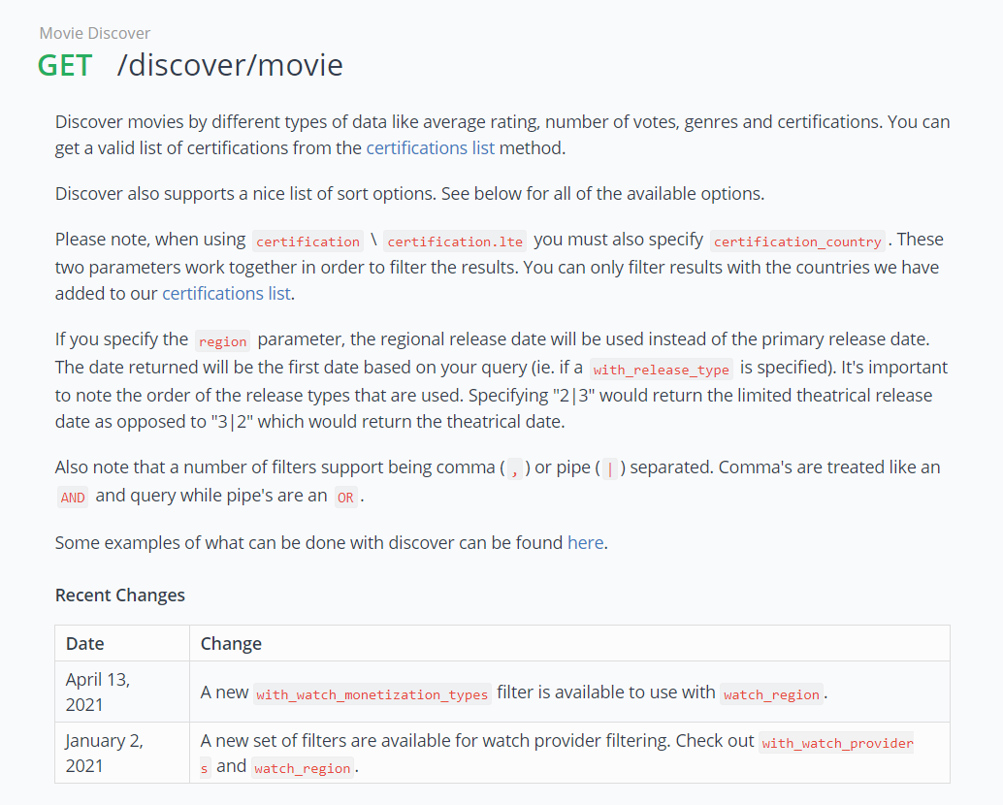
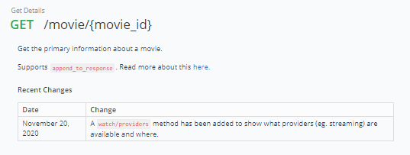
20 Movies per page, but lacks information
More information, but retrieve one by one

Slide 8
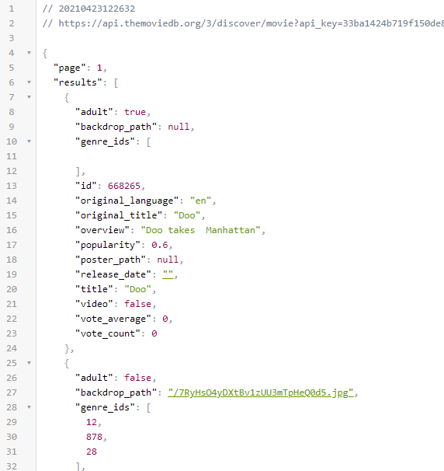

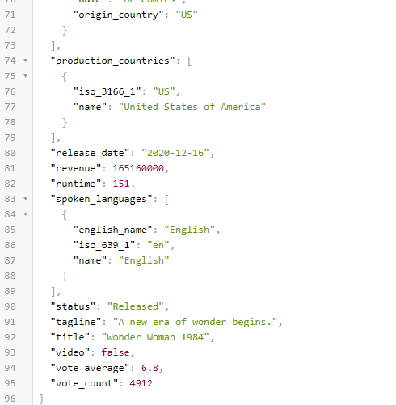
25 lines worth of information per movie
95 Lines worth of information per movie

Slide 9
Movie Extraction
Access 500 different pages of movies by altering URL using loop
URL String = “URL STRING”+str(pagenumber)
Extract 10,000 Movie ID into a list
Extract individual Movie ID data, store in CSV
Using Try and Except in extraction phases helped skip errors during automation

Slide 10
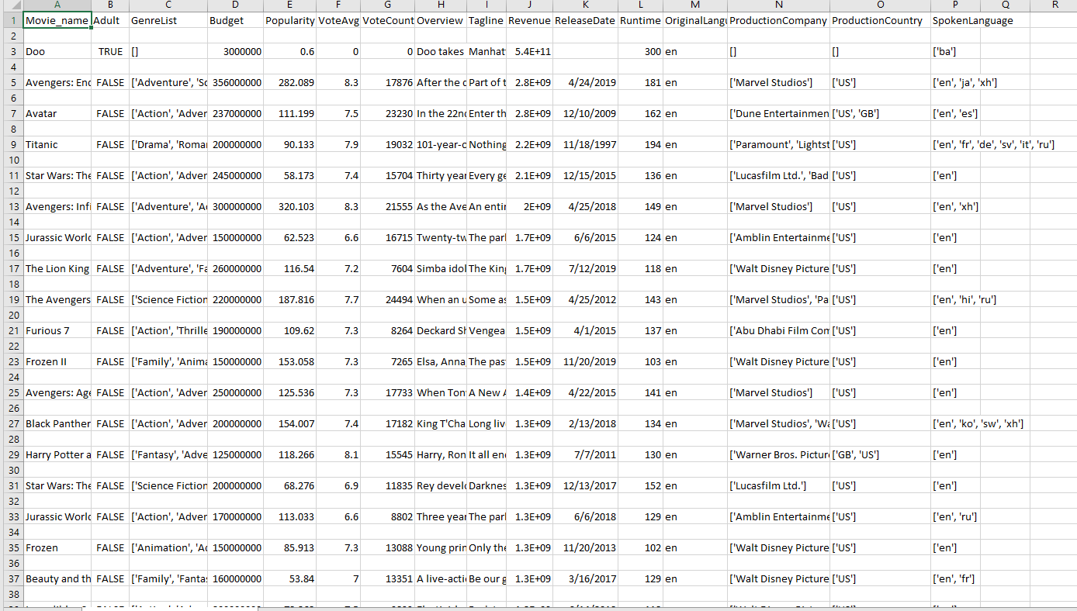

Data Cleaning

Slide 11
Data Curation
Profit = Revenue - Budget

Slide 12
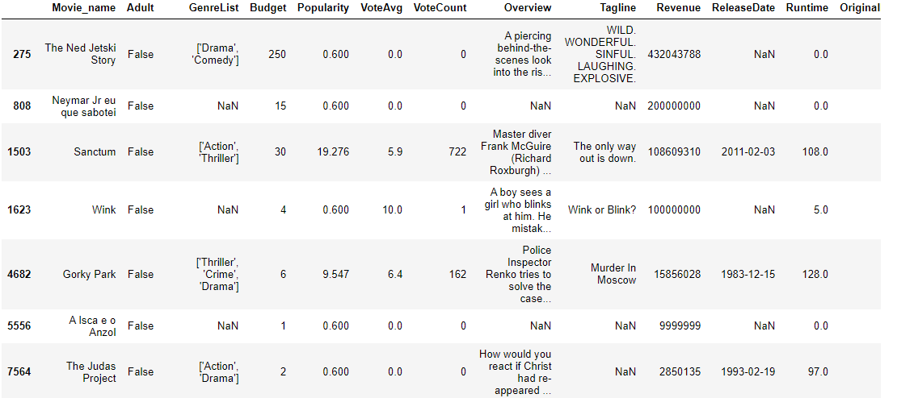
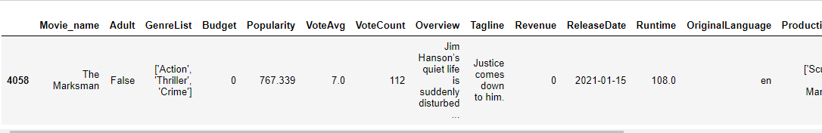
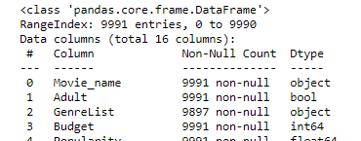
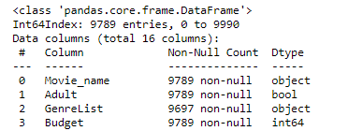
Removing Illogical Data

Slide 13
02
Exploratory Analysis
Numeric Data

Slide 14
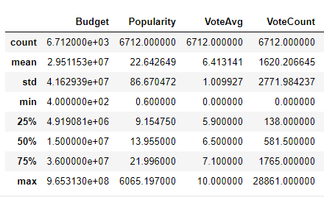
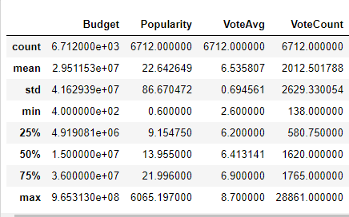

Vote Count/ Vote Average
Impute with mean of VoteCount & VoteAvg
Calculate mean of VoteCount & VoteAvg

Slide 15
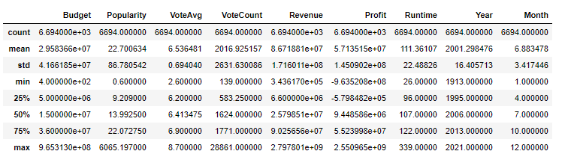
Statistical Summary

Slide 16
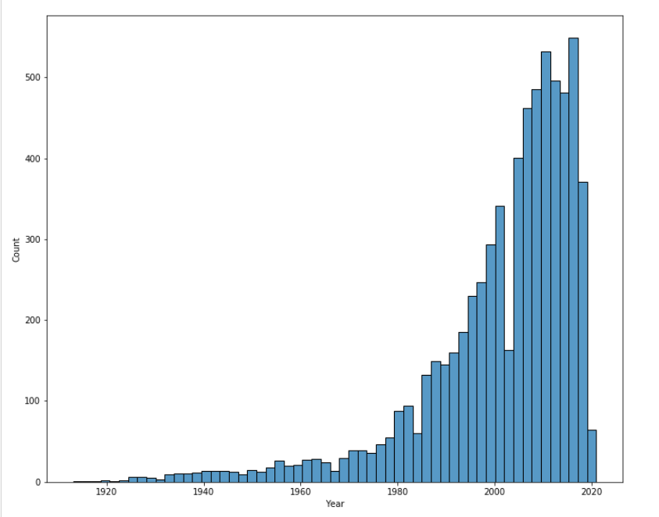

Slide 17
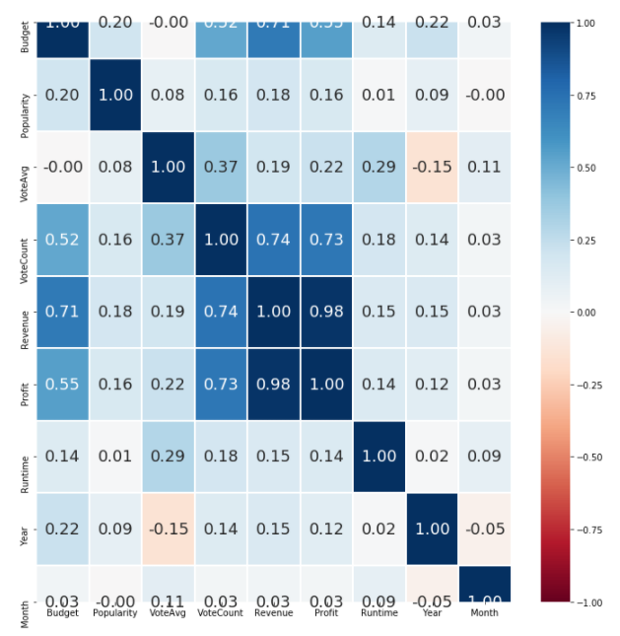

Slide 18
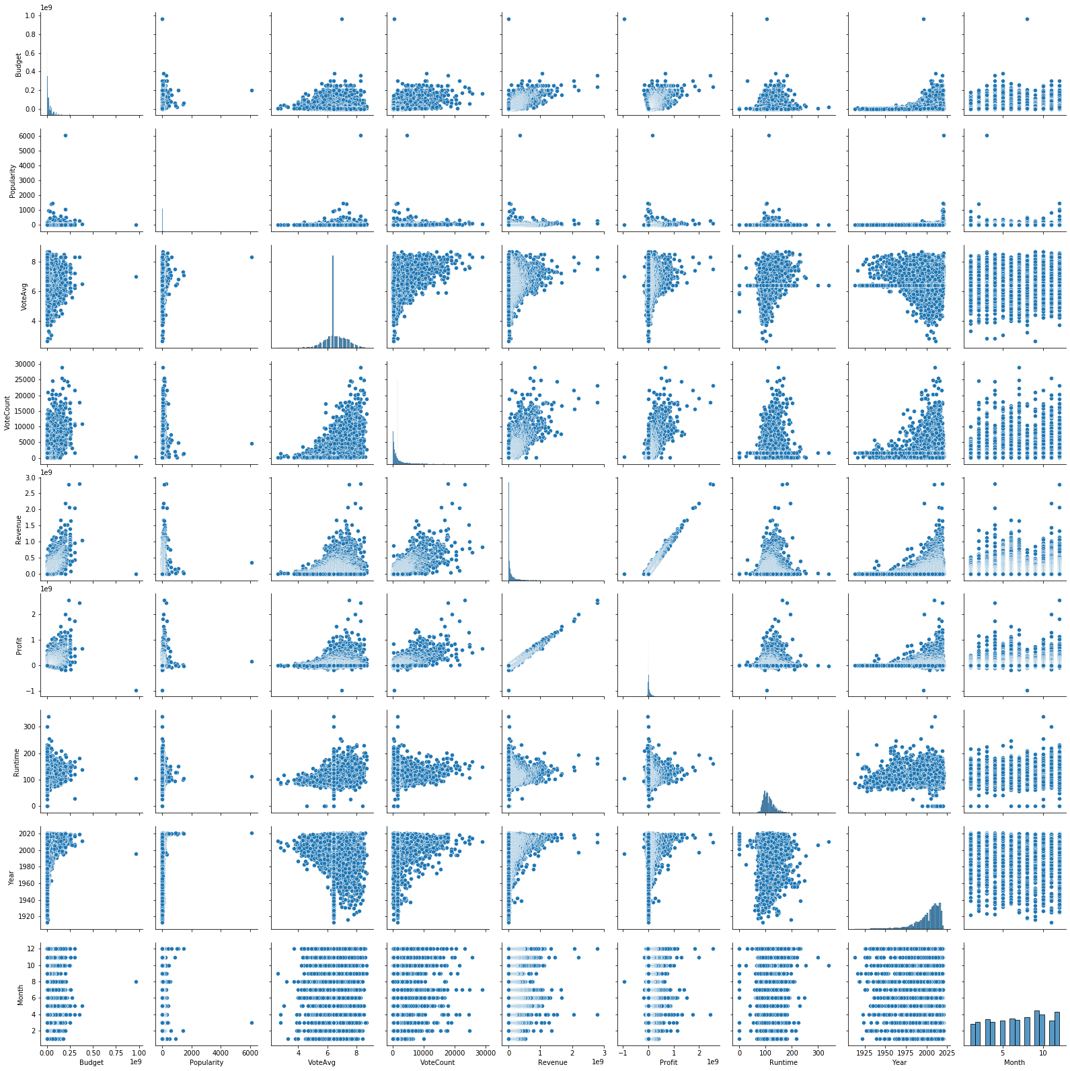

Slide 20
02
Exploratory Analysis
Categorical Data

Slide 21

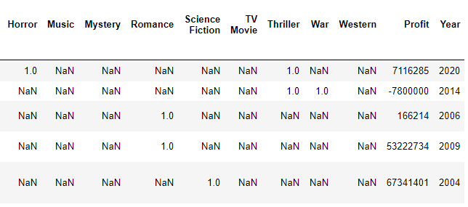
Genre Data Curation
One-Hot Encoding

Slide 22
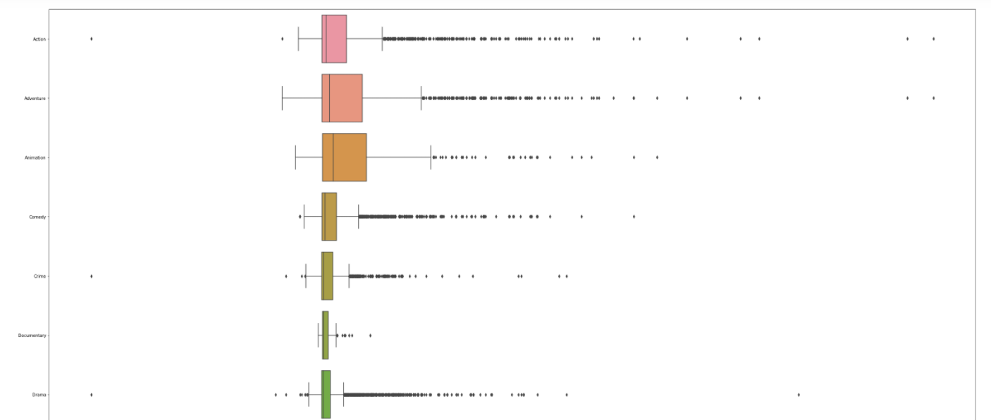
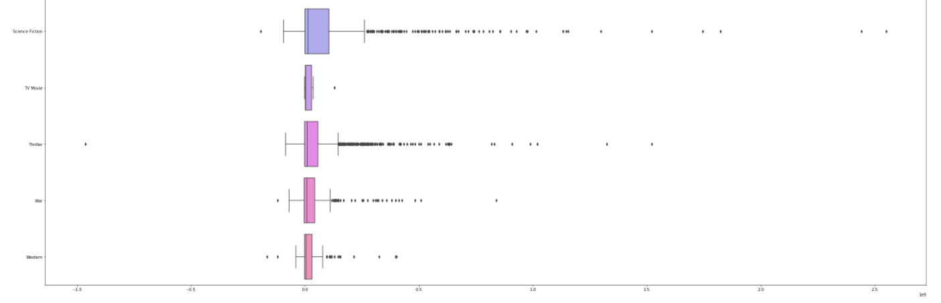
Genre Analysis

Slide 23
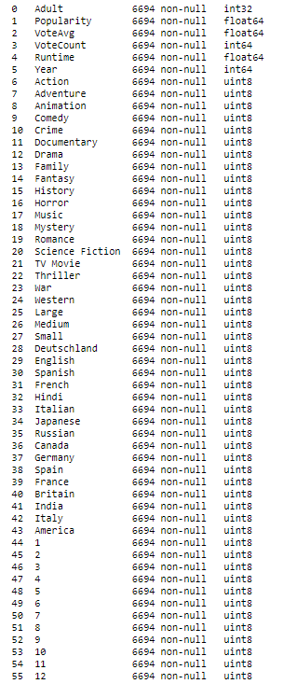


Dealing with High Cardinality Categorical Data
Choose Top 8 Languages
Directly One-Hot encoding the Data will not be smart
Categorize companies based on movie production count
7207 columns just based on these 3 categories alone

Slide 24
03
Machine Learning

Slide 25
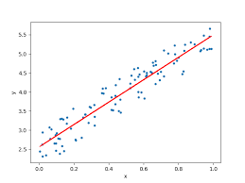

What did we choose?
Linear Regression
Random Forest Regression

Slide 26
Linear Regression
How does it work?
Step 1: Dividing Data
Dataset is divided into training set and testing set.
Step 2: Training Models
Linear Model Regression model is trained and coefficients are recorded.
Step 3: Linear Equation formed
Linear Equation is formed using Y=mx+c where m is the coefficient and x is the predicting variable.

Slide 27
How we did it:
1)Extract Numeric Data
2)Split into Test and Training test set
3) Train the Linear Regression model

Slide 28
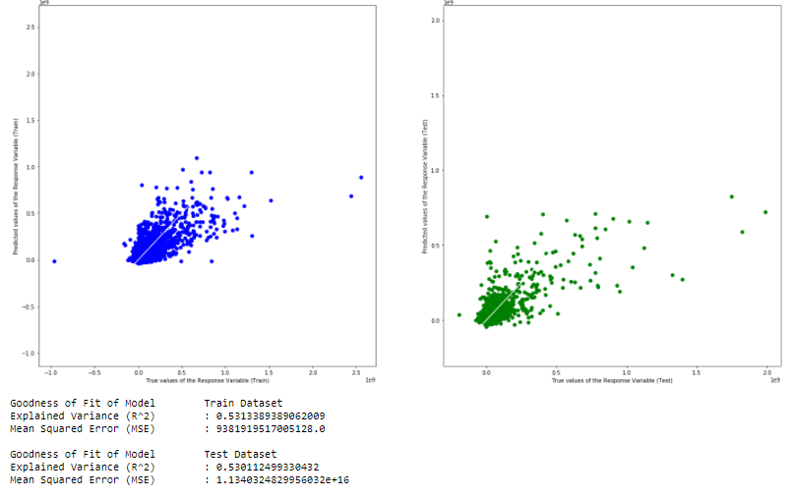
How we did it:
4) Predict response variable for both test and train data
5)Evaluate the Linear Regression Model

Slide 29
Random Forest Regression
How does it work?
Step 1: Random samples
Random samples are continuously taken from training data
Step 2: Training Models
Random Forest Regressor model is trained for each sample and predictions is recorded
Step 3: Ensemble predictions
Prediction is calculated by averaging all the predictions taken

Slide 30
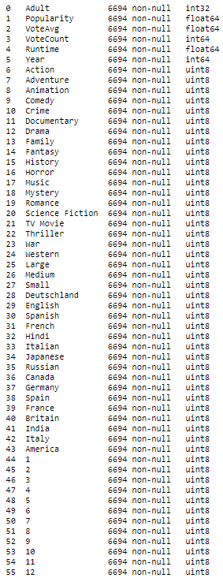
How we did it:
Transform

Slide 31
How we did it:
1)Splitting into training and testing data
2)Training model
3)Predict Profits

Slide 32
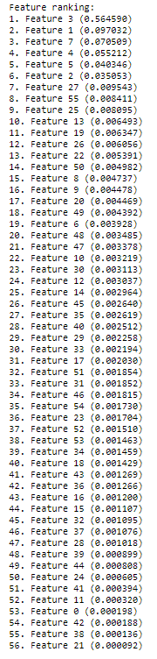

How we did it:
4) Calculate Feature Importance

Slide 33

Improvement:
Dropping least importance feature to try to increase explained variance value.

Slide 34
“I am always ready to learn even though I don’t like to be taught”
—Winston Churchill

Slide 35
Analysis
What are some key takeaways from our Data Science analysis

Slide 36
What Key Feature predicts the profit a movie makes the most?
Explained Variance: 0.678
Vote Count
Popularity
Adventure
Runtime
Year
Vote Average
Small Production Company
December
Profit
Runtime

Slide 37
Adventure, Small Production Company and December.
Which of these features are most useful?

Slide 38
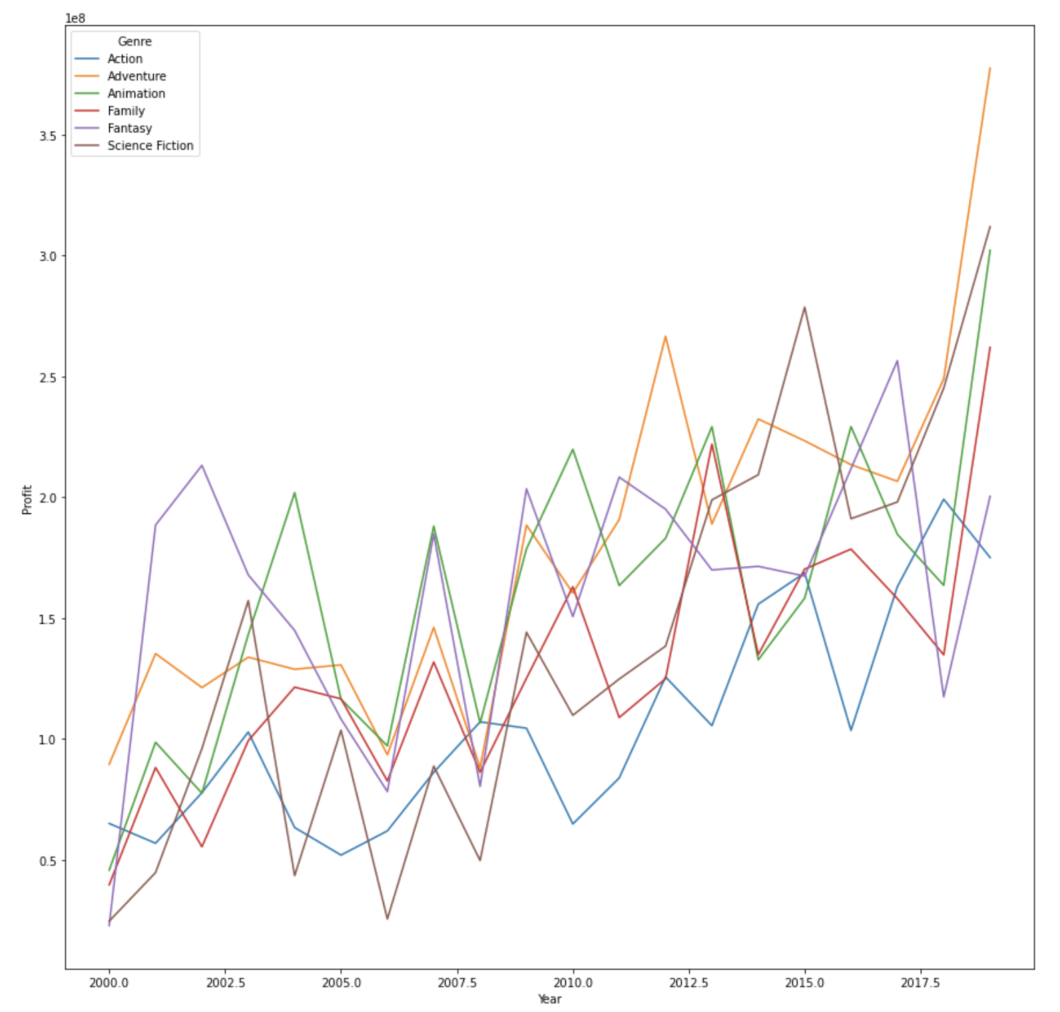
Genre
Adventure
Steep rise 2010 onwards

Slide 39
Production Company
Small
Large
Medium
Bringing most profit over the years
Lower profit than small production companies but higher profit than medium production companies
Least profit over the years

Slide 40
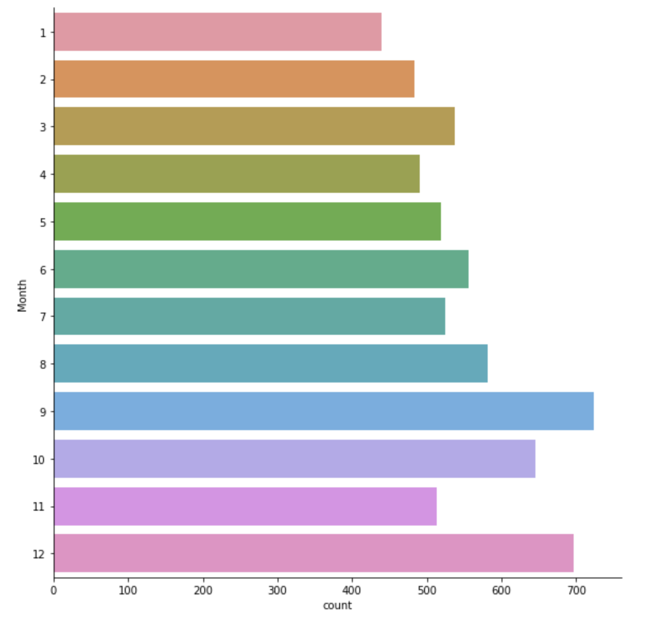
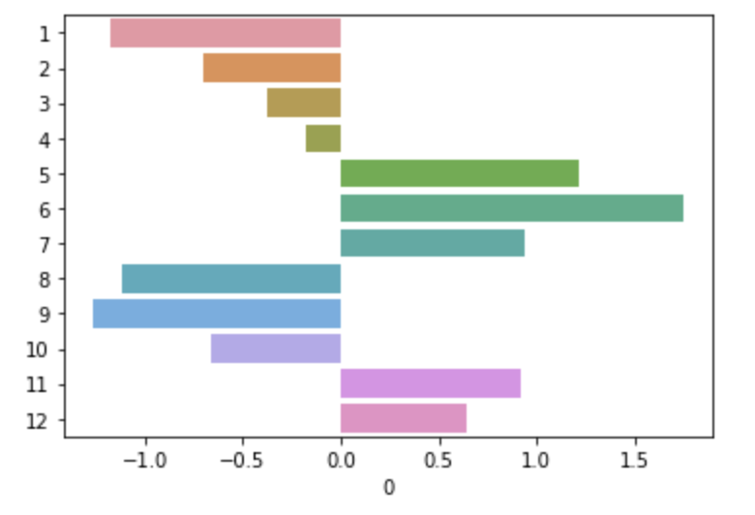
Month of Release
December
Why?
Closer to Holiday Season

Slide 41
Outcome
ADVENTURE
SMALL PRODUCTION COMPANY
DECEMBER
POPULARITY, VOTE COUNT, VOTE AVERAGE
PROFIT

Slide 42
Recommendations

Slide 43
01
02
03
Favour making Adventure Films
Launch the movie during the winter breaks.
Approach small production companies to make films

Slide 44
Team Work
Koh Jun Kai - Data Extraction, Data Cleaning and Categorical Data Exploration
Xin Yan - Data visualization, Machine Learning - Random Forest
Anamika Kolady - Numeric Data Exploration ,Linear Regression on Numeric Data, Feature Importances

Slide 45
Resources
https://www.freecodecamp.org/news/how-to-use-the-tree-based-algorithm-for-machine-learning/
https://www.javatpoint.com/machine-learning-random-forest-algorithm
https://stackabuse.com/random-forest-algorithm-with-python-and-scikit-learn/
https://towardsdatascience.com/an-implementation-and-explanation-of-the-random-forest-in-python-77bf308a9b76
https://www.analyticsvidhya.com/blog/2015/11/easy-methods-deal-categorical-variables-predictive-modeling
https://medium.com/analytics-vidhya/how-to-work-with-masked-data-in-machine-learning-c2c040d6feca
How to convert categorical data to numerical data in python | Python Basics Tutorial
https://towardsdatascience.com/this-tutorial-will-make-your-api-data-pull-so-much-easier-9ab4c35f9af
https://scikit-learn.org/stable/modules/generated/sklearn.metrics.mean_squared_error.html

Slide 46
THANK YOU

