Slide 1
Car Rental System
Group8

Slide 2
Team Member
Aaditya Kasbekar 2826114
Sakshi Wadaskar 2820228
Manali Raut 2209799
Sejal Satav 2871966
Jun Lin 2335057
Daoxiumei Chen 2308359
Zhangyu Ruan 2304795

Slide 3
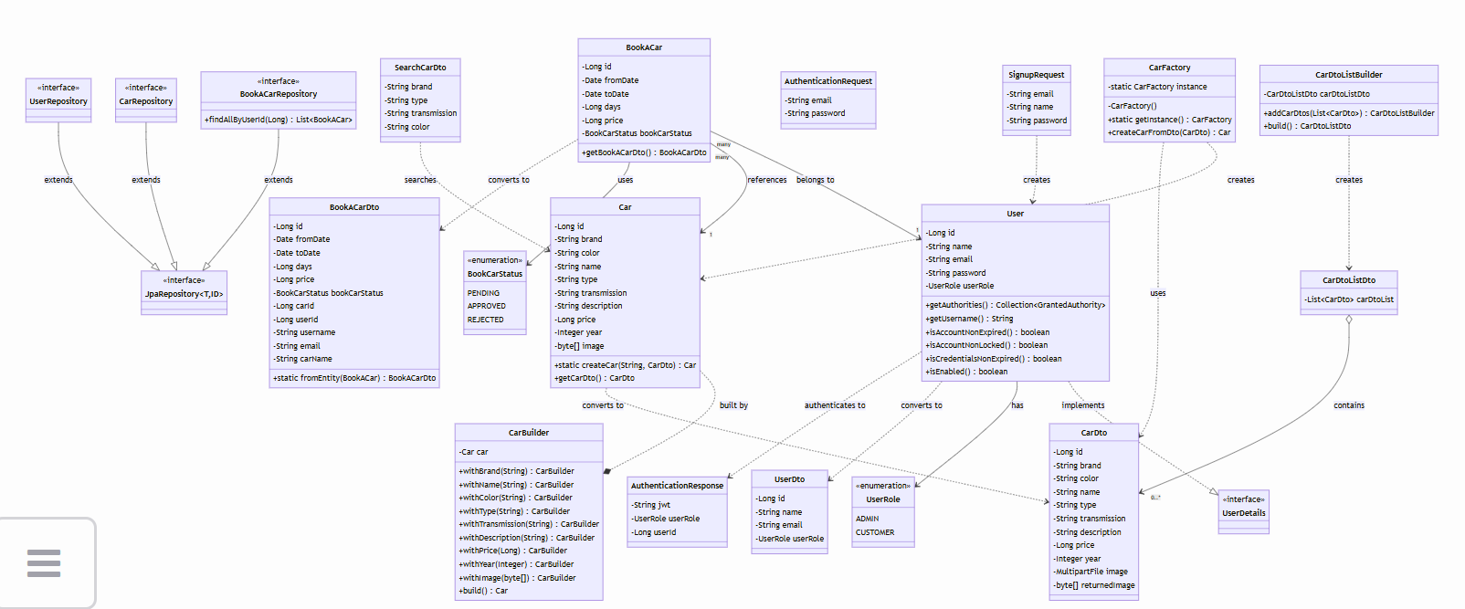
UML Diagram

Slide 4
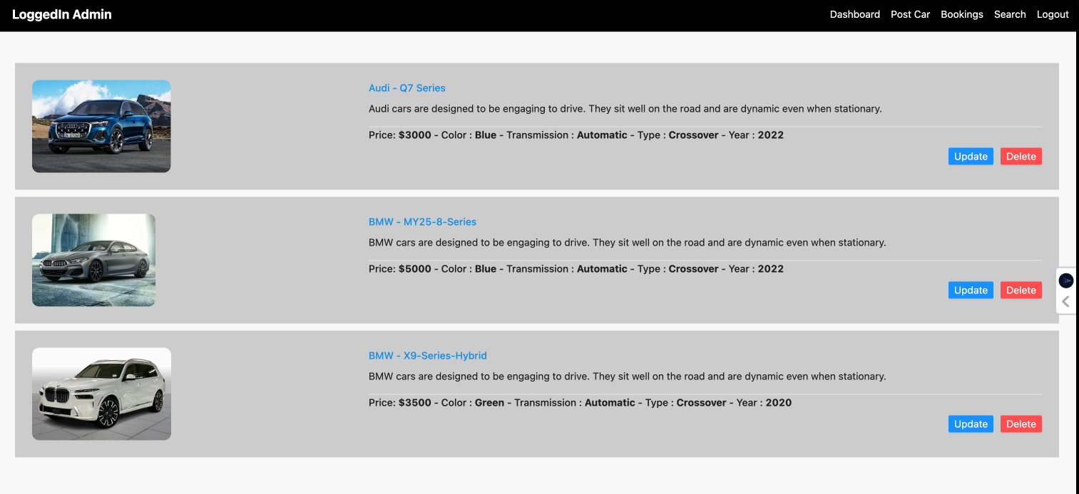
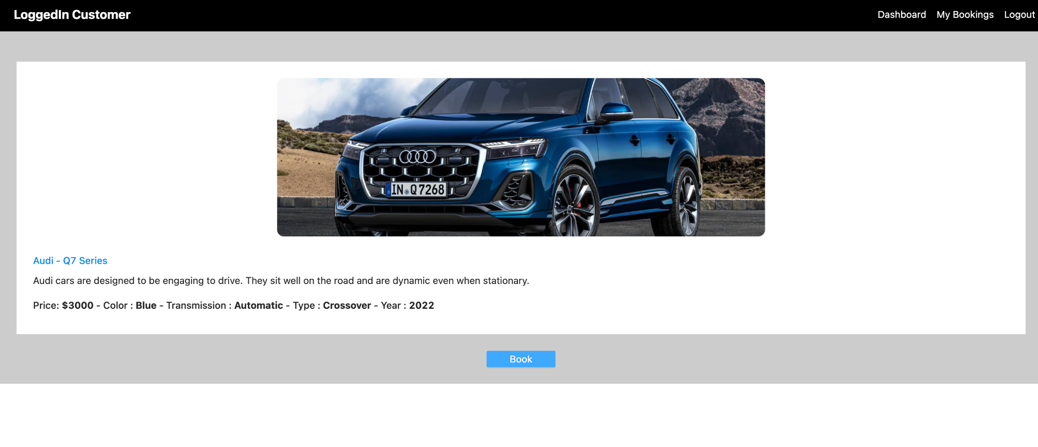
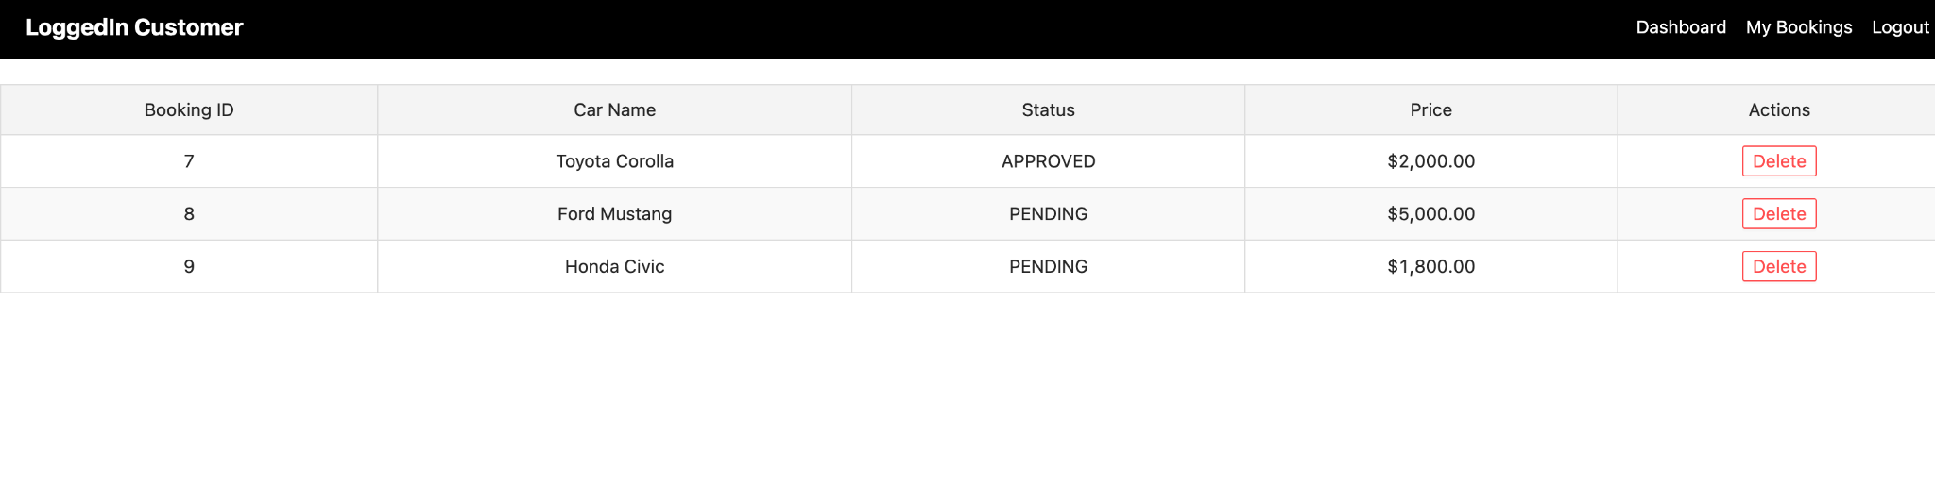
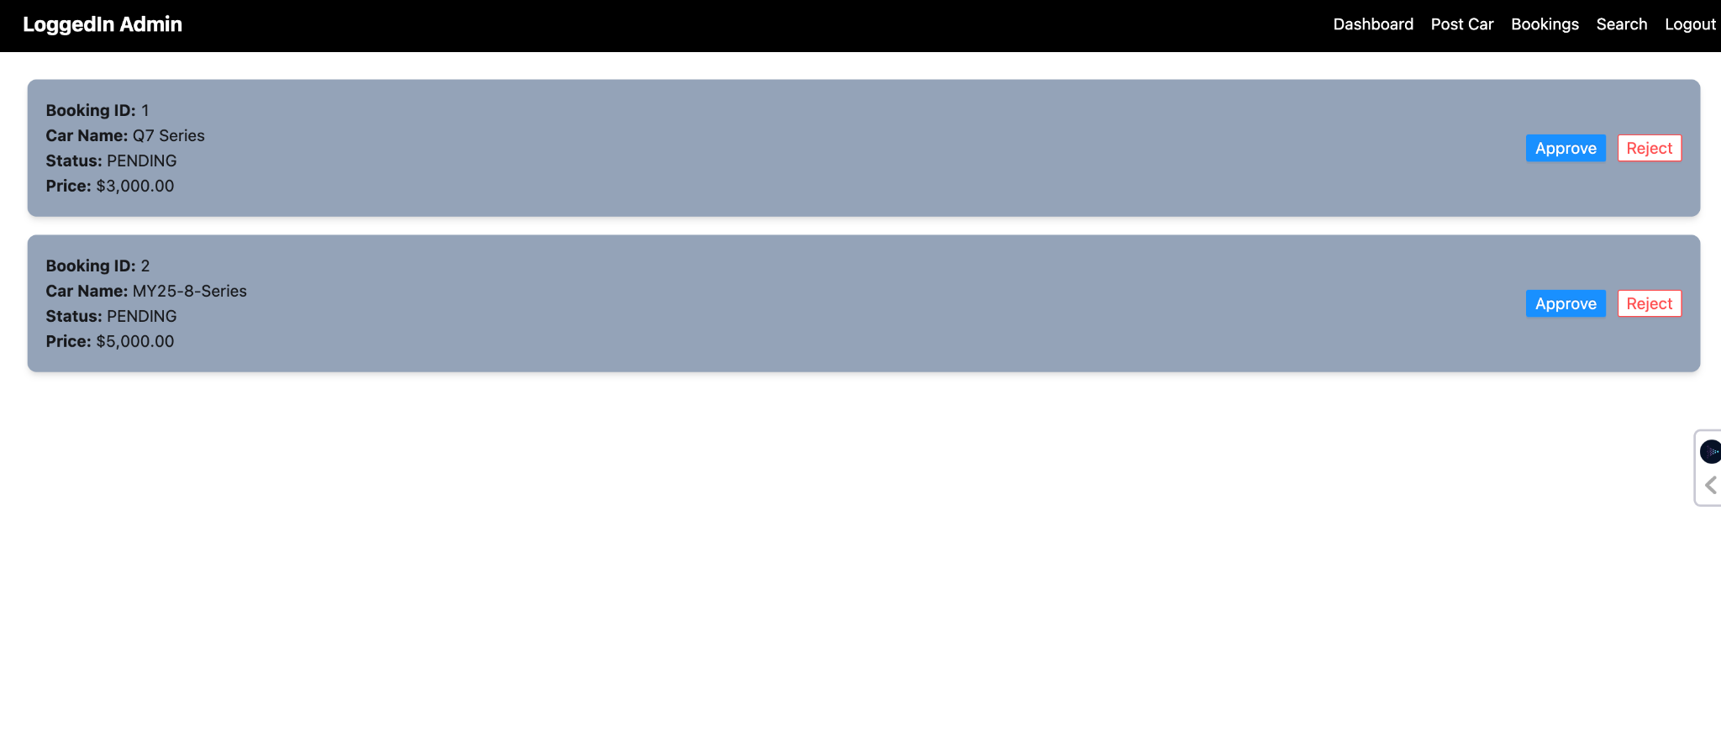
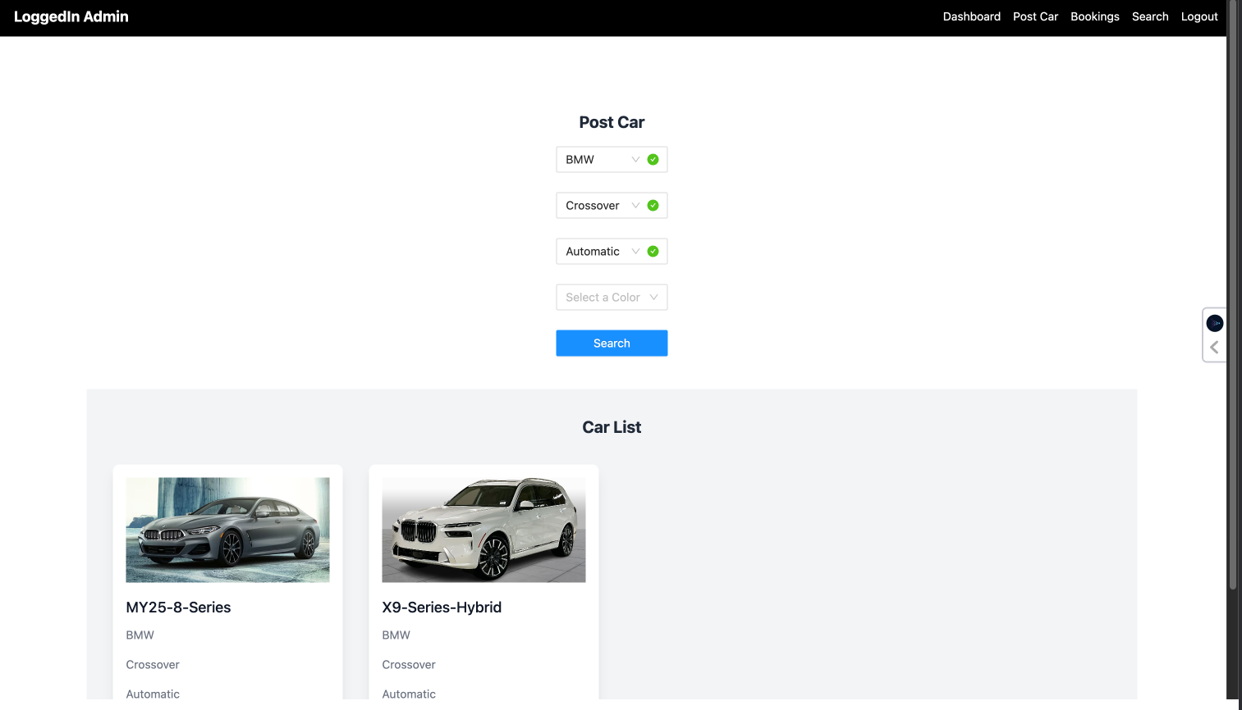
Screenshots of the system

Slide 5
Operating Instructions
Prerequisites & Setup:
Java 17+, Maven, Node.js 16+, MySQL
Database: Create carrentalsystem in MySQL
Backend: Run in car-rental-spring directory
./mvnw clean install
./mvnw spring-boot:run
Frontend: Run in car-rental-angular directory
npm install
ng serve
Application Features:
Admin Portal: Manage cars, handle bookings
Customer Portal: Browse & book cars

Slide 6
OOPS Concepts used
Exception handling
Present in JWT authentication
Used in user service for UserNotFoundException
Error handling in car posting/updating
Streams & Lambda function
Used in service implementations for mapping entities to DTOs
Present in getBookings() and getAllCars() methods
Used in repositories with Optional handling
Enum
BookCarStatus (PENDING, APPROVED, REJECTED)
UserRole (ADMIN, CUSTOMER)
Encapsulation
Through @Data in all entities and DTOs
Private fields with controlled access
Service layer abstraction
Inheritance
Services implementing interfaces
JpaRepository extensions
User implements UserDetails
Design Patterns
Builder Pattern (in Car entity)
Strategy Pattern (in BookACar status handling)
Repository Pattern (through Spring Data JPA)
Factory Method (in DTOs)
Singleton (through Spring's @Service, @Component)
Polymorphism
Through service interfaces
In Car entity methods (calculateRentalPrice, isAvailable)
In status handling strategy

Slide 7
Technology and Design concepts used
– Applied Learning from CSYE6200 lectures
Java Core Concepts
Object-Oriented Programming
Design Patterns
– Applied Learning from independent research
Framework: Spring Boot, React, HTML/CSS5
Database: SQL

Slide 8
Third-party libraries of packages used
Backend Dependencies:
Spring Boot Starter Web
Spring Security
Spring Data JPA
MySQL Connector
JWT Authentication
Lombok
Frontend Dependencies:
React/Angular
Node.js
npm packages
Bootstrap/Material UI

Slide 9
Future Enhancements and Lessons Learned
Future Enhancements:
Payment Gateway Integration
Email Notification System
Advanced Search Filters
User Reviews & Ratings
Mobile Application
Lessons Learned:
Importance of Design Patterns
Value of Clean Code
Team Collaboration
Version Control Best Practices
Agile Development Methods

