Slide 1
STM32 F722ZE NUCLEO BOARDS
6조
조장 장인상
조원 이준태
정지원
이미르

Slide 2
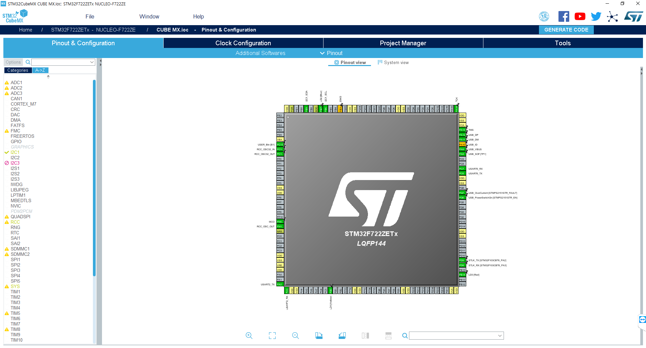
STM32 CUBE MX
A graphical software configuration tool that allows the generation of C initialization code using graphical wizards.
https://www.st.com/resource/en/data_brief/stm32cubemx.pdf

Slide 3
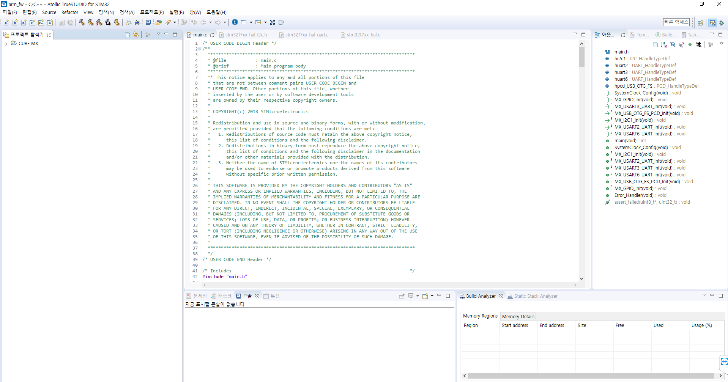
Atollic TrueSTUDIO for STM32
Extensive STM32 device and board support Video tutorials, documentation and discussion forums available
https://atollic.com/truestudio

Slide 4
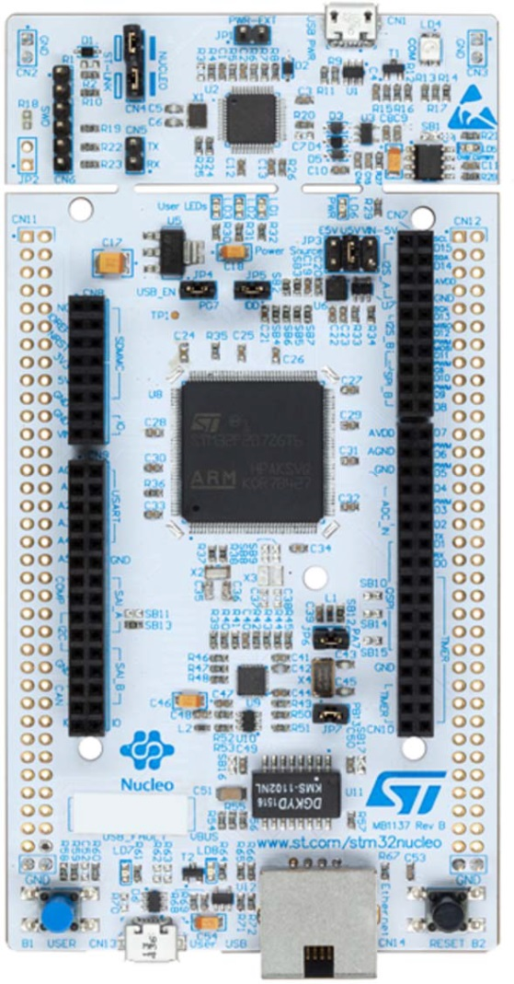
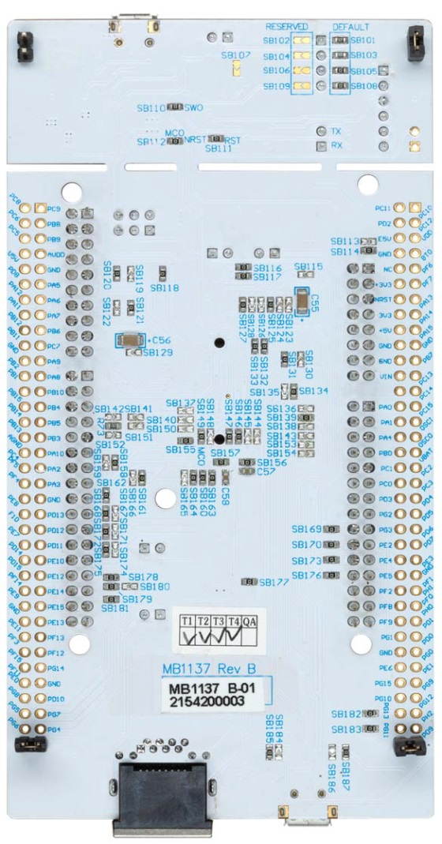
Following Features
CPU : Arm Cortex-M7 core
STM32 microcontroller in LQFP144 package
Ethernet compliant with IEEE-802.3-2002
USB OTG or full-speed device
3 user LEDs
2 push-buttons: USER and RESET
LSE crystal : 32.768 kHz crystal oscillator HSE crystal : 8MHz crystal oscillator
Board connectors : - USB with Micro-AB - Ethernet RJ45

Slide 5
CUBE MX PWM Configuration
Sysclk : 216MHz
PWM pulse period : 20ms(f=50Hz)
Prescaler : 1/432
Counter period : 1/10000
1count period : 20ms/10000=0.002ms
Pulse width count = pulse width / 1count period ex) Servo middle = 760 Stepper neutral = 750
Servo(Steering) Motor
Pulse period : 20ms(f=50Hz)
Max left pulse width : 1.08ms
Max right pulse width : 1.96ms
Middle pulse width : 1.52ms
Stepper(Speed) Motor
Pulse period : 20ms(f=50Hz)
Full reverse : 1ms
Neutral : 1.5ms
Full forward : 2ms

Slide 6
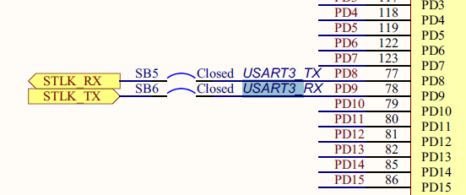
USART communication
Available on PD8 and PD9 - PD8 : USART3 TX, SB5 ON and SB7 OFF - PD9 : USART3 RX, SB6 ON and SB4 OFF
Can be connected either to ST-LINK or to ST morpho connector.

Slide 7

Steering
Protocol
760
0
R/L
540
L15
980
R15
Steering Left/Right bit
L : 0, R : 1
Steering bit
0(0000)~15(1111) stage
Speed
Neutral : 0
Forward : 1~3 Stage
Reverse : only 1 stage
Speed bit
0(000) : neutral
1(001)~3(011) : 1~3 stage forward
4(100) : only 1 stage reverse(slow)

