Slide 1
STM32 F722ZE NUCLEO BOARDS
6조
조장 장인상
조원 이준태
정지원
이미르

Slide 2
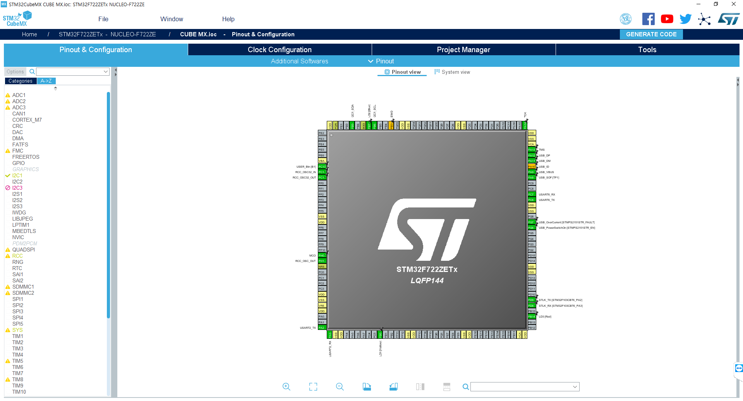
STM32 CUBE MX
A graphical software configuration tool that allows the generation of C initialization code using graphical wizards.
https://www.st.com/resource/en/data_brief/stm32cubemx.pdf

Slide 3
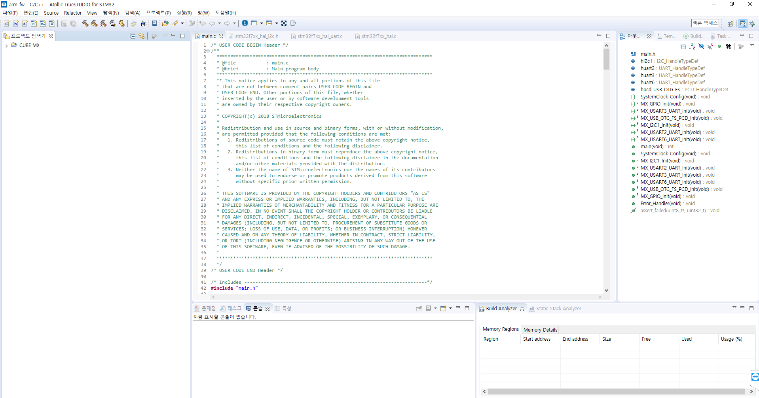
Atollic TrueSTUDIO for STM32
Extensive STM32 device and board support Video tutorials, documentation and discussion forums available
https://atollic.com/truestudio

Slide 4
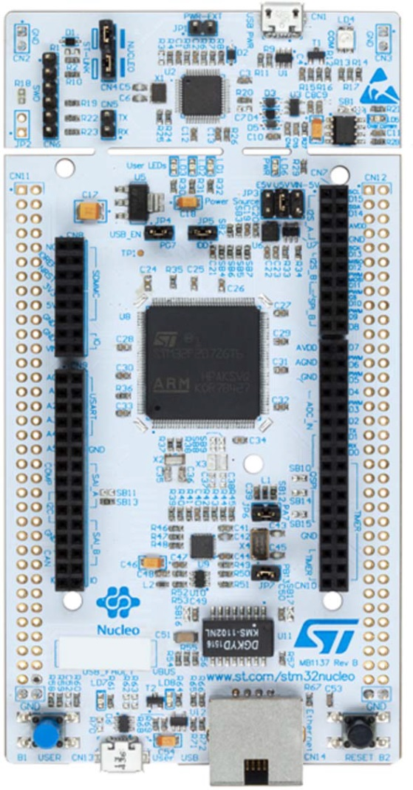
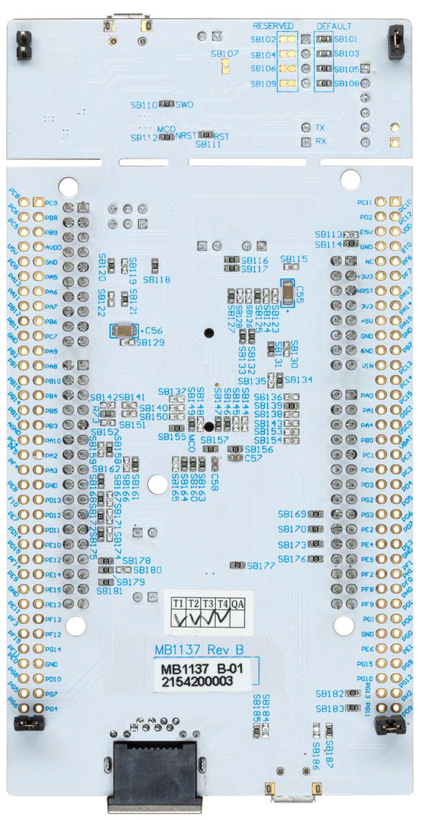
Following Features
CPU : Arm Cortex-M7 core
STM32 microcontroller in LQFP144 package
Ethernet compliant with IEEE-802.3-2002
USB OTG or full-speed device
3 user LEDs
2 push-buttons: USER and RESET
LSE crystal : 32.768 kHz crystal oscillator HSE crystal : 8MHz crystal oscillator
Board connectors : - USB with Micro-AB - Ethernet RJ45

Slide 5
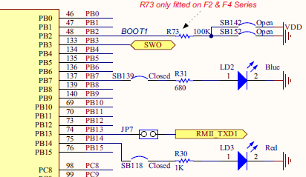
3 USER LEDs
User LD1 : a green user LED is connected to the STM32 I/O PB0 (SB120 ON and SB119 OFF) or PA5 (SB119 ON and SB120 OFF) corresponding to the ST Zio D13.
User LD2 : a blue user LED is connected to PB7.
User LD3 : a red user LED is connected to PB14.

Slide 6
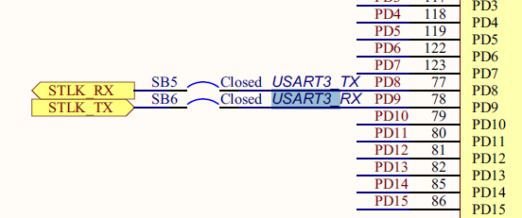
USART communication
Available on PD8 and PD9 - PD8 : USART3 TX, SB5 ON and SB7 OFF - PD9 : USART3 RX, SB6 ON and SB4 OFF
Can be connected either to ST-LINK or to ST morpho connector.

Slide 7
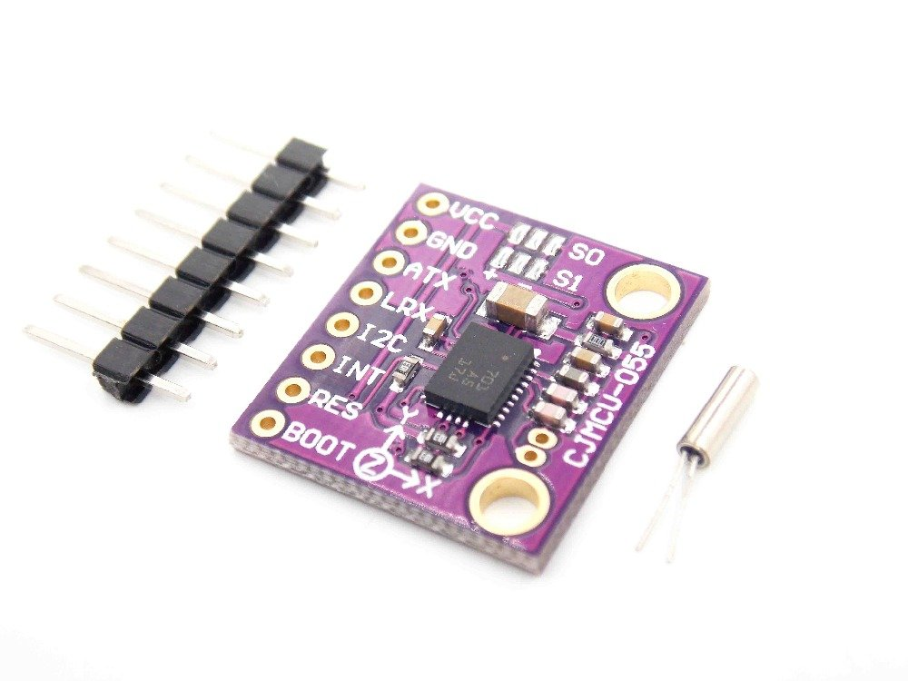
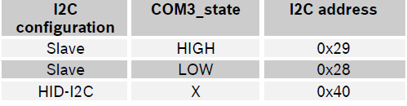
IMU SENSOR(BOSCH BNO055)
Sensor : Gyroscope, Accelerometer, Geomagnetic
Output data : Quaternion, Euler angles, Rotation vector, Gravity, Heading
Interface : HID-I2C, I2C, USART
OPR_MODE Register : 0x3D - IMU : [OPR_MODE] : XXXX1000b - In the IMU mode, the relative orientation of the BNO055 in space is calculated
from the accelerometer and gyroscope data.
I2C Protocol - The I2C bus uses SCL and SDA signal lines. - supports standard mode and fast mode - only 7-bit address mode is supported

Slide 8
Clock Configuration
SYSCLK : 216 MHz - HSE Input frequency : 8 MHz - PLLM : /4, *N : X216, /P : /2
Pinout & Configuration
I2C1 GPIO - Mode : I2C - PB6 : I2C1_SCL, Pull-up - PB9 : I2C1_SDA, Pull-up
USART3 GPIO - Mode : Asynchronous - PD8 : USART3_TX, No pull-up - PD9 : USART3_RX, No pull-up
LEDs GPIO - PB0 : Output Push Pull - PB7 : Output Push Pull - PB14 : Output Push Pull
Project Manager

