Slide 1
Understand data
Data field ID
container
Coding | Meaning
1 | College or University degree
2 | A levels/AS levels or equivalent
3 | O levels/GCSEs or equivalent
4 | CSEs or equivalent
5 | NVQ or HND or HNC or equivalent
6 | Other professional qualifications eg: nursing, teaching
-7 | None of the above
-3 | Prefer not to answer
6138-0.4
Follow up
Data field: 6138 Qualifications
Follow up: 0 at recruitment
container: 4 data field may have many values (for example, disease code, up to 200)
How to clean up?
In practice, we prefer simple data as binary categories
Options: -----highest qualifications?
-----consider University degree only?
-----separate professional qualifications?

Slide 2
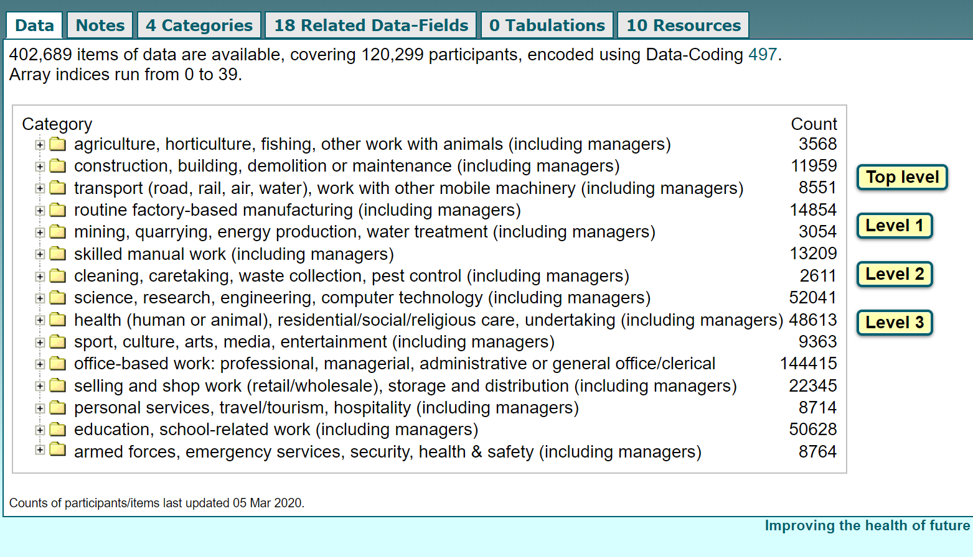
Maybe just classify them into high and low risk?
low
high
OR we can calculate odd ratio in each category to find out if there is any difference?

Slide 3
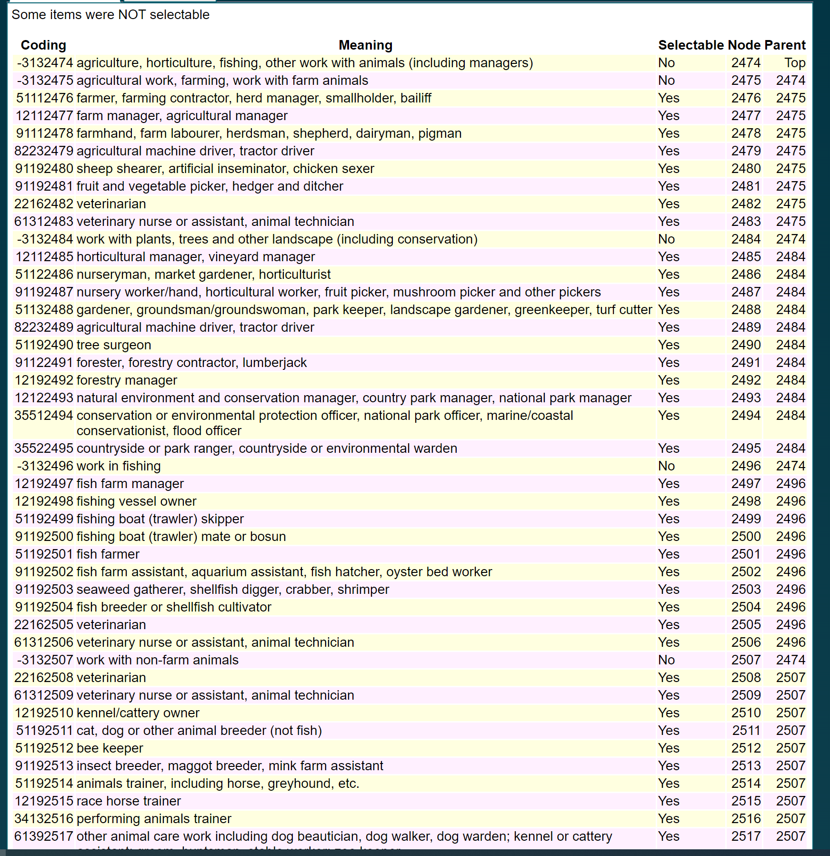
All below belongs to this category

Slide 4
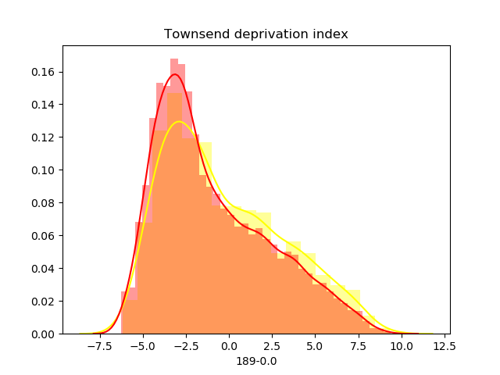
189-0.0
Covid negative
Is the difference significant?
Covid positive

Slide 5
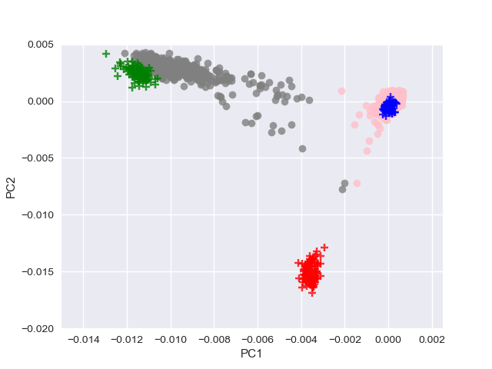
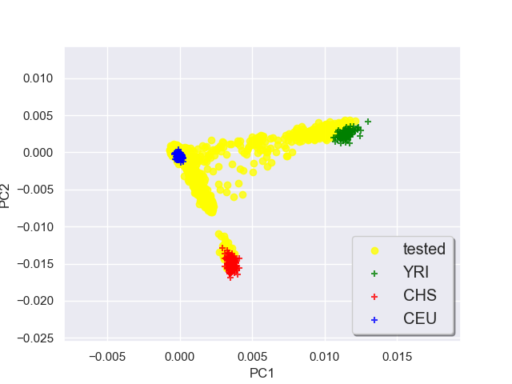
Using genetic data to identify race
10000 SNPs
+: CEU (85)
+: YRI (88)
+: CHB (97)
Randomly choose 5000 CEU and 500 AFR by self-report

Slide 6
Multiple logistic regression model
Optimization terminated successfully.
Current function value: 0.367092
Iterations 8
Logit Regression Results
==============================================================================
Dep. Variable: final_result No. Observations: 13034
Model: Logit Df Residuals: 13028
Method: MLE Df Model: 5
Date: Wed, 16 Sep 2020 Pseudo R-squ.: 0.006936
Time: 21:20:04 Log-Likelihood: -4784.7
converged: True LL-Null: -4818.1
LLR p-value: 4.663e-13
==============================================================================
coef std err z P>|z| [0.025 0.975]
------------------------------------------------------------------------------
PC1 107.8168 18.285 5.896 0.000 71.979 143.655
PC2 -54.0916 21.901 -2.470 0.014 -97.016 -11.167
PC3 8.9904 37.868 0.237 0.812 -65.229 83.209
PC4 -67.4371 95.996 -0.703 0.482 -255.585 120.711
PC5 -0.2066 18.470 -0.011 0.991 -36.407 35.993
intercept -2.0031 0.028 -70.996 0.000 -2.058 -1.948
==============================================================================
PC1 p value is: 3.714282582341431e-09
PC2 p value is: 0.01351690692258477
PC3 p value is: 0.8123327081630767
PC4 p value is: 0.482366276197408
PC5 p value is: 0.9910749259003474
intercept p value is: 0.0

