Slide 1
Understand data
Data field ID
container
Coding | Meaning
1 | College or University degree
2 | A levels/AS levels or equivalent
3 | O levels/GCSEs or equivalent
4 | CSEs or equivalent
5 | NVQ or HND or HNC or equivalent
6 | Other professional qualifications eg: nursing, teaching
-7 | None of the above
-3 | Prefer not to answer
6138-0.4
Follow up
Data field: 6138 Qualifications
Follow up: 0 at recruitment
container: 4 data field may have many values (for example, disease code, up to 200)
How to clean up?
In practice, we prefer simple data as binary categories
Options: -----highest qualifications?
-----consider University degree only?
-----separate professional qualifications?

Slide 2
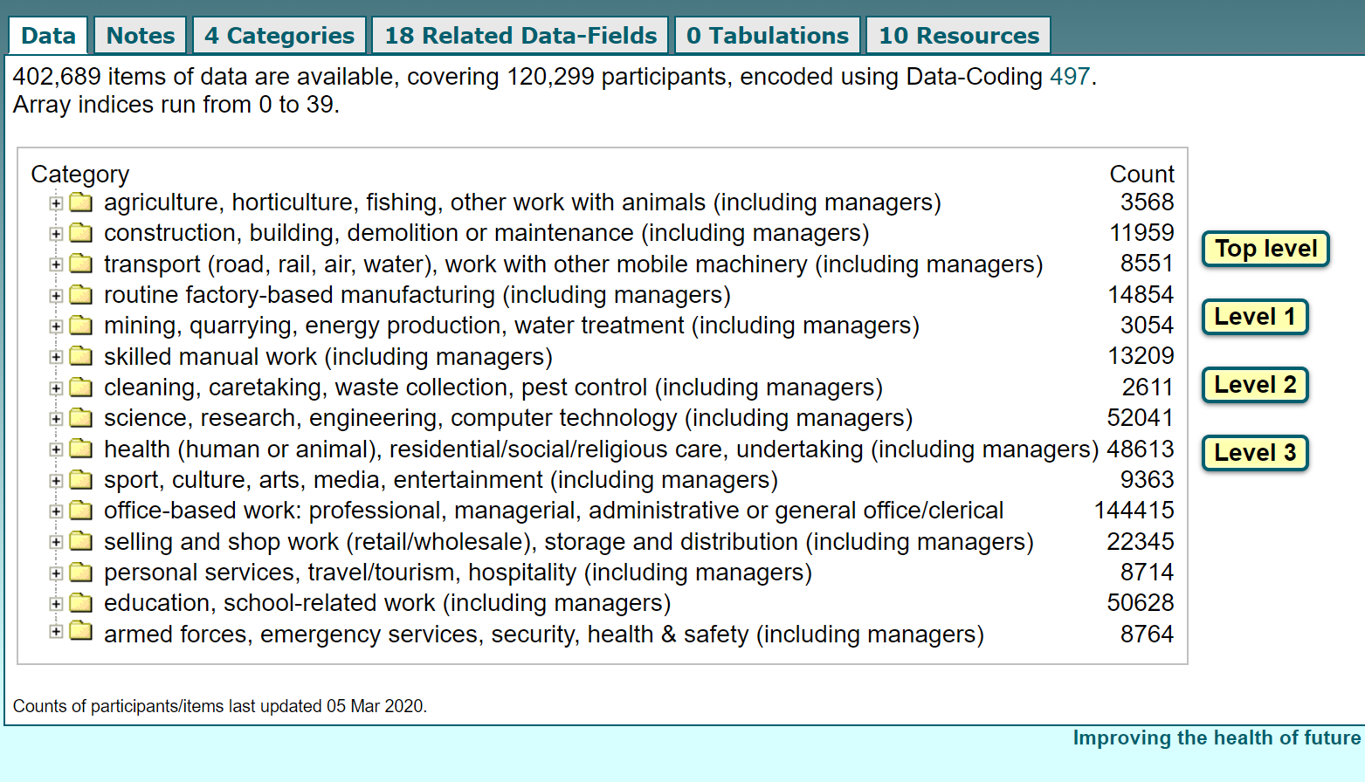
Maybe just classify them into high and low risk?
low
high
OR we can calculate odd ratio in each category to find out if there is any difference?

Slide 3
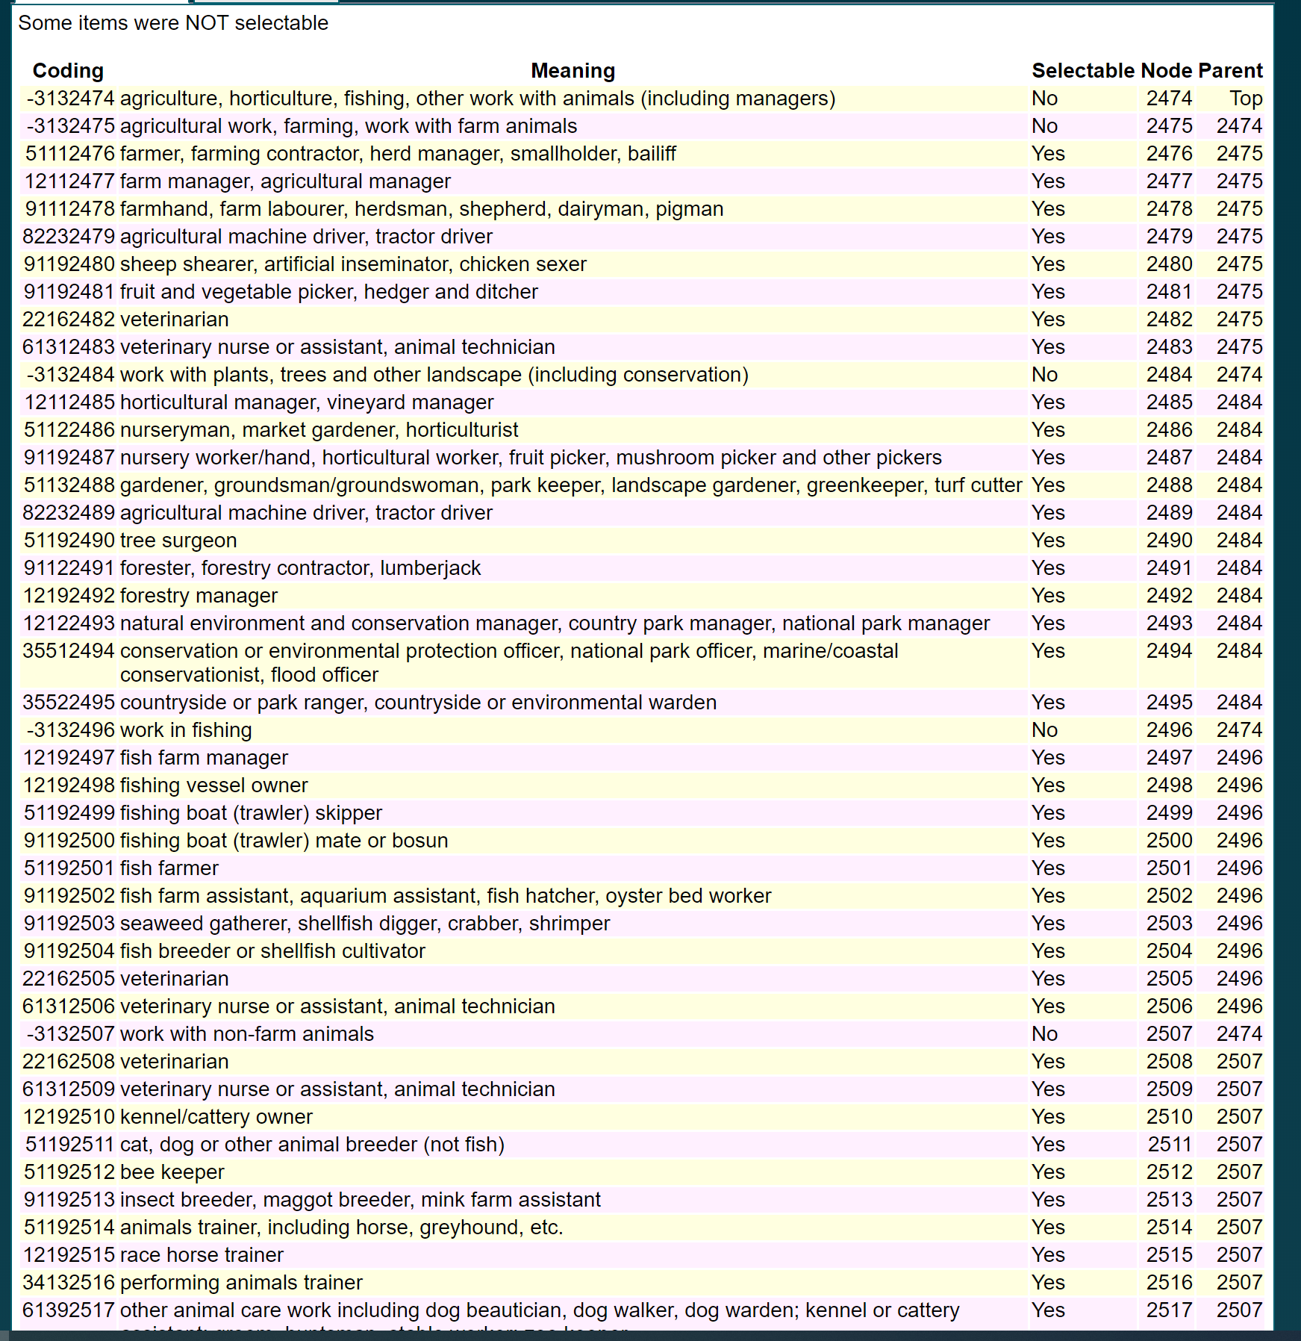
All below belongs to this category

Slide 4
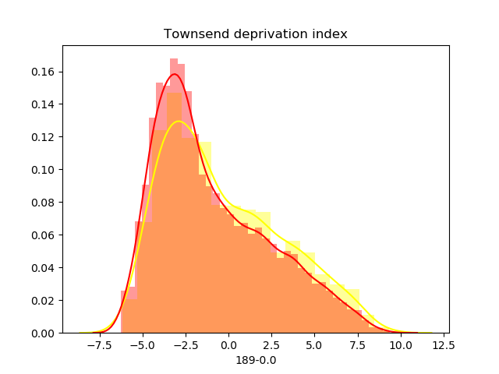
189-0.0
Covid negative
Is the difference significant?
Covid positive

