Slide 1
Toward Unified Multimodal LLMs
Jun Zhan
Fudan University

Slide 2
PhD Main Works: 端到端的多模态交互模型
▎ 从语音到音视频，从语义建模到全信息建模，从各模态独立表征到跨模态统一表征
时间
工作
核心内容
发表
引用
GitHub ★
2023.05
SpeechGPT
基于 semantic token 的语音 LLM
EMNLP 2023 Findings
849
1.4k
2024.01
SpeechGPT-Gen
semantic 和 acoustic 分离建模的语音 LLM
arXiv
60
同上
共用仓库
2024.02
AnyGPT
基于离散 token，文本、图像、语音、音乐的理解与生成统一 LLM
ACL 2024
344
888
2025.01
SpeechGPT2.0-preview
Global AR + Local AR 的完整语音建模
开源模型
—
375
2025.08
VStyle
语音对话模型 Voice Style Adaptation 能力的 LALM-As-a-Judge 基准
ICASSP 2026
11
34
2026.05
OmniVAE
联合学习音频与视频表征的 VAE
ICLR (Under Review)
—
95
Ongoing
SpeechMotionLM
实习工作
全双工 Speech-Motion LLM —— 语音与 3D 人体的联合建模
Target: ICML
—
—
■ 蓝色 = 第一作者；其余为合作工作 引用数来自 Google Scholar（总引用 2,012），Star 数来自 GitHub，统计于 2026-10-26

Slide 3
Collaborations: 参与的高影响力项目
▎ 覆盖对话大模型、预训练数据配比、音乐生成、对话语音合成与音频理解
时间
项目
核心内容
发表
引用
GitHub ★
2023.04
MOSS
复旦开源的插件增强对话大语言模型
163
12.3k
MIR 2024
2024.03
Data Mixing Laws
通过预测语言建模性能来优化预训练数据配比
218
113
ICLR 2025
2025.01
YuE
开源长篇歌曲生成基础模型（lyrics-to-song）
107
12.8k
ICLR 2026
2025.06
MOSS-TTSD
长篇多说话人对话语音合成，支持零样本音色克隆
8
1.4k
Tech Report 2026
2026.04
MOSS-Audio
统一理解语音、环境声与音乐（描述、问答、推理）
36
693
Tech Report 2026
5 个项目合计 GitHub ★ 27k+、引用 532 引用数来自 Google Scholar，Star 数来自 GitHub，统计于 2026-10-26 · MIR = Machine Intelligence Research

Slide 4
SpeechGPT: Empowering Large Language Models with Intrinsic Cross‑Modal Conversational Abilities
Can LLM unify multimodal understanding and generation?
Notes:
我们提出了AnyGPT，一种基于自回归离散序列建模的多模态融合方案

Slide 5
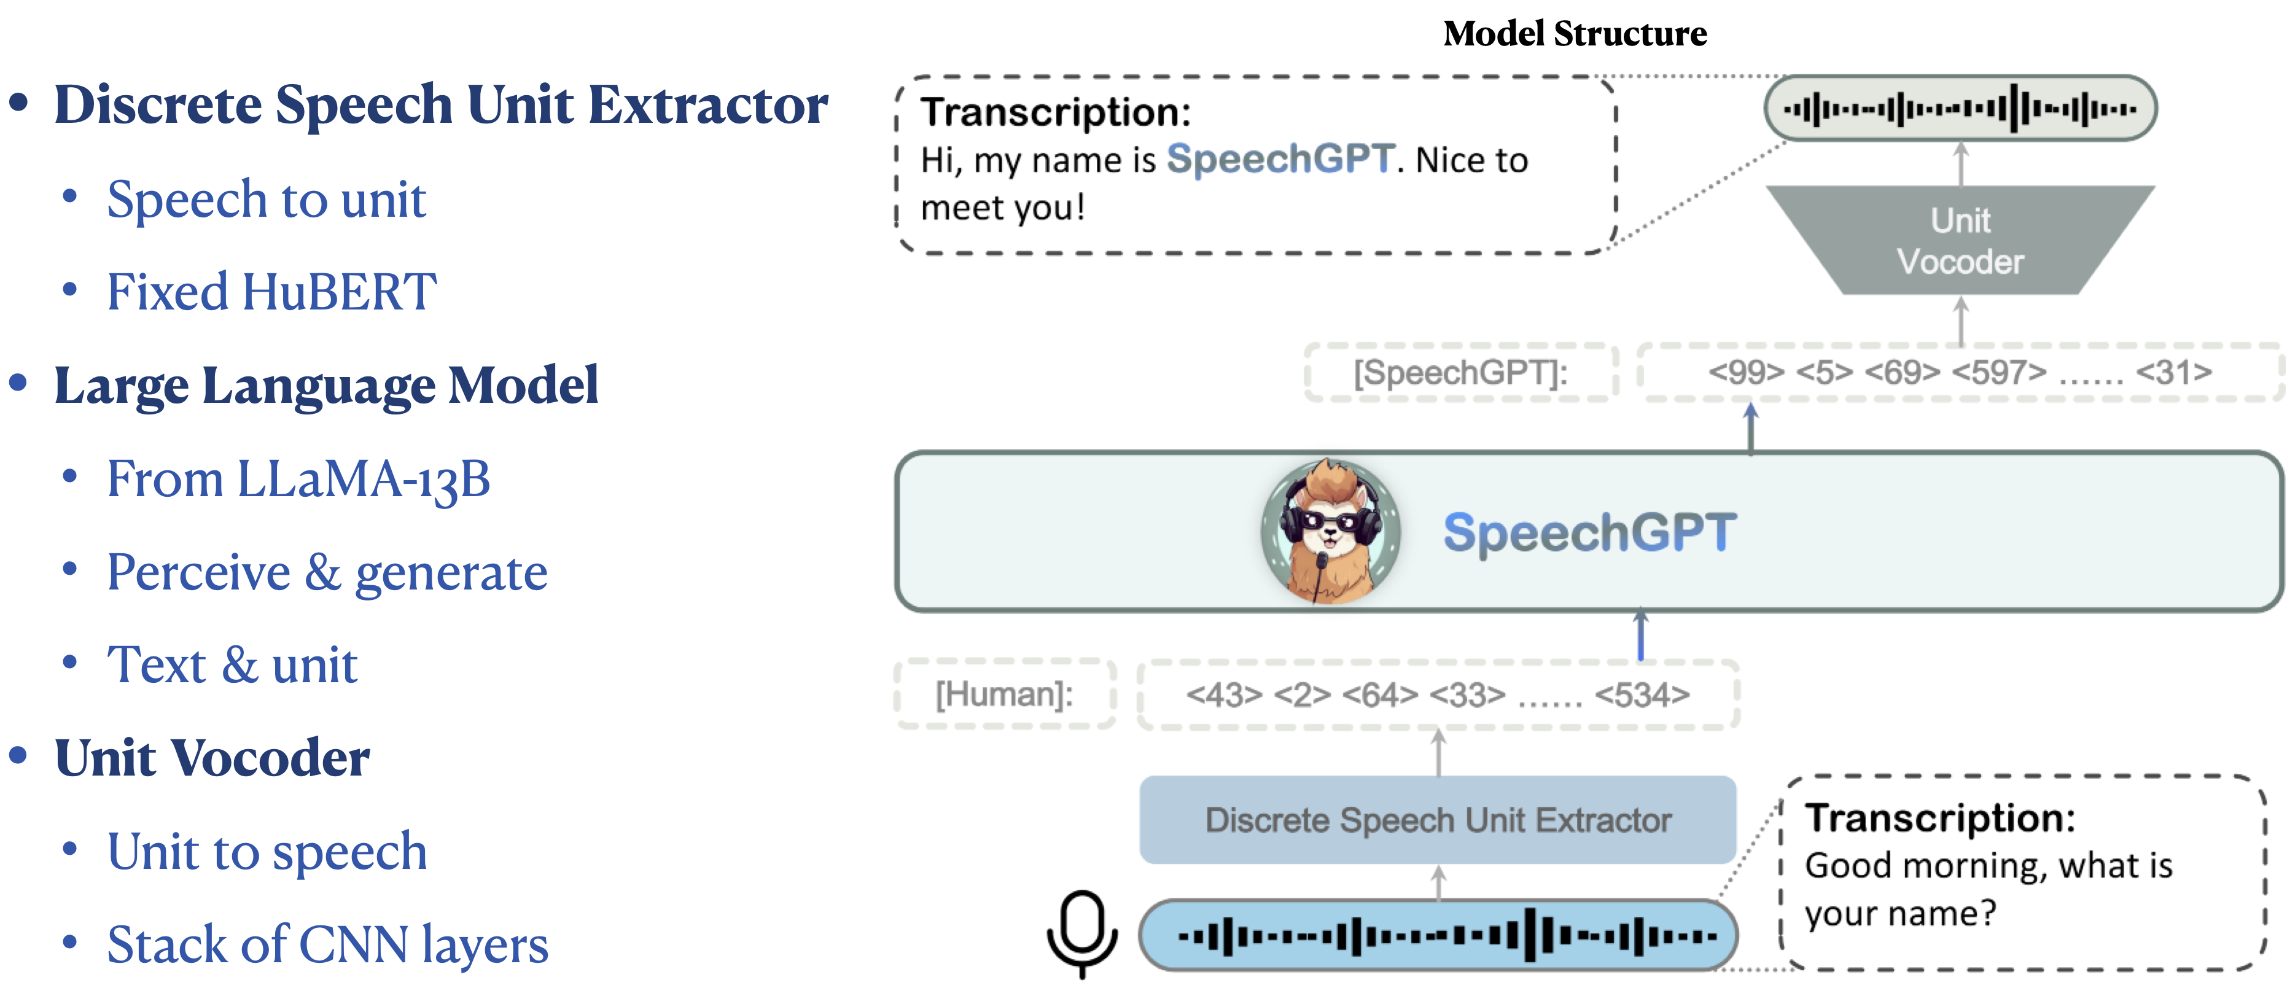
SpeechGPT Overview
Notes:
基于上面的想法，我们首先实现了SpeechGPT。SpeechGPT借助语音离散化技术把连续的语音信号表示为离散的token，从而通过扩充词表的方式结合到LLM之中，从而使得LLM可以进行语音模态的理解和生成。
首先介绍一下我们SpeechGPT的模型结构，由语音离散表示提取器，LLM和离散单元声码器组成，其中离散表示提取器我们直接用了HuBERT，它把语音转换成离散的token
大语言模型即可以接收和产生文本，也可以接收和产生语音的离散表示。离散表示声码器把语音token转换成语音信号。

Slide 6
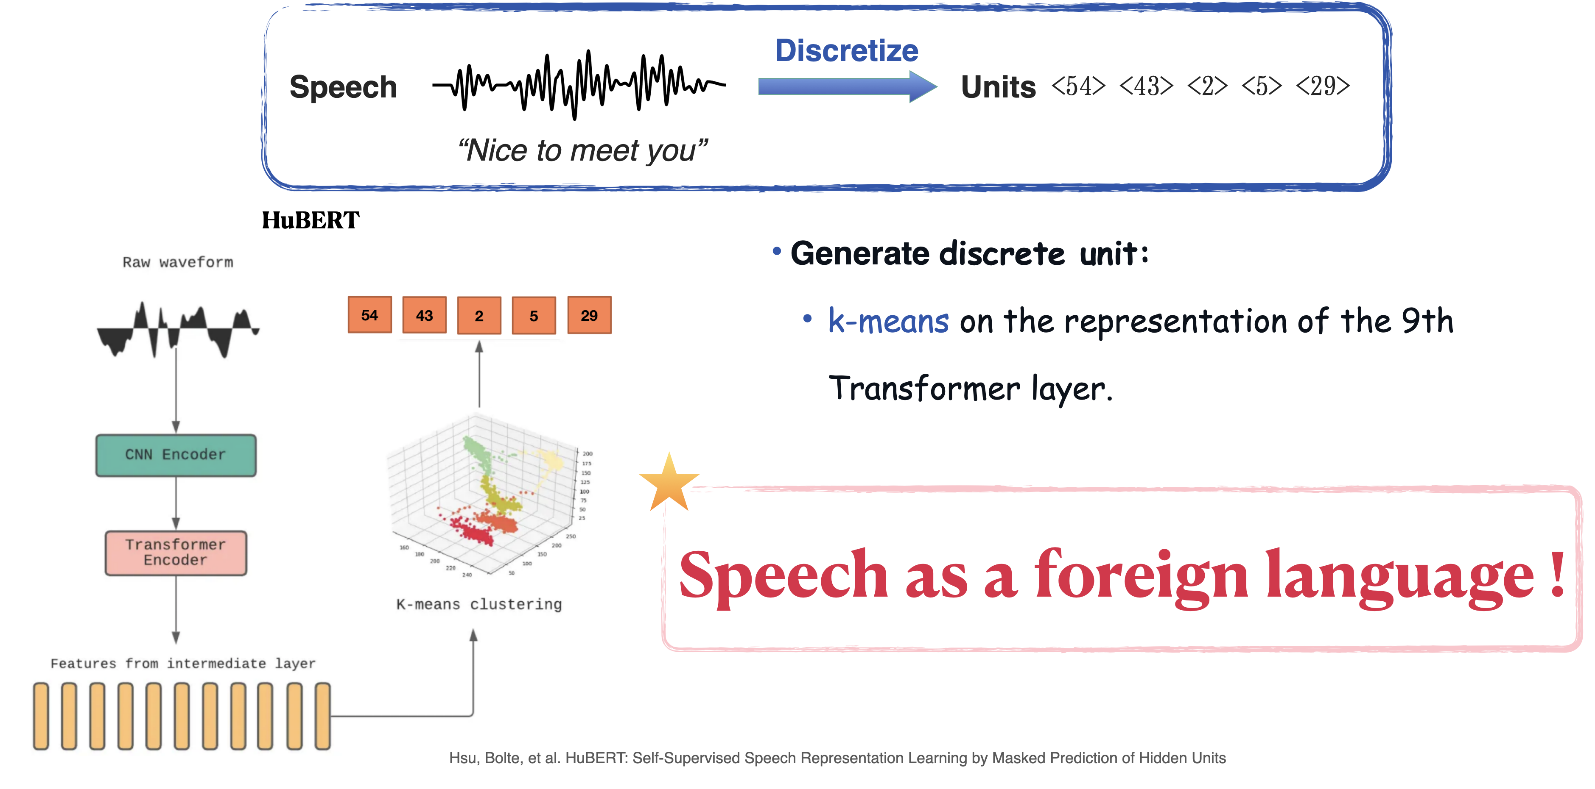
SpeechGPT: Self-supervised Representation HuBERT
Notes:
我们首先在语音模态上进行了尝试
这里要先介绍一下HuBERT，它是一个语音自监督表示学习模型。
它常常被用做为语音离散表示提取器，通过在它获得的连续表示上做kmeans来得到语音的离散符号。
这样我们就可以用这种离散符号来代表语音。
对于LLM来说，就可以把语音看作是一种从未见过的foreign language来处理。

Slide 7
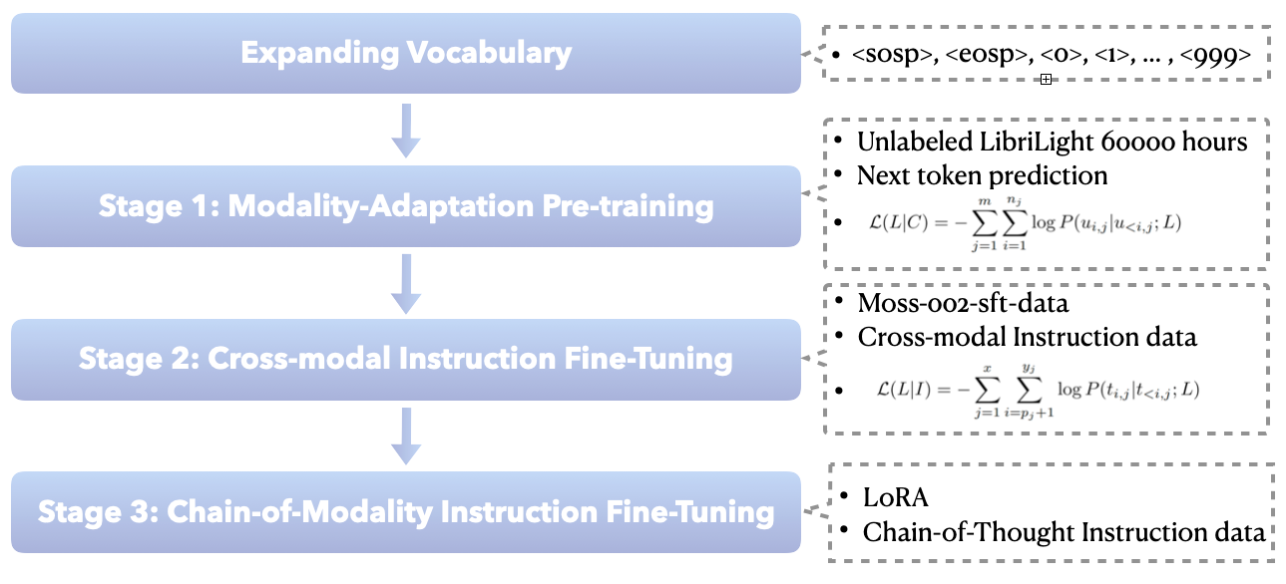
SpeechGPT Training
Notes:
SpeechGPT训练前首先会扩充词表，把语音的token添加到LLM的词表之中。它的训练分为三阶段，第一阶段是模态适应预训练，在纯语音数据上做next-token-prediction的任务；第二阶段为跨模态指令微调，在配对的语音文本数据上进行训练；第三阶段是模态链指令微调，在我们构造的chain-of-modality语音对话数据上进行lora fientune。

Slide 8
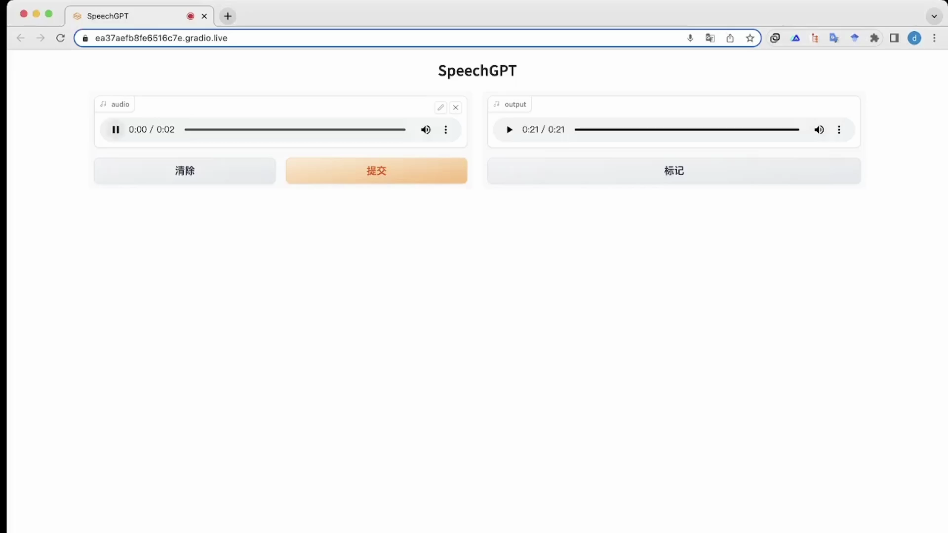
SpeechGPT demo

Slide 9
AnyGPT: Unified Multimodal LLM with
Discrete Sequence Modeling
Can SpeechGPT be extended to more modalities?
visual information, other type of audio...
Notes:
我们提出了AnyGPT，一种基于自回归离散序列建模的多模态融合方案

Slide 10
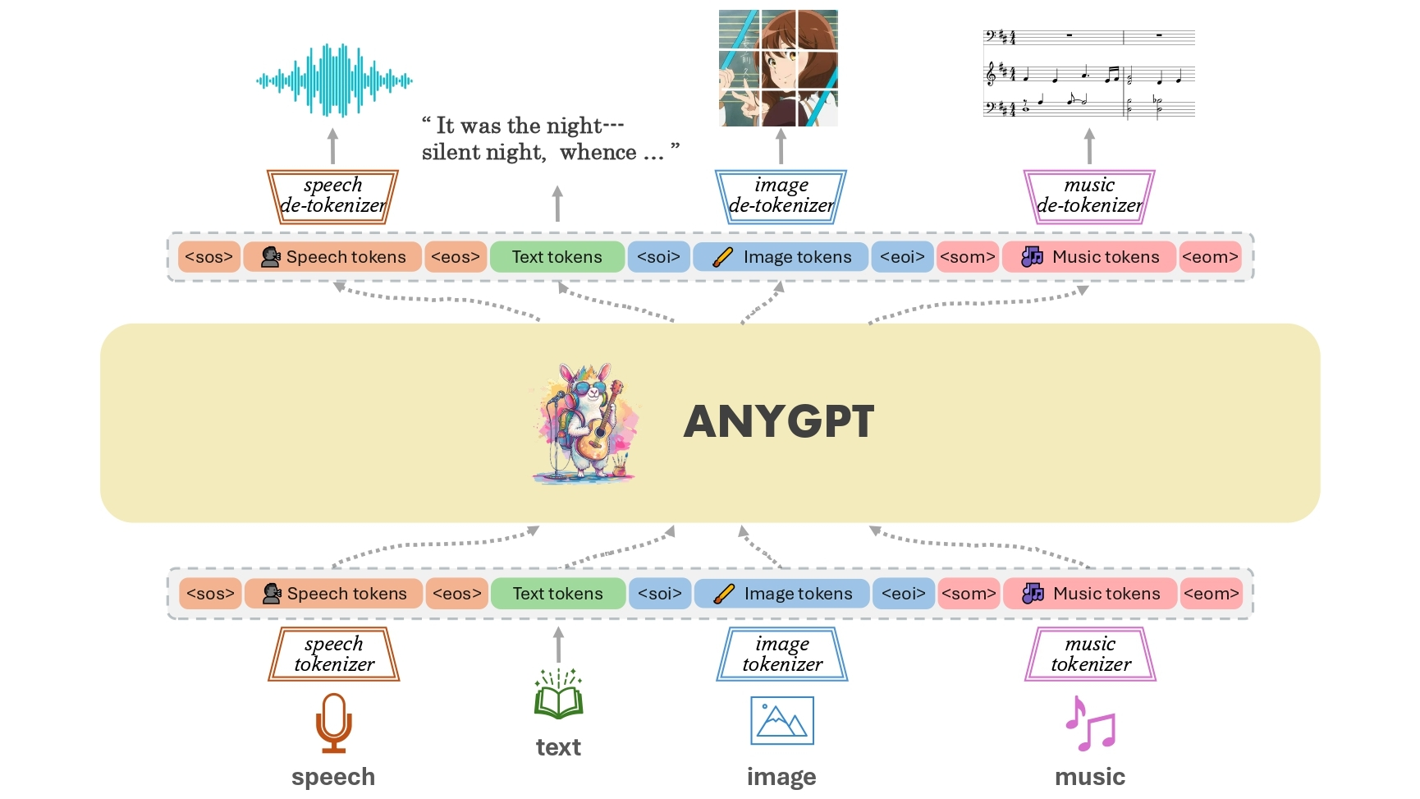
AnyGPT: Design
Hubert Unit lose too much information
  LLM can’t perceive and generate perceptual information
VQ-VAE tokens keep enough information
  but too hard to train
We use a Semantic-Perceptual two-stage Modeling Architecture
Notes:
我们继续进行了尝试，提出了能进行 任意模态到任意模态转换的AnyGPT
AnyGPT的整体结构，总共有文本、语音、图像、音乐四种模态。
模型包含三部分，第一部分是每个模态的Tokenizer，将连续信号转换为离散的token，第二部分是自回归的LLM，用于预测token序列，第三部分是每个模态的de-tokenizer，用于生成原始的模态内容，如图像和音频。
AnyGPT 提出了一种生成式训练多模态数据的途径：将所有模态的数据转换为统一的离散表示，采用 Next Token Prediction 任务在LLM上统一训练。
从压缩即智能的角度出发，当LLM的困惑度（PPL）足够低，就有可能将互联网的海量多模态数据压缩在同一个模型中。

Slide 11
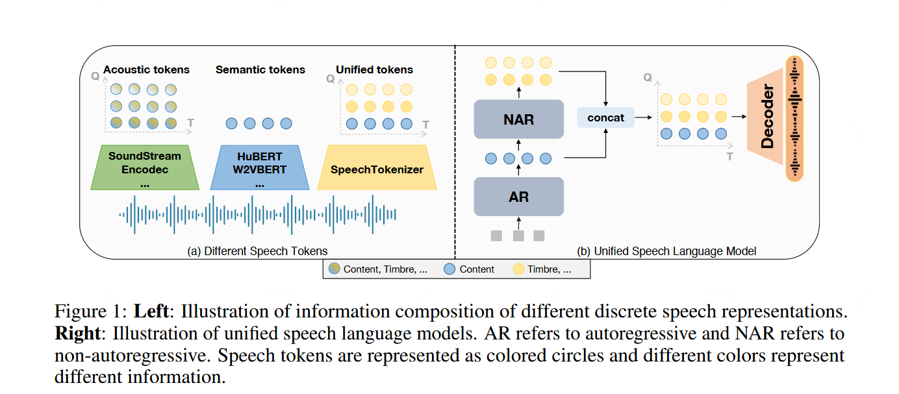
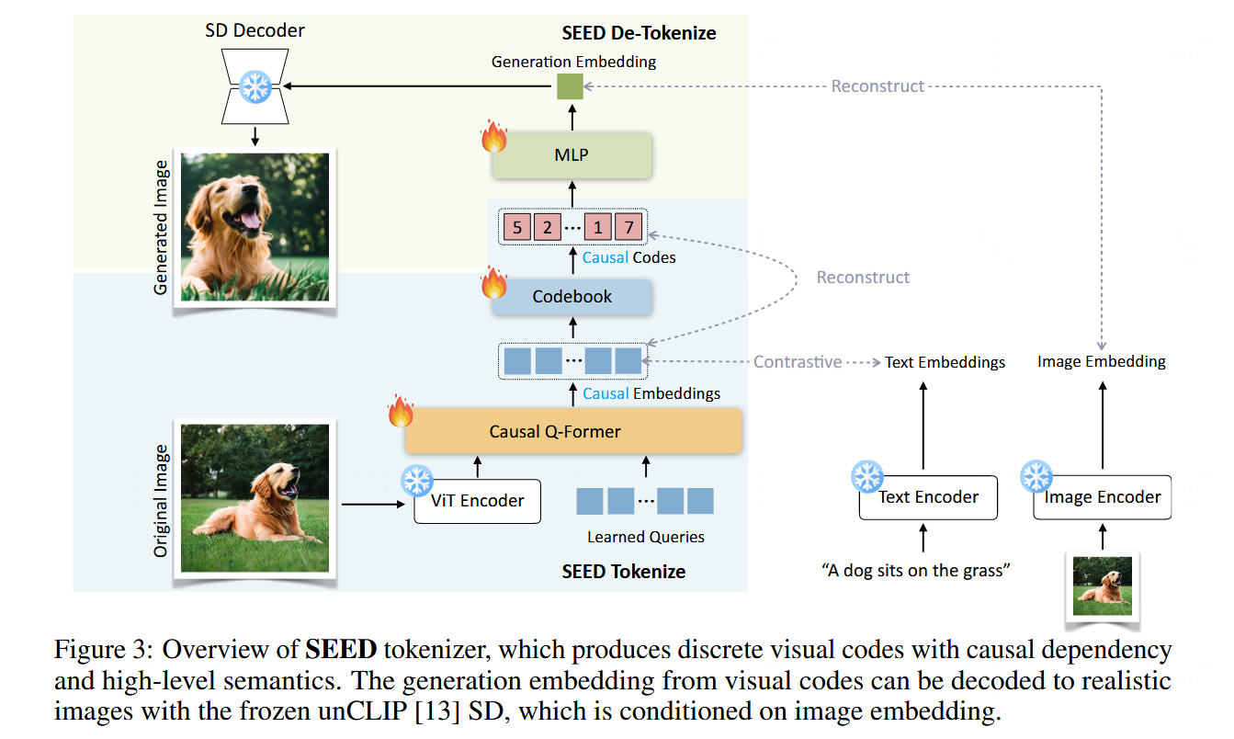
AnyGPT: Overview
Multimodal Tokenizers
  Speech: SpeechTokenizer
  Image: Seed
  Music: Encodec
Autoregressive LM
De-Tokenizers
  Speech: Soundstorm+ SpeechTokenizer Decoder
  Image: Diffusion Model
  Music: Encodec
Notes:
我们继续进行了尝试，提出了能进行 任意模态到任意模态转换的AnyGPT
AnyGPT的整体结构，总共有文本、语音、图像、音乐四种模态。
模型包含三部分，第一部分是每个模态的Tokenizer，将连续信号转换为离散的token，第二部分是自回归的LLM，用于预测token序列，第三部分是每个模态的de-tokenizer，用于生成原始的模态内容，如图像和音频。
AnyGPT 提出了一种生成式训练多模态数据的途径：将所有模态的数据转换为统一的离散表示，采用 Next Token Prediction 任务在LLM上统一训练。
从压缩即智能的角度出发，当LLM的困惑度（PPL）足够低，就有可能将互联网的海量多模态数据压缩在同一个模型中。

Slide 12
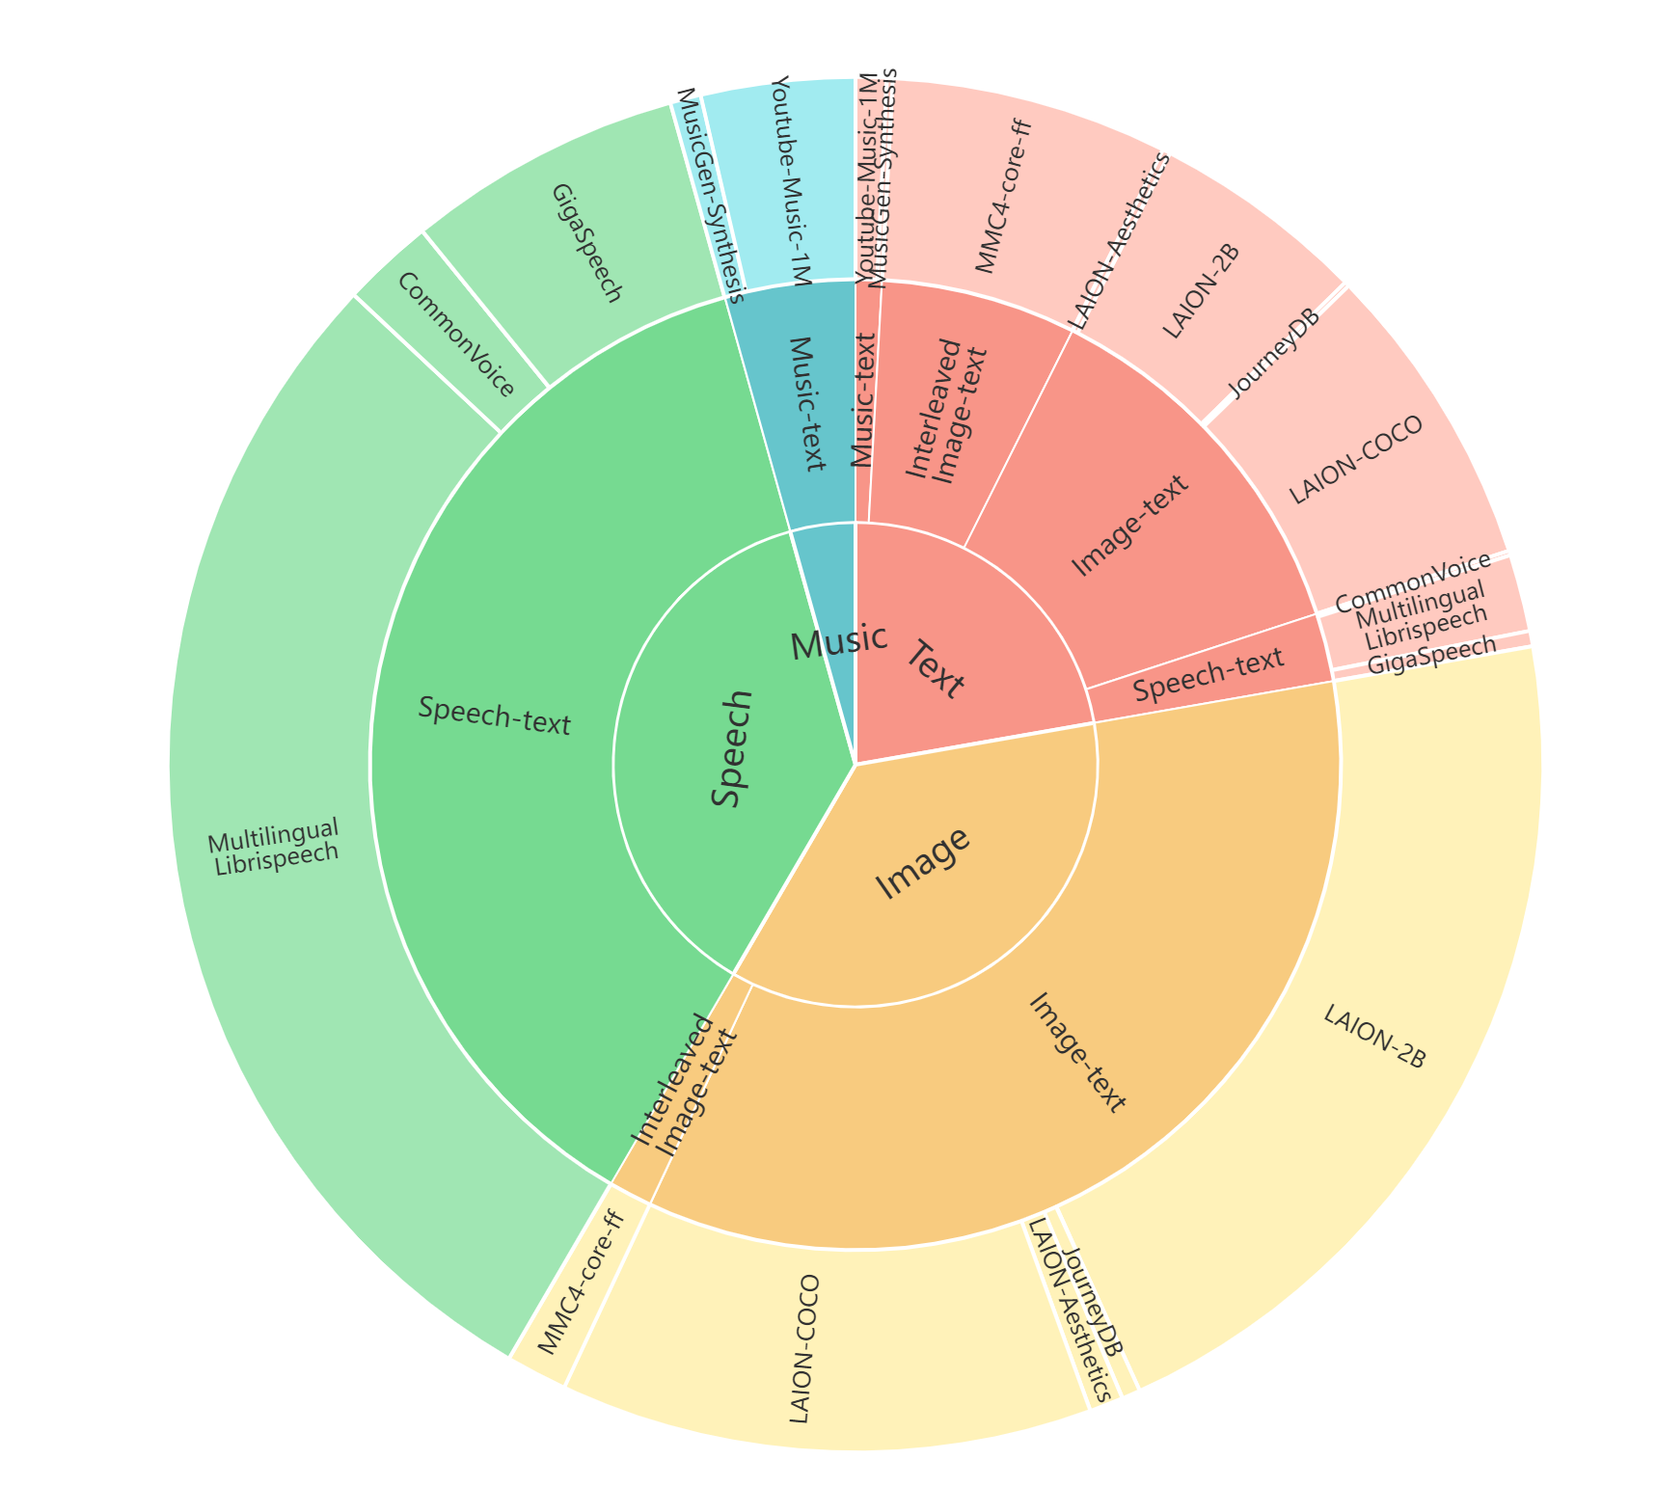
Multimodal Alignment Pretraining
Image-to-Text
Speech-to-Text
Music-to-Text
Text-to-Image
Text-to-Speech
Text-to-Music
Image-text Interleaved data
Notes:
要训练这样的模型，在数据层面存在着很大的挑战，现有的多模态对齐数据通常只包含两个模态，很少有三模态甚至四模态同时对齐的数据
因此，我们构建以文本为中心的多模态对齐数据集，使文本成为连接不同模态的桥梁。
对于其他模态和文本的配对数据，我们随机选择caption或者generation作为生成方向，另外我们加入了图文自然交错的文档数据，基于这些数据训练多模态对齐模型

Slide 13
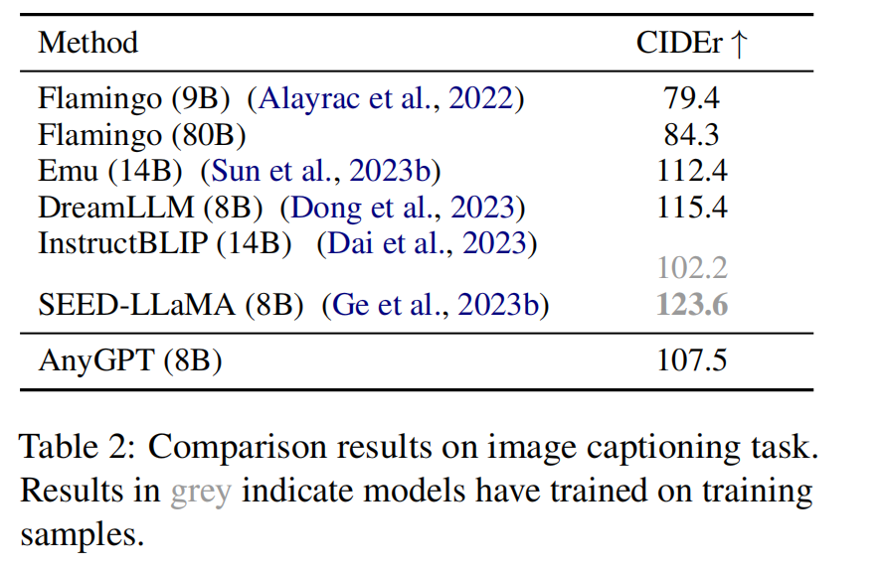
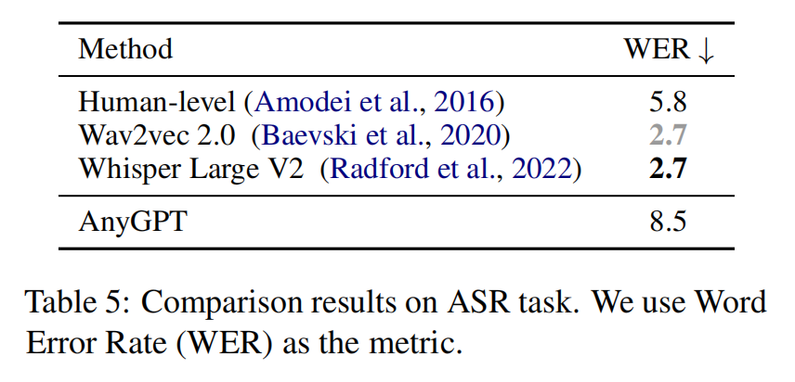
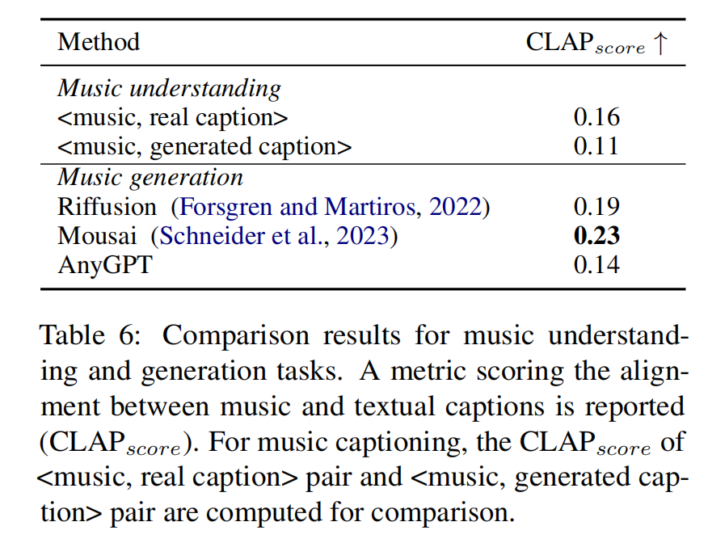
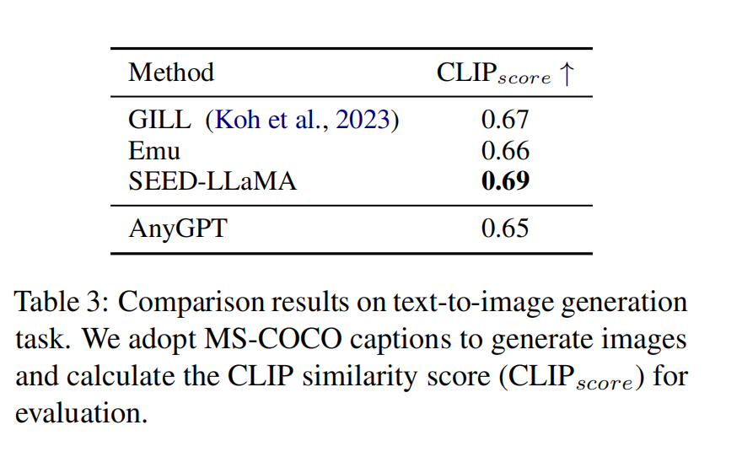
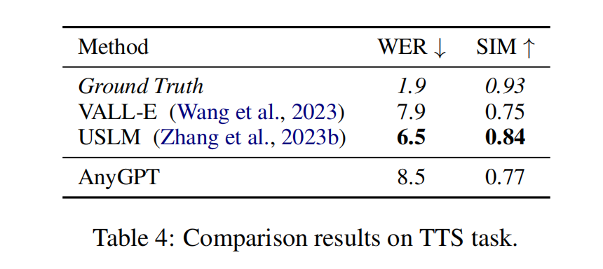
Base Model Evaluation
看图说话（Image Caption）
语音识别（ASR）
音乐描述 & 音乐生成(text-to-music)
文生图（Image Generation）
零样本语音合成（Zero-shot TTS）
Notes:
在得到多模态对齐的base模型后，我们对模型在每个模态上的性能进行了评估，包括看图说话，文生图、语音识别、零样本语音合成、音乐描述和音乐生成，共三个非文本模态和六个任务。
我们比较的baseline都是在对应模态或者任务上的专有模型，值得注意的是，为了评估AnyGPT的通用性能，我们在所有数据集上都是zero-shot设定，训练数据中不包含这些数据集的训练集，而很多baseline混合了相应的训练集数据或者直接在对应数据集上进行微调
但AnyGPT仍然可以在每个模态上均达到和专有模型接近的性能，证明多种模态可以通过离散化表示有效地融入到一个模型中。

Slide 14
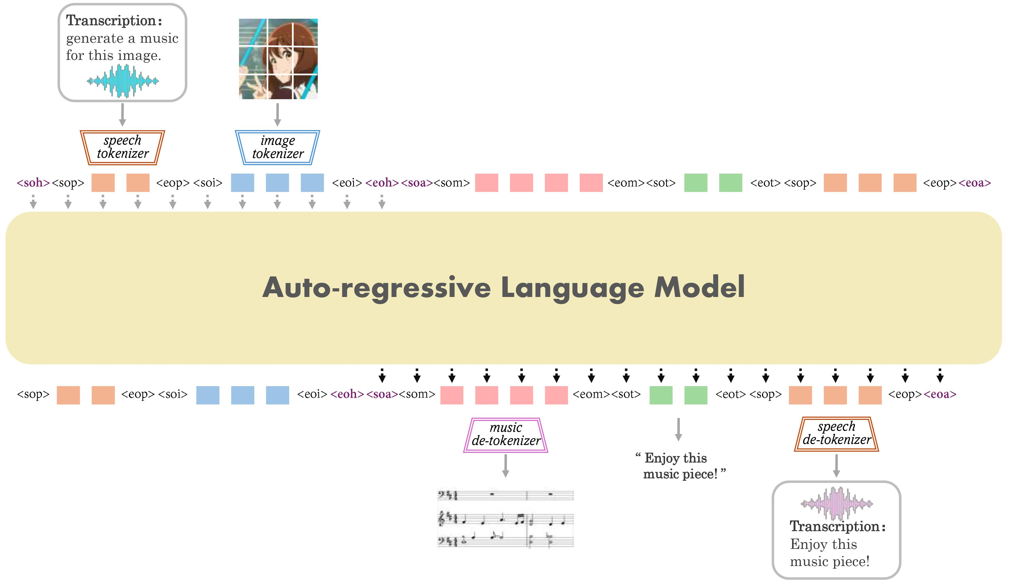
Instruction Tuning
Multimodal alignment model
Any-to-any generation model
Notes:
在对齐模型的基础上，我们希望模型能实现任意模态组合的对话，既能理解用户给出的多模态元素与指令，也能根据需要生成相应模态组合的回复。
由于现在并没有这样的指令数据集，因此我们设计并合成了AnyInstruct数据集

Slide 15
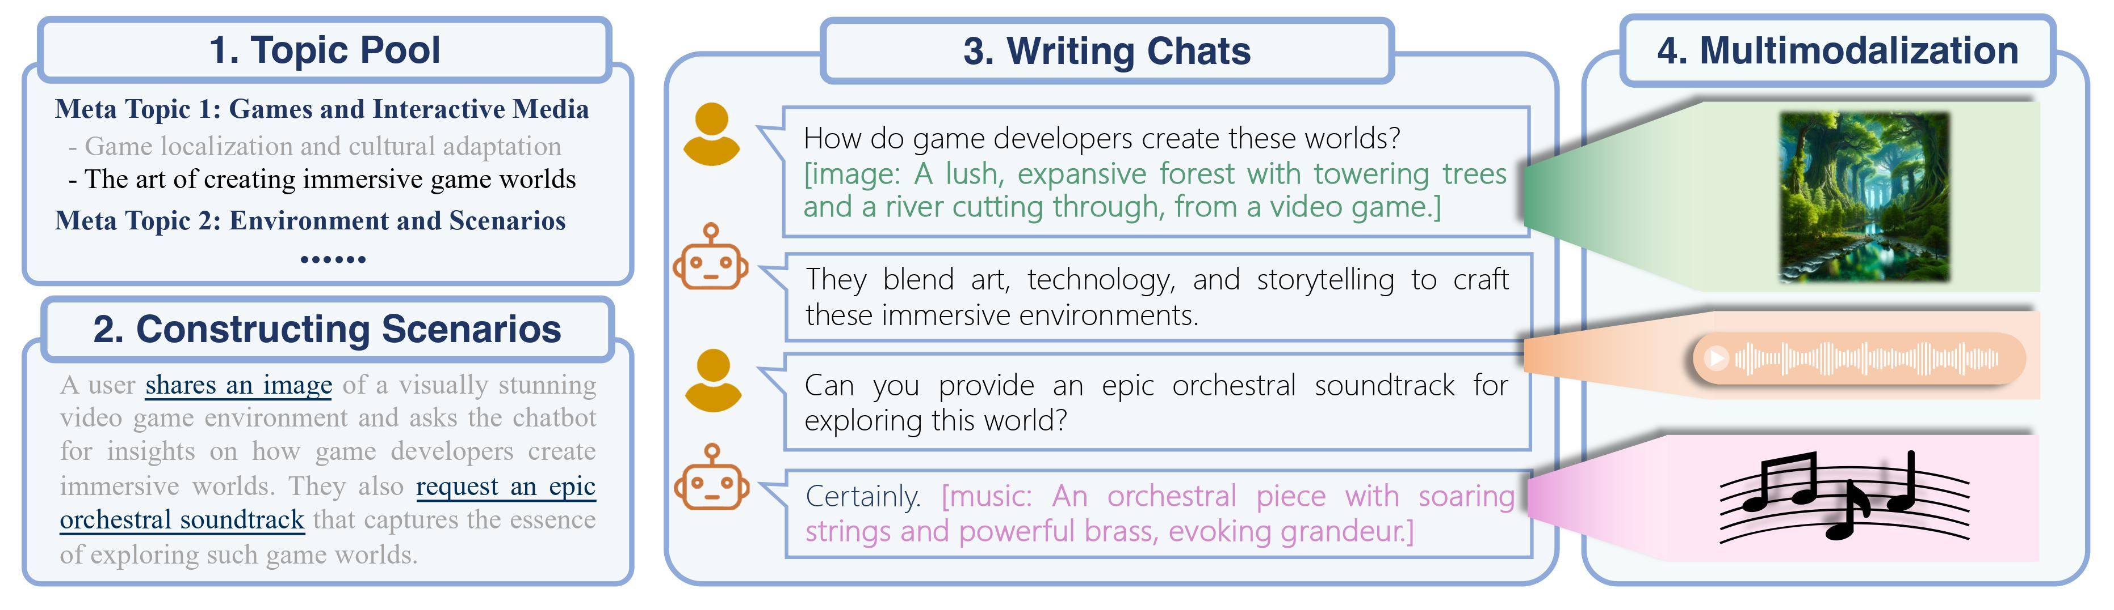
AnyInstruct: Any-to-any Instruction Dataset
Multimodal alignment model
Any-to-any generation model
A
Notes:
指令数据集AnyInstruct的构造流程。
分为两个阶段，第一阶段我们通过GPT-4生成依次生成对话的主题、场景和内容，在对话中所有的多模态元素通过caption的方式表现。
为了保证生成数据中模态组合的多样性，我们会手写一些涵盖各种模态组合的对话样本，每次随机采样一部分作为GPT的示例。
第二阶段我们会抽取出所有多模态元素的caption，通过多模态生成模型生成真实的多模态内容，图像使用的是DALLE-3，音乐使用的是MusicGen，语音使用的是Azure的TTS API。
如图所示是一个游戏场景创作的例子，包含一个秘境的图片和适合这个场景的背景音乐。

Slide 16

Any-to-Any Demo
Notes:
在AnyInstruct数据集上微调后，AnyGPT能适应任意模态交错的对话，如语音对话、生成图像和音乐

Slide 17
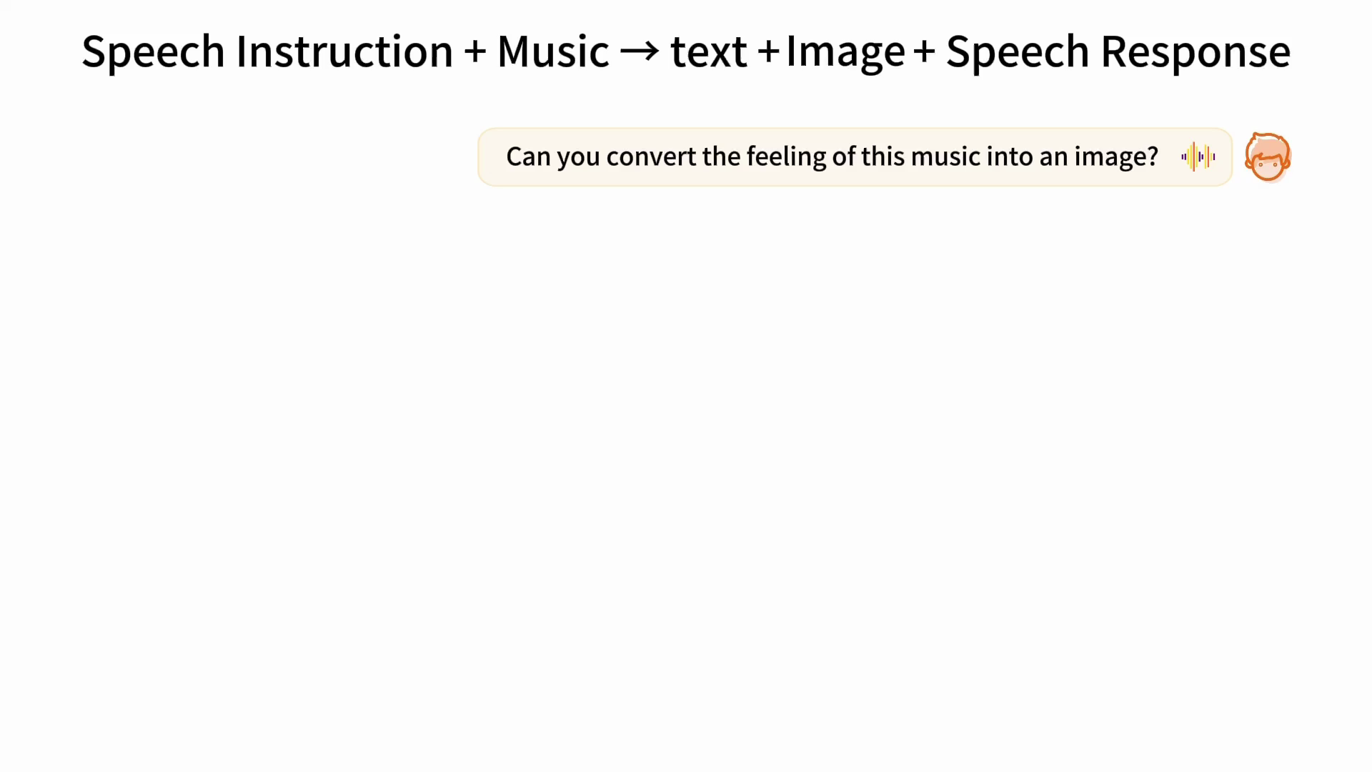
Any-to-Any Demo
Notes:
完成音乐和图像之间的转换

Slide 18

Any-to-Any Demo
Notes:
甚至不需要文本作为中间过渡，直接将图片转换为音乐，尽管这种组合在预训练数据中是不存在的，只有指令数据集中少量存在。说明AnyGPT通过离散化表示和text-centric多模态数据，在一定程度上实现了各种模态之间的两两对齐

Slide 19
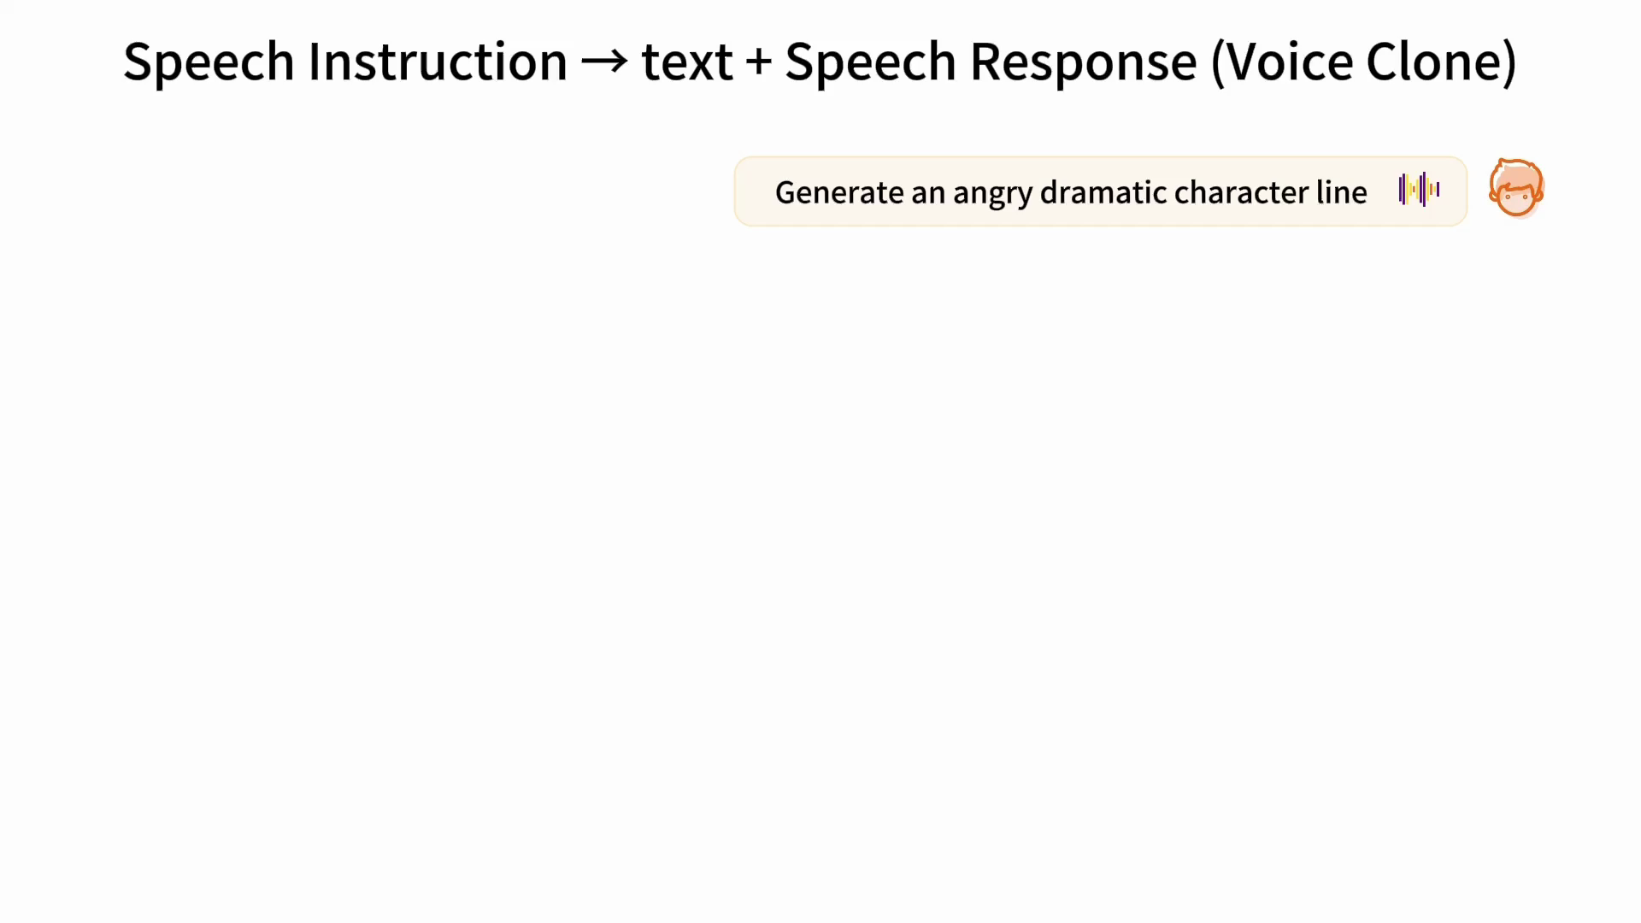
Any-to-Any Demo
More cases: https://junzhan2000.github.io/AnyGPT.github.io/
Notes:
一个声音克隆的例子，最后一句是被克隆的语音。AnyGPT对语音的内容和副语言学信息分别建模，通过在包含数千说话人的语音数据上训练，给定一个几秒钟的语音prompt，anygpt可以直接克隆prompt的音色和情感。

Slide 20
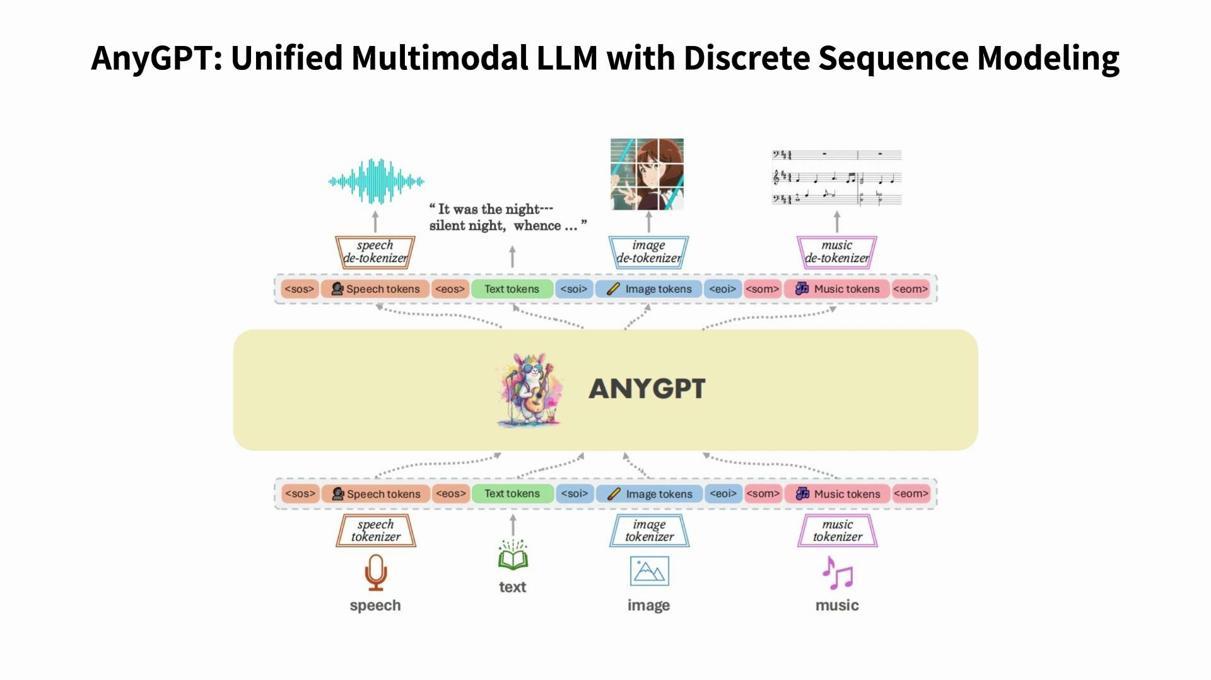
Any-to-Any Demo
Notes:
（隐藏幻灯片）完整demo，总共3分钟

Slide 21
SpeechGPT2:
End-to-End Human-Like Spoken Chatbot
Can we build a unified model to perform end-to-end modeling of complete multimodal information?
Notes:
我们提出了AnyGPT，一种基于自回归离散序列建模的多模态融合方案

Slide 22
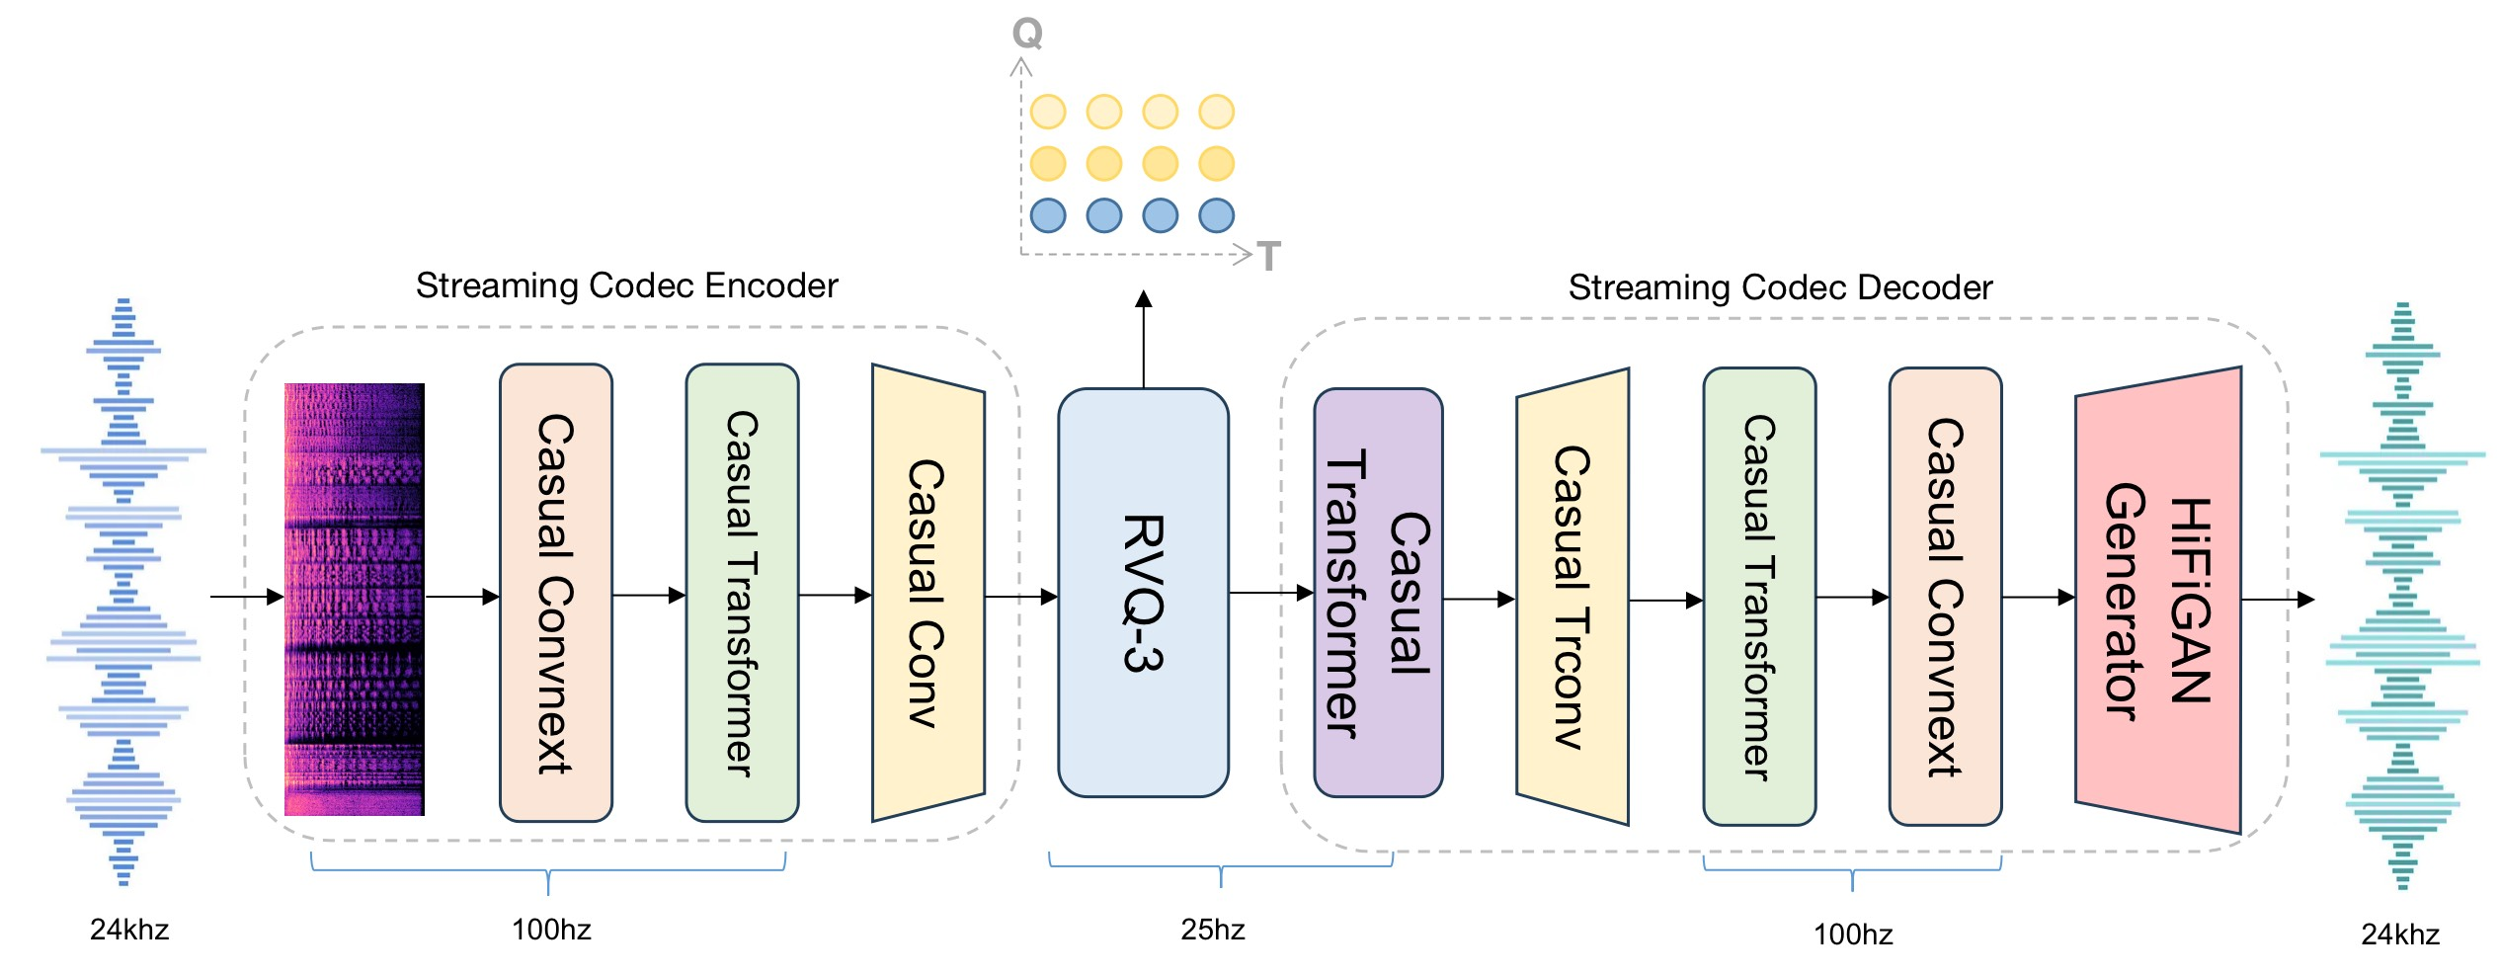
SpeechGPT2.0-preview Codec
The representation should be lossless, compact, and possess easily learnable features such as semantics.
采用causal CNN和 causal Transformer，支持流式编解码
低tps，25*3 tokens / s
语义-声学联合建模

Slide 23
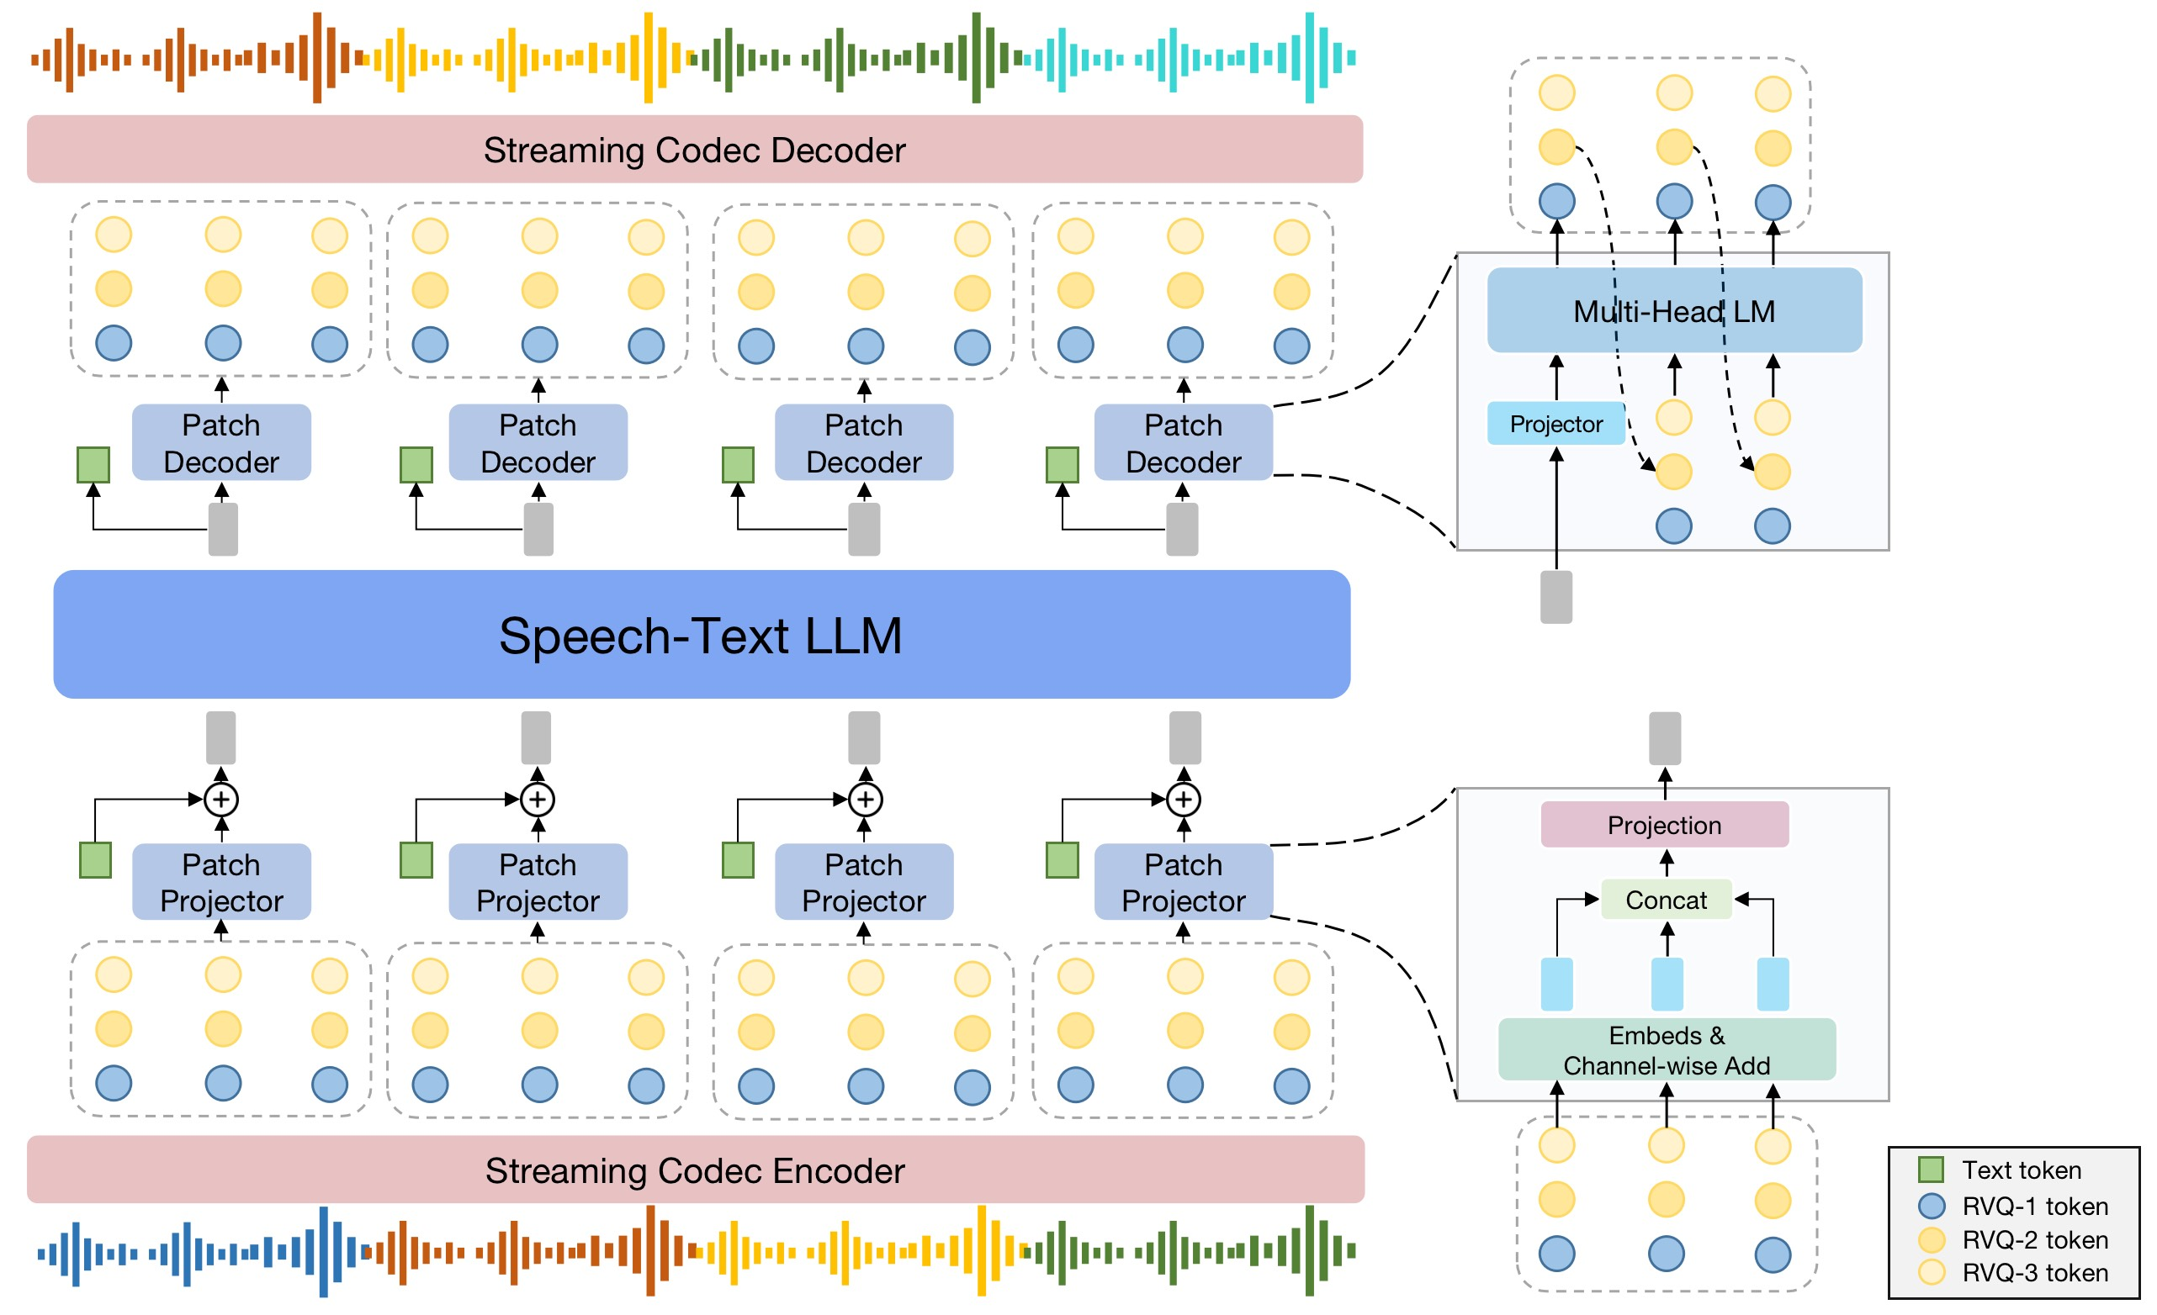
SpeechGPT2.0-preview Architecture
The model should be able to effectively model long multimodal sequences and efficiently learn dense low-level features.
Global AR for global, high level semantic information
Local AR for local context, low level information
高效预测稠密的RVQ token
缩小语音和文本序列之间的模态差异

Slide 24

SpeechGPT2.0-preview Ability
预训练数据: in the wild语音
  内容标注：ASR
  caption标注：Gemini
  文本语音时间对齐：TorchFA
对话数据
  口语化
  风格、情感转换
  角色扮演

Slide 25

Improved TTS
副语言学token控制：笑声、重读、停顿等
Text | Speech
You went to the party [laughter] even though I explicitly told you not to?
Going to the moon is a challenging task that requires a lot of planning and resources [laughter]
文本指令控制的TTS
Text Instruction | Speech
说话者情绪激动却努力保持理性，语气中带着如释重负的欣喜，言语间流露出难以抑制的兴奋之情
说话人以学术探讨的语气娓娓道来，语速平缓且富有逻辑，体现出一位研究者的严谨与开放态度
对话TTS
Text | Speech
[S1]你觉得这个方案怎么样？[S2]整体还不错，但是[S1]时间安排有问题？[S2]嗯，而且预算也[S1]太高了是吧？[S2]对，如果能减少一些[S1]不必要的开支？[S2]没错，就是这个意思。

Slide 26
VStyle: A Benchmark For Voice Style Adaptation With Spoken Instructions
How can we construct an automated and quantitative evaluation benchmark for end-to-end generation?

Slide 27
Motivation
Goal & Challenge
Goal: Train a speech model for voice transformation based on arbitrary human instructions
Challenges:
  Evaluating multimodal generation models is difficult
  Human evaluation is unstable and labor-intensive
Our Solution: VStyle Benchmark
Leverages LALMs' strong audio understanding ability
Covers multiple instruction types
Assesses three hierarchical dimensions: textual adherence, stylistic adherence, and overall naturalness.

Slide 28
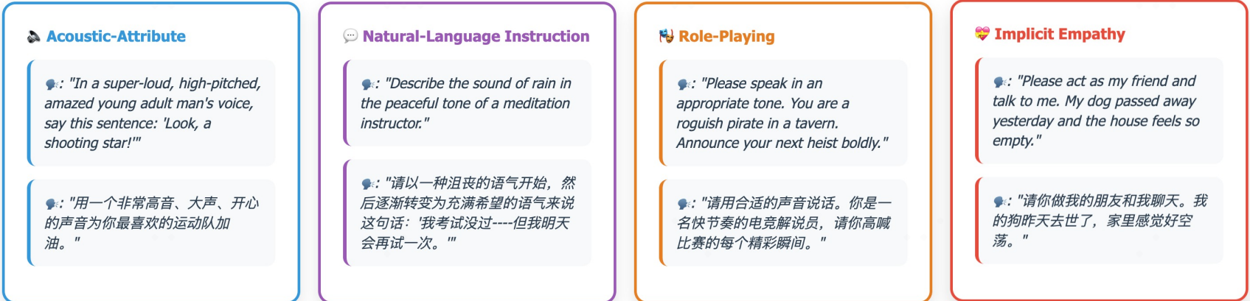
Overview
Acoustic-Attributes
  age, gender
  speaking rate, pitch, loudness, and emotion.
Natural Language Instructions
  emotion
  style
  variation
Role-Playing
  scenario
  character
Implicit Empathy
  anger
  anxiety and fear
  sadness
  joy and excitement
Notes:
emotion, referring to unconstrained descriptions of affective states; style, allowing free-form specification of global speech style; and variation, which entails temporal variation between emotions and styles within a single utterance, thereby showcasing a model’s fine-grained controllability.

Slide 29
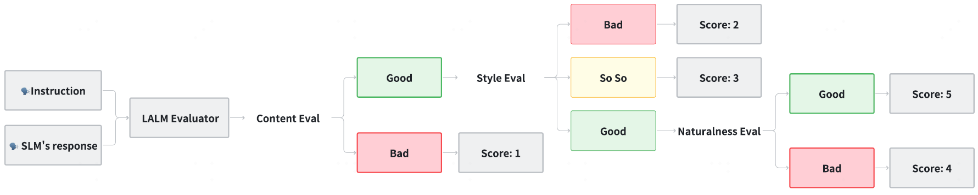
Evaluation Pipeline
Three hierarchical dimensions:
  Textual Adherence – correctness of generated content
  Stylistic Adherence – appropriateness of style, tone, or emotion
  Overall Naturalness – human-likeness and fluidity of speech
Scoring Process (5-Point MOS Scale)
Notes:
Reflects the incremental skill requirements for realistic speech models
Combines perceptual understanding and reasoning of LALMs
Produces consistent, stable, and interpretable evaluations

Slide 30
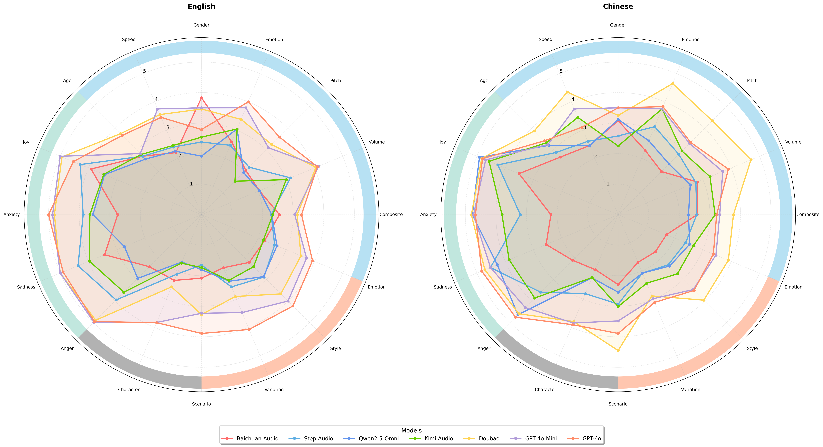
Evaluation Results
Significant performance gap between open-source and commercial models
Variation across task categories
Language preference among models

Slide 31
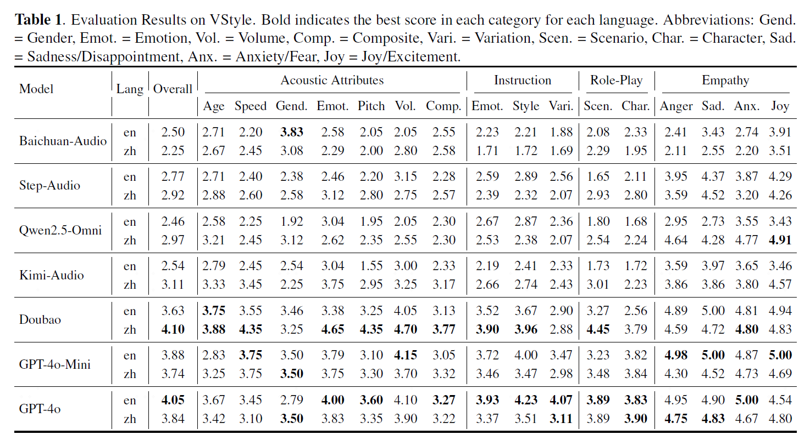
Evaluation Results
Significant performance gap between open-source and commercial models
Variation across task categories
Language preference among models

Slide 32
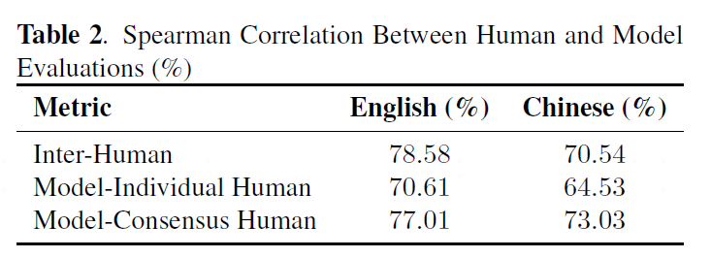
Evaluation Consistency Analysis
Assess the consistency between model scores and human evaluations
  Five expert annotators
  Follow the same evaluation guidelines
  Spearman’s correlation coefficient
Key Findings
  Model–human correlations are close to inter-human agreement levels
  The model reliably captures human evaluation patterns across languages
Notes:
Metrics
Inter-Human Agreement: Correlation among human annotators
Model–Individual Human Agreement: Correlation between model and each human annotator
Model–Consensus Human Agreement: Correlation between model and the average human score
Spearman’s correlation coefficient to measure consistency
Model-based evaluation provides efficient, scalable, and near human-level consistency

Slide 33
OmniVAE: An Audio-Video VAE with Cross-Modal Alignment for Joint Generation
Can we use a unified tokenizer for audio and video representation?
Notes:
我们提出了AnyGPT，一种基于自回归离散序列建模的多模态融合方案

Slide 34
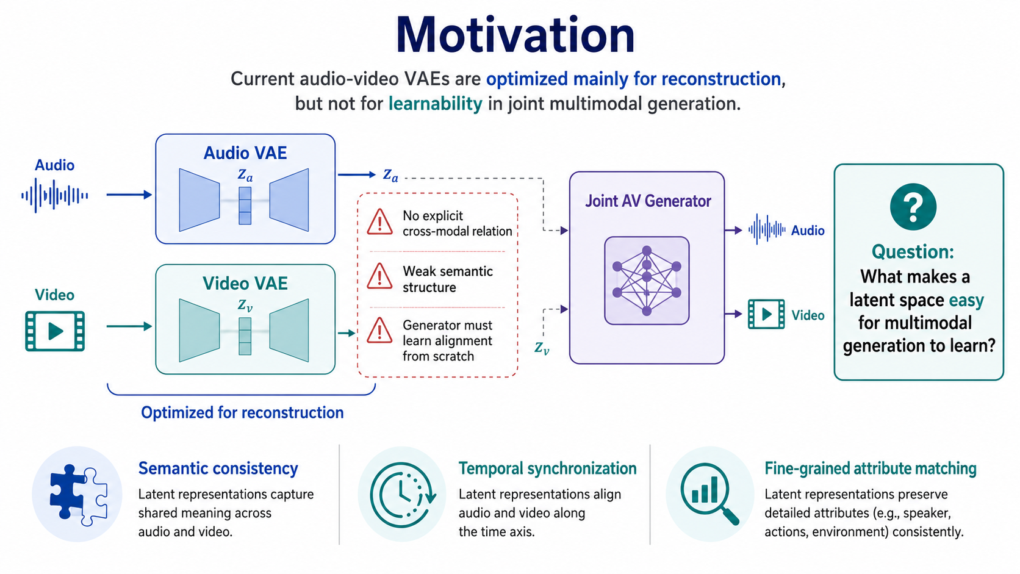
OmniVAE: Motivation
Notes:
Building on this, we proposed AnyGPT, a model that performs any-to-any modality conversion.
AnyGPT covers four modalities in total: text, speech, image, and music.
The model has three parts: (1) a per-modality tokenizer that converts continuous signals into discrete tokens; (2) an autoregressive LLM that predicts the token sequence; and (3) a per-modality de-tokenizer that renders the tokens back into raw content such as images and audio.
AnyGPT offers a generative recipe for training on multimodal data: convert every modality into a unified discrete representation and train the LLM with a single next-token-prediction objective.
From the "compression is intelligence" perspective, once the LLM's perplexity is low enough, it becomes possible to compress the vast multimodal data of the internet into a single model.

Slide 35
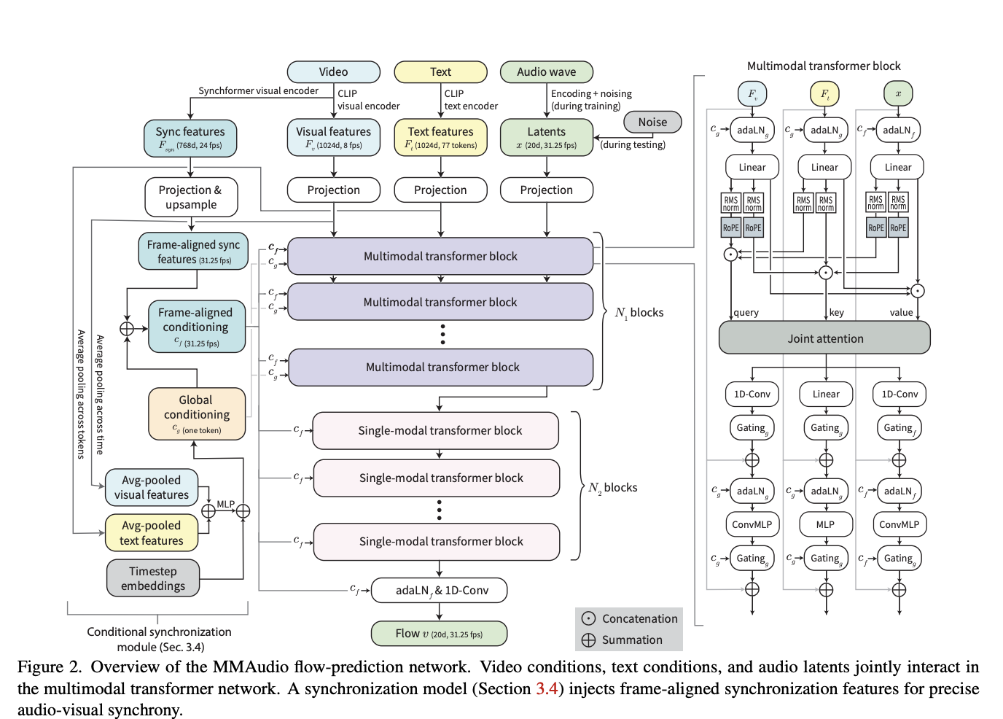
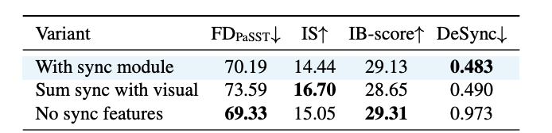
OmniVAE: Motivation
Video2Audio Models often use sync feature as input
  MMAudio, Hunyuan-Video-Foley
Notes:
Building on this, we proposed AnyGPT, a model that performs any-to-any modality conversion.
AnyGPT covers four modalities in total: text, speech, image, and music.
The model has three parts: (1) a per-modality tokenizer that converts continuous signals into discrete tokens; (2) an autoregressive LLM that predicts the token sequence; and (3) a per-modality de-tokenizer that renders the tokens back into raw content such as images and audio.
AnyGPT offers a generative recipe for training on multimodal data: convert every modality into a unified discrete representation and train the LLM with a single next-token-prediction objective.
From the "compression is intelligence" perspective, once the LLM's perplexity is low enough, it becomes possible to compress the vast multimodal data of the internet into a single model.

Slide 36
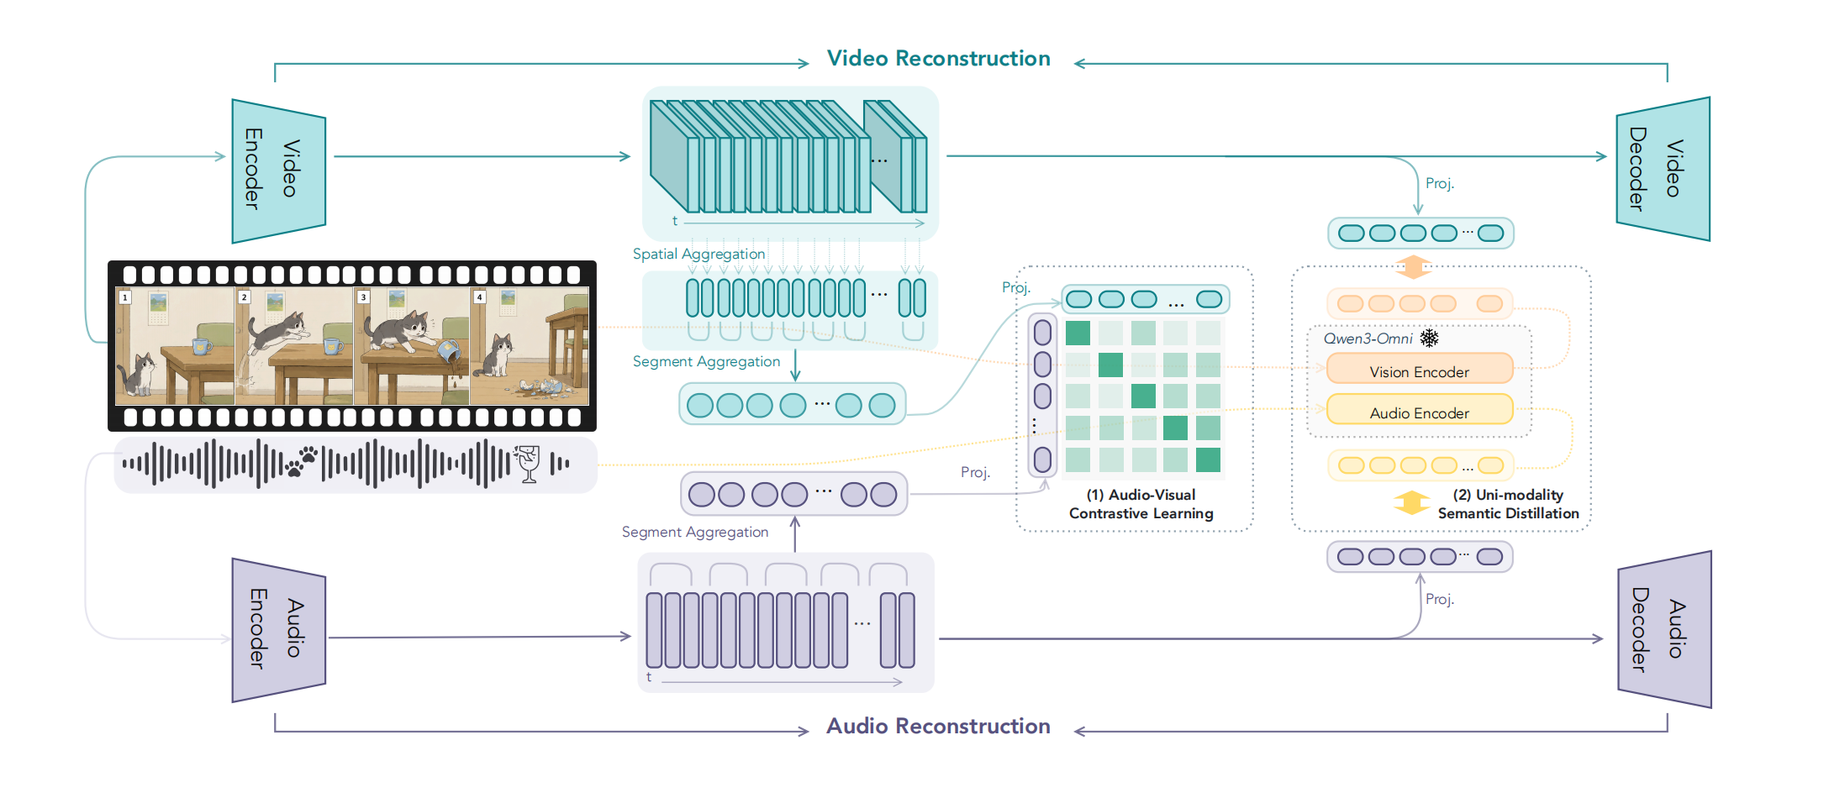
OmniVAE: Overview
Semantic distillation: gives every latent a stable semantic anchor
Segment-level alignment: from clip-level relevance to fine-grained local correspondence
Notes:
Building on this, we proposed AnyGPT, a model that performs any-to-any modality conversion.
AnyGPT covers four modalities in total: text, speech, image, and music.
The model has three parts: (1) a per-modality tokenizer that converts continuous signals into discrete tokens; (2) an autoregressive LLM that predicts the token sequence; and (3) a per-modality de-tokenizer that renders the tokens back into raw content such as images and audio.
AnyGPT offers a generative recipe for training on multimodal data: convert every modality into a unified discrete representation and train the LLM with a single next-token-prediction objective.
From the "compression is intelligence" perspective, once the LLM's perplexity is low enough, it becomes possible to compress the vast multimodal data of the internet into a single model.

Slide 37
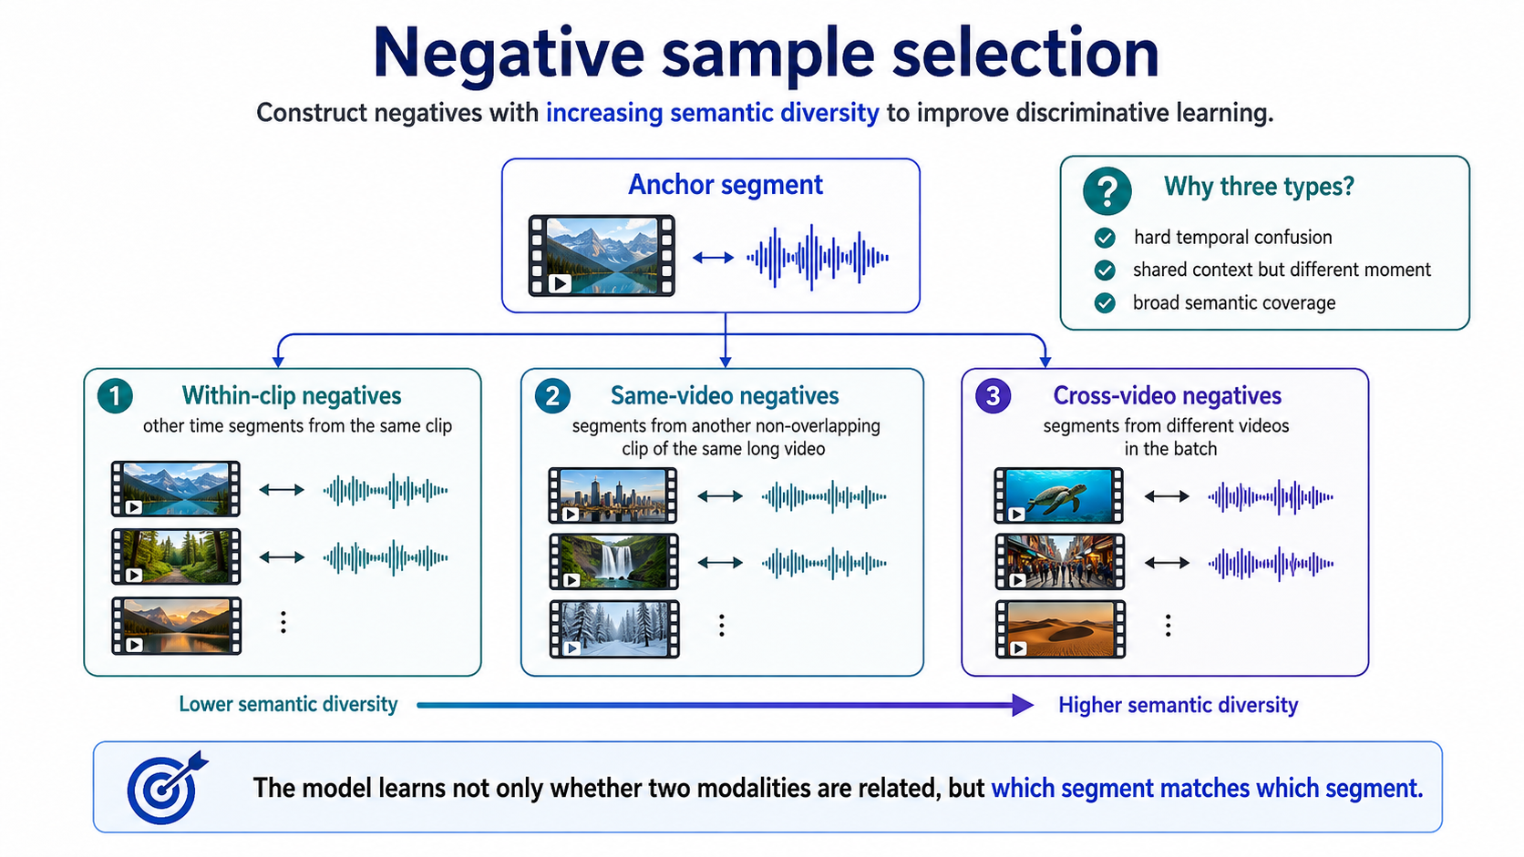
OmniVAE: Negative Sample Selection
Notes:
Building on this, we proposed AnyGPT, a model that performs any-to-any modality conversion.
AnyGPT covers four modalities in total: text, speech, image, and music.
The model has three parts: (1) a per-modality tokenizer that converts continuous signals into discrete tokens; (2) an autoregressive LLM that predicts the token sequence; and (3) a per-modality de-tokenizer that renders the tokens back into raw content such as images and audio.
AnyGPT offers a generative recipe for training on multimodal data: convert every modality into a unified discrete representation and train the LLM with a single next-token-prediction objective.
From the "compression is intelligence" perspective, once the LLM's perplexity is low enough, it becomes possible to compress the vast multimodal data of the internet into a single model.

Slide 38
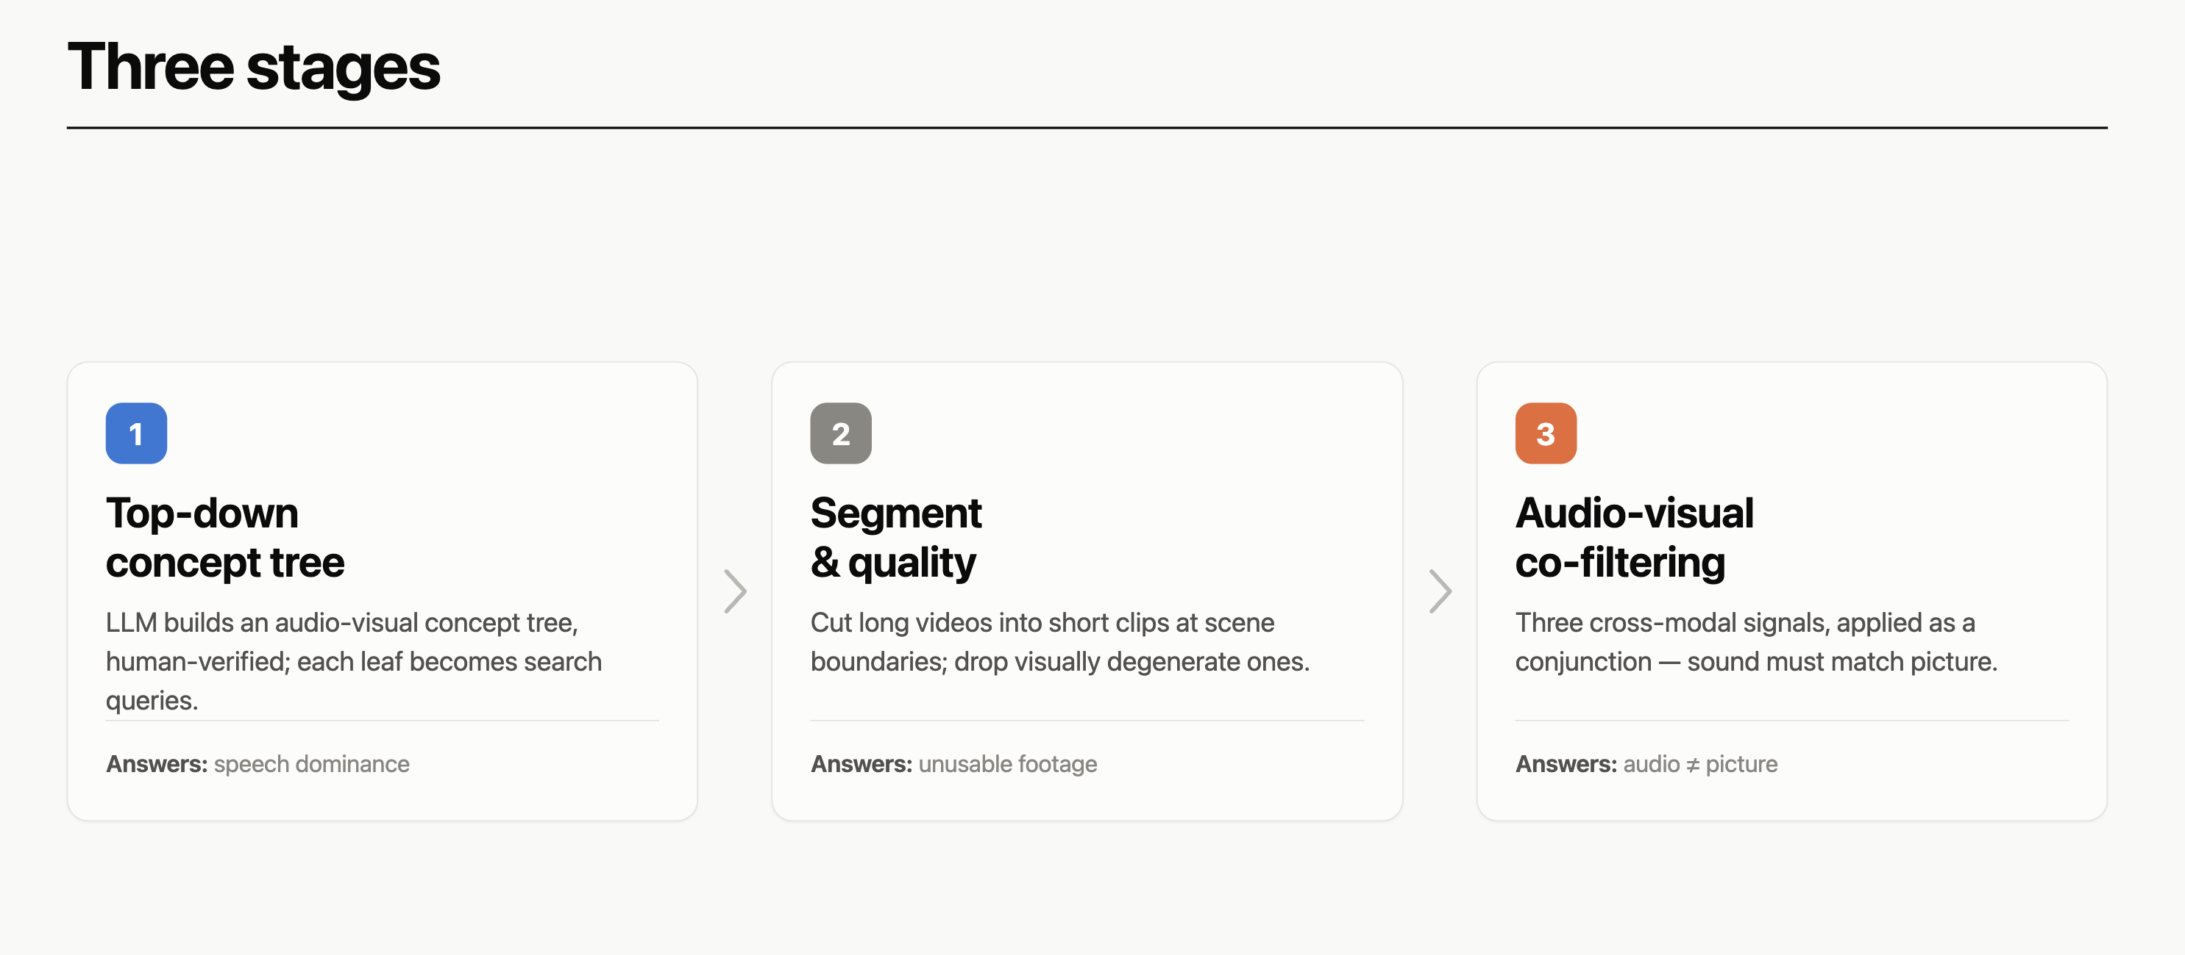
OmniVAE: Data Pipeline
Notes:
Building on this, we proposed AnyGPT, a model that performs any-to-any modality conversion.
AnyGPT covers four modalities in total: text, speech, image, and music.
The model has three parts: (1) a per-modality tokenizer that converts continuous signals into discrete tokens; (2) an autoregressive LLM that predicts the token sequence; and (3) a per-modality de-tokenizer that renders the tokens back into raw content such as images and audio.
AnyGPT offers a generative recipe for training on multimodal data: convert every modality into a unified discrete representation and train the LLM with a single next-token-prediction objective.
From the "compression is intelligence" perspective, once the LLM's perplexity is low enough, it becomes possible to compress the vast multimodal data of the internet into a single model.

Slide 39
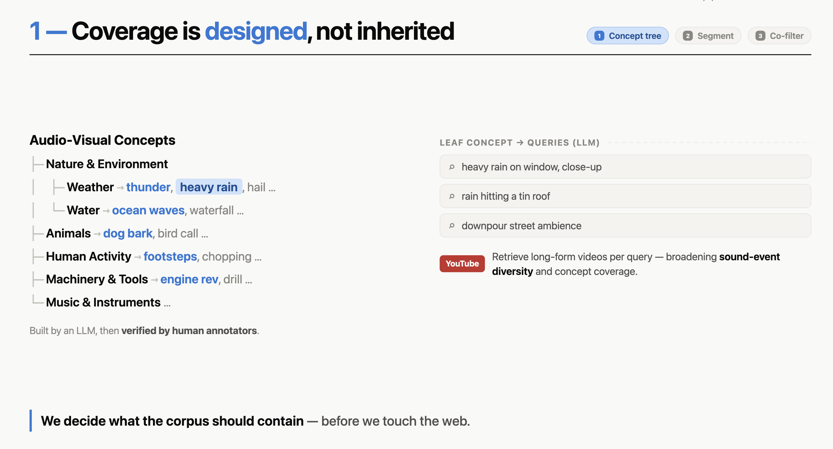
OmniVAE: Data Pipeline
Notes:
Building on this, we proposed AnyGPT, a model that performs any-to-any modality conversion.
AnyGPT covers four modalities in total: text, speech, image, and music.
The model has three parts: (1) a per-modality tokenizer that converts continuous signals into discrete tokens; (2) an autoregressive LLM that predicts the token sequence; and (3) a per-modality de-tokenizer that renders the tokens back into raw content such as images and audio.
AnyGPT offers a generative recipe for training on multimodal data: convert every modality into a unified discrete representation and train the LLM with a single next-token-prediction objective.
From the "compression is intelligence" perspective, once the LLM's perplexity is low enough, it becomes possible to compress the vast multimodal data of the internet into a single model.

Slide 40
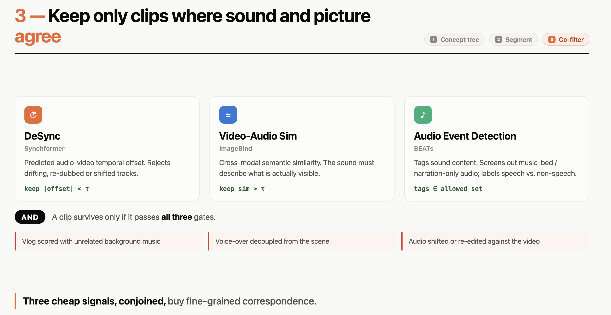
OmniVAE: Data Pipeline
Notes:
Building on this, we proposed AnyGPT, a model that performs any-to-any modality conversion.
AnyGPT covers four modalities in total: text, speech, image, and music.
The model has three parts: (1) a per-modality tokenizer that converts continuous signals into discrete tokens; (2) an autoregressive LLM that predicts the token sequence; and (3) a per-modality de-tokenizer that renders the tokens back into raw content such as images and audio.
AnyGPT offers a generative recipe for training on multimodal data: convert every modality into a unified discrete representation and train the LLM with a single next-token-prediction objective.
From the "compression is intelligence" perspective, once the LLM's perplexity is low enough, it becomes possible to compress the vast multimodal data of the internet into a single model.

Slide 41
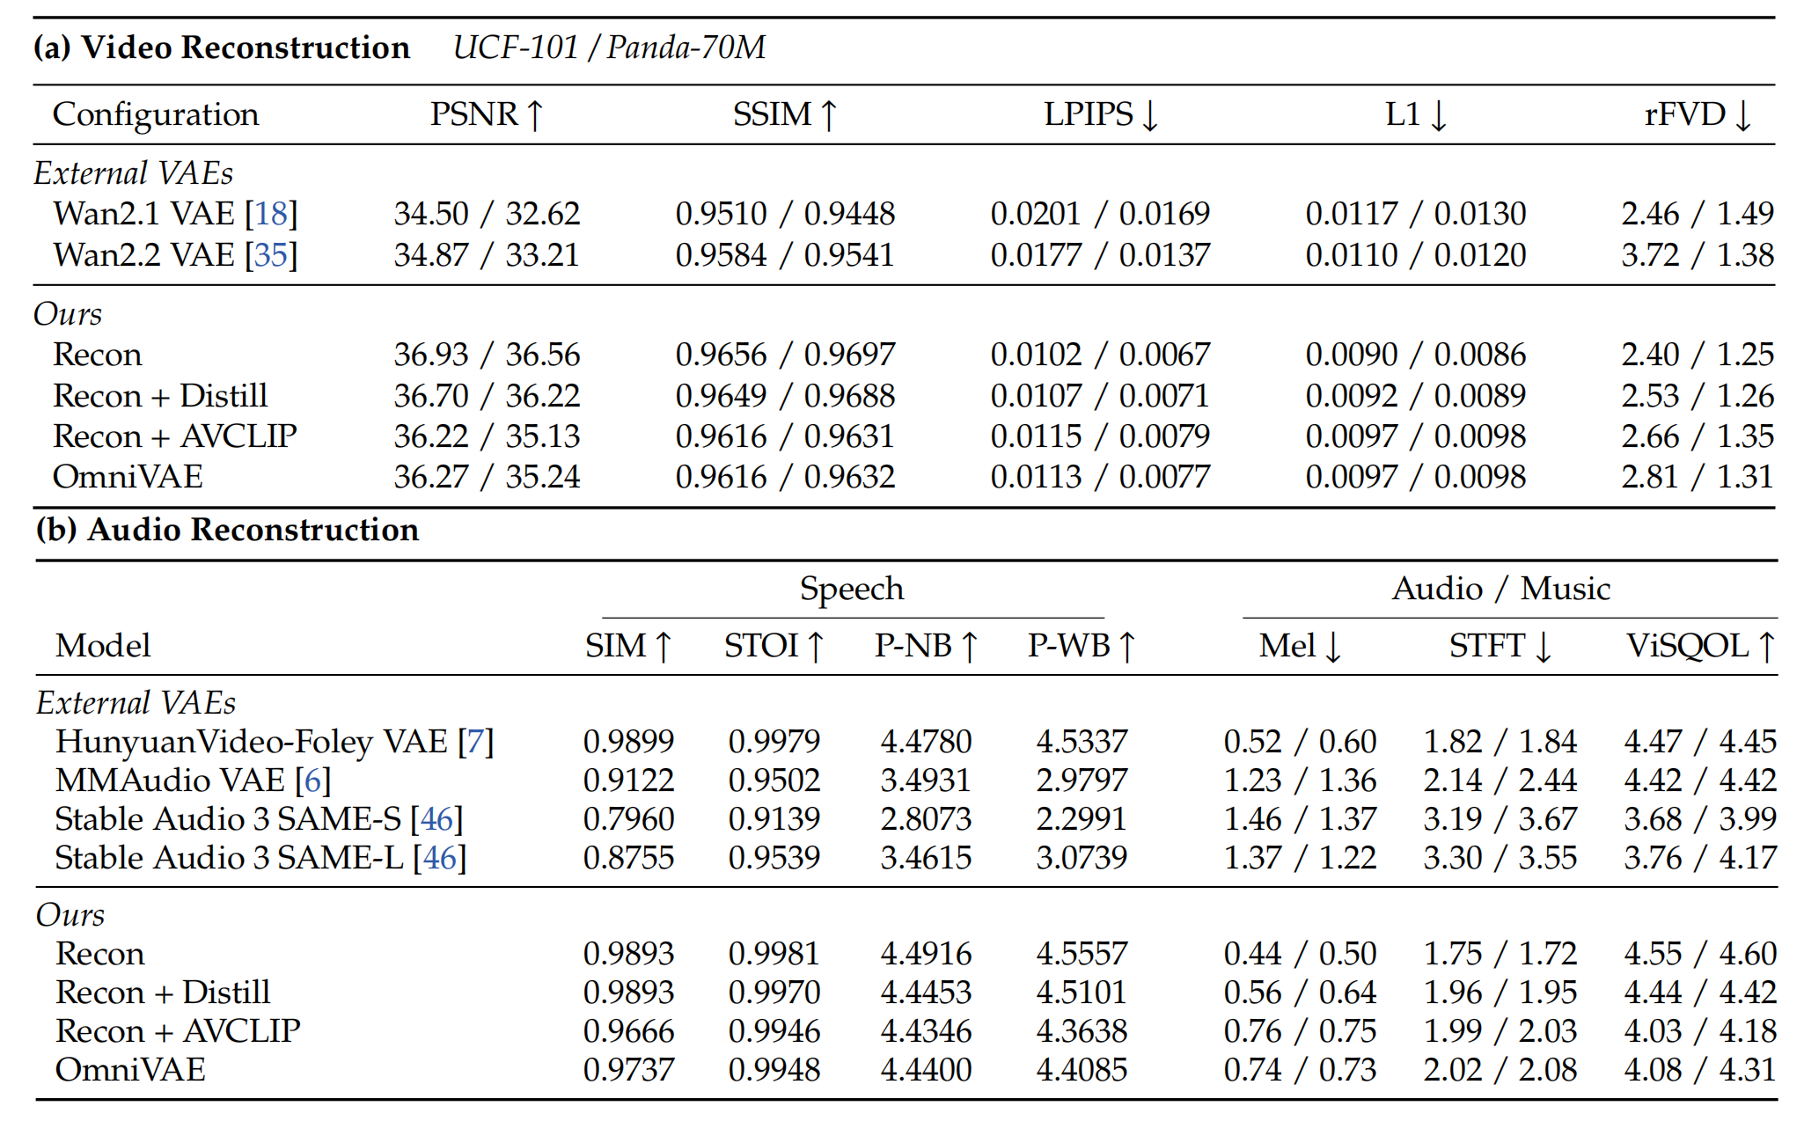
OmniVAE: Reconstruction
Adding the alignment objectives leaves audio and video reconstruction essentially on par with the reconstruction-only baseline.
Notes:
Building on this, we proposed AnyGPT, a model that performs any-to-any modality conversion.
AnyGPT covers four modalities in total: text, speech, image, and music.
The model has three parts: (1) a per-modality tokenizer that converts continuous signals into discrete tokens; (2) an autoregressive LLM that predicts the token sequence; and (3) a per-modality de-tokenizer that renders the tokens back into raw content such as images and audio.
AnyGPT offers a generative recipe for training on multimodal data: convert every modality into a unified discrete representation and train the LLM with a single next-token-prediction objective.
From the "compression is intelligence" perspective, once the LLM's perplexity is low enough, it becomes possible to compress the vast multimodal data of the internet into a single model.

Slide 42
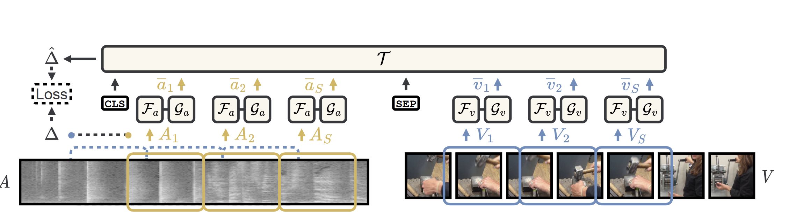
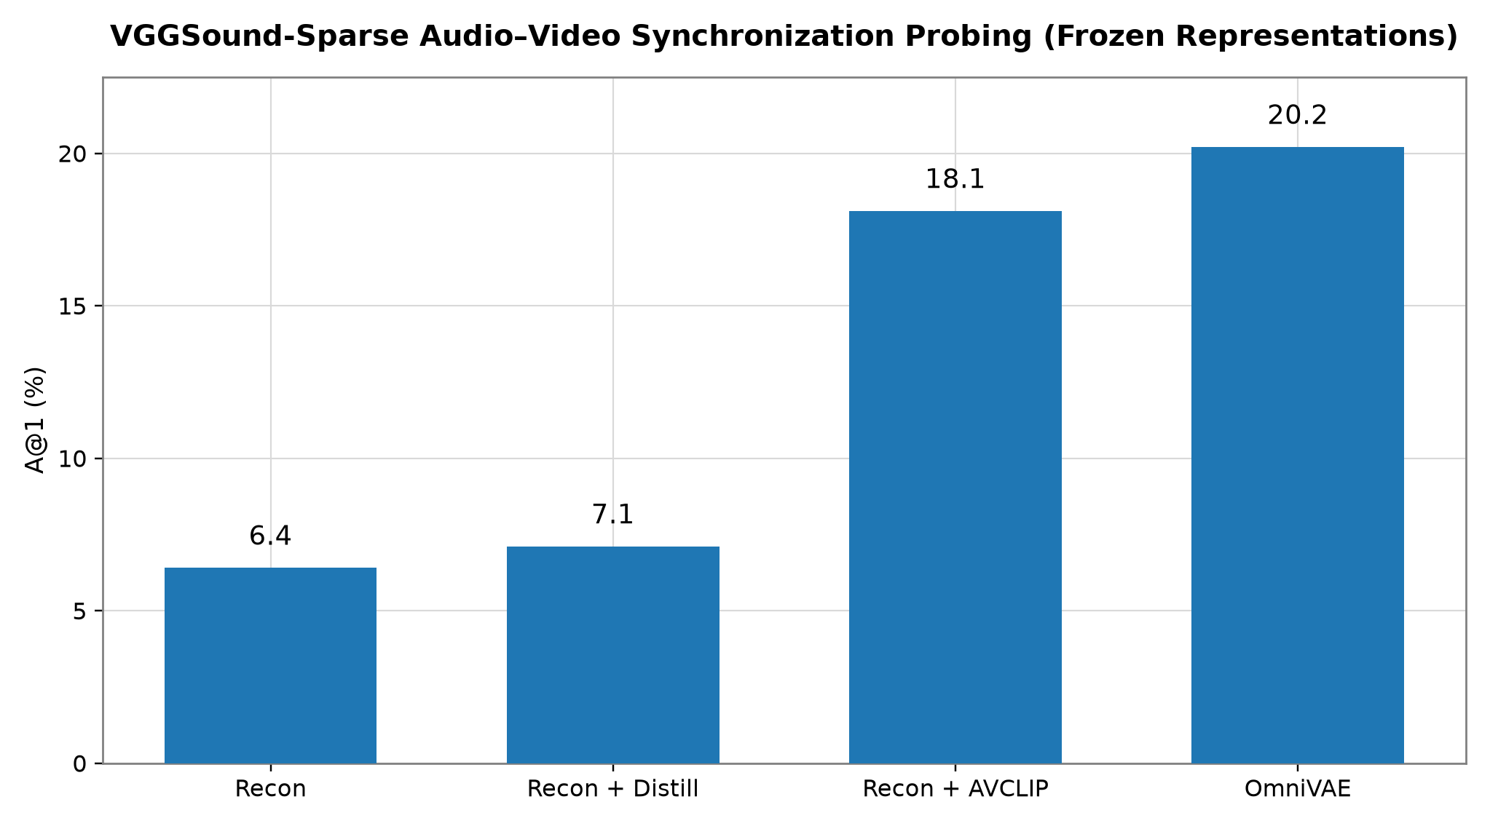
OmniVAE: Audio-Video Desync
Notes:
Building on this, we proposed AnyGPT, a model that performs any-to-any modality conversion.
AnyGPT covers four modalities in total: text, speech, image, and music.
The model has three parts: (1) a per-modality tokenizer that converts continuous signals into discrete tokens; (2) an autoregressive LLM that predicts the token sequence; and (3) a per-modality de-tokenizer that renders the tokens back into raw content such as images and audio.
AnyGPT offers a generative recipe for training on multimodal data: convert every modality into a unified discrete representation and train the LLM with a single next-token-prediction objective.
From the "compression is intelligence" perspective, once the LLM's perplexity is low enough, it becomes possible to compress the vast multimodal data of the internet into a single model.

Slide 43
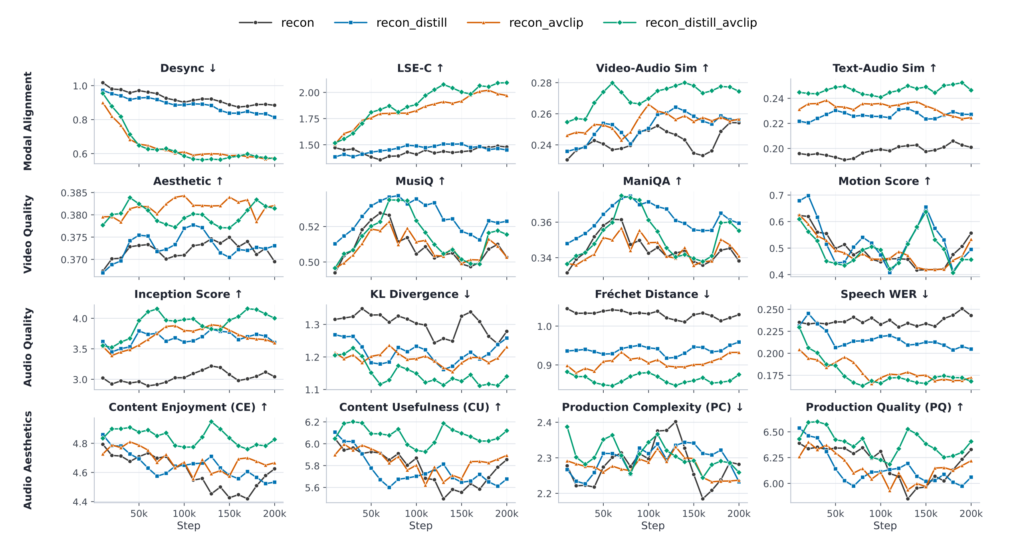
OmniVAE: Text-to-Audio-Video
Evaluated on three axes: audio-video alignment, audio generation quality, and video generation quality.
Notes:
Building on this, we proposed AnyGPT, a model that performs any-to-any modality conversion.
AnyGPT covers four modalities in total: text, speech, image, and music.
The model has three parts: (1) a per-modality tokenizer that converts continuous signals into discrete tokens; (2) an autoregressive LLM that predicts the token sequence; and (3) a per-modality de-tokenizer that renders the tokens back into raw content such as images and audio.
AnyGPT offers a generative recipe for training on multimodal data: convert every modality into a unified discrete representation and train the LLM with a single next-token-prediction objective.
From the "compression is intelligence" perspective, once the LLM's perplexity is low enough, it becomes possible to compress the vast multimodal data of the internet into a single model.

Slide 44
SpeechMotionLM:
A Full-Duplex Speech-Motion LLM
Can one full-duplex model listen, see, talk — and move its face and body?
Internship project · Seamless Next · status as of 2026-10-20

Slide 45
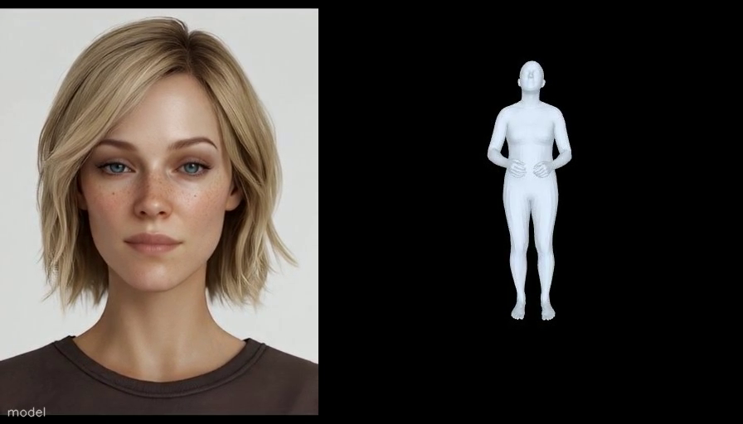
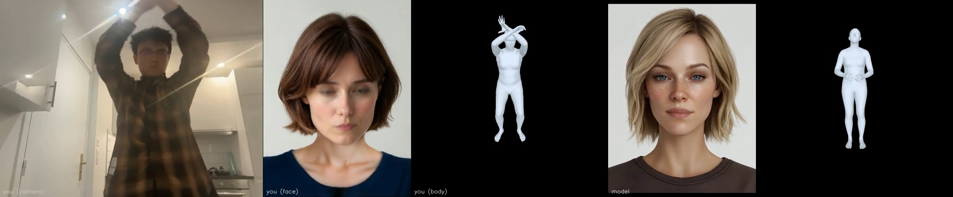
End-to-end: one model listens, talks and moves
Overview
  Full-duplex speech-motion LLM that jointly models speech and 3D human motion (body, hands, face)
  Case 1 (right): the user only talks; the model answers with voice, face and body
  Case 2 (below): the model also sees the user's face and body through the camera
▲ Case 1 · speech in → speech + face + body out
◀ Case 2
left to right: the user's camera, the face and body read from it, then the model's face and body
Notes:
Building on this, we proposed AnyGPT, a model that performs any-to-any modality conversion.
AnyGPT covers four modalities in total: text, speech, image, and music.
The model has three parts: (1) a per-modality tokenizer that converts continuous signals into discrete tokens; (2) an autoregressive LLM that predicts the token sequence; and (3) a per-modality de-tokenizer that renders the tokens back into raw content such as images and audio.
AnyGPT offers a generative recipe for training on multimodal data: convert every modality into a unified discrete representation and train the LLM with a single next-token-prediction objective.
From the "compression is intelligence" perspective, once the LLM's perplexity is low enough, it becomes possible to compress the vast multimodal data of the internet into a single model.

Slide 46
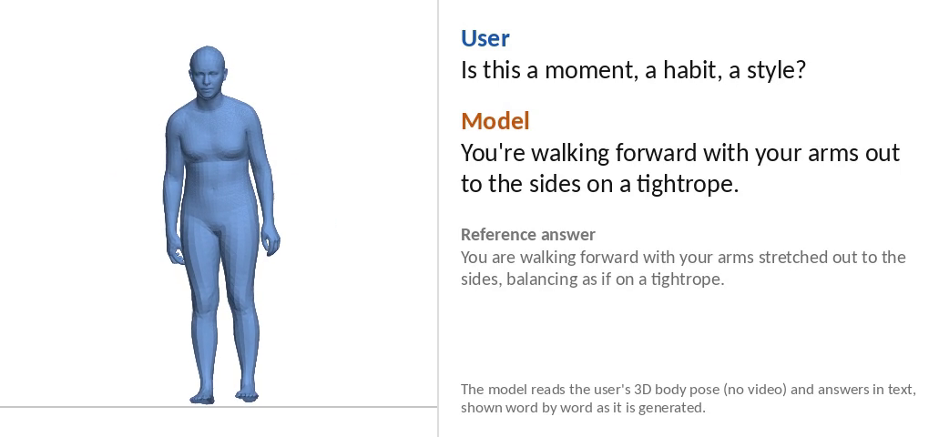
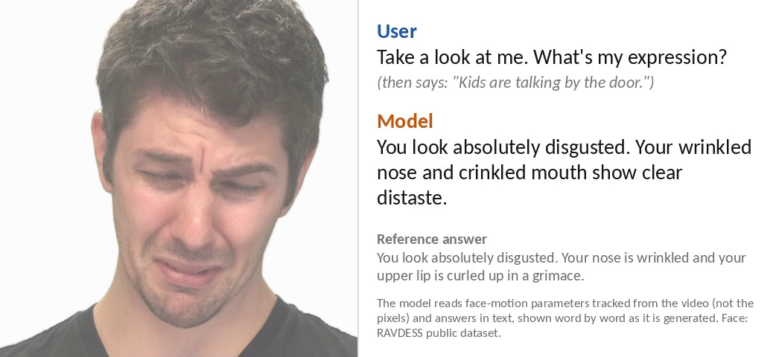
Understands the user's face and body
A user encoder feeds the camera's face and body into the frozen speech LM, which answers in words
MODEL SETUP
trained
frozen
Conditions encoder output added to the LM input, starting at zero · the system's own voice is taken out of the input
Trained only the user encoder
Frozen the 7B LM and its depth decoder · the spoken answer is not trained
Data body : face = 50 : 50 · body: 790 k motion descriptions, 4 sources · face: 333 k real-face dialogues in 3 tasks
User's voice
a question, then a 3 s pause
Audio codec
Mimi
7B speech LM
Moshi
Text answer
the LM's text stream
User's face + body
raw parameters from video
User encoder
causal · 10 layers · 0.67 B
Results · one model, all tasks · one seed
BODY · the user performs a motion and asks what it is
BLEU-4 word overlap · BERTScore meaning overlap · emotion named the answer has the right emotion word
Model You're walking forward with your arms out to the sides on a tightrope.
Reference You are walking forward with your arms stretched out to the sides, balancing as if on a tightrope.
What the user asks
Clips
Metric
Ours
Read it against
Body · what am I doing?
675
BLEU-4
.118
rewrites .107 * · e2e .147 §
BERTScore
.774
e2e .780 §
Face · what's my expression?
256
emotion named
.40
Emotion, 10 classes †
2,068
accuracy
.66
most common class: .12
FACE · “What's my expression?”
Emotion · S2D's 7 classes †
1,543
accuracy
.66
S2D ‡: .47
Model You look absolutely disgusted. Your wrinkled nose and crinkled mouth show clear distaste.
Reference You look absolutely disgusted. Your nose is wrinkled and your upper lip is curled up in a grimace.
* one LLM-rewritten reference scored against the others — not a human ceiling
† a separate 9B vision-language model on face crops · best checkpoint picked on the test set
‡ S2D: a public, pretrained video facial-expression recognizer (IEEE TAC 2024), run as-is · scored on the 1,543 clips labelled with one of its 7 emotions
§ same test after the encoder is merged into the newest end-to-end model (speech + face + body, offline test, one seed)

Slide 47
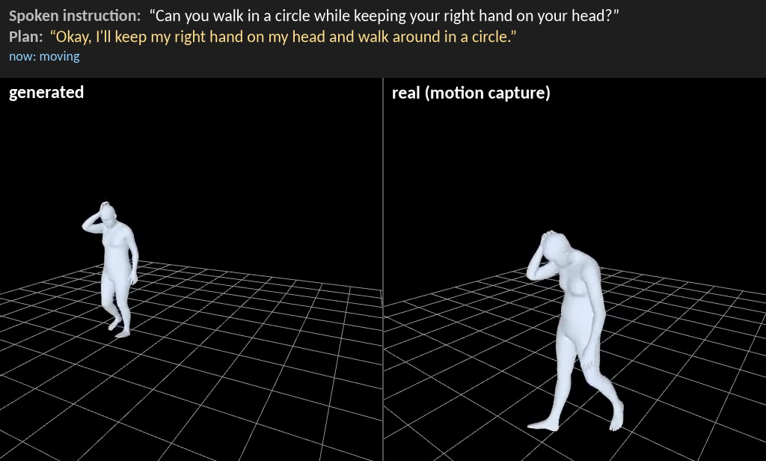
Body motion from a spoken instruction
Hears the instruction, writes a short plan, then moves — R1 at 92–96 % of real motion, above MotionStreamer
MODEL SETUP
trained
frozen
Spoken instruction
the user's voice
7B speech LM
PersonaPlex · 4096-d
Conditions plan revealed once thinking ends · own voice empty · speech / plan dropped 10 / 10 / 5 % ⇒ plan guidance 0.6 at test
Trained generator + plan and history encoders, from scratch
Frozen the 7B (states precomputed), audio codec, VAEs
Data instruction clips, 4 sources · the last stage also mixes in conversation (2 : 1)
Plan text
first person, written first
Plan encoder
2 layers
Motion generator
4-layer causal trunk
+ diffusion head
Body VAE
decoder
48-d · 6.25 Hz
Body
SMPL-H
Own past motion
last motion patch
History encoder
6 layers
How we measure R1 right instruction ranked 1st of 32 texts, chance .03 · GT real motion, same evaluator
CASE · generated (left) vs motion capture (right) · video
Text following · HumanML3D test, 512 clips · R1 ↑ · one seed
ours reaches 96 % (Guo) and 92 % (MS) of real-motion R1
vs MotionStreamer (public, streaming) · same 512 clips, same scoring · one seed
Guo R1 ↑
MS R1 ↑
Guo FID ↓
MS FID ↓
ours (newest)
.471
.649
0.55
31.3
MotionStreamer
.443
.608
0.61
28.7
real motion (GT)
.493
.708
—
—
video from an earlier checkpoint of the same model · hand-picked

Slide 48
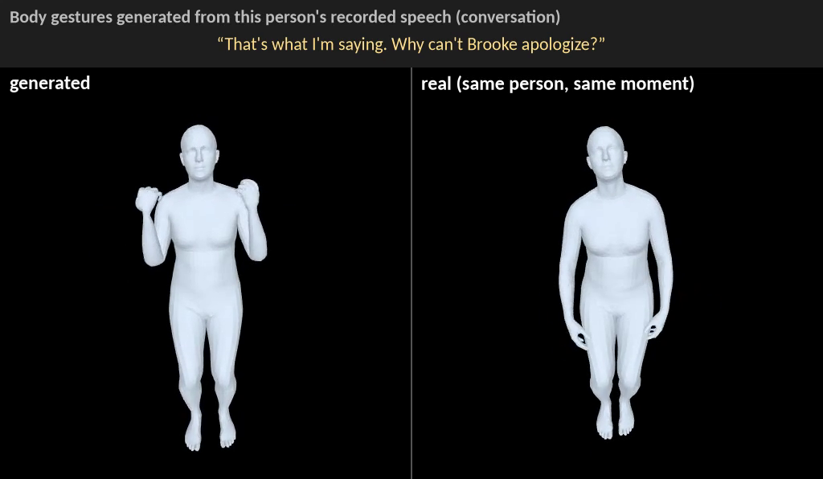
One body model: instructions + conversation
Same weights for both — each training row fills either the instruction slots or the speech slot
MODEL SETUP
trained
frozen
Switching by which slots a row fills — no task flag, no extra module
Trained the whole generator, from scratch · frozen: the 7B (states precomputed), codec, VAEs
Recipe instruction-only stages first, then a last stage with instruction : conversation = 2 : 1
Instruction row
plan + 7B state · own voice silent
Plan encoder
+ adapter for the 7B state
Conversation row
speech audio · no plan, no 7B
Audio codec
Mimi
Motion generator
4-layer causal trunk
+ diffusion head
Body VAE
decoder
48-d · 6.25 Hz
Body
SMPL-H
Own past motion
last motion patch
History encoder
6 layers
The joint stage · conversation body FGD ↓ (Mosaic test)
CASE · speech in, body out · video
Input
20 s of one side of a real conversation — audio only
Note
same clip and time steps · ours gestures more than real speakers in many clips
Instruction following holds · HumanML3D test, 512 clips · R1 ↑
instr. only ‡
5 k
10 k ★
real (GT)
Guo R1
.473
.459
.471
.493
What we learned
MS R1
.637
.637
.649
.708
1
Order matters an instruction-only last stage undoes it: FGD ~9 → 23–34, same R1
Adding conversation keeps instruction R1 at the level of the best instruction-only model, while conversation body FGD reaches about 16
2
Joint from the start best FGD (~8), but HumanML3D R1 only ≤ .36 / .59
3
Mix ratio 2 : 1 = 7 : 3 · weighting the loss by data source is worse
One seed · ★ chosen checkpoint · ‡ best instruction-only model (no conversation) · FGD swings between checkpoints · video from an earlier checkpoint of the same line

Slide 49
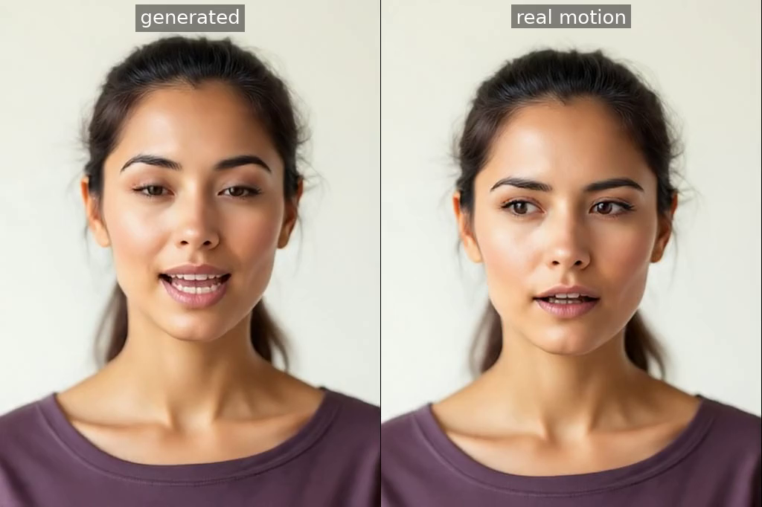
Talking face from speech
The most natural face of our real-time models; lip sync is still the main gap
MODEL SETUP
trained
frozen
Both voices
the live conversation
7B speech LM
PersonaPlex · 4096-d state
Conditions all inputs dropped together in 20% of rows ⇒ one guidance knob (0.6 at test) · no user camera
Trained the face generator only, from scratch
Frozen 7B LM (+ depth decoder), codec, face VAE
Data Mosaic conversations, natural + improvised 1 : 1 · 80 k steps · the 7B first reads a voice + system prompt, as in the live demo
Own speech
what the agent is saying
Audio codec
Mimi · 8 codebooks
Face generator
4-layer causal trunk
+ diffusion head
Face VAE
decoder
16-d · 6.25 Hz
Face
25 fps
Own past face
last face patch
History encoder
6 layers
How we measure Sync-C ↑ / Sync-D ↓ lip sync (SyncNet) · FFD · face FID ↓ realism
CASE · speech in, face out
Mosaic conversation test · 200 clips, both voices
Sync-C ↑
Sync-D ↓
FFD ↓
face FID ↓
Newest model
1.22
7.15
1.09
3.76
Demo model (older)
1.72
7.03
1.41
4.91
Offline, sees future audio
1.82
6.94
0.26
1.67
Real Mosaic clips *
2.93
—
—
—
Natural lowest FFD of our real-time models (1.09)
Lip sync Sync-C 1.22 (1.11 averaged over two seeds) — below the demo model (1.72); real clips 2.93
Left generated from the conversation audio · right: the real person's tracked face, same renderer
Note the clip with the best lip sync of the 200 (Sync-C 4.96; real face 4.84) · hand-picked
Future audio the offline model hears ahead and is far more natural (FFD 0.26, Sync-C 1.82)
One seed unless noted · * tracked real faces of 100 Mosaic training clips, same renderer and scorer, windows start at speech — not the 200 test clips · the demo model generates face and body together

Slide 50
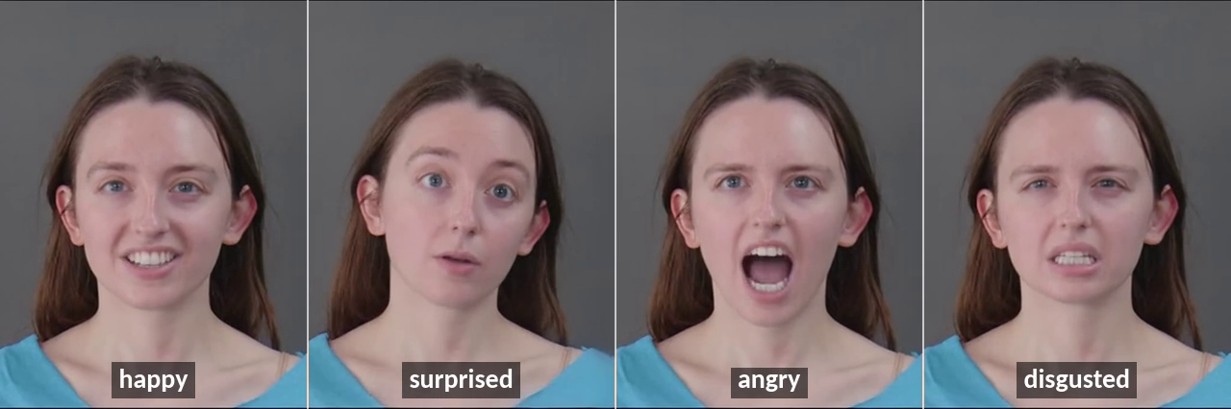
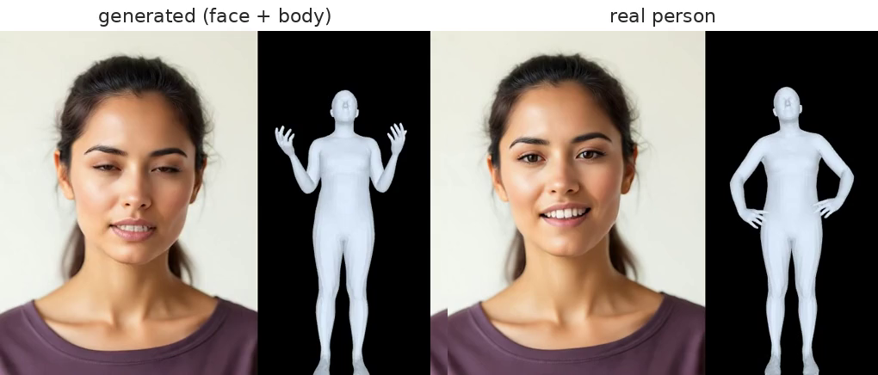
Face on request · face and body together
The same face model also follows an instruction; a linked face + body generator moves both in conversation
Face on request · 673 test instructions · three seeds
Face + body together · Mosaic conversation test, 200 clips
emotion recognised by a separate classifier · R@1 right instruction found among 32, chance .03
FGD body realism · Sync-C / Sync-D lip sync · FFD face realism
Ours
Real clips
Floor
Body FGD ↓
Sync-C ↑
Sync-D ↓
FFD ↓
Emotion recognised
.754
.893
.12 shuffled
Newest
8.11
1.41
6.89
1.11
Instruction found (R@1)
.388
.492
.03 chance
Previous
9.79
1.18
6.99
2.01
Still talks after adding instructions, conversation lip sync is unchanged (Sync-C 1.11 vs 1.11, two seeds)
Still follows instructions HumanML3D 512: Guo R1 .446 / MS R1 .616 (real motion .493 / .708)
Video: happy · surprised · angry · disgusted on request (silent; an earlier instruction-only face model, hand-picked)
Video: newest linked model, generated face + body (left) vs the real person (right) on the same speech, same renderer · hand-picked (best lip sync of 200)
One seed unless noted · instruction-face set differs from the earlier 400-instruction set, so old numbers are not comparable · the newest instruction-face run saved scores only, so its video comes from an earlier instruction-face model

Slide 51
Where each skill stands
Every skill goes through three stages: trained alone → joined inside its module → merged into the one end-to-end model
done
in research
new merge (offline)
① Trained alone
one task, one small model
② Inside its module
joined with the module's other tasks
③ In the end-to-end model
merged into the full speech model
older version in demo
not started
Full-duplex dialogue
done
—
in demo new merge: 2× turn-taking
Converse
Spoken Q&A
done
—
in demo also in new merge
Facial expression
done
done
new merge
Understand
the user
Emotion
done
done
new merge weaker
Body motion
done
done
new merge best score yet
Face from speech
done
done one face model
new merge old one in demo
Body from speech
done
done
new merge old one in demo
Move the
avatar
Face from instruction
done
done same face model
not started
Body from instruction
+ think first
done
done one body model + speech
new merge plans itself, weaker
Face + body together
done one shared head
done two-way link chosen
new merge old one in demo
React
React to the user's movement
in research two people, no speech
not started
camera wired off by default
Goal every row reaches ③ in ONE new model. Today: the demo runs an earlier merge; a new full merge covers 9 of 11 rows, tested offline; live trial being set up.
Understand = say in words what the camera shows · React = change the avatar's own speech or motion because of it

Slide 52
Architecture: one speech LM that hears, sees, talks and moves
All inputs are added into one vector every 80 ms; the 7B speaks and writes, and a motion generator turns its state into face and body
INPUT · summed into one vector
BACKBONE
OUTPUT
module training:
trained
frozen
Text token
its own last token
7B speech LM
32 layers × 4096
one step = 80 ms
hears the user
and itself
frozen
Depformer
8 codes in turn
8 audio tokens
Mimi
decoder
Speak
voice
24 kHz
Agent audio
its own last 8 audio codes
Text head
1 token / step
a word of the reply — or a plan token
plan (CoT) between <BCOT> … <ECOT> · never spoken
Write
+
User audio
8 audio codes from the mic
1 × 4096
Motion generator
face 16-d
VAE decoders
→ avatar video
25 fps
reads every 160 ms:
User camera
tracker → user encoder
Move
LM state
own voice
body 48-d
plan
own motion
↺ the agent's own outputs come back as next input
1
Hear and decide
every 80 ms the 7B hears the user and itself, then speaks and writes in the same step
2
Move with the words
the motion generator reads the 7B's state, its own voice and the plan → face and body codes
3
See the user
the camera condition is added to the same input — no extra LM steps; its encoder adds ~13 ms

Slide 53
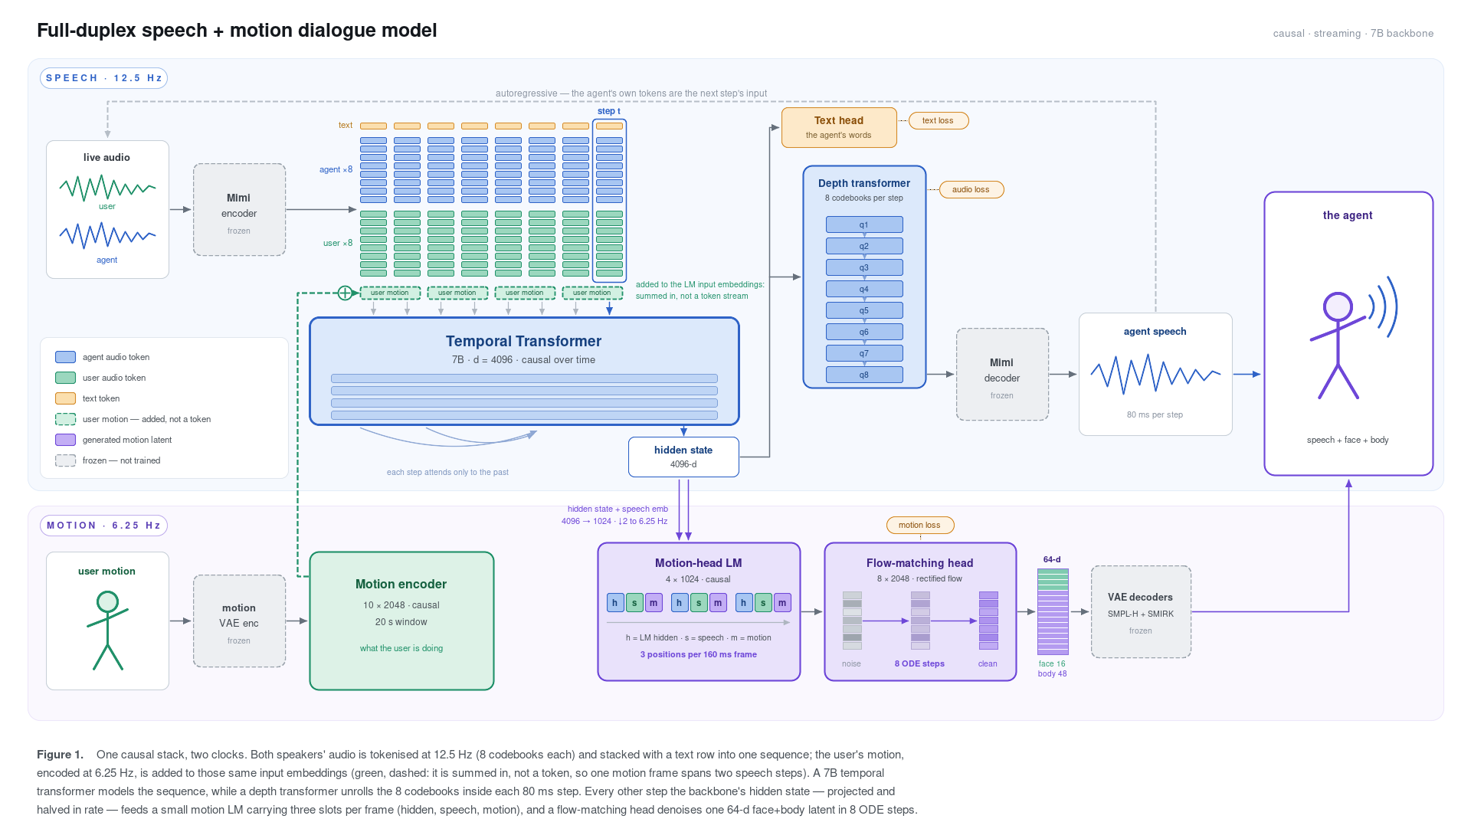
SpeechMotionLM: Architecture
Notes:
Building on this, we proposed AnyGPT, a model that performs any-to-any modality conversion.
AnyGPT covers four modalities in total: text, speech, image, and music.
The model has three parts: (1) a per-modality tokenizer that converts continuous signals into discrete tokens; (2) an autoregressive LLM that predicts the token sequence; and (3) a per-modality de-tokenizer that renders the tokens back into raw content such as images and audio.
AnyGPT offers a generative recipe for training on multimodal data: convert every modality into a unified discrete representation and train the LLM with a single next-token-prediction objective.
From the "compression is intelligence" perspective, once the LLM's perplexity is low enough, it becomes possible to compress the vast multimodal data of the internet into a single model.

Slide 54
Think first: each segment has its own rules
Before an instructed move, the agent writes a short silent plan — r plan tokens per 80 ms step, so planning takes a fraction of a second
User speaks
Pause
Plan (CoT)
Bridge
Move
User audio
“Can you do a full-body sideways jump to your left?”
Agent text
<BCOT> Okay, I'll jump sideways to my left … <ECOT>
Agent audio
fixed silence
silent — the agent never speaks in an instructed-move turn
Agent motion
listening
idle
1 motion frame per 2r plan tokens · body idle
smooth bridge ≤ 2 s
the instructed move
Inside the plan at r = 5
vs the old scheme: 1 plan token = 80 ms
<BCOT> Okay , I '
ll jump side ways to
my left with my whole
body . <ECOT>
Old
18 tokens × 80 ms = 1.44 s
→ move
LM step 1 · 80 ms
LM step 2 · 80 ms
LM step 3 · 80 ms
LM step 4 · 80 ms
motion frame 1 · 10 plan tokens
motion frame 2 · 8 plan tokens
New
4 steps = 0.32 s → move
Why r = 5: a text-only LM step takes 11 ms ⇒ 6 fit in 80 ms; 5 with the motion head on the same GPU
Training mixes r per clip: half r = 5, the rest r = 1, 2, 3, 4, 6
same 18-token plan
Median think time on the test set: 1.44 s → 0.32 s

Slide 55
Think first: how the plan reaches the motion head
Two routes into the head's speech slot: a plan summary that switches on at <ECOT>, and the 7B's state, updated every step
A · plan slot — the whole plan at once
Plan tokens
“Okay, I'll jump
sideways to my left
with my whole body.”
text embedding
of the 7B · frozen
linear
2-layer causal
encoder
projection
0 until <ECOT>
then the summary
S speech slot
own voice (8 audio codes)
+ A + B
→ trunk → diffusion head
+
B · LM state — updates every step
7B speech LM
frozen · writes r tokens
last hidden state
every 80 ms
average 2 steps
→ one per 160 ms
linear
starts at 0
What each motion frame receives (the 18-token plan, r = 5)
frame 1 · plan
frame 2 · plan, has <ECOT>
frame 3 · bridge
frame 4 … · move
A plan slot
0
whole-plan summary
whole-plan summary
whole-plan summary
B LM state
after “… side ways to”
after “… body . <ECOT>”
keeps updating
keeps updating
The motion follows the plan
give it another clip's plan ⇒ text-match R1 falls to chance (.01–.04 vs .03); earlier model
Module training
plan text comes from the data; the frozen 7B reads it; plan or speech dropped on ~10 % of rows
Not built yet
the live loop where the LM writes its own plan at r tokens per step, and the end-to-end model

Slide 56
Training data: what we start from
Five kinds of real data — then synthesized into two-person dialogues (next pages)
Real conversations
Body motion + captions
Face video
Spoken Q&A
Full-duplex speech
2.5k h
1.5k h
2.9k h
20.3k h
3.9k h
two people · voice + face + body
one person · one caption per clip
11 public talking-head sets
question → answer · voice only
two overlapping voice channels
Mosaic
2,199
RoMo
1,053
VoxCeleb2
2,041
FlexiSLM
12,962
Behavior-SD
2,127
MSR
325
Bones-Seed
286
MEAD
236
VoiceAssistant
2,866
Fisher
1,802
Motion-X++
83
CelebV-Text
193
EchoX
2,310
HumanML3D
44
TalkingHead-1KH
156
InstructS2S
2,209
Hallo3
124
6 others
185
9.1k h captured; 2.2k h have every track
+ Nymeria 264 h (body VAE only)
raw 3.5k h before the head-pose filter
Used for face & body from speech · turn-taking · VAEs
Used for body from instruction · body understanding · body VAE
Used for face understanding · face from instruction · face VAE
Used for keeps the agent smart · gets synthetic face & body
Used for interruptions & back-channels · side experiments only
Synthesized dialogue rows built from them
Q&A + face & body
Body · understand
Body · generate
Face · understand
Face · dialogue
Face · from instruction
1.92M ≈15k h
900k ≈3.9k h
453k
334k ≈1.9k h
142k 638 h
113k 162 h

Slide 57
Every example becomes a two-person dialogue
Whatever we start from, we fill in the missing words, voices, faces and bodies until both people are complete
Every example looks like this
Starting from
Words
an LLM writes
Voices
TTS speaks
Faces & bodies
a motion model draws
Becomes
User
voice
Real conversation
Mosaic, MSR
✓
✓
✓
dialogue as is
face
body
Spoken Q&A
FlexiSLM, InstructS2S
✓
✓
+
Agent
Q&A with bodies
voice
Full-duplex speech
Fisher, Behavior-SD
✓
✓
+
words
overlapping talk
face
body
Motion clip + caption
RoMo, Bones-Seed, …
+ instruction
+ plan
+ user
voice
real clip
+ filler
“show me …”
one clock · speech 12.5 Hz · motion 6.25 Hz
One exception the two motion VAEs train on single-person clips
Face clip + emotion
VoxCeleb2, MEAD, …
+ instruction
+ plan
+ voices
real face
+ bodies
“look surprised …”
✓
already real
+
we add it
Then quality checks → faces & bodies compressed into VAE codes

Slide 58
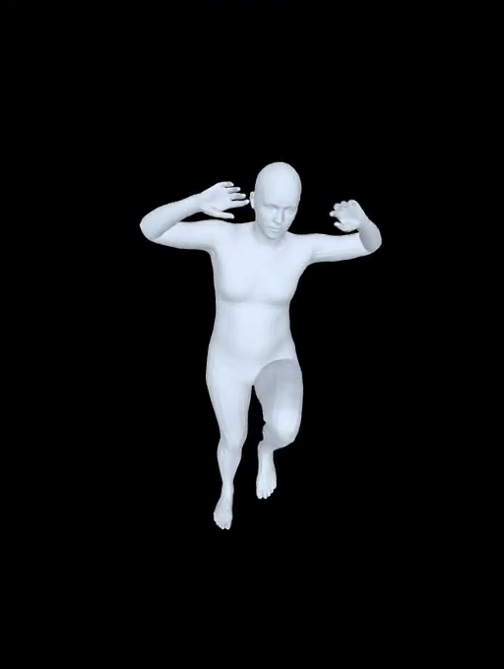
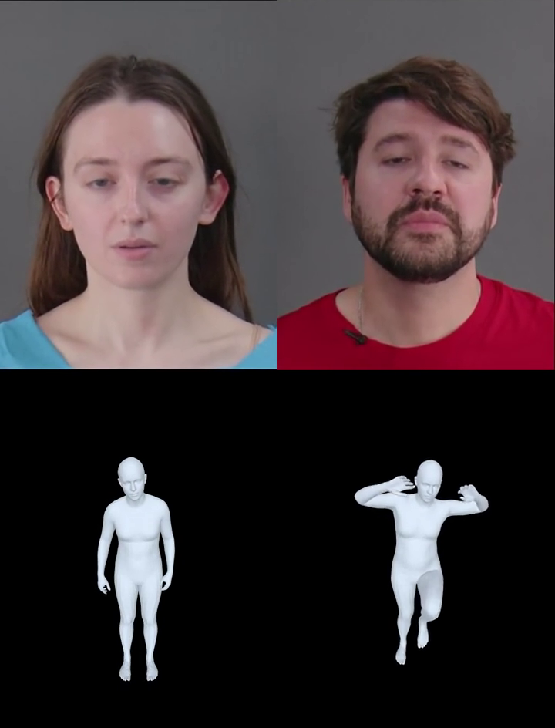
One example, from a motion clip to a dialogue
A 3.7 s motion-capture clip becomes a 7.5 s two-person dialogue: instruction → silent plan → the real move
1
Real clip
2
Words
3
Voice
4
Faces & bodies
5
The dialogue
an LLM writes
TTS speaks
a motion model draws
User “Show me the Floor Tap To Knee Tuck move.”
Plan “Alright, let me tap the floor with my hand and then tuck my knee up towards my chest.”
User the instruction in a random voice · 2.75 s
Agent stays silent; the plan is never spoken
Both people drawn from the audio: user talks, agent listens
The move agent's body replaced by the real clip, frame-exact — turned upright, put on the ground
Motion-X++ · 3.7 s
“Floor Tap To Knee Tuck”
The 7.5 s timeline, to scale
left user · right agent · ▶ plays in PowerPoint
bridge 0.4 s
user asks
the real clip, frame-exact
pause
plan 0.4 s
0 s
1 s
2 s
3 s
4 s
5 s
6 s
7 s
Trains on voice tokens 12.5 Hz · plan tokens · per person: body codes 46 × 48 and face codes 46 × 16 (6.25 Hz)

Slide 59
Training: learn each skill alone, then join, then merge
Modules first (cheap, easy to measure), on top of the same frozen 7B — the end-to-end merge comes last
0 Motion VAEs body 48-d + face 16-d per 160 ms · trained first, then frozen · done
1
Generation
Speech → face
conversation
+ face from instruction
1 : 1 mix
face: eval running
face
face and body heads train;
everything else frozen
body
Clean captions
4 motion sources
+ own past motion
+ conversation
2 : 1
body: done
rerun on the new VAE at step 3 → 4
2
Understanding
Body motion → text
+ face
1 : 1 mix
done
only the user encoder trains;
text loss only
the LM can already talk; it only has to learn to see
3
Joint face + body
Face model + body model
from step 1
Links only
20k steps
Unfreeze all
100k · low lr
running · 5 designs
links between the two heads;
branches frozen, then unfrozen
links start at 0 ⇒ training starts from two working models
4
Unified
Merge modules
+ spoken Q&A + full-duplex
End-to-end fine-tune
full mix
not started
all weights train
Demo today = an earlier merge of older modules (no think-first plan, older VAEs, camera off)
7B speech LM frozen in steps 1–3 ⇒ modules train cheaply and the LM keeps its voice · today two frozen 7Bs: body reads PersonaPlex, face and understanding read Moshi

Slide 60
How we measure each capability
One test set and a few metrics per capability — every number is read next to a reference row
Capability
Test set
Metrics — what they mean
Read it against
R1 ↑ (Guo / MS evaluators) the right instruction ranked 1st of 32 · chance .03
FID ↓ realism: generated vs real motion, as distributions
real motion, same evaluator
MotionStreamer (public)
Body from instruction
HumanML3D test · 512
Body in conversation
conversation test · 200
FGD ↓ distance between generated and real gesture statistics
the model the run started from
(no real-vs-real floor yet)
Face from speech
conversation · 200
Sync-C ↑ / Sync-D ↓ lip-sync confidence / distance (SyncNet)
FFD ↓ · face FID ↓ realism of the face vs real faces
real Mosaic clips
offline model that sees the future
Face from instruction
673 instructions × 3 seeds
Emotion hit ↑ a classifier sees the asked-for emotion
R@1 ↑ the right instruction is found from the face
real faces · shuffled instructions
Body understanding
675 motions the user performs
BLEU-4 ↑ word overlap with the reference description
BERTScore ↑ meaning overlap
one real answer scored against
the others (BLEU-4 .107)
Face & emotion
understanding
256 “what's my expression?”
2,068 emotion clips
Emotion hit ↑ the answer names the right emotion
Accuracy ↑ 10-way emotion
a public expression model (S2D)
on the same clips
Full-Duplex-Bench
v1.0 · v1.5
Handled correctly ↑ speaks when it should, stays quiet on pauses / “uh-huh”
Latency ↓ how fast it responds or stops
PersonaPlex 7B (public),
run with our prompt
Full-duplex dialogue
Real time
live server · 1 node
ms per 160 ms step ↓ GPU work per motion step — must fit in 160 ms
the 160 ms budget
Noise R1 moves up to .02–.03 with the seed · FGD jumps 7–41 between neighbouring checkpoints · conversation numbers come from two evaluation setups that are never mixed

Slide 61
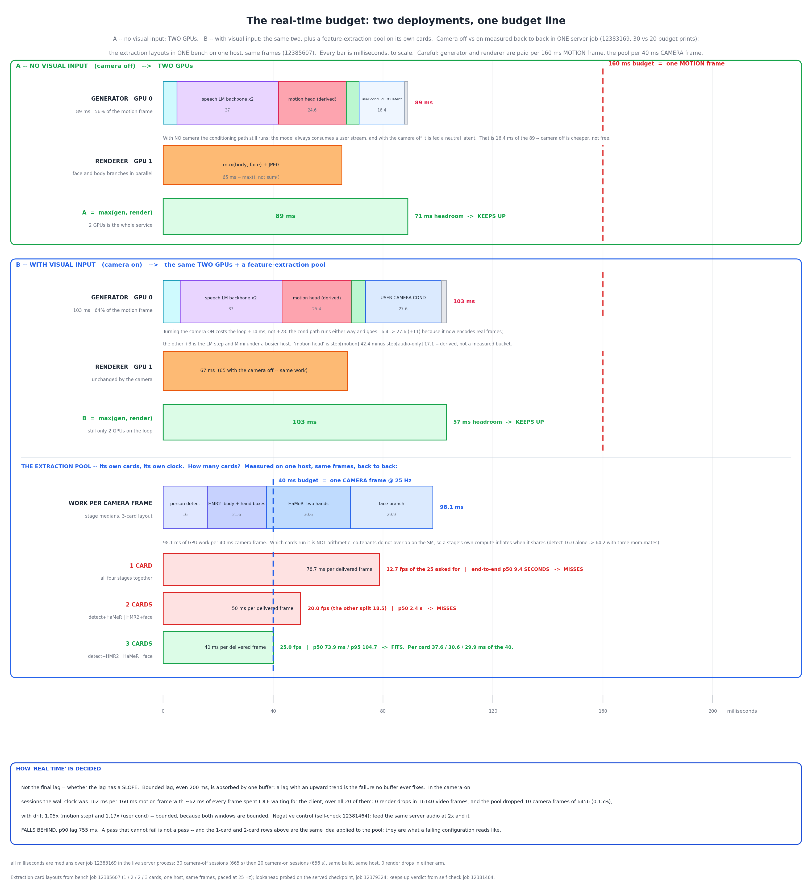
Real-time Latency Budget: camera off
Notes:
Building on this, we proposed AnyGPT, a model that performs any-to-any modality conversion.
AnyGPT covers four modalities in total: text, speech, image, and music.
The model has three parts: (1) a per-modality tokenizer that converts continuous signals into discrete tokens; (2) an autoregressive LLM that predicts the token sequence; and (3) a per-modality de-tokenizer that renders the tokens back into raw content such as images and audio.
AnyGPT offers a generative recipe for training on multimodal data: convert every modality into a unified discrete representation and train the LLM with a single next-token-prediction objective.
From the "compression is intelligence" perspective, once the LLM's perplexity is low enough, it becomes possible to compress the vast multimodal data of the internet into a single model.

Slide 62
Real-time Latency Budget: camera on
Notes:
Building on this, we proposed AnyGPT, a model that performs any-to-any modality conversion.
AnyGPT covers four modalities in total: text, speech, image, and music.
The model has three parts: (1) a per-modality tokenizer that converts continuous signals into discrete tokens; (2) an autoregressive LLM that predicts the token sequence; and (3) a per-modality de-tokenizer that renders the tokens back into raw content such as images and audio.
AnyGPT offers a generative recipe for training on multimodal data: convert every modality into a unified discrete representation and train the LLM with a single next-token-prediction objective.
From the "compression is intelligence" perspective, once the LLM's perplexity is low enough, it becomes possible to compress the vast multimodal data of the internet into a single model.

Slide 63
Long-Term Vision
Always on · Sees and hears · Learns by interacting
Virtual / Embodied Agent
Interactive World Model
your voice · face · room
your actions
♪
you
its voice · face · actions
AI agent
you
sight + sound of the world
AI world
AI as someone you talk to
AI as a world you step into
avatars · game characters · robots
games · films · robot training grounds
In the long run, one model is both — our picture of Multimodal AGI
Notes:
Maybe we can use a share semantic space for all the modalities, and use a individual semantic and perceptual space for individual modality

Slide 64
Long-Term Goal
Interactive, long-horizon, real-time audio-visual models
for agents and for worlds
Real-time interaction
Long-horizon memory
One audio-visual-action space
Learning from interaction
listen and talk at once
hours long, no drift
sight and sound together
gets better with use
Built on our work: SpeechGPT · AnyGPT · SpeechGPT2.0-preview · VStyle · OmniVAE · SpeechMotionLM
Now
talking avatars
Next
always-on agents, playable worlds
Further
one model for both
Notes:
Maybe we can use a share semantic space for all the modalities, and use a individual semantic and perceptual space for individual modality

Slide 65
Thanks

