Slide 1


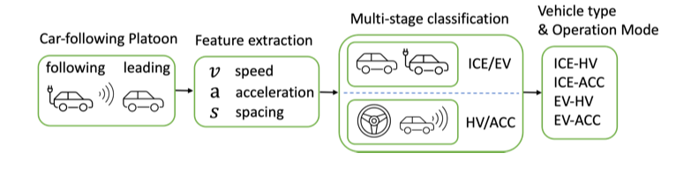
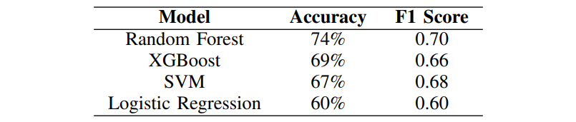
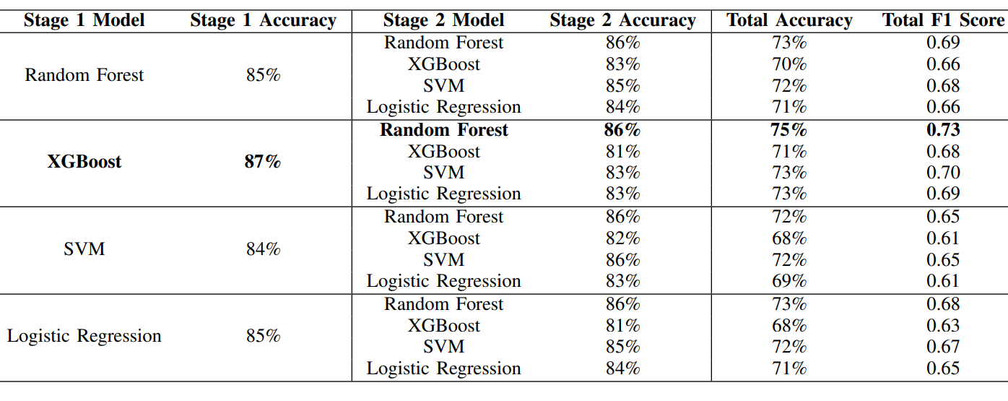
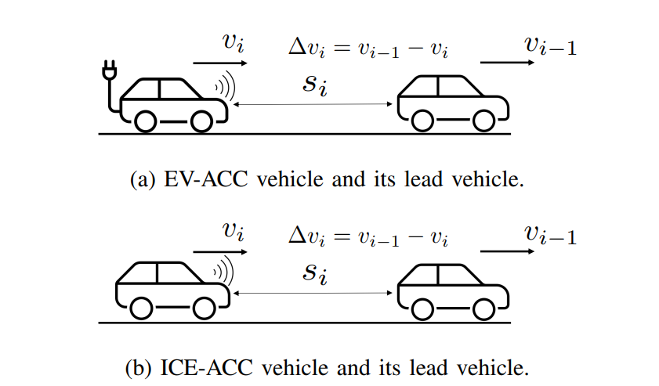

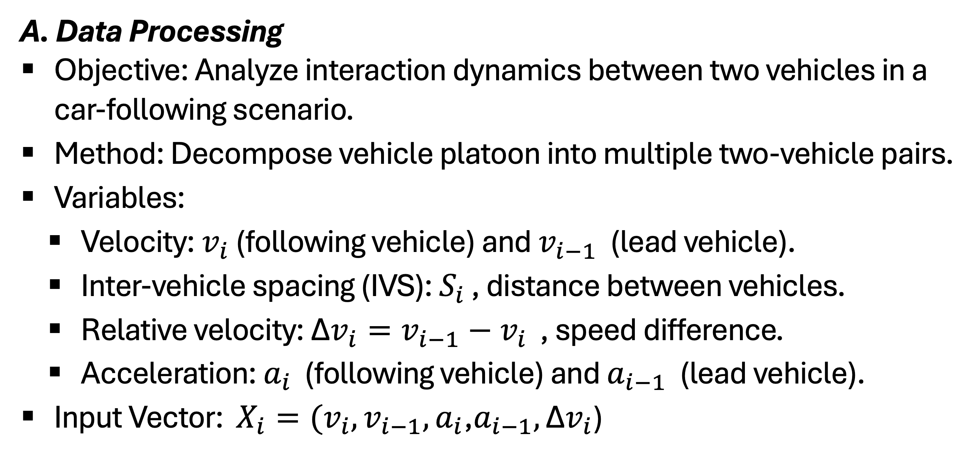
Data-Driven Classification of Vehicle Driving Behavior in Mixed Traffic Using Car-Following Trajectories
Jun Zhao, Mingfeng Shang, Gabriel Geffen, Yao-Jan Wu
I. Introduction
B. Data Descriptive Analysis
Objective: Investigate differences in car-following behaviors across four categories: EV-ACC, ICE-ACC, EV-HV, and ICE-HV.
Class Imbalance: Addressed using class weighting strategies.
Findings:
    EVs:
      Less oscillatory behavior and smoother spacing
      Follow lead vehicles more closely than ICE vehicles.
    ACC-equipped vehicles:
      Smoother car-following dynamics.
    Human-driven vehicles :
      Keep longer following distances and show more oscillatory behavior than ACC-equipped vehicles.
Automated Vehicles (AVs): Transforming transportation, improving string stability and traffic throughput, reducing fuel consumption and emissions.
Electric Vehicles (EVs): Increasing adoption, distinct powertrain characteristics affecting traffic dynamics.
Challenges: Limited understanding of the interplay between vehicle powertrain types and operation modes in real-world mixed traffic.
Objective: Classify vehicles in mixed traffic using two approaches: single-stage models that directly categorize the data and multi-stage models that perform classification in sequential steps.
II. Modeling
A. Single-stage classification model
Description: Performing classification in one step by directly mapping input data to output labels.
Advantages: Simplicity and efficiency.
Challenges: May underperform with complex or hierarchical data patterns.
Models: Random Forest (RF), XGBoost, Support Vector Machine (SVM), Logistic Regression (LR).
B. Multi-stage classification model
Description: Decomposing the classification task into sequential subtasks for improved accuracy and interpretability.
Approach: Two-stage model first classifies operation mode (ACC vs. Human-driven), then vehicle type (EV vs. ICE).
Advantages: Improving interpretability and potentially higher accuracy.
Challenges: Increasing latency and potential error propagation.
IV. Results
A. Single-stage classification models
Random Forest: Highest accuracy (74%) and F1 Score (0.70).
XGBoost, SVM, Logistic Regression: Comparatively lower performance.
B. Multi-stage classification models
Sequence Operation Mode-Vehicle Type: First classify operation mode, then vehicle type.
  Stage 1: XGBoost achieved 87% accuracy.
  Stage 2: Random Forest achieved 86% accuracy.
  Overall: 75% accuracy and F1 Score of 0.73.
Sequence Vehicle Type-Operation Mode: First classify vehicle type, then operation mode.
  Similar performance: Slightly lower accuracy and F1 Score.
C. Comparisons between the single-stage and the multi-stage model
Single-stage vs. Multi-stage:
  Single-stage: Simplicity and fewer tuning steps.
  Multi-stage: Better interpretability and slightly higher performance.
  Conclusion: Both approaches are effective; choice depends on the need for simplicity vs. interpretability.
III. Data
A. Data Processing
Objective: Analyze interaction dynamics between two vehicles in a car-following scenario.
Method: Decompose vehicle platoon into multiple two-vehicle pairs.
Variables:
    Velocity: $v_{i}$​ (following vehicle) and $v_{i−1}$​ (lead vehicle).
    Inter-vehicle spacing (IVS): $S_{i}$​ , distance between vehicles.
    Relative velocity: ${\text{Δ}v_{i}=v}_{i−1}−v_{i}$​ , speed difference.
    Acceleration: $a_{i}$​ (following vehicle) and $a_{i−1}$​ (lead vehicle).
Input Vector: ${X_{i}=(v_{i}, v}_{i−1},a_{i}\text{​}\text{,}a_{i−1},\text{​}\text{Δ}v_{i}$)​
V. Concluding Remarks
Impact: Vehicle automation and electrification significantly influence traffic dynamics.
Framework: Effective in classifying vehicle types and operation modes using real-world trajectory data.
Future Work: Incorporate synthetic and data-driven trajectories to enhance model robustness and practical applicability

