Slide 1

Digital Marketing Campaign Conversion Prediction
Submit By : Juned Ansari
- Boston Institute Of Analytics BIA

Slide 2

PROJECT CONTENT
Introduction
Data Preprocessing
Exploratory Data Analysis (EDA)
Feature Engineering
Model Selection
Model Evaluation

Slide 3
INTRODUCTION
This project aims to enhance campaign effectiveness in the digital marketing sector by accurately predicting customer conversions.
By leveraging machine learning, the project seeks to identify potential converters and optimize marketing strategies.
The objective is to develop a robust machine learning model that predicts customer conversions based on various demographic and engagement factors, enabling improved campaign targeting, increased conversion rates, and maximized return on advertising spend (ROAS).

Slide 4
Exploratory Data Analysis (EDA)
Key Insights:
Checked for missing values (None found).
Distribution of Conversion(Target variable is imbalanced).
Visuals:
Count plot of Conversion.
Box plots of Ad Spend and Time On Site by Conversion.

Slide 5
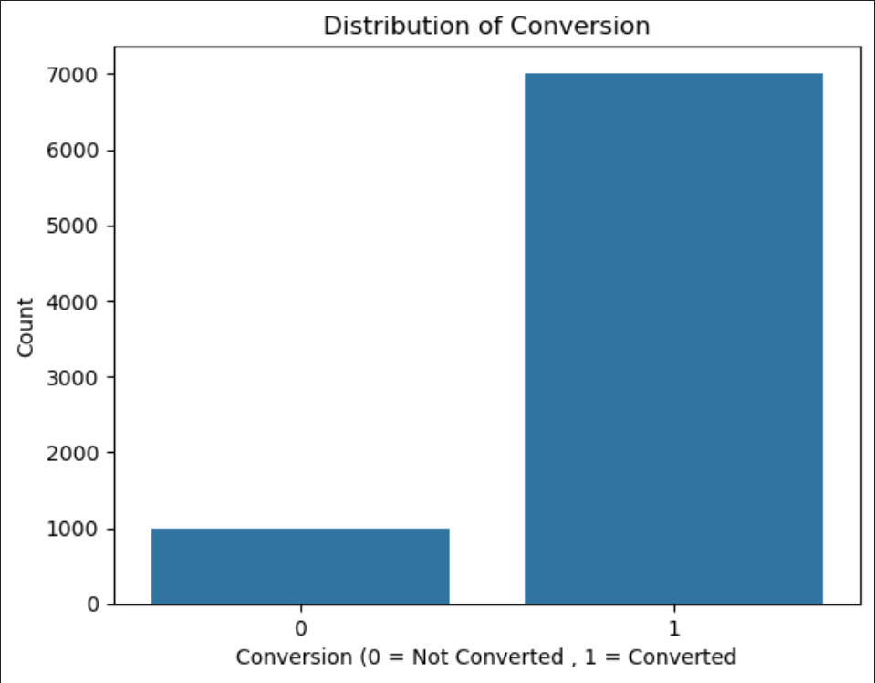
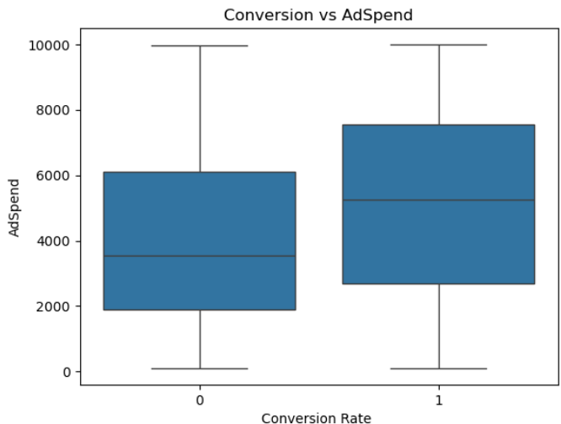
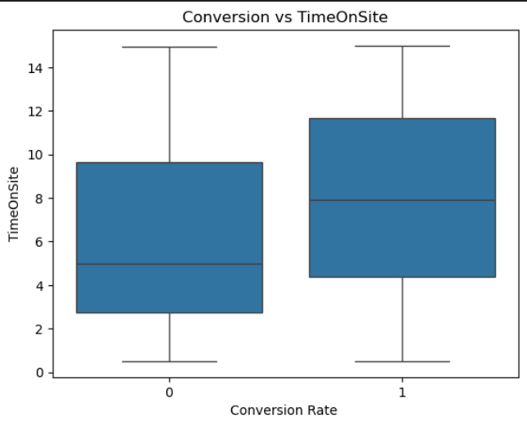
EDA
Box Plot
Box Plot
Count Plot

Slide 6
Feature Engineering
In this process we convert or drop different feature that have significant or not have significant impact on the Dependent feature.
Like we convert categorical Data type into numerical so that Algorithm can understand the data .
In this project we have Campaign Channel, Campaign Type and Gender as categorical Data type so we have to convert this to numerical using different encoding technique like One Hot Encoding.
Here is the code that convert this to numerical and drop the feature that not have significant impact on target variable.
Standardized numerical features using StandardScaler.
Outcome : Data is ready for model training.

Slide 7
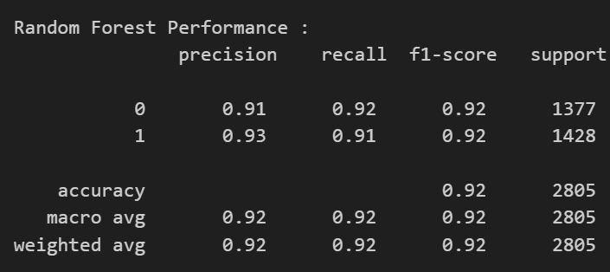
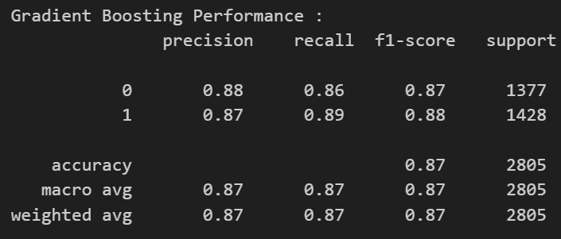
Model Selection
In this process we try different type of model or algorithm that give better result on the data and give good accuracy.
There are different type of algorithm, that perform better on categorical problem in this project I use Logistic Regression, Random Forest, Gradient Boosting and Decision Tree.
Performance Summary:
Random Forest performed the best in terms of accuracy & recall.
Gradient Boosting had competitive results.

Slide 8
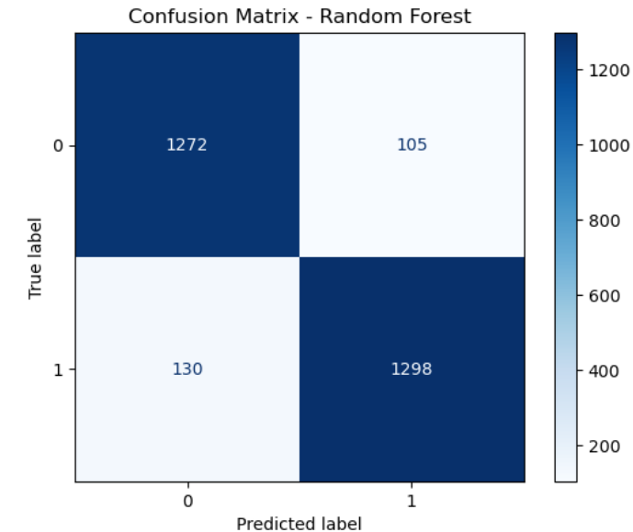
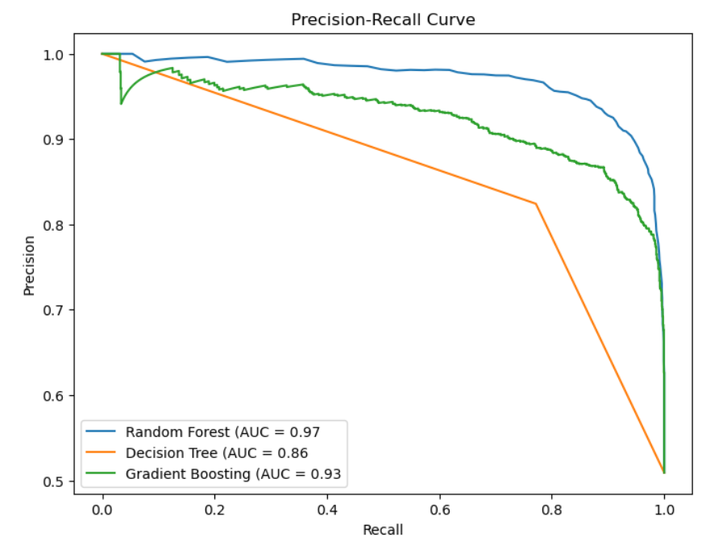
Model Evaluation
Metrics Used:
Accuracy, Precision, Recall, F1-Score
Precision-Recall Curve
Cross-validation scores
Confusion Matrix Analysis:
Model effectively predicts conversions but needs fine-tuning.

Slide 9
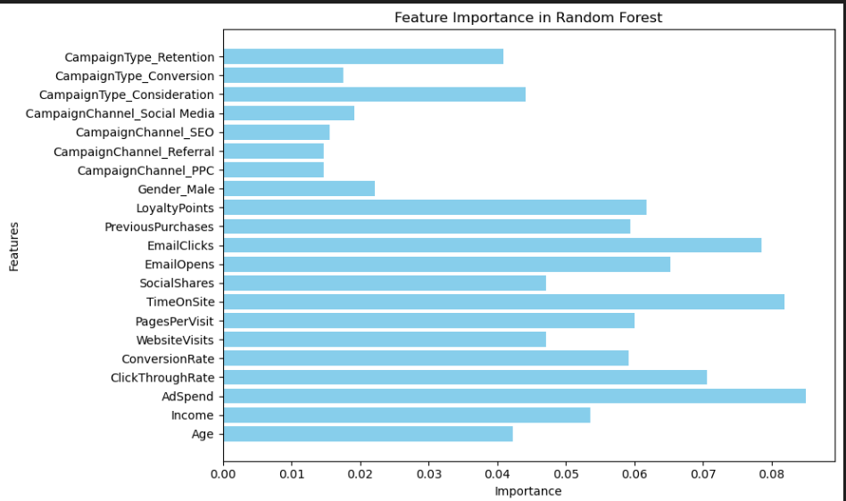
Feature Importance
Key Features Driving Conversion:
Ad Spend
Time On Site
Email Clicks
Visualization: Bar chart of feature importance from Random Forest model.

Slide 10
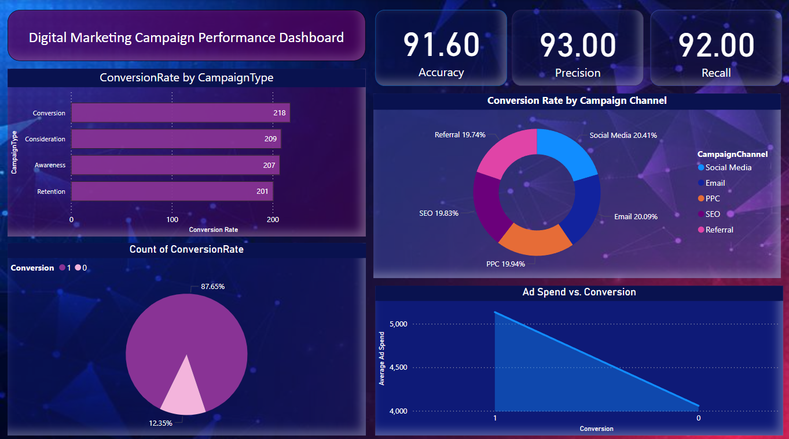
Power BI Dashboard Overview
Dashboard Components:
Key Metrics (Accuracy, Precision, Recall)
Conversion Rate by Campaign Type
Ad Spend vs. Conversion
Count of Conversion Rate
Conversion Rate by Campaign Channel
Purpose: Provides actionable insights for marketing teams.

Slide 11
Conclusion & Next Steps
Key Takeaways:
Ad Spend & Time On Site significantly impact conversions.
Random Forest outperformed other models.
Power BI dashboard helps in decision-making.
Future Improvements:
Hyperparameter tuning for better model performance.
Incorporate more customer behavioral data.
A/B testing to refine marketing strategies.

Slide 12
Thank You

