Slide 1

Credit Score Prediction
Submit By : Juned Ansari

Slide 2
Introduction
Objective: Predict credit scores based on customer financial attributes.
Importance: Helps financial institutions assess creditworthiness.
Approach: Data preprocessing, feature engineering, model training, evaluation.

Slide 3
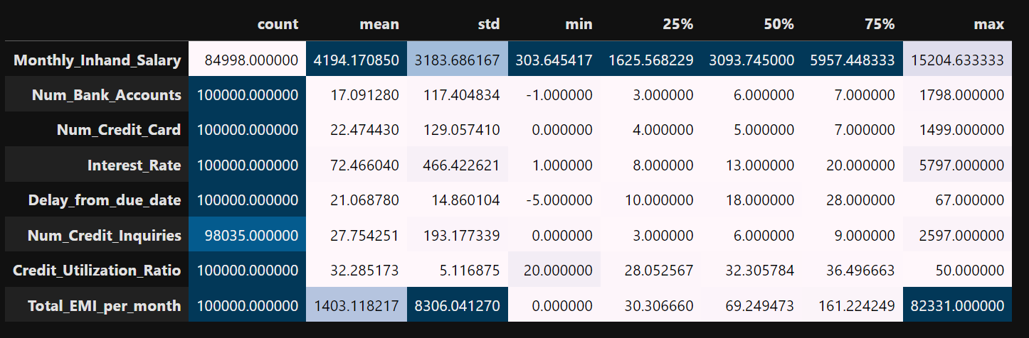
Dataset Overview
Dataset Source & Size: Includes 28 features related to customer financial attributes.
Key Features: Demographics, loan details, payment behavior.
Target Variable: Credit Score (categories: Poor, Standard, Good).

Slide 4
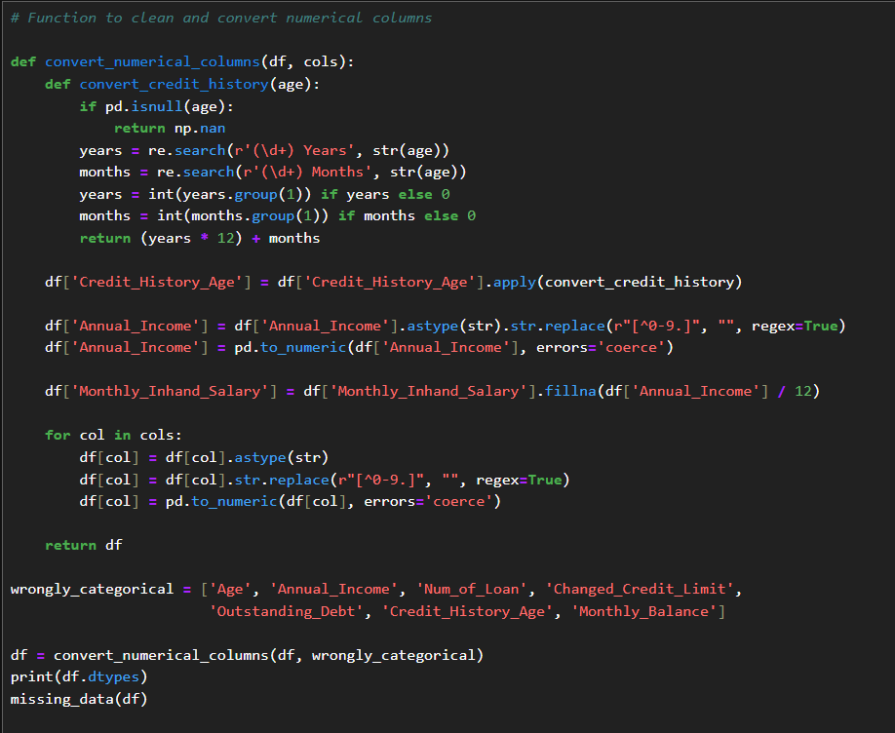
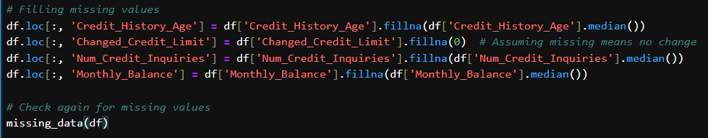
Data Preprocessing
Handling Missing Values: Used appropriate imputation methods.
Encoding Categorical Variables: Converted categorical features into numerical representations.
Normalization: Applied where necessary to standardize data.

Slide 5
Feature Selection
Method Used: Random Forest and XGBoost feature importance.
Selected Features:
Outstanding_Debt
Interest_Rate
Credit_Mix
Payment_of_Min_Amount
Num_Credit_Inquiries
Num_Credit_Card
Num_Bank_Accounts
Delay_from_due_date
Credit_History_Age
Num_of_Loan
Changed_Credit_Limit
Payment_Behaviour_Low_spent_Small_value_payments

Slide 6
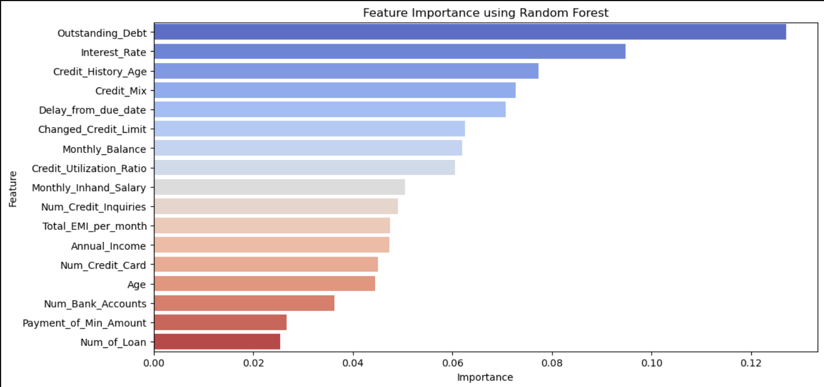

Slide 7
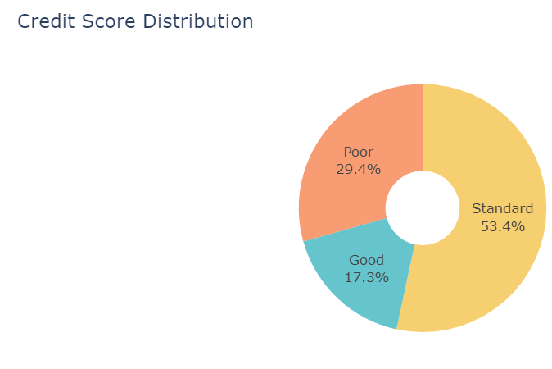
Data Visualization Model Selection
Exploratory Data Analysis (EDA):
Distribution of target variable (Credit Score categories).
Correlation heatmap.
Boxplots for key financial attributes.

Slide 8
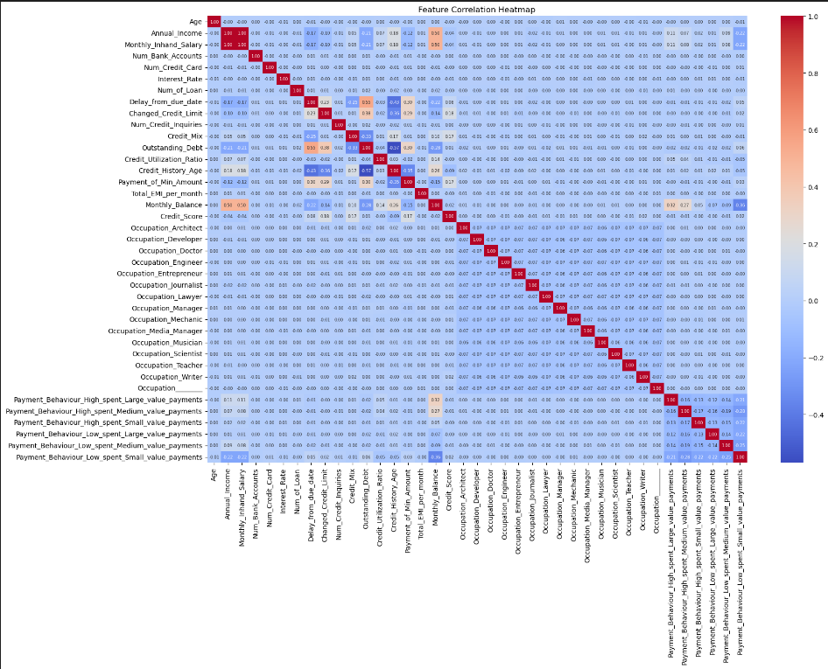
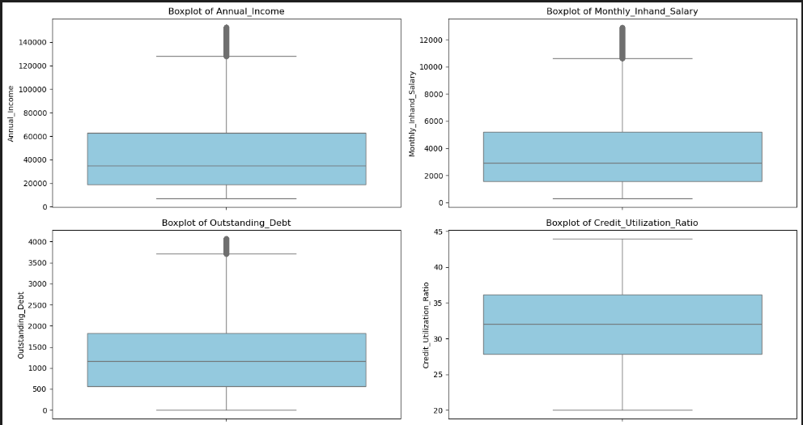
Correlation heatmap.
Boxplots for key financial attributes

Slide 9
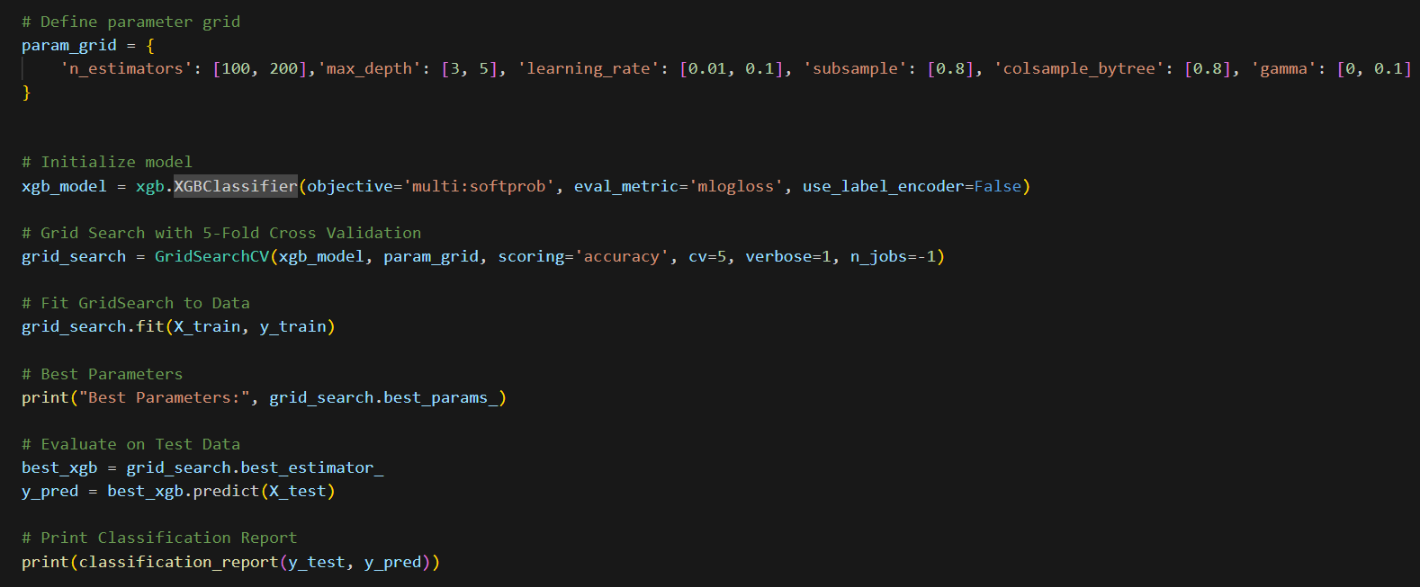
Model Selection
Models Compared:
Random Forest
XGBoost (Final Model)
Selection Criteria: Higher accuracy and generalization.
Hyperparameter Tuning: Optimized using GridSearchCV.

Slide 10
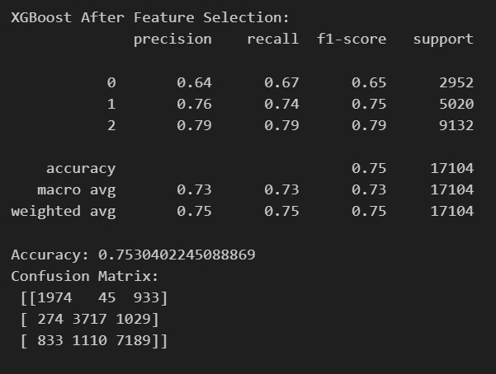
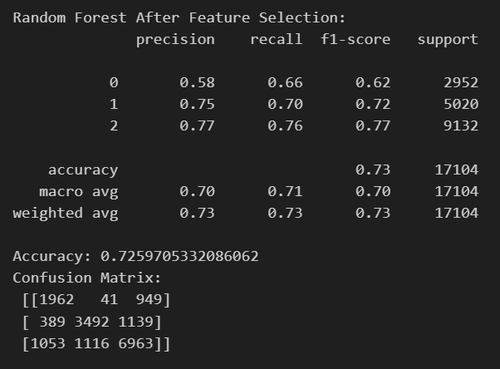
Model Evalution
Performance Metrics Used:
Accuracy
Precision, Recall, F1-Score
Confusion Matrix
Final Results:
XGBoost outperformed Random Forest with better accuracy and lower overfitting.

Slide 11
Conclusion Future Improvements
Summary: This project successfully classified credit scores using machine learning, leveraging key financial and behavioral attributes.
Findings:
XGBoost outperformed other models in accuracy and generalization.
The most influential features were Outstanding_Debt, Credit_Mix, and Payment_Behaviour.
Machine learning can effectively enhance credit scoring methodologies, improving decision-making for financial institutions.

Slide 12
Future Improvements
Incorporating more diverse financial data: Adding alternative credit data sources, such as rent payments and utility bills, to improve model predictions.
Enhancing model robustness: Experimenting with deep learning models and ensemble techniques for higher accuracy.
Deploying the model as a web application: Making the model accessible for real-time credit score predictiondapting the model to new financial trends and behaviors over time.

Slide 13
Thank You

