Slide 1
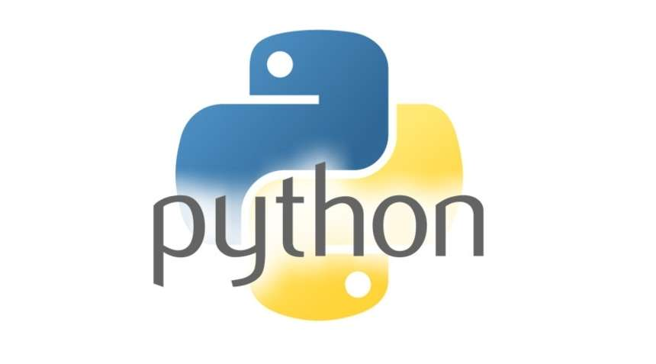
Introduction to Python
Python is a popular programming language used for software, web, and automation.

Slide 2
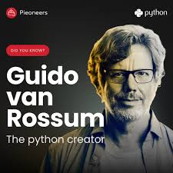
What is Python?
Python is a high-level programming language
(Easy for humans to read and understand)
Developed by Guido van Rossum
(Released in 1991)
Open-source and free
(Anyone can use and modify it)

Slide 3
Why Python?
Easy syntax , Simple English like syntax.
Easy to learn and read
Beginner friendly
Less code

Slide 4
Features of Python
Interpreted
- Python executes code line by line
Dynamically typed
- No need to declare variable types.
- Python decides the type at runtime.
Object-oriented
Platform Independent
- Python programs run on Windows, Linux, and macOS without modification.

Slide 5
Where Python is Used
Web Development (Django, Flask)
Data Science & Data Analysis (NumPy, Pandas, Matplotlib)
Artificial Intelligence & Machine Learning (TensorFlow, PyTorch, Scikit-learn)
Game Development (Pygame)
Desktop Applications (Tkinter, PyQt, Kivy)

Slide 6
Python vs Other Languages
Python has simple and readable syntax; others are more complex.
Python uses less code; others need more lines.
Python is easy for beginners; others have a steeper learning curve.
Python is interpreted; others are usually compiled.
Python has rich libraries; others have limited built-in support.

Slide 7
Python Installation
Download Python from www.python.org
Run the installer
Check “Add Python to PATH”
Click Install Now
Verify installation using python --version

Slide 8
Python Execution Modes
Interactive Mode
- Run Python commands one by one in the Python shell.
Script Mode
- Write code in a .py file and run it as a program.

Slide 9
First Python Program
print('Hello World’)
print() → displays output on the screen
“Hello World” → message to be shown

Slide 10
Variables in Python
Variables are containers for storing data values.
In Python, there is no special command to declare a variable.
A variable is created automatically when you first assign a value to it.
No need to declare the data type.
Value can change any time.

Slide 11
Python Data Types
int – integer number (….-3,-4,0,4,5,23…..)
float - decimal numbers (10.5, 3.14)
str - text values ("Python")
bool - True or False

Slide 12
Input and Output in Python
input() takes input from user (by default string)
  Var = input(“Enter your name”)
print() shows output
  print(Var)

Slide 13
Simple Example
a = 10
b = 20
print(a + b)

Slide 14
Advantages of Python
Easy to learn and read – beginner-friendly syntax
High-level language – handles complex tasks automatically
Cross-platform – works on Windows, Linux, macOS
Large libraries – ready-to-use modules for many tasks
Open-source – free to use and distribute
Versatile – used in web, AI, data science, automation, and more

Slide 15
Summary
Python is easy
Beginner friendly
Powerful language

