Slide 1
Marriage hall booking System
“Plan Your ‘Magical Moments’ with Us”

Slide 2
Team Member's
Registration No. | Name
2110030107 | Manjunadha
2110030137 | Junaid
2110030142 | Pawan
2110030143 | Rohith

Slide 3

Table of Contents
Problem statement
literature review
GitHub setup
Work allocation to team member
Data set collection
Tools setup

Slide 4
Problem statement
Create an application which allows the user to book a Marriage hall at particular date and location and it should allow the user to customize the halls as needed and it should provide a variety of payment options for booking the wedding halls.
The application must show the accurate wedding halls that are searched by the user.
The user can book any Marriage hall from anywhere and anytime in a simple way and can even get the detailed receipts of bills.

Slide 5
literature review
In this project our job is to design a Marriage Hall Booking Application so that anyone can book the halls in a easy and simple way.
In this topic, this literature review will discuss about the Marriage hall booking system. This literature review is a summary and explanation of the complete and current state of knowledge on limited topics as found in journal articles.
In the below slides we have mentioned some articles related to drawbacks of the Previous versions of marriage hall booking systems.

Slide 6
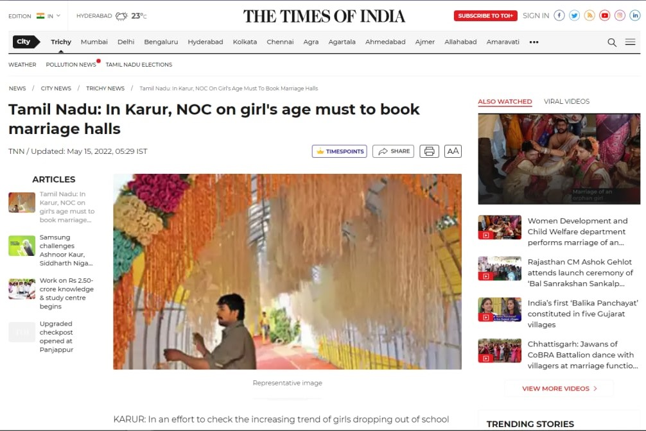

Draw Backs of Existing solutions:

Slide 7
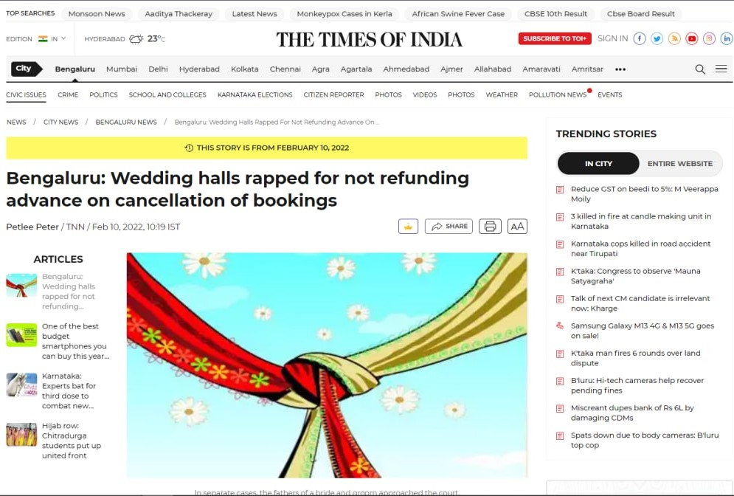

Slide 8
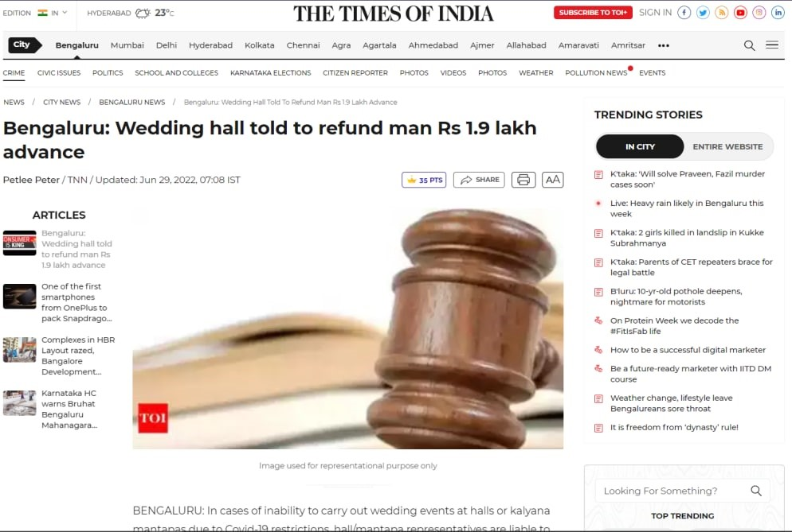

Slide 9
What we want to do
Create a User-friendly Interface
Taking less amount for advance booking
Refunding at higher rates as compared to other websites.
Taking age of bride and groom (age-restriction according to Govt. rule)
Sending Alerts to the user.
Entire Marriage is taken care by our management.
Preventing unverified users/Fake users for safe and secure booking.
Secure database servers to prevent data breaches.
Local marriage halls are also considered.

Slide 10
What do you know about the solution of it using proposed design method
Our system consists of four modules
User Module
In this module, the user search the information of Hall in specific area.
User can also check the details of Hall
User can check the booked date of Hall in calendar
Owner Module
In this module Owner can update their profile and also see the booking enquiries in their own login account.
Owner updates the booking details of Hall.

Slide 11
Registration Module
In this module user can register his function hall by filling the registration form.
After registration the owner can upload photos , address, details and so on
Booking Module
In this module User can book the Hall.
When user is satisfied with the details of Hall if he/she want to book the Hall then user can click on “Book Now” button and fill the form of booking and submit the form click on “Submit” button then user get conformation message for submitting the data

Slide 12
EVERYTHING ABOUT WEBSITE
We used HTML,CSS,JavaScript, Bootstrap to design the Frontend of the website.
It has a user friendly interface can be understood easily.
For the backend of the website we are using SQL(To store the data) & PHP(XAMPP) for the connection between HTML and Database.
We use secure databases to avoid data breaches and to provide secure access to the user.
We also check the data stored in our database and remove the users with fake names and mail-id.

Slide 13
WEBSITE WORKING PROCEDURE
First a Homepage is displayed to the user.
Then a Sign-In /Sign-Up is shown on Navigation Bar of the page displayed to the user.
If the user has a account(previously) he can enter his credentials in sign In page. Our servers will check whether the user has any account previously if not the user has to sign up/register.
Marriage Function hall is to be chosen by the user. On clicking Book
Date and Time has to be chosen by the user on submitting. A message is shown to the user about their booking of the marriage hall
After storing their details in the server user can simply logout from the site.
The details can be accessed by the user who has valid Email and Password.

Slide 14
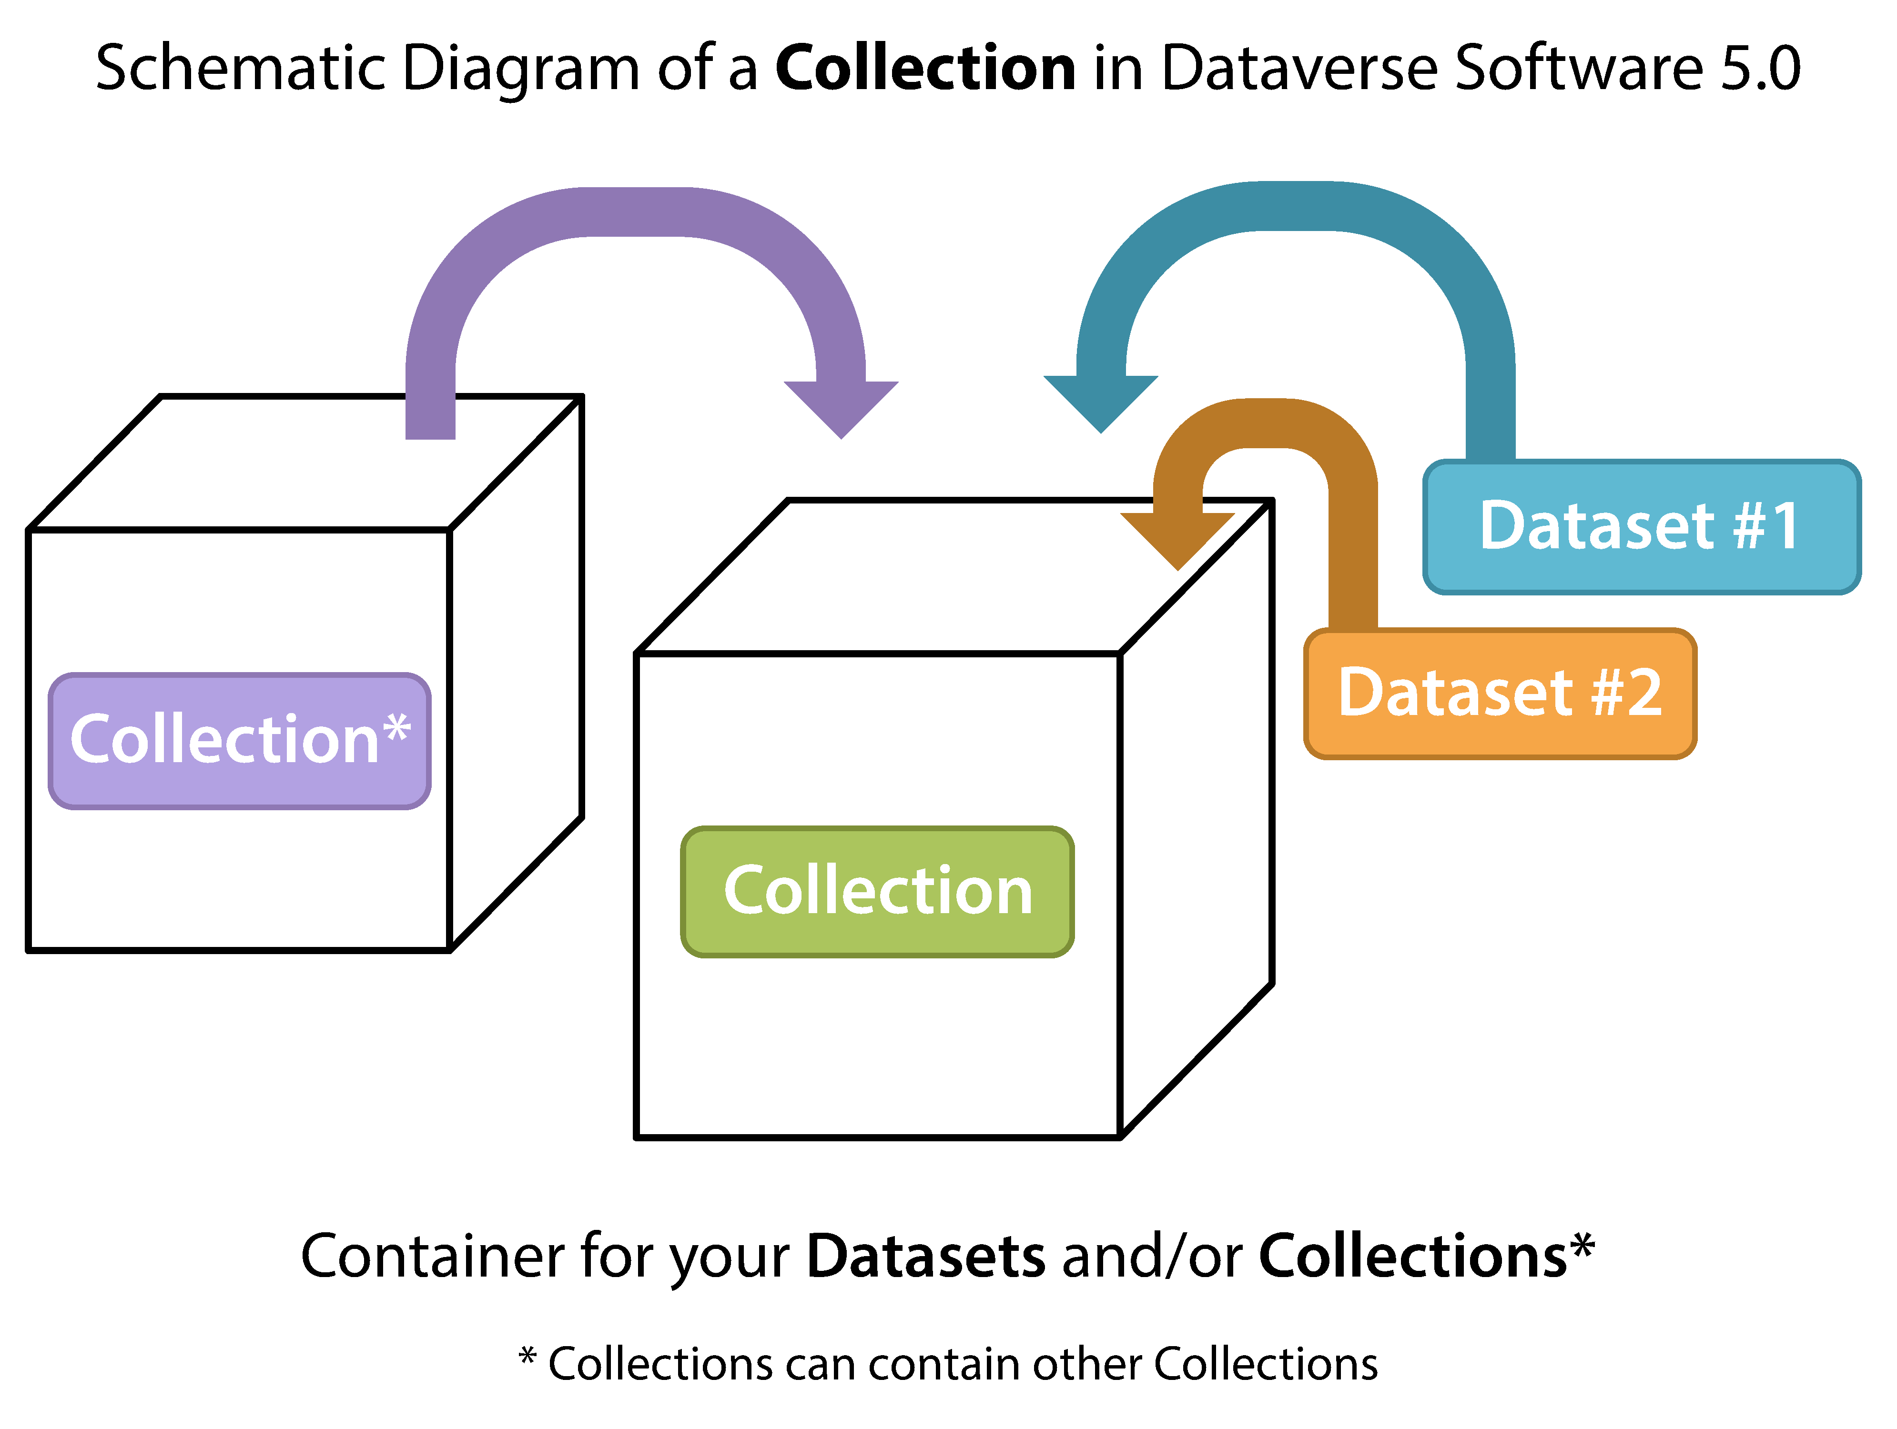
Data set collection
A data set is a collection of numbers or values that relate to a particular subject. Items of related data are
User Credentials -(Username, Password);
User Details-(Name ,Age ,Gender, Mobile Number ,Mail ID)
Owner Credentials-(Username ,Password)
Venue(Hall Name ,Hall capacity ,Hall type (A/c or Non A/c),Location , Contact Details)
Booking Details(Booking ID , Booking Date and time, Payment Receipts)
How does a data set works
An sample example

Slide 15




Tools setup
We will be using different software's to achieve the desired outcome
VS Code – For Execution of the Code
MySQL -For creating and maintaining database
Star UML -For UML Diagrams
Terra ER – For ER Diagrams
XAMPP – For PHP Connection between HTML and Database

Slide 16
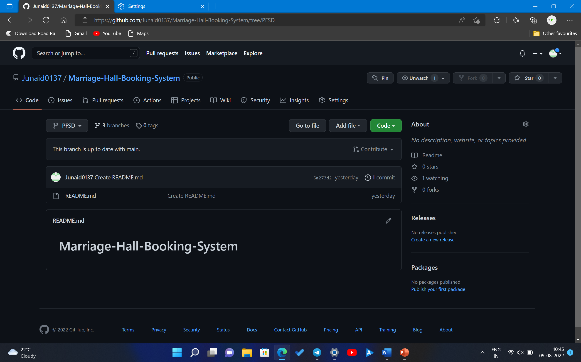

GitHub setup
Screenshot of our Repository
The below mentioned link is the path to the project repository where you can access the source code and more information about our project.
LINK : Junaid0137/Marriage-Hall-Booking-System at PFSD (github.com)

Slide 17
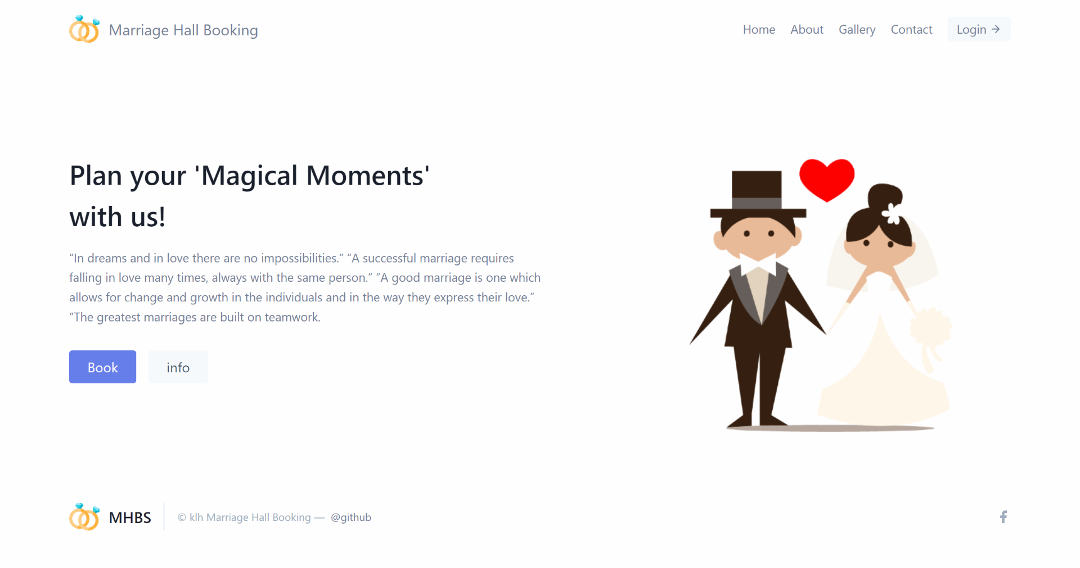
Images of the website

Slide 18
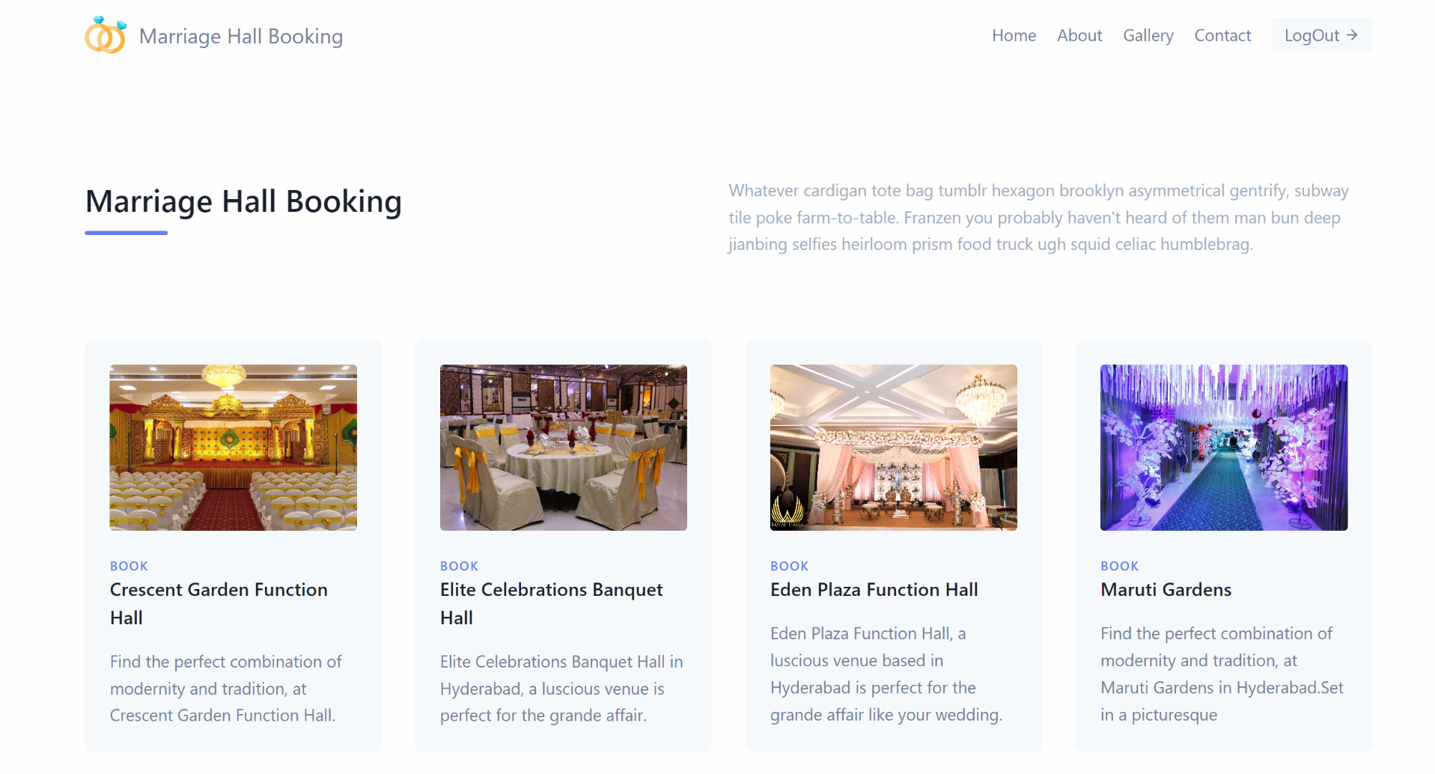
Images of the website

Slide 19
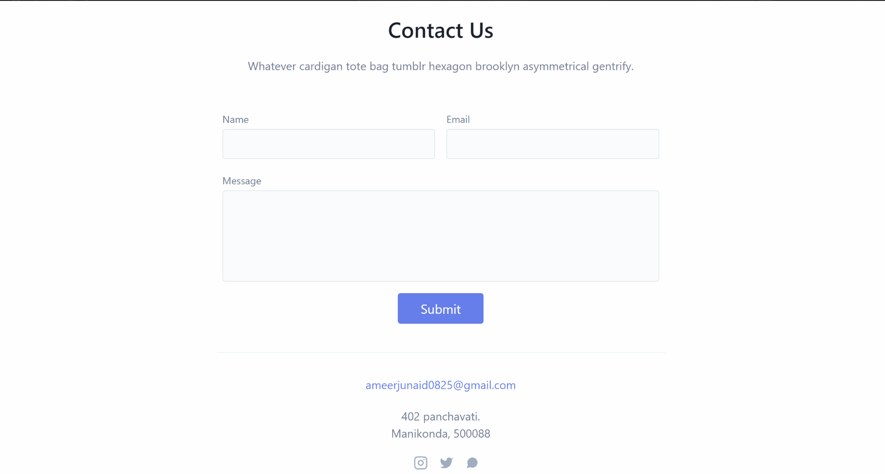
Images of the website

Slide 20
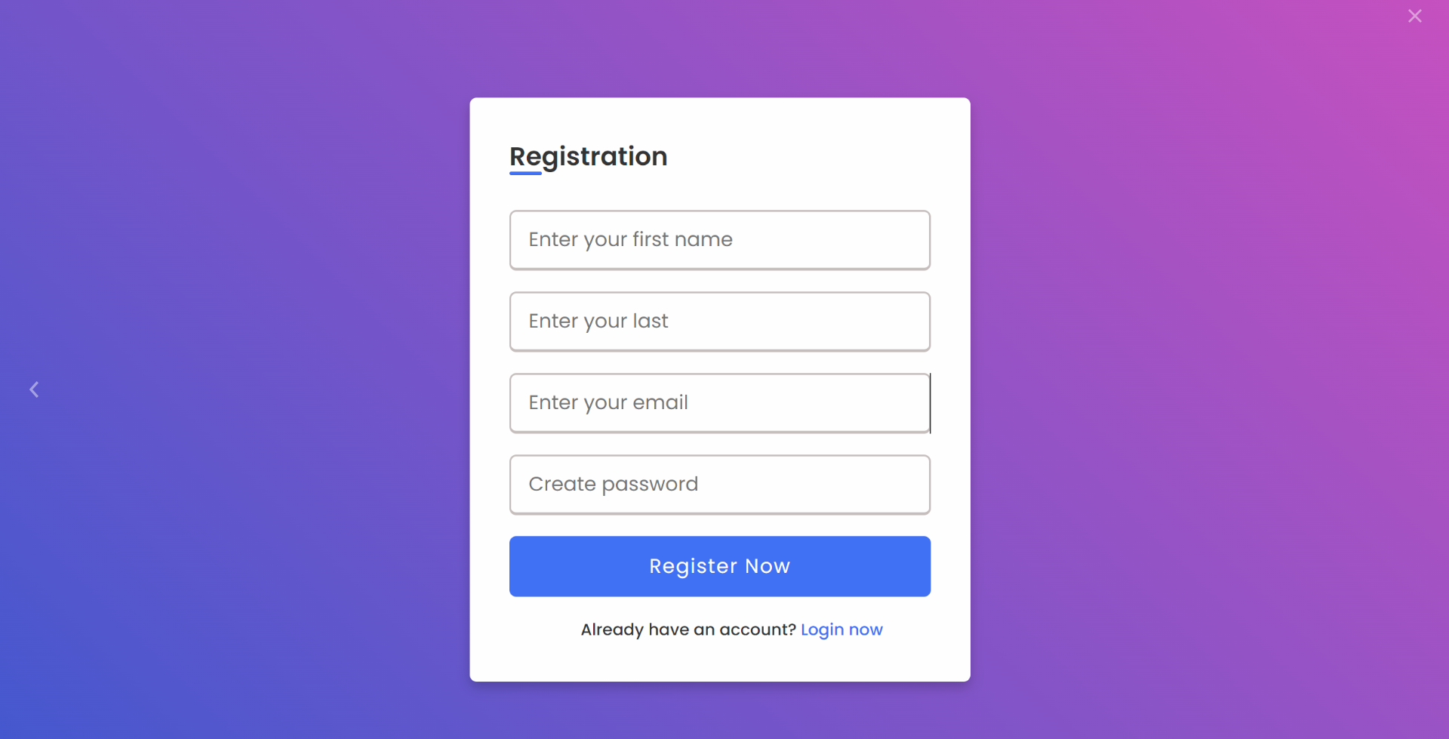
Images of the website

Slide 21
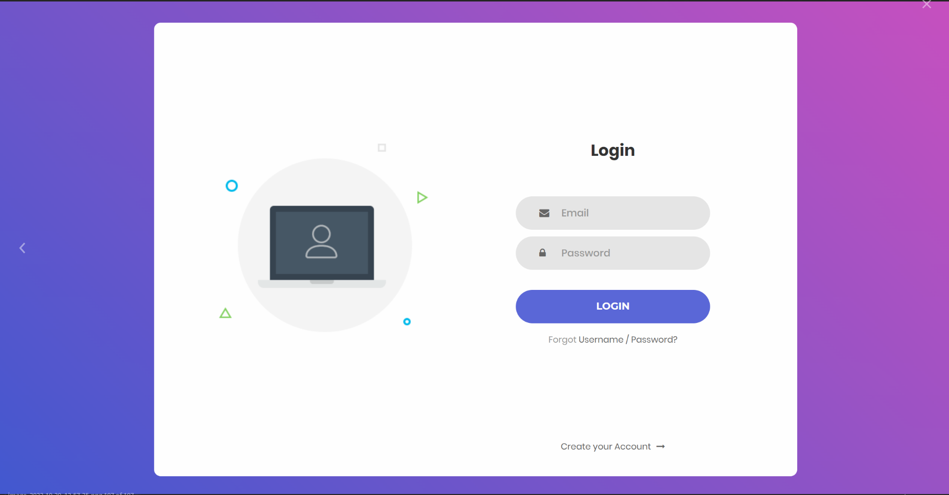
Images of the website

Slide 22
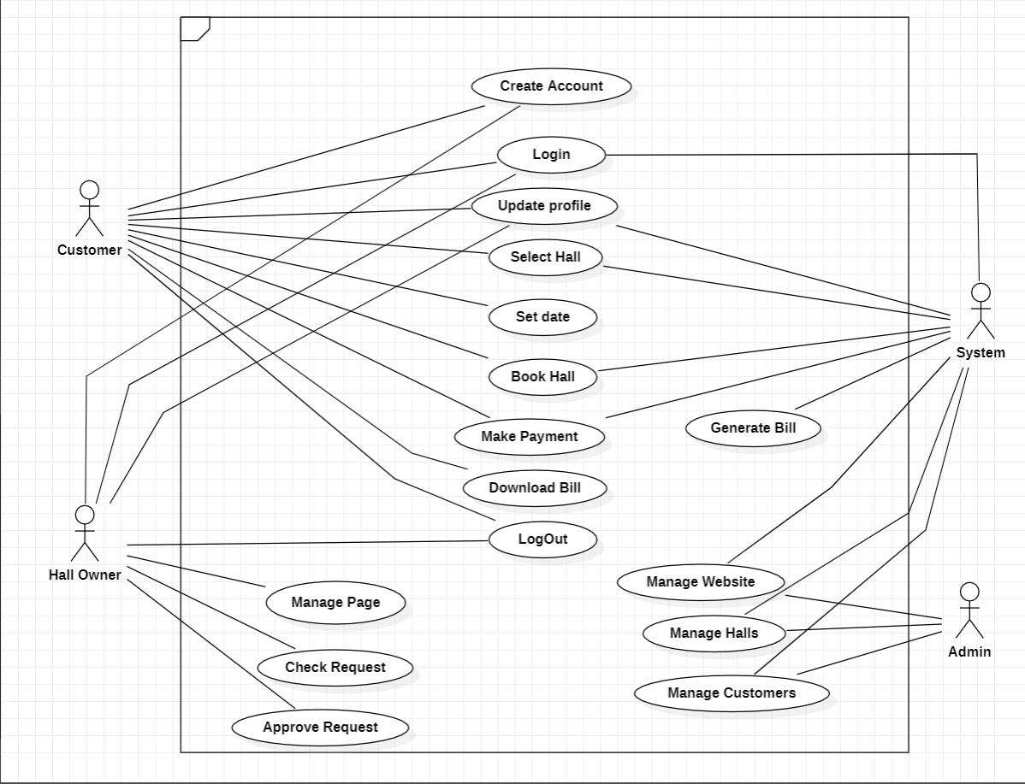
Use case diagram

Slide 23
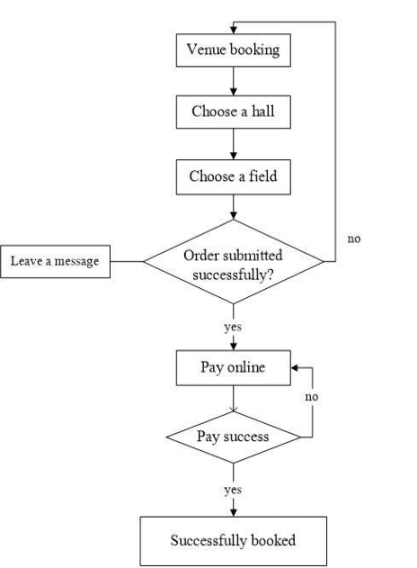
Flow Chart

Slide 24
Thank you

