Slide 1
Marriage Hall Booking
Plan Your Magical Moments with Us!

Slide 2
Team members
Sri Sai Pawan (2110030142)
T Rohith Sai Teja (2110030143)
​Mallena Manjunadha (2110030107)
Syed Ameer Junaid (2110030137)

Slide 3
Table of content
Data Set Collection
Tools Setup
Implementation
Flow Chart
GitHub Commits
Work Progress

Slide 4
Problem statement
Create an application which allows the user to book a Marriage hall at particular date and location and it should allow the user to customize the halls as needed and it should provide a variety of payment options for booking the wedding halls.
The application must show the accurate wedding halls that are searched by the user.
The user can book any Marriage hall from anywhere and anytime in a simple way and can even get the detailed receipts of bills.

Slide 5
Data set collection
A data set is a collection of related, discrete items of related data that may be accessed individually or in combination or managed as a whole entity.
The Data Set’s used for the project are mentioned in the below slide

Slide 6
Data set collection
User Credentials
User details
Owner credentials
venue
Booking details
User Name
password
Name
Age
Gender
Mobile Number
Mail ID
User Name
Password
Hall Name
Hall Capacity
Hall Type
Location
Contact Details
Booking ID
Booking Date, Time
Payment Receipts

Slide 7



tools
VS CODE
MY SQl
STAR UML
Used for writing HTML, CSS and JavaScript
Used for storing data into the database
Used for designing ‘USE CASE’ , ‘UML’ DIAGRAMS
And for sketching the flow chart

Slide 8
Our system consists of four modules
User Module
In this module, the user search the information of Hall in specific area.
User can also check the details of Hall
User can check the booked date of Hall in calendar
Owner Module
In this module Owner can update their profile and also see the booking enquiries in their own login account.
Owner updates the booking details of Hall.

Slide 9
Registration Module
In this module user can register his function hall by filling the registration form.
After registration the owner can upload photos , address, details and so on
Booking Module
In this module User can book the Hall.
When user is satisfied with the details of Hall if he/she want to book the Hall then user can click on “Book Now” button and fill the form of booking and submit the form click on “Submit” button then user get conformation message for submitting the data

Slide 10
Implementation

Slide 11
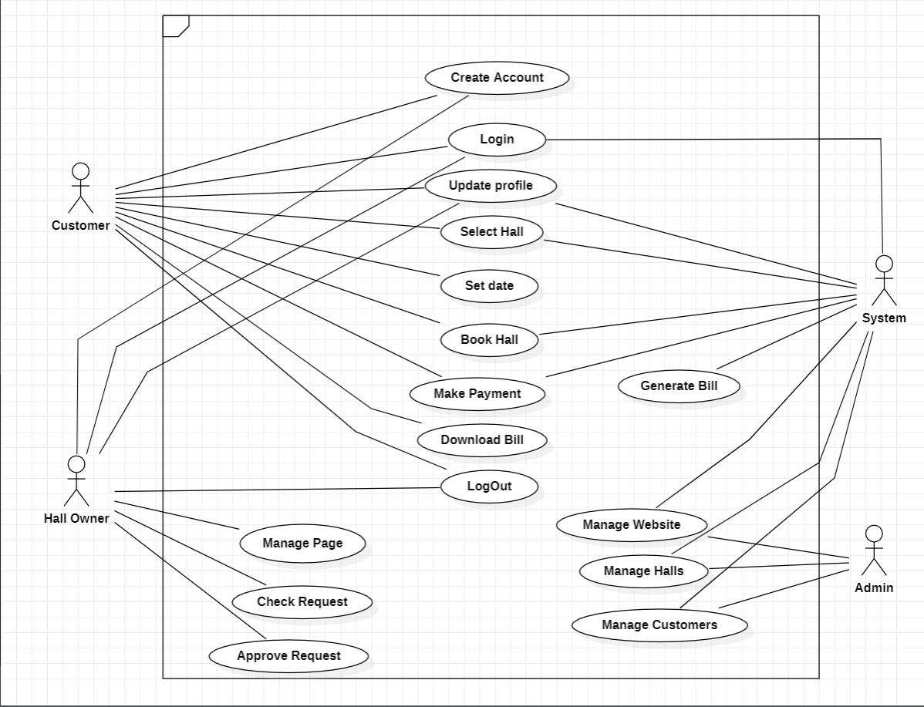
Use case diagram

Slide 12
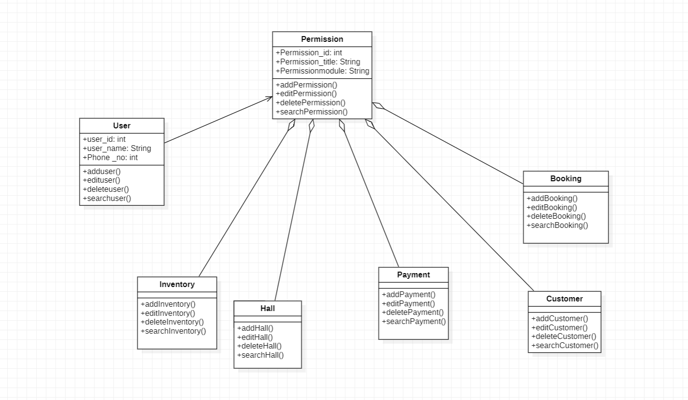
Class diagram

Slide 13
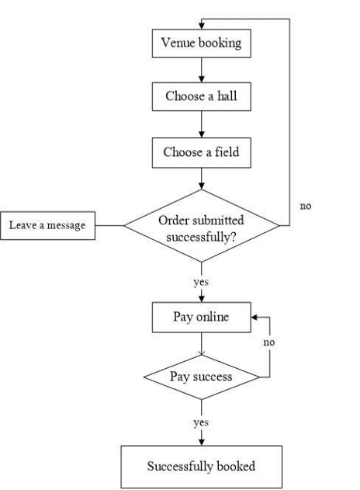
Flow chart

Slide 14
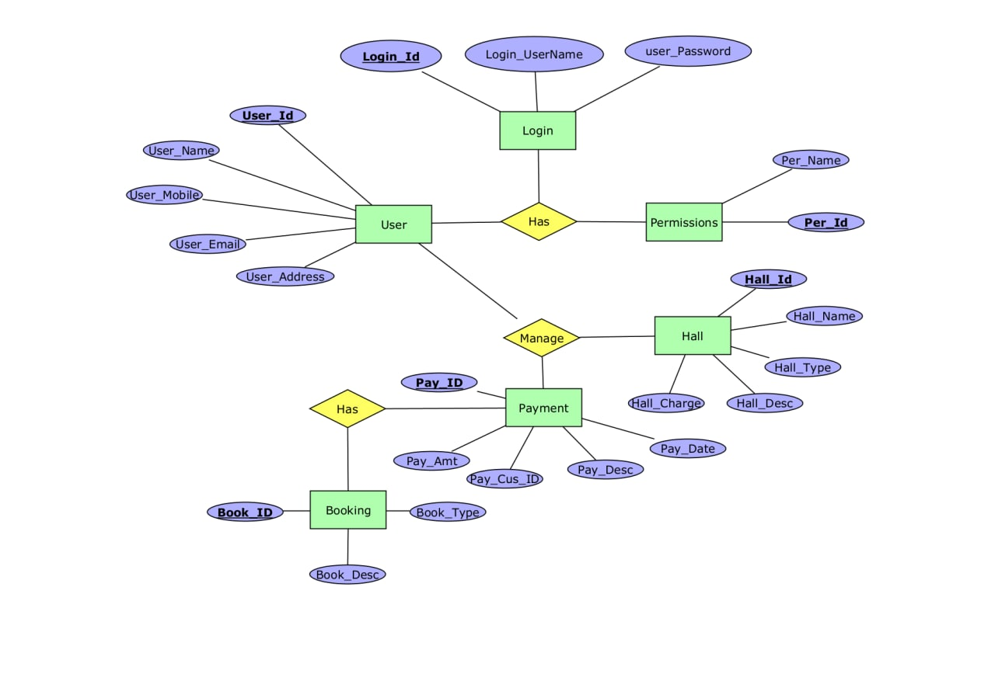
Er diagram

Slide 15
Work progress
Whereas, need to gain more knowledge about backend and frontend development
Coding related part will be soon started after all the required resources are acquired

Slide 16
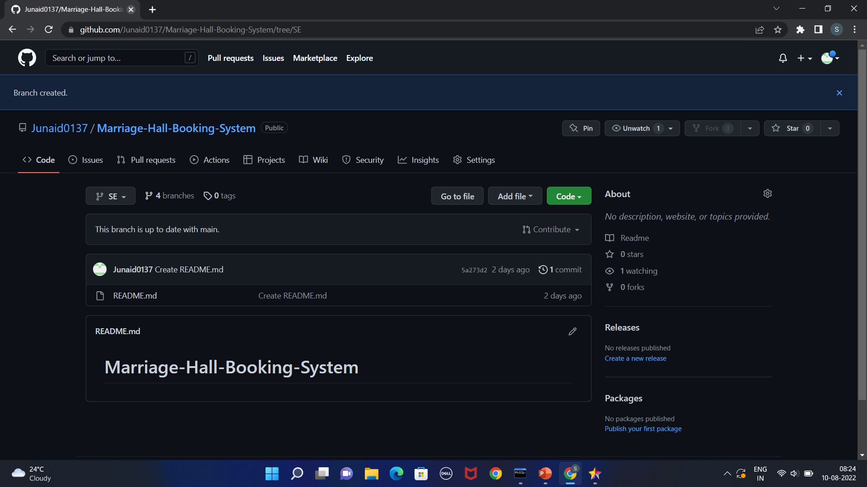

GitHub setup
LINK : Junaid0137/Marriage-Hall-Booking-System (github.com)

Slide 17
THANK YOU

