Slide 1



Machine Learning LAB
Week 7

Slide 2
Lab Agenda
Activity 1: K fold cross validation
Confusion Matrix
ROC Curve

Slide 3
Learning Evaluation

Slide 4

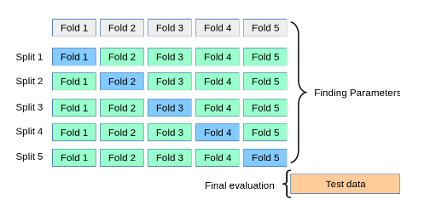
K-Fold Cross Validation Process

Slide 5
K-Fold Cross Validation Process
from sklearn.model_selection import (
KFold,
StratifiedKFold,
RepeatedKFold,
RepeatedStratifiedKFold
)
# 1. Normal K-Fold
kf = KFold(n_splits=5, shuffle=True, random_state=42)
# 2. Stratified K-Fold
skf = StratifiedKFold(n_splits=5, shuffle=True, random_state=42)
# 3. Repeated K-Fold
rkf = RepeatedKFold(n_splits=5, n_repeats=3, random_state=42)
# 4. Repeated Stratified K-Fold
rskf = RepeatedStratifiedKFold(n_splits=5, n_repeats=3, random_state=42)

Slide 6



Loss Function (Confusion Matrix)
Confusion Matrix for Binary Classification:
 | Actual
Predicted |  | Positive | Negative
 | Positive | True Positive (TP) | False Positive (FP): Error I
 | Negative | False Negative (FN) Error II | True Negative (TN)
Accuracy Measures:
Precision : The model predicted data points belong to Class A , how many were actually belong to class A.
Recall: Of all the data points that belong to class A how many were detected by Model.
Accuracy: All correct predictions (both positive and negative) out of all predictions.
 | Actual
Predicted |  | Spam | No Spam
 | Spam | 12 | 3
 | No Spam | 2 | 11

Slide 7
K-Fold Cross Validation
# Import required libraries
import pandas as pd
import numpy as np
import matplotlib.pyplot as plt
from sklearn.model_selection import KFold, cross_val_score, cross_val_predict
from sklearn.ensemble import RandomForestClassifier
from sklearn.preprocessing import LabelEncoder
from sklearn.metrics import confusion_matrix, roc_curve, roc_auc_score, classification_report
Step 1: Load and prepare the data
df = pd.read_csv("/content/titanic.csv")[['Survived', 'Pclass', 'Gender', 'Age', 'SibSp', 'Parch', 'Fare']].dropna()
# Convert 'Gender' to numeric (male=1, female=0)
df['Gender'] = LabelEncoder().fit_transform(df['Gender'])

Slide 8
# Split features and target
X = df.drop('Survived', axis=1)
y = df['Survived']
# Step 2: Define model and K-Fold
kf = KFold(n_splits=5, shuffle=True, random_state=42)
model = RandomForestClassifier(random_state=42)
# Step 3: Cross-validation for accuracy
scores = cross_val_score(model, X, y, cv=kf, scoring='accuracy')
print("Cross-Validation Accuracies:", scores)
print("Average Accuracy:", scores.mean())
# Step 4: Generate predictions using cross-validation
y_pred = cross_val_predict(model, X, y, cv=kf)
y_prob = cross_val_predict(model, X, y, cv=kf, method='predict_proba')[:, 1]

Slide 9
# Step 5: Evaluate model performance
print("\nConfusion Matrix:\n", confusion_matrix(y, y_pred))
print("\nClassification Report:\n", classification_report(y, y_pred))
print("ROC AUC Score:", roc_auc_score(y, y_prob))
# Step 6: Plot the ROC Curve
fpr, tpr, _ = roc_curve(y, y_prob)
plt.plot(fpr, tpr, label=f"AUC = {roc_auc_score(y, y_prob):.2f}")
plt.plot([0, 1], [0, 1], 'r--') # Random guess line
plt.xlabel("False Positive Rate")
plt.ylabel("True Positive Rate")
plt.title("ROC Curve")
plt.legend()
plt.show()

Slide 10
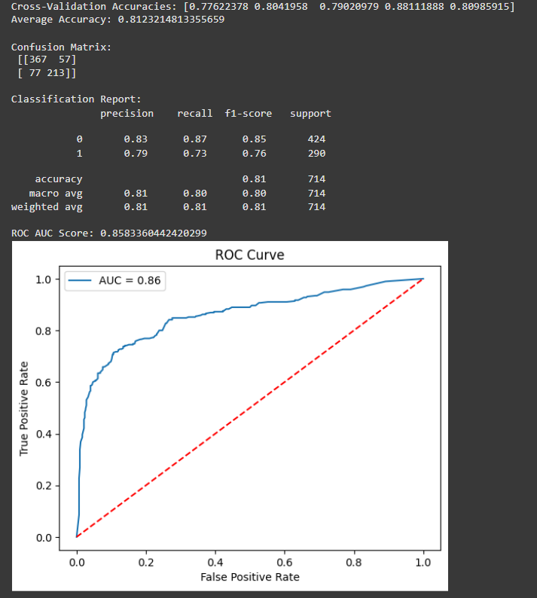

Slide 11
Activity 2
Perform same activity on the iris data set.
Show Confusion Matrix
Show Precision and Recall Score
Show ROC Curve and AUC Score

