Slide 1



Machine Learning LAB
Week 05

Slide 2
K-Means Clustering
1 - Imports
2 - Loading the data
3 - Exploratory Analysis
4 - Preprocessing the data
5 - Trainin K-Means Clustering to Find Clusters
6 - Evaluating K-Means Clustering

Slide 3
IMPORTS AND DATA LOADING
import pandas as pd
from sklearn.preprocessing import LabelEncoder
from sklearn.cluster import KMeans
from sklearn.decomposition import PCA
import matplotlib.pyplot as plt
# Step 1: Load the dataset
data = pd.read_csv("/content/mushroomss.csv")
# Display first few rows
print("Dataset Preview:")
print(data.head())
# Step 2: Check for missing values
print("\nMissing Values in Each Column:")
print(data.isnull().sum())

Slide 4
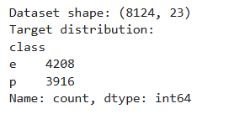
EXPLORATORY DATA ANALYSIS
print(f"Dataset shape: {mushroom_data.shape}")
print(f"Target
distribution:\n{mushroom_data['class'].value_counts()}")

Slide 5
EXPLORATORY DATA ANALYSIS
plt.figure(figsize=(15, 10))
plt.subplot(2, 3, 1)
sns.countplot(data=mushroom_data, x='class')
plt.title('Target Distribution')
plt.subplot(2, 3, 2)
sns.countplot(data=mushroom_data, x='cap-shape', hue='class')
plt.title('Cap Shape vs Class’)
plt.subplot(2, 3, 3)
sns.countplot(data=mushroom_data, x='cap-color', hue='class')
plt.title('Cap Color vs Class')

Slide 6
EXPLORATORY DATA ANALYSIS
plt.subplot(2, 3, 4)
sns.countplot(data=mushroom_data, x='population’)
plt.title('Population Distribution')
plt.subplot(2, 3, 5)
sns.countplot(data=mushroom_data, x='habitat’)
plt.title('Habitat Distribution')
plt.subplot(2, 3, 6)
sns.countplot(data=mushroom_data, x='odor', hue='class’)
plt.title('Odor vs Class')
plt.tight_layout()
plt.show()

Slide 7
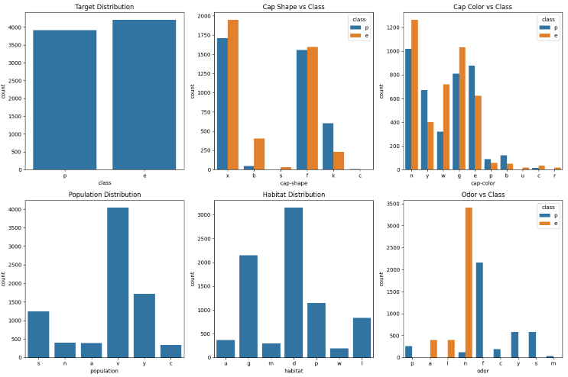
EXPLORATORY DATA ANALYSIS

Slide 8
DATA PREPROCESSING
# Handle missing values
mushroom_df = mushroom_data.dropna()
# Separate features and target
mushroom_features = mushroom_df.drop('class', axis=1)
mushroom_labels = mushroom_df['class']
# Encode categorical features
encoder = OrdinalEncoder()
mushroom_prepared =
encoder.fit_transform(mushroom_features)
mushroom_prep_df = pd.DataFrame(mushroom_prepared,
columns=mushroom_features.columns)

Slide 9
MODEL IMPLEMENTATION
KMEANS CLUSTERING
# Create and fit KMeans model
k_clust = KMeans(n_clusters=2, random_state=42)
k_clust.fit(mushroom_prep_df)
# Get results
k_labels = k_clust.labels_

Slide 10
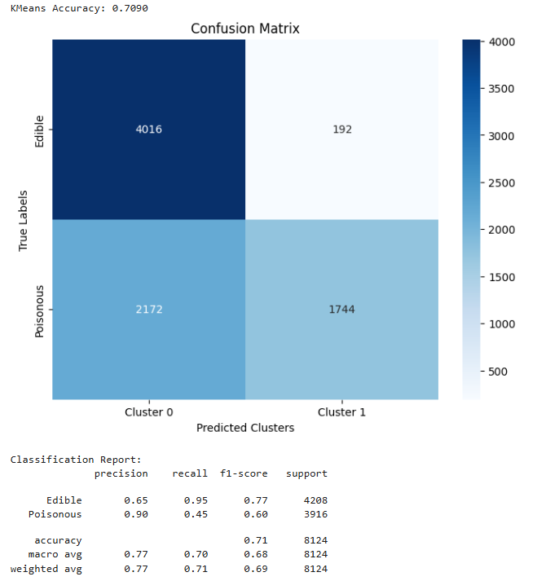
MODEL EVALUATION
# Map true labels to numerical values
map_dict = {'e': 0, 'p': 1}
true_labels = mushroom_labels.map(map_dict)
# Calculate accuracy
accuracy = accuracy_score(true_labels, k_labels)
print(f"KMeans Accuracy: {accuracy:.4f}")

Slide 11
Preprocessing Pipeline
Confusion matrix
plt.figure(figsize=(8, 6))
cm = confusion_matrix(true_labels, k_labels)
sns.heatmap(cm, annot=True, fmt='d', cmap='Blues’,
xticklabels=['Cluster 0', 'Cluster 1’],
yticklabels=['Edible', 'Poisonous’])
plt.title('Confusion Matrix')
plt.xlabel('Predicted Clusters')
plt.ylabel('True Labels')
plt.show()
# Classification report
print("\nClassification Report:")
print(classification_report(true_labels, k_labels, target_names=['Edible', 'Poisonous']))

Slide 12
UNSUPERVISED LEARNING
import pandas as pd
from sklearn.preprocessing import LabelEncoder
from sklearn.cluster import KMeans
from sklearn.decomposition import PCA
import matplotlib.pyplot as plt
# Step 1: Load the dataset
data = pd.read_csv("/content/mushroomss.csv")
# Display first few rows
print("Dataset Preview:")
print(data.head())
# Step 2: Check for missing values
print("\nMissing Values in Each Column:")
print(data.isnull().sum())
# Step 3: Encode categorical features (if any)
label_encoders = {}
for column in data.columns:
if data[column].dtype == 'object':
le = LabelEncoder()
data[column] = le.fit_transform(data[column])
label_encoders[column] = le

Slide 13
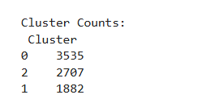
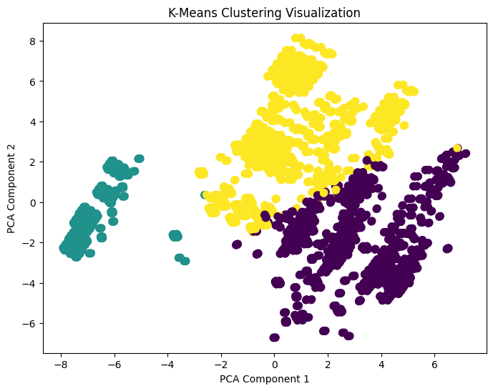
UNSUPERVISED LEARNING
# Step 4: Apply K-Means Clustering
kmeans = KMeans(n_clusters=3, random_state=42)
data['Cluster'] = kmeans.fit_predict(data)
# Step 5: Display cluster centers and counts
print("\nCluster Centers:\n", kmeans.cluster_centers_)
print("\nCluster Counts:\n", data['Cluster'].value_counts())
# Step 6: Visualize clusters using PCA (2D)
pca = PCA(n_components=2)
reduced_data = pca.fit_transform(data.drop('Cluster', axis=1))
plt.figure(figsize=(8,6))
plt.scatter(reduced_data[:,0], reduced_data[:,1], c=data['Cluster'], cmap='viridis', s=50)
plt.title('K-Means Clustering Visualization')
plt.xlabel('PCA Component 1')
plt.ylabel('PCA Component 2')
plt.show()

Slide 14
Activity
Dataset:
Mall_Customers
Tasks:
Load the dataset and display it.
Apply K Mean & DBSCAN Algorithm and plot clusters using Annual Income vs Spending Score.
Scale features using StandardScaler and re-run K-Means.
Compare both results did scaling change clusters?
Use the Elbow Method to find the best k.
Briefly interpret each cluster.
Also:
Add a fake feature "LuckyNumber" (random 0–100) and explain its effect on clustering.

