Slide 1



Machine Learning LAB
Week 01

Slide 2
Lab Contents
Loading the Dataset
Preprocess the Dataset
Data Visualization
Exploring the Dataset
Machine Learning Workflow

Slide 3
Python Machine Learning Steps
Python Machine Learning Workflow
Loading the Dataset (Consists of Input Features (X) and Class/Output (y)
Preprocess the Dataset
Analyze the Data Set
Apply Learning Scheme OR Algorithm
Generate Model and Predict
Evaluate the Model
Understanding Nature of Problem

Slide 4
Loading the Dataset
Many ways to Load Data in Python:
Load Data from Dataset module of Python
Save in Simple Arrays
Save in Dictionary OR Data frame in Pandas
Load data from File mostly in CSV format
Load data from Web source

Slide 5
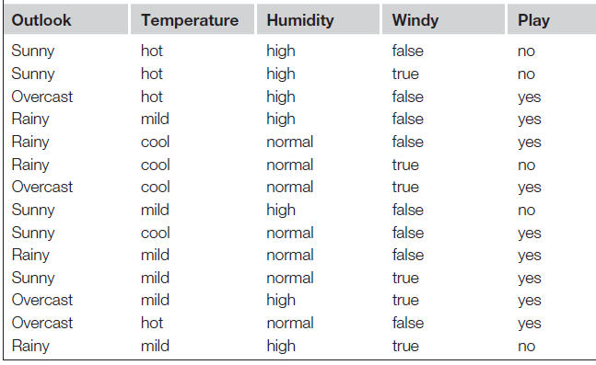
Example
(Weather Data)
Features
Instances/Examples
Input/X
Output/Y/Target
Type of Problem (R/C)

Slide 6
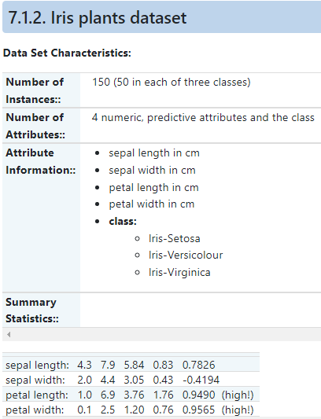
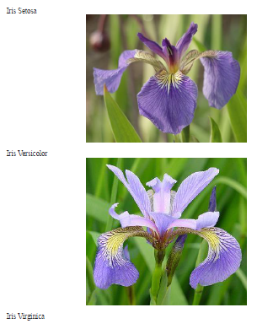
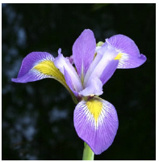

Slide 7
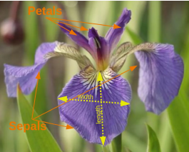
Iris Dataset

Slide 8
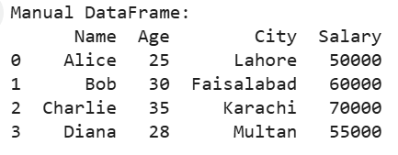
Loading the Dataset
1. Manual Data Creation

Slide 9
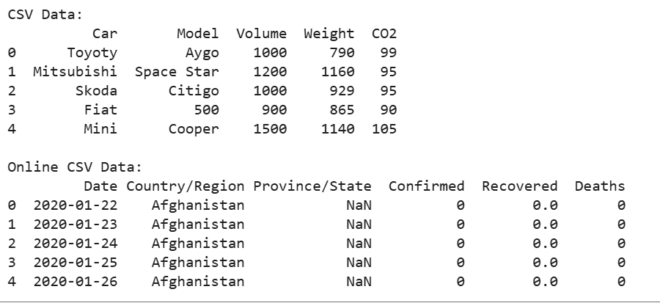
Loading the Dataset
2. Loading from CSV File

Slide 10
Loading the Dataset
Loading from JSON File

Slide 11
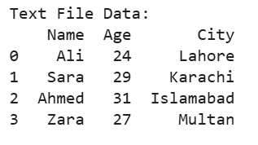
Loading the Dataset
Loading from Excel File
Loading from Text File

Slide 12
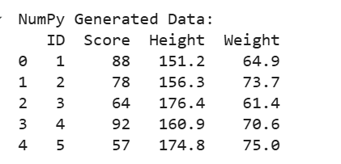
Loading the Dataset
Creating Sample Data with NumPy

Slide 13
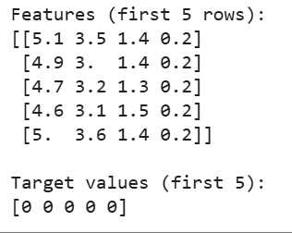
Loading the Dataset
Using Sklearn

Slide 14
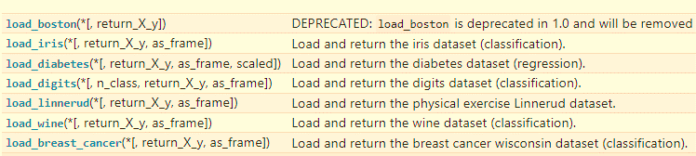
Loading the Dataset
Other data sets

Slide 15
Data Preprocessing
Two major tasks are:
Handling Missing Values
Handling Categorical Values
1. Handling Missing Values
Most ML algorithms cannot work with missing features.
Options for Missing Values:
Remove rows containing missing values.
Remove columns containing missing values.
Fill values with a replacement (e.g., 0, mean, median, mode).

Slide 16
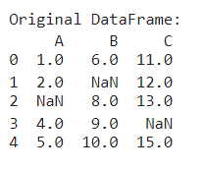
Data Preprocessing

Slide 17
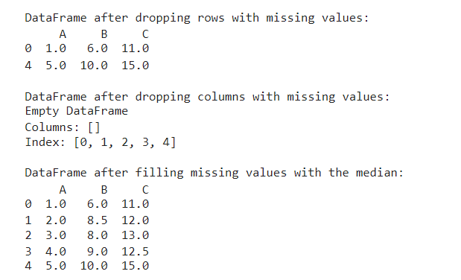
Data Preprocessing

Slide 18
Data Preprocessing
Handling Categorical Values
Most ML algorithms prefer numerical values, not text.
We need to convert categorical attributes into numbers.
Manual Mapping (custom conversion)
Label Encoding (convert labels into numbers)
One-Hot Encoding (create binary columns for each category)

Slide 19
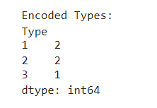
Data Preprocessing

Slide 20
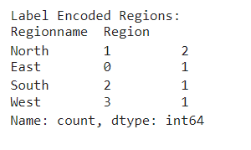
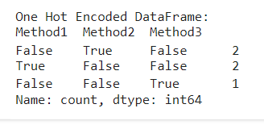
Data Preprocessing

Slide 21
Data Visualization

Slide 22
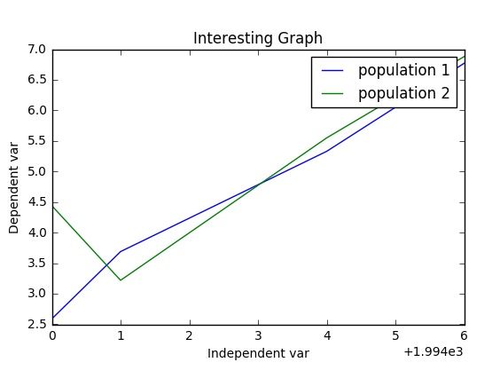
Data Visualization

Slide 23
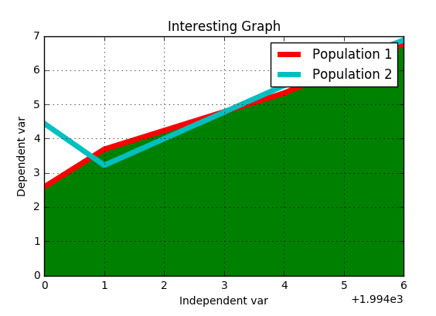
Data Visualization

Slide 24
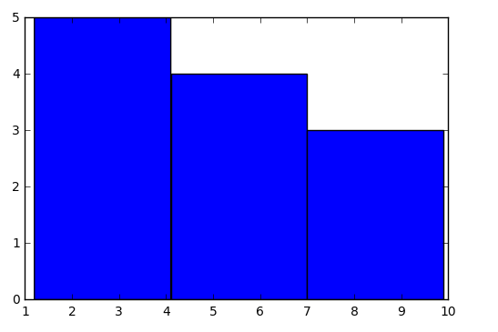
Data Visualization

Slide 25
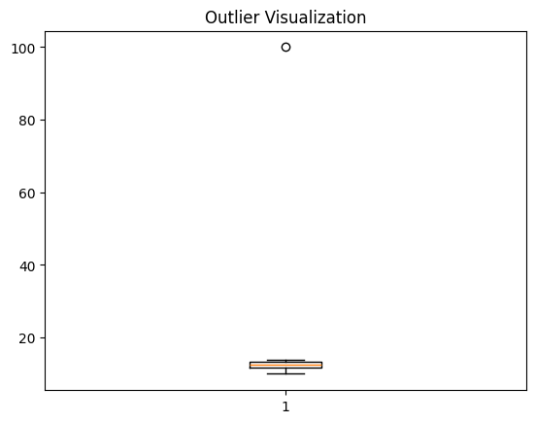
Data Visualization

Slide 26
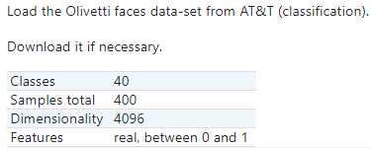
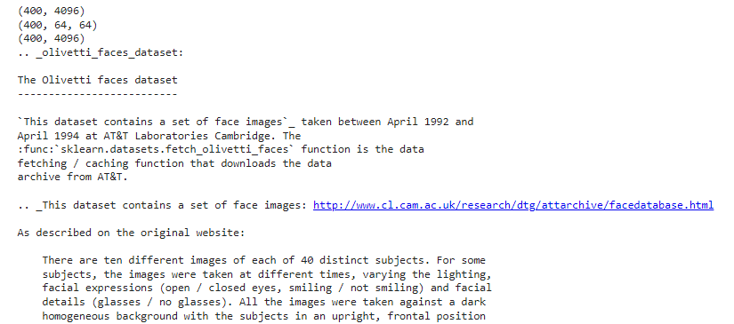
Exploring Data Set

Slide 27
Exploring Data Set

Slide 28
Exploring Data Set

Slide 29
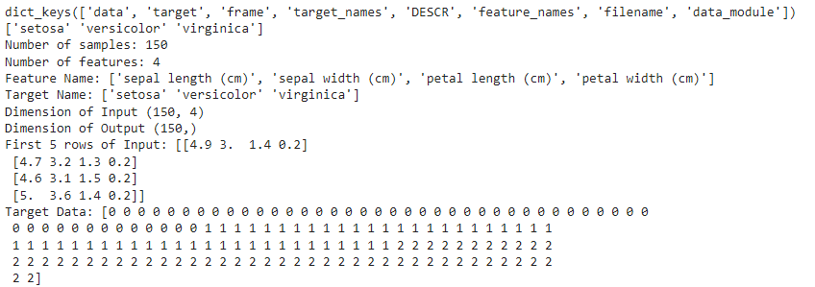
Exploring the Datset
from sklearn.datasets import load_iris
iris = load_iris()
print(iris.keys())
print(iris["target_names"])
n_samples, n_features = iris.data.shape
print('Number of samples:', n_samples)
print('Number of features:', n_features)
print('Feature Name:', iris.feature_names)
print('Target Name:', iris.target_names)
print("Dimension of Input",iris.data.shape)
print("Dimension of Output", iris.target.shape)
print("First 5 rows of Input:",iris.data[1:5])
print("Target Data:",iris.target)

Slide 30
Activity 1
Pakistani Provinces Analysis
Create a dataset of 4 provinces of Pakistan with columns:
Province, Population (millions), Literacy Rate (%), Region (North, South, East, West).
Tasks:
Handle any missing values (drop one row, fill another with median).
Encode the Region column (Label Encoding + One-Hot Encoding).
Visualize population vs literacy rate using a scatter plot (label each province).
Detect if there is any province behaving like an outlier in literacy rate.

Slide 31
Activity 2
Student Performance Tracker
Generate random data for 100 students:
ID, Math, Science, English, Grade (A/B/C).
Tasks:
Handle missing marks (fill with mean).
Encode the categorical Grade column.
Plot a histogram of Math scores with 10 bins.
Identify if any student has an unusually high/low total score using a boxplot.
Summarize findings (e.g., which grade performed best overall).

Slide 32
Activity 3
COVID-19 Dataset Exploration
Load the online dataset:
https://raw.githubusercontent.com/datasets/covid-19/master/data/time-series-19-covid-combined.csv
Tasks:
Extract only Pakistan’s data.
Handle missing values (if any) properly.
Plot a line chart showing cases over time.
Find the day with the highest confirmed cases.
Detect any outliers in daily cases using a boxplot.

Slide 33
Activity 4
Multi-format Data Loading & Visualization Challenge
You are provided with three small files:
students.csv (contains names and marks)
attendance.json (contains student names with attendance %)
extra.xlsx (contains bonus marks per student)
Task:
Load all three files into Pandas DataFrames.
Merge them into a single DataFrame with columns: Name, Marks, Attendance, Bonus.
Create a scatter plot of Marks vs Attendance and highlight students with attendance < 70%.
Apply one-hot encoding on Name.

Slide 34
Activity 5
Data Cleaning & Outlier Detection with Visualization
You are given the dataset below
data = {
"Name": ["Ahsan", "Hira", "Bilal", "Zara", "Salman", "Mahnoor"],
"Age": [25, 27, 35, 29, None, 40],
"Salary": [50000, None, 75000, 2000000, 60000, 90000],
"Department": ["IT", "Finance", "IT", "HR", "Finance", "IT"]
}
Tasks:
Handle missing values properly.
Encode the categorical feature Department.
Detect outliers in the Salary column using boxplot visualization.
Comment on whether Zara’s salary should be treated as an outlier or not.

