Slide 1

Typing Speed Calculator
Web Programming Project Built using React.js, HTML, CSS, JavaScript
A real-time typing performance analyzer that measures speed and accuracy with interactive UI
Professor: Mrs. Reya Sharma
WEB PROGRAMMING BCSE203E
L33+L34+L59+L60

Slide 2

Team Information
Junaid Ahamed S
24BCE2653
L33+34+59+60

Slide 3
Project Summary
This project is a web-based Typing Speed Tester developed using React.js.
It allows users to test their typing speed in real time by typing a randomly generated paragraph.
The application provides immediate feedback on performance including:
Words Per Minute (WPM)
Accuracy
Number of correct characters

Slide 4
Key features of the application:
Multiple difficulty levels (Easy, Medium, Hard, Code)
Real-time typing feedback with color indicators
Countdown timer for test duration
Press TAB key to restart the test
Performance rating system
Clean and responsive user interface

Slide 5
How Does The Code Work?
The application is built using React functional components and hooks.
Main components include:
App (Main controller)
Timer (handles countdown)
LiveStats (displays performance metrics)
TypingBox (handles typing input)
Result (displays final results)
React hooks used:
useState for managing state
useEffect for timers and lifecycle
useRef for input focus
useCallback for optimized functions

Slide 6
Working logic:
A random paragraph is selected based on difficulty
User starts typing → timer begins automatically
Input is compared character-by-character with the paragraph
Characters are marked:
Green → correct
Red → incorrect
Real-time stats are updated continuously

Slide 7
Performance calculations:
WPM (Words Per Minute): Based on correct characters typed divided by time
Accuracy: (Correct characters / Total typed) × 100
Timer: Runs for 60 seconds using setInterval
Test ends when:
Timer reaches zero OR
Paragraph is fully typed

Slide 8

Source Code

Slide 9
App.css
@import url('https://fonts.googleapis.com/css2?family=JetBrains+Mono:wght@
300;400;500;700&family=Space+Mono:
wght@400;700&display=swap');
:root {
--bg: #0d0f14;
--bg2: #13161e;
--bg3: #1a1e2a;
--border: #2a2f3f;
--text: #c8cdd8;

Slide 10
.app {
display: flex;
flex-direction: column;
align-items: center;
min-height: 100vh;
padding: 2rem;
}
.app-header {
text-align: center;
margin-bottom: 2rem;
}
.logo {
font-size: 2rem;
font-weight: bold;
}
.controls {
display: flex;
gap: 1rem;
margin-bottom: 2rem;
}
.ctrl-btn {
background: var(--bg2);
border: 1px solid var(--border);
padding: 0.4rem 0.8rem;
cursor: pointer;
}
.test-area {
width: 100%;
max-width: 800px;
}
.timer-wrapper {
display: flex;
align-items: center;
gap: 1rem;
}
.timer-number {
font-size: 2rem;
color: var(--cyan);
}
.timer-bar-bg {
flex: 1;
height: 4px;
background: var(--bg3);
}
.timer-bar-fill {
height: 100%;
background: var(--cyan);
}
.live-stats {
display: flex;
gap: 0.5rem;
}
.stat-pill {
background: var(--bg2);
border: 1px solid var(--border);
padding: 0.5rem;
text-align: center;
}
.stat-val {
font-size: 1.2rem;
color: white;
}
.typing-box {
background: var(--bg2);
border: 1px solid var(--border);
padding: 1.5rem;
}
.text-display {
line-height: 1.8;
}
.char-correct { color: var(--green); }
.char-wrong { color: var(--red); }
.char-cursor { border-bottom: 2px solid var(--cyan); }

Slide 11
.result-screen {
background: var(--bg2);
border: 1px solid var(--border);
padding: 2rem;
text-align: center;
}
.result-number {
font-size: 2.5rem;
}
.restart-btn {
border: 1px solid var(--green);
padding: 0.5rem 1.5rem;
cursor: pointer;
}
App.js
import { useState, useEffect, useRef,
useCallback } from "react";
import "./App.css";
const PARAGRAPHS = {
easy: [
"the cat sat on the
mat and looked at the sun
the dog ran in
the park and had a
lot of fun the bird
sang a song and flew
up to the sky it
was a warm and bright
day in the month of
may", "she went to the store
to buy some bread and
milk she paid for the
food and walked back home
the air was cool and
the birds were singing she
felt happy and calm as
she walked along the road",
"he likes to read books
and learn new things every
day he goes to the
library and picks a book
to read he sits by
the window and reads for
many hours he loves stories
about space and far away
worlds",
"the sun rises in the
east and sets in the
west the moon shines at
night and lights up the
dark sky the stars are
tiny dots of light that
fill the night we can
see them on a clear
dark night",
],

Slide 12
medium: [
"The quick brown fox jumps
over the lazy dog near
the riverbank Several birds took
flight as the commotion startled
them Nature has a remarkable
way of balancing chaos and
tranquility in every moment we
observe", "Learning to type faster requires
consistent practice and focused attention
Your fingers should rest on
the home row keys moving
efficiently to each letter Over
time muscle memory takes over
and speed increases naturally",
"Modern technology has transformed the
way humans communicate and share
information Social networks connect billions
of people across different time
zones and cultures Yet meaningful
conversation still depends on clarity
and thoughtful expression",
"Scientists discovered that deep ocean
trenches harbor unique ecosystems thriving
under extreme pressure Bioluminescent creatures
navigate the perpetual darkness using
chemical light These environments challenge
our understanding of where life
can exist",
],
hard: [
"Cryptographic algorithms such as RSA
and AES 256 protect sensitive
data through mathematical complexity Developers
must implement proper key rotation
salted hashing and secure transport
layers TLS 1 3 to
prevent vulnerabilities Always audit dependencies
one misconfigured package can compromise
an entire system",
"The phenomenon of quantum entanglement
suggests that particles once linked
instantaneously affect each other regardless
of distance defying classical physics
Einstein famously called this spooky
action at a distance Modern
quantum computers exploit superposition and
entanglement to solve problems exponentially
faster",
"In distributed systems the CAP
theorem states consistency availability and
partition tolerance cannot all be
guaranteed simultaneously Engineers must make
trade offs for example Apache
Kafka prioritizes throughput and fault
tolerance over strict consistency Understanding
these trade offs is crucial
for scalable architecture",
"Object oriented design relies on
four pillars encapsulation abstraction inheritance
and polymorphism Well structured code
adheres to SOLID principles particularly
the single responsibility principle Refactoring
legacy code Watch for code
smells long methods deep nesting
and duplicated logic",
],
code: [
"const fetchData async url try
const res await fetch url
if not ok throw new
Error Network error const data
await res json return data
catch err console error Failed
err message return null",
"function mergeSort arr if arr
length less than equal one
return arr const mid Math
floor arr length divided by
two const left mergeSort arr
slice zero mid const right
mergeSort arr slice mid return
merge left right",

Slide 13
"class EventEmitter constructor
this events
empty object on event listener
if not events event create
array push listener emit event
args run each function",
"const debounce fn delay let timer
return args clearTimeout timer
setTimeout
call fn apply this args delay
window addEventListener resize
debounce handleResize
three hundred",
],
};
Index.js
import React from 'react’;
import ReactDOM from
'react-dom/client';import './App.css’;
import App from
'./App';const root = ReactDOM.createRoot
(document.getElementById('root’));
root.render( <React.StrictMode> <App />
</React.StrictMode>);

Slide 14

Output

Slide 15
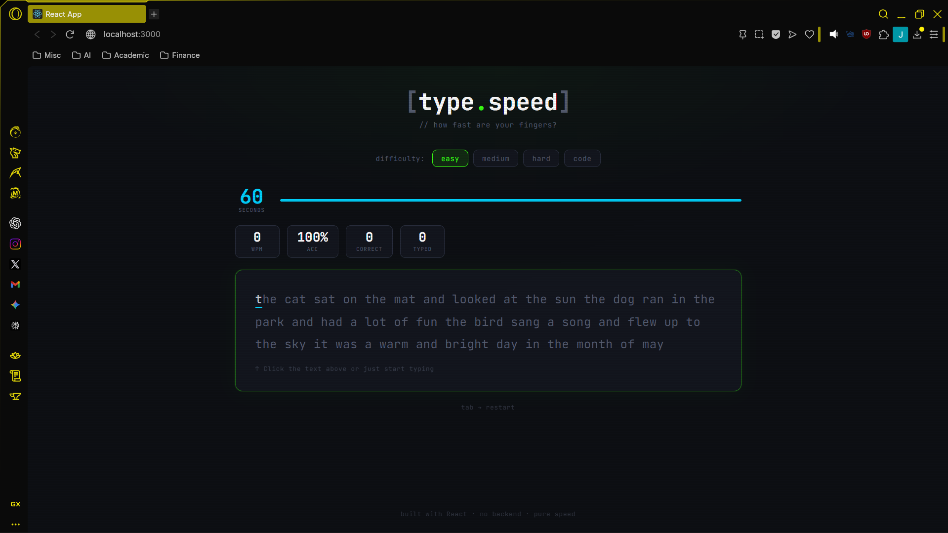

Slide 16
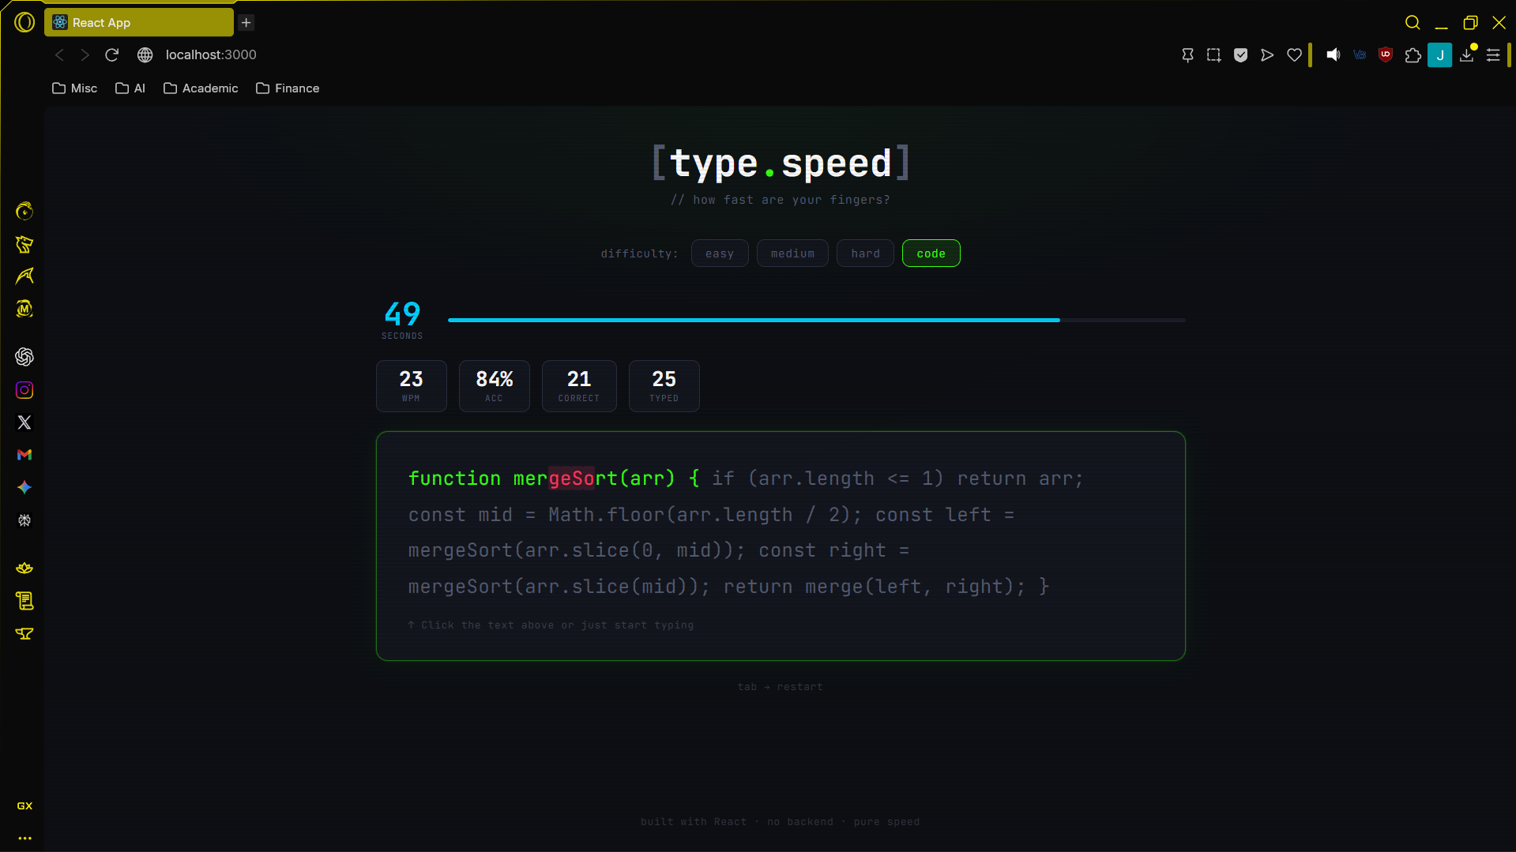

Slide 17
