Slide 1


Chicago Reported Crime
Year - 2020

Slide 2
Team Members
Arnaz Alavi
Junaid Dawood
Ratika Chauhan
Ratna Jadhav
Seong-Min Kim

Slide 3
Purpose
@Ratna

Slide 4









Development Approach
DATA SOURCE
Web API
Chicago Police Department's CLEAR System
ETL
MongoDB
Flask
FRONT-END
D3
Java Script
HTML
CSS
Pandas
Notes:
As part of out coding approach, we started of by finding an open-source dataset that can be used to develop our full stack application
Extracted the dataset and processed the same through ETL Process
We then loaded the final datasets to MongoDB using Panda Pymongo
Created Flask Framework on local server to extract and filter data from MongoDB.
The visualization for the dashboards are constructed in HTML, CSS and JS.

Slide 5

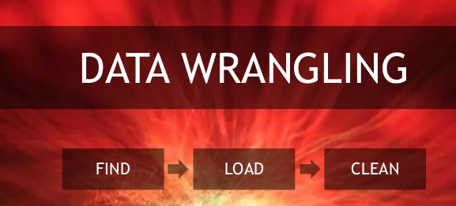



Notes:
For the process of converting the raw data into more usable format we started of by selected the right parameters to pull the data set we need.
Web API request to retrieve Reported Crime in Chicago in 2020
Pandas library format Dates, creating summarized dictionary, and cleaning dataset
PyMongo to load the final sets into a Mongodb with collections
Flask App that retrieves the data from Mongo and applies the summarization and filtering.
Javascript that calls the flask endpoints to get the data for visualization (Chart JS and D3).
HTML and CSS that present the charts, visuals and dropdown filters.
7. Bootstrap CSS that provides a Dashboard template.

Slide 6
Chicago Crime Map Limitation & Challenge’s
Source of API (Geojson)
https://data.cityofchicago.org/resource/ijzp-q8t2.geojson
Geojson format with Leaflet used to draw the map
Geojson data has “feature’ array/list that make is easy to plot the map.
Data Format issue : Data was not fully loaded as geojson format because some other challenges. The list was missing. A line was added to a python script to convert data fully to a geojson format after the for loop.
data = { 'features' : features}
Performance issue : Data Extraction is limited to only three prime types using a query python script
mongo.db.events.find({ '$and': [{'properties.year': '2020’}, {'properties.primary_type': selector}] })
Data from MongoDB passed to a map JavaScript using Jinga and flask application.
Notes:
Goejson format -> "features": [{"type":"Feature","geometry":{"type":"Point","coordinates":[-87.727999591,41.967287545]},"properties":
Data Loaded to MongoDB ->{'type': 'Feature',
'geometry': {'type': 'Point', 'coordinates': [-87.561272312, 41.764728045]},
'properties': {'location_state': ‘’,
Example app.py script:
cursor= mongo.db.events.find({ '$and': [{'properties.year': '2020'}, {'properties.primary_type': selector}] })
features=[]
for geojson_feature in cursor:
features.append({
"type": geojson_feature['type'],
"geometry": geojson_feature['geometry'],
"properties" : geojson_feature['properties']
}
)
#print(features)
data = { 'features' : features}

Slide 7

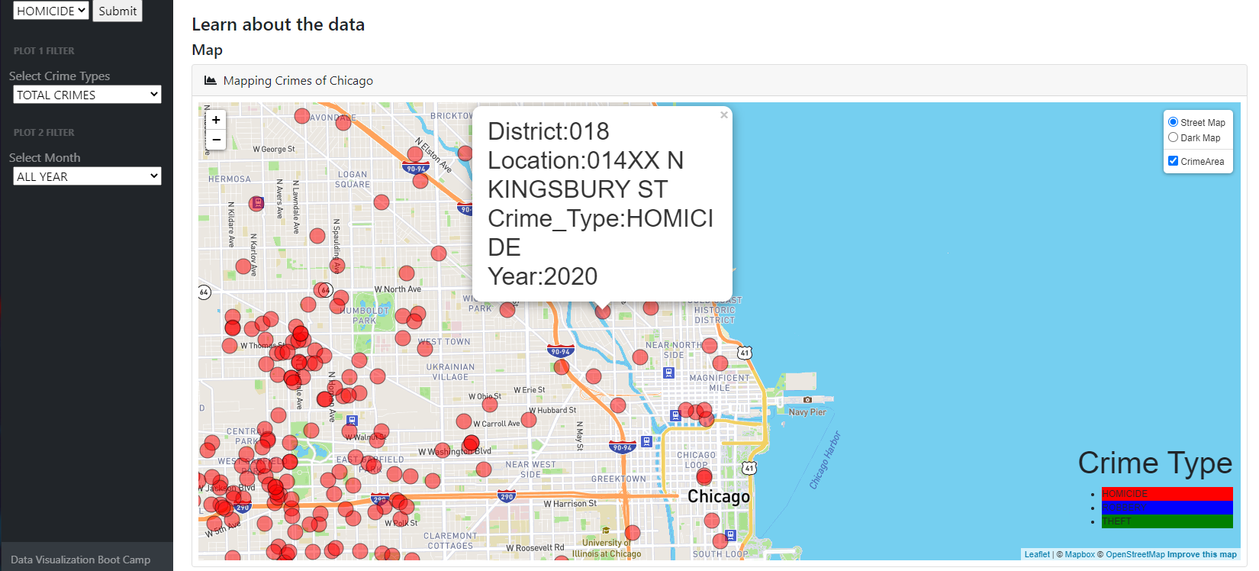



Geo-Map
A selector to pick from three crime types.
Two Base layers: Using streetmap tile layer and darkmap tile layer .Visible at a time.
A Overlay layer: Go over the base layer and can be turn off and on.
Circle markers to display the location of the crimes. The crime types are distinguish by colors.

Slide 8
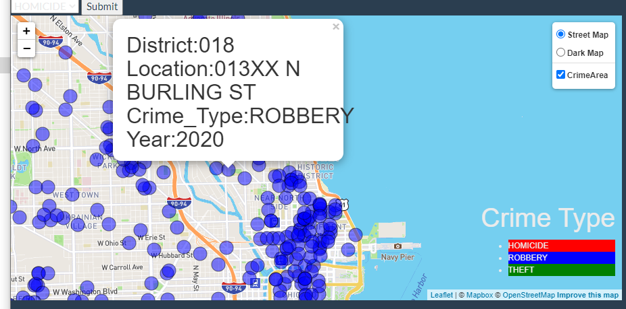
Geo-Map (cont.)
For crime type Robbery, set the circle to blue.
For crime type Robbery, set the circle to blue.
For crime type Robbery, set the circle to blue.
When a marker is clicked, a popup appears to display district , location, crime type and year.

Slide 9
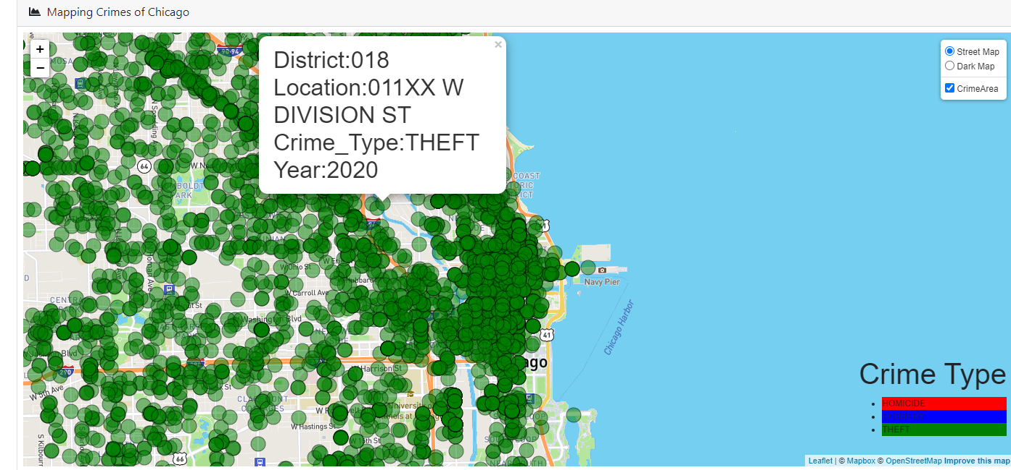
Geo-Map (cont.)
Mouse over on a circle marker highlight the circle marker
Mouse out change back the circle marker un highlighted.
Three crime labels represented at the bottom of the map.

Slide 10
Chart 2
@Seong-Min

Slide 11
Front –End Follow up with live Demo
HTML -@ratna
index.html

Slide 12

LIVE DEMO

