Slide 1



A Bias Compensating Value Iteration Based Q-learning Algorithm for Model-Free Game-Theoretic HVAC Optimal Control
Junaid Anwar¹ and Syed Ali Asad Rizvi²
¹EE, San José State University, USA
²EE, Tennessee Technological University, USA
Paper ID: MoAT8.1
Session: Poster Session, Grand Station I-II Presenter: Junaid Anwar
October 6, 2025
2025 Modeling, Estimation, and Control Conference (MECC 2025)
Oct. 5 – 8, 2025, Sheraton at Station Square, Pittsburg, PA, USA.

Slide 2
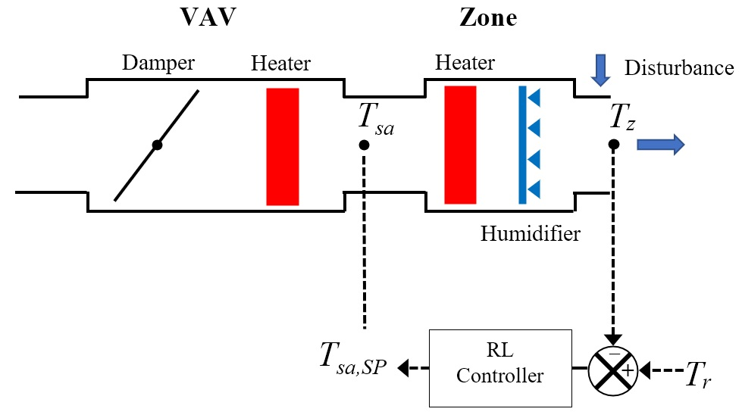
HVAC Game Control Formulation
Fig. 1 An RL loop for a zone controlled with two players as decision variables
Unlike classical LQR, here each player has its own distinct cost function
Individual player weights
2

Slide 3
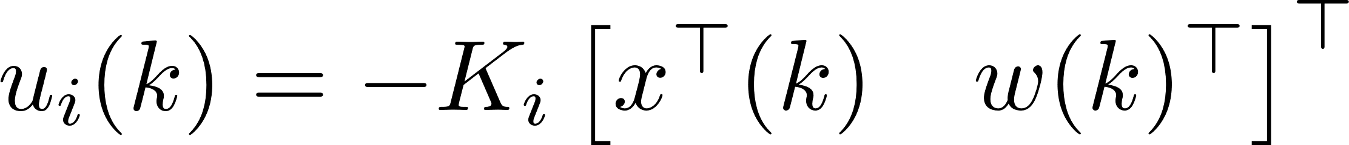
State Feedback Two-Player Game
Q-functions
Game theoretic control policy for each player
Optimal game policy
Individual Q-function
Bias compensation term
Our recent state feedback PI method needs an initially stabilizing policy
IJRNC ’25
2

Slide 4
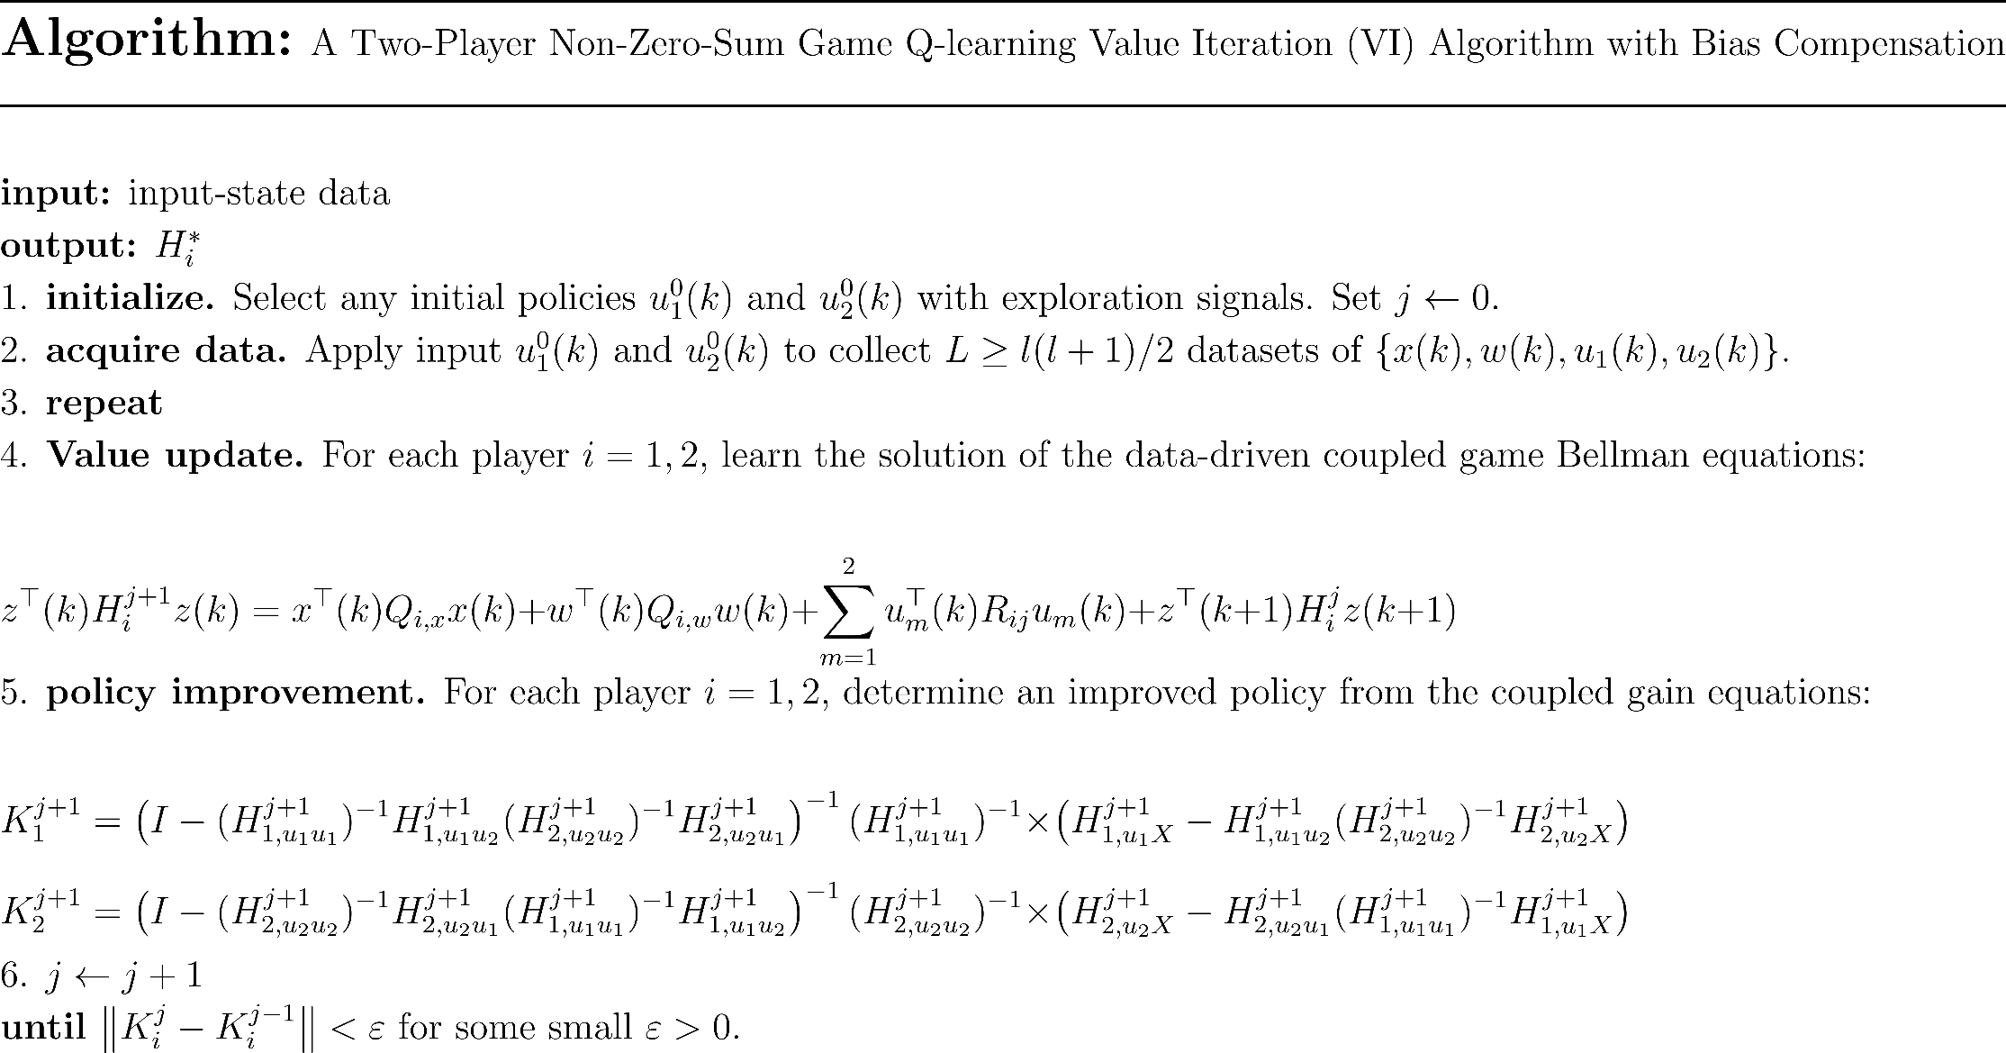
NZS Q-learning VI Algorithm

Slide 5
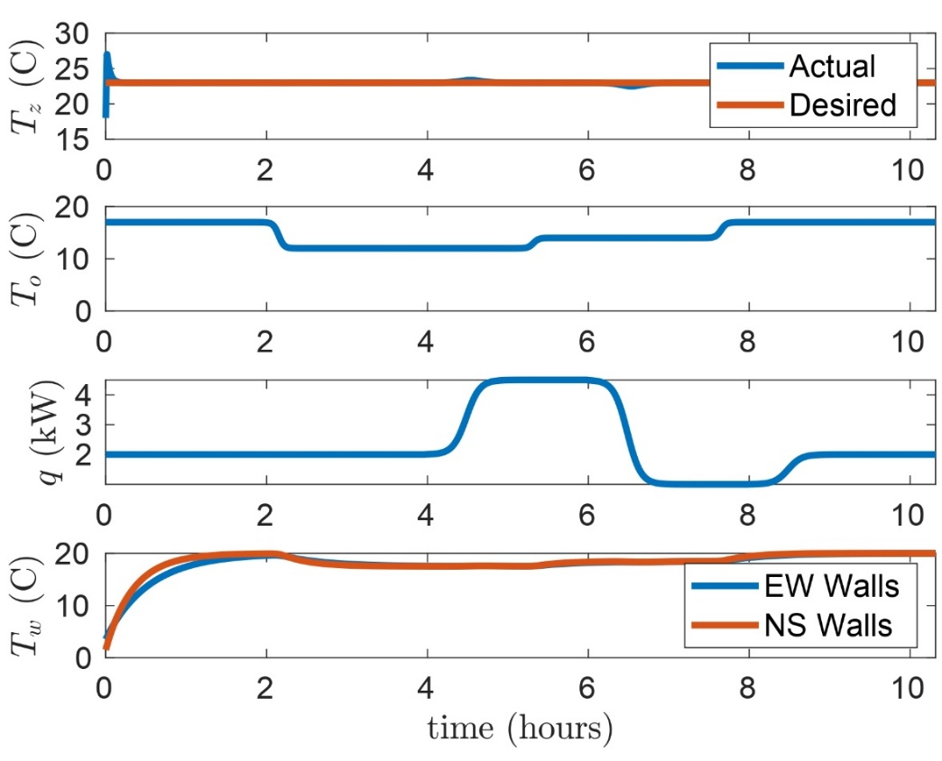
Tracking Performance
Fig. 1: An HVAC zone with two players as decision variables
Fig. 2: Tracking response of the learned controller

Slide 6
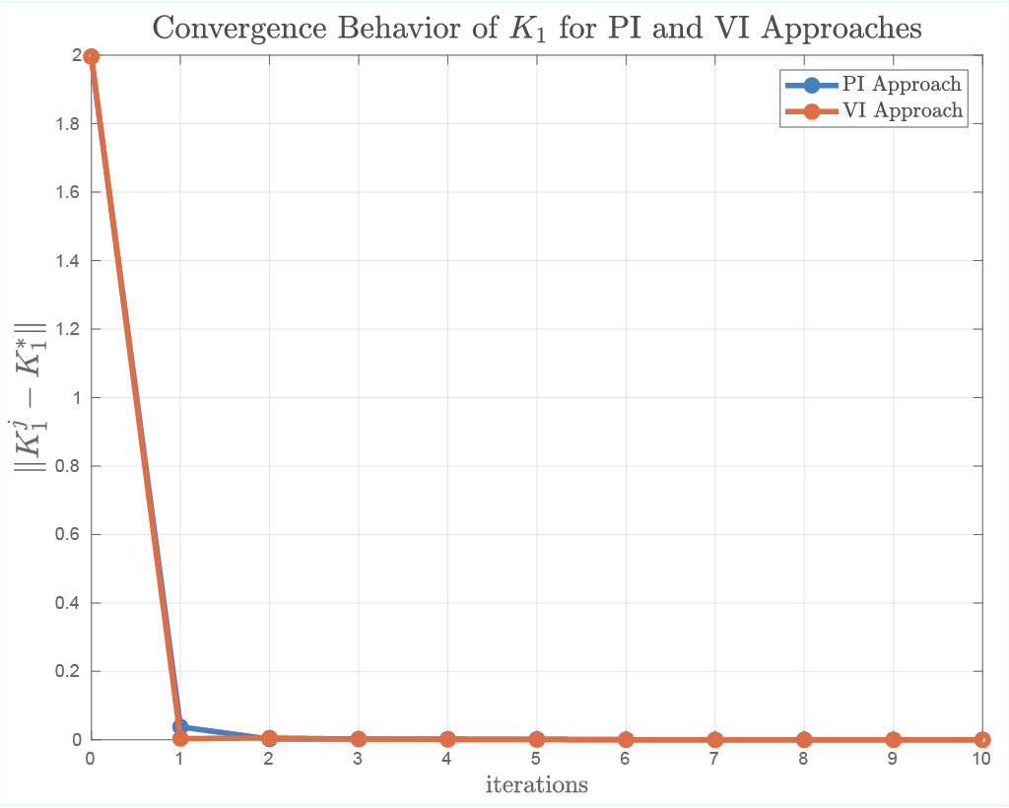
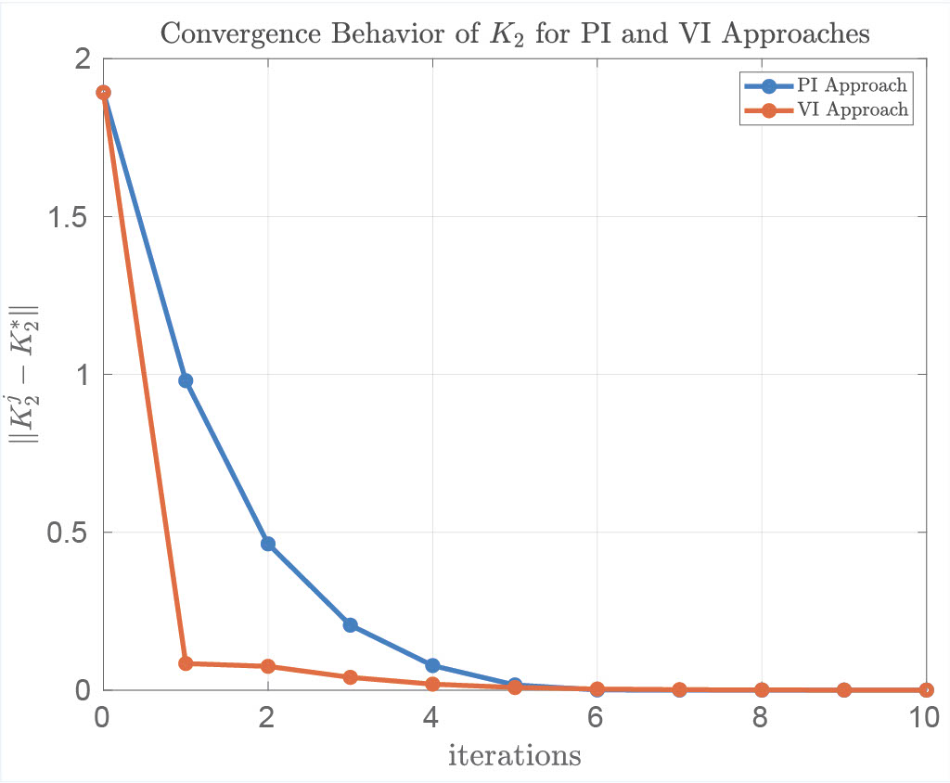
Parameter Convergence
Fig. 3 Convergence of Player 1 and 2 gains under varying load and disturbances
Benefits of proposed VI method
No warm start: learns without a stable policy; simpler updates
GARE-optimal: reaches model-based state-feedback solution

Slide 7
Join me in the interactive session to learn more about this work.
Thank you!

