Slide 1
Diffie-Hellman

Slide 2
The problem:
Two persons are employing a Diffie-Hellman scheme to fix up a session key for their communications. They are using a prime modulus of
61845915503831114091865164962647232917206327870669899
and a base value of 3.
Your operatives report that they have witnessed the Diffie-Hellman exchanges of information
23476518809109841512388888255597834570025548669239101
And
5815015754374921280955691220093049847105334794690583
Find the shared secret key.

Slide 3
Brute Force
Baby-Step Giant-Step

Slide 4
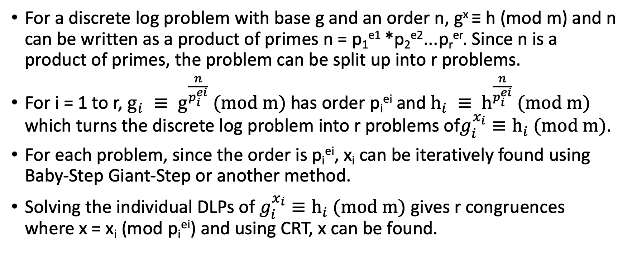
Pohlig-Hellman
For a discrete log problem with base g and an order n, g^{x} ≡ h (mod m) and n can be written as a product of primes n = p₁^{e1} *p₂^{e2}...p_{r}^{er}. Since n is a product of primes, the problem can be split up into r problems.
For i = 1 to r, $g_{i} ≡ g^{\frac{n}{p_{i}^{ei}}} (mod m)$has order p_{i}^{ei} and $h_{i} ≡ h^{\frac{n}{p_{i}^{ei}}} (mod m)$ which turns the discrete log problem into r problems of$g_{i}^{x_{i}}≡h_{i} (mod m)$.
For each problem, since the order is p_{i}^{ei}, x_{i} can be iteratively found using Baby-Step Giant-Step or another method.
Solving the individual DLPs of $g_{i}^{x_{i}}≡h_{i} (mod m)$ gives r congruences where x = x_{i} (mod p_{i}^{ei}) and using CRT, x can be found.

Slide 5
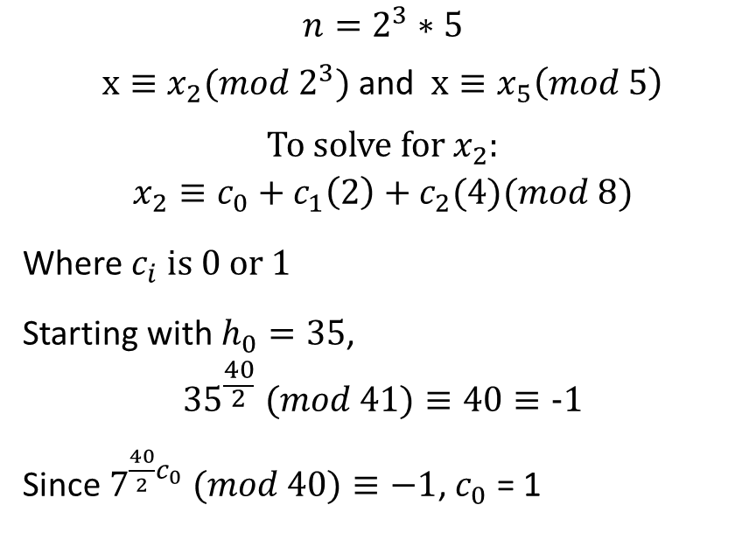
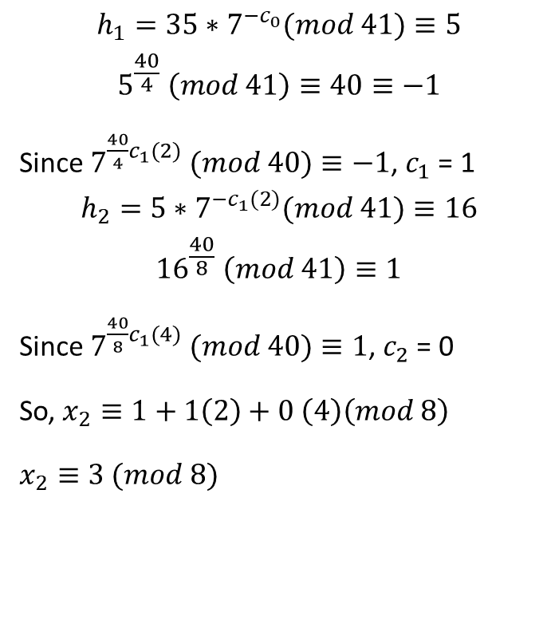
Pohlig-Hellman Example
Given: m = 41 g = 7 n = 40 h=35
Find x such that $g^{x}≡h(mod m)$
$$n=2^{3}∗5$$
$x≡x_{2}(mod{ 2}^{3})$ and $x≡x_{5}\left(mod 5\right)$
To solve for $x_{2}$:
$$x_{2}≡c_{0}+c_{1}\left(2\right)+c_{2}(4)(mod 8)$$
Where $c_{i} is 0 or 1$
Starting with $h_{0}=35$,
$${35}^{\frac{40}{2}} (mod 41)≡40≡−1$$
Since $7^{\frac{40}{2}c_{0}} (mod 40)≡−1$, $c_{0}$ = 1
$$h_{1}=35∗7^{{−c}_{0}}(mod 41)≡5$$
$$5^{\frac{40}{4}} \left(mod 41\right)≡40≡−1$$
Since $7^{\frac{40}{4}c_{1}(2)} (mod 40)≡−1$, $c_{1}$ = 1
$$h_{2}=5∗7^{{−c}_{1}(2)}(mod 41)≡16$$
$${16}^{\frac{40}{8}} \left(mod 41\right)≡1$$
Since $7^{\frac{40}{8}c_{1}(4)} (mod 40)≡1$, $c_{2}$ = 0
So, $x_{2}≡1+1\left(2\right)+0 \left(4\right)\left(mod 8\right)$
$x_{2}≡3 (mod 8)$

Slide 6
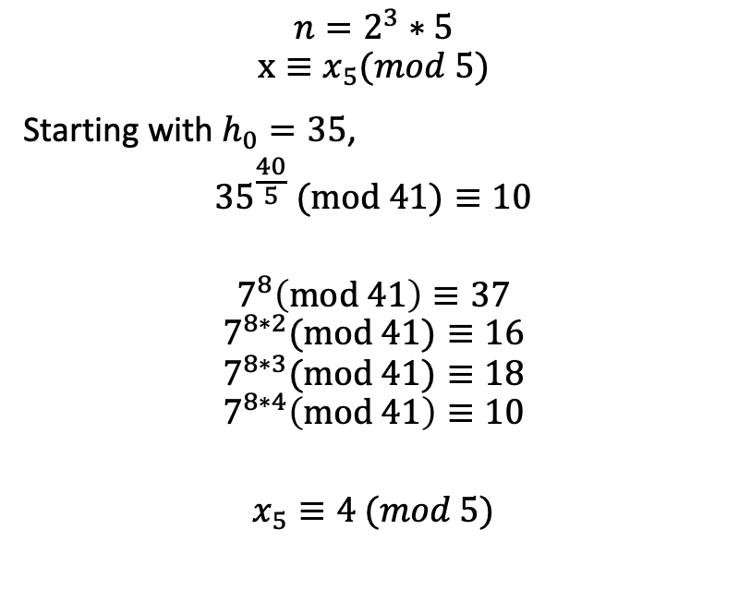
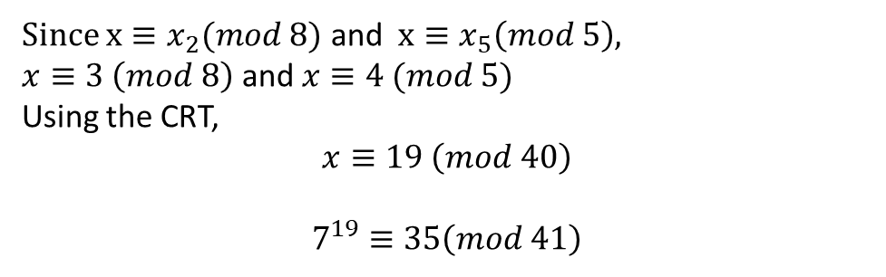
Pohlig-Hellman Example
Given: m = 41 g = 7 n = 40 h=35
Find x such that $g^{x}≡h(mod m)$
Since $x≡x_{2}(mod 8)$ and $x≡x_{5}\left(mod 5\right)$,
$x≡3 \left(mod 8\right)$ and $x≡4 (mod 5)$
Using the CRT,
$$x≡19 \left(mod 40\right)$$
$$7^{19}≡35\left(mod 41\right)$$
$$n=2^{3}∗5$$
$$x≡x_{5}(mod 5)$$
Starting with $h_{0}=35$,
$${35}^{\frac{40}{5}} (mod 41)≡10$$
$$7^{8}\left(mod 41\right)≡37$$
$$7^{8∗2}(mod 41)≡16$$
$$7^{8∗3}(mod 41)≡18$$
$$7^{8∗4}\left(mod 41\right)≡10$$
$$x_{5}≡4 (mod 5)$$

Slide 7
Pollard’s Lambda/Kangaroo algorithm
First Introduced in 1987 by John Pollard
A probabilistic method solves DLP g^x = h(mod p)

Slide 8
Intuition on Kangaroo method
A simple fact
d
0
x
b
x = b - d

Slide 9

Intuition on Kangaroo method
How to solve g^{x} = h (mod p)?
Tame Kangaroo vs Wild Kangaroo
0
g^{x}
g^{b}

Slide 10
Intuition on Kangaroo method
How to solve g^{x} = h (mod p)?
Tame Kangaroo vs Wild Kangaroo
0
g^{x}
g^{b}

Slide 11
Intuition on Kangaroo method
How to solve g^{x} = h (mod p)?
Tame Kangaroo vs Wild Kangaroo
0
g^{x}
g^{b}

Slide 12
Intuition on Kangaroo method
How to solve g^{x} = h (mod p)?
Tame Kangaroo vs Wild Kangaroo
g^{b+d}
0
g^{x}
g^{b}

Slide 13

Intuition on Kangaroo method
How to solve g^{x} = h (mod p)?
Tame Kangaroo vs Wild Kangaroo
g^{b+d}
0
g^{x}
g^{b}

Slide 14
Intuition on Kangaroo method
How to solve g^{x} = h (mod p)?
Tame Kangaroo vs Wild Kangaroo
g^{b+d}
0
g^{x}
g^{b}

Slide 15
Intuition on Kangaroo method
How to solve g^{x} = h (mod p)?
Tame Kangaroo vs Wild Kangaroo
g^{b+d}
0
g^{x}
g^{b}

Slide 16
Intuition on Kangaroo method
How to solve g^{x} = h (mod p)?
Tame Kangaroo vs Wild Kangaroo
g^{b+d}
0
g^{x}
g^{b}

Slide 17
Intuition on Kangaroo method
How to solve g^{x} = h (mod p)?
Tame Kangaroo vs Wild Kangaroo
g^{b+d}
0
g^{x}
g^{b}

Slide 18
Intuition on Kangaroo method
How to solve g^{x} = h (mod p)?
Tame Kangaroo vs Wild Kangaroo
g^{b+d}
0
g^{x}
g^{b}

Slide 19
Intuition on Kangaroo method
How to solve g^{x} = h (mod p)?
Tame Kangaroo vs Wild Kangaroo
g^{b+d}
0
g^{x}
g^{b}

Slide 20
Intuition on Kangaroo method
How to solve g^{x} = h (mod p)?
Tame Kangaroo vs Wild Kangaroo
g^{b+d}
0
g^{x}
g^{b}

Slide 21
Intuition on Kangaroo method
How to solve g^{x} = h (mod p)?
Tame Kangaroo vs Wild Kangaroo
g^{b+d}
0
g^{x}
g^{b}
g^{x+f}

Slide 22
Intuition on Kangaroo method
How to solve g^{x} = h (mod p)?
Tame Kangaroo vs Wild Kangaroo
g^{x+f}
=
g^{b+d}
0
g^{x}
g^{b}

Slide 23
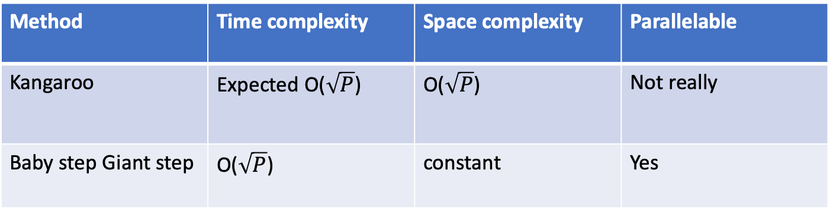
Intuition on Kangaroo method
Wild Kangaroo vs Tame Kangaroo
Comparison with baby-step-giant-step
Method | Time complexity | Space complexity | Parallelable
Kangaroo | Expected O($\sqrt{P}$) | O($\sqrt{P}$) | Not really
Baby step Giant step | O($\sqrt{P}$) | constant | Yes

Slide 24
Index Calculus

Slide 25
Initial attempt

Slide 26
Issues

Slide 27
Linear Sieve

