Slide 1
Big Data
Paper report presentation

Slide 2
An efficient approximation for point-set diameter in higher dimensions, by Mahdi Imanparast, Seyed Naser Hashemi and Ali Mohades
Accepted in the 28th Canadian Conference on Computational Geometry

Slide 3

Diameter problem
Given a finite set S of n points in R^{d}, find D(S) =$\max_{∀p,q∈S} (||p−q||$)

Slide 4

Diameter problem
Given a finite set S of n points in R^{d}, find D(S) =$\max_{∀p,q∈S} (||p−q||$)
x
y
D(S)
S in R²

Slide 5
Diameter problem
Literature
O(n log n) exact algorithm for d <= 3
For d > 3, only approximation algorithm runs in near-linear time

Slide 6
Diameter problem
Brute force
Iterate through O(n²) pair (p, q) and maintain maximal ||p - q||
Takes O(d*n²) time, not practical in higher dimensions

Slide 7

Diameter problem
2-approximation
Pick any point p $∈$ S, find D* = $\max_{q∈S}$ (||p - q||)
D* <= D(S) <= 2D*, D* is a 2-approximation of diameter of set S
Time complexity O(d*n)

Slide 8
Diameter problem
2-approximation
Pick any point p $∈$ S, find D* = $\max_{q∈S}$ (||p - q||)
D* <= D(S) <= 2D*, D* is a 2-approximation of diameter of set S
Time complexity O(d*n)
q
D*
p

Slide 9
Diameter problem
grid
Decompose space into net of grids
Rounding points into grid points
D(S)

Slide 10
Diameter problem
grid
Decompose space into net of grids
Rounding points into grid points
D(S)

Slide 11
Diameter problem
grid
Decompose space into net of grids
Rounding points into grid points
D(S)

Slide 12
Diameter problem
grid
Decompose space into net of grids
Rounding points into grid points

Slide 13




Diameter problem
grid
Decompose space into net of grids, Rounding points into grid points
Error introduced = O(${εD}^{∗}$) = O($ε$D(S))
$$\frac{{εD}^{∗}}{\sqrt{2}}$$
$${εD}^{∗}$$
(In R^{d}, $\frac{{εD}^{∗}}{\sqrt{d}}$)

Slide 14
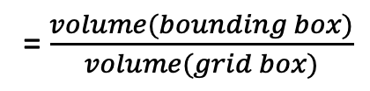

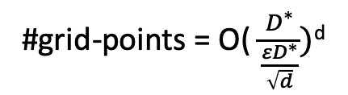
Diameter problem
grid
Decompose space into net of grids, Rounding points into grid points
Error introduced = O(${εD}^{∗}$) = O($ε$D(S))
$$\frac{{εD}^{∗}}{\sqrt{2}}$$
$${εD}^{∗}$$
#grid-points = O( $\frac{D^{∗}}{\frac{{εD}^{∗}}{\sqrt{d}}})$^{d}
= O( $\frac{\sqrt{d}}{ε})$^{d}
(In R^{d}, $\frac{{εD}^{∗}}{\sqrt{d}}$)
= $\frac{volume(bounding box)}{volume(grid box)}$

Slide 15

Diameter problem
grid
Decompose space into net of grids, Rounding points into grid points
Error introduced = O(${εD}^{∗}$) = O($ε$D(S))
$$\frac{{εD}^{∗}}{\sqrt{2}}$$
$${εD}^{∗}$$
#grid-points = O( $\frac{D^{∗}}{\frac{{εD}^{∗}}{\sqrt{d}}})$^{d}
= O( $\frac{\sqrt{d}}{ε})$^{d}
(In R^{d}, $\frac{{εD}^{∗}}{\sqrt{d}}$)
= $\frac{volume(bounding box)}{volume(grid box)}$
Time: O(#grid-points ²$)$

Slide 16
Diameter problem
Direction partitioning [Agarwal at 1992]
Partition space into unit direction vectors
Find extreme points along each direction vector
D(S)

Slide 17

Diameter problem
Direction partitioning [Agarwal at 1992]
Partition space into unit direction vectors
Find extreme points along each direction vector
1) V = {$∀i∈\left[0,t\right):v_{i}=(cos\frac{2πi}{t},sin\frac{2πi}{t})$}
D(S)

Slide 18
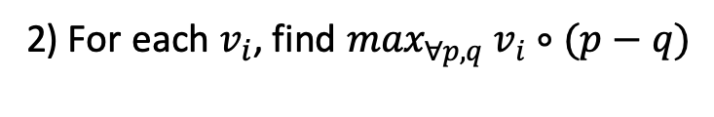
Diameter problem
Direction partitioning [Agarwal at 1992]
Partition space into unit direction vectors
Find extreme points along each direction vector
1) V = {$∀i∈\left[0,t\right):v_{i}=(cos\frac{2πi}{t},sin\frac{2πi}{t})$}
2) For each $v_{i}$, find $\max_{∀p,q}$ $v_{i}∘(p−q)$
D(S)

Slide 19
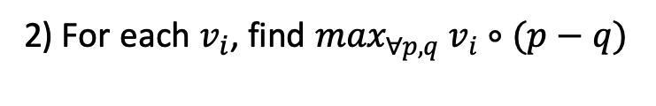
Diameter problem
Direction partitioning [Agarwal at 1992]
Partition space into unit direction vectors
Find extreme points along each direction vector
1) V = {$∀i∈\left[0,t\right):v_{i}=(cos\frac{2πi}{t},sin\frac{2πi}{t})$}
q’
2) For each $v_{i}$, find $\max_{∀p,q}$ $v_{i}∘(p−q)$
P’

Slide 20
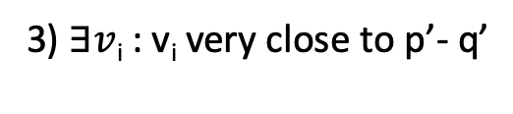

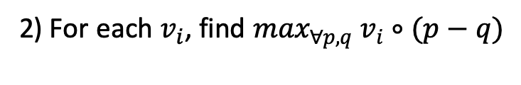
Diameter problem
Direction partitioning [Agarwal at 1992]
Partition space into unit direction vectors
Find extreme points along each direction vector
1) V = {$∀i∈\left[0,t\right):v_{i}=(cos\frac{2πi}{t},sin\frac{2πi}{t})$}
q’
$$θ$$
2) For each $v_{i}$, find $\max_{∀p,q}$ $v_{i}∘(p−q)$
3) $∃v$_{i} : v_{i} very close to p’- q’
P’

Slide 21
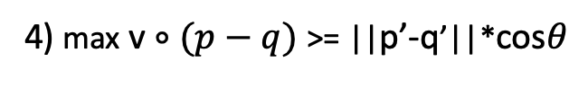
Diameter problem
Direction partitioning [Agarwal at 1992]
Partition space into unit direction vectors
Find extreme points along each direction vector
1) V = {$∀i∈\left[0,t\right):v_{i}=(cos\frac{2πi}{t},sin\frac{2πi}{t})$}
q’
$$θ$$
2) For each $v_{i}$, find $\max_{∀p,q}$ $v_{i}∘(p−q)$
3) $∃v$_{i} : v_{i} very close to p’- q’
4) max v $∘(p−q)$ >= ||p’-q’||*cos$θ$
P’

Slide 22

Diameter problem
Direction partitioning algorithm for computing diameter in R²
Let V = {$∀i∈\left[0,t\right):v_{i}=(cos\frac{2πi}{t},sin\frac{2πi}{t})$}, a set of t unit direction vectors

Slide 23
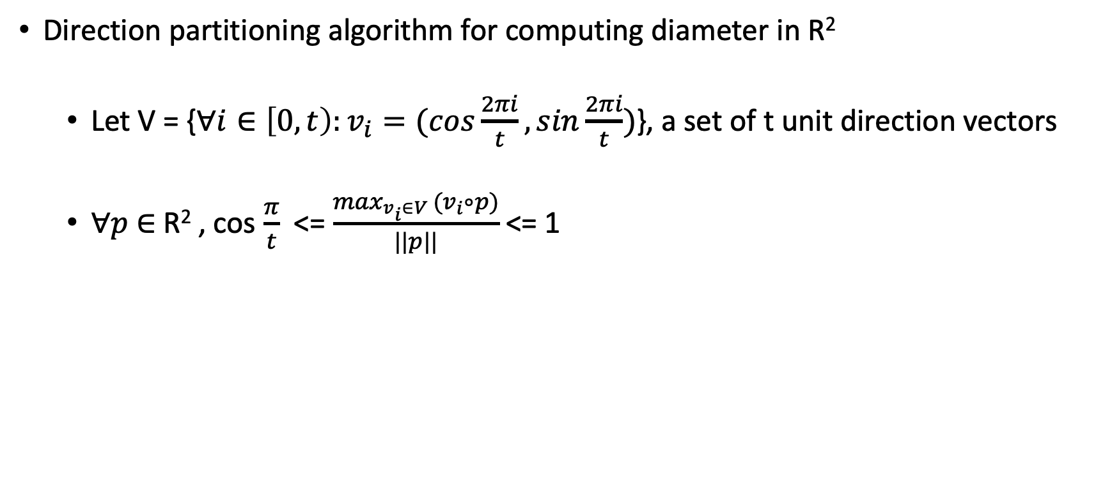
Diameter problem
Direction partitioning algorithm for computing diameter in R²
Let V = {$∀i∈\left[0,t\right):v_{i}=(cos\frac{2πi}{t},sin\frac{2πi}{t})$}, a set of t unit direction vectors
$∀p$ $∈$ R² , cos $\frac{π}{t}$ <= $\frac{\max_{v_{i}∈V }(v_{i}∘p)}{||p||}$<= 1

Slide 24
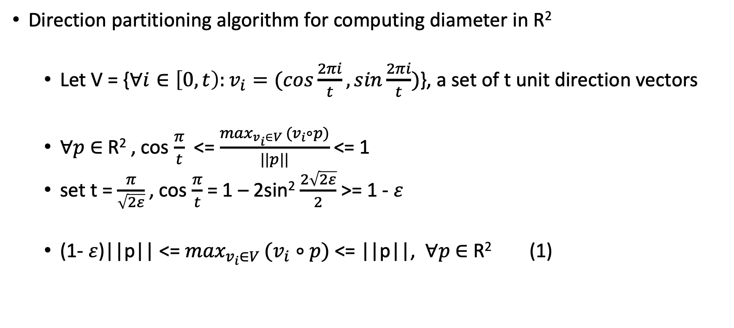
Diameter problem
Direction partitioning algorithm for computing diameter in R²
Let V = {$∀i∈\left[0,t\right):v_{i}=(cos\frac{2πi}{t},sin\frac{2πi}{t})$}, a set of t unit direction vectors
$∀p$ $∈$ R² , cos $\frac{π}{t}$ <= $\frac{\max_{v_{i}∈V }(v_{i}∘p)}{||p||}$<= 1
set t = $\frac{π}{\sqrt{2ε}}$, cos $\frac{π}{t}$ = 1 – 2sin² $\frac{2\sqrt{2ε}}{2}$ >= 1 - $ε$
(1- $ε$)||p|| <= $\max_{v_{i}∈V }(v_{i}∘p)$ <= ||p||, $∀p$ $∈$ R² (1)

Slide 25

Diameter problem
Direction partitioning algorithm for computing diameter in R²
Given a finite set S of n points in R², p,q $∈$ S
(1- $ε$)||p - q|| <= $\max_{v_{i}∈V }v_{i}∘\left(p−q\right)$ <= ||p-q|| (1)
Find ($\overline{v}$, $\overline{p}$, $\overline{q}$) such that $\overline{v}$ $∘\left(\overline{p}−\overline{q}\right)$ is maximal.

Slide 26
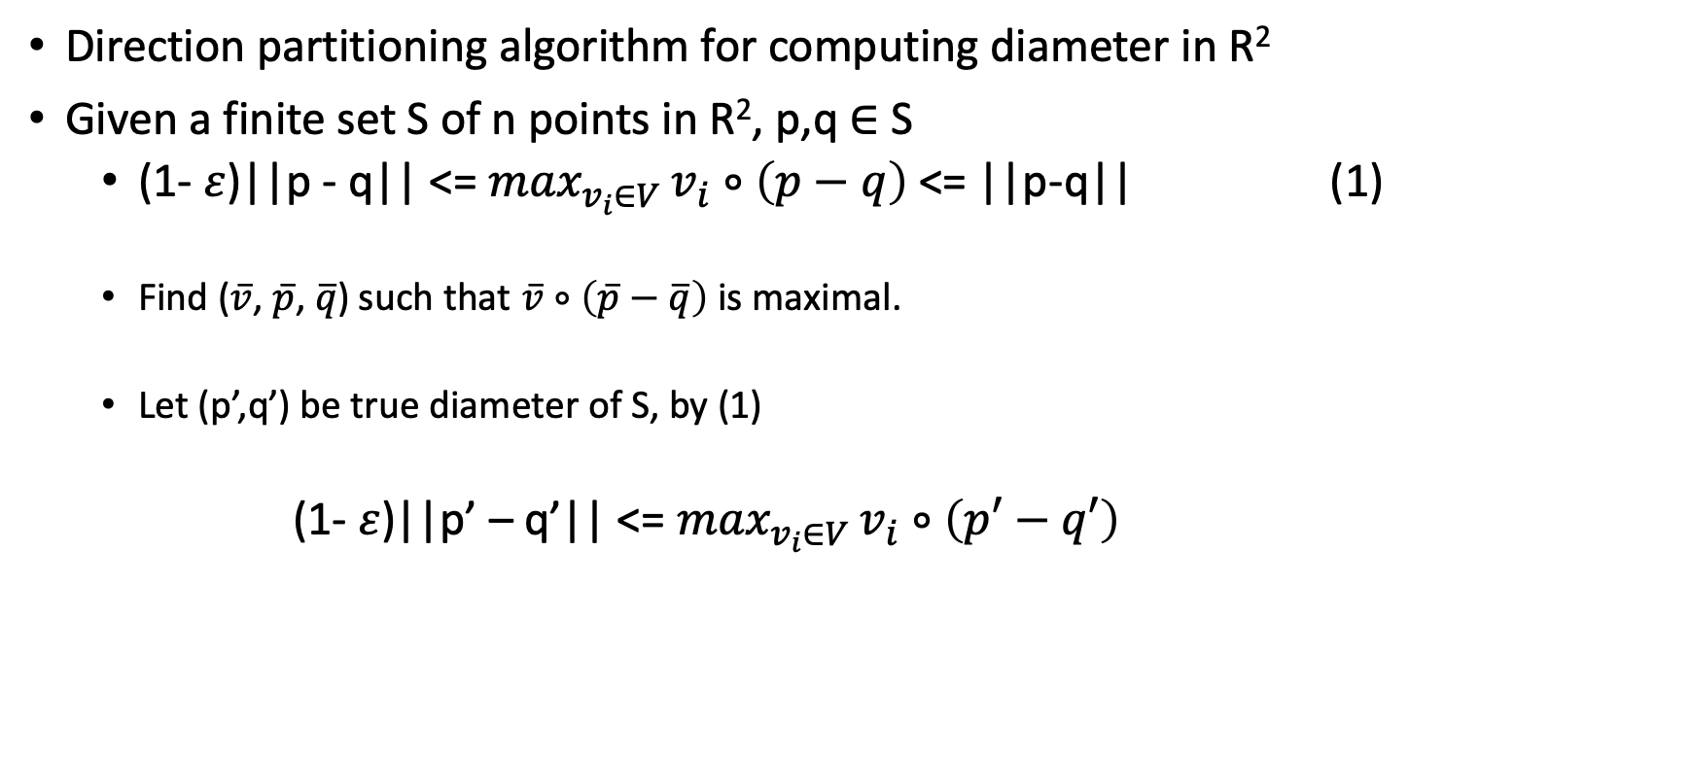
Diameter problem
Direction partitioning algorithm for computing diameter in R²
Given a finite set S of n points in R², p,q $∈$ S
(1- $ε$)||p - q|| <= $\max_{v_{i}∈V }v_{i}∘\left(p−q\right)$ <= ||p-q|| (1)
Find ($\overline{v}$, $\overline{p}$, $\overline{q}$) such that $\overline{v}$ $∘\left(\overline{p}−\overline{q}\right)$ is maximal.
Let (p’,q’) be true diameter of S, by (1)
(1- $ε$)||p’ – q’|| <= $\max_{v_{i}∈V }v_{i}∘\left(p′−q′\right)$

Slide 27
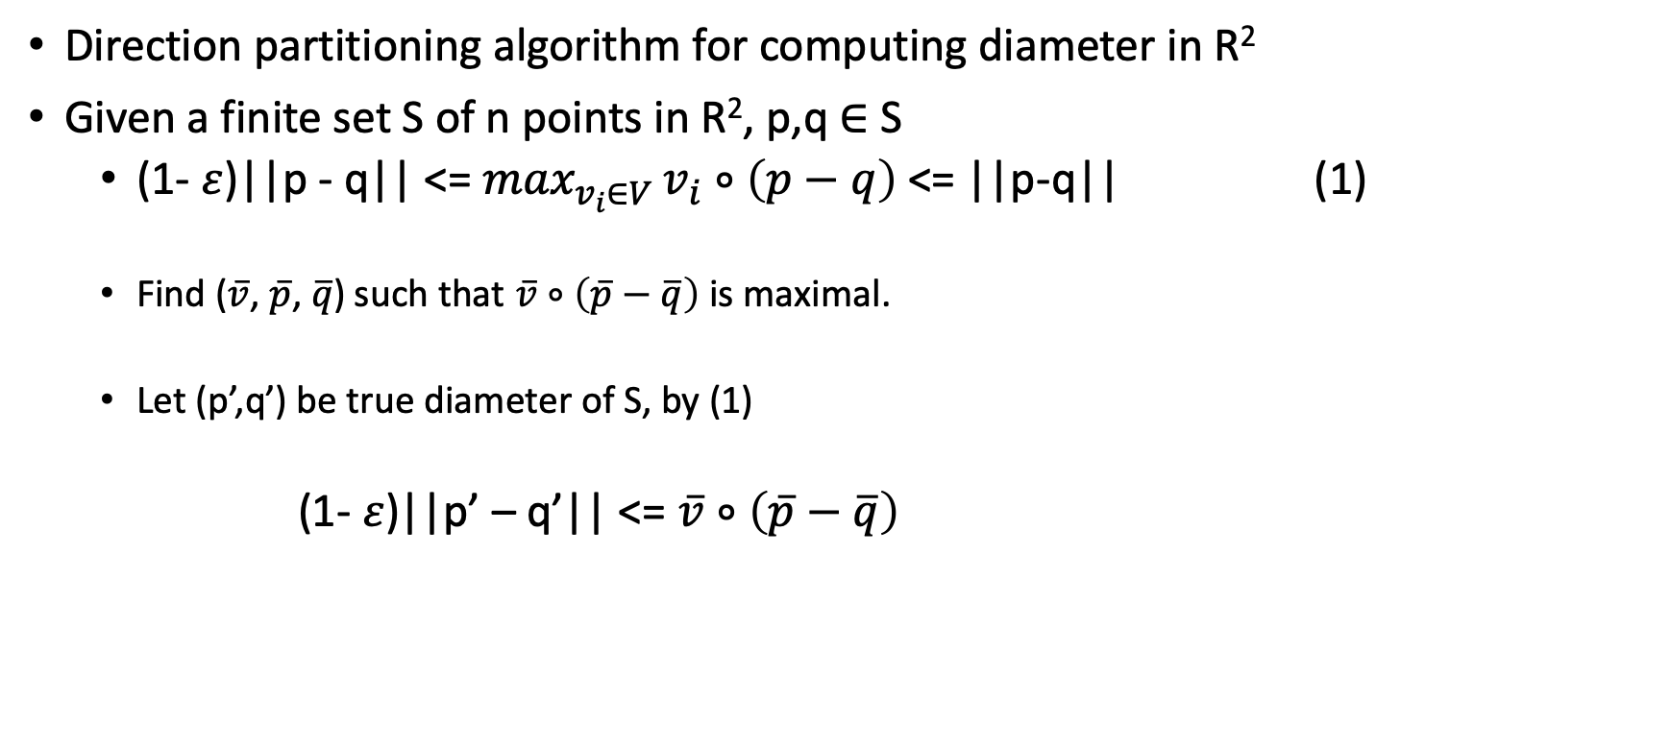
Diameter problem
Direction partitioning algorithm for computing diameter in R²
Given a finite set S of n points in R², p,q $∈$ S
(1- $ε$)||p - q|| <= $\max_{v_{i}∈V }v_{i}∘\left(p−q\right)$ <= ||p-q|| (1)
Find ($\overline{v}$, $\overline{p}$, $\overline{q}$) such that $\overline{v}$ $∘\left(\overline{p}−\overline{q}\right)$ is maximal.
Let (p’,q’) be true diameter of S, by (1)
(1- $ε$)||p’ – q’|| <= $\overline{v}$ $∘\left(\overline{p}−\overline{q}\right)$

Slide 28
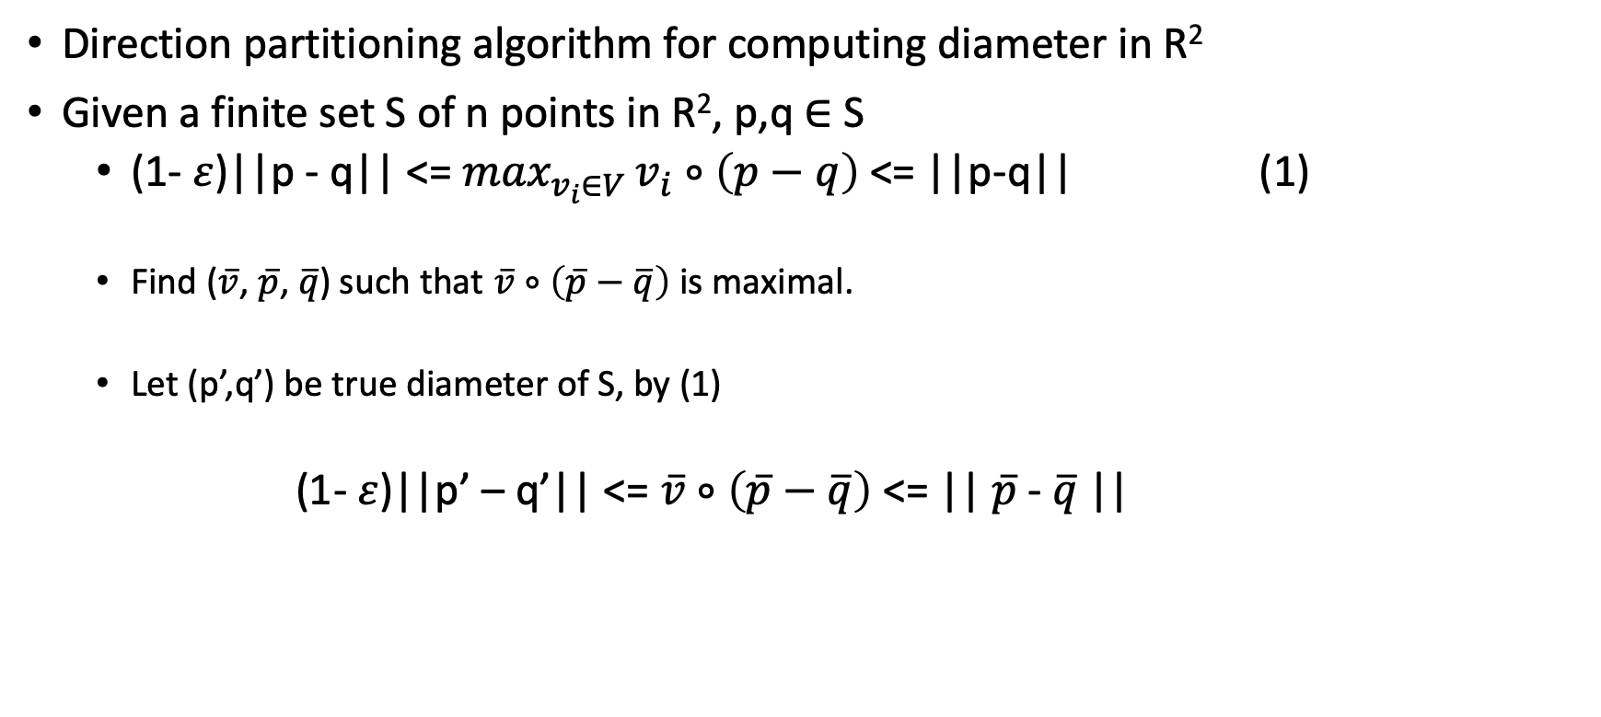
Diameter problem
Direction partitioning algorithm for computing diameter in R²
Given a finite set S of n points in R², p,q $∈$ S
(1- $ε$)||p - q|| <= $\max_{v_{i}∈V }v_{i}∘\left(p−q\right)$ <= ||p-q|| (1)
Find ($\overline{v}$, $\overline{p}$, $\overline{q}$) such that $\overline{v}$ $∘\left(\overline{p}−\overline{q}\right)$ is maximal.
Let (p’,q’) be true diameter of S, by (1)
(1- $ε$)||p’ – q’|| <= $\overline{v}$ $∘\left(\overline{p}−\overline{q}\right)$ <= || $\overline{p}$- $\overline{q}$||

Slide 29
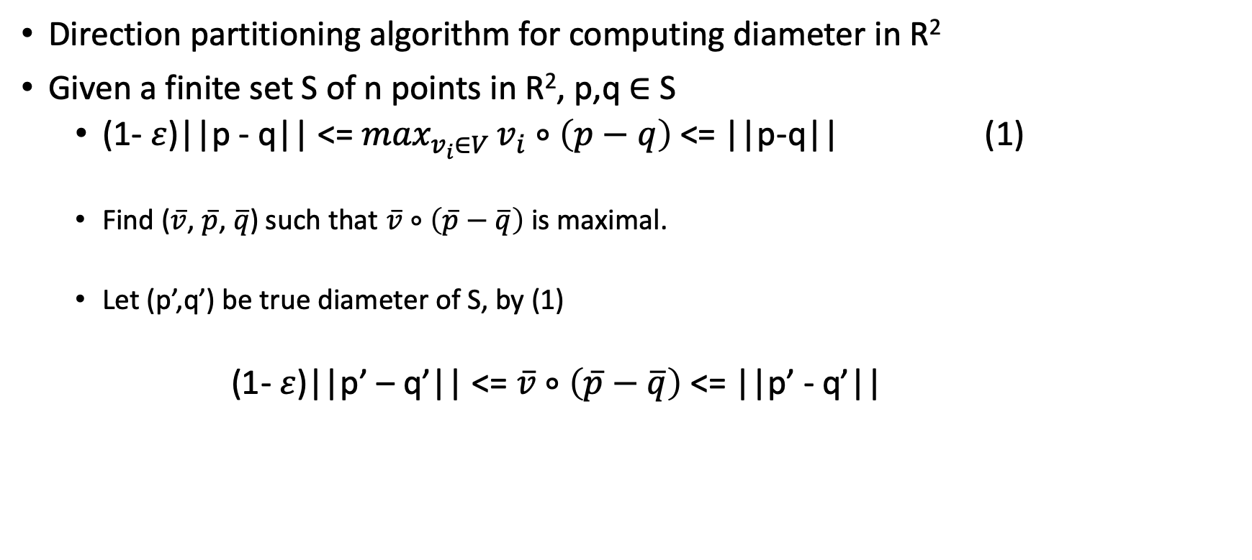
Diameter problem
Direction partitioning algorithm for computing diameter in R²
Given a finite set S of n points in R², p,q $∈$ S
(1- $ε$)||p - q|| <= $\max_{v_{i}∈V }v_{i}∘\left(p−q\right)$ <= ||p-q|| (1)
Find ($\overline{v}$, $\overline{p}$, $\overline{q}$) such that $\overline{v}$ $∘\left(\overline{p}−\overline{q}\right)$ is maximal.
Let (p’,q’) be true diameter of S, by (1)
(1- $ε$)||p’ – q’|| <= $\overline{v}$ $∘\left(\overline{p}−\overline{q}\right)$ <= ||p’ - q’||

Slide 30
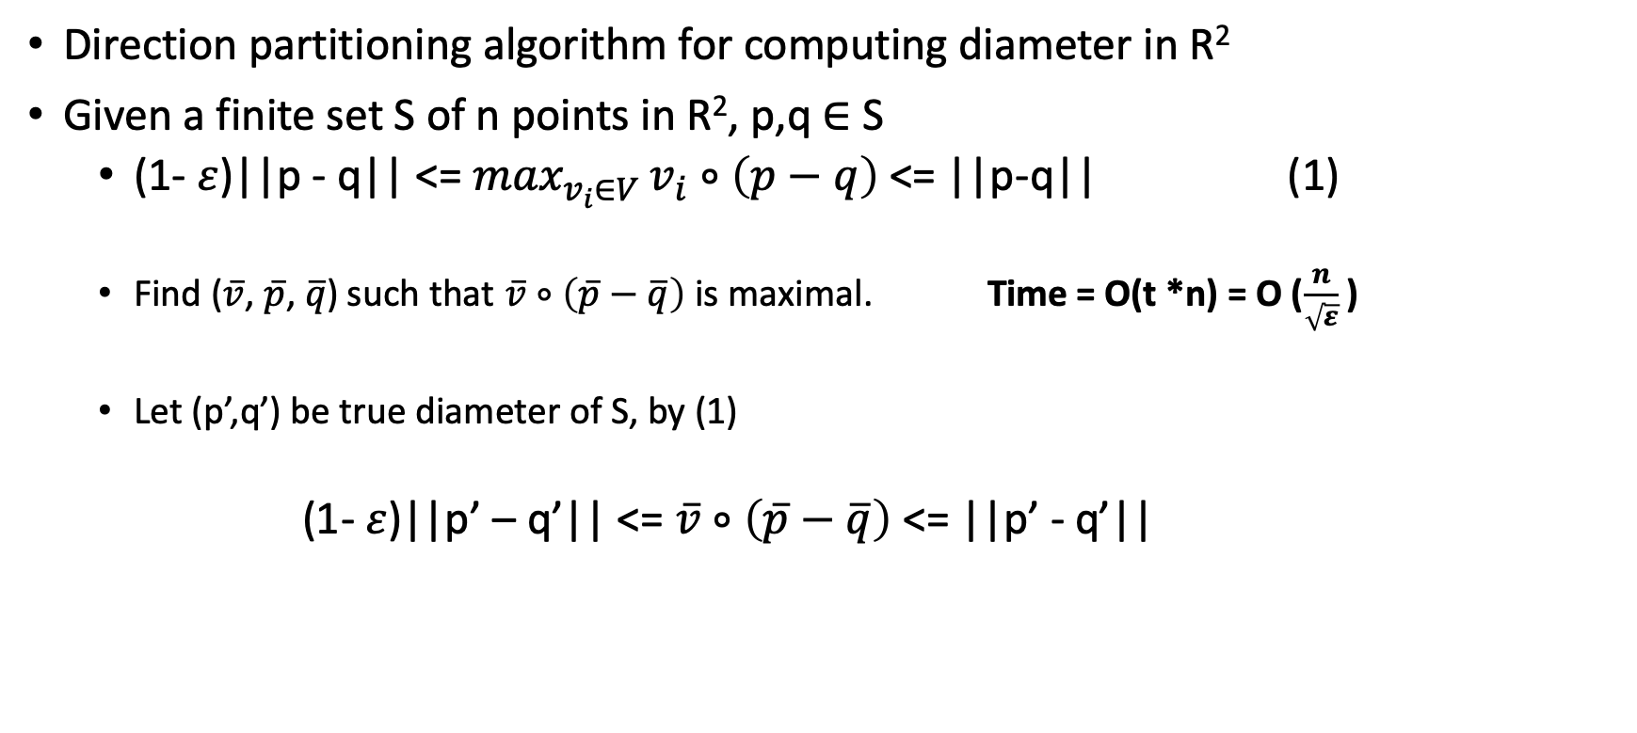
Diameter problem
Direction partitioning algorithm for computing diameter in R²
Given a finite set S of n points in R², p,q $∈$ S
(1- $ε$)||p - q|| <= $\max_{v_{i}∈V }v_{i}∘\left(p−q\right)$ <= ||p-q|| (1)
Find ($\overline{v}$, $\overline{p}$, $\overline{q}$) such that $\overline{v}$ $∘\left(\overline{p}−\overline{q}\right)$ is maximal. Time = O(t *n) = O ($\frac{n}{\sqrt{ε}}$ )
Let (p’,q’) be true diameter of S, by (1)
(1- $ε$)||p’ – q’|| <= $\overline{v}$ $∘\left(\overline{p}−\overline{q}\right)$ <= ||p’ - q’||

Slide 31
Diameter problem
Direction partitioning algorithm for computing diameter in R^{d}
Given a finite set S of n points in R^{d}

Slide 32
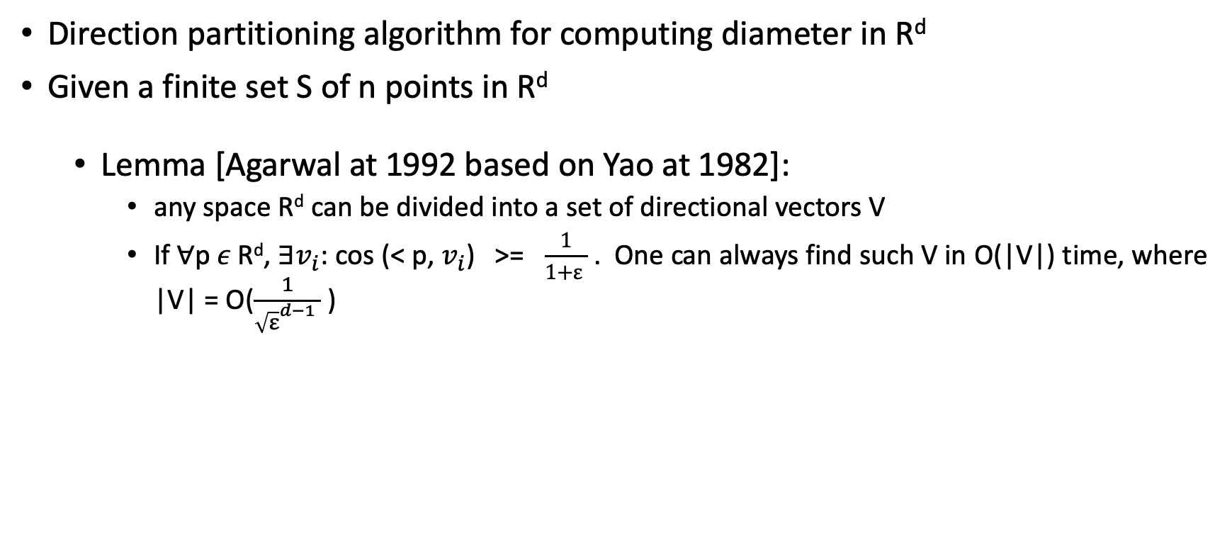
Diameter problem
Direction partitioning algorithm for computing diameter in R^{d}
Given a finite set S of n points in R^{d}
Lemma [Agarwal at 1992 based on Yao at 1982]:
any space R^{d} can be divided into a set of directional vectors V
If $∀$p$ε \text{R}\text{d}$, $∃v_{i}$: cos (< p, $v_{i}$) >= $\frac{1}{1+ε }$ . One can always find such V in O(|V|) time, where |V| = O($\frac{1}{{\sqrt{ε}}^{d−1} }$ )

Slide 33
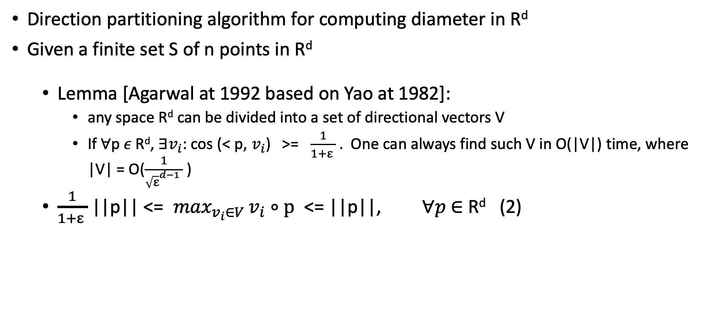
Diameter problem
Direction partitioning algorithm for computing diameter in R^{d}
Given a finite set S of n points in R^{d}
Lemma [Agarwal at 1992 based on Yao at 1982]:
any space R^{d} can be divided into a set of directional vectors V
If $∀$p$ε \text{R}\text{d}$, $∃v_{i}$: cos (< p, $v_{i}$) >= $\frac{1}{1+ε }$ . One can always find such V in O(|V|) time, where |V| = O($\frac{1}{{\sqrt{ε}}^{d−1} }$ )
$\frac{1}{1+ε }$ ||p|| <= $\max_{v_{i}∈V }v_{i}∘p$ <= ||p||, $∀p$ $∈$ R^{d} (2)

Slide 34
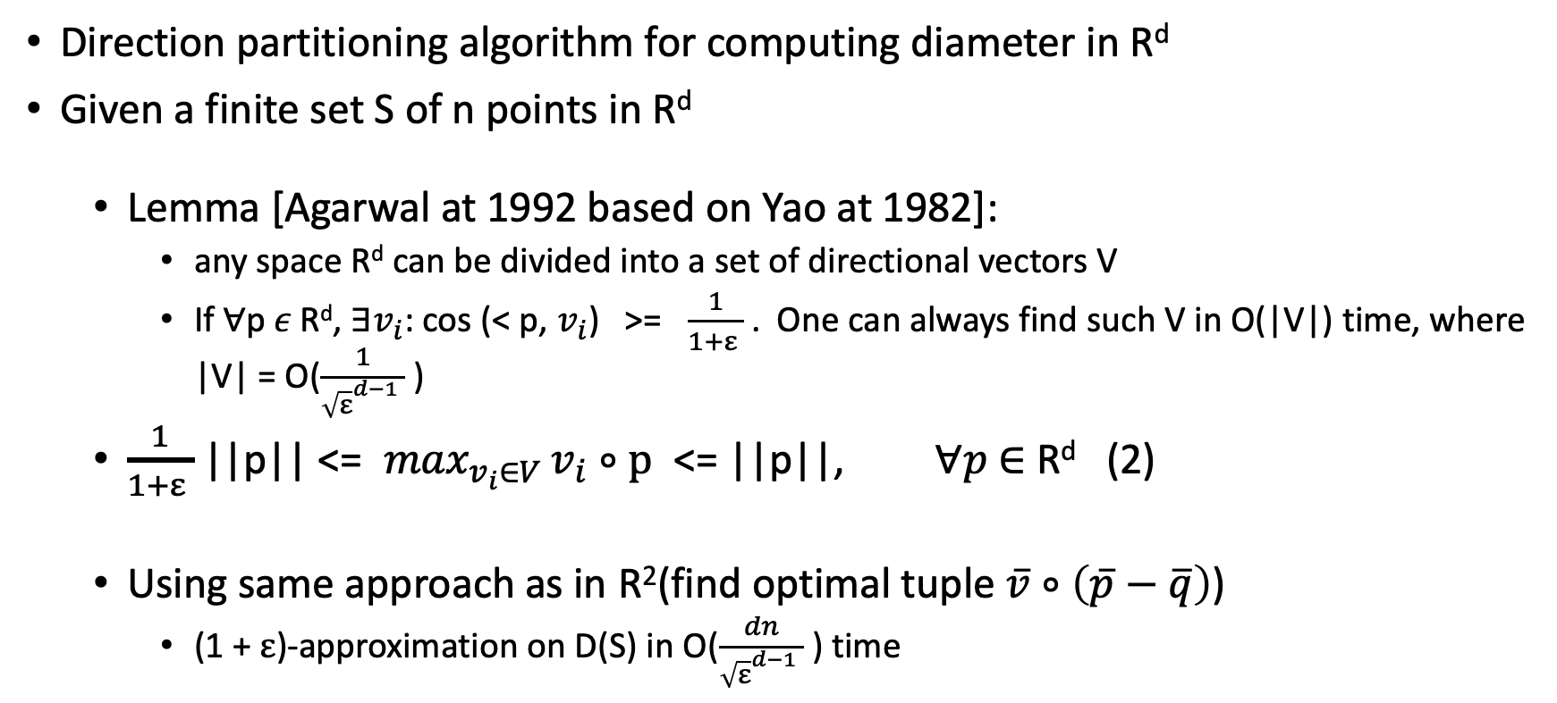
Diameter problem
Direction partitioning algorithm for computing diameter in R^{d}
Given a finite set S of n points in R^{d}
Lemma [Agarwal at 1992 based on Yao at 1982]:
any space R^{d} can be divided into a set of directional vectors V
If $∀$p$ε \text{R}\text{d}$, $∃v_{i}$: cos (< p, $v_{i}$) >= $\frac{1}{1+ε }$ . One can always find such V in O(|V|) time, where |V| = O($\frac{1}{{\sqrt{ε}}^{d−1} }$ )
$\frac{1}{1+ε }$ ||p|| <= $\max_{v_{i}∈V }v_{i}∘p$ <= ||p||, $∀p$ $∈$ R^{d} (2)
Using same approach as in R²(find optimal tuple $\overline{v}$ $∘\left(\overline{p}−\overline{q}\right)$)
(1 + $ε$)-approximation on D(S) in O($\frac{dn}{{\sqrt{ε}}^{d−1} }$ ) time

Slide 35

Diameter problem
Dimension Reduction in R^{d} [Chan at 2002]
$\frac{1}{1+ε }$ ||p|| <= $\max_{v_{i}∈V }v_{i}∘p$ <= ||p||, for any p $∈$ R^{d} (2)

Slide 36

Diameter problem
Dimension Reduction in R^{d} [Chan at 2002]
$\frac{1}{1+ε }$ ||p|| <= $\max_{v_{i}∈V }v_{i}∘p$ <= ||p||, for any p $∈$ R^{d} (2)
($\frac{1}{1+ε })$² ($p_{1}^{2}$+ $p_{2}^{2}$) <= $\max_{v_{i}∈V }{(v}_{1}∗p_{1}$ + $v_{2}∗p_{2})$² <= ($p_{1}^{2}$+ $p_{2}^{2}$) Only look at 2 dimensions (3)
add terms $p_{3}^{2}$+ $p_{4}^{2}$ …. + $p_{d}^{2}$ to (3)

Slide 37
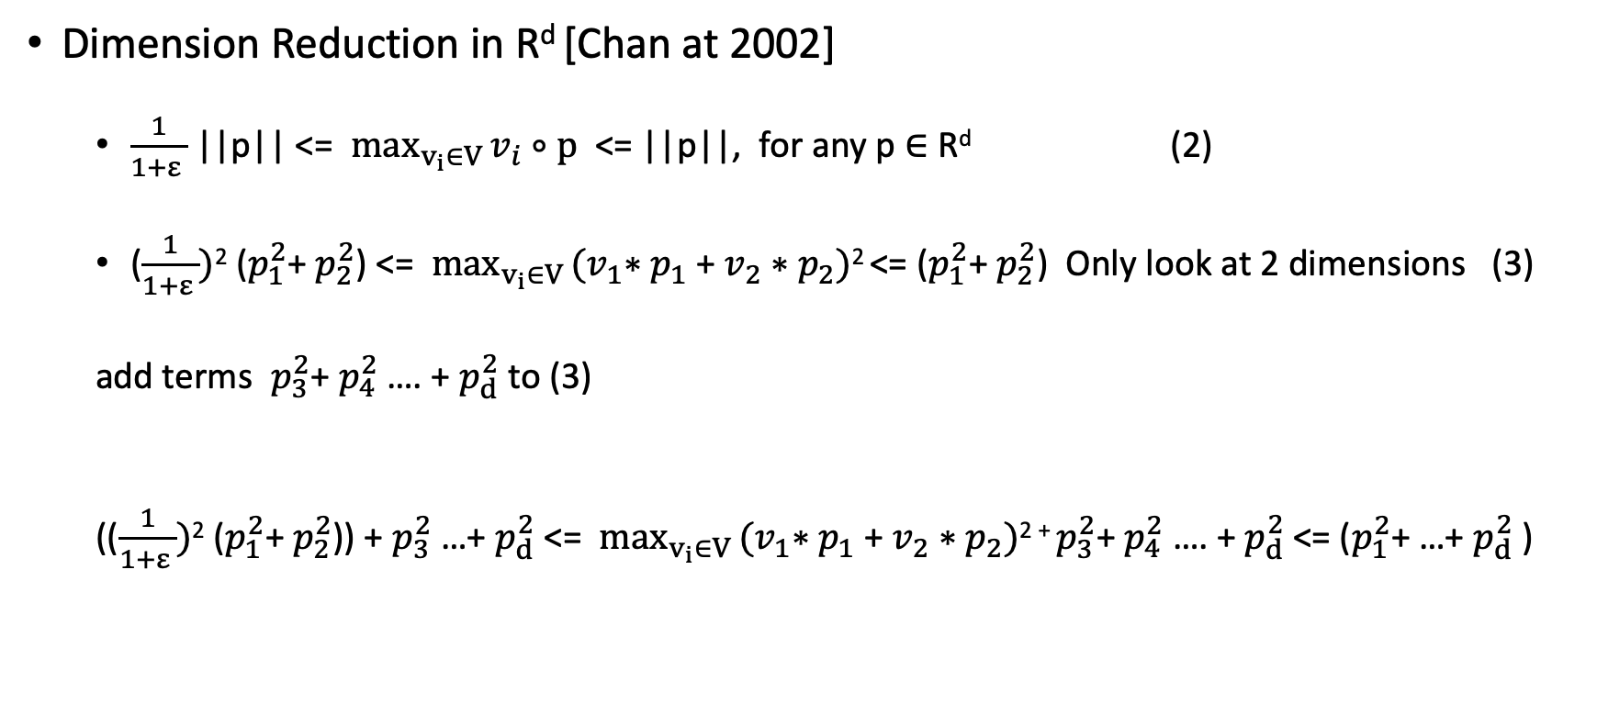
Diameter problem
Dimension Reduction in R^{d} [Chan at 2002]
$\frac{1}{1+ε }$ ||p|| <= $\max_{v_{i}∈V }v_{i}∘p$ <= ||p||, for any p $∈$ R^{d} (2)
($\frac{1}{1+ε })$² ($p_{1}^{2}$+ $p_{2}^{2}$) <= $\max_{v_{i}∈V }{(v}_{1}∗p_{1}$ + $v_{2}∗p_{2})$² <= ($p_{1}^{2}$+ $p_{2}^{2}$) Only look at 2 dimensions (3)
add terms $p_{3}^{2}$+ $p_{4}^{2}$ …. + $p_{d}^{2}$ to (3)
(($\frac{1}{1+ε })$² ($p_{1}^{2}$+ $p_{2}^{2}$)) + $p_{3}^{2}$ …+ $p_{d}^{2}$<= $\max_{v_{i}∈V }{(v}_{1}∗p_{1}$ + $v_{2}∗p_{2})$² ⁺ $p_{3}^{2}$+ $p_{4}^{2}$ …. + $p_{d}^{2}$<= ($p_{1}^{2}$+ …+ $p_{d}^{2}$)

Slide 38
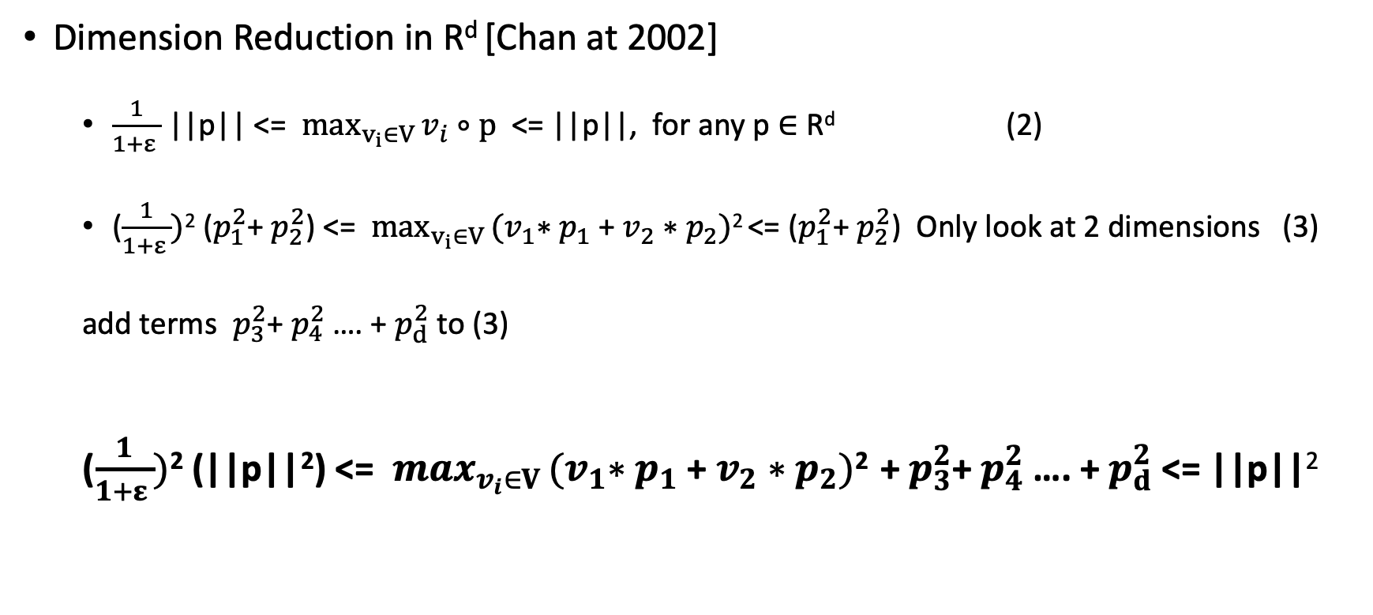
Diameter problem
Dimension Reduction in R^{d} [Chan at 2002]
$\frac{1}{1+ε }$ ||p|| <= $\max_{v_{i}∈V }v_{i}∘p$ <= ||p||, for any p $∈$ R^{d} (2)
($\frac{1}{1+ε })$² ($p_{1}^{2}$+ $p_{2}^{2}$) <= $\max_{v_{i}∈V }{(v}_{1}∗p_{1}$ + $v_{2}∗p_{2})$² <= ($p_{1}^{2}$+ $p_{2}^{2}$) Only look at 2 dimensions (3)
add terms $p_{3}^{2}$+ $p_{4}^{2}$ …. + $p_{d}^{2}$ to (3)
($\frac{1}{1+ε })$² (||p||²) <= $\max_{v_{i}∈V }{(v}_{1}∗p_{1}$ + $v_{2}∗p_{2})$² +$p_{3}^{2}$+ $p_{4}^{2}$ …. + $p_{d}^{2}$<= ||p||²

Slide 39

Diameter problem
Dimension Reduction in R^{d} [Chan at 2002]
($\frac{1}{1+ε })$² (||p||²) <= $\max_{v_{i}∈V }{(v}_{1}∗p_{1}$ + $v_{2}∗p_{2})$² +$p_{3}^{2}$+ $p_{4}^{2}$ …. + $p_{d}^{2}$<= ||p||²

Slide 40
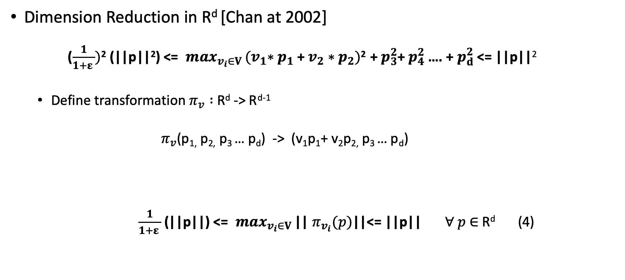
Diameter problem
Dimension Reduction in R^{d} [Chan at 2002]
($\frac{1}{1+ε })$² (||p||²) <= $\max_{v_{i}∈V }{(v}_{1}∗p_{1}$ + $v_{2}∗p_{2})$² +$p_{3}^{2}$+ $p_{4}^{2}$ …. + $p_{d}^{2}$<= ||p||²
Define transformation $π_{v} :$R^{d} -> R^{d-1}
$π_{v}$(p_{1,} p_{2,} p₃ … p_{d}) -> (v₁p₁+ v₂p_{2,} p₃ … p_{d})
$\frac{1}{1+ε }$ (||p||) <= $\max_{v_{i}∈V }$|| $π_{v_{i}}(p)$||<= ||p|| $∀ p$ $∈$R^{d} (4)

Slide 41

Diameter problem
Dimension Reduction in R^{d} [Chan at 2002]
$\frac{1}{1+ε }$ (||p-q||) <= $\max_{v_{i}∈V }$|| $π_{v_{i}}(p−q)$||<= ||p-q|| $∀ p$,q $∈$R^{d} (4)

Slide 42
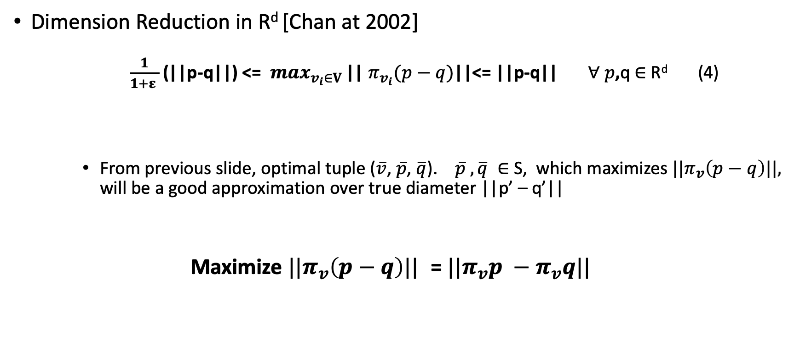
Diameter problem
Dimension Reduction in R^{d} [Chan at 2002]
$\frac{1}{1+ε }$ (||p-q||) <= $\max_{v_{i}∈V }$|| $π_{v_{i}}(p−q)$||<= ||p-q|| $∀ p$,q $∈$R^{d} (4)
From previous slide, optimal tuple ($\overline{v}$, $\overline{p}$, $\overline{q}$). $\overline{p}$ $,\overline{q} ∈$S, which maximizes ${||π}_{v}\left(p−q\right)||,$ will be a good approximation over true diameter ||p’ – q’||
Maximize ${||π}_{v}\left(p−q\right)||$ = ${||π}_{v}p −π_{v}q||$

Slide 43

Diameter problem
Dimension Reduction in R^{d} [Chan at 2002]
Step1: break unit sphere(circle) into t parts. Form a set V of direction vectors.
V = {$∀i∈\left[0,t\right):v_{i}=(cos\frac{2πi}{t},sin\frac{2πi}{t})$}

Slide 44

Diameter problem
Dimension Reduction in R^{d} [Chan at 2002]
Step1: break unit sphere(circle) into t parts. Form a set V of direction vectors.
V = {$∀i∈\left[0,t\right):v_{i}=(cos\frac{2πi}{t},sin\frac{2πi}{t})$}
Step2: Find ($\overline{v}$, $\overline{p}$, $\overline{q}$) such that ${||π}_{v_{i}}\left(p−q\right)||,$ is maximal. Do this recursively for each $v_{i}$ $∈$ V

Slide 45
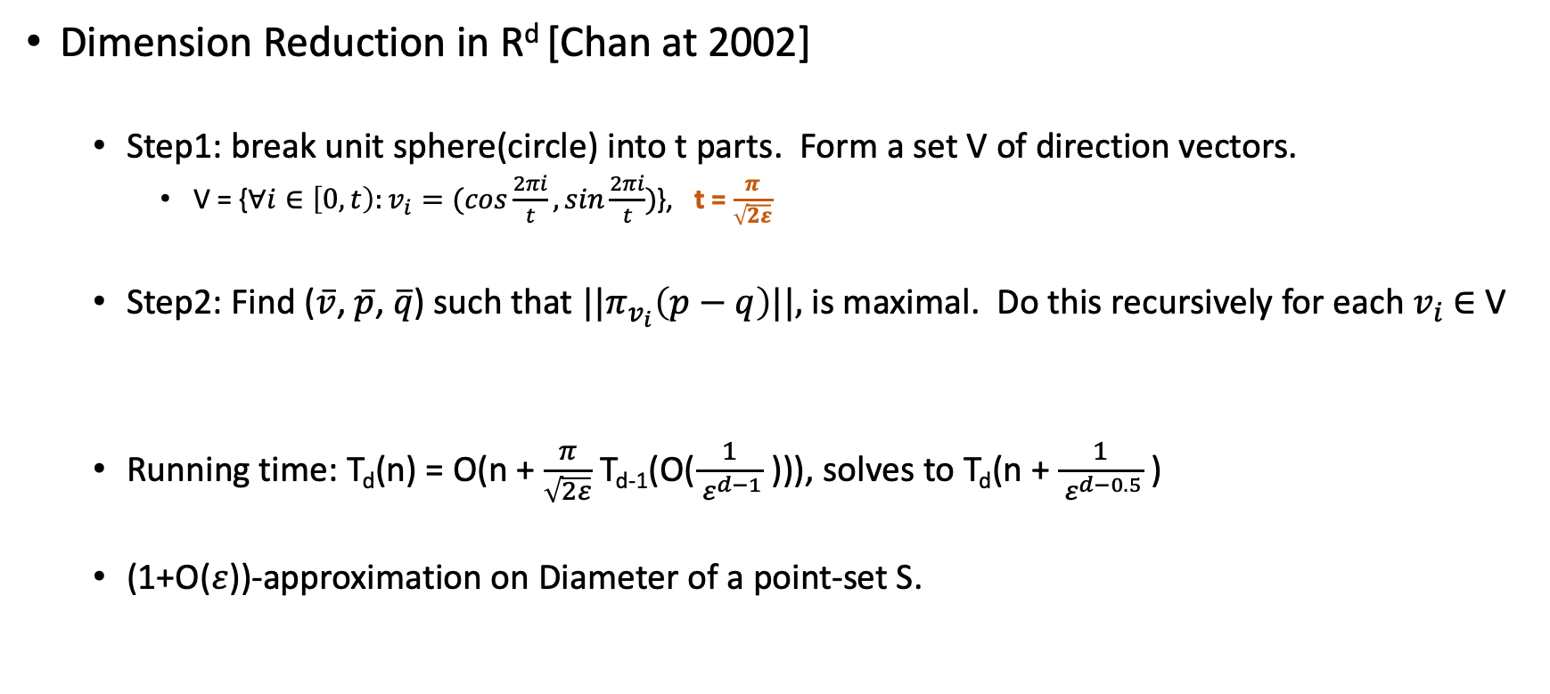
Diameter problem
Dimension Reduction in R^{d} [Chan at 2002]
Step1: break unit sphere(circle) into t parts. Form a set V of direction vectors.
V = {$∀i∈\left[0,t\right):v_{i}=(cos\frac{2πi}{t},sin\frac{2πi}{t})$}, t = $\frac{π}{\sqrt{2ε}}$
Step2: Find ($\overline{v}$, $\overline{p}$, $\overline{q}$) such that ${||π}_{v_{i}}\left(p−q\right)||,$ is maximal. Do this recursively for each $v_{i}$ $∈$ V
Running time: T_{d}(n) = O(n + $\frac{π}{\sqrt{2ε}}$ T_{d-1}(O($\frac{1}{ ε^{d−1}}$ ))), solves to T_{d}(n + $\frac{1}{ ε^{d−0.5}}$ )
(1+O($ε$))-approximation on Diameter of a point-set S.

Slide 46

Diameter problem
(1+$ε$)-approximation Algorithm [Mahdi Imanparast, Seyed Naser Hashmi, Ali Mohades].
Given Given a finite set S of n points in R^{d}, an error parameter $ε$
D(S)

Slide 47
Diameter problem
(1+$ε$)-approximation Algorithm [Mahdi Imanparast, Seyed Naser Hashmi, Ali Mohades].
Given Given a finite set S of n points in R^{d}, an error parameter $ε$
D(S)

Slide 48

Diameter problem
(1+$ε$)-approximation Algorithm [Mahdi Imanparast, Seyed Naser Hashmi, Ali Mohades].
Given Given a finite set S of n points in R^{d}, an error parameter $ε$
$$u$$
Set S
Set U

Slide 49
Diameter problem
(1+$ε$)-approximation Algorithm [Mahdi Imanparast, Seyed Naser Hashmi, Ali Mohades].
Given Given a finite set S of n points in R^{d}, an error parameter $ε$
$$u$$
Set S
Set U

Slide 50

Diameter problem
(1+$ε$)-approximation Algorithm [Mahdi Imanparast, Seyed Naser Hashmi, Ali Mohades].
Given Given a finite set S of n points in R^{d}, an error parameter $ε$
$$v$$
Set S
Set U
Set V

Slide 51



Diameter problem
(1+$ε$)-approximation Algorithm [Mahdi Imanparast, Seyed Naser Hashmi, Ali Mohades].
$$B_{2}$$
$$v$$
Set S
Set U
Set V
B₁,B₂ contains
$$B_{1}$$

Slide 52

Diameter problem
(1+$ε$)-approximation Algorithm [Mahdi Imanparast, Seyed Naser Hashmi, Ali Mohades].
$$B_{2}$$
$$v$$
Set S
Compute Diam(B₁ $∪$B₂)
Set U
Set V
B₁,B₂ contains
$$B_{1}$$

Slide 53
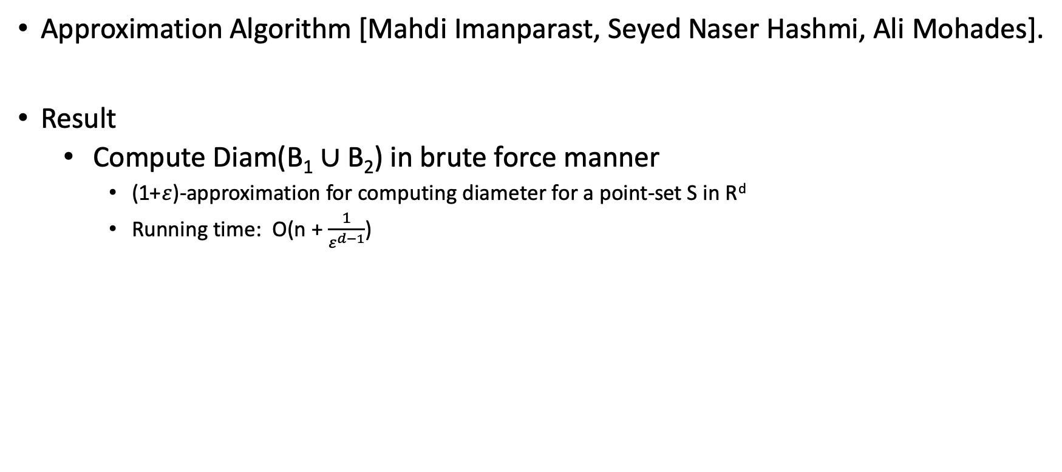
Diameter problem
Approximation Algorithm [Mahdi Imanparast, Seyed Naser Hashmi, Ali Mohades].
Result
Compute Diam(B₁ $∪$B₂) in brute force manner
(1+$ε$)-approximation for computing diameter for a point-set S in R^{d}
Running time: O(n + $\frac{1}{ε^{d−1}}$)

Slide 54
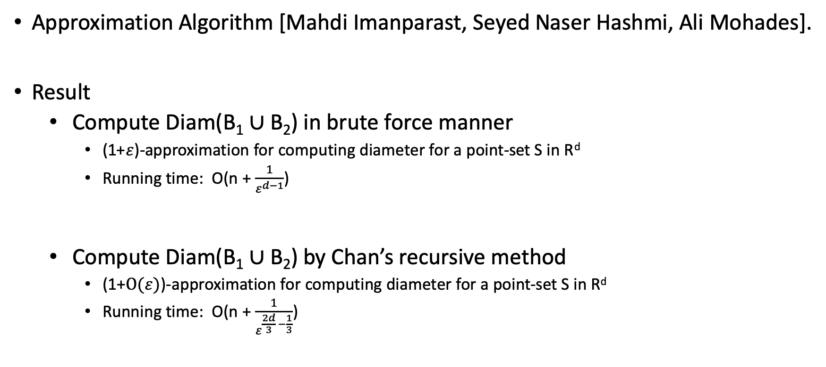
Diameter problem
Approximation Algorithm [Mahdi Imanparast, Seyed Naser Hashmi, Ali Mohades].
Result
Compute Diam(B₁ $∪$B₂) in brute force manner
(1+$ε$)-approximation for computing diameter for a point-set S in R^{d}
Running time: O(n + $\frac{1}{ε^{d−1}}$)
Compute Diam(B₁ $∪$B₂) by Chan’s recursive method
(1+$O(ε)$)-approximation for computing diameter for a point-set S in R^{d}
Running time: O(n + $\frac{1}{ε^{\frac{2d}{3} −\frac{1}{3}}}$)

Slide 55
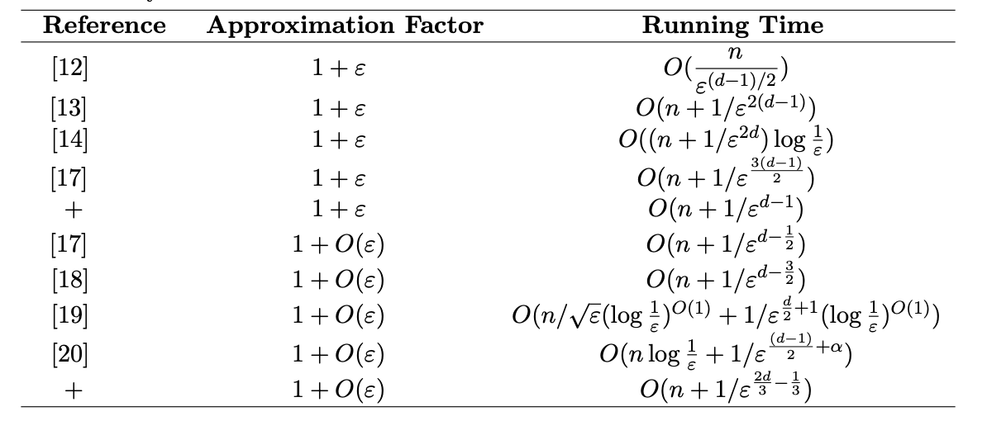
Diameter problem
Approximation Algorithm [Mahdi Imanparast, Seyed Naser Hashmi, Ali Mohades].

Slide 56
Diameter problem
Approximation Algorithm [Mahdi Imanparast, Seyed Naser Hashmi, Ali Mohades].
Open question
This double rounding technique might apply to various distance computing algorithms. E.g. computing nearest neighbor

