Slide 1
9. Continuous Bayes’ rule, Derived Random Variables
Prof. Hong Xu
Credit to Prof. Andrej Bogdanov

Slide 2
Independence
X and Y are independent if
f_{XY}(x, y) = f_{X}(x) f_{Y}(y) for all x, y
if and only if
E[g(X)h(Y)] = E[g(X)]E[h(Y)] for all g, h

Slide 3
Independent Normals
X, Y are Normal(0, 1)

Slide 4
Independent Normals
X is Normal(μ, σ), Y is Normal(μ’, σ’)

Slide 5
Continuous Bayes’ rule
f_{X|Y}(x | y) f_{Y}(y)
f_{Y | X}(y | x) =
f_{X}(x)

Slide 6


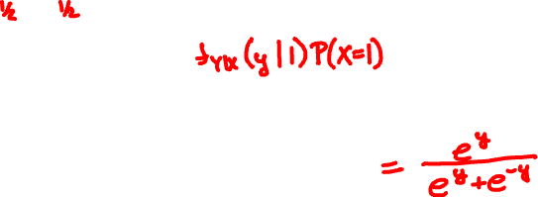
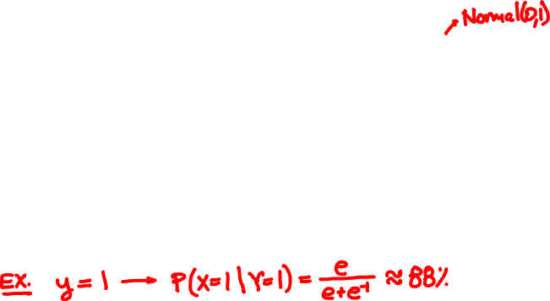
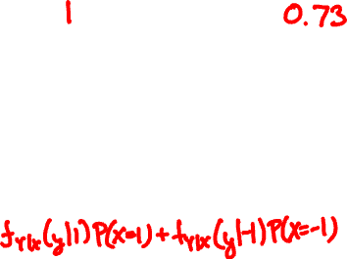
X = 1 or -1
Y = X + N
P(X = 1 | Y = y) =

Slide 7
Rain falls at Poisson(Λ) drops/sec
Λ itself is Exponential(1)
You’re hit by 2 drops. What is your guess for Λ?
https://www.wolframalpha.com/

Slide 8
Derived random variables

Slide 9
X is Uniform(0, 1). What is the PDF of Y = √X?

Slide 10
🚙
V = 50 Exponential(1) km/h
50km
0km
What is the PDF of the travel time?

Slide 11
Shifting and scaling
Y = aX + b

Slide 12
Normalization
X is Normal(μ, σ)
Y = (X – μ)/σ

Slide 13
What is the PDF of the loser?

Slide 14
X, Y are independent Uniform(0, 1).
What is the PDF of Y/X?

Slide 15
Convolution
X, Y are independent. What is the PMF/PDF of X + Y?

Slide 16
Toss two 3-sided dice.
What is the sum of face values?

Slide 17
Romeo and Juliet arrive in Shatin at independent Exponential(1) hours past noon.
How long is the wait?

Slide 18
Sum of Independent Normals

Slide 19
Sum of Independent Normals

