Slide 1
3. Conditional Probability and Independence
Prof. Hong Xu
Credit to Prof. Andrej Bogdanov

Slide 2
Total probability theorem
F
F^{c}
P(E)
= P(E∩F) + P(E∩F^{c})
S
E
= P(E|F)P(F) + P(E|F^{c})P(F^{c})
F₃
F₁
F₄
More generally, if F₁,…, F_{n}
partition Ω then
E
F₂
F₅
P(E) = P(E|F₁)P(F₁) + … + P(E|F_{n})P(F_{n})

Slide 3
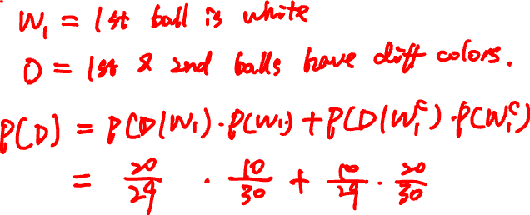
An urn has 10 white balls and 20 black balls. You draw two at random. What is the probability that their colors are different?

Slide 4
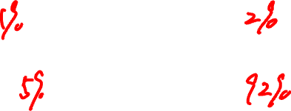
Geography quiz…
What is the capital of Romania?
A: Brasov
B: Budapest
C: Bucharest
D: Bratislava
Did you know or were you lucky?

Slide 5
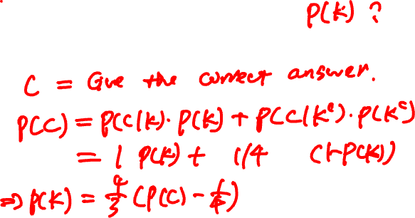
Geography quiz
Probability model
There are two types of students:
Type K: Knows the answer
Type K^{c}: Picks a random answer

Slide 6

1
2
3
I choose a cup at random and then a random ball from that cup. The ball is red. You need to guess where the ball came from.
Which cup would you guess?

Slide 7

Cause and effect
1
2
3
cause:
C₁
C₂
C₃
effect:
R

Slide 8
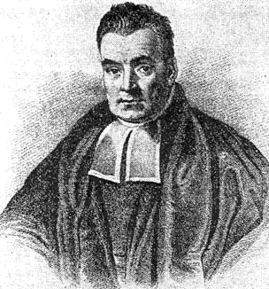
Bayes’ rule
P(E|C) P(C)
P(E|C) P(C)
P(C|E) =
=
P(E)
P(E|C) P(C) + P(E|C^{c}) P(C^{c})
More generally, if C₁,…, C_{n} partition S then
P(E|C_{i}) P(C_{i})
P(C_{i}|E) =
P(E|C₁) P(C₁) + … + P(E|C_{n}) P(C_{n})

Slide 9
Cause and effect
1
2
3
cause:
C₁
C₂
C₃
effect:
R
P(R|C_{i}) P(C_{i})
P(C_{i}|R) =
P(R|C₁) P(C₁) + P(R|C₂) P(C₂) + P(R|C₃) P(C₃)

Slide 10
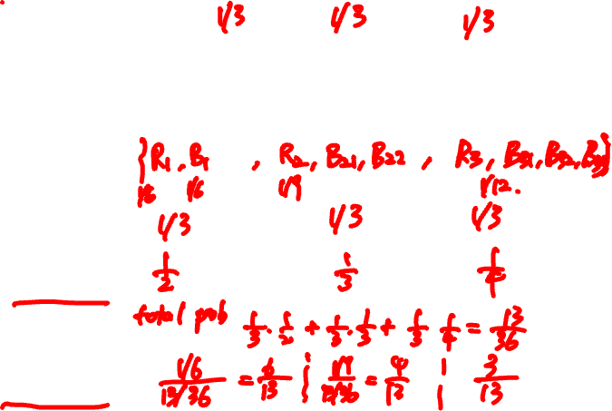
Cause and effect
1
2
3
Ω =
P(C_{i}) =
P(R|C_{i}) =
P(R) =
P(C_{i} |R) =

Slide 11
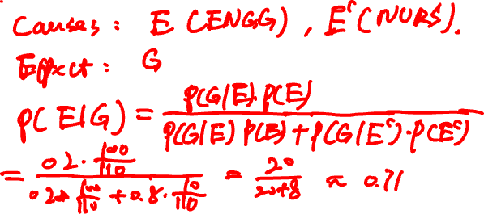
Two classes take place in Lady Shaw Building.
ENGG2430 has 100 students, 20% are girls.
NURS2400 has 10 students, 80% are girls.
A girl walks out. What are the chances that she is from the engineering class?

Slide 12
Summary of conditional probability
Conditional probabilities are used:
1
When there are causes and effects
to estimate the probability of a cause when we observe an effect
2
To calculate ordinary probabilities
Conditioning on the right event can simplify the description of the sample space

Slide 13
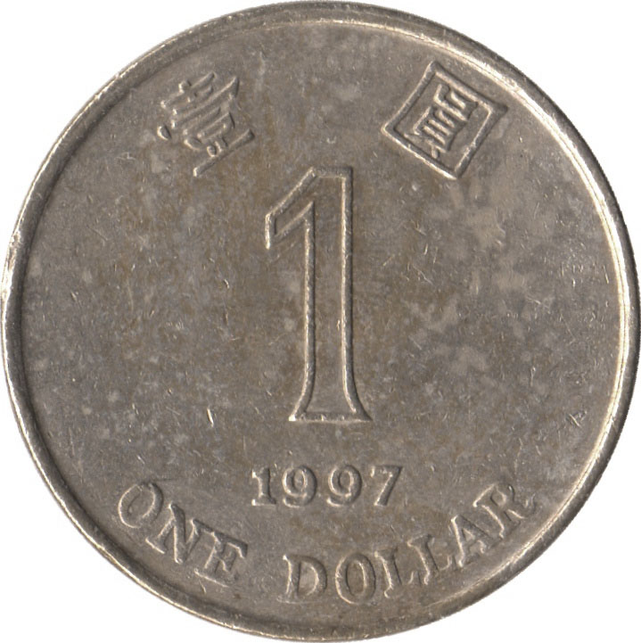
Independence of two events
Let E₁ be “first coin comes up H”
E₂ be “second coin comes up H”
Then P(E₂ | E₁) = P(E₂)
P(E₂∩E₁) = P(E₂)P(E₁)
Events A and B are independent if
P(A∩B) = P(A) P(B)

Slide 14

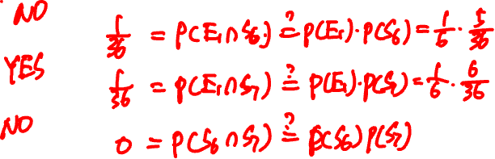
Examples of (in)dependence
Let E₁ be “first die is a 4”
S₆ be “sum of dice is a 6”
S₇ be “sum of dice is a 7”
E₁ and S₆?
E₁ and S₇?
S₆ and S₇?
Notes:
0

Slide 15
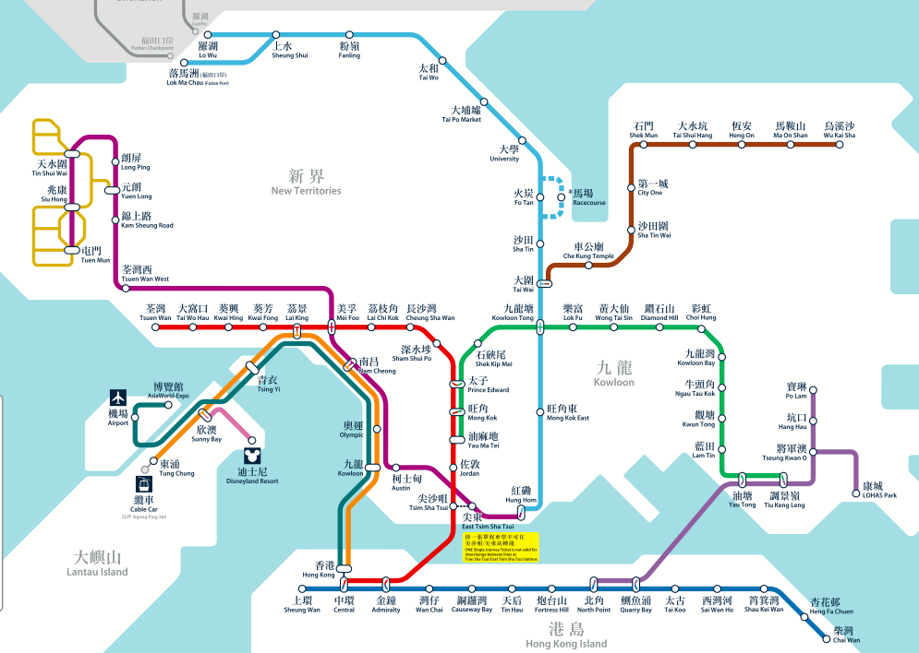

Sequential components
ER: “East Rail Line is working”
P(ER) = 70%
MS: “Ma On Shan Line is working”
P(MS) = 98%

Slide 16
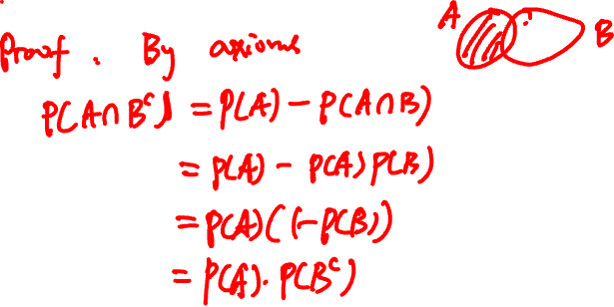
Algebra of independent events
If A and B are independent, then A and B^{c} are also independent.

Slide 17
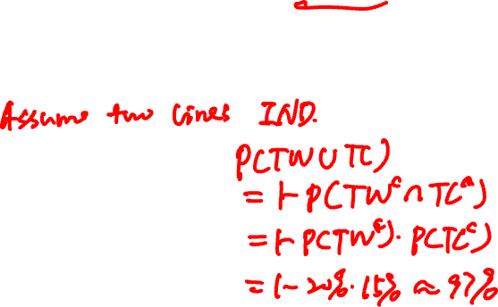
Parallel components
TW: “Tsuen Wan Line is operational”
P(TW) = 80%
TC: “Tung Chung Line is operational”
P(TC) = 85%

Slide 18
Independence of three events
Events A, B, and C are independent if
P(A∩B) = P(A) P(B)
P(B∩C) = P(B) P(C)
P(A∩C) = P(A) P(C)
and P(A∩B∩C) = P(A) P(B) P(C).

Slide 19
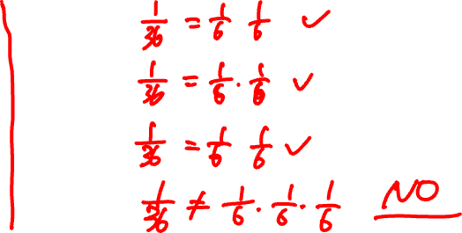
(In)dependence of three events
Let E₁ be “first die is a 4”
E₂ be “second die is a 3”
S₇ be “sum of dice is a 7”
1/6
E₁, E₂?
E₁
E₁, S₇?
1/36
E₂
S₇
E₂, S₇?
1/6
1/6
E₁, E₂, S₇?
Notes:
This example shows pairwise independence not enough for independence

Slide 20
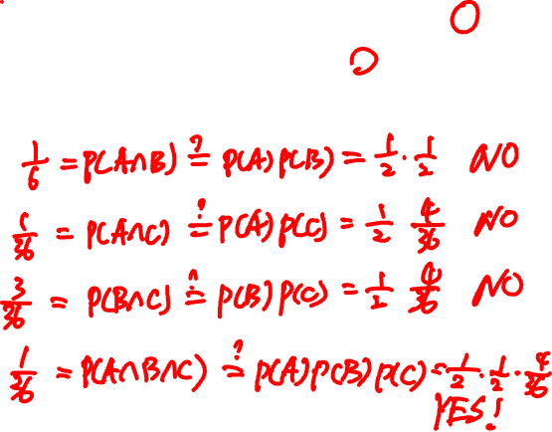
(In)dependence of three events
Let A be “first roll is 1, 2, or 3 ”
B be “first roll is 3, 4, or 5”
C be “sum of rolls is 9”
A, B?
A, C?
B, C?
A, B, C?
Notes:
This example shows P(ABC) = P(A)P(B)P(C) can hold but A, B, C still not independent

Slide 21
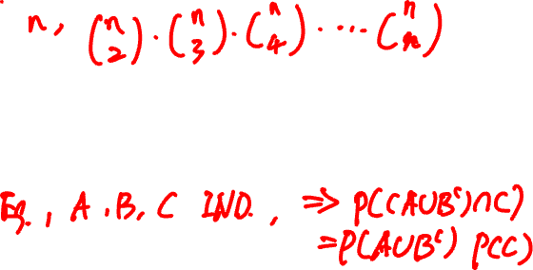
Independence of many events
Events A₁, A₂, … are independent if for every subset of the events, the probability of the intersection is the product of their probabilities.
Algebra of independent events
Independence is preserved if we replace some event(s) by their complements, intersections, unions

Slide 22
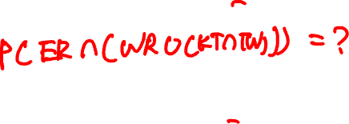
Multiple components
P(ER) = 70%
P(WR) = 75%
P(TW) = 85%
P(KT) = 95%

Slide 23
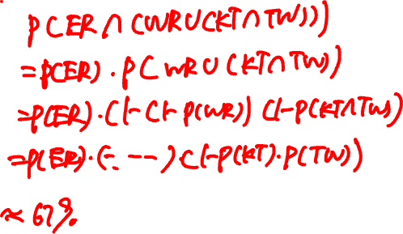
Multiple components
P(ER) = 70%
P(WR) = 75%
P(KT) = 95%
P(TW) = 85%

Slide 24
Conditional independence
A and B are independent conditioned on F if
P(A ∩ B | F) = P(A | F) P(B | F)
Alternative definition:
P(A | B ∩ F) = P(A | F)

Slide 25
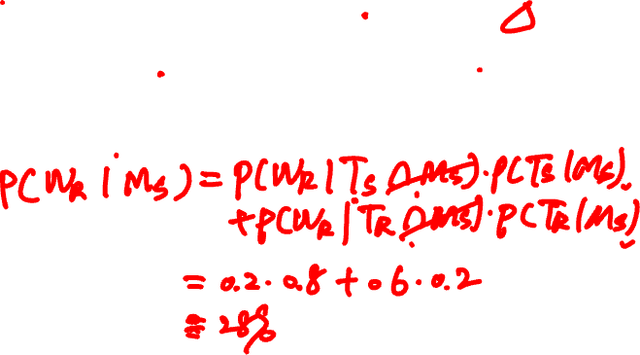
today
tomorrow
☀️
80% ☀️, 20% 🌧
🌧
40% ☀️, 60% 🌧
It is ☀️ on Monday. Will it 🌧 on Wednesday?

Slide 26
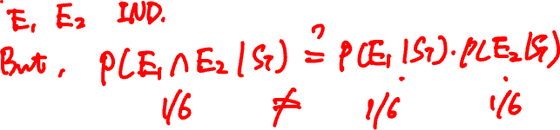
Conditioning does not preserve independence
Let E₁ be “first die is a 4”
E₂ be “second die is a 3”
S₇ be “sum of dice is a 7”
Notes:
E1, E2 are independent, but dependent conditioned on S7

Slide 27


Slide 28
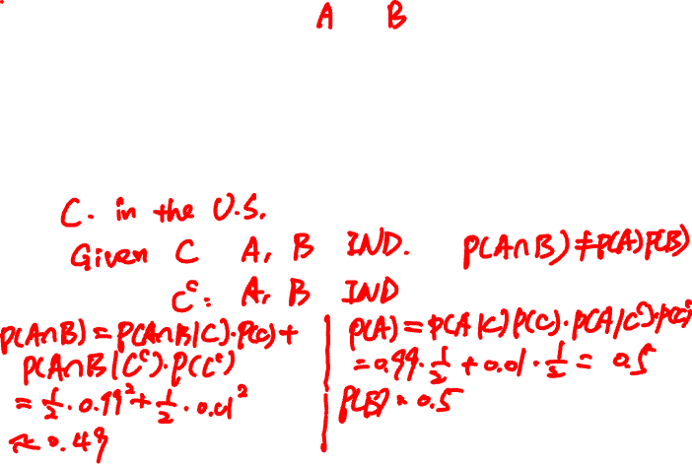
Conditioning may destroy dependence
Probability model
🙎🏻‍♂️
🙍🏻‍♀️
🇺🇸
👍
👍
99%
1%
🇨🇳
👎
👎
Notes:
The events A = “Alice likes the movie” and B = ”Bob likes the movie” are conditionally independent, but unconditionally dependent P(A and B) = ½ * .99^2 + ½ * .01^2 very close to ½, P(A) = P(B) = 1/2

